Slide 1
Perkins Mid-Year Review
James Sprunt Community College

Slide 2
Perkins Impact on CTE at JSCC
19-20 Perkins funds were targeted for:
CTE program improvement
Professional development for CTE faculty
NCPN Conference
National Simulation Conference
Annual Conference of Teachers of Accounting at Two-year Colleges
CTE program enhancement
Agribusiness Academy Coordinator
Student preparation for the workplace
Career Counselor
Program equipment

Slide 3
Comprehensive Local Needs Assessment
Pathways selected for review
Health Education
Associate Degree Nursing; Practical Nursing
Ag & Natural Resources
Agribusiness Technology, Applied Animal Science Technology; Swine Management Technology
Transportation Technology
Diesel & Heavy Equipment Technology
Assessment team
Duplin County Partnership for Career Planning
Gaps identified

Slide 4
Promising Practice
Duplin Agribusiness Academy Coordinator
Integral component in linking secondary and post-secondary CTE programs in Ag & Natural Resources program area
Agribusiness Academy begin in 2010; Coordinator position began in 2017
Coordinator is an employee of DCS but is housed at JSCC
Position is funded by DCS and JSCC; originally funded with Catalyzing CTE Pathways grant funds; shifted to basic grant funds this year
Works closely with JSCC ag instructors; involves JSCC instructors and students in academy activities
Responsibilities include pathway maintenance, employer engagement, career counseling, work-based learning

Slide 7
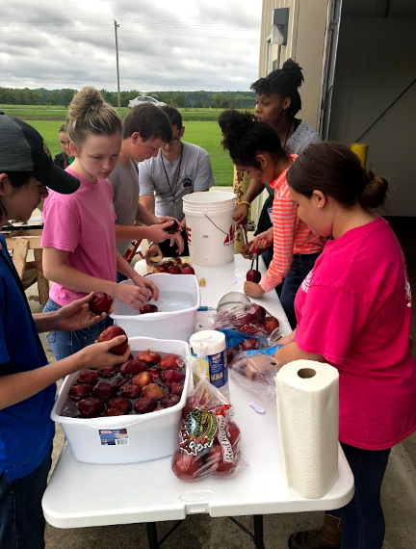

Slide 8
Budget Update
Expenditures to date
Portion of Salary/fringe for Career Counselor
Portion of Salary/fringe for Agribusiness Academy Coordinator
Faculty professional development
Tutors for CTE students
Activities remaining
Faculty professional development
Tutors for CTE students
Potential impact of CLNA on Perkins budget
Plan for spending unexpended funds

