Slide 1
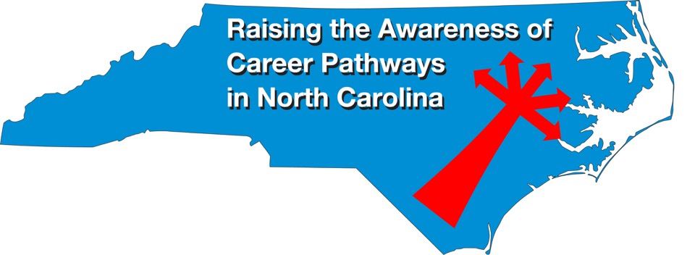
October 14, 2020 Careers in Biotech Manufacturing and Creating Clean Energy
Download the PowerPoint and access the recording: www.ncperkins.org/presentations
Notes:
Chris
We are here to help promote the great jobs, often unknown, in the great state of North Carolina.
Through these monthly meetings, we are going to let you know about some great career opportunities in North Carolina.
And bring in special guests to let you know about the great career opportunities in North Carolina.
Please download this PowerPoint file and use it anyway you can to help get folks on a career pathway.
The reference showing from where the information was found, as well as the contact information for our guests is in the Notes section under each slide.
Get the PowerPoint on our NCPerkins.org website on our Presentations and Webinars page.
Here is the direct address on the screen.
-----
Many of the videos shown during this webinar can be found here:
https://www.ncperkins.org/video/

Slide 2
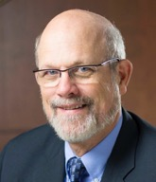
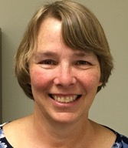
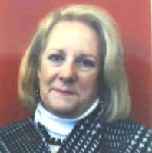
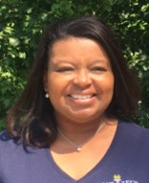
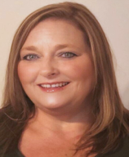
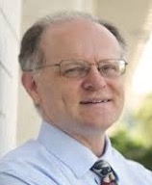
Raising the Awareness of Career Pathways in North Carolina
Bob Witchger
Patti Coultas
Tony Reggi
Cheryl Cox
NC Dept of Public Instruction
Michelle Lair
Mary Olvera
Chris Droessler
Notes:
Chris
I always say our webinars are like radio but with pictures.
And here are a few pictures of your hosts for these monthly explorations into career pathways.
(Why does the photographer have the best photo?)
Our contact information is in the notes section under this slide.
Dr. Bob Witchger
919-807-7126
WitchgerB@nccommunitycolleges.edu
Dr. Tony R. Reggi
919-807-7131
ReggiA@nccommunitycolleges.edu
Patti Coultas
919-807-7130
CoultasP@nccommunitycolleges.edu
Dr. Mary Olvera
919-807-7120
OlveraM@nccommunitycolleges.edu
Michelle Lair
919-807-72227
LairM@nccommunitycolleges.edu
Chris Droessler
919-807-7068
DroesslerC@nccommunitycolleges.edu
Cheryl Cox
919-807-3814
Cheryl.Cox@dpi.nc.gov

Slide 3
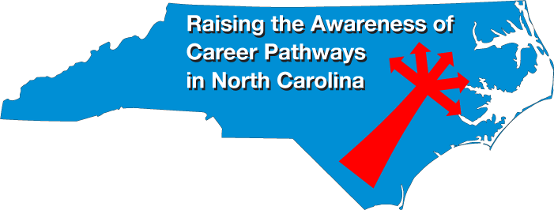
Notes:
www.ncperkins.org/presentations

Slide 4
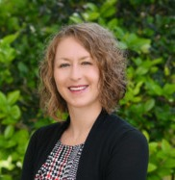
Dr. Lisa K Smelser
Lead Instructor of Biotechnology
Central Carolina Community College
Notes:
Michelle
Dr. Lisa Smelser lsmelser@cccc.edu
BioWork: https://www.cccc.edu/biowork/ Bioprocess Technology: https://www.cccc.edu/curriculum/majors/bioprocess/
Program overview
https://www.cccc.edu/curriculum/program-info-sheets/CCCC-Program-Info-Bioprocess_Technology.pdf
Programs Offered:
https://www.cccc.edu/curriculum/guides/C50440.pdf
https://www.cccc.edu/curriculum/guides/D50440.pdf
https://www.cccc.edu/curriculum/guides/A50440.pdf
ECU Transfer Program
https://cet.ecu.edu/techsystems/undergraduate-programs/industrial-technology-transfer/
BioWork
https://www.ncbionetwork.org/biowork
Video
https://www.youtube.com/watch?v=LujqOE1AiXg&feature=youtu.be

Slide 5
Industry Partners
Vaccine components
Pfizer
Cell and Gene Therapy
Pfizer and Audentes Therapeutics
Injectables
KriGen Pharmaceuticals
Notes:
Michelle
Dr. Lisa Smelser lsmelser@cccc.edu
BioWork: https://www.cccc.edu/biowork/ Bioprocess Technology: https://www.cccc.edu/curriculum/majors/bioprocess/
Program overview
https://www.cccc.edu/curriculum/program-info-sheets/CCCC-Program-Info-Bioprocess_Technology.pdf
Programs Offered:
https://www.cccc.edu/curriculum/guides/C50440.pdf
https://www.cccc.edu/curriculum/guides/D50440.pdf
https://www.cccc.edu/curriculum/guides/A50440.pdf
ECU Transfer Program
https://cet.ecu.edu/techsystems/undergraduate-programs/industrial-technology-transfer/
BioWork
https://www.ncbionetwork.org/biowork
Video
https://www.youtube.com/watch?v=LujqOE1AiXg&feature=youtu.be

Slide 6
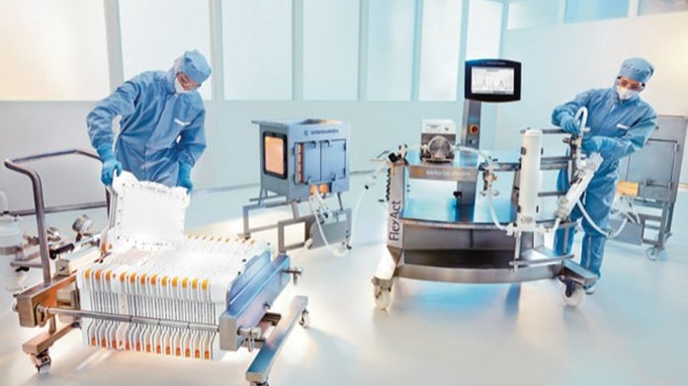
Notes:
Michelle
Dr. Lisa Smelser lsmelser@cccc.edu
BioWork: https://www.cccc.edu/biowork/ Bioprocess Technology: https://www.cccc.edu/curriculum/majors/bioprocess/
Program overview
https://www.cccc.edu/curriculum/program-info-sheets/CCCC-Program-Info-Bioprocess_Technology.pdf
Programs Offered:
https://www.cccc.edu/curriculum/guides/C50440.pdf
https://www.cccc.edu/curriculum/guides/D50440.pdf
https://www.cccc.edu/curriculum/guides/A50440.pdf
ECU Transfer Program
https://cet.ecu.edu/techsystems/undergraduate-programs/industrial-technology-transfer/
BioWork
https://www.ncbionetwork.org/biowork
Video
https://www.youtube.com/watch?v=LujqOE1AiXg&feature=youtu.be

Slide 7
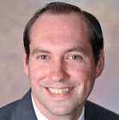
Drew M. Goodson, CPA
Dean of Career and Technical Education Central Carolina Community College
Notes:
Michelle
Drew M. Goodson, CPA Dean of Career and Technical Education Central Carolina Community College S9161 Marchant Hall 1105 Kelly Drive Sanford, NC 27330 (919) 718-7445 dgoodson@cccc.edu

Slide 8
Notes:
www.ncperkins.org/presentations

Slide 9
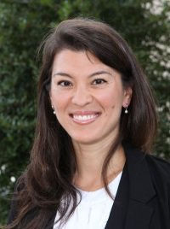
Susan Sanford
Executive Director of RTCC
Research Triangle Cleantech Cluster (RTCC)
Notes:
Susan Sanford
Research Triangle Cleantech Cluster (RTCC)
NC Cleantech Corridor – advancing cleantech from Charlotte to RTP
O: 919-334-4078, M: 919-308-6441
YouTube • @tricleantech
susan@researchtrianglecleantech.org

Slide 10
Notes:
Susan Sanford
Research Triangle Cleantech Cluster (RTCC)
NC Cleantech Corridor – advancing cleantech from Charlotte to RTP
O: 919-334-4078, M: 919-308-6441
YouTube • @tricleantech
susan@researchtrianglecleantech.org

Slide 11
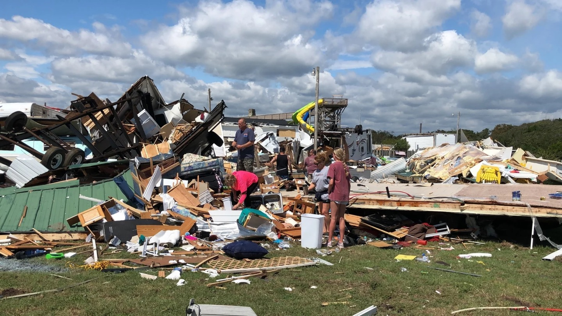
Notes:
Susan Sanford
Research Triangle Cleantech Cluster (RTCC)
NC Cleantech Corridor – advancing cleantech from Charlotte to RTP
O: 919-334-4078, M: 919-308-6441
YouTube • @tricleantech
susan@researchtrianglecleantech.org

Slide 12
Notes:
Susan Sanford
Research Triangle Cleantech Cluster (RTCC)
NC Cleantech Corridor – advancing cleantech from Charlotte to RTP
O: 919-334-4078, M: 919-308-6441
YouTube • @tricleantech
susan@researchtrianglecleantech.org

Slide 13
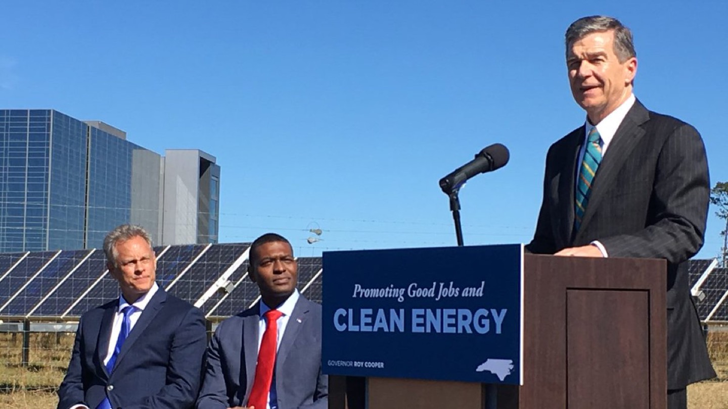
Notes:
Susan Sanford
Research Triangle Cleantech Cluster (RTCC)
NC Cleantech Corridor – advancing cleantech from Charlotte to RTP
O: 919-334-4078, M: 919-308-6441
YouTube • @tricleantech
susan@researchtrianglecleantech.org

Slide 14
Notes:
Susan Sanford
Research Triangle Cleantech Cluster (RTCC)
NC Cleantech Corridor – advancing cleantech from Charlotte to RTP
O: 919-334-4078, M: 919-308-6441
YouTube • @tricleantech
susan@researchtrianglecleantech.org

Slide 15
Notes:
Susan Sanford
Research Triangle Cleantech Cluster (RTCC)
NC Cleantech Corridor – advancing cleantech from Charlotte to RTP
O: 919-334-4078, M: 919-308-6441
YouTube • @tricleantech
susan@researchtrianglecleantech.org

Slide 16
Notes:
Susan Sanford
Research Triangle Cleantech Cluster (RTCC)
NC Cleantech Corridor – advancing cleantech from Charlotte to RTP
O: 919-334-4078, M: 919-308-6441
YouTube • @tricleantech
susan@researchtrianglecleantech.org

Slide 17
Notes:
Susan Sanford
Research Triangle Cleantech Cluster (RTCC)
NC Cleantech Corridor – advancing cleantech from Charlotte to RTP
O: 919-334-4078, M: 919-308-6441
YouTube • @tricleantech
susan@researchtrianglecleantech.org

Slide 18
Notes:
Susan Sanford
Research Triangle Cleantech Cluster (RTCC)
NC Cleantech Corridor – advancing cleantech from Charlotte to RTP
O: 919-334-4078, M: 919-308-6441
YouTube • @tricleantech
susan@researchtrianglecleantech.org

Slide 19
Notes:
Susan Sanford
Research Triangle Cleantech Cluster (RTCC)
NC Cleantech Corridor – advancing cleantech from Charlotte to RTP
O: 919-334-4078, M: 919-308-6441
YouTube • @tricleantech
susan@researchtrianglecleantech.org

Slide 20
Notes:
Susan Sanford
Research Triangle Cleantech Cluster (RTCC)
NC Cleantech Corridor – advancing cleantech from Charlotte to RTP
O: 919-334-4078, M: 919-308-6441
YouTube • @tricleantech
susan@researchtrianglecleantech.org

Slide 21
Notes:
Susan Sanford
Research Triangle Cleantech Cluster (RTCC)
NC Cleantech Corridor – advancing cleantech from Charlotte to RTP
O: 919-334-4078, M: 919-308-6441
YouTube • @tricleantech
susan@researchtrianglecleantech.org

Slide 22
Notes:
Susan Sanford
Research Triangle Cleantech Cluster (RTCC)
NC Cleantech Corridor – advancing cleantech from Charlotte to RTP
O: 919-334-4078, M: 919-308-6441
YouTube • @tricleantech
susan@researchtrianglecleantech.org

Slide 23
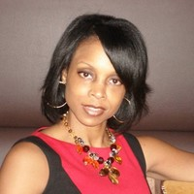
Dana Davis
Director of Human Resources
NC Electric Cooperatives
Notes:
Dana Davis
Director, Human Resources
North Carolina Electric Membership Corporation
Dana.Davis@NCEMCS.com

Slide 24
Notes:
Dana Davis
Director, Human Resources
North Carolina Electric Membership Corporation
Dana.Davis@NCEMCS.com

Slide 25
Notes:
Dana Davis
Director, Human Resources
North Carolina Electric Membership Corporation
Dana.Davis@NCEMCS.com

Slide 26
Notes:
Dana Davis
Director, Human Resources
North Carolina Electric Membership Corporation
Dana.Davis@NCEMCS.com

Slide 27
Notes:
Dana Davis
Director, Human Resources
North Carolina Electric Membership Corporation
Dana.Davis@NCEMCS.com

Slide 28
Notes:
Dana Davis
Director, Human Resources
North Carolina Electric Membership Corporation
Dana.Davis@NCEMCS.com

Slide 29
Notes:
Dana Davis
Director, Human Resources
North Carolina Electric Membership Corporation
Dana.Davis@NCEMCS.com

Slide 30
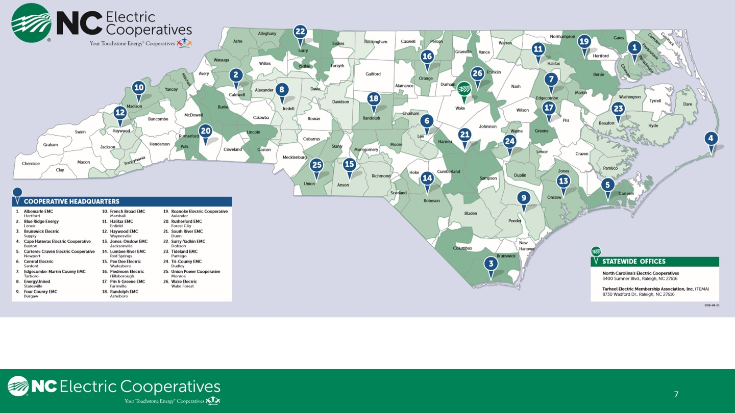
Notes:
Dana Davis
Director, Human Resources
North Carolina Electric Membership Corporation
Dana.Davis@NCEMCS.com

Slide 31
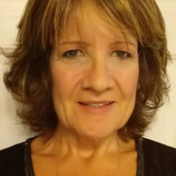
Maureen Price
Recruiter
PowerSecure, Inc.
Notes:
Maureen Price | Recruiter
meprice@powersecure.com
PowerSecure, Inc. | Human Resources
1609 Heritage Commerce Ct. Wake Forest, NC 27587
O: 919-453-1761 C:984-202-0241
powersecure.com

Slide 32
Notes:
Maureen Price | Recruiter
meprice@powersecure.com
PowerSecure, Inc. | Human Resources
1609 Heritage Commerce Ct. Wake Forest, NC 27587
O: 919-453-1761 C:984-202-0241
powersecure.com

Slide 33
Notes:
Maureen Price | Recruiter
meprice@powersecure.com
PowerSecure, Inc. | Human Resources
1609 Heritage Commerce Ct. Wake Forest, NC 27587
O: 919-453-1761 C:984-202-0241
powersecure.com

Slide 34
Notes:
Maureen Price | Recruiter
meprice@powersecure.com
PowerSecure, Inc. | Human Resources
1609 Heritage Commerce Ct. Wake Forest, NC 27587
O: 919-453-1761 C:984-202-0241
powersecure.com

Slide 35
Notes:
Maureen Price | Recruiter
meprice@powersecure.com
PowerSecure, Inc. | Human Resources
1609 Heritage Commerce Ct. Wake Forest, NC 27587
O: 919-453-1761 C:984-202-0241
powersecure.com

Slide 36
Notes:
Maureen Price | Recruiter
meprice@powersecure.com
PowerSecure, Inc. | Human Resources
1609 Heritage Commerce Ct. Wake Forest, NC 27587
O: 919-453-1761 C:984-202-0241
powersecure.com

Slide 37
Notes:
Maureen Price | Recruiter
meprice@powersecure.com
PowerSecure, Inc. | Human Resources
1609 Heritage Commerce Ct. Wake Forest, NC 27587
O: 919-453-1761 C:984-202-0241
powersecure.com

Slide 38
Notes:
Maureen Price | Recruiter
meprice@powersecure.com
PowerSecure, Inc. | Human Resources
1609 Heritage Commerce Ct. Wake Forest, NC 27587
O: 919-453-1761 C:984-202-0241
powersecure.com

Slide 39
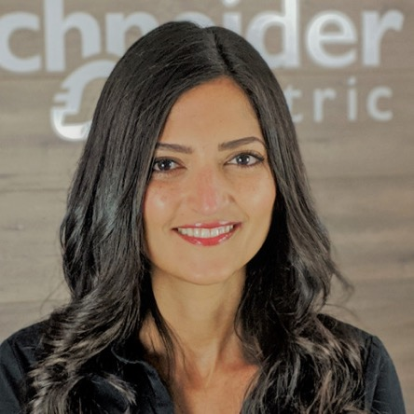
Suzan Noser
Human Resources Director – US Services
Schneider Electric

Slide 40
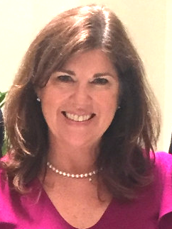
Missy Akin
Corporate Recruiter
Brady Services
Notes:
Missy Akin
Corporate Recruiter
Brady Services
Missy.akin@bradyservices.com

Slide 41
Notes:
Missy Akin
Corporate Recruiter
Brady Services
Missy.akin@bradyservices.com

Slide 42
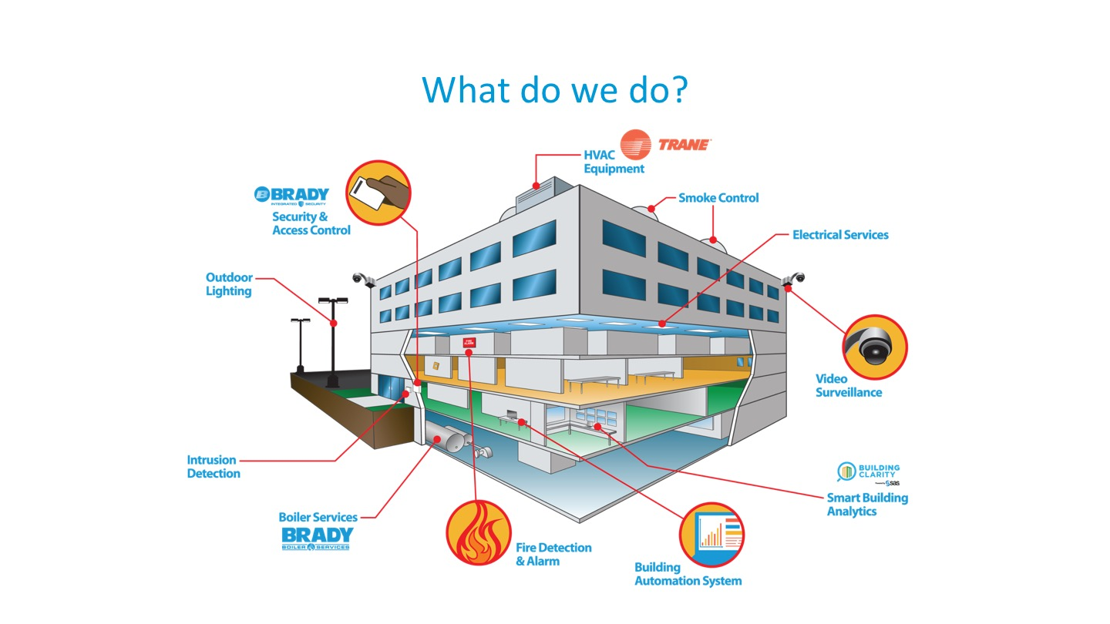
Notes:
Missy Akin
Corporate Recruiter
Brady Services
Missy.akin@bradyservices.com

Slide 43
Notes:
Missy Akin
Corporate Recruiter
Brady Services
Missy.akin@bradyservices.com

Slide 44
Notes:
Missy Akin
Corporate Recruiter
Brady Services
Missy.akin@bradyservices.com

Slide 45
Notes:
Missy Akin
Corporate Recruiter
Brady Services
Missy.akin@bradyservices.com

Slide 46
Notes:
Missy Akin
Corporate Recruiter
Brady Services
Missy.akin@bradyservices.com

Slide 47
Raising the Awareness of Career Pathways in North Carolina
Next meeting is November 18, 2020
Download the PowerPoint and access the recording: www.ncperkins.org/presentations
Notes:
Our next meeting like this one will be on ------.
(We will skip December and be back in January.)
You can go to the NCPerkins website to register for that meeting.
We'll also send you a reminder, since you are now on our mailing list.
So go ahead and sign up for all the meetings, and you'll be reminded the day before.
If you liked something you saw here, send folks to the recording. Find it at that same web page.

