Slide 1
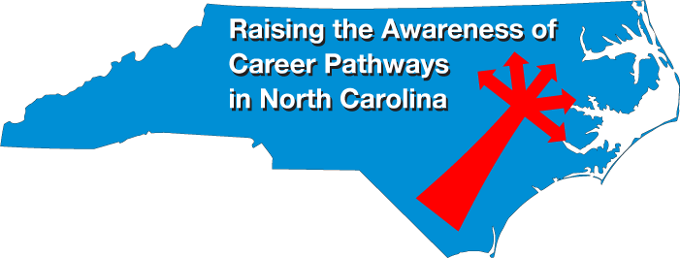
March 19, 2020
Dr. Bob Witchger
Chris Droessler
NC Community Colleges
Cheryl Cox
NC Department of Public Instruction
www.ncperkins.org/presentations
Notes:
We are here to help promote the great jobs, often unknown, in the great state of North Carolina.
Through these monthly meetings, we are going to let you know about some great career opportunities in North Carolina.
Bring in special guests to let you know about the great career opportunities in North Carolina.
Please download this PowerPoint file and use it anyway you can to help get folks on a career pathway.
The reference showing from where the information was found, as well as the contact information for our guests is in the Notes section under each slide.
Get the PowerPoint on our NCPerkins.org website on our Presentations and Webinars page.
Here is the direct address on the screen.
====
Dr. Bob Witchger
919-807-7126
witchgerb@nccommunitycolleges.edu
Chris Droessler
919-807-7068
droesslerc@nccommunitycolleges.edu
Cheryl Cox
919-807-3814
cheryl.cox@dpi.nc.gov

Slide 2
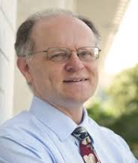
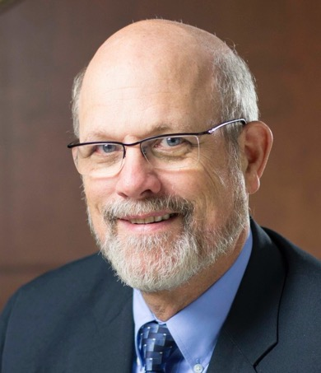
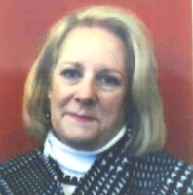
Chris Droessler NC Community Colleges
Raising the Awareness of Career Pathways in North Carolina
Cheryl Cox
NC Dept of Public Instruction
Bob Witchger NC Community Colleges
www.ncperkins.org/presentations
Notes:
I always say our webinars are like radio but with pictures.
And here a re a few pictures of your hosts for these monthly explorations into career pathways.
Why does the photographer have the best photo?
Our contact information is in the notes section under this slide.
Download this PowerPoint file at the address you see on the screen.
ncperkins dot org slash presentations
Cheryl is not with us on the webinar this week, but she sends her regards to
all of you who are helping us to raise the awareness of career pathways in North Carolina.
Dr. Bob Witchger
919-807-7126
WitchgerB@nccommunitycolleges.edu
Chris Droessler
919-807-7068
DroesslerC@nccommunitycolleges.edu
Cheryl Cox
919-807-3814
Cheryl.Cox@dpi.nc.gov

Slide 3
Notes:
Expecting 20 sheds from 7 counties.
Cancelled for 2020
This is a fascinating event watching these kids build these sheds in such a professional manner.
High school teams from multiple counties
You can put in a bid to win one of the sheds and have it delivered to your back yard.
That's a better deal, and a better shed than you would get a t a hardware store.
Let's bring in Phil Vice to tell us about it .
====
2020 S.H.E.D. Building Competition + Expo
https://www.eventbrite.com/e/2020-shed-building-competition-expo-tickets-93206981591
Phil Vice, Senior Administrator
pvice@wcpss.net
Career and Technical Education Wake County Public School System
5625 Dillard Dr.
Cary, NC 27518
919.533-7065
919.589-6196 Fax # NEW NUMBER

Slide 4
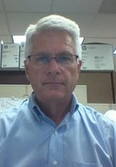
Phil Vice
Senior Administrator Technology and Trade & Industrial Education Wake County Public School System
Notes:
Might be listening in by phone today, but can’t speak.
====
Phil Vice, Senior Administrator
pvice@wcpss.net
Career and Technical Education Wake County Public School System
5625 Dillard Dr.
Cary, NC 27518
919.533-7065
919.589-6196 Fax # NEW NUMBER

Slide 5
Notes:
www.ncperkins.org/presentations

Slide 6
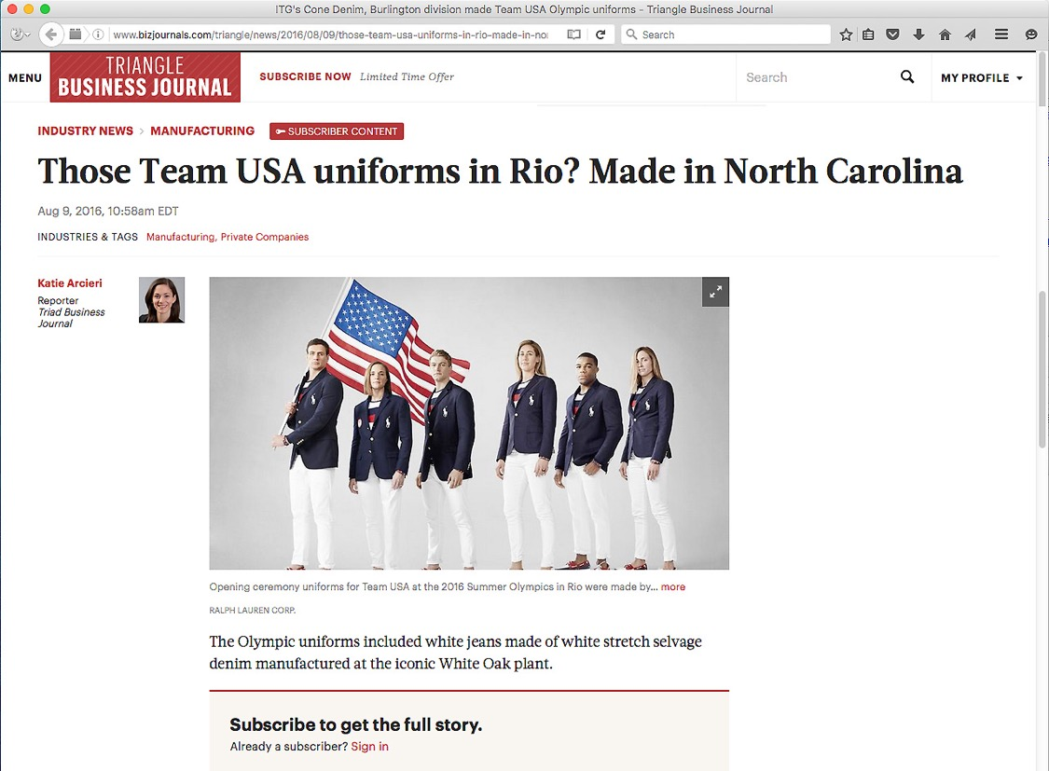
Notes:
The textile industry is alive and well in North Carolina. And four years ago, folks around the world got a chance to see our textiles in action at the Olympics.
The white thread in the pants you see here was made in North Carolina and shipped to South Carolina where the white fabric was made.
Then the white fabric came back to North Carolina where the pants were assembled in Rutherfordton and Greensboro, North Carolina.
The blazers were assembled in Burlington, Raeford, and Cordova, North Carolina
Additionally, a company in Charlotte made the wetsuits for the USA Rowing Team.
There are no longer sweat shops in North Carolina with young ladies hunched over a manual sewing machine.
No -- these textile operations are high tech and require smart folks to operate the equipment.
textile production is big in North Carolina.
====
Opening Ceremony
http://www.bizjournals.com/triangle/news/2016/08/09/those-team-usa-uniforms-in-rio-made-in-north.html?ana=e_du_prem&s=article_du&ed=2016-08-09&u=DFsejj4U8KnV9lBFgI8D1Q03b85e1a&t=1470853007&j=75380092
Rowing Team
http://www.wcnc.com/sports/olympics/local-business-made-olympic-uniforms/280016944
White fabric
http://www.wyff4.com/sports/2016-olympics/upstate-company-helps-make-uniforms-for-us-olympians/41032828
Pants
http://www.twcnews.com/nc/triangle-sandhills/news/2016/08/6/usa-olympic-opening-ceremony-uniforms-made-in-nc.html
Blazers
http://www.twcnews.com/nc/triangle-sandhills/news/2016/08/6/usa-olympic-opening-ceremony-uniforms-made-in-nc.html

Slide 7
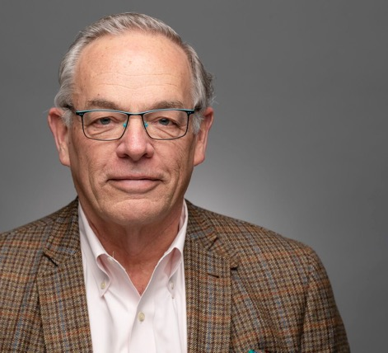
Jim Bryan
President, Fairystone Fabrics, Inc.
Burlington
Notes:
Jim Bryan
President
Fairystone Fabrics, Inc.
2247 N. Park Ave.
Burlington, NC 27217
336-395-1553 - Work
336-213-0204 – Cell
www.fairystonefabrics.com
jbryan@fairystonefabrics.com
Workforce development has always been important. New machines with new technologies brought a new urgency to grow our own technological workforce. We increased our partnership with Alamance Community College to offer courses for existing employees to upgrade their knowledge and skills. Expert OJT classes and a number of electrical classes have been attended by a number of our team members over the last 4 years.
We hired consultants to give everyone training in LEAN principles, 5 S root cause analysis and team building.
In 2015 we became founding members of AlamanceCAP (Career Accelerator Program) which is our High School apprenticeship program. We now have 5 motivated young people who are “Earning while they are Learning”. They attend school and work part time in a structured 4 to 5-year program that results in an Associates Degree from ACC and a journeyman’s license from the state of North Carolina.
As a result of our workforce efforts, we received local and state recognition. Alamance Community College selected us for their 2017 Business Partner of the Year. This was due to our 29 years of support and collaboration in workforce development. The North Carolina Manufacturing Extension Partnership awarded us their leadership in Workforce Development Award for 2017. In 2018 we joined the Eastern Triad Workforce Training Initiative to expand our efforts on a regional basis. Business North Carolina and The Triad Business Journal wrote articles celebrating our 50 years of success in business as well.

Slide 8
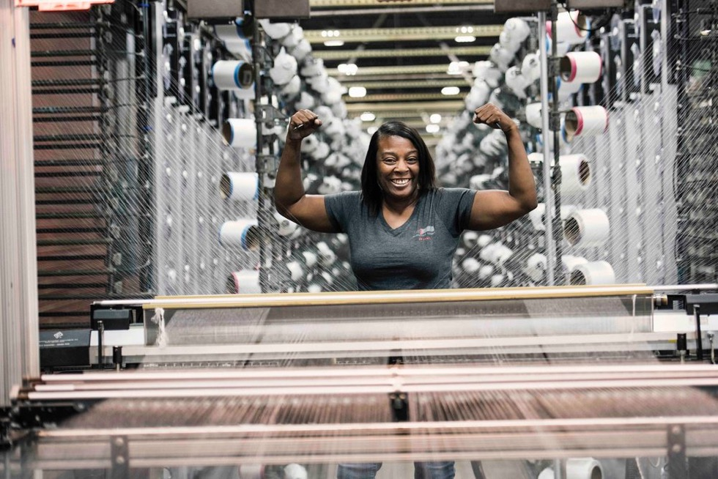
Fairystone Fabrics
Notes:
https://www.fairystonefabrics.com/

Slide 9
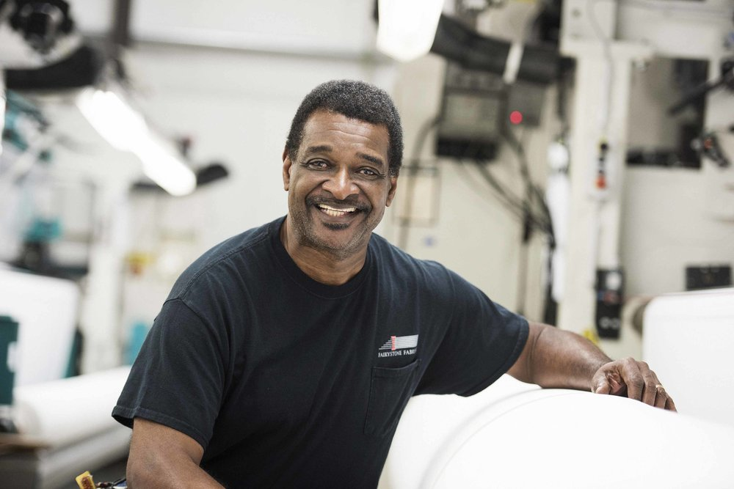
Fairystone Fabrics
Notes:
https://www.fairystonefabrics.com/

Slide 10
Fairystone Fabrics
Notes:
https://www.fairystonefabrics.com/

Slide 11
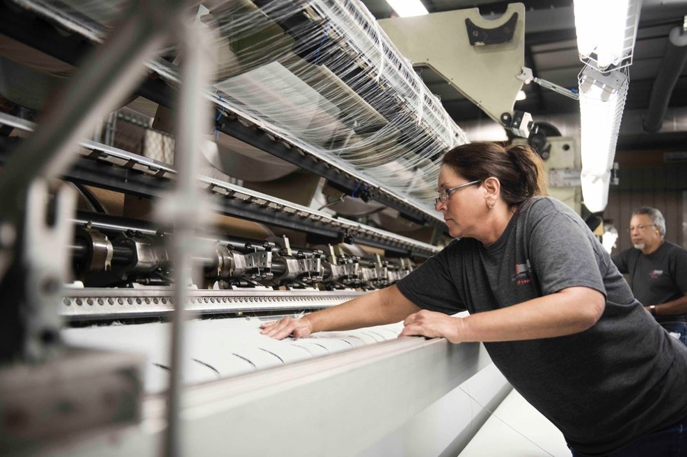
Fairystone Fabrics
Notes:
https://www.fairystonefabrics.com/

Slide 12
Fairystone Fabrics
Notes:
https://www.fairystonefabrics.com/

Slide 13
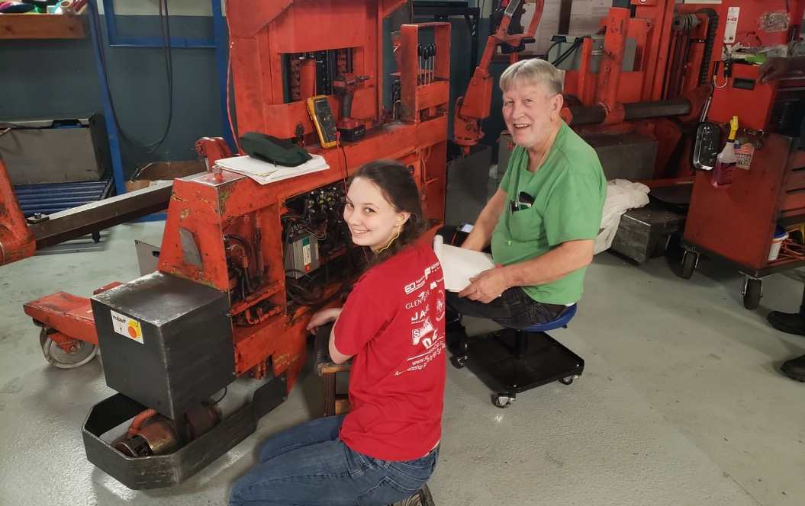
Fairystone Fabrics
Notes:
https://www.fairystonefabrics.com/

Slide 14
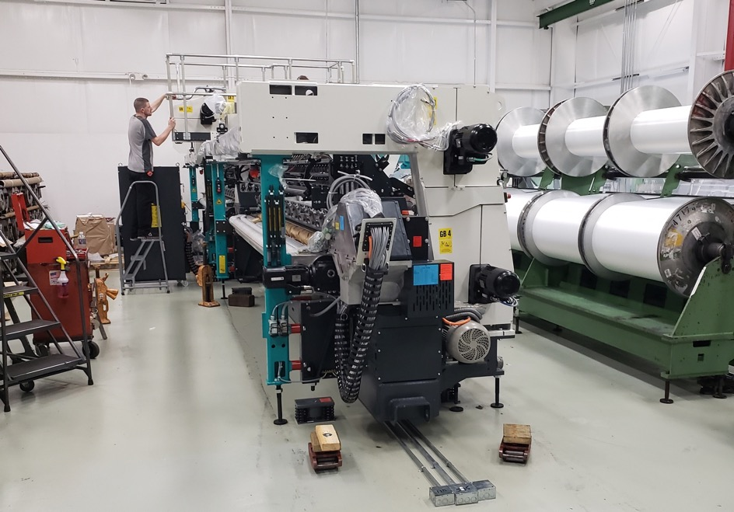
Fairystone Fabrics
Notes:
https://www.fairystonefabrics.com/

Slide 15
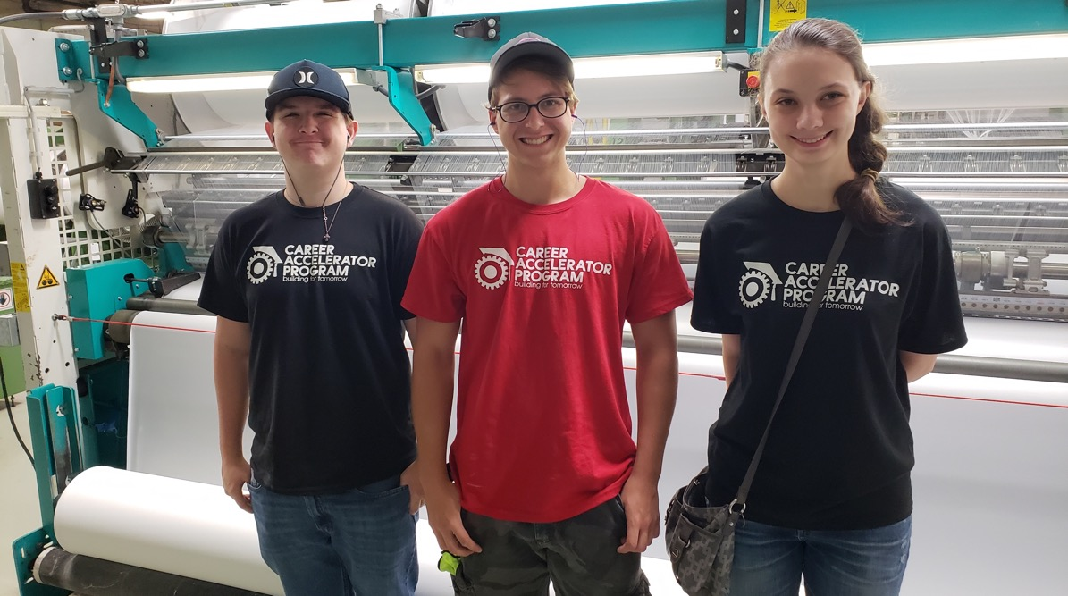
Fairystone Fabrics Preapprentices
Notes:
Preapprentices
https://www.fairystonefabrics.com/

Slide 16
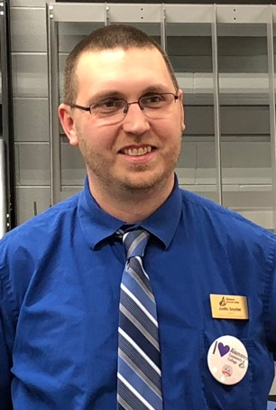
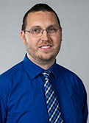
Justin Snyder
Dean, Industrial Technologies
Alamance Community College
Notes:
Justin Snyder
justin.snyder@alamancecc.edu
336-506-4279
Education Advisor at North Carolina Nursery and Landscape Association

Slide 17
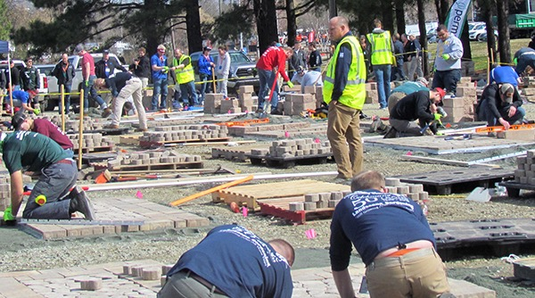
Alamance Community College National Landscape Association Student Career Days
Notes:
National Landscape Association Student Career Days event at Alamance Community College
Over 1500 students from across the country for 4 days.
Justin Snyder
justin.snyder@alamancecc.edu
336-506-4279
Education Advisor at North Carolina Nursery and Landscape Association

Slide 18
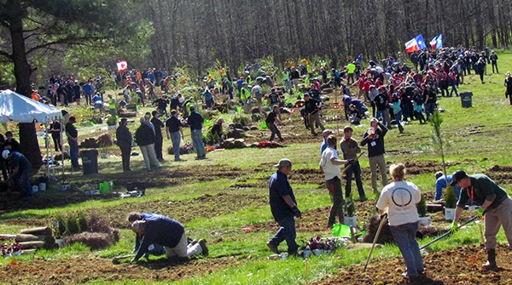
Alamance Community College National Landscape Association Student Career Days
Notes:
National Landscape Association Student Career Days event at Alamance Community College
Over 1500 students from across the country for 4 days.
Justin Snyder
justin.snyder@alamancecc.edu
336-506-4279
Education Advisor at North Carolina Nursery and Landscape Association

Slide 19
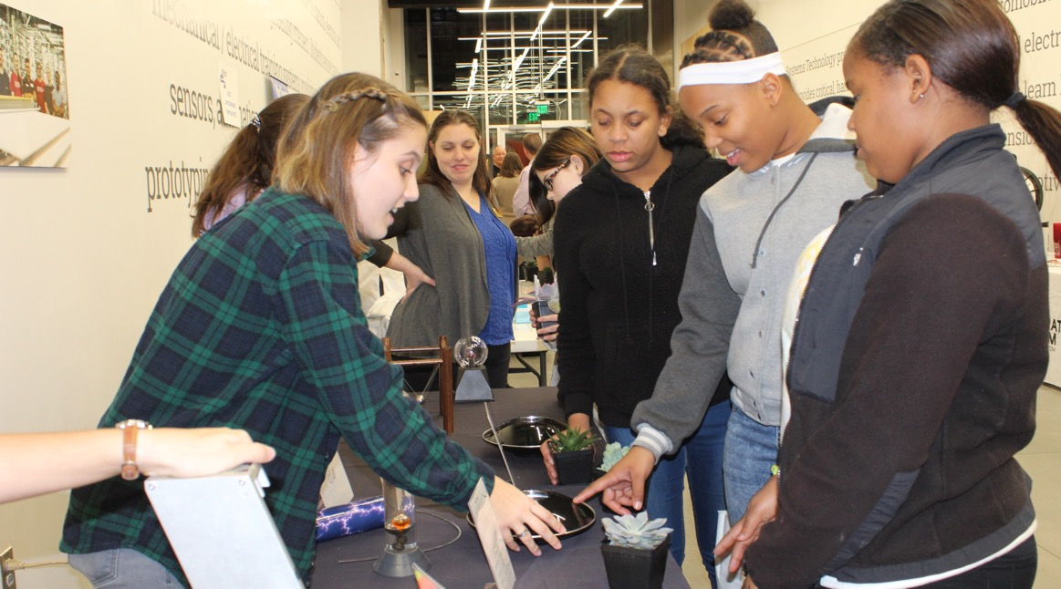
Alamance Community College Girls Take Over Tech
Notes:
Girls Take Over Tech
Justin Snyder
justin.snyder@alamancecc.edu
336-506-4279
Education Advisor at North Carolina Nursery and Landscape Association

Slide 20
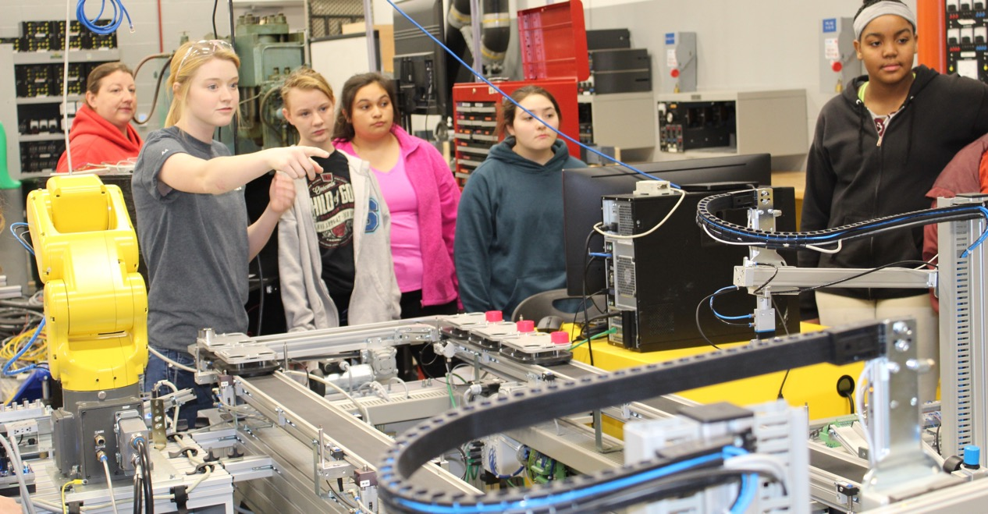
Alamance Community College Girls Take Over Tech
Notes:
Girls Take Over Tech
Justin Snyder
justin.snyder@alamancecc.edu
336-506-4279
Education Advisor at North Carolina Nursery and Landscape Association

Slide 21
Notes:
www.ncperkins.org/presentations

Slide 22
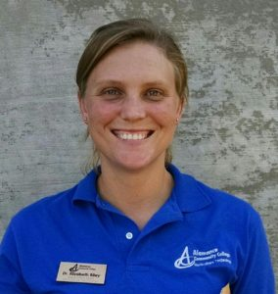
Elizabeth Riley
Department Head, Horticulture Technology & Agricultural Biotechnology
Alamance Community College
Notes:
Elizabeth Riley
Department Head, Horticulture Technology & Agricultural Biotechnology
Alamance Community College
Phone: 336-506-4192
Email: elizabeth.riley@alamancecc.edu
alamancecc.edu/horticulture

Slide 23
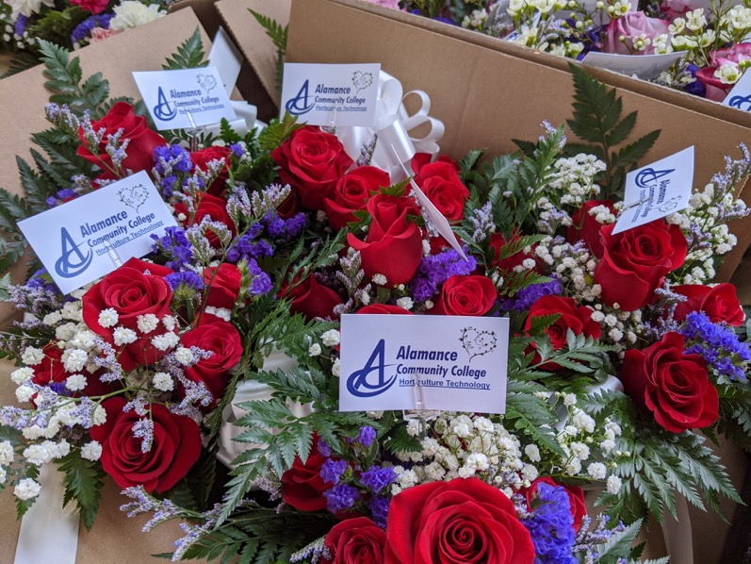
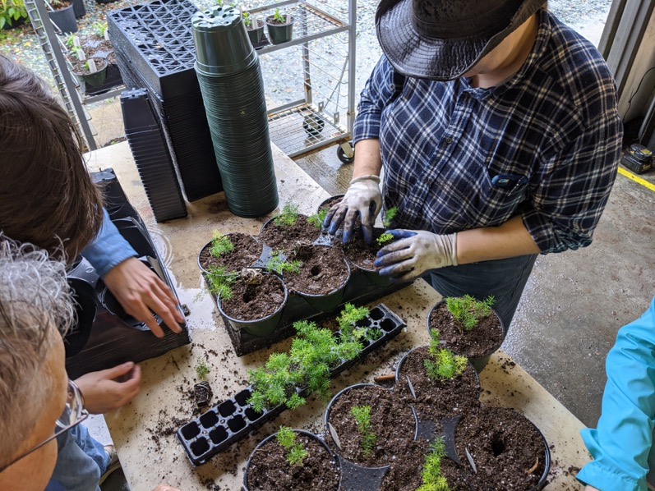
Alamance Community College Horticulture program
Notes:
Elizabeth Riley
Department Head, Horticulture Technology & Agricultural Biotechnology
Alamance Community College
Phone: 336-506-4192
Email: elizabeth.riley@alamancecc.edu
alamancecc.edu/horticulture

Slide 24
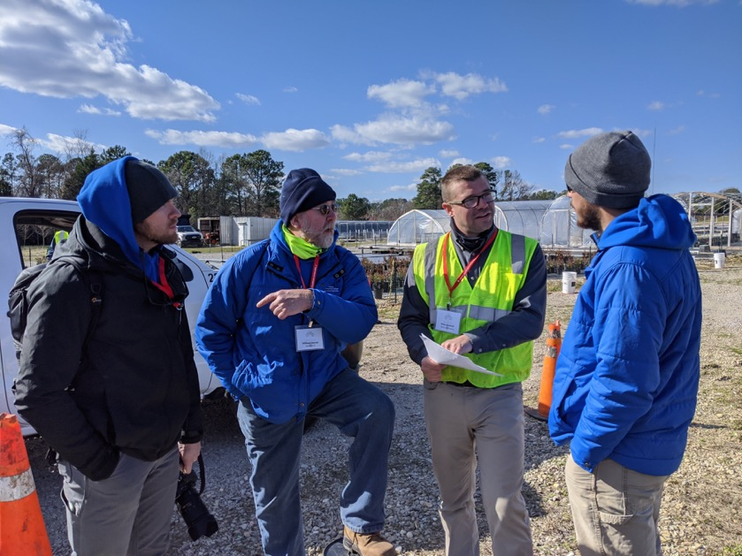
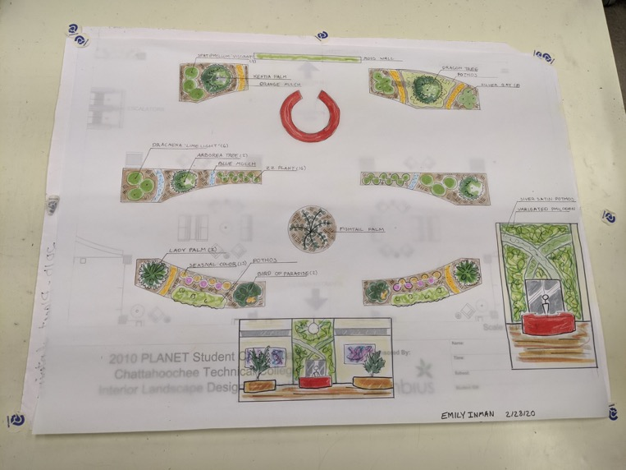
Alamance Community College Horticulture program
Notes:
Elizabeth Riley
Department Head, Horticulture Technology & Agricultural Biotechnology
Alamance Community College
Phone: 336-506-4192
Email: elizabeth.riley@alamancecc.edu
alamancecc.edu/horticulture

Slide 25
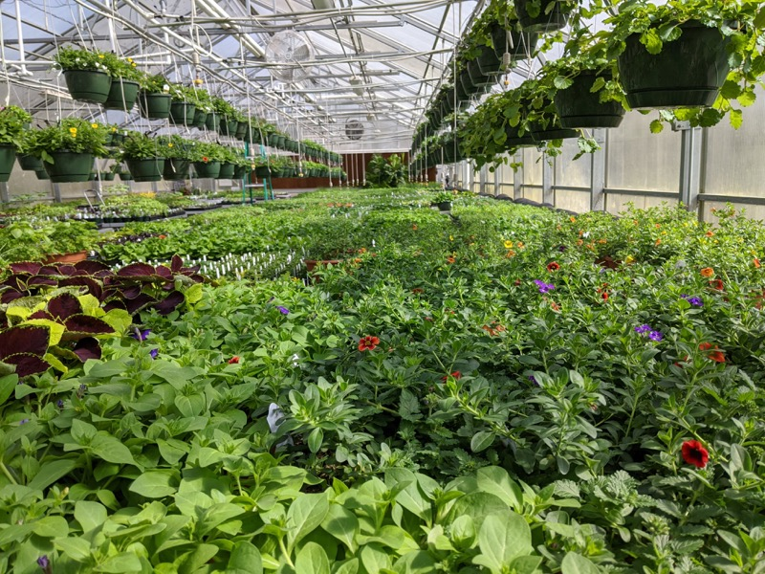
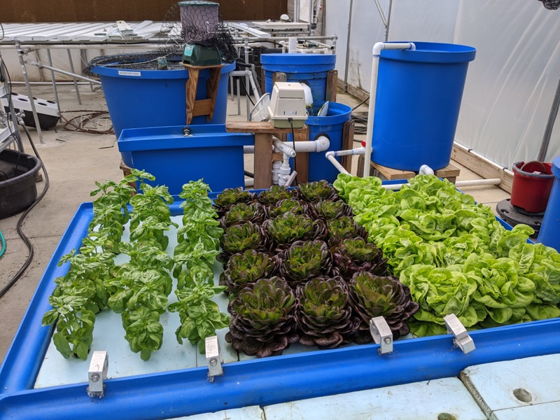
Alamance Community College Horticulture program
Notes:
Elizabeth Riley
Department Head, Horticulture Technology & Agricultural Biotechnology
Alamance Community College
Phone: 336-506-4192
Email: elizabeth.riley@alamancecc.edu
alamancecc.edu/horticulture

Slide 26
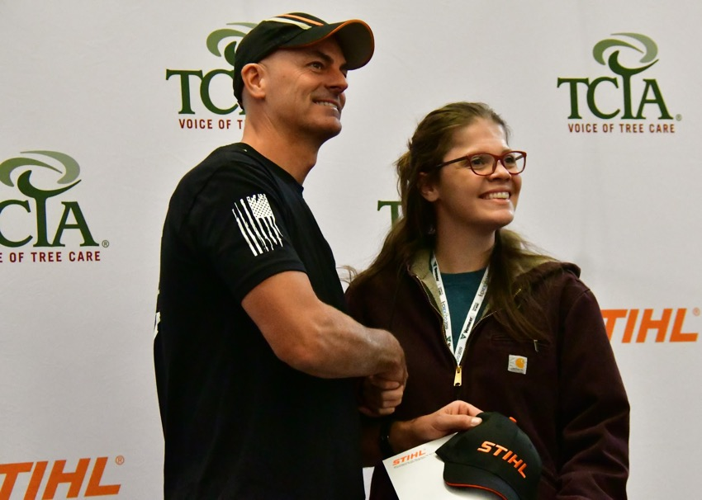
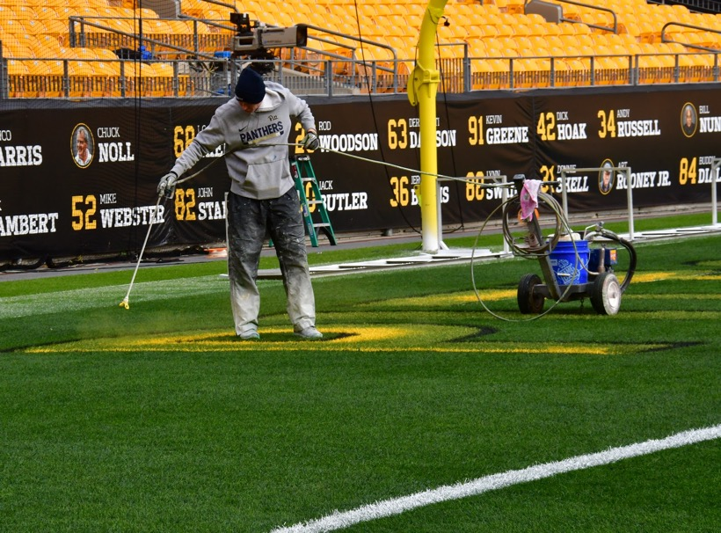
Alamance Community College Horticulture program
Notes:
Elizabeth Riley
Department Head, Horticulture Technology & Agricultural Biotechnology
Alamance Community College
Phone: 336-506-4192
Email: elizabeth.riley@alamancecc.edu
alamancecc.edu/horticulture

Slide 27
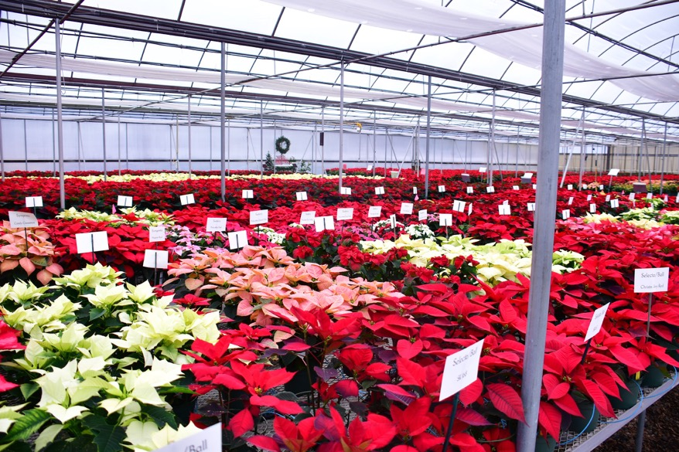
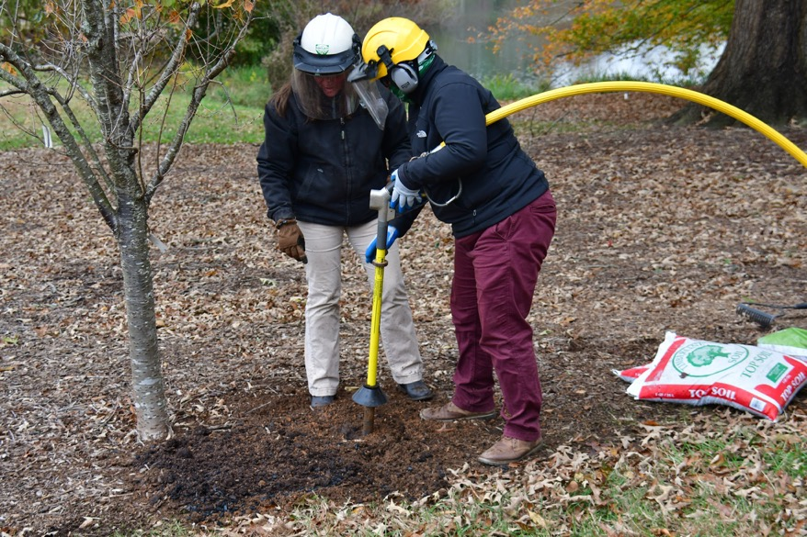
Alamance Community College Horticulture program
Notes:
Elizabeth Riley
Department Head, Horticulture Technology & Agricultural Biotechnology
Alamance Community College
Phone: 336-506-4192
Email: elizabeth.riley@alamancecc.edu
alamancecc.edu/horticulture

Slide 28
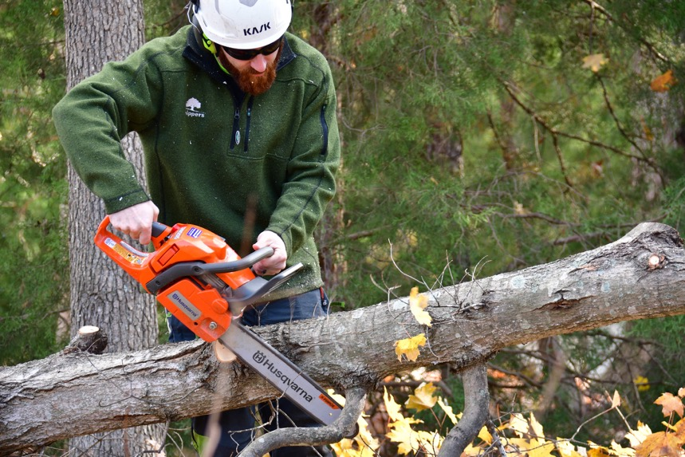
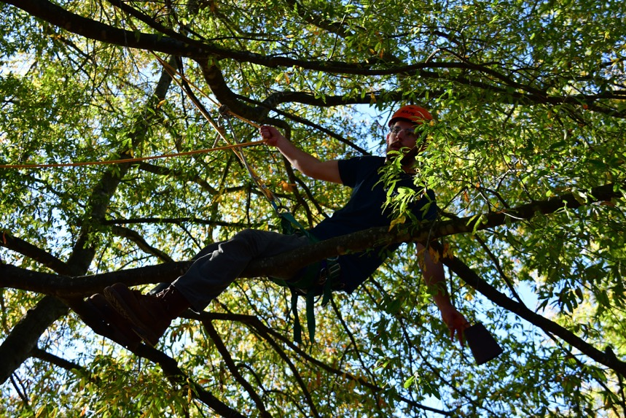
Alamance Community College Horticulture program
Notes:
Elizabeth Riley
Department Head, Horticulture Technology & Agricultural Biotechnology
Alamance Community College
Phone: 336-506-4192
Email: elizabeth.riley@alamancecc.edu
alamancecc.edu/horticulture

Slide 29
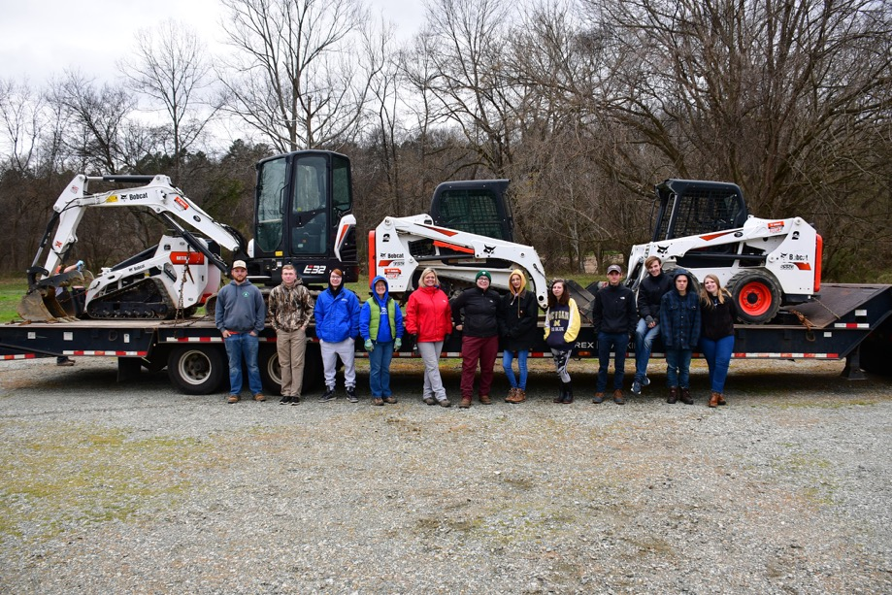
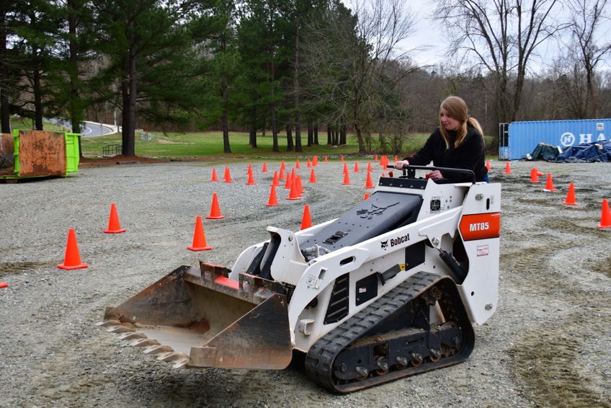
Alamance Community College Horticulture program
Notes:
Elizabeth Riley
Department Head, Horticulture Technology & Agricultural Biotechnology
Alamance Community College
Phone: 336-506-4192
Email: elizabeth.riley@alamancecc.edu
alamancecc.edu/horticulture

Slide 30
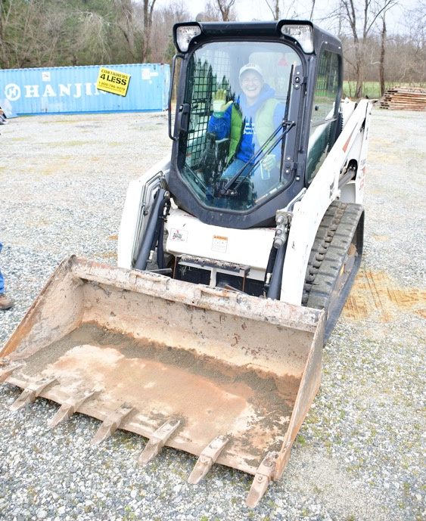
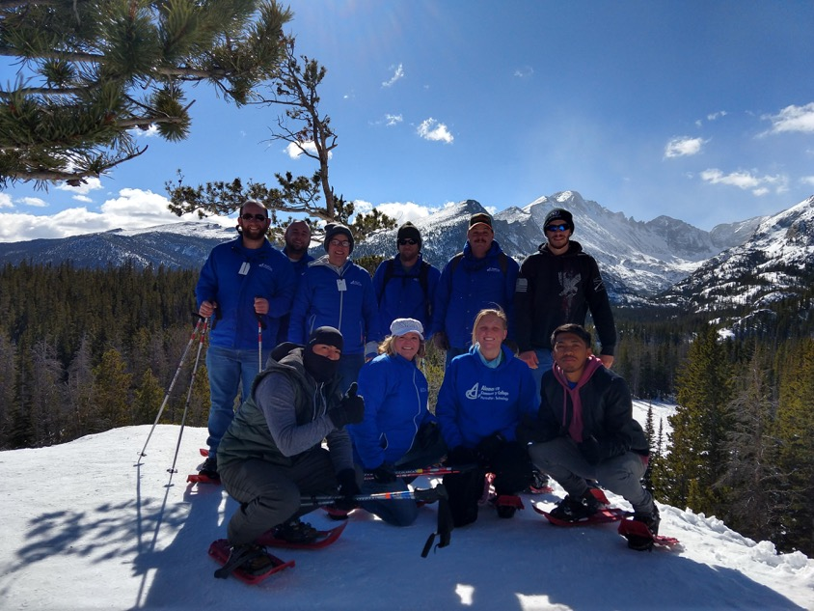
Alamance Community College Horticulture program
Notes:
Elizabeth Riley
Department Head, Horticulture Technology & Agricultural Biotechnology
Alamance Community College
Phone: 336-506-4192
Email: elizabeth.riley@alamancecc.edu
alamancecc.edu/horticulture

Slide 31
Notes:
www.ncperkins.org/presentations

Slide 32
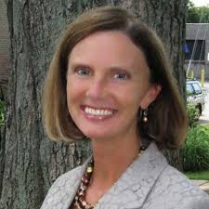
Kathryn P. Castelloes
ApprenticeshipNC Director
NCCCS
Notes:
Kathryn P. Castelloes, ApprenticeshipNC
919.807.6991 - Office
Castelloesk@nccommunitycolleges.edu

Slide 33
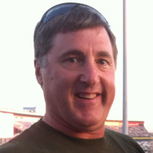
Frank Scuiletti
Program Coordinator: Construction, Engineering, Industrial, Transport, Criminal Justice, Fire Protection, & Work-Based Learning
Notes:
Frank Scuiletti <scuilettif@nccommunitycolleges.edu>

Slide 34
