Slide 1
Perkins
mid-Year Review
2020

Slide 2
Budget update
As of January 9, 2020
Approx. 54% of funds expended
Approx. 26% of funds encumbered
~ 20% of budget remaining for approved activities in the spring
Reserve Funds – 100% expended

Slide 3
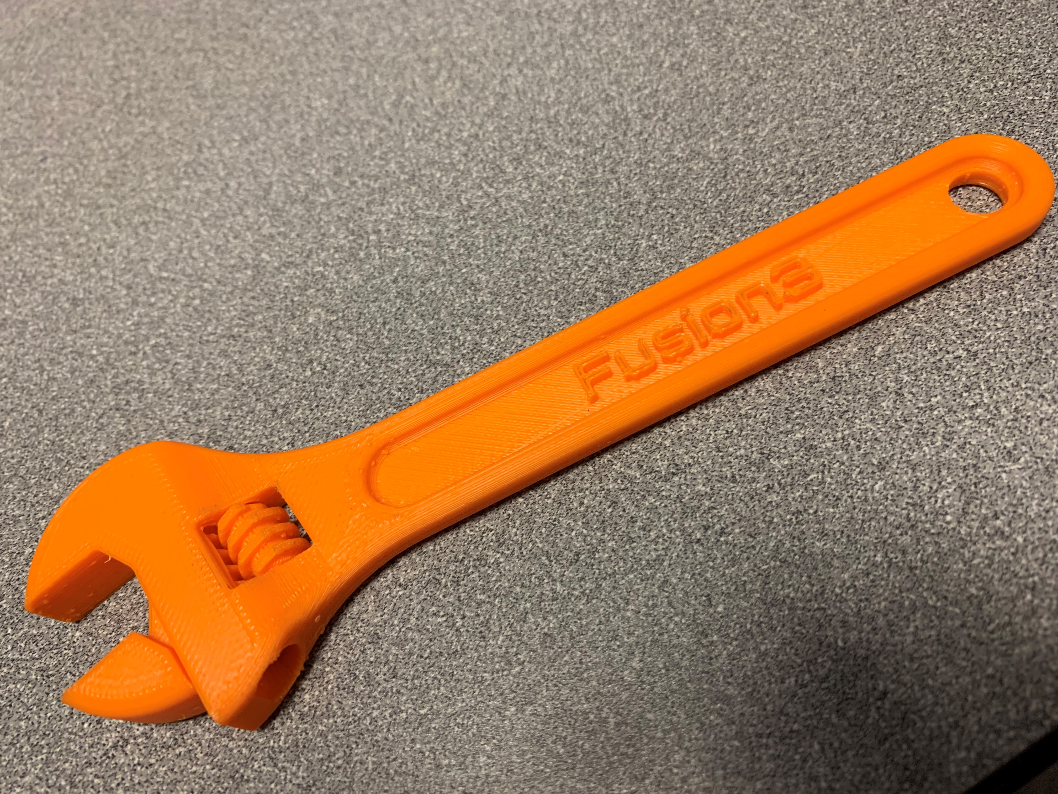
The perkins difference welding Program modernization
New Welding Program CAD Certificates
DFT 151 – Spring 2020
Instructor professional development
STEM Lab Building Construction
Strengthening Relationships
Regional employers
Secondary institutions

Slide 4
Comprehensive Local Needs Assessment
Comprehensive Local Needs Assessment
· Data
· Program Advisory Boards/Employers
· Community Partners
· Focus Groups/Interviews
Programs reviewed
· Cosmetology/Esthetics
· Criminal Justice
· Electrical
· Welding

Slide 5
Comprehensive Local Needs Assessment
Gaps Identified
· Work-based learning
· Employability skills
· Update equipment to mirror industrial work spaces
· Strengthen ability to offer in-house credentialing for CTE students
Community Partners
· Secondary Schools
· WIOA Adult, Dislocated Worker, and Youth
· Economic Development
· Workforce Development Board
· Vocational Rehabilitation

