Slide 1
Perkins Update
December 12, 2023

Slide 2
Career & Technical Education Team
Bob Witchger
Tony Reggi
Patti Coultas
Mary Olvera
Stefanie Schroeder
Darice McDougald
Lane Freeman
Jennifer McLean
Aaron Mabe

Slide 3
Purpose of Perkins
Develop more fully the academic knowledge and technical and employability skills of secondary education students and postsecondary education students who elect to enroll in CTE curriculum programs and programs of study
Notes:
The Strengthening Career and Technical Education for the 21st Century Act reauthorized and updated the Carl D. Perkins Career and Technical Education Act of 2006 to become the current Carl D. Perkins Career and Technical Education Act of 2006 as amended by the Strengthening Career and Technical Education for the 21st Century Act (Perkins V)
This updated act stresses:
- Academic, Technical, and Employability Skills
- Funding Secondary and Postsecondary CTE
- Focusing on Students who elect to enroll in CTE Programs of Study

Slide 4
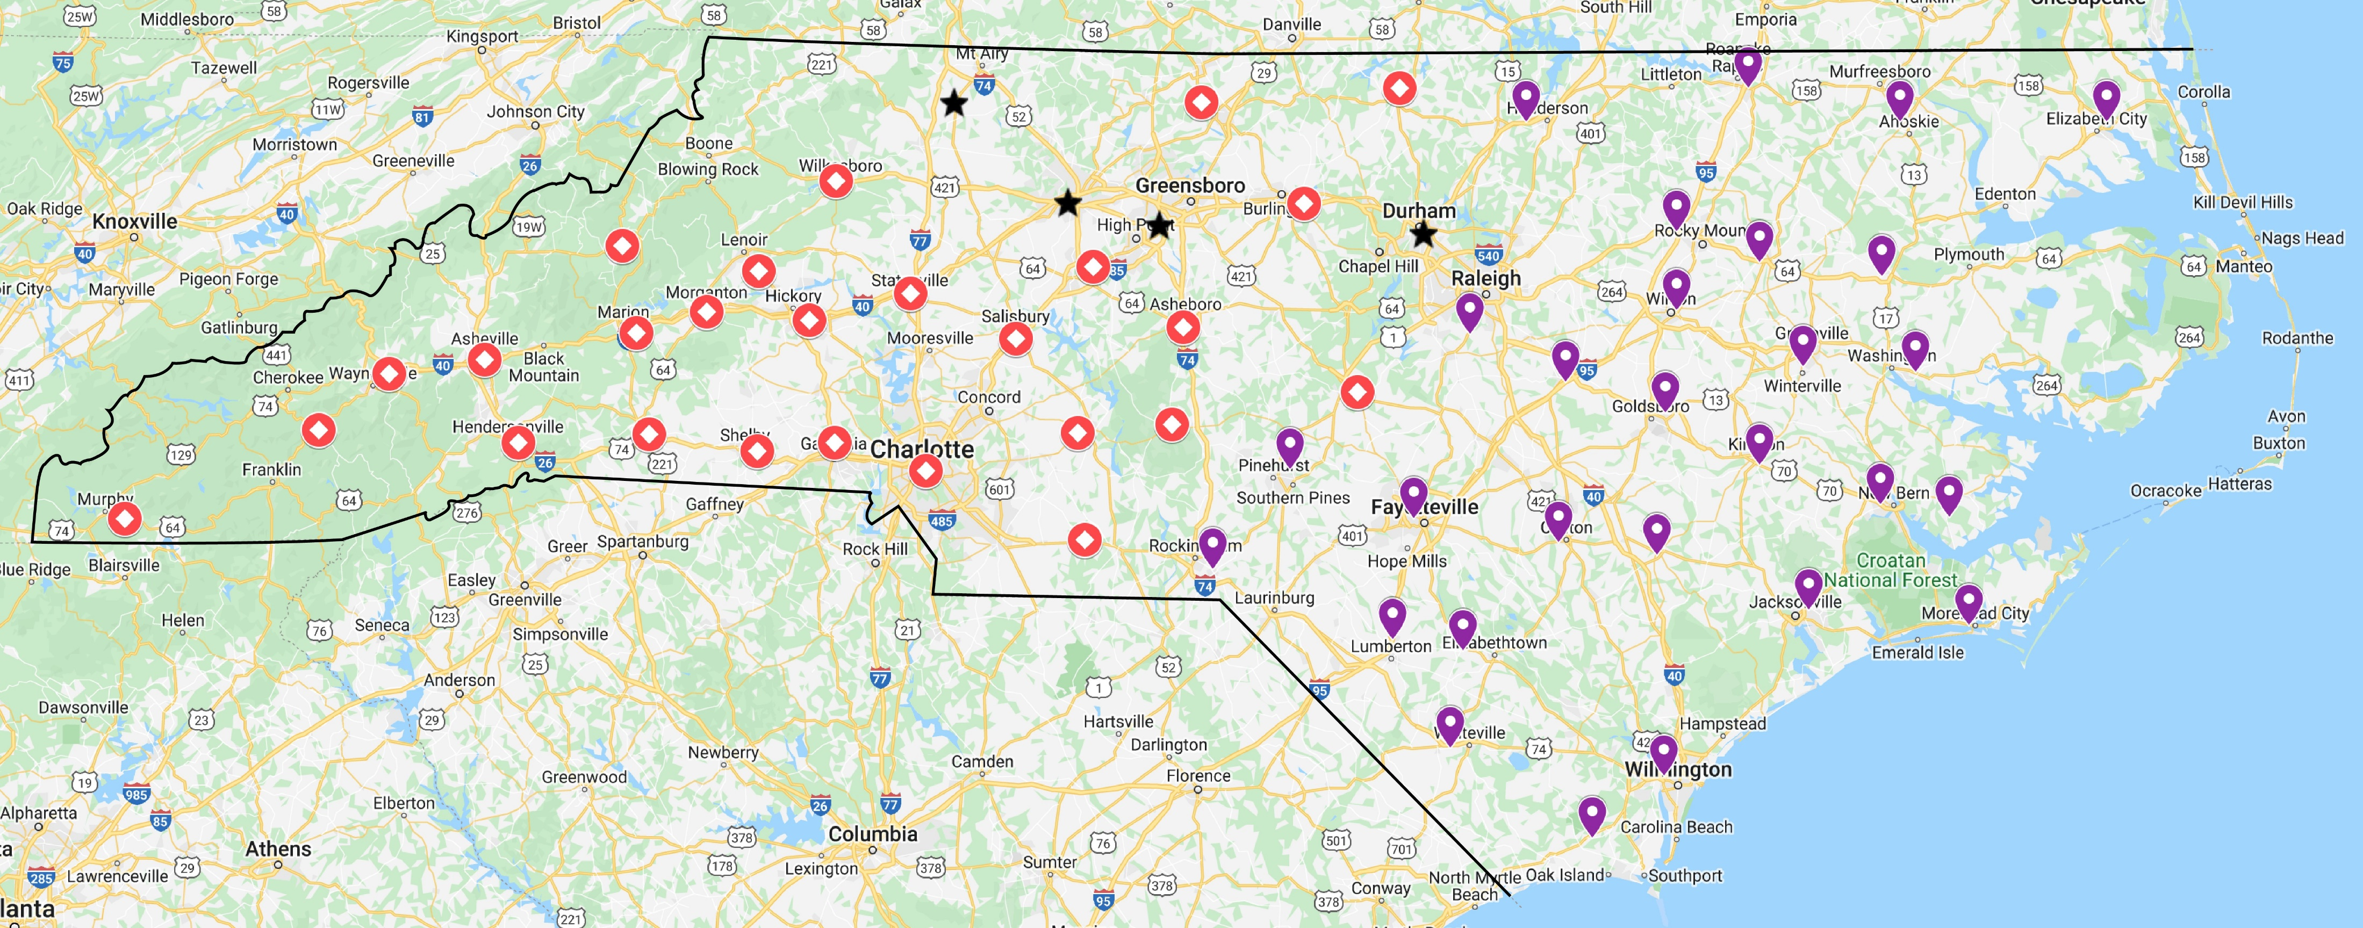
Colleges by CTE Coordinator
CTE COORDINATOR – MAIN CONTACT
Stefanie Schroeder
Patti Coultas
Mary Olvera

Slide 5
Documents Due January 12, 2024
Locally Articulated Course List (HS-CC)
9-14 Pathways
Mid-Year Local Plan Status Update (add status to most recent modified plan)
XDBR for December 31, 2023
Semi-Annual Time Certifications for July – December 2023
Perkins 2023-24 Mid-Year Questions

Slide 6
Perkins 2023-24 Mid-Year Questions 1 & 2
How does your college engage stakeholders in the CLNA process to determine gaps, needs, and supports for special populations?
Describe career guidance offered to students before enrolling and while participating in CTE Programs.

Slide 7
Perkins 2023-24 Mid-Year Questions 3 & 4
What framework does your college use to communicate/illustrate CTE 9-14 Career Pathways? What elements are included (courses, work-based learning, credentials earned, career information)? How are articulated course credits included? How are articulated credit awarded (applied to transcript)?
What challenges does your college have for successful implementation of their Perkins plan this year (2023-24)? Do you need any support from NCCCS?

Slide 8
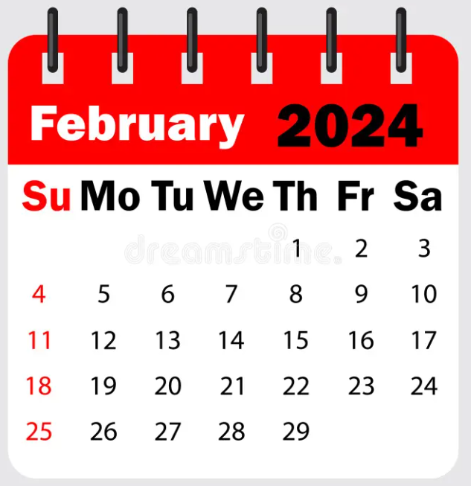
Mid-Year Review and Grant Technical Assistance
Caraway Conference Center
Room & dinner will be available starting February 5th
Please plan on staying the entire time to network and listen to other college’s promising practices.
Room and board paid by Perkins Leadership*
Colleges must pay for mileage

Slide 9
Mid-Year Tentative Agenda
Tuesday, February 6th
7:30 breakfast
8:30 – 4:30 Roundtable discussions on Perkins Elements
Wednesday, February 7th
7:30 breakfast
8:30 – 3:00 5-minute updates from each college
3:15 AI workshop
Thursday, February 8th
Time 8:30 – 2:30 Group technical assistance by topic

Slide 10
Logistics & Registration
NCCCS Perkins Leadership funds will pay for 1 room per college. Includes room for 3 nights (Mon, Tues. & Wed.) Monday is optional Also includes Monday dinner, Tuesday breakfast, lunch, & dinner, Wednesday breakfast, lunch & dinner and Thursday breakfast and lunch
NCCCS Perkins Leadership funds will pay for lunch for all participants
Additional rooms may be reserved separately through Caraway Conference Center or any area lodging
Registration: Coming soon

Slide 11
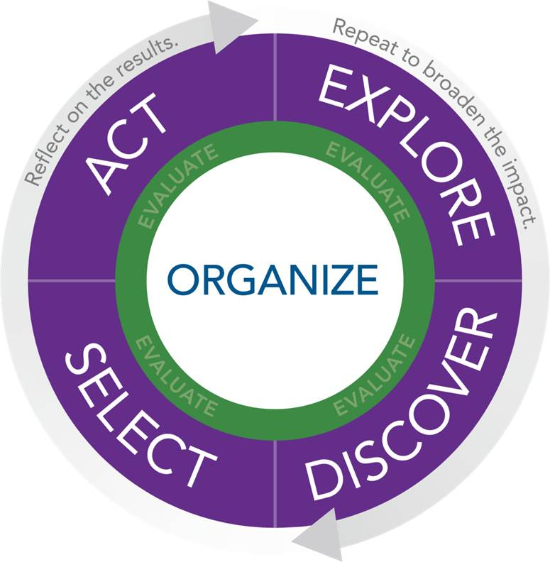
NAPE's Equity in Perkins V Workshop
NAPE's Equity in Perkins V engages educators in the foundational work of building an equity lens and provides guided learning experiences to apply equity principles to local data sets.
NAPE’s Equity in Perkins V workshop utilizes the NAPE PIPETM instructional improvement process as a model to scaffold institutional improvement to address the needs of marginalized student groups and the opportunities available within high-skill, high-wage, and in-demand fields. In this multi-day program, participants will develop the mindset, knowledge, and skills necessary to address the equity gaps in Career and Technical Education programs.
April 2 - 3, 2024 Caraway Conference Center
23 Colleges with teams of 3
More information coming soon
Example of Impact
“I so appreciate the introduction to so many crucial aspects of the work & the invitation/resources to explore more deeply”
~ Educator

Slide 12
ll-perkins Listserv

Slide 13
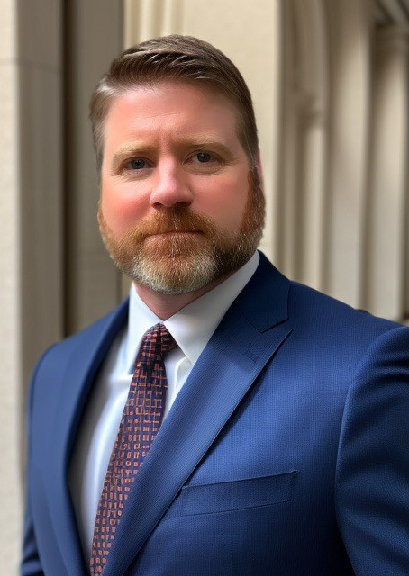
Lane Freeman
Director of Online Learning
Notes:
Aaron Mabe
919-807-7098
mabea@nccommunitycolleges.edu

Slide 14
Director of Online Learning Updates
2024 Immersive Learning Conference:
Focus on career exploration, aligning with CTE goals.
Priority for North Carolina Career Coaches.
Perkins Leadership Funding covers room and food costs.
Individual institutions responsible for transportation.
Opportunity for networking and exploring technology in education.

Slide 15
Online Learning Updates continued
“Leveraging AI in Higher Education" Session:
Introduction to AI and its relevance in higher education.
Practical applications in teaching, administration, and student services.
Strategies for AI integration in curriculum and administration.
Ethical considerations and future AI trends.
Hands-on activities to experience AI tools.
Targeted at faculty, staff, and student services, enhancing their work through AI.

Slide 16
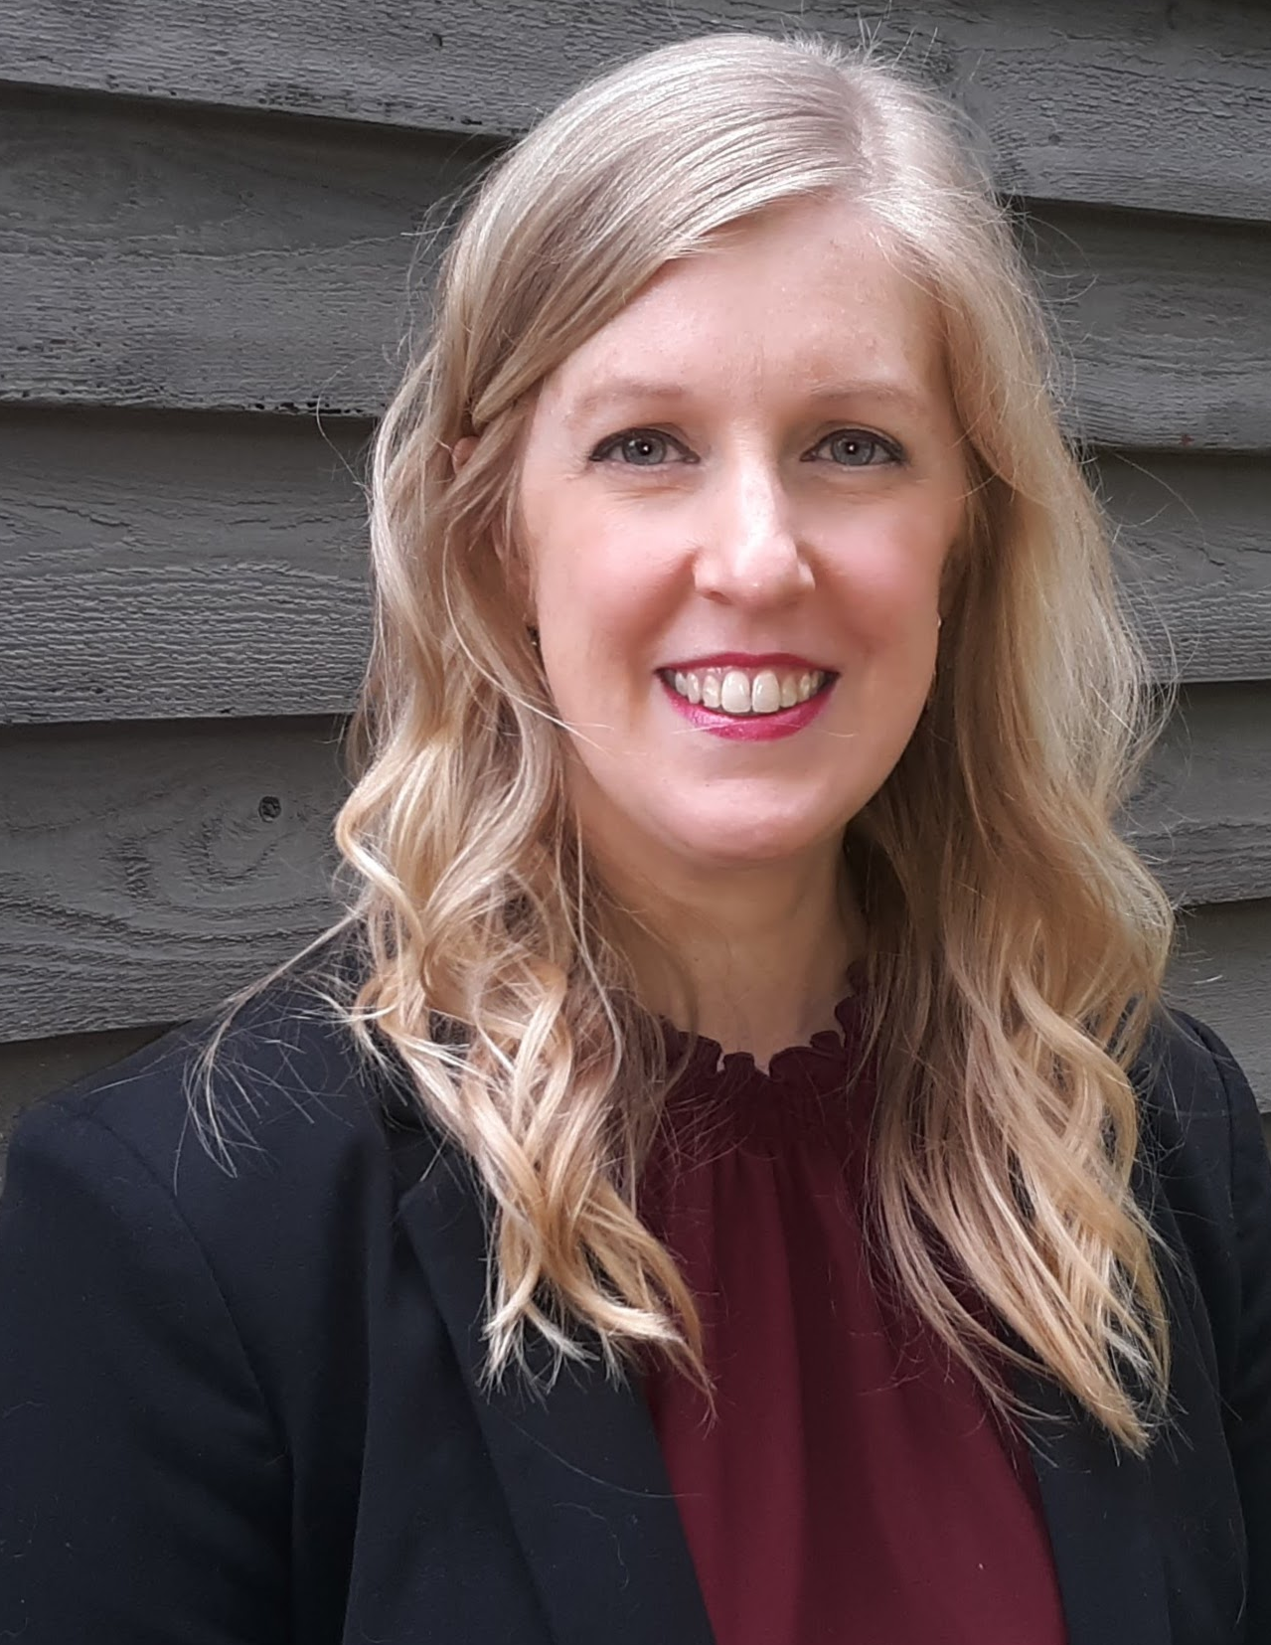
Jennifer McLean
Associate Director of Student Support
Notes:
Aaron Mabe
919-807-7098
mabea@nccommunitycolleges.edu

Slide 17
Digging Deep in Career Exploration Workshops
December 5 – Wayne Community College
TBD rescheduled Catawba Valley
Who should attend?
Career Coaches and Career Counselors
*Lunch $10 cash only at the door

Slide 18
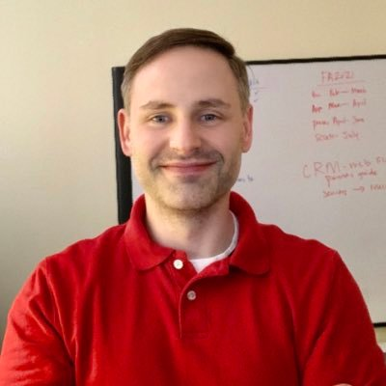
Aaron Mabe
Coordinator for Career and College Promise
Notes:
Aaron Mabe
919-807-7098
mabea@nccommunitycolleges.edu

Slide 19
Dual Enrollment Conference
The NC Community College System, in partnership with the NC Department of Public Instruction, the Early College Research Center at UNC-Greensboro, and the RAND Corporation, would like to invite you to our second dual enrollment conference.
The theme this year is
Unlocking Potential, Expanding Opportunity: The Role of Dual Enrollment
This Conference is free to attend. Completely virtual February 28-29, 2024 from 10am – 5pm
For more information and to register: https://de24.vfairs.com/
Notes:
https://de24.vfairs.com/

Slide 20
CCP Operating Procedures Updated
The updated CCP Operating Procedures/Section 14 can be viewed HERE (link is spelled out in the notes)
One of the major updates within the procedures includes a change in reporting - depending on the student's career goals, CTE Pathways may be considered a primary pathway.
Additional policy updates include guidance on Pathway Completers, stackable credentials, and Credit for Prior Learning.
Changes will take effect Spring 2024
Notes:
https://ncccsstg.wpengine.com/wp-content/uploads/2023/11/CCP-Operating-Procedures-SPRING-2024-FINAL-CPRM.pdf

Slide 21
Promising Practice Video from 2022-2023
Martin and Roanoke-Chowan Community Colleges
Health program collaboration
Immersive Learning at Martin Community College

Slide 22
Virtual Office Hours for Technical Assistance
2nd Tuesday of the month 1-2pm
4th Wednesday of the month 9-10
** See NCPerkins course announcements for TEAMS link
Need help?
Let's meet.
CTE Team Perkins
Virtual
Office Hours
Drop in to ask a CTE Coordinator your questions

Slide 23
Fall 2024 System Conference
Start planning now to submit a proposal to present!
Ideas and Topics for a CTE Strand
October 13-15, 2024
Convention Center, Raleigh
Notes:
Put in chat ideas and topics

Slide 24
Perkins Monthly Updates 2023-24
Jan 9, 2024
Feb 13, 2024
Mar 12, 2024
Apr 9, 2024
May 14, 2024
Jun 11, 2024
 Register now so they are on your calendar! www.ncperkins.org/presentations
Attendance (or viewing the recording within 30 days) is recorded on monitoring rubric. Recording may be accessed at the same link as the registration.
Notes:
Register now and let the system remind you.

Slide 25
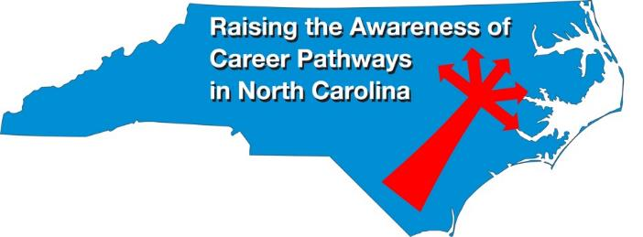
Raising the Awareness of Career Pathways Monthly Webinars
Jan. 17 – Engineering Technology
Feb. 21 – Biotechnology & Clinical Trials Research Associate
Mar. 20 – Business Administration
Apr. 17 – Public Safety
May 15 – Cyber Crime Technology
Register for all webinars at www.ncperkins.org/presentations

Slide 26
Technical Assistance is available
We are here to help!
Team Perkins is available by phone, email, virtually, or in-person

