Slide 1
Perkins Update
September 12, 2023

Slide 2
Career & Technical Education Team
Bob Witchger
Tony Reggi
Patti Coultas
Mary Olvera
vacant
Darice McDougald
Lane Freeman
Jennifer McLean
Aaron Mabe

Slide 3
Hiring a CTE Coordinator
Currently

Slide 4
Curriculum Programs Team
Michelle Lair
Dr. Lori Byrd
Dr. Hilmi Lahoud
Aaron Mabe
Todd Roth
Nedra Dixon
Peyton Bell
Gail Robertson
Reyna Rodriguez
Mary Olvera

Slide 5
Purpose of Perkins
Develop more fully the academic knowledge and technical and employability skills of secondary education students and postsecondary education students who elect to enroll in CTE curriculum programs and programs of study
Notes:
The Strengthening Career and Technical Education for the 21st Century Act reauthorized and updated the Carl D. Perkins Career and Technical Education Act of 2006 to become the current Carl D. Perkins Career and Technical Education Act of 2006 as amended by the Strengthening Career and Technical Education for the 21st Century Act (Perkins V)
This updated act stresses:
- Academic, Technical, and Employability Skills
- Funding Secondary and Postsecondary CTE
- Focusing on Students who elect to enroll in CTE Programs of Study

Slide 6
Perkins 2023-24 Budgets by Voc Code
P.D. 7.67%
Wages
45.25%
Equipment 32.63%

Slide 7
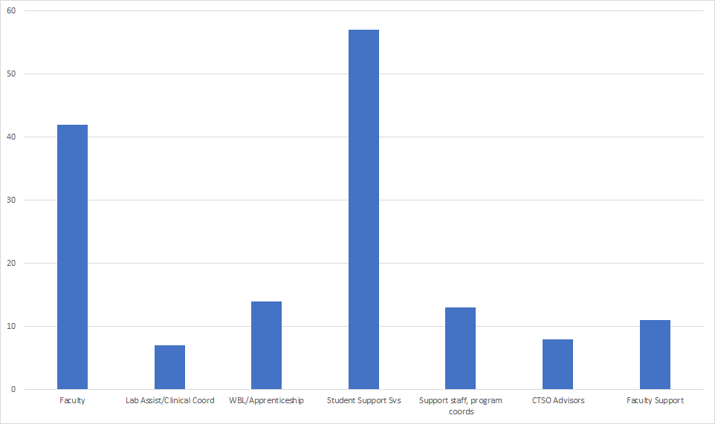
Perkins funded positions by type
Notes:
Student Support Svs: Career coach, success coach, tutors, advisors, disability services, outreach, etc
Faculty Support: PD/Instructional Designer, Instructional Coach, Curriculum Alignment Specialist

Slide 8
2022-23 Perkins data coming soon
Perkins performance indicator data to be updated in October or November
CLNA Guide is being updated to include Special Populations Performance Indicator CLNA requirements and template

Slide 9
Updated All CTE Program CLNA
Identify gaps and needs through the:
Evaluation of student performance by subpopulation on Perkins core indicators.
Evaluation of the CTE programs offered (size, scope, quality, and alignment to workforce needs).
Evaluation of the progress toward implementing CTE 9-14 Programs of Study.
Evaluation of CTE educators and support professionals: recruitment, retention and training activities.
Evaluation of progress toward implementing equal access to CTE for all students.

Slide 10
Improving Instruction via Innovation
AI Professional Development Series in partnership with the Student Success Center
NC ACCESS Education Programs Conference this week! Web-based tools to improve online instruction.
Contact Lane Freeman to schedule webinars specific to your institution or community of practice.
Collaboration with VLC Professional Development Center to customize a Best Practice in Online Learning for CTE faculty course offerings.
2024 Immersive Learning Conference will take place April 22nd – 24th The focus will be on Career Exploration in CTE fields.

Slide 11
Articulation & Pathway Work
CCP Onboarding and Leadership Institute
Tuesday, Sept. 19th at Randolph, Wednesday, Sept. 20 at Caldwell, and Thursday, Sept 28th at Fayetteville
CCP Operating Procedures
9-14 Pathways
Articulation
Advising
Articulation
developing procedures, advising tips, and best practices
future regional trainings will be forthcoming

Slide 12
Career Development Trainings
What career development topics would you like to see in this year's training schedule?
Please answer in "Question" Box
Jennifer McLean, Associate Director of Student Support Services

Slide 13
Promising Practice Video from 2022-2023
Sampson Community College
Secondary faculty CTE program awareness tours
https://youtu.be/B4dbI-JlbF0?si=R-YQ2izZgovLuHxp

Slide 14
Virtual Office Hours for Technical Assistance
Today from 3-4pm
All Primary & Secondary Contacts will be sent a link.
Please feel free to share the link.
A permanent schedule will be determined soon.
Need help?
Let's meet.
CTE Team Perkins
Virtual
Office Hours
Drop in to ask a CTE Coordinator your questions

Slide 15
Perkins Webinar for Business Office Staff*
Topics
What is Perkins?
Comprehensive Local Needs Assessment
Perkins V Required Uses & Voc Codes
Optional Voc Codes
Perkins Admin
WIOA Infrastructure contribution
Equipment
Wages/Payroll
CTSOs
Reserve/Special Projects
Perkins Process
Approved plans, budgets, and modifications
Budget Reports and what we review
Coming Soon!
*And anyone else who may find it beneficial

Slide 16
Fall 2024 System Conference
Start planning now to submit a proposal to present!
Ideas and Topics for a CTE Strand
October 13-15, 2024
Convention Center, Raleigh
Notes:
Put in chat ideas and topics

Slide 17
Career Exploration Guides
Let us know if you need any!
40 guides per case
Contact Darice to order them
Mcdougaldd@nccommunitycolleges.edu
Available online at https://nccareers.org/printables-tools

Slide 18
Alignment and Curriculum Enhancement Projects
EDU Curriculum Enhancement – 3 Sessions Oct 30-Nov 3, Feb 26-Mar 1, May 20-May 2
Contextualizing courses (specific to English)
Military credit for prior learning
Mapping CDA portfolio to Credit for Prior Learning opportunities
Develop trainings for ED TPA and NCEES
Course revisions to align with State Board of Education literacy priorities
Business Administration – follow-up to work from spring 2023
Cosmetology Program Alignment re: Cosmetology Board changes - February 19-23
Human Services Technology
Program alignment for HSE Social Work – Nov 13-17
Program alignment for HSE Addiction and Recovery – Feb 12-16

Slide 19
Proposed Alignment & Curriculum Enhancement Projects
Advertising and Graphic Design
Dental
Medical Office Administration & Health Care Management
Accounting and Finance

Slide 20
Perkins Monthly Updates 2023-24
Oct 10, 2023
Nov 14, 2023
Dec 12, 2023
Jan 9, 2024
Feb 13, 2024
Mar 12, 2024
Apr 9, 2024
May 14, 2024
Jun 11, 2024
 Register now so they are on your calendar! www.ncperkins.org/presentations
Attendance (or viewing the recording within 30 days) is recorded on monitoring rubric. Recording may be accessed at the same link as the registration.
Notes:
Register now and let the system remind you.

Slide 21
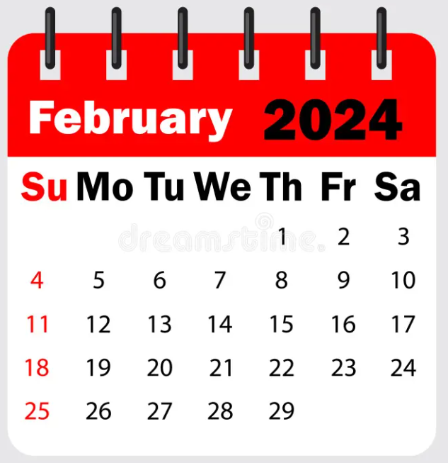
Mid-Year Review and Grant Technical Assistance
Caraway Conference Center
Room & dinner will be available starting February 5th
Please plan on staying the entire time to network and listen to other college’s promising practices.
Room and board paid by Perkins Leadership.
Colleges must pay for mileage

Slide 22
Manufacturing Day – October 6, 2023
Please register your event on https://www.mfgday.com/

Slide 23
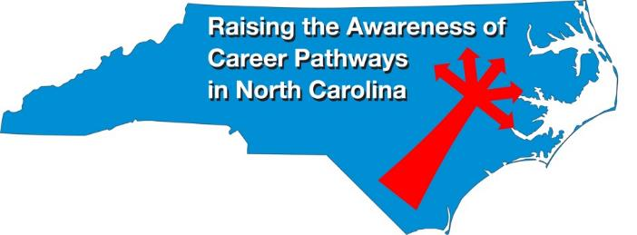
Raising the Awareness of Career Pathways Monthly Webinars
Every 3rd Wednesday of the month
September 20th
Educator Preparation Programs
Register for all webinars at www.ncperkins.org/presentations

Slide 24
National Disability Employment Awareness Month – October 2023
October 18, 9am-10am
Webinar
To Register: www.ncperkins.org/presentations or https://register.gotowebinar.com/register/4883145972769091420

Slide 25
https://www.ncpn.info
Over 70 informative and innovative sessions presented by leaders and experts in five strands:
Career Counseling, Development, and Advising
Teaching and Learning
Designing / Delivering Programs
Establishing / Growing Partnerships
Workforce Development
Nov 8–10 In Charlotte

Slide 26
Technical Assistance is available
We are here to help!
Team Perkins is available by phone, email, virtually, or in-person

