Slide 1
Southwestern community college
Perkins Mid-Year Update
January 28, 2020
Thom Brooks

Slide 2
Budget Updates and Promising Practices
Voc Code 11 – Strengthen the Academic, Career and Technical Skills of Students
Voc Code 13 – All Aspects of Industry
Voc Code 14 – Develop, Improve, or Expand the Use of Technology
Voc Code 15 – Professional Development
Voc Code 17 – Initiate, Improve, Expand, or Modernize CTE Programs
Reserve Fund Allocation – Program evaluation, modernization, and faculty development

Slide 3
Voc Code 11 – Strengthen the Academic, Career and Technical Skills of Students
Provide tutoring and learning support for CTE students
Peer tutors, professional tutors, and lab tutors to support academic and technical skill development of CTE students
Update: Tutor funds are being expended on schedule
Promising Practice
86% course success rate for students participating in Perkins supported tutoring

Slide 4
Voc Code 13 – All Aspects of Industry
Expanding participation in work based learning in CTE programs
Employ a PT work based learning coordinator with Perkins support
Update: WBL coordinator funds are being expended on schedule
Promising Practice
Created electronic process for orientation, assessment, and documentation of WBL participation

Slide 5
Voc Code 14 – Develop, Improve or Expand the use of Technology
Provide workshops and consultations in distance learning technology to instructors
Provide workshops in the use of classroom technologies
Certify at 4 CTE distance learning courses as Exemplary or Distinguished each year
Update: Instructional Technologist employed on January 1
Promising Practice
Employed a new instructional technologist to train and support CTE faculty in the development of online courses and health simulations

Slide 6
Voc Code 15 – Professional Development
Provide discipline specific professional development for CTE instructors:
Occupational Therapy Assistant
Physical Therapy Assistant
Provide professional development for WBL coordinator
Update: Funds are being expended for monthly workshops; discipline specific PD is upcoming later in the Spring
Promising Practice
Provide monthly on-campus TOPs workshops in topics such as soft skill development, grading rubrics, and engaging students in collaborative learning

Slide 7
Voc Code 17 – Initiate, Improve, Expand, or Modernize CTE Programs
Provide funds for expansion of Welding program
Equipment to support the physical and curriculum expansion of the WLD program
Provide funds to modernize the Medical Sonography program
Simulation Equipment
Update: Orders are in process for all equipment
Promising Practice
Provide funds for collaborative project whereby Mechatronics students will create a Telepresence Robot for use by Health Sciences Students

Slide 8
Perkins Expansion Funds
Expansion funds were directed support improved student outcomes in the Nursing program
Evaluation of the Nursing program by nursing consultants
Professional Development for Nursing faculty
Modernization of equipment
Update: evaluation and equipment purchases are complete. Professional development is scheduled later this spring.
Promising Practice
Use of expansion funds to concentrate on the evaluation and improvement of a specific CTE program: Nursing

Slide 9
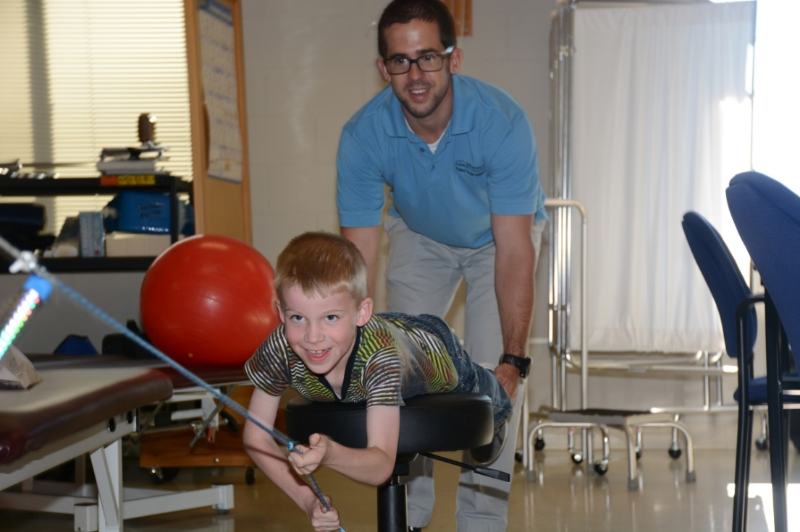
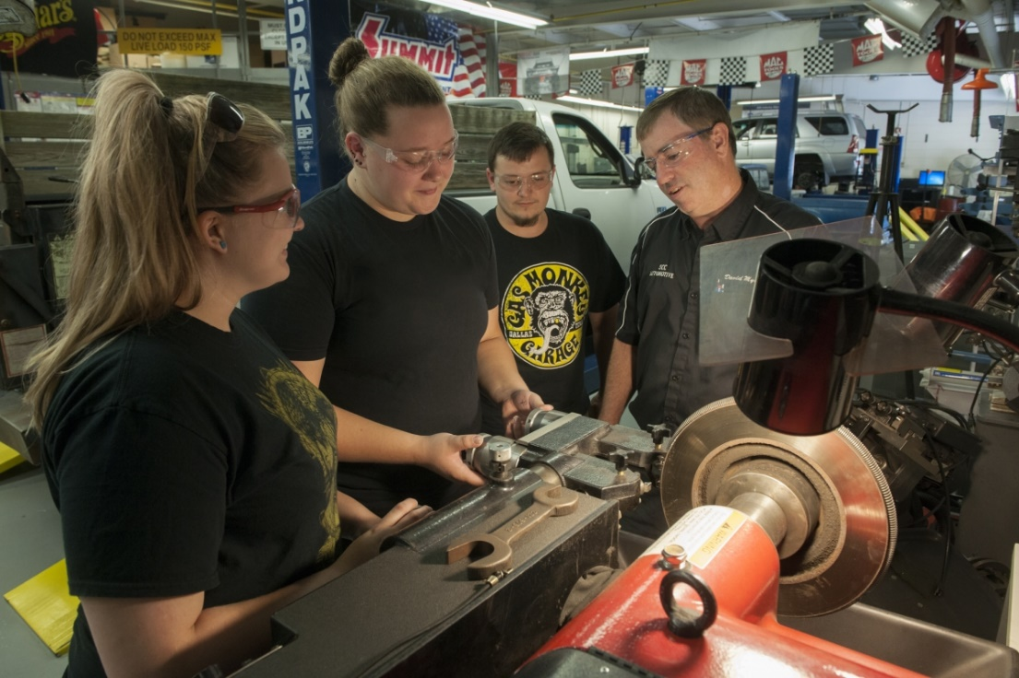
Insights from the CLNAs
Performed CLNA for Health Sciences and Automotive

Slide 10
Insights from the CLNAs - Automotive
Course success rates of Native American (40%) and Black (70%) students are below that of other race/ethnic groups during 2018-19.
While college-age students complete automotive credentials at above average rate compared to the overall SCC student body, this rate is much lower for high school CCP automotive students: 13%.
Employment outlook data indicate that there are more job openings in the local service area than currently being served by the enrollment in the AAS program; 38 annual job openings (new and turnover) are projected, while 23 students were registered in the AAS program. This gap is wider on a regional level with an estimated 158 annual openings.

Slide 11
Insights from the CLNAs - Automotive
This results from NCTower and SCC graduate survey data under-employment of graduates in a field that has been assessed as In-Demand: NCTower shows 71% employment in the year following graduation and graduate surveys indicate 46% employment.
During 2018-19, 15 students enrolled in college-age automotive courses had taken high school automotive CCP courses with SCC. While this represents 38% of the college-age enrollment, it is approximately 15% of the annual CCP enrollment that subsequently enrolled in automotive at SCC upon high school graduation.

Slide 12
Insights from the CLNAs - Automotive
Special populations students performed lower in all three categories (income, disability, unemployment) for EMS and Nursing
SCC Health Science programs appear to have less ethnic and racial diversity than the overall SCC student body and the service area population: Health Science students are 87.6% white compared to 78.2% for entire SCC student body and 82.3% for the service area population.
Minority students enrolled in the programs perform comparably, but fewer students enroll from the beginning.

Slide 13
Insights from the CLNAs – Health Sciences
Table 6: Program Enrollment and Job Openings
Program | Enrollment | Annual Job Openings Service Area | % of Svc Area Openings Enrolled | Annual Job Openings Regional | % of Regional Openings Enrolled
Emergency Medical Science | 26 | 35 | 37% | 80 | 16%
Health Information Technology | 24 | 3 | 400% | 27 | 44%
Human Services Technology | 42 | 18 | 117% | 61 | 34%
Medical Assisting | 22 | 25 | 44% | 198 | 6%
Medical Laboratory Technology | 20 | 7 | 143% | 50 | 20%
Medical Sonography | 19 | 1 | 950% | 12 | 79%
Nurse Aide | 3 | 119 | 1% | 746 | 0%
Nursing Associate Degree | 74 | 70 | 53% | 500 | 7%
Occupational Therapy Assistant | 28 | 2 | 700% | 16 | 88%
Phlebotomy | 12 | 5 | 120% | 62 | 10%
Physical Therapist Assistant | 28 | 3 | 467% | 38 | 37%
Radiography | 25 | 4 | 313% | 38 | 33%
Respiratory Therapy | 32 | 3 | 533% | 23 | 70%
Therapeutic Massage | 17 | 9 | 94% | 40 | 21%
AVERAGE | 372.00 | 304.00 | 61% | 1,891.00 | 10%

Slide 14
Insights from the CLNAs – Health Sciences
 | NCCCS Tier | Entry Wage | Hourly 25th Percentile Wage | Average SWDB Area Wage | 200% Federal Poverty Level wage | NCTower Wages 1yr Post-grad | NCTower Wages 5yr Post-grad
All Occupations |  | $19,406 | $21,211 | $36,421 | $24,980
Emergency Medical Science | 1B | $31,054 | $32,531 | $36,504 | X | $39,300 | $42,534
Health Information Technology | 1B | $25,459 | $27,352 | $37,003 | X | $24,002 | $31,675
Human Services Technology | 2 | $26,413 | $28,260 | $33,771 | X | $24,002 | N/A
Medical Assisting | 1B | $26,812 | $27,202 | $30,466 | X | $22,650 | $29,245
Medical Laboratory Technology | 1B | $37,232 | $40,976 | $49,275 | X | $31,578 | $36,762
Medical Sonography | 1A | $44,088 | $45,485 | $53,745 | X | $21,569 | $34,009
Nurse Aide | 1B | $20,062 | $21,036 | $24,417 |  | $17,979 | $19,236
Nursing Associate Degree | 1A | $48,806 | $52,146 | $60,472 | X | $44,349 | $50,522
Table 14: Area Wages for Health Science Programs

Slide 15
Questions

