Slide 1
October 20, 2021 Careers in Dental Hygiene
Download the PowerPoint and access the recording: www.ncperkins.org/presentations
Notes:
Chris
We are here to help promote the great jobs, often unknown, in the great state of North Carolina.
Through these monthly meetings, we are going to let you know about some great career opportunities in North Carolina.
And bring in special guests to let you know about the great career opportunities in North Carolina.
Please download this PowerPoint file and use it anyway you can to help get folks on a career pathway.
The reference showing from where the information was found, as well as the contact information for our guests is in the Notes section under each slide.
Get the PowerPoint on our NCPerkins.org website on our Presentations and Webinars page.
Here is the direct address on the screen.
-----
Many of the videos shown during this webinar can be found here:
https://www.ncperkins.org/video/

Slide 2
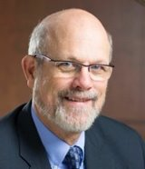
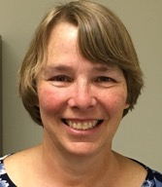
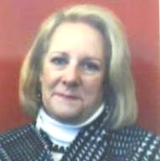
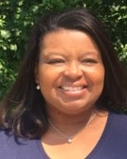
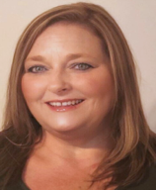
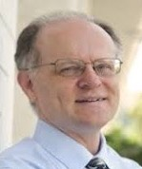
Raising the Awareness of Career Pathways in North Carolina
Bob Witchger
Patti Coultas
Tony Reggi
Cheryl Cox
NC Dept of Public Instruction
Michelle Lair
Mary Olvera
Chris Droessler
Notes:
Chris
I always say our webinars are like radio but with pictures.
And here are a few pictures of your hosts for these monthly explorations into career pathways.
(Why does the photographer have the best photo?)
Our contact information is in the notes section under this slide.
Dr. Bob Witchger
919-807-7126
WitchgerB@nccommunitycolleges.edu
Dr. Tony R. Reggi
919-807-7131
ReggiA@nccommunitycolleges.edu
Patti Coultas
919-807-7130
CoultasP@nccommunitycolleges.edu
Dr. Mary Olvera
919-807-7120
OlveraM@nccommunitycolleges.edu
Michelle Lair
919-807-72227
LairM@nccommunitycolleges.edu
Chris Droessler
919-807-7068
DroesslerC@nccommunitycolleges.edu
Cheryl Cox
NC Department of Public Instruction
919-807-3814
Cheryl.Cox@dpi.nc.gov

Slide 3
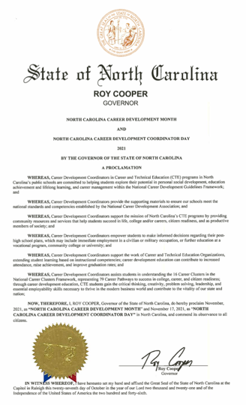

Slide 4
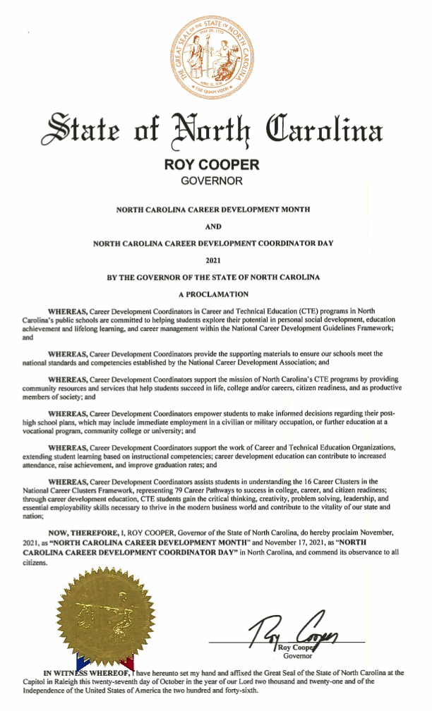
Notes:
And if we zoom in on the bottom of the proclamation, get past all the WereAs’s and get to the Therefore:
What this means is that this is North Carolina Career Development Month
and Today is North Carolina Career Development Coordinator Day.
Thanks to all of the Career Development Coordinators (or CDCs as we call them)
for what you are doing across this great state to help our children learn all they can,
so they can make an informed decision of what they want to be when they grow up.

Slide 5
Notes:
https://nccareers.org/occupation-profile

Slide 6
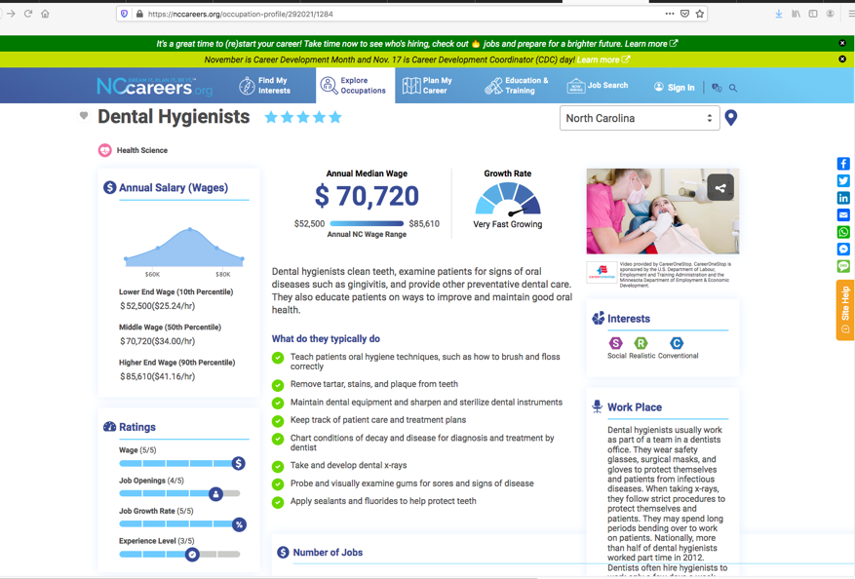
NCCareers.org
Notes:
https://nccareers.org/occupation-profile/351011/1284

Slide 7
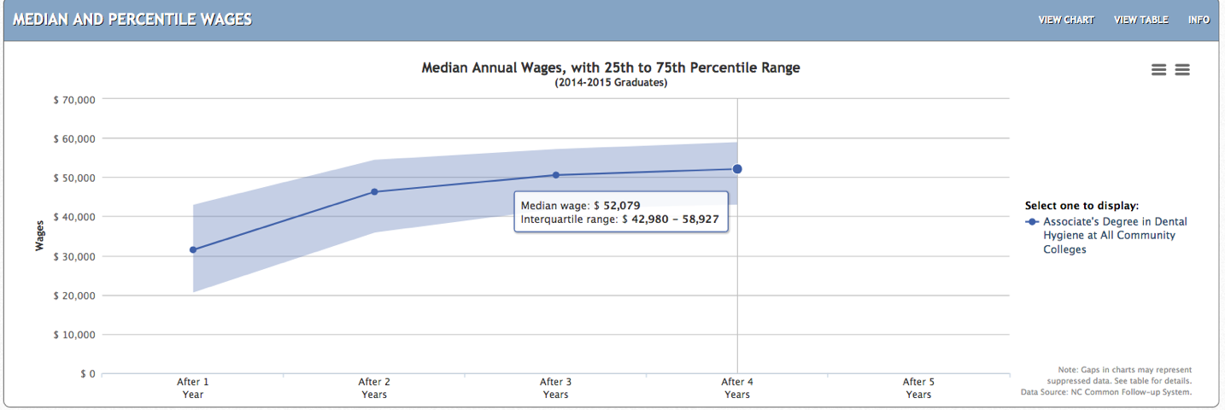
Dental Hygiene– NC Associate Degree Graduates
Data from NCTower.com
Notes:
Data from NCTower.com

Slide 8
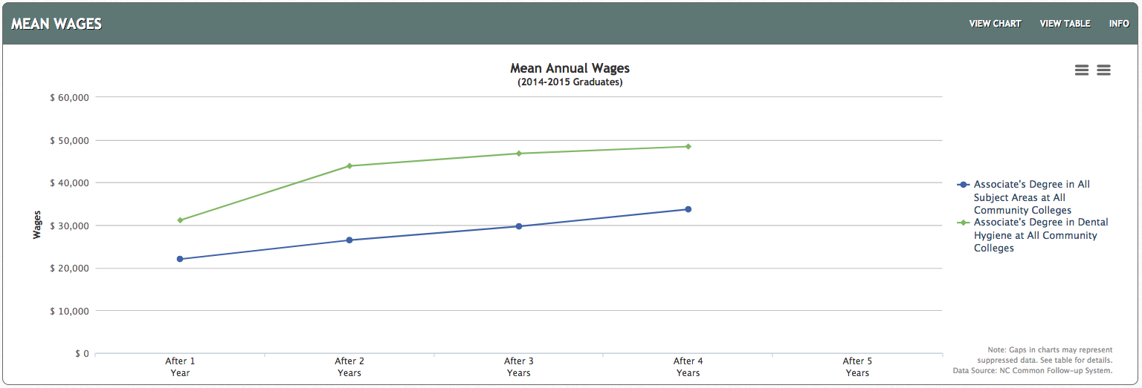
NC AAS Degrees – Wages Over Four Years of Employment
Dental Hygiene AAS
All AAS
Notes:
Data from NCTower.com

Slide 9
Dr. Lori Byrd
Associate Director, Academic Programs – Health Sciences
NC Community College System
Notes:
Dr. Lori Byrd
Associate Director, Academic Programs - Health Sciences
byrdl@nccommunitycolleges.edu
919-807-7118

Slide 10
Dental Hygiene (A45260)
The Dental Hygiene curriculum provides individuals with the knowledge and skills to access, plan, implement, and evaluate dental hygiene care for the individual and the community.
Students will learn to prepare the operatory, take patient histories, note abnormalities, plan care, teach oral hygiene, clean teeth, take x-rays, apply preventive agents, complete necessary chart entries, and perform other procedures related to dental hygiene care.
Graduates of this program may be eligible to take national and state/regional examinations for licensure which are required to practice dental hygiene. Employment opportunities include dental offices, clinics, schools, public health agencies, industry, and professional education.
Notes:
Associate Degree Program at NC Community Colleges
https://www.nccommunitycolleges.edu/academic-programs/nc-community-college-system-catalog

Slide 11
Dental Hygiene (A45260)
Asheville-Buncombe Technical Community College
Cape Fear Community College
Catawba Valley Community College
Central Carolina Community College
Central Piedmont Community College
Coastal Carolina Community College
Fayetteville Technical Community College
Forsyth Technical Community College
Guilford Technical Community College
Halifax Community College
Edgecombe Community College
Nash Community College
Wake Technical Community College
Wayne Community College
Lenoir Community College
Notes:
List of colleges that teach this program
https://www.nccommunitycolleges.edu/academic-programs/nc-community-college-system-catalog

Slide 12
Notes:
www.ncperkins.org/presentations

Slide 13
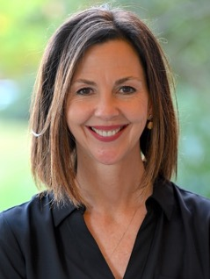
Michelle Ping, RDH, M.Ed.
Dental Division Chair
Fayetteville Technical Community College
Notes:
Michelle Ping
Division Chair-Dental
pingm@faytechcc.edu
(910) 678-8575
Michelle C. Ping, RDH, M.Ed.
Dental Hygiene Department Chair
Dental Division Chair
PO Box 35236
2201 Hull Road (HTC 101D)
Fayetteville, NC 28303-0236
Phone: 910-678-8575
Fax: 910-486-3639

Slide 14
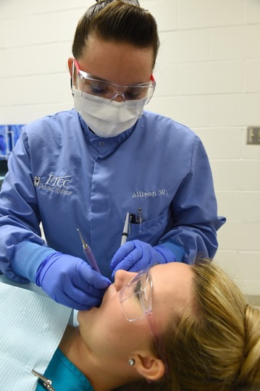
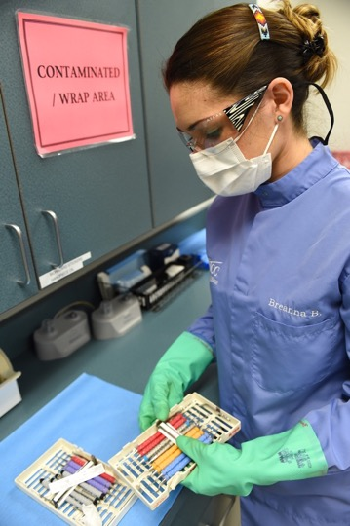
Notes:
Michelle Ping
Division Chair-Dental
pingm@faytechcc.edu <pingm@faytechcc.edu>
(910) 678-8575
Michelle C. Ping, RDH, M.Ed.
Dental Hygiene Department Chair
Dental Division Chair
PO Box 35236
2201 Hull Road (HTC 101D)
Fayetteville, NC 28303-0236
Phone: 910-678-8575
Fax: 910-486-3639

Slide 15
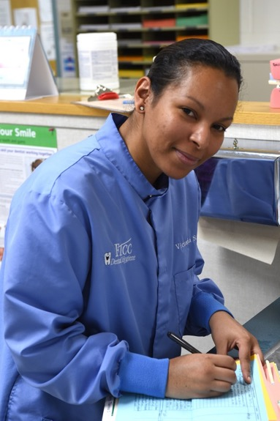
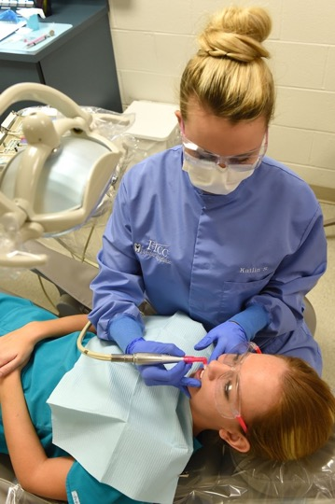
Notes:
Michelle Ping
Division Chair-Dental
pingm@faytechcc.edu <pingm@faytechcc.edu>
(910) 678-8575
Michelle C. Ping, RDH, M.Ed.
Dental Hygiene Department Chair
Dental Division Chair
PO Box 35236
2201 Hull Road (HTC 101D)
Fayetteville, NC 28303-0236
Phone: 910-678-8575
Fax: 910-486-3639

Slide 16
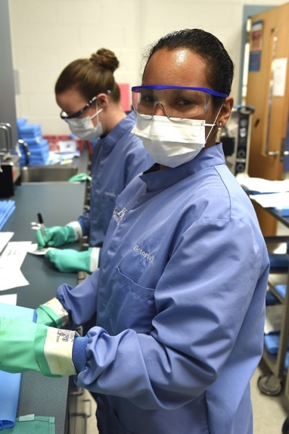
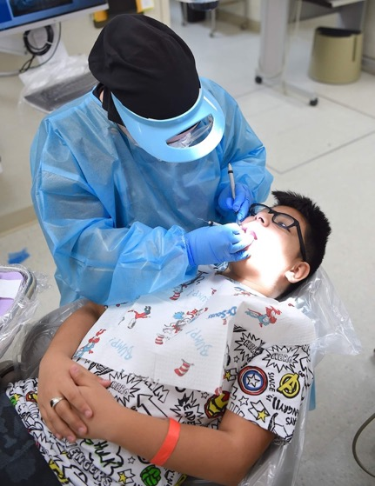
Notes:
Michelle Ping
Division Chair-Dental
pingm@faytechcc.edu <pingm@faytechcc.edu>
(910) 678-8575
Michelle C. Ping, RDH, M.Ed.
Dental Hygiene Department Chair
Dental Division Chair
PO Box 35236
2201 Hull Road (HTC 101D)
Fayetteville, NC 28303-0236
Phone: 910-678-8575
Fax: 910-486-3639
https://touch.facebook.com/FAYTECHCC/photos/pcb.4031746710202284/4031744506869171/?type=3&source=49

Slide 17
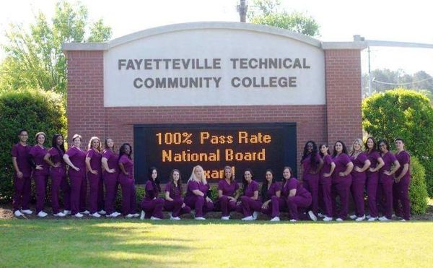
Notes:
Fayetteville Technical Community College
https://www.facebook.com/ftcchealthprograms/posts/ftcc-dental-hygiene-programcongratulations-to-the-ftcc-dental-hygiene-students-1/1859292160992671/

Slide 18
Notes:
www.ncperkins.org/presentations

Slide 19
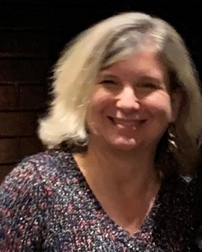
Brenda Sanner, RDH, MS
Dental Hygiene Program Chair
Central Piedmont Community College
Notes:
Brenda L Sanner, RDH, MS Program Chair, Dental Hygiene Central Piedmont Community College Charlotte,NC 28235 704-330-6503
Brenda Sanner
Dental Hygiene Program Chair
Central Piedmont Community College
brenda.sanner@cpcc.edu

Slide 20
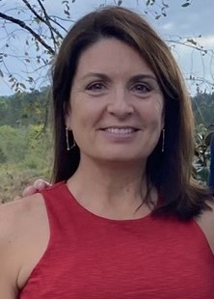
Dr. Sandra Ruocco
Clinic Dentist
Central Piedmont Community College

Slide 21
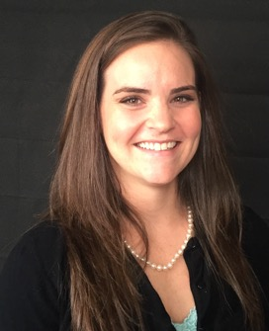
Katie de Rego
Second-Year Student
Central Piedmont Community College

Slide 22
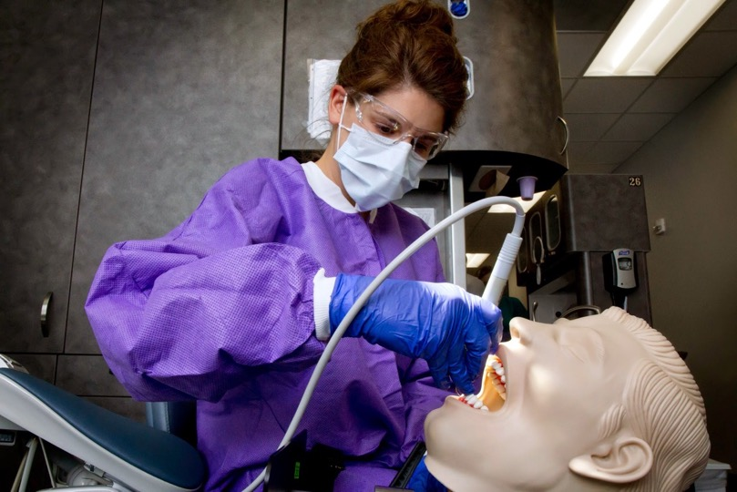
Notes:
Central Piedmont Community College
https://www.cpccfoundation.org/blog/dental-hygiene-program-anniversary-scholarship-challenge-match-endow-scholarship/

Slide 23
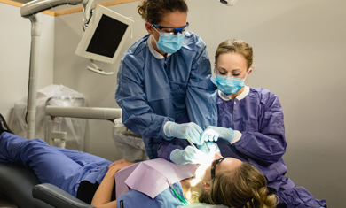
Notes:
Central Piedmont Community College
https://www.cpcc.edu/sites/default/files/2019-12/CENTRAL2018_DLV-1009-0559_390x235.jpg

Slide 24
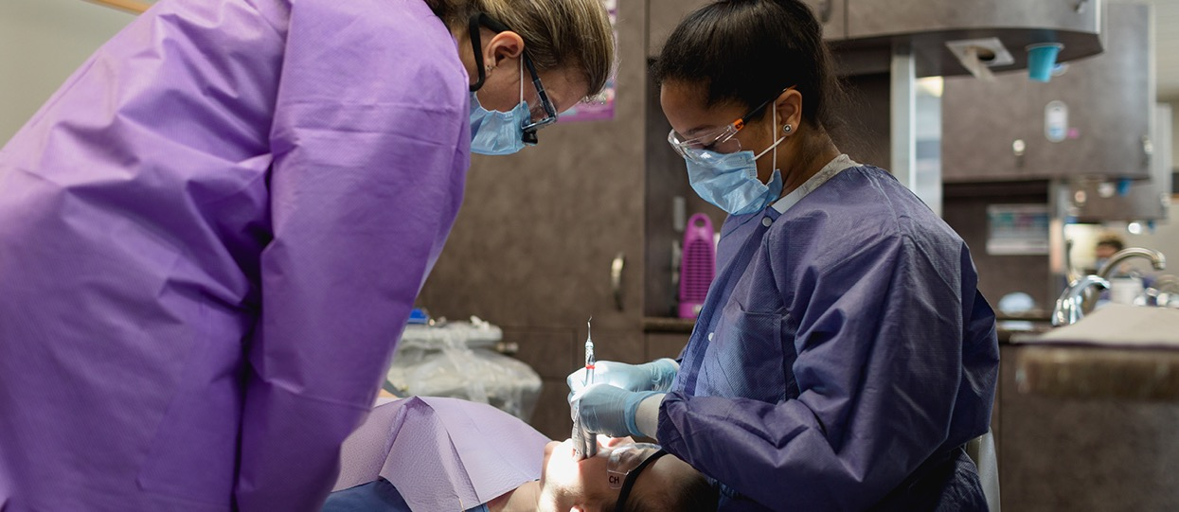
Notes:
Central Piedmont Community College
https://www.cpcc.edu/sites/default/files/2021-05/CENTRAL2018-DLV-0123-1440x625.jpg
https://www.cpcc.edu/community-and-arts/dental-clinic

Slide 25
Notes:
www.ncperkins.org/presentations

Slide 26
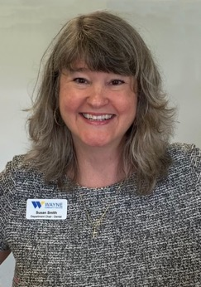
Susan Smith
Dental Department Chair
Wayne Community College
Notes:
srsmith@waynecc.edu;
919-739-6838
919-739-6838
srsmith@waynecc.edu

Slide 27
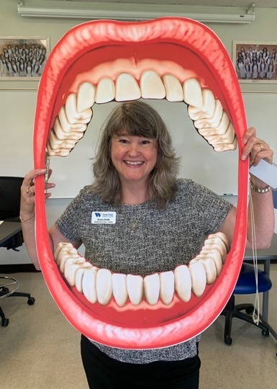
Notes:
Wayne Community College

Slide 28
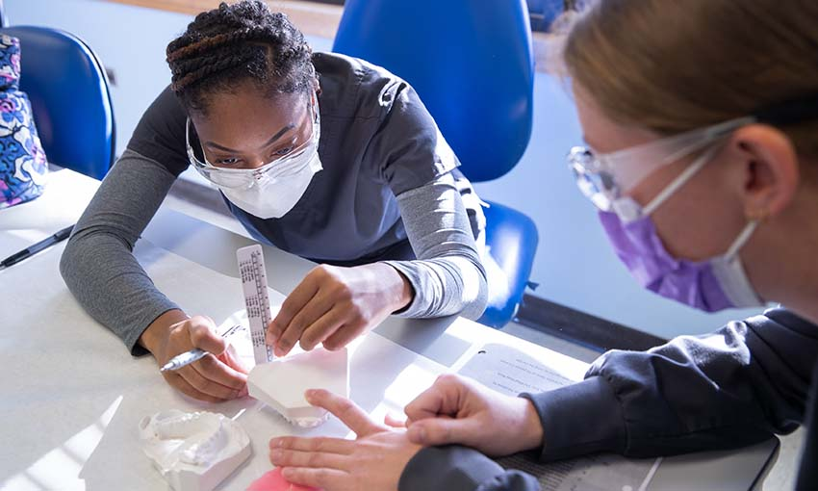
Notes:
Wayne Community College
https://www.waynecc.edu/programs/dental-hygiene/

Slide 29
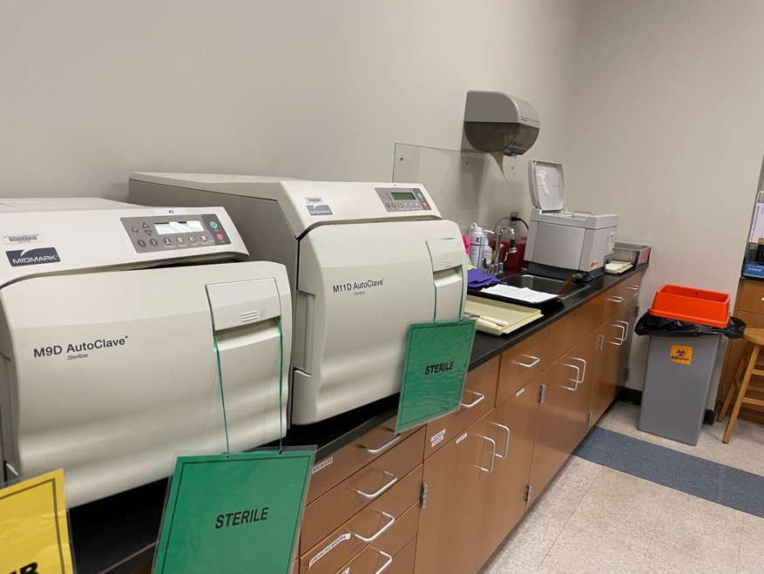
Notes:
Wayne Community College

Slide 30
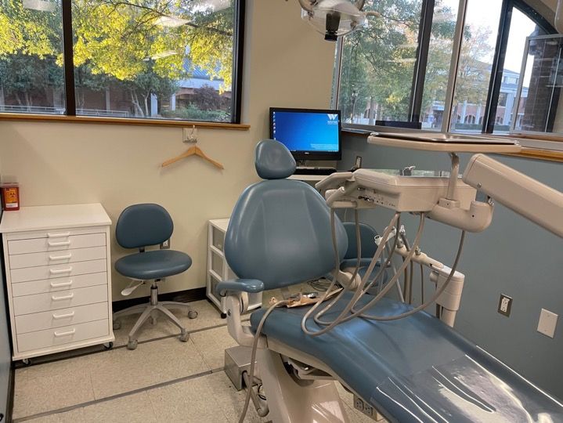
Notes:
Wayne Community College

Slide 31
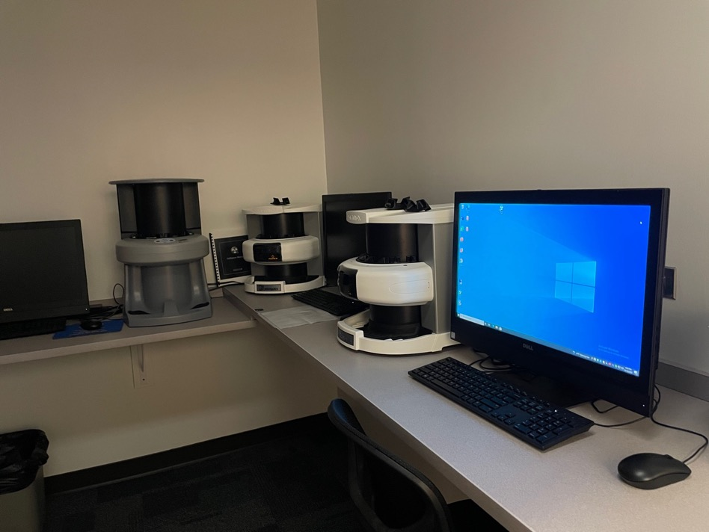
Notes:
Wayne Community College

Slide 32
Notes:
www.ncperkins.org/presentations

Slide 33
Abra Brooks, RDH, BSDH
Instructor, 1st Year Dental Hygiene Coordinator
Asheville-Buncombe Technical College
Notes:
Abra Brooks, RDH, BSDH
Instructor, Dental Hygiene
A-B Tech Community College
340 Victoria Rd.
Asheville, NC 28801
828-398-7267
abraubrooks@abtech.edu
abraubrooks@abtech.edu;
828-398-7267
Phone: (828) 398-7267 Email: abraubrooks@abtech.edu

Slide 34
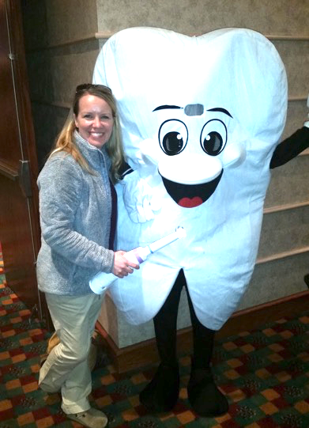
Notes:
Abra Brooks, RDH, BSDH
Instructor, Dental Hygiene
A-B Tech Community College
340 Victoria Rd.
Asheville, NC 28801
828-398-7267
abraubrooks@abtech.edu
abraubrooks@abtech.edu;
828-398-7267
Phone: (828) 398-7267 Email: abraubrooks@abtech.edu

Slide 35
Notes:
Abra Brooks, RDH, BSDH
Instructor, Dental Hygiene
A-B Tech Community College
340 Victoria Rd.
Asheville, NC 28801
828-398-7267
abraubrooks@abtech.edu
abraubrooks@abtech.edu;
828-398-7267
Phone: (828) 398-7267 Email: abraubrooks@abtech.edu

Slide 36
Notes:
Abra Brooks, RDH, BSDH
Instructor, Dental Hygiene
A-B Tech Community College
340 Victoria Rd.
Asheville, NC 28801
828-398-7267
abraubrooks@abtech.edu
abraubrooks@abtech.edu;
828-398-7267
Phone: (828) 398-7267 Email: abraubrooks@abtech.edu

Slide 37
Notes:
Abra Brooks, RDH, BSDH
Instructor, Dental Hygiene
A-B Tech Community College
340 Victoria Rd.
Asheville, NC 28801
828-398-7267
abraubrooks@abtech.edu
abraubrooks@abtech.edu;
828-398-7267
Phone: (828) 398-7267 Email: abraubrooks@abtech.edu

Slide 38
Notes:
Abra Brooks, RDH, BSDH
Instructor, Dental Hygiene
A-B Tech Community College
340 Victoria Rd.
Asheville, NC 28801
828-398-7267
abraubrooks@abtech.edu
abraubrooks@abtech.edu;
828-398-7267
Phone: (828) 398-7267 Email: abraubrooks@abtech.edu

Slide 39
Notes:
Abra Brooks, RDH, BSDH
Instructor, Dental Hygiene
A-B Tech Community College
340 Victoria Rd.
Asheville, NC 28801
828-398-7267
abraubrooks@abtech.edu
abraubrooks@abtech.edu;
828-398-7267
Phone: (828) 398-7267 Email: abraubrooks@abtech.edu

Slide 40
Notes:
Abra Brooks, RDH, BSDH
Instructor, Dental Hygiene
A-B Tech Community College
340 Victoria Rd.
Asheville, NC 28801
828-398-7267
abraubrooks@abtech.edu
abraubrooks@abtech.edu;
828-398-7267
Phone: (828) 398-7267 Email: abraubrooks@abtech.edu

Slide 41
Notes:
Abra Brooks, RDH, BSDH
Instructor, Dental Hygiene
A-B Tech Community College
340 Victoria Rd.
Asheville, NC 28801
828-398-7267
abraubrooks@abtech.edu
abraubrooks@abtech.edu;
828-398-7267
Phone: (828) 398-7267 Email: abraubrooks@abtech.edu

Slide 42
Notes:
Abra Brooks, RDH, BSDH
Instructor, Dental Hygiene
A-B Tech Community College
340 Victoria Rd.
Asheville, NC 28801
828-398-7267
abraubrooks@abtech.edu
abraubrooks@abtech.edu;
828-398-7267
Phone: (828) 398-7267 Email: abraubrooks@abtech.edu

Slide 43
Notes:
Abra Brooks, RDH, BSDH
Instructor, Dental Hygiene
A-B Tech Community College
340 Victoria Rd.
Asheville, NC 28801
828-398-7267
abraubrooks@abtech.edu
abraubrooks@abtech.edu;
828-398-7267
Phone: (828) 398-7267 Email: abraubrooks@abtech.edu

Slide 44
Notes:
Abra Brooks, RDH, BSDH
Instructor, Dental Hygiene
A-B Tech Community College
340 Victoria Rd.
Asheville, NC 28801
828-398-7267
abraubrooks@abtech.edu
abraubrooks@abtech.edu;
828-398-7267
Phone: (828) 398-7267 Email: abraubrooks@abtech.edu

Slide 45
Notes:
Abra Brooks, RDH, BSDH
Instructor, Dental Hygiene
A-B Tech Community College
340 Victoria Rd.
Asheville, NC 28801
828-398-7267
abraubrooks@abtech.edu
abraubrooks@abtech.edu;
828-398-7267
Phone: (828) 398-7267 Email: abraubrooks@abtech.edu

Slide 46
Notes:
Abra Brooks, RDH, BSDH
Instructor, Dental Hygiene
A-B Tech Community College
340 Victoria Rd.
Asheville, NC 28801
828-398-7267
abraubrooks@abtech.edu
abraubrooks@abtech.edu;
828-398-7267
Phone: (828) 398-7267 Email: abraubrooks@abtech.edu

Slide 47
Notes:
Abra Brooks, RDH, BSDH
Instructor, Dental Hygiene
A-B Tech Community College
340 Victoria Rd.
Asheville, NC 28801
828-398-7267
abraubrooks@abtech.edu
abraubrooks@abtech.edu;
828-398-7267
Phone: (828) 398-7267 Email: abraubrooks@abtech.edu

Slide 48
Notes:
Abra Brooks, RDH, BSDH
Instructor, Dental Hygiene
A-B Tech Community College
340 Victoria Rd.
Asheville, NC 28801
828-398-7267
abraubrooks@abtech.edu
abraubrooks@abtech.edu;
828-398-7267
Phone: (828) 398-7267 Email: abraubrooks@abtech.edu

Slide 49
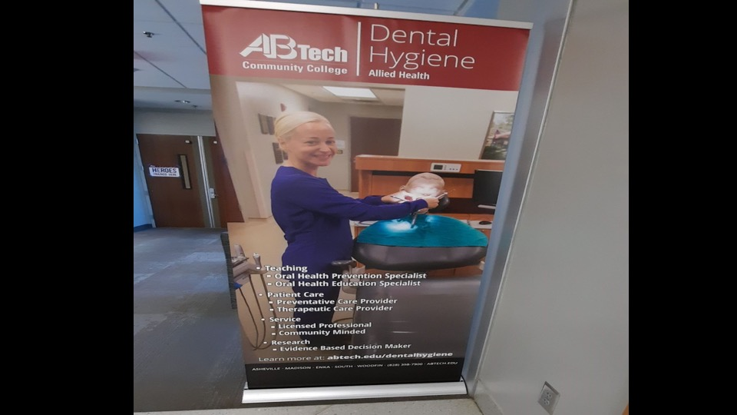
Notes:
Abra Brooks, RDH, BSDH
Instructor, Dental Hygiene
A-B Tech Community College
340 Victoria Rd.
Asheville, NC 28801
828-398-7267
abraubrooks@abtech.edu
abraubrooks@abtech.edu;
828-398-7267
Phone: (828) 398-7267 Email: abraubrooks@abtech.edu

Slide 50
Brenda Fisher, RDH, BSDH
Dental Hygiene Chair
Asheville-Buncombe Technical College
Notes:
Ab Tech
Brenda Fisher
828-398-7284
brendahfisher@abtech.edu
Not presenting today

Slide 51
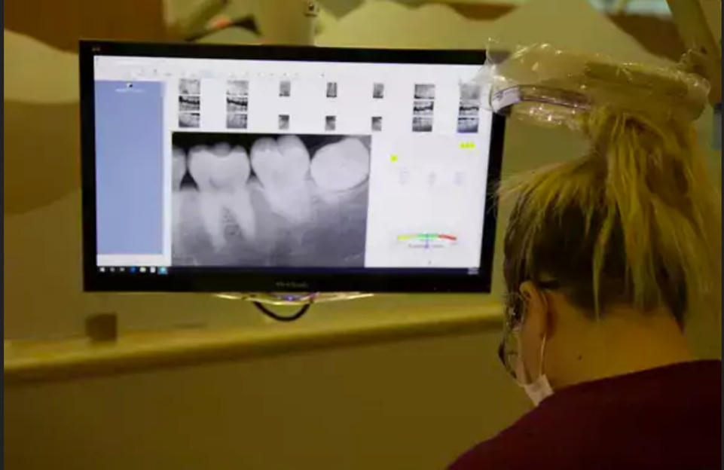
Notes:
Asheville-Buncombe Technical College
https://abtech.edu/programs/academic/dental-hygiene

Slide 52
Notes:
www.ncperkins.org/presentations

Slide 53
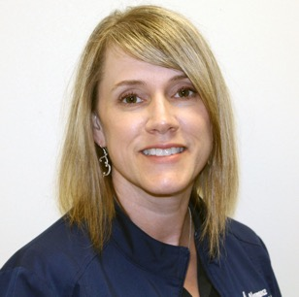
Joanna Roberts
Department Head – Dental Assisting
Alamance Community College
Notes:
Joanna Roberts
Alamance Community College
Dental Assisting Department Head
(336) 506-4153
joanna.roberts@alamancecc.edu
Joanna Roberts
Department Head – Dental Assisting
336-506-4153
joanna.roberts@alamancecc.edu

Slide 54
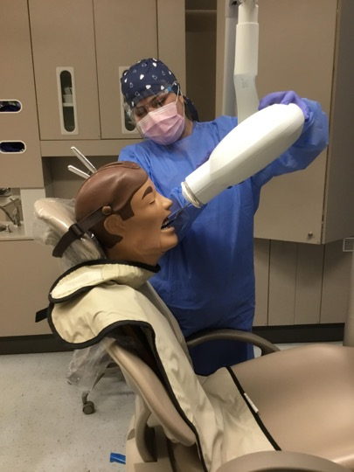
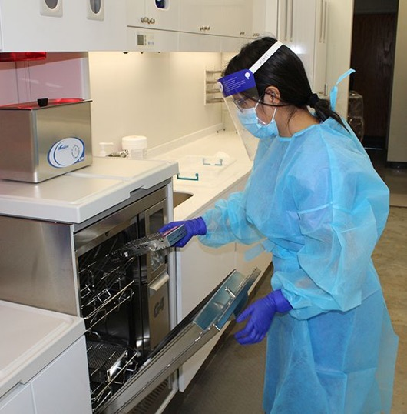
Notes:
Joanna Roberts
Alamance Community College
Dental Assisting Department Head
(336) 506-4153
joanna.roberts@alamancecc.edu
Joanna Roberts
Department Head – Dental Assisting
336-506-4153
joanna.roberts@alamancecc.edu

Slide 55
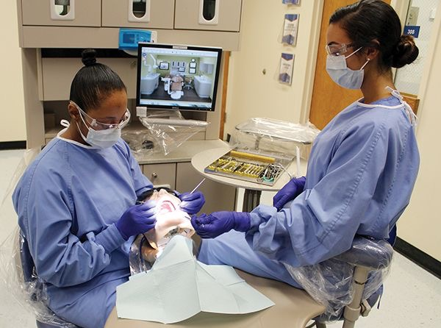
Notes:
Joanna Roberts
Alamance Community College
Dental Assisting Department Head
(336) 506-4153
joanna.roberts@alamancecc.edu
Joanna Roberts
Department Head – Dental Assisting
336-506-4153
joanna.roberts@alamancecc.edu

Slide 56
Raising the Awareness of Career Pathways in North Carolina
Next meeting is January 19, 2022 –
Careers in Environmental Science and Protection Technicians.
Download the PowerPoint and access the recording: www.ncperkins.org/presentations
Notes:
Our next meeting like this one will be on ------.
(We will skip December and be back in January.)
You can go to the NCPerkins website to register for that meeting.
We'll also send you a reminder, since you are now on our mailing list.
So go ahead and sign up for all the meetings, and you'll be reminded the day before.
If you liked something you saw here, send folks to the recording. Find it at that same web page.

