Slide 1
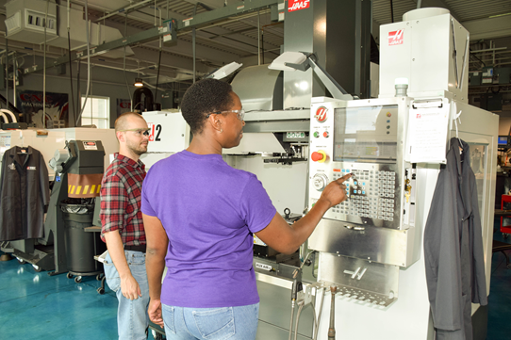
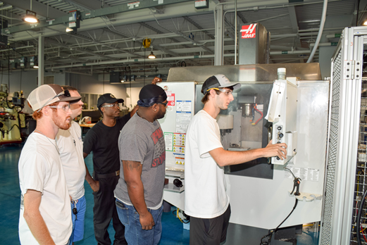
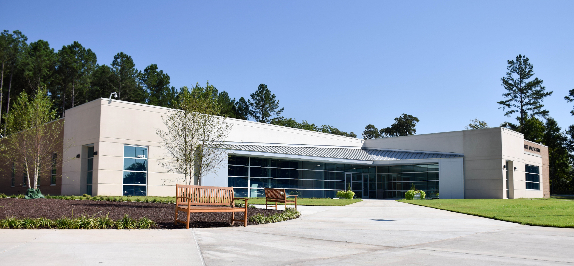
Nash Community College
Perkins Mid-Year Review
January 21, 2020
Notes:
This presentation will highlight CTE programs and activities Perkins has impacted, focusing on Industrial and Advanced Manufacturing this year. It is important to mention the tremendous support Perkins provides the College across multiple CTE programs including Nursing and Allied Health, Information and Business Technologies, and Public Safety and Services programs. Also, the SkillsUSA framework and participation is significantly enhanced and expanded as a direct result of Perkins Funding.

Slide 2
Making A Difference in
Career and Technical Education
at Nash Community College
PERKINS
Modern
Industry Training
Growth
Skilled Workforce
Credentials
Pathways
Notes:
Perkins is used to support equipment, faculty development, and industry-based activities to improve many aspects of a CTE program. Examples follow…

Slide 3
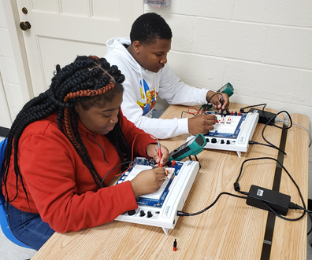
CITI High School – Electrical and Industrial Technologies Lab
NI ELVIS III Prototyping Boards
Program growth/expansion to CITI High School (9-14 Pathway)
Skills-based training in circuit theory, analysis and real world circuit simulations
Center for Industry, Technology and Innovative (CITI) High
Notes:
9 National Instruments ELVIS Prototyping Boards
Nine ELVIS Prototyping boards were purchased for instruction at the Center for Industry, Technology and Innovative (CITI) High School. CITI High is a collaborative endeavor between the Nash-Rocky Mount Public Schools and Nash Community College allowing students to complete an AAS degree, diploma or certificates while earning high school credits for graduation. The ELVIS boards are used to teach electrical/electronic circuit theory and are used in conjunction with MultiSIM circuit simulation software. The combination of ELVIS boards and MultiSIM allows circuit simulations to be compared to real world circuits using actual components. Students can easily visualize and analyze circuits with simulated instruments, advanced analyses, and thousands of components to reinforce circuit theory.
First class, now 10th Graders in this CTE track = 13 students

Slide 4
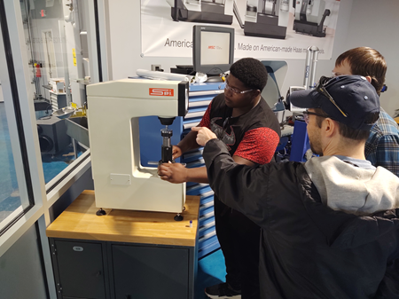
Computer-Integrated Machining
Rockwell Hardness Tester
Modernization of industry equipment
Skill acquisition to verify the hardness of steels
Notes:
Rockwell Hardness Tester
The Computer-Integrated Machining Program had a 25 year old Rockwell hardness tester (equipment to test the hardness of materials) that was no longer functioning. Funds were utilized to purchase a new hardness tester that allows students to verify the hardness of steels after being hardened, tempered, or annealed.

Slide 5
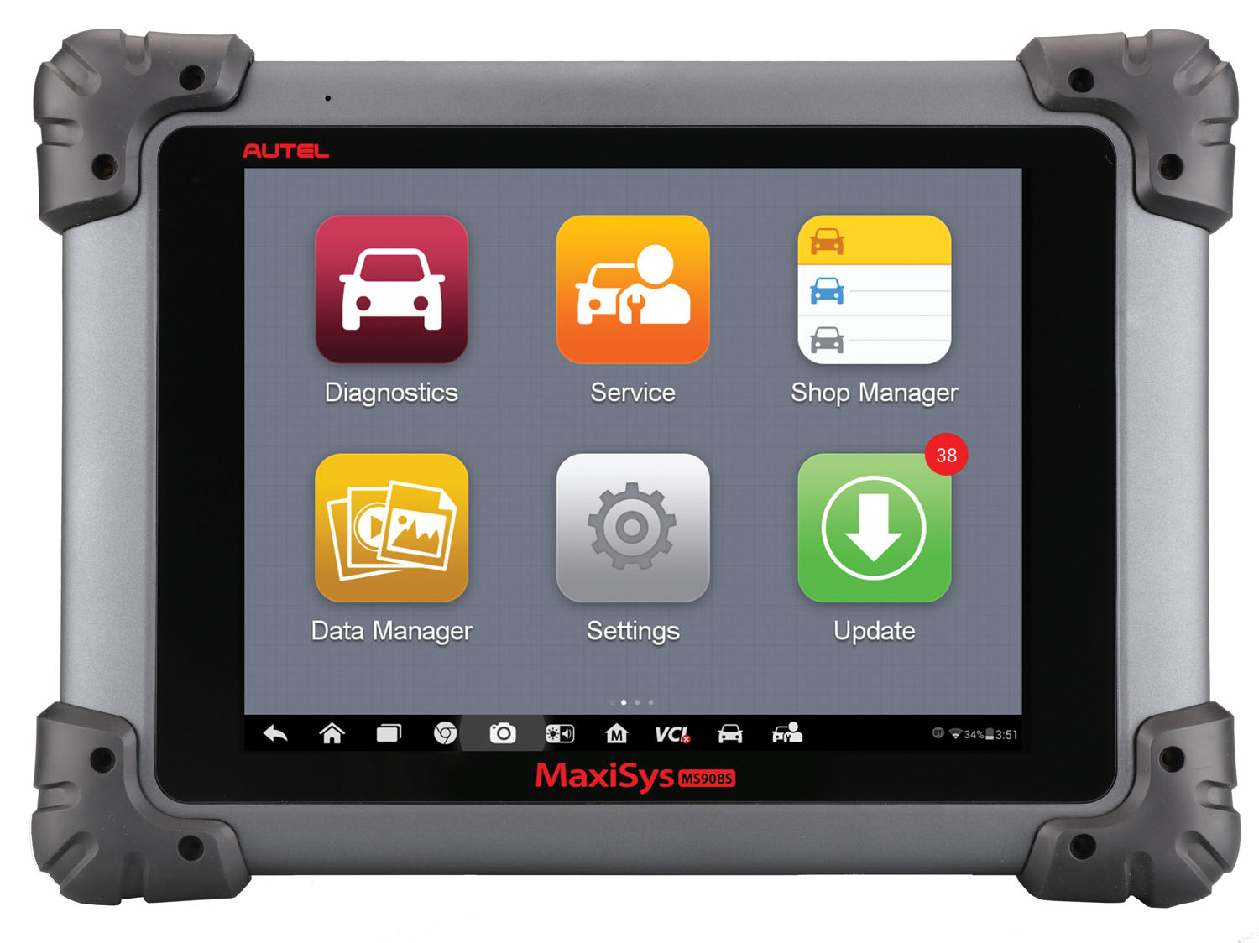
Automotive Systems Technology
Strut Compressor
Improved program safety
Contemporary learning
Autel Automotive Diagnostic
& ECU Programming
Modernization of program resources
Industry-expected skill
Maintain NATEF Accreditation
Notes:
Strut Compressor - The old compressor was deemed unsafe by the faculty and replacement was imperative to provide for student safety. Students utilize the strut compressor when repairing or replacing the front suspension of many automobiles.
Autel Diagnostics Tool - Provides students with most current technology to develop industry-expected skill for automobile diagnostics and servicing, aids in meeting the equipment requirements for maintaining NATEF accreditation and has an extensive US, Asian and European automobile database.

Slide 6
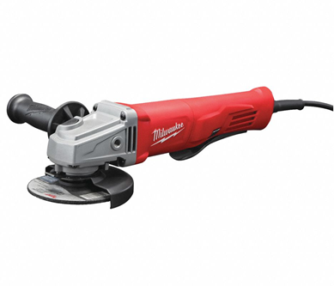
Welding Technologies
Pipe Beveler and Disc Grinders
Student training and preparation for American Welding Society (AWS) credentialing qualifications.
Industry recognized third-party credentials
Notes:
Pipe Beveler
A pipe beveler was purchased to aid welding students in preparing pipe for American Welding Society (AWS) qualifications. AWS qualifications are third party credentials that welding students can earn based on welding standards. Pipe welding qualifications are the most difficult to earn due to the welding skills required and the metal preparation.The pipe beveler is used to prepare the pipe for the welding qualification test. This allows students to more efficiently and accurately prepare the pipe improving the qualification process.
Milwaukee Disc Grinders
Six angle & disc grinders were purchased for use in the Welding Technology program. Angle & disc grinders are used extensively by students when preparing samples in their efforts to earn AWS qualifications.

Slide 7
Computer-Integrated Machining
HTEC (Haas Technical Education Center Network – State and National
AIMS (Association of Instructors in Machine Shop) – State, Biannual
Provides a PLC for machine shop educators
= new technologies
= instructional and recruitment strategies
Faculty Development
Alex Barnhill, NCC Instructor National HTEC President AIMS President | George Shook, NCC Instructor National HTEC Council
Notes:
National HTEC
The Computer-Integrated Machining instructors (George Shook and Alex Barnhill) attended the Haas Technical Education Center Network (HTEC), a worldwide organization of manufacturing technology educators, in Kalispell, MT. HTEC is a professional learning community of machine shop educators from across the United States and Canada that meet to learn new technologies from vendors and share instructional and recruitment strategies. Alex Barnhill is currently serving as the HTEC National President and George Shook serves on the National HTEC Council.
AIMS/HTEC (State)
The Computer-Integrated Machining instructors attended the combined meeting of the Association of Instructors in Machine Shop (AIMS) and HTEC meeting in Hickory, NC. AIMS is a professional learning community of NCCC machine shop instructors that meets biannually. This biannual conference meets at different community colleges across the state and meets one day for HTEC and on day for AIMS. Instructors meet to discuss teaching strategies, new technologies, meet with vendors, and take industry tours. Alex Barnhill currently serves as the AIMS president.

Slide 8
Faculty Development
Welding Technologies
OSHA #501 Training for General Industry
= Faculty are authorized safety trainers
Provides opportunity for students to earn the OSHA 30 Hour for General Industry Card from the US Department of Labor during the program.
Added to the Welding CTE Pathway effective Spring 2020
Jay Manning, NCC Instructor Welding Technologies | Carl Harris, NCC Instructor Welding Technologies
Notes:
OSHA #501 Training
The Welding Technology instructors (Jay Manning and Carl Harris) attended the OSHA #501 for General Industry training to become authorized safety trainers. This allows the instructors the ability to provide the necessary training for students to earn the OSHA 30 Hour for General Industry card from the US Department of Labor. The OSHA 30 Hour training was added to the Welding CCP pathway and will be initiated starting in spring 2020.

Slide 9
Faculty Development
Electrical Systems Technology
FANUC Robotics Handling Tool Operations and Programming Train-the-Trainer
Festo/NC3 Industry 4.0 Train-the-Trainer
Provides opportunity for students to earn industry certifications:
FANUC Robotics Certifications
National Coalition of Certification Centers (NC3) 4.0 Certifications
Spencer Davis, NCC Instructor Electrical Systems Technology
Notes:
Fanuc Robot Training
Spence Davis attended the Fanuc Robotics Handling Tool Operations and Programming train-the-trainer course. NCC has been offering students the opportunity to earn Fanuc Robotics certifications for about ten years. Traditionally we have had two instructors certified. With the recent retirement of Tim Brown and the unexpected death of Stan Shields we were left with no certified instructors. It became imperative for another instructor to become certified so students could continue to earn Fanuc Robotics certifications. Students will be able to earn certifications again starting in Spring 2020.
Festo/NC3 Industry 4.0 Train-the-trainer
Spencer Davis attended the Festo Industry 4.0 train-the-trainer which will allow NCC students the opportunity to earn National Coalition of Certification Centers (NC3) Industry 4.0 certifications. Industry 4.0 is the name given to the growing combination of traditional manufacturing and industrial platforms and practices with the latest smart technology. Industry 4.0 provides increased automation, improved communication and monitoring, as well as smart machines that can analyse and diagnose issues without the need for human intervention. Students will be eligible to earn certifications starting in spring 2020.

Slide 10
Promising (Successful) Practice
2018-2019
Perkins supported faculty training and certifications in
Industrial and Advanced Manufacturing Department
86 students earned 147 industry certifications last year
2019-2020
24 additional students have earned 51 certifications in fall semester from the training last year
Instructor training this year will further expand certification
opportunities starting this spring
Notes:
Successful Practices:
Last year NCC received a Golden Leaf Foundation, Community-Based Grant which included the purchase of equipment to provide students the opportunity to earn NC3 certifications. The grant did not allow for training of instructors. NCC was able to leverage Perkins funding for the training and certification of 7 instructors which included multimeter, precision measurement, sensors and PLC. Last year 86 students earned a total of 147 certifications. During fall semester 2019, 24 students earned 51 certifications. This year an Electrical Systems Instructor was sent for NC3/Festo Industry 4.0 training and certification. Students will be eligible to earn Industry 4.0 certifications starting in spring 2020.

Slide 11
Notes:
Nash Community College participation in SkillsUSA continues to grow due to Perkins funding support. The SkillsUSA framework is embedded across CTE programs at the College.

