Slide 1
Perkins 2019-2020 Mid-Year Review
Stanly Community College

Slide 2
How Perkins Funds Are Making a Difference
Supporting salary for a Simulation Hospital Coordinator
Textbook-free redesigns in Technology and Criminal Justice
Outreach and Career Education Events such as
Stanly Academic & Career Exploration
Health Sciences Camp
Advanced Manufacturing Day activities
Extreme Entrepreneurship Event
SkillsUSA
Professional development for 17 CTE faculty

Slide 3
Professional Development
Lois Smith & Rita Love

Slide 4
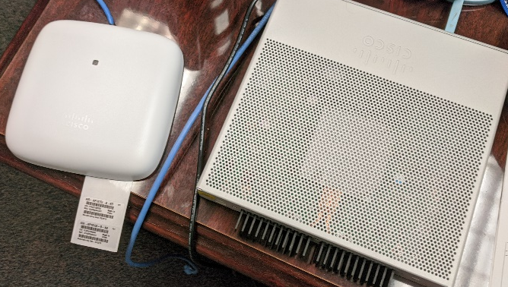
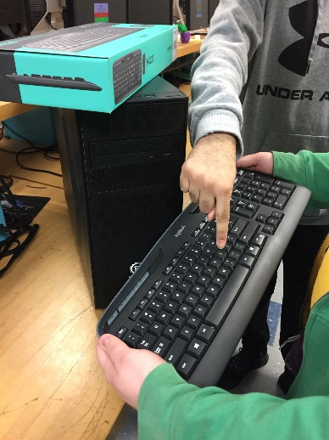
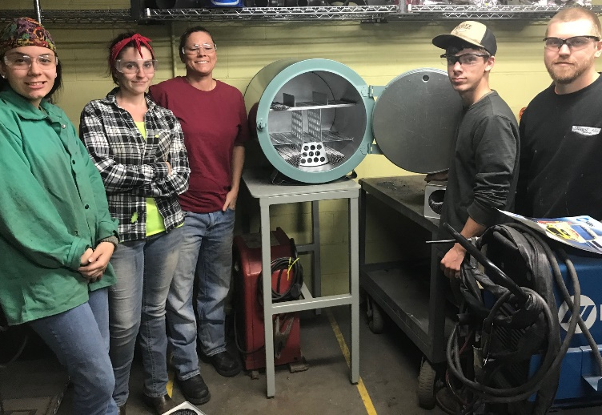
How Perkins Funds Are Making a Difference
Equipment for multiple CTE programs including Welding, Heavy Equipment, Cybersecurity, Computer Engineering Technology, Nursing, Criminal Justice, Collision Repair & Refinishing Technology, Agri-business

Slide 5
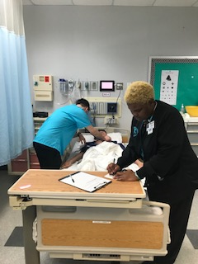
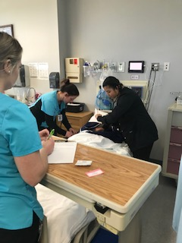
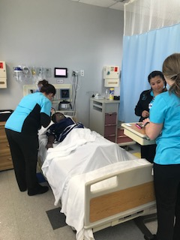
JUNO Culturally Diverse Patient Simulators
Lois Smith & Rita Love

Slide 6
Comprehensive Local Needs Assessment
As much as possible, we tried to use existing mechanisms to gather input and tried to cover as many programs as possible.
We grouped similar programs into “program areas.”
Program advisory boards gathered input from faculty, students, and industry.
NCWorks Career Center Team meeting was used to gather input from Workforce Development Boards, Service Providers, and Community Agencies.
Other meetings gathered input from Equity Team representatives, counselors, administration, and e-Learning.

Slide 7
Comprehensive Local Needs Assessment
Meetings with Stanly County Schools CTE personnel provided secondary school input and gave us a chance to provide input on their CLNA.
Surveys were used to gather input from Special Populations on certain topics.
Utilized employment/wage data from NCPerkins, EMSI, NC Department of Commerce, and data pulled by Centralina Workforce Development.

Slide 8
Comprehensive Local Needs Assessment Gaps/Needs Discovered
Many programs are not producing enough students to meet the industry demand.
Need to increase outreach to local middle and high schools for CCP.
As technology continues to change, lab equipment needs to keep up with the changes.
Essential skills (soft skills) are needed across the board.
Childcare and transportation were recurring financial issues related to special populations.

Slide 9
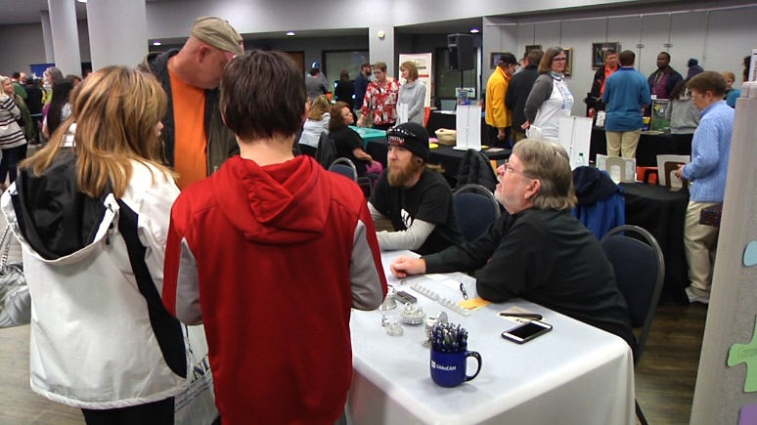
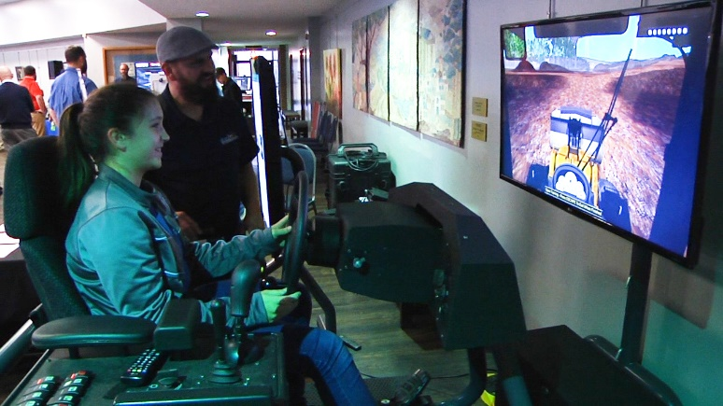
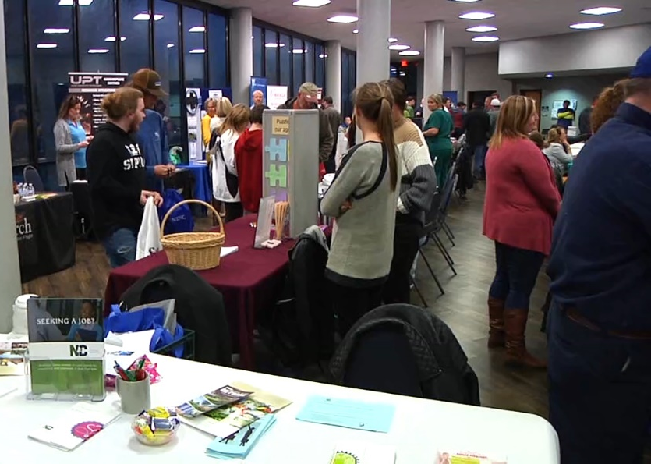
CTE Promising Practice – STANLY ACE
Stanly Academic & Career Exploration (ACE)
First event held in February 2019
Second event schedule for February 18, 2020
Perkins paid for marketing for the event

Slide 10
Budget Update
66 - 71% of Perkins Basic Grant Funds spent or encumbered as of 1/23/2020.
100% of Perkins Reserve Funds spent or encumbered as of 1/23/2020.
Funds have been spent on equipment, salaries, software, professional development, and educational outreach events.
Utilized faculty mini-grants to allocate $41,320 or 18% of the regular Perkins budget.
Most remaining funds are designated for professional development, SkillsUSA, and some equipment purchases.

Slide 11
Questions?
Jeff Parsons
Associate VP – School of Advanced Manufacturing, Industry, Technology, and Trades
Stanly Community College
Albemarle, NC
704-991-0321
jparsons7694@stanly.edu

