Slide 1
Perkins Update
August 9, 2022

Slide 2
Career & Technical Education Team
Bob Witchger
Tony Reggi
Patti Coultas
Mary Olvera
vacant
Darice McDougald

Slide 3
CTE Team staffing updates

Slide 4
Promotions
Dr. Tony Reggi is now the Associate Director of CTE
He will focus on:
Leadership Projects
MOA (Office of Civil Rights Reviews)
Assisting with monitoring Perkins grants

Slide 5
Hiring another CTE Coordinator
Currently
Post closes today. Post link is in the notes
Notes:
https://www.governmentjobs.com/careers/northcarolina/jobs/3650775/education-program-administrator-i-coordinator-for-career-and-technical-education

Slide 6
Our Partners in Academic Programs
Michelle Lair
Lori Byrd
Hilmi Lahoud
Aaron Mabe
Gail Robertson
Reyna Rodriguez
Frank Scuiletti
vacant
Nedra Dixon

Slide 7
Academic Programs staffing updates

Slide 8
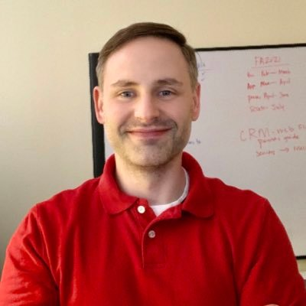
New Career & College Promise Coordinator
Aaron Mabe, CCP Coordinator
Academic Programs Section Programs & Student Services Division
919-807-7098
mabea@nccommunitycolleges.edu

Slide 9
Hiring a Curriculum Compliance Coordinator
Currently

Slide 10
More changes coming
Frank Scuiletti
Senior Program Administrator
Program Coordinator for Construction, Engineering, Industrial, Transport, and Work-Based Learning
Retiring on September 1st
Contact Michelle Lair after that until a new person is hired.

Slide 11
Purpose of Perkins
Develop more fully the academic knowledge and technical and employability skills of secondary education students and postsecondary education students who elect to enroll in CTE curriculum programs and programs of study
Notes:
The Strengthening Career and Technical Education for the 21st Century Act reauthorized and updated the Carl D. Perkins Career and Technical Education Act of 2006 to become the current Carl D. Perkins Career and Technical Education Act of 2006 as amended by the Strengthening Career and Technical Education for the 21st Century Act (Perkins V)
This updated act stresses:
- Academic, Technical, and Employability Skills
- Funding Secondary and Postsecondary CTE
- Focusing on Students who elect to enroll in CTE Programs of Study

Slide 12
Partnership with CORD
Ann-Claire Anderson
Senior Vice President, Special Projects

Slide 13
www.nc-net.info

Slide 14
CTE Faculty Professional Development Survey
Fall 2022

Slide 15
Survey Purpose
To determine the professional development needs and preferences of NCCCS CTE faculty so that NC-NET can provide targeted courses and content

Slide 16
Survey Administration
All CTE faculty are invited to participate
Link to survey emailed to:
Perkins contacts for distribution
Individual faculty members
Discipline or program-specific email groups
Survey Dates: August 16 – 26
Will not collect faculty names
Optional provision of email address to register for drawing; email data will not be disaggregated

Slide 17
Survey Content
College
Program Area
Part time or Full time status
New to teaching
Preferred professional development delivery formats
Content needs
Motivation

Slide 18
Specific Topics
Teaching and learning
Student success
21st-century/employability
Distance learning
Career pathways
Other topics (open response)
Factors contributing to positive experience

Slide 19
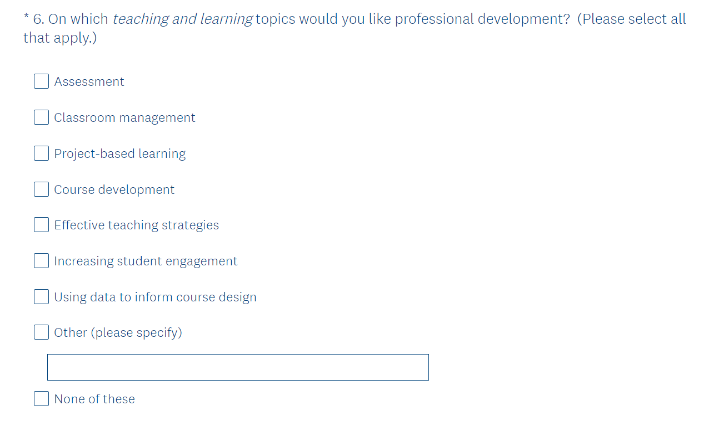
Teaching and Learning

Slide 20
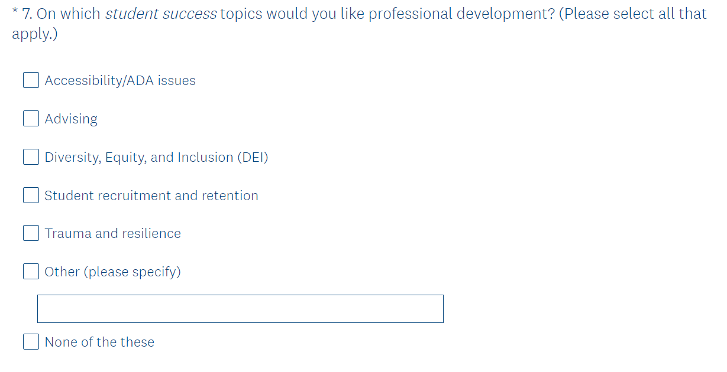
Student Success

Slide 21
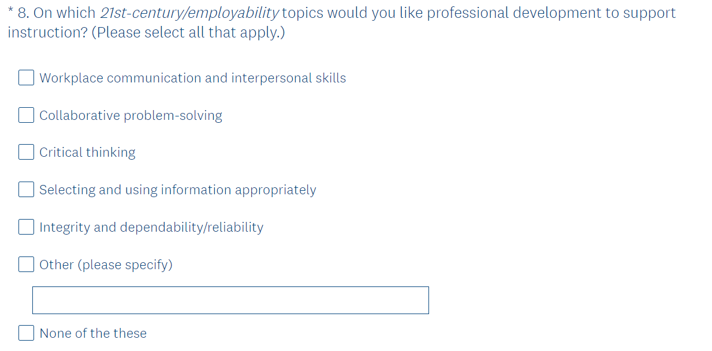
21st-Century/Employability Skills

Slide 22
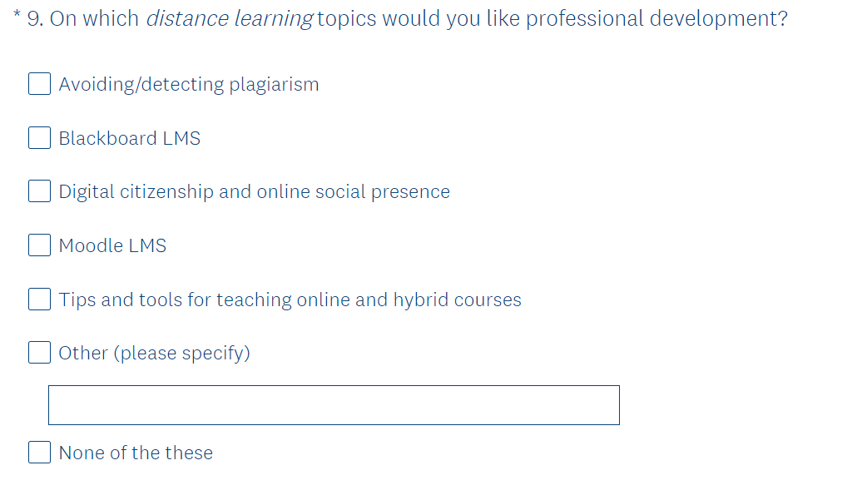
Distance Learning

Slide 23
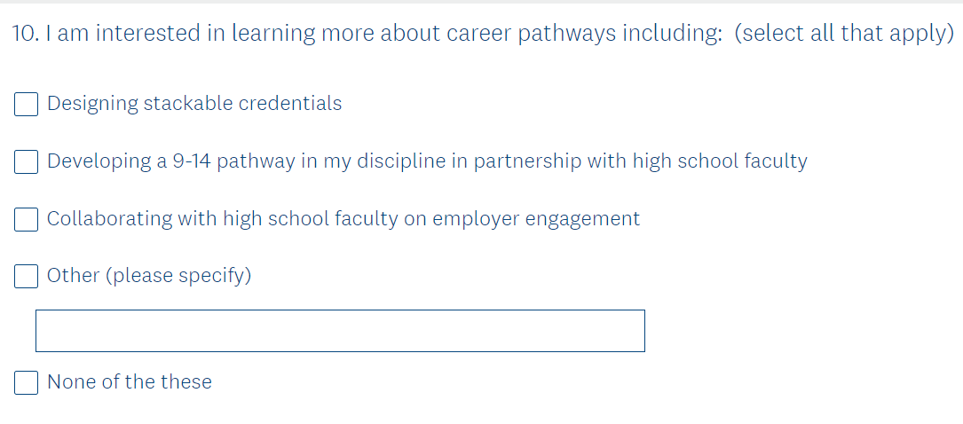
Career Pathways

Slide 24
Fall NC-NET Course Schedule
https://www.nc-net.info/nc-net-academy-course-schedule

Slide 25
Promising Practice Video 2022
Catawba Valley Community College
Champion Scholars Summer Program
See all the videos: https://www.ncperkins.org/video/
Notes:
August:
Catawba Valley Nash

Slide 26
Perkins Budget for 2022-23
Should be on the agenda as part of the board packet for
August 19, 2022

Slide 27
Federal Audit Report
Finding identified that all data on the 10 special populations was missing in the CLNA
More information will be coming in the future

Slide 28
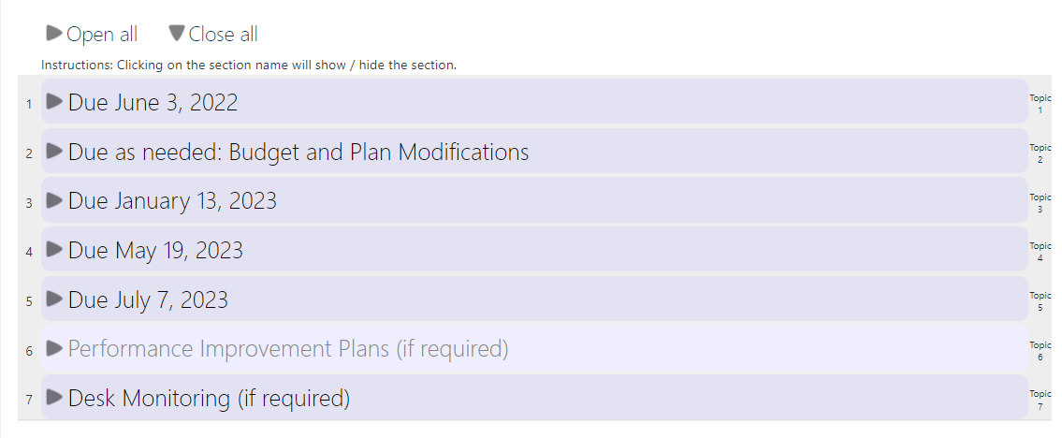
NCPerkins course update

Slide 29
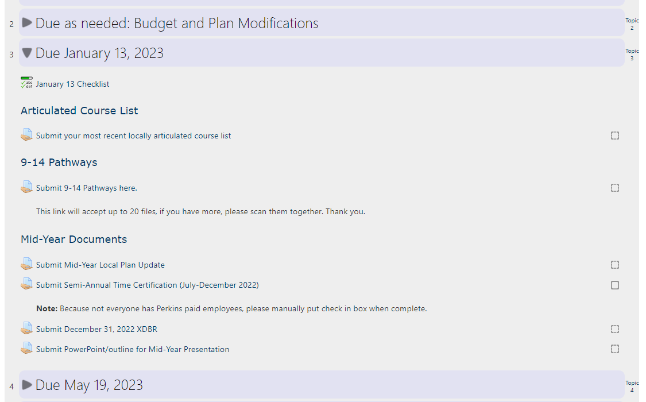
Open just the section you want to view

Slide 30
Progress Checklist

Slide 31
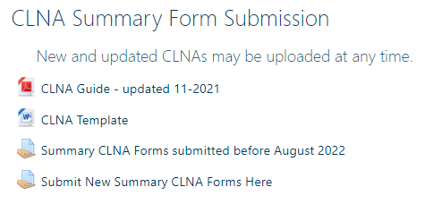
Cleaning up the CLNA Moodle
We have downloaded all CLNAs from the NCPerkins Moodle to our server
All old CLNAs are still available, but no new submissions may be made
A NEW Submission link has been created.

Slide 32
Dashboard Levels of Performance Update
Top, left graph on disaggregated data dashboards for each Performance Indicator
New: The State and Local Levels of Performance for the most recent year
Gaps in performance may be more obvious
Notes:
Hispanic students are not performing as well as other students, nor meeting the college’s negotiated level.

Slide 33
Potential Leadership Projects for 2022-23
CORD – NC-NET
SkillsUSA
Career Counseling
Updated Career Exploration Guide
Curriculum Alignment Projects: Cybersecurity, Biopharmaceutical Technology
Elementary Education Residency licensure certificate

Slide 34
Online Learning Updates - Lane Freeman
Moodle Mastery 101 for Healthcare Professionals
Begins September 2nd, 2022
Basics in Moodle
Regardless of Moodle skills, participants will benefit
Moodle Mastery Series Since January 2022
21 Automotive Faculty Across 12 Colleges
22 Early Childhood Instructors Across 18 Colleges
Notes:
https://sites.google.com/view/moodlemastery101healthcare/home

Slide 35
Online Learning Updates continued
Moodle Mastery 102 tentative for January 2023
System Office Conference and Distance Education
Immersive Learning Implementation
Contact
Lane Freeman, Director of Online Learning freemanl@nccommunitycolleges.edu
919-807-7107

Slide 36
Postsecondary Association of CTE (PACE)
Division of the Association for Career and Technical Education (ACTE)
Exploring postsecondary involvement in NC

Slide 37
Updating the Career Clusters Guide

Slide 38
Career Clusters Guide Interviews
 | Career Cluster | # of stories
1 | Ag, Food & Natural Resources | 2
2 | Architecture & Construction | 5
3 | Arts, A/V Tech & Communications | 0
4 | Business & Management | 1
5 | Education & Training | 2
6 | Finance | 0
7 | Government & Public Admin | 0
8 | Health Science | 4
9 | Hospitality & Tourism | 0
10 | Human Service | 0
11 | Information Technology | 1
12 | Law, Public Safety, Corrections, & Security | 2
13 | Manufacturing | 7
14 | Marketing | 1
15 | STEM | 0
16 | Transportation, Distribution & Logistics | 3
We want to have at least 2 interviews
for each career cluster

Slide 39
Semi-Annual Time Certification Reminder
For anyone paid with Perkins funds through payroll which are engaged in activities that are 100% CTE/Perkins approved. Including:
Full time or part time faculty
Extra duty contract work
Support Staff (career coaches, WBL Coordinators, etc.)
Time Periods: July 1 – December 31 and January 1 – June 30
MUST be signed by employee, supervisor, and Perkins contact.

Slide 40
Preparing for the Mid-Year Reviews
January – hopefully in-person
PowerPoint
How are the findings of the CLNA being addressed?
Plan updates: activities, anticipated problems/issues, successes
Share a CTE Promising Practice that you’re doing this year
Budget Update – Has equipment been ordered? Are you on track to spend it all?
Questions, comments, suggestions

Slide 41
Application due May 19, 2023

Slide 42
Perkins Monthly Updates
2nd Tuesday of the month from 9-10 am
Register now for all of them https://www.ncperkins.org/presentations/
Dates:
Sept. 13, 2022
Oct. 11, 2022 (System Conference)
Nov. 8, 2022
Jan. 10, 2022
Feb. 14, 2022
Mar. 14, 2022
April 11, 2022
May 9, 2022
June 13, 2022
Attendance (or viewing the recording within 30 days) is recorded on monitoring rubric. Recording may be accessed at the same link as the registration.
Notes:
Register now and let the system remind you.

Slide 43
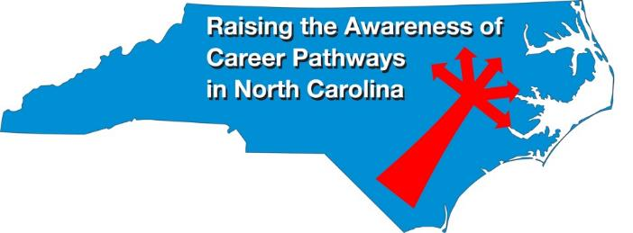
Raising the Awareness of Career Pathways Webinars
August 17, 2022
September 21, 2022
October 19, 2022
November 16, 2022
January 18, 2023
February 15, 2023
March 15, 2023
April 19, 2023
Register for all webinars at
www.ncperkins.org/presentations

Slide 44
Upcoming Fall Conferences
Notes:
NCCCS System Conference https://projects.coned.ncsu.edu/opd/NCCCS/
ACTE Postsecondary CTE Event https://www.acteonline.org/postsecondarycteevent/

Slide 45
More upcoming fall conferences
Notes:
NCWorks https://public.ncworks.gov/TRAINResources/Prod/2022NCWPCRegistrationBrochure.pdf
National Career Pathways Network https://www.ncpn.info/ncpn-connect-2022/
ACTE CareerTech Vision https://www.acteonline.org/event/careertech-vision-2022/

Slide 46
Promising Practice Video 2022
Nash Community College
Topic: SkillsUSA Skillibus
See all the videos: https://www.ncperkins.org/video/
Notes:
August
Catawba Valley
Nash

Slide 47
Technical Assistance is available
We are here to help!
Team Perkins is available by phone, email, virtually, or in-person

Slide 48
Next Webinar September 13, 2022
Register now via ncperkins.org/presentations

