Slide 1
Perkins Mid-Year Review
South Piedmont Community College
January 29, 2020

Slide 2
Perkins Funds …
Improved Advising in CTE Programs in rural high schools
Career Coach
Enhanced HVAC Program
Outdated Equipment replaced to meet industry standards
Better Prepared Students for the Workplace
Newer equipment
Faculty training

Slide 3
Improved Advising in CTE Programs
Career coach
New position in rural areas of Union and Anson counties
Improve secondary participation in postsecondary CTE programs of study
Expand opportunities for secondary students in rural counties and economically depressed areas
Help address the gap in serving special populations
Provide intrusive advising to improve success

Slide 4
Enhanced HVAC Program
Outdated Equipment replaced to allow students the training necessary to meet industry standards
Heat Pump
Air Handlers
Refrigeration
Gas Furnaces

Slide 5
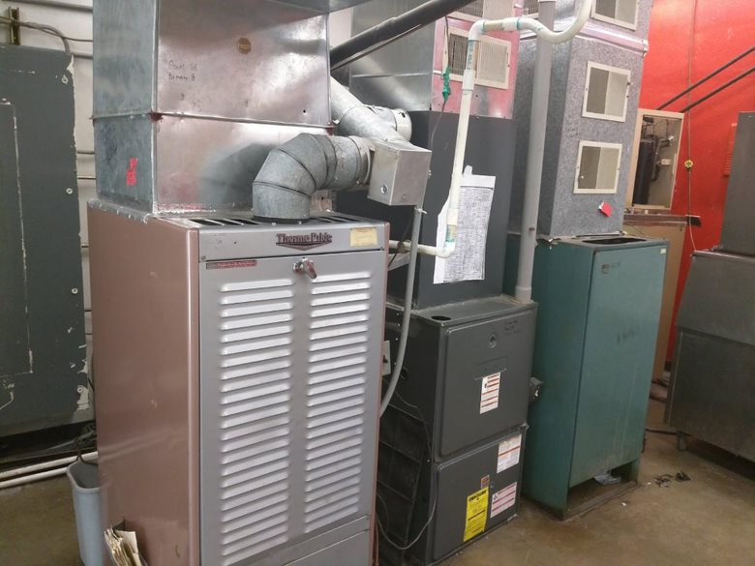
Outdated HVAC Equipment

Slide 6
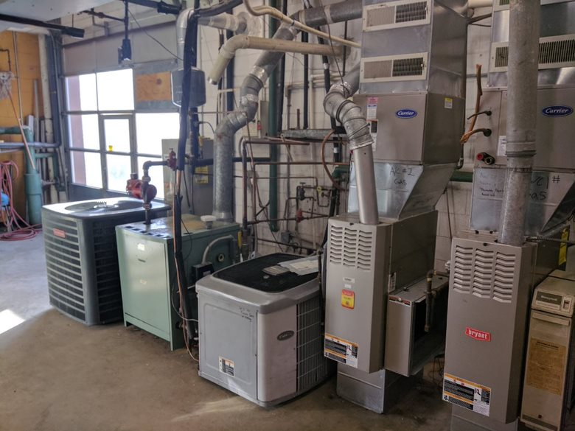

Slide 7
New Lab – New Equipment

Slide 8
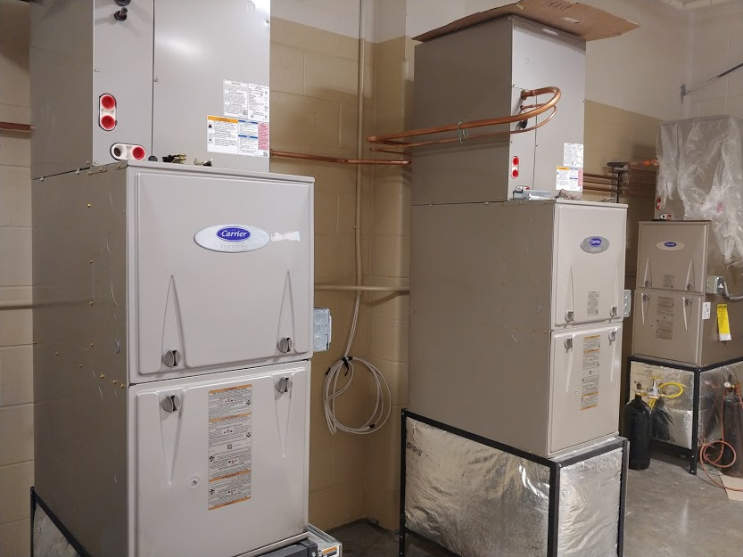

Slide 9
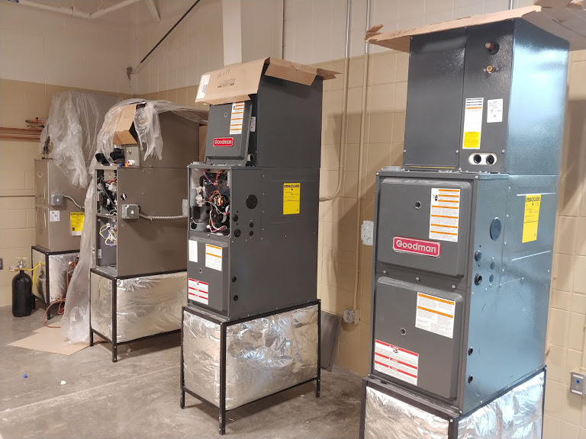

Slide 11
Prepared Students for the Workplace
Newer equipment allows training for students on equipment found in the current workplace
Professional Development for Faculty
HVAC faculty trained in latest commercial refrigeration technology
Work-based Learning faculty attended NCWBL conference

Slide 12
Comprehensive Needs Assessment

Slide 13
Four Pathways
Associate Degree Nursing
Information Technology
Digital Media Technology
Cyber Crime Technology
Industrial Systems Technology
Electrical Systems Technology
Welding Technology
Automotive Systems Technology

Slide 14
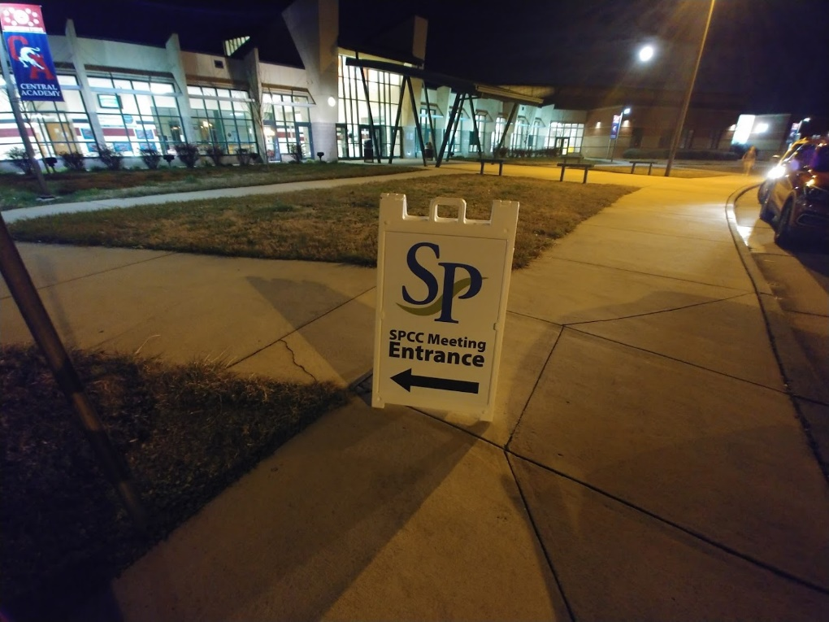
Gathering of Information
Meeting December 11
Post-Secondary
Administration
Instruction
Secondary
Administration
Instruction
Special Populations
Service Agencies
Career Guidance
Community
Business/Industry
Workforce Development
Students
Parents

Slide 16
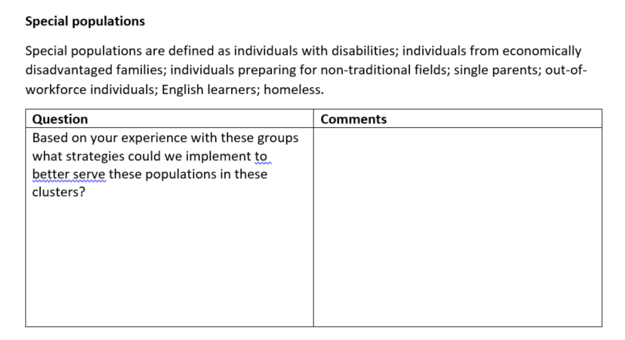

Slide 17
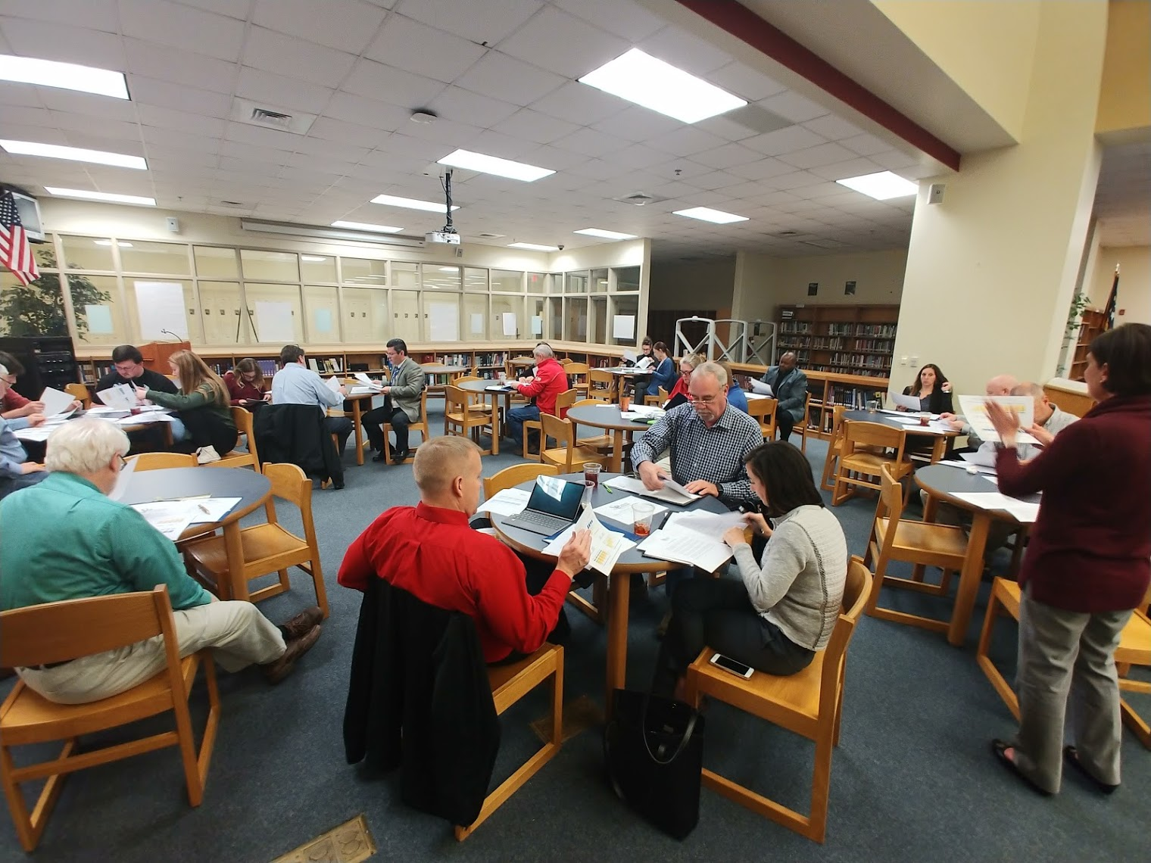

Slide 19
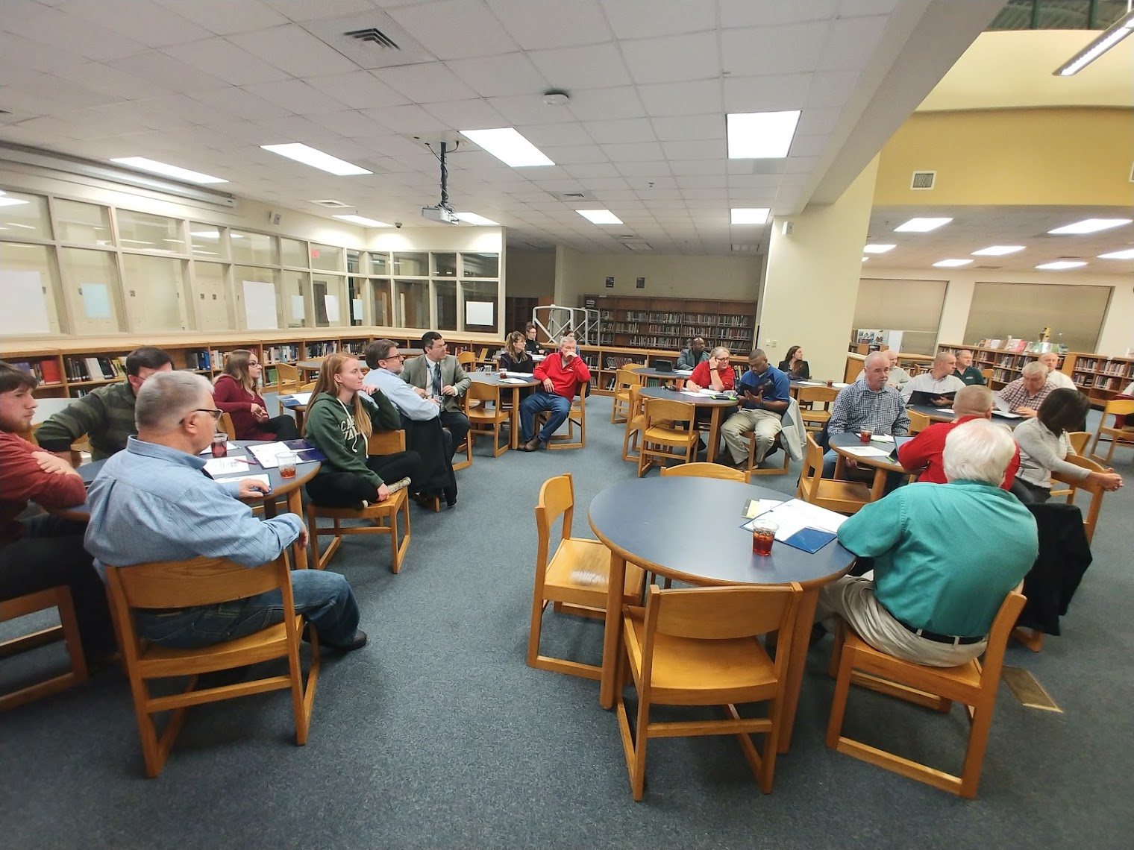

Slide 20
Gaps
Enrolled students in Associate Degree Nursing are predominantly female
9.5% male
The program is not attracting males
Limited clinical space available as multiple programs are vying for student opportunities in hospital and healthcare setting
Salary gap between faculty salary and industry salary makes it difficult to attract and retain quality faculty

Slide 21
Gaps
GPAs are lower than the college
Few non-traditional students
Caucasian females represented 14% of Information Technology enrollment, compared to 35% of overall college enrollment for the same time period
Retention lower than the college
CCP students not enrolling in the college after high school graduation
Number of graduates has increased
Mostly CCP CTE students in certificate pathways
Still doesn’t meet the job demand

Slide 22
Gaps
Enrolled students are predominantly white males
Graduates are primarily certificate earners
Industry requiring associate degree earners
Program is not attracting minority populations
Number of graduates not meeting job demand
There is a need to train faculty in:
Latest trainers from companies such as Festo and Lab-Volt
Higher levels of NIMS, MSSC, and AWS certifications

Slide 23
Gaps
GPAs in the two most recent academic years have declined
GPAs are lower than the college
Few non-traditional students enrolled in the program
Less than 12% of total enrollment is female
College does not have a full-time program lead
Inadequate facilities
Enrollment doubled
Classroom space has remained the same
Most of the equipment is outdated or shared

Slide 24
Promising Practice

Slide 25
Experience Events
Hands-on events designed to immerse community in vocational and technical jobs
Outreach for under-served and under-represented populations
Help dispel antiquated notions of vocational work

Slide 26
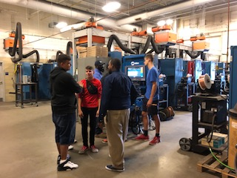
Make It In Union

Slide 27
Community Events

Slide 28
Budget Update
Monies thus far have been spent on:
HVAC equipment to provide student training on a variety of brands to align with industry standards
Professional development for faculty for HVAC and WBL
Career Coach which focuses on rural areas to provide high school students the information needed for career pathways and a seamless transition to CTE programs within the college

Slide 29
Budget Update
CLNA Focus
Provide up-to-date equipment and software for CLNA programs
Hire additional faculty for A.D.N and Automotive Technology
Create a SIM Lab for students and community to provide additional educational opportunities
Continue supporting the Career Coach for career guidance and advising to high school students in CTE pathways

Slide 30
Budget Update
Remaining funds for 2019-2020
A new HVAC Lab has been created to allow for additional training. Continue to upgrade the equipment to meet industry standards
Continue to support 65% from Perkins the Career Coach who is targeting rural areas and focusing on CTE pathways for high school students to transition to college after high school graduation
Purchase a career software, “Career Coach”, to allow for informative career decisions for students

Slide 31
Thank You!

