Slide 1
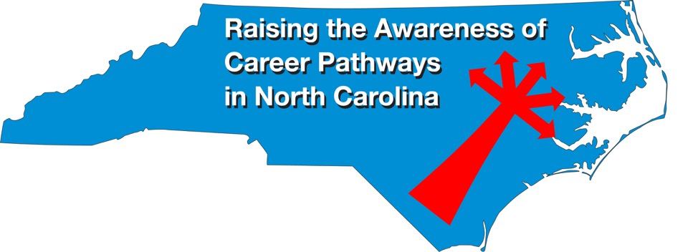
Engineering Technology January 17, 2024
Download the PowerPoint and access the recording: www.ncperkins.org/presentations

Slide 2
Career & Technical Education Team
Bob Witchger
Tony Reggi
Patti Coultas
Mary Olvera
Stefanie Schroeder
Darice McDougald
Lane Freeman
Jennifer McLean
Aaron Mabe

Slide 3
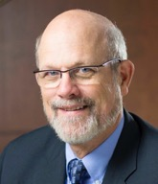
Dr. Bob Witchger
CTE Director, Team Perkins
Notes:
Dr. Robert (Bob) Witchger
NCCCS, CTE Director
919-807-7126
witchgerb@nccommunitycolleges.edu

Slide 4
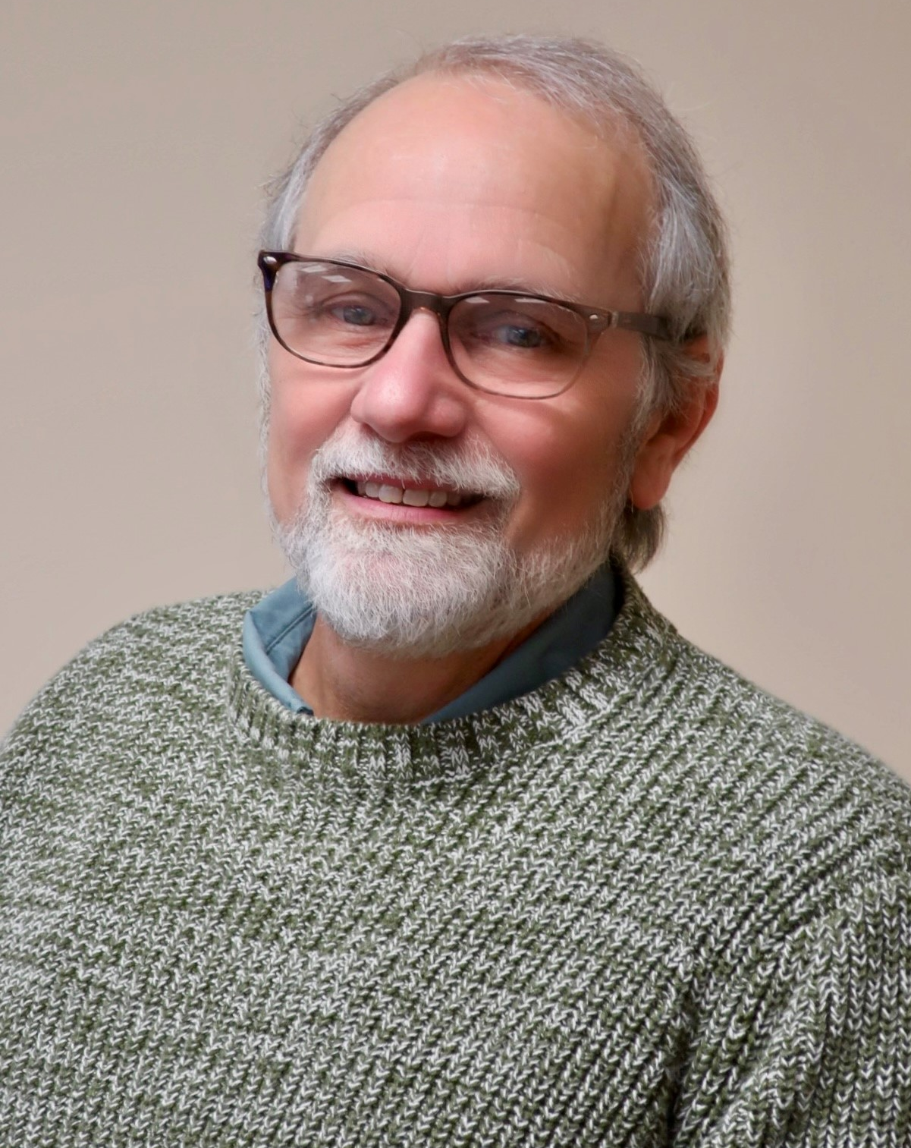
Dr. Tony Reggi
CTE Associate Director
Notes:
Tony Reggi
919-807-7131
reggia@nccommunitycolleges.edu

Slide 5
Patti Coultas
CTE Coordinator
Notes:
Patti Coultas
919-807-7130
coultasp@nccommunitycolleges.edu

Slide 6
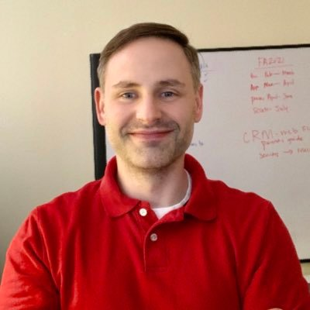
Aaron Mabe
Coordinator for Career and College Promise
Notes:
Aaron Mabe
919-807-7098
mabea@nccommunitycolleges.edu

Slide 7
Dr. Mary Olvera
CTE Coordinator and Program Administrator
Public Service Technologies, Agriculture and Natural Resources Technologies, and Commercial Artistic Productions
Notes:
Dr. Mary Olvera
Career and Technical Education Coordinator & Program Administrator
Public Service Technologies, Agriculture and Natural Resources Technologies, and Commercial Artistic Productions
North Carolina Community College System Office
919-807-7120
olveram@nccommunitycolleges.edu

Slide 8
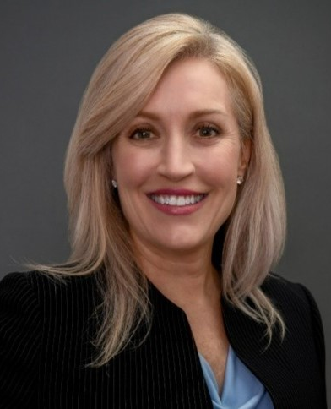
Stefanie Schroeder
CTE Coordinator
Notes:
Stefanie Schroeder
919-807-7232
schroeders@nccommunitycolleges.edu

Slide 9
Engineering vs Engineering Technology
Theoretical
Applied
Research | Complex Analysis | Complex Design | Development | Test & Evaluation |  | Test & Evaluation | Mfg. & Construction | Production | Technical Analysis | Distribution & Sales
Engineering Technology
Engineering
Notes:
https://nccareers.org/occupation-profile/291292/1284

Slide 10
NC Community College Engineering Technology Programs

Slide 11
Engineering Technology
Outline of Five Career Options

Slide 12
Mechanical Engineering Technician
Role Overview:
Apply principles of mechanical engineering to design and develop mechanical systems and products.
Responsibilities:
Collaborate with engineers to create detailed designs.
Conduct tests and analyze data to ensure product functionality.
Assist in the manufacturing and maintenance processes.

Slide 13
Electrical Engineering Technician
Role Overview:
Support electrical engineers in designing, testing, and maintaining electrical systems and components.
Responsibilities:
Assist in the development of electrical schematics and layouts.
Test and troubleshoot electrical systems.
Collaborate with cross-functional teams on projects.

Slide 14
Civil Engineering Technician
Role Overview:
Aid civil engineers in planning, designing, and overseeing construction projects.
Responsibilities:
Conduct surveys to gather data for project planning.
Assist in drafting plans using computer-aided design (CAD) software.
Monitor construction sites to ensure compliance with specifications.

Slide 15
Computer Engineering Technician
Role Overview:
Work at the intersection of computer science and electrical engineering to develop and implement computer systems.
Responsibilities:
Collaborate on the design and testing of computer hardware.
Develop and maintain software applications.
Troubleshoot and resolve hardware and software issues.

Slide 16
Aerospace Engineering Technician
Role Overview:
Support aerospace engineers in the design and maintenance of aircraft and spacecraft.
Responsibilities:
Assist in the development of aerospace systems and components.
Conduct tests to evaluate the performance of aerospace systems.
Collaborate with teams to ensure compliance with safety regulations.

Slide 17
Gaston College
Scotty Brooks
Program Chair, Engineering Technology
Notes:
Scotty Brooks
Brooks.scotty@gaston.edu

Slide 18
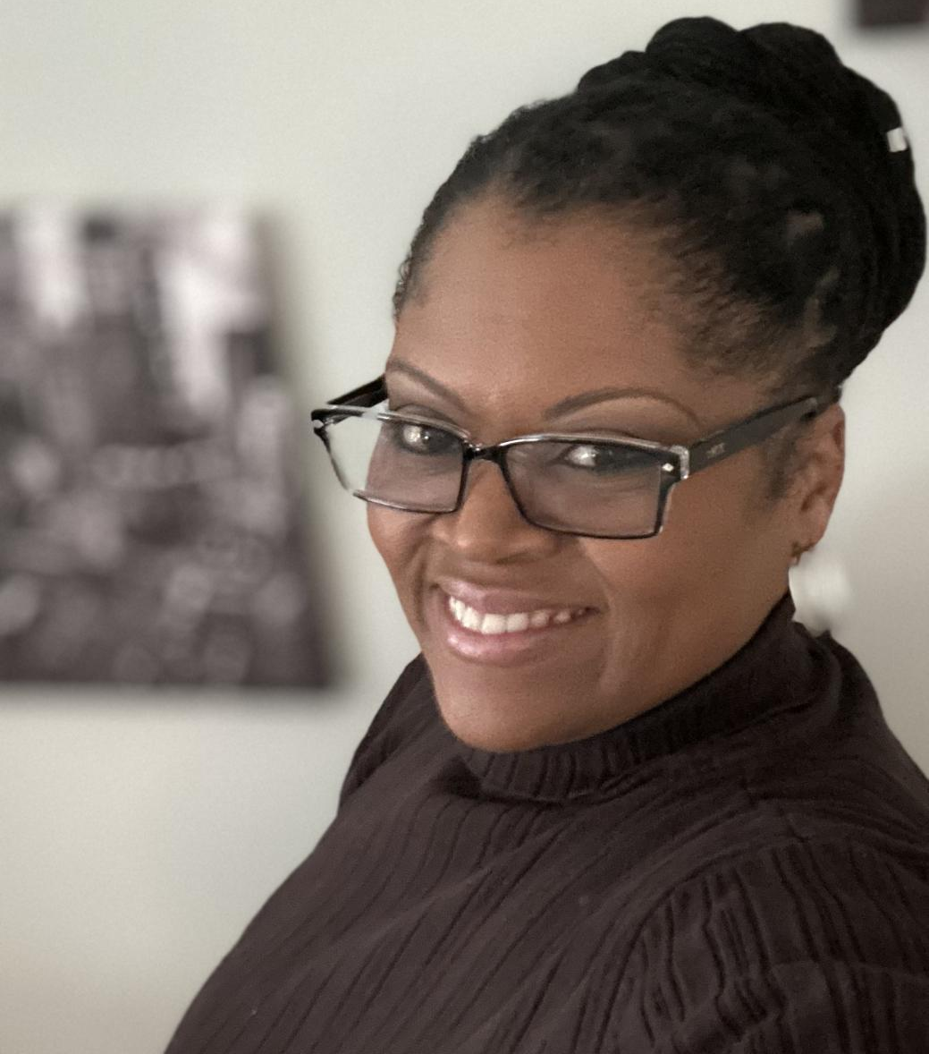
Gaston College
Katrina McClain
Dean of College Now
Notes:
Katrina McClain
Mcclain.katrina@gaston.edu

Slide 19
Gaston College
Brittany Wilson
Academic Advisor – College Now
Notes:
Brittany Wilson
Wilson.brittany@gaston.edu

Slide 20
Martin Community College
Ryal Watkins
Division Chair, Advanced Manufacturing
Notes:
Ryal Watkins
rwatkins@martincc.edu

Slide 21
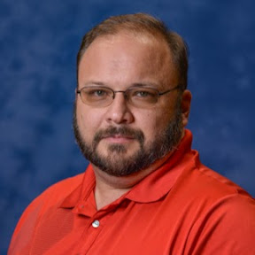
McDowell Technical Community College
Brandon Hensley
Dean of Career & Technical Education
Universal Advanced Manufacturing Center
Notes:
Brandon Hensley
Dean of Career and Technical Education
McDowell Technical Community College
gbhensley28@go.mcdowelltech.edu

Slide 22
Engineering at MTCC
Associate in Engineering (Transfer)
Applied Engineering Technology
Mechatronics Engineering Technology
Notes:
This is our board of trustees and we have one commissioner’s appointee that will be named in August.

Slide 23
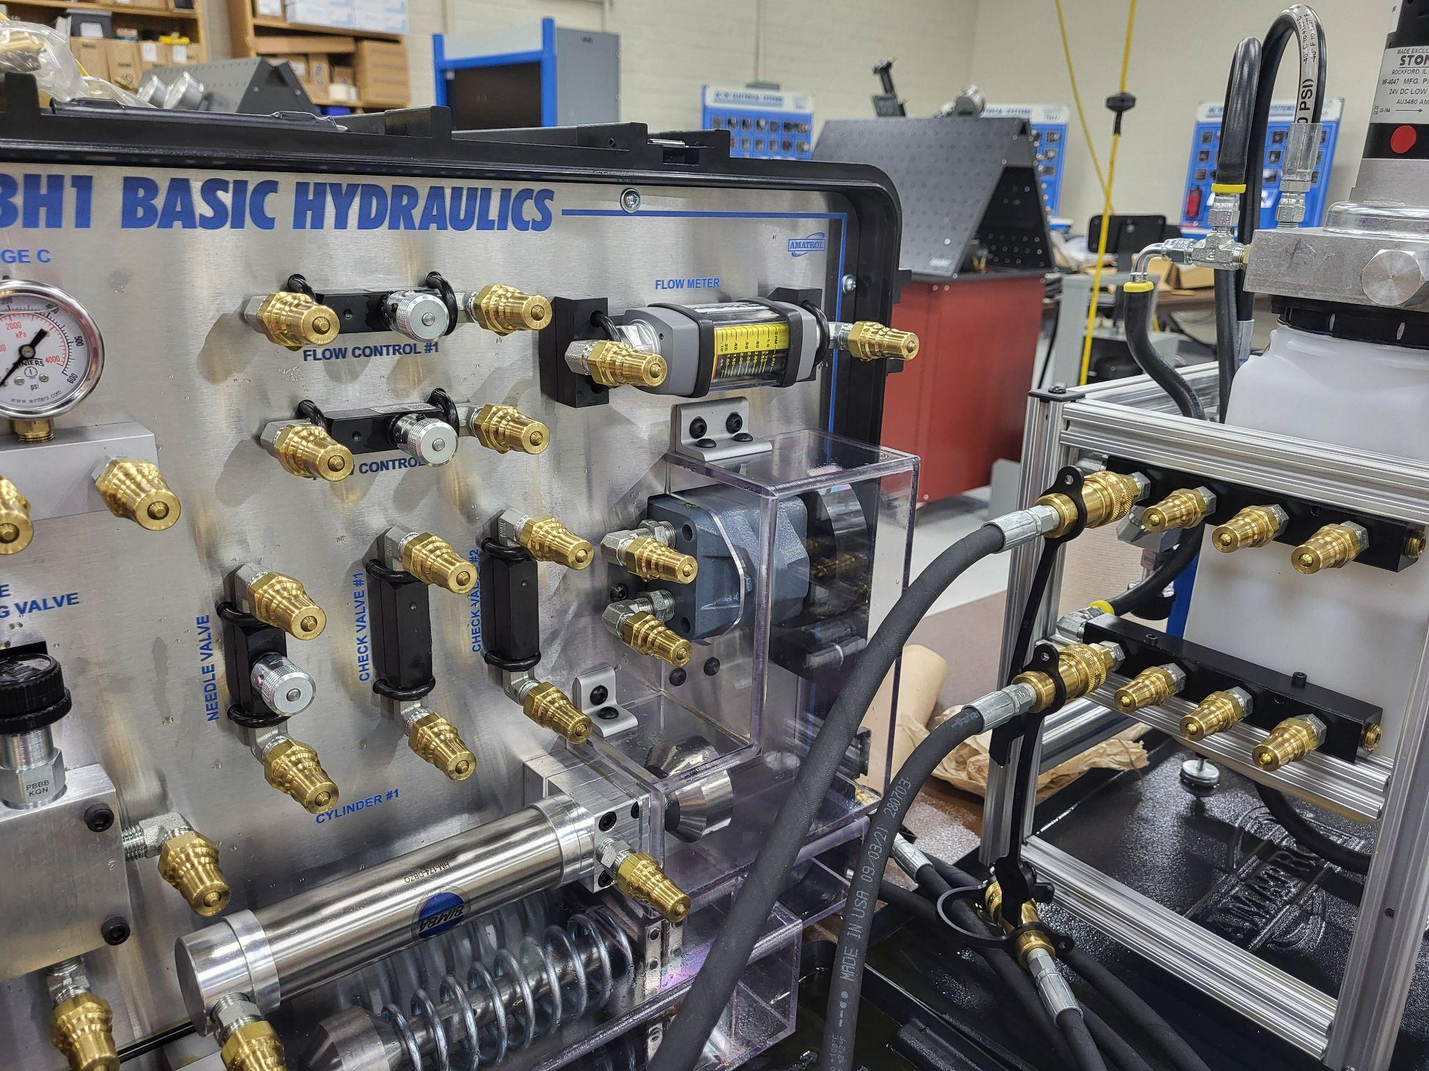
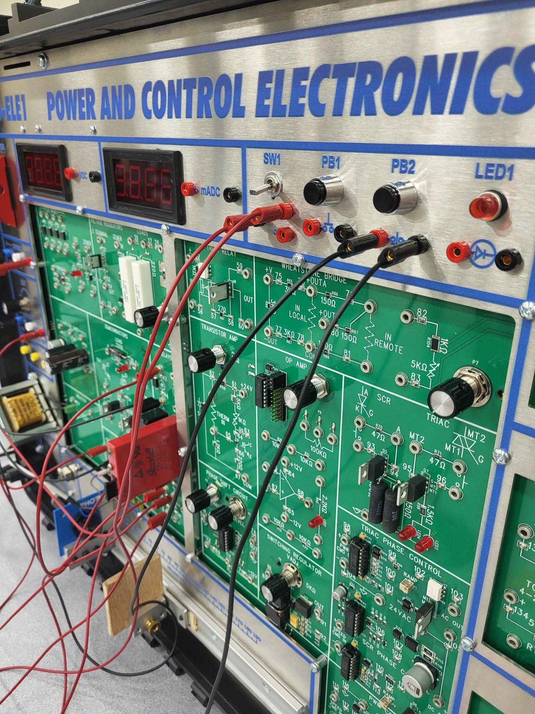
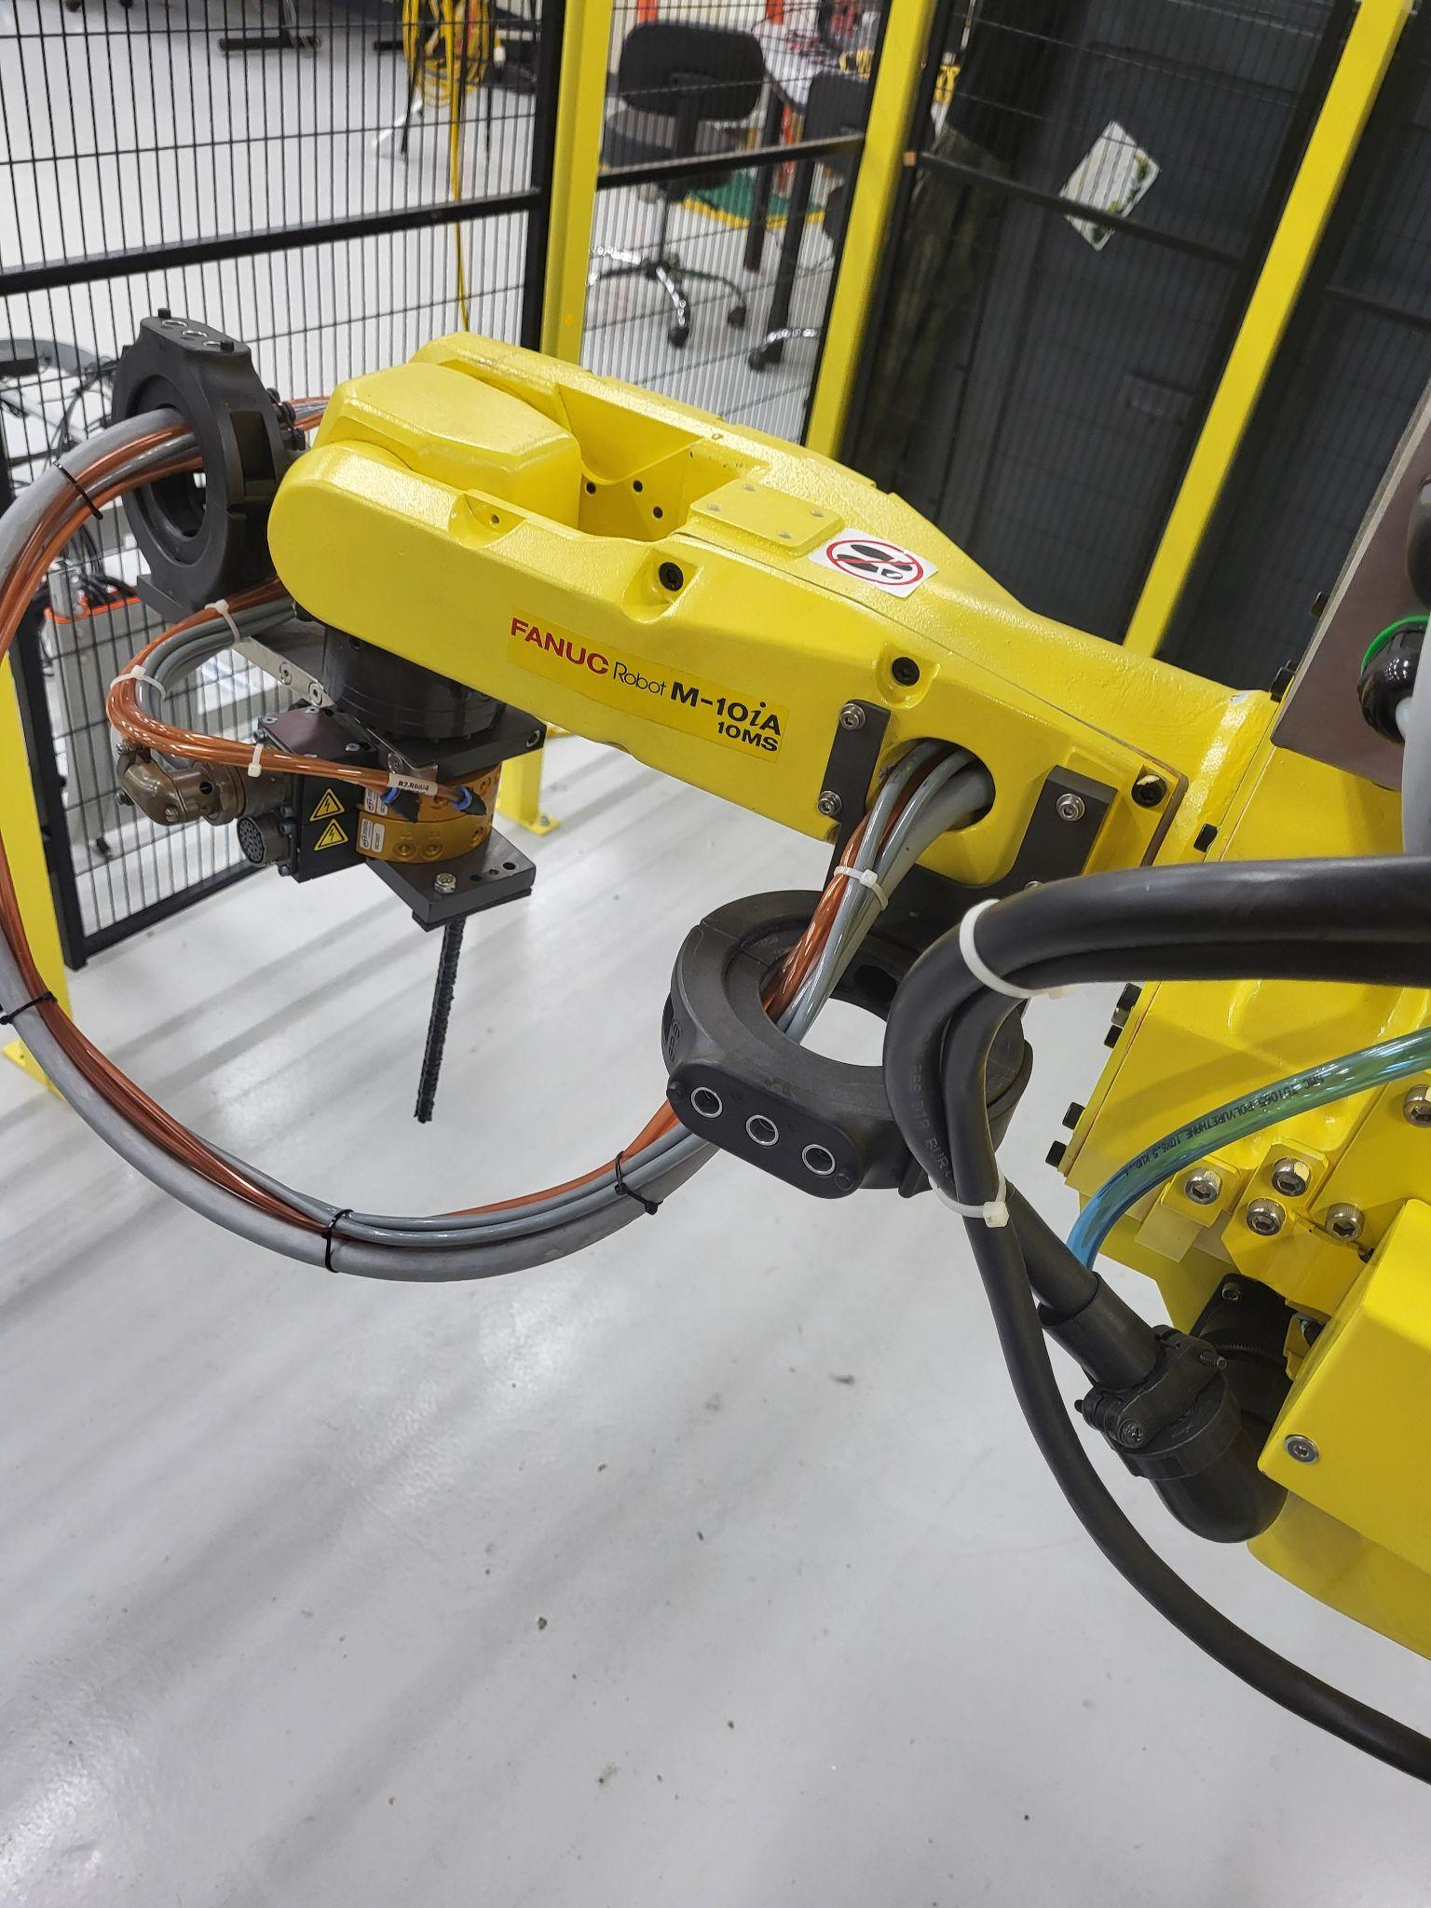
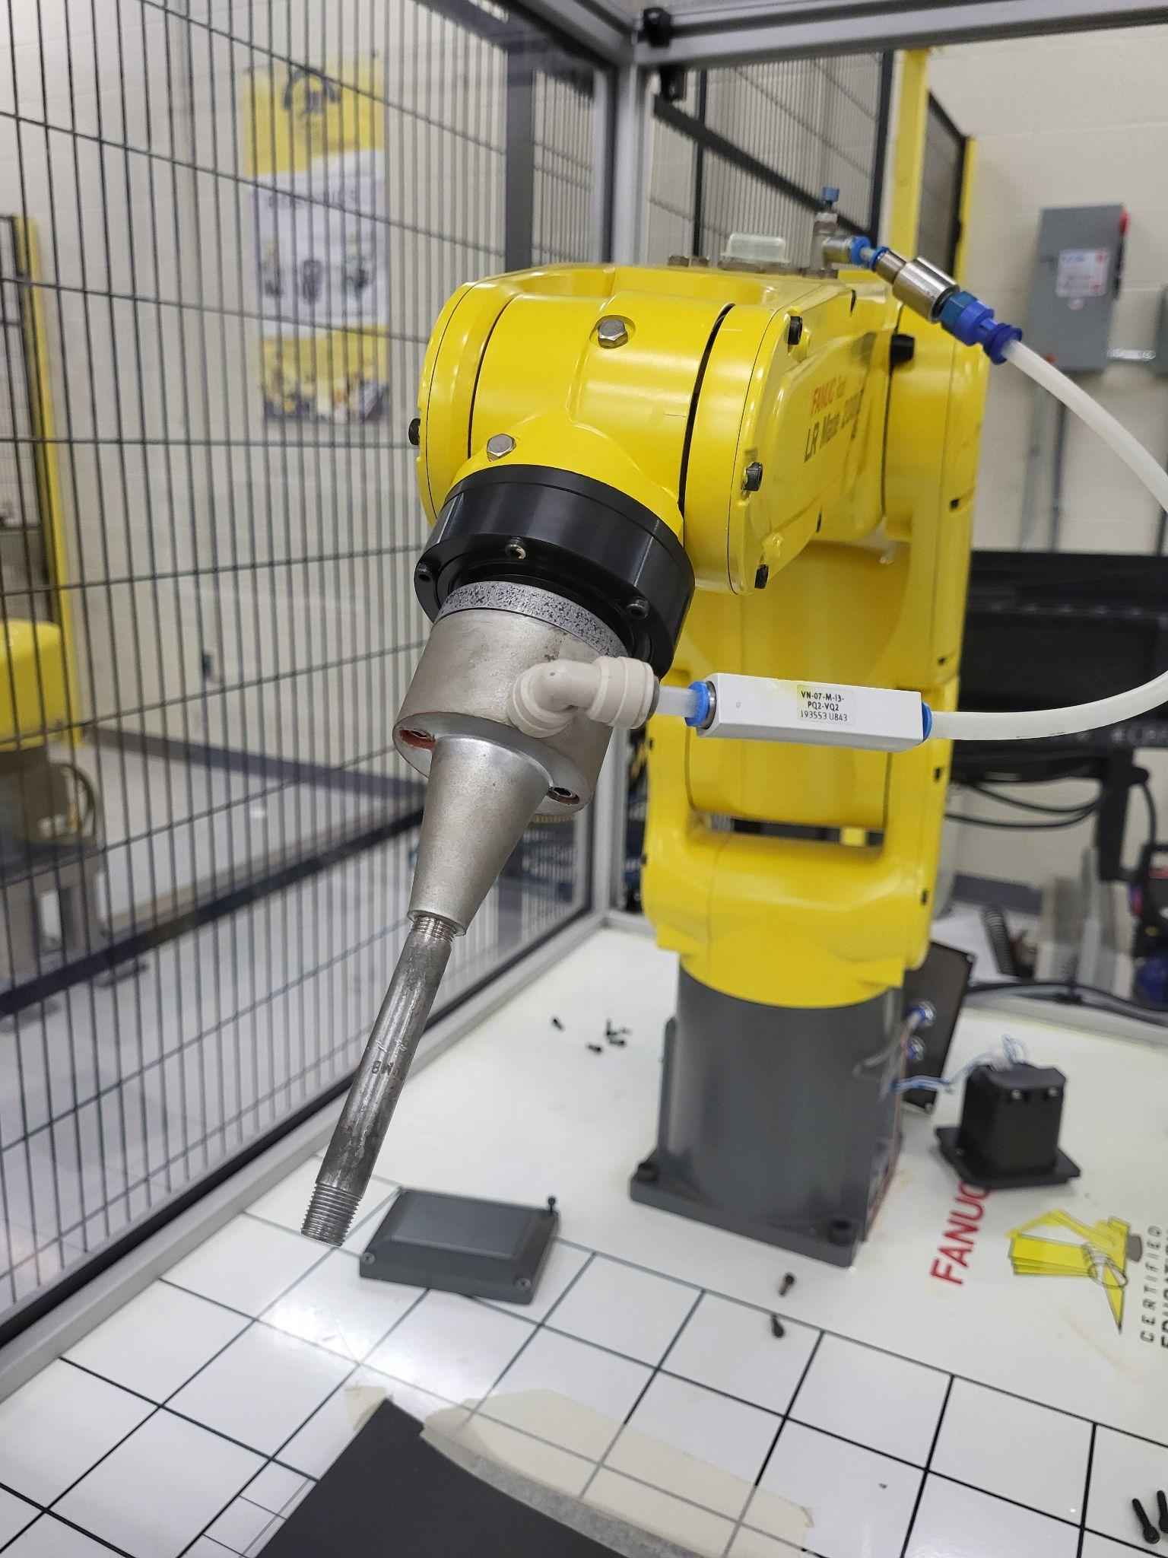
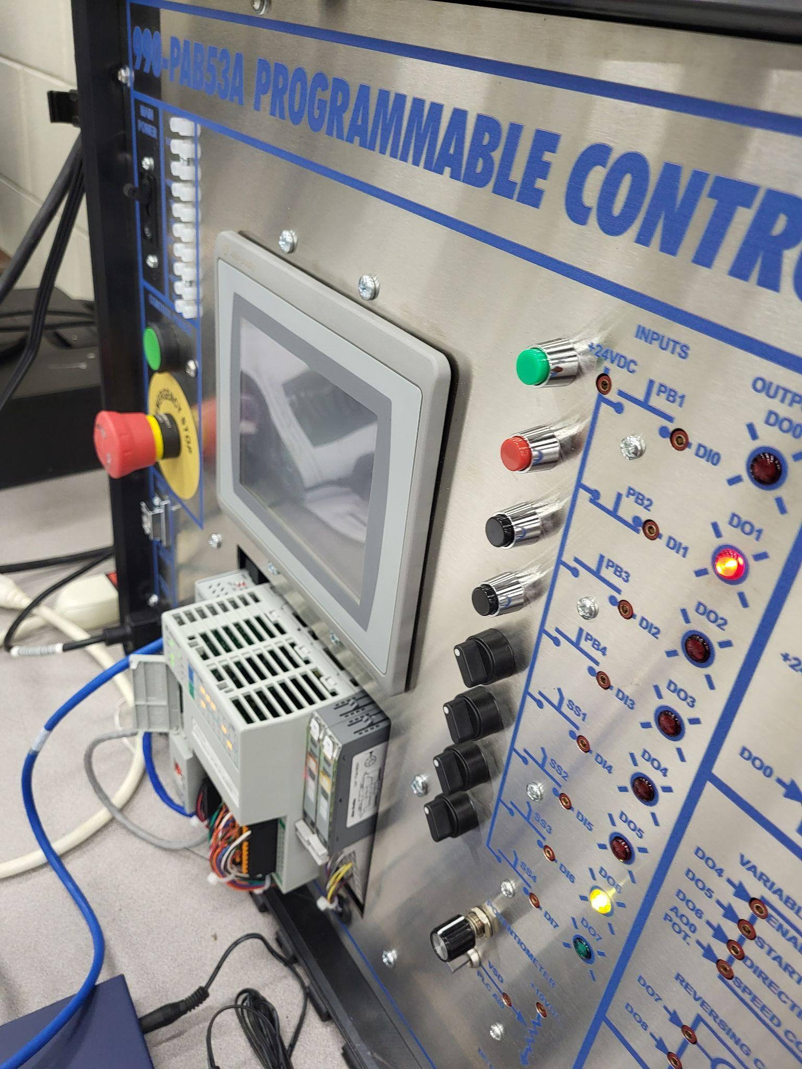
Engineering at MTCC
New Equipment
Notes:
Welcome to our new employees in each division.

Slide 24
Engineering at MTCC
Notes:
This is our board of trustees and we have one commissioner’s appointee that will be named in August.

Slide 25
Wilkes Community College
Stacie Taylor
Chair, Applied Engineering Technologies
Notes:
Stacie Taylor
sbtaylor965@wilkescc.edu

Slide 26
Wilkes Community College
Bryan Hartzog
Lead Instructor
Industrial Engineering/Robotics, Automation, and Mechatronics Technology
Notes:
Bryan Hartzog
jbhartzog762@wilkescc.edu

Slide 27
Wilkes CC Applied Engineering Technology

Slide 28
Wilkes Community College
YouTube Link to
WWC Robotics, Automation, and Mechatronics Technology Video
https://www.youtube.com/watch?v=jLCS8_qC5Ak

Slide 29
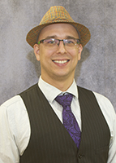
Wilson Community College
Josh Stevens
Applied Engineering Instructor
Notes:
Josh Stevens
jstevens@wilsoncc.edu

Slide 30
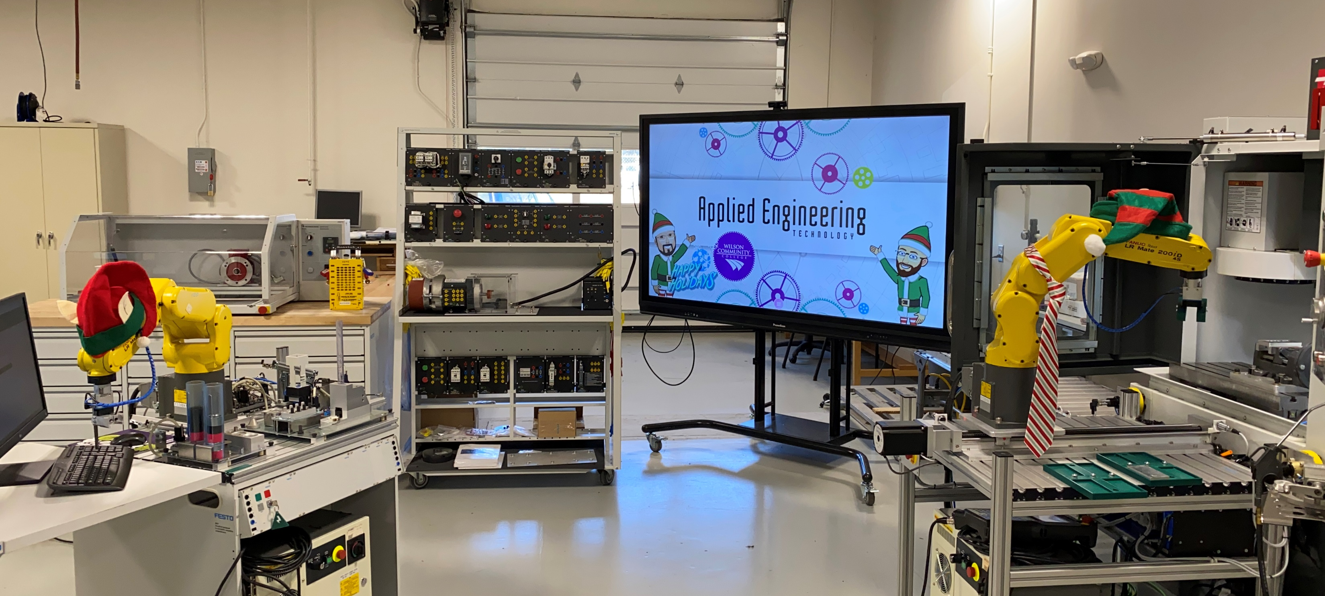
Wilson CC Applied Engineering Technology

Slide 31
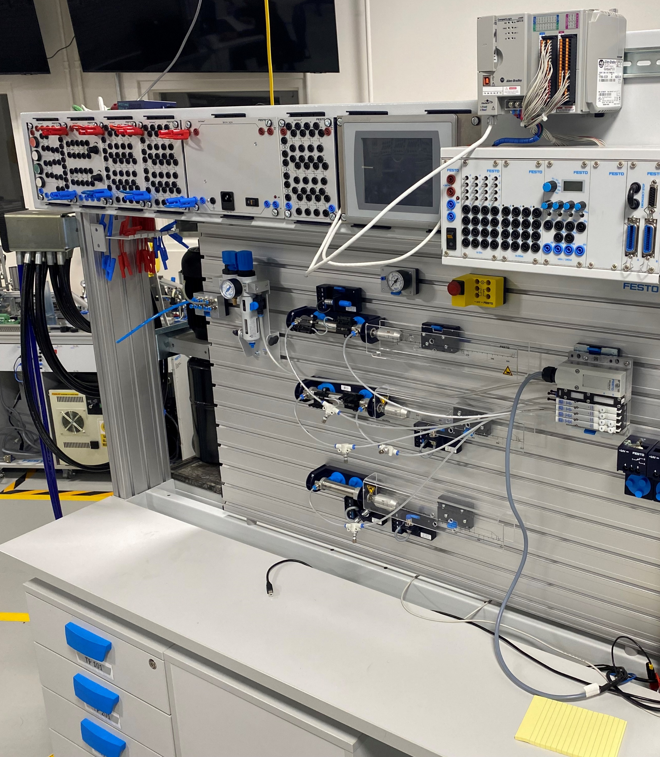
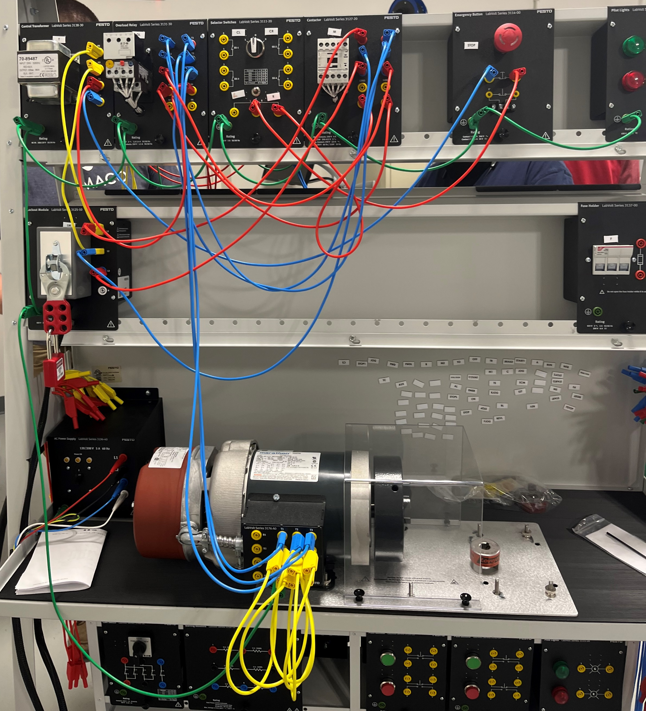
Wilson CC Engineering Tech Lab

Slide 32
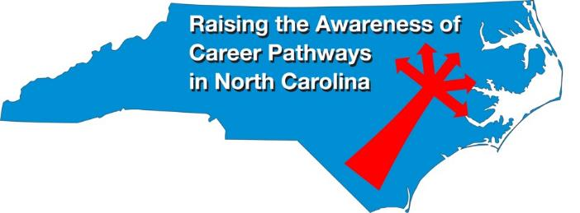
Raising the Awareness of Career Pathways Webinars
Feb. 21, 2024 – Biotechnology & Clinical Trails Research Associates
Mar. 20, 2024 – Business Administration
Apr. 17, 2024 – Public Safety
May 15, 2024 – Cyber Crime Technology
Register for all webinars at www.ncperkins.org/presentations

