Slide 1
Surprises in the Future Job Market
Chris Droessler
CTE Coordinator
NC Community Colleges
DroesslerC@NCCommunityColleges.edu
www.ctpnc.org/presentations
Get the PowerPoint
www.ncPerkins.org
Notes:
Thank You for the kind words.
The job market has changed considerably from when we graduated from high school. Many of the careers that our youth will have - have yet to be thought of, which makes career preparation an even bigger challenge.
In this session, we will be looking at some aspects of the job market that might just surprise you.
Download a copy of this PowerPoint and the related handouts by going to C T P N C dot ORG (new website - NCperkins.org) and click on the “presentations” link at the top of the page.
Feel free to use all or part of any of my presentations. If it can help get someone on a path toward a rewarding career, then you can take and use anything I have to give.
I have documented my information sources in the notes section of each slide in the PowerPoint to allow you to further research anything that you see here.
-- So buckle up, and crank up the flux capacitor, you’re in for a fast ride into the future!
====
NCWorks Training Center
February 24, 2016 @ 2:00 PM

Slide 2
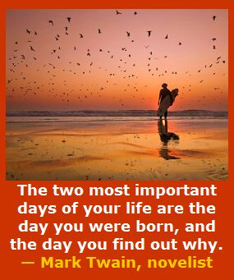
Notes:
Too many people go through life not knowing who they are -- and why they are here on planet Earth.
For some -- the revelation comes late in life.
Throughout this webinar series -- we will be looking at helping young adults figure out who they are, -- and why they are here, -- and where they are going.
Somewhere along the way-- all of us found out that we cared about helping others–
and we were supposed to be right here – this very morning –
listening to an old high-school shop teacher talk about the future.
========
http://www.goodreads.com/quotes/505050-the-two-most-important-days-in-your-life-are-the
“The two most important days in your life are the day you are born and the day you find out why.”
― Mark Twain
http://www.huffingtonpost.com/karen-ann-kennedy/the-two-most-important-days-of-your-life_b_5229311.html
Photo
http://myincrediblewebsite.com/mark-twain-on-the-days-of-your-life/

Slide 3
N.C. Division of Workforce Solutions
We help people find jobs and achieve their career goals, and we help employers find and retain a qualified workforce.
Notes:
3
Here is the mission statement for the N.C. Division of Workforce Solutions
“We help people find jobs and achieve their career goals, and we help employers find and retain a qualified workforce.”
Before all of this can happen, we have to first help the youth discover their career goals.
====
http://www.nccommerce.com/wf/about-us/commission-on-workforce-development

Slide 4
NC Education Plan
All students must graduate from high school and be career, college, and citizenship READY.
Notes:
4
And here is the simplified version of our state school board mission.
It does not matter whether you are working with youth or adults, Everyone must be career, college, and citizenship ready.
Notice the “and.” That means we recognize that everyone needs to be ready for all three.
Career ready means they have the technical skills and soft skills for which the employer is looking, and they are ready to get and keep the job.
“College ready” does not mean that everyone needs a four-year college degree. It means life-long learning. The learning does not stop after high school graduation. Learning continues through the rest of your working life.
With the ever-changing world in which we live, everyone must continuously learn to keep up with the latest in their chosen profession.
====
http://legislative.ncpublicschools.gov/resources-for-legislation/2012/20120608-sup-howmeasure.pdf

Slide 5
Notes:
The current and future job market is full of surprises.
Let’s start off by talking about education attainment.
=======
Gomer photo:
http://www.nofrackingway.us/wp-content/uploads/2014/05/gomer.jpg

Slide 6
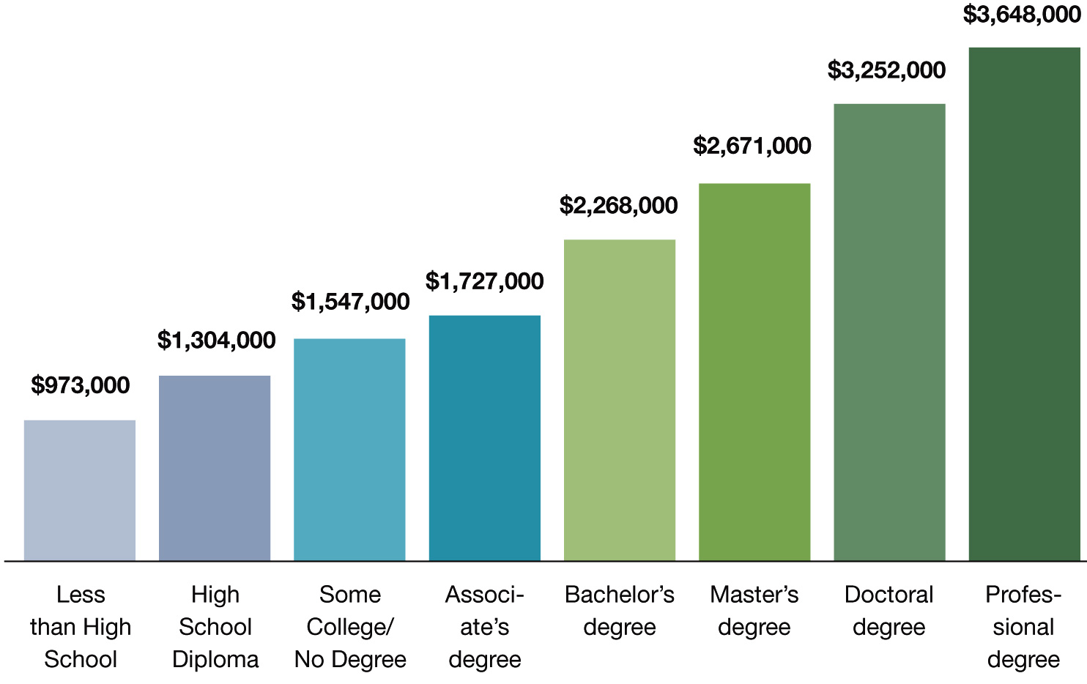
Degree Level Matters
People with more education make more money than those with less education
Notes:
This chart shows that, on average, people earn more over their lifetime if they have a higher level of education.
There’s no surprise here. But the reason I include this chart is to remind you that this chart shows people who are currently employed.
What does this say to our youth who will be employed three to ten years from now? Will the chart look different for them?
What if lifetime education costs and student loan interest is figured in? Does that narrow the gap?
What about the cost of business attire, business social expenses, club memberships, and other expenses that might be different at different levels of employment?
What if all of that is figured in?
What about a lifestyle choice?
What does this chart tell our youth about their future?
====
http://cew.georgetown.edu/collegepayoff/
http://www9.georgetown.edu/grad/gppi/hpi/cew/pdfs/collegepayoff-summary.pdf
Page 4, 5
6

Slide 7
Average Starting Salaries for 2009 College Graduates in FL
$47,708 Associate in Science (community college)
$44,558 Bachelor degree (private college)
$39,108 Certificate (community college)
$36,552 Bachelor degree (state college)
Miami Herald - Jan 1, 2011
Notes:
This study in Florida looked at the actual starting salaries of college graduates. What they discovered was that the community college graduates earned more money than the folks who earned a Bachelor’s degree.
The stark reality is that there is a high demand for jobs for which you prepare by attending community college. And those jobs being in high demand, often command surprisingly high salaries.
I assume that many of the bachelor-degree graduates in this study could not find a job in their field and settled for much less.
Compare this slide with the previous slide, and you can see that the data can be very confusing. The previous slide tells were we were for past graduates, this slide shows were we are now for our current graduates.
I’m about to show you where we will be in the future, -- which is when our state’s youth will be employed.
But first, -- let’s look at a few more states.
====
http://www.miamiherald.com/2011/01/01/1996875/study-less-earn-more-at-least.html#ixzz1BP94m3Nj
http://www.miamiherald.com/2011/01/01/1996875/study-less-earn-more-at-least.html
7

Slide 8
Average Starting Salaries for 2005 College Graduates in OH
$35,648 Associate degree
$33,218 Bachelor degree
Notes:
Ohio found similar results when they polled their college graduates.
Associate degree pays more then bachelor degree.
I’m not down on Bachelor degrees,
it’s just that associate degrees have been the Rodney Dangerfield of the education world.
It’s time they get the respect they deserve.
====
http://www.ohiocommunitycolleges.org/public-page.php?s=community-college-facts
8

Slide 9
Average Salaries
TN CC earn $1,300 higher than 4-year grads.
VA CC - occupational and technical degree programs earn $2,500 more than bachelor's.
Notes:
Recent Tennessee Community College graduates earn more than the graduates of the state's four-year institutions.
Similar for Virginia.
I have seen data for several more states that all show that the folks earning a two-year technical degree, on average, start out making more money than the folks with a four-year degree.
Unfortunately, I can not find the data for North Carolina.
============
http://money.cnn.com/2013/02/26/pf/college/community-college-earnings/index.html
9

Slide 10
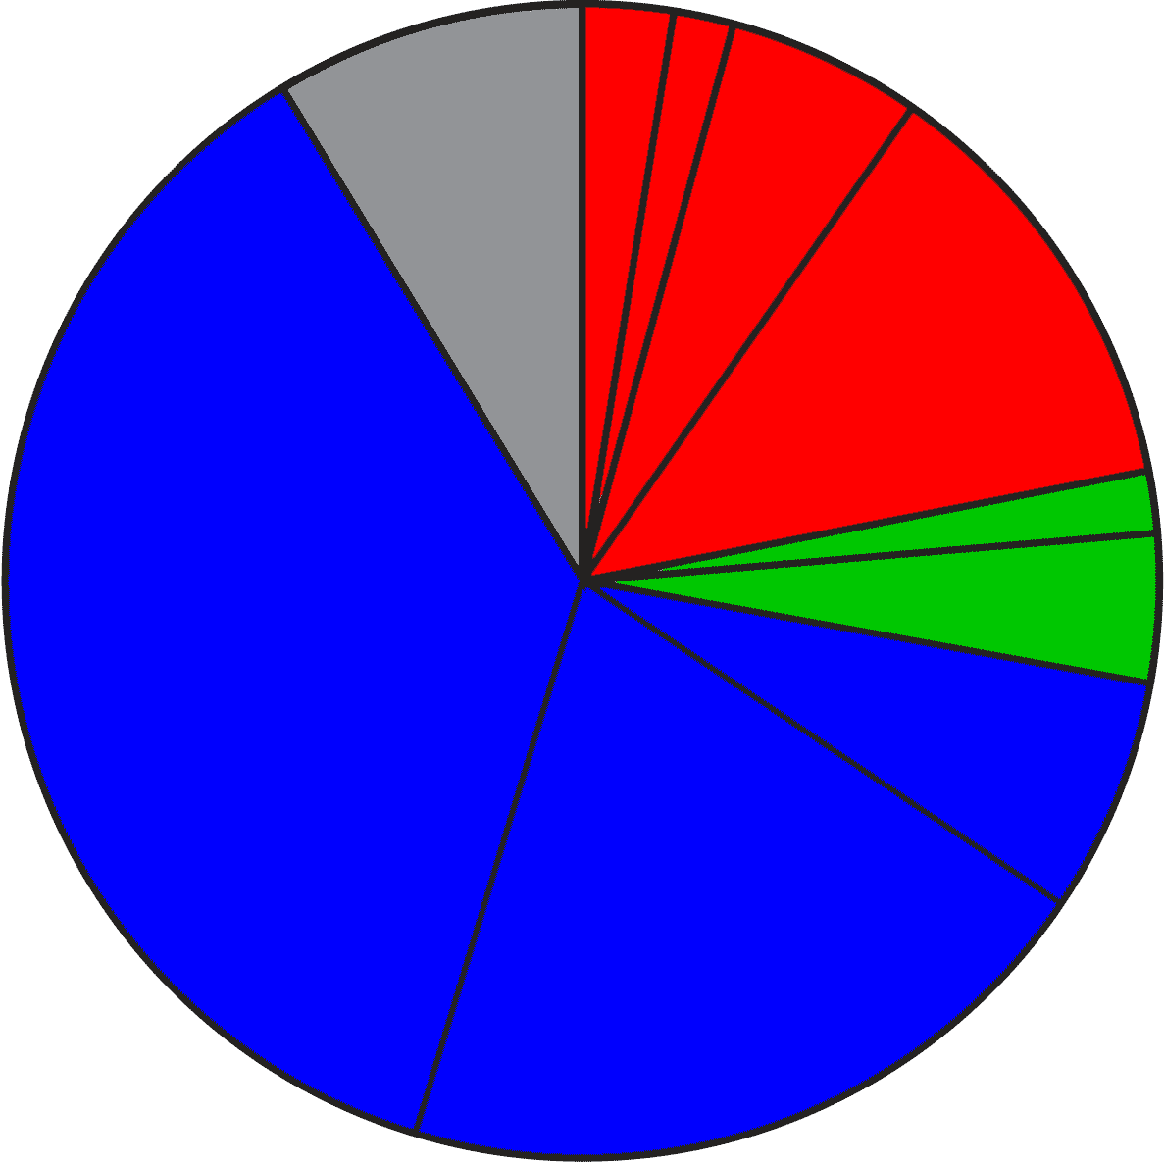
2020 Projected NC Employment: Education Required for All Jobs
Doctorate & Professional degree
work exp.
Master’s degree
8.7%
Bachelor + work exp.
5.5%
Bachelor’s degree
12.3%
1.7%
Associate degree
4.2%
36.6%
1,2 year college
short OJT
6.6%
long OJT
20.2%
moderate OJT
Notes:
Who likes pie?
Here you see the breakdown of the minimum education required -- for all jobs projected in North Carolina – for the year 2020.
The red jobs require four or more years of college.
Green jobs require one or two years of college.
You will notice that the largest portion, in blue, are the jobs that do not require any education past high school in order to get the job. They do require various amounts of On The Job Training.
The 8.7 percent in the gray slice of the pie requires previous work experience. Think of this as the worker who rises up to become the shop foreman or a manager.
====
NC Employment Security Commission data via www.CareerOutlook.US
http://careeroutlook.us/
These are for all jobs that get a paycheck, not for contracted positions, or small business owners who do not write themselves a paycheck.
NC Projections for 2020
2.54% Doctoral or professional degree
1.68% Master's Degree
5.47% Bachelor's Degree plus work experience
12.25% Bachelor's Degree
1.74% Associate Degree
4.17% One/two years of college
6.59% Long-term on-the-job (OJT) training
20.24% Moderate-term on-the-job (OJT) training
36.6% Short-term on-the-job (OJT) training
8.72% Work experience in a related occupation

Slide 11
2015 NC High School Graduate Intentions
Other
Employment
9.7%
Military
Trade and
Business
Schools
4.6%
Public Senior
Institutions
34.4%
Private
Junior
Colleges
37.2%
Community and
Technical Colleges
10.4%
Private Senior
Institutions
Notes:
And here you see the breakdown of the postsecondary intentions of our North Carolina high school graduates this past year.
The red shows that almost half of them say they are going to a four-year college program.
The green is one or two years at a community college, junior college, or trade school.
The blue is joining the military or going directly into employment.
The small Other category at the top of the pie -- is the one-point-nine percent of our graduates who plan to sit on Mom’s couch the rest of their lives playing Nintendo.
====
http://apps.schools.nc.gov/pls/apex/f?p=1:17:0::NO:::
NCDPI Statistical Profile: Table 12.1 High School Graduates Intentions
Of the 98,846 graduates in the class of 2015, here is where they say they are going after high school.
34.4% Public Senior Institutions
10.4% Private Senior Institutions
37.2% Community/Technical College
0.5% Private Junior College
1.2% Trade/Business School
4.6% Military
9.7% Employment
1.9% Other

Slide 12
Postsecondary Intentions vs. Reality
Graduate Intentions
Education Required
8.7%
OJT
4 year
14.3%
21.9%
4 year
5.9%
44.8%
1-2 year
1-2 year
OJT
38.9%
63.4%
Notes:
Here we can compare these two charts.
On the left is where the students say they are going, and on the right is what kind of education the jobs require.
→almost 45 percent of our students say they are going to a four-year college program, which will prepare them for 22 percent of the job openings. Do you see that in the red part of the two charts?
If you do the math, it looks like half of them will be left holding a sheepskin with no job to show for it.
And remember, this shows all jobs, even those already filled by someone.
→In green you see that almost 40 percent of our high school graduates say they are going to a one- or two-year program at a community college or private training facility.
This prepares them for almost 6 percent of the jobs.
Whether you use old math or new math, you still see that there is some disparity between the number of people going into a postsecondary education program and the number of jobs that will demand that kind of education.
→Though the blue on the right shows that 63 percent of the jobs do not require postsecondary education (that means that you can get any of those jobs right out of high school), -- there are community college and technical school programs for most of these jobs, -- which means that the education is not required, -- but in these days of high unemployment, the postsecondary education is preferred, -- and you will be more likely to get hired, and might start at a higher salary.
=============

Slide 13
Associate Degree Required (2011 NC Starting Salaries – 2018 High Demand)
$62,210 Construction Managers
$51,360 Dental Hygienists
$46,040 Registered Nurses
$42,350 Respiratory Therapists
$40,690 Radiologic Technologists and Technicians
$40,420 Physical Therapist Assistants
$28,030 Paralegals and Legal Assistants
$26,840 Medical and Clinical Laboratory Technicians
$19,810 Veterinary Technologists and Technicians
$17,400 Preschool Teachers, except Special Education
Notes:
Here are High Demand jobs in North Carolina that require a 2-year associate degree.
Getting your foot in the door with one of these entry-level jobs can lead to other jobs. Some employers may even pay for the college education you need to advance.
I’ve underlined the word Manager to remind you that this occupation requires previous work in the industry as well as the associate degree, so that is one reason why the starting salary is higher then many of the others.
Look at all of the health professionals!
All of the jobs on this list can relate to the Healthcare industry, which weathered the recession quite well.
Go to college for two years and start making some good money.
Many people are convinced that community college graduates don’t make good salaries.
That just is not so.
Times have changed.
===============
www.CareerOutlook.us based on NC Employment Security Commission data
High Demand is above the Mean of all Average Total Annual Openings, which for 2008-2018 is above 60 openings per year.

Slide 14
Bachelor Degree Required (2011 NC Starting Salaries - 2018 High Demand)
$86,820 Computer and Information Systems Managers
$72,800 Financial Managers
$71,430 Software Developers, Systems Software
$63,180 Medical and Health Services Managers
$61,140 Software Developers, Applications
$54,740 Sales Managers
$54,430 Computer Systems Analysts
$49,890 Financial Analysts
$49,270 Network and Computer Systems Administrators
$47,950 Management Analysts
$46,380 Civil Engineers
$43,880 Accountants and Auditors
$43,360 Securities, Commodities, and Financial Services Sales Agents
$40,950 Financial Specialists, All Other
$40,830 Environmental Scientists and Specialists, Including Health
$40,790 Compensation, Benefits, and Job Analysis Specialists
$39,040 Sales Representatives, Wholesale and Manufacturing, Technical and Scientific Products
$38,140 Training and Development Specialists
$38,040 Compliance Officers
$37,160 Cost Estimators
$36,990 Market Research Analysts and Marketing Specialists
$36,230 Personal Financial Advisors
$35,500 Public Relations Specialists
$34,770 Secondary School Teachers, Except Special and Career/Technical Education
$34,060 Special Education Teachers, Preschool, Kindergarten, and Elementary School
$33,750 Elementary School Teachers, Except Special Education
$33,710 Middle School Teachers, Except Special and Career/Technical Education
$33,630 Kindergarten Teachers, Except Special Education
$33,380 Mental Health and Substance Abuse Social Workers
$32,890 Child, Family, and School Social Workers
$32,160 Adult Basic and Secondary Education and Literacy Teachers and Instructors
$28,300 Clergy
$28,100 Graphic Designers
$16,890 Recreation Workers
Notes:
Here we are looking at the high demand jobs in North Carolina that require a bachelor degree, starting with the highest starting salaries.
Below the bottom of the page, down near the floor, are the school teachers in the low 30 thousands.
Here again the underlined occupations are in management, which means that not only does the job require a bachelor degree, but also requires some years of work experience in that field. These are not jobs that you get four years out of high school.
Unfortunately, more schooling does not always mean more money.
A Dental Hygienist with only two years of college, makes more money the first year than many of these jobs that require a 4-year degree.
Considering the student loans to pay back, who will be able to afford that fancy sports car the soonest?
-- Don’t think that more education always means higher income.
=============
www.CareerOutlook.us based on NC Employment Security Commission data
High Demand is above the Mean of all Average Total Annual Openings, which for 2008-2018 is above 60 openings per year.

Slide 15
Postsecondary Enrollment
Fall 2008 – 19.6 million graduate, undergraduate, and first-professional students
62% enrolled in 4-year institutions
36% enrolled in 2-year institutions
2% enrolled in less-than-2-year institutions
Notes:
15
These data show that almost twice as many folks are going to a four-year college than a two-year college.
But what I have been showing you on the last few slides seems to indicate that many of the four-year graduates will be left holding a sheepskin, -- but no job.
======
National Center for Education statistics, U.S. Department of Education (nces.ed.gov)
“Enrollment in Postsecondary Institutions, Fall 2008; Graduation Rates, 2002 & 2005 Cohorts; and Financial Statistics, Fiscal Year 2008”
http://nces.ed.gov/pubs2010/2010152rev.pdf

Slide 16
57.2% of bachelor’s-seeking students get degree in 6 years (36.4% in 4 years)
31.4% of degree or certificate-seeking students at 2-year institution get degree in 3 years (18.9% in 2 years)
Notes:
16
And Too many folks go to college and never complete their degree.
→Almost half of the folks that start a four-year college program will drop out -- or take a lot longer than 4 years.
These are our national statistics.
→Similarly, less than a third of the folks who start a certificate or associate degree complete their certificate or degree in three years.
======
http://www.usnews.com/usnews/news/articles/051128/28bowen.htm
National Center for Education statistics, U.S. Department of Education (nces.ed.gov)
“Enrollment in Postsecondary Institutions, Fall 2008; Graduation Rates, 2002 & 2005 Cohorts; and Financial Statistics, Fiscal Year 2008”
http://nces.ed.gov/pubs2010/2010152rev.pdf
----
GRS=150 percent of normal completion time
GR200=200 percent of normal completion time
The 2009 Graduation Rates (GRS) component collected counts of full-time, first-time10 degree/certificate-seeking undergraduate students beginning college in the reference period, and their completion status as of August 31, 2008 (150 percent of normal program completion time) at the same institution where the students started. Four-year institutions use cohort year 2002 as the reference period, while less-than-4-year institutions use cohort year 2005 as the reference period. For 4-year institutions operating on standard academic terms (semester, trimester, quarter), students beginning in cohort year 2002 are those that first attended college in the fall of the 2002-03 academic year. For 4-year institutions operating on other than standard academic terms, students beginning in cohort year 2002 are those that first attended college between September 1, 2002 and August 31, 2003. Similarly, for less-than-4-year institutions operating on standard academic terms (semester, trimester, quarter), students beginning in cohort year 2005 are those that first attended college in the fall of the 2005-06 academic year. For less-than-4-year institutions operating on other than standard academic terms, students beginning in cohort year 2005 are those that first attended college between September 1, 2005 and August 31, 2006. The GRS component was required of all Title IV institutions that had full-time, first-time degree/certificate-seeking undergraduate students in the reference period. For this collection, 6,009 institutions in the United States and other jurisdictions were required to respond; of these, 5,989, or 99.7 percent, responded. Of the institutions in the United States (excluding any other jurisdictions), 5,865 were required to complete this component and 5,845, or 99.7 percent, responded.

Slide 17
North Carolina 6-year Graduation Rate – 2008
57.6% average
Notes:
17
Here’s a chart that shows the graduation rate for all of the four-year colleges in North Carolina
Almost half of the students that we send to a four-year college program in North Carolina will drop out or take longer than 6 years to complete.
This chart shows the percentage of students who start a four-year degree and complete it within 6 years.
Duke’s graduation rate, on the far left, is very high, but they are also very picky about who they let in.
One drawback to this data is that it is showing how many start a four-year program and complete it in six years at the same institution.
Some of the smaller, private colleges have low graduation rates because students might start there, and then transfer to a larger state university.
This counts as a negative where the student started, and does not count at all where the student completed their degree.
Anytime you look at data, you have to take time to truly understand it, -- so you don’t jump to the wrong conclusion.
The main point I want to make here is that when we send someone to a four-year college, we need to make sure they are really ready for the work -- and are in the right education program for their career pathway.
====
www.collegeresults.org
Average 57.6% for all NC undergraduates listed

Slide 18
It makes you think?
What happens to our 4-year program dropouts?
25% of all students in Community College have a 4-year degree.
Notes:
18
What happens to our college dropouts? Do they come back to high school -- or their youth services provider and say “That didn’t work out. What should I try next?”
Probably not.
→Many university graduates are going to community colleges to get the specific training they need for a job.
I’m not saying that four-year degrees are not important… But for career purposes, (especially entry-level) it may not always be the best choice.
Our state’s largest Community College claims to be the largest graduate school in North Carolina based on the number of students they have who already have a four-year degree.
It’s important to tell the youth about life-long learning. Gone are the days where the first part of your life was learning and the rest of your life is doing.
Now the learning and doing go together -- forever.

Slide 19
The Condition of College & Career Readiness 2015
59% of the 2015 national HS graduating class took the ACT
86% of 2015 ACT-tested graduates aspired to postsecondary education
31% of the ACT-tested graduates are not meeting any of the ACT Benchmarks
40% of the ACT-tested graduates met 3 or 4 of the ACT Benchmarks
Notes:
The ACT test measures College Readiness with a series of four benchmarks in English, Reading, Math, and Science.
→Nationwide, 59 percent of the high school graduates have taken the ACT, and 86 percent of the folks tested say they are going on to college.
→ACT research has shown those students meeting three or four of the ACT College Readiness Benchmarks are likely to be successful in postsecondary education.
Nationwide, this means that the 40% of the test takers who met three or four ACT College Readiness Benchmarks have a strong likelihood of experiencing success in college.
What they are saying is that 24 percent of our high school graduates are college ready.
And an alarming 76 percent of our high school graduates are not ready for college, even community college.
=======
http://www.act.org/research/policymakers/cccr15/
The Condition of College & Career Readiness 2015

Slide 20
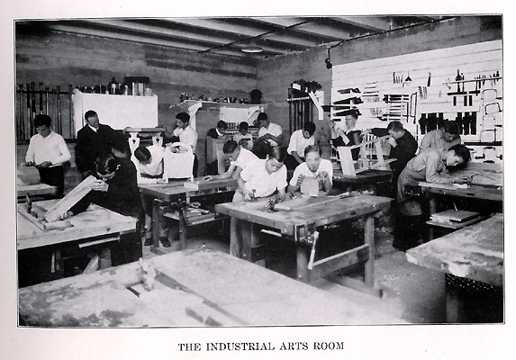
Notes:
I’m certified to teach Industrial Arts Education.
How many of you took Industrial Arts, or Shop class while in high school?
Unfortunately, some of our high schools are still teaching classes that look like this.
Some because a lack of funds to modernize,
Some because the same teacher is still there after 30 years.
=====
http://www.rootsweb.ancestry.com/~innwigs/ImageArchive/LibertyTownship/LibertyTwpPorterCoIndiana-LibertyCenterHighSchool-IndustrialArtsRoom-1931-SS.jpg

Slide 21
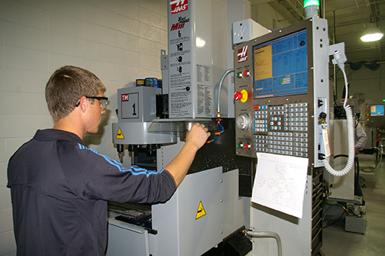
Notes:
But our modern shop classes should look like this. And many of them do.
We’ve had to modernize to keep up with business and industry.
====
http://www.caboces.org/sites/default/files/images/John%20Gethicker/AMPBabb8744LR.jpg

Slide 22
Notes:
Why would a school counselor allow a young lady to take a manufacturing class knowing that she could end up with a job like this?
Compare the cleanliness of the work environment in this OLD picture with …
====
https://dwd.wisconsin.gov/dwd/dwdhistory/images/women_in_factory_big.jpg

Slide 23
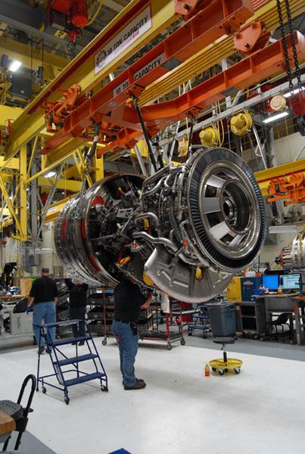
Notes:
…this one, where they are building jet engines in Durham, North Carolina.
You could eat off of that floor!
====
http://www.bizjournals.com/triangle/news/2012/08/03/slideshow-a-look-at-ge-aviations.html?ana=e_du_pap&s=article_du&ed=2012-08-03
Slideshow: A look at General Electric Aviation engine plant
The Durham plant, just off Miami Boulevard, is beginning to retool as the company triples its production of GEnx turbofan engines for Boeing Co.’s (NYSE: BA) new 787 Dreamliner. It has also recently expanded production of the giant GE90 engine and several lines of smaller engines, all of which are aimed at replacing older designs that are less fuel efficient.
photo shows:
A GE90 engine nears completion at the GE Aviation factory off South Miami Boulevard in Durham. The GE90 is used for large commercial aircraft such as the Boeing 777. More than 1,000 777s have been built over the years, incorporating a total of more than 2,000 engines from Boeing, Rolls-Royce and United Technologies' Pratt & Whitney division.

Slide 24
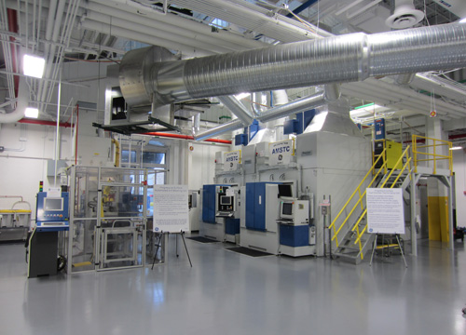
Notes:
The reality is that most educators, students, and their parents have no idea of what is happening in today’s factories -- or many other occupations as well.
Name one TV show that shows employees working in a modern factory.
How can students, teachers, and everyone else learn about modern industry?
Field trips, job shadowing, internships, open houses?
=====
http://files.gereports.com/wp-content/uploads/2012/04/AMSTC3.jpg

Slide 25
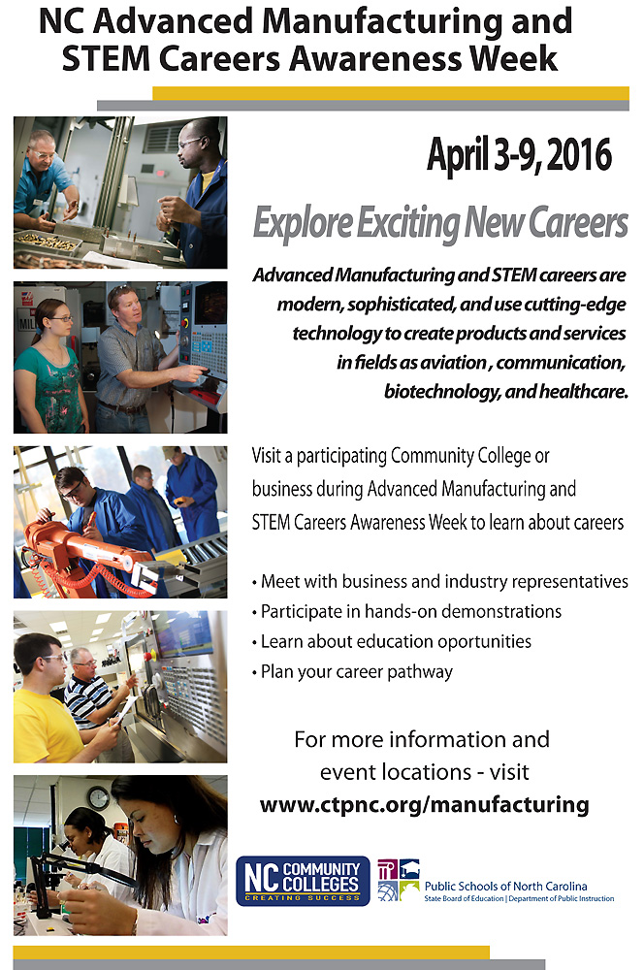
ctpnc.org
Notes:
Here are approximately 60 open houses all across the state in April helping people learn about the modern careers in Advanced Manufacturing and other STEM careers.
North Carolina Advanced Manufacturing and STEM Careers Awareness Week is a joint venture between North Carolina Public Schools, the Community College System, and the Department of Commerce.
Make sure that the youth of this state know about these open houses.
These events are not just for high school students, they are for college students and even adults who are still refining their career pathway.
This handout is available with the PowerPoint you are viewing.
Download all of this at
C T P N C dot ORG.
Again that’s C T P N C dot ORG.
======
www.ctpnc.org/manufacturing

Slide 26
We are currently preparing people for jobs that don’t yet exist …
Notes:
You may have seen this quote that is spread across the next three slides.
It profoundly reminds us that we are preparing people for jobs that don’t yet exist…

Slide 27
… using technologies that haven’t yet been invented …
Notes:
… Using technologies that have not yet been invented …

Slide 28
… in order to solve problems we don’t even know are problems yet.
Notes:
… In order to solve the problems -- that we do not yet know are problems.
How do we enable the next generation with the knowledge and tools they will need to do this?

Slide 29
Who predicted these?
Cell phones for everyone
iPads, Kindles
Smart phones
iPod - portable music and videos
Hand-held GPS
Text messaging
Blogs, Twitter
MySpace, FaceBook
Wikipedia, YouTube
Pinterest
Google Plus
Tumblr
Instagram
SUVs
Self driving cars
Electric cars
Wearable Tech - Fitbits
Cloud computing
“Reality” TV
3D printing
Webinars like this one !!
Notes:
Think back 20 years ago.
Would you have predicted any of these?
What’s next?
How soon will these become obsolete? Yes, these will all be obsolete someday soon!

Slide 30
Old technologies making a comeback
Vegetable powered-Diesel engines
Electric cars
Wind power
Rain barrels
Recycling building materials
Biofuel (Moonshine)
Notes:
Some of the latest trends are actually old technologies making a comeback.
Over 100 years ago. When Rudolph Diesel first demonstrated his diesel engine, he powered it with peanut oil.
Then along came this cheap stuff called petroleum that even Jed Clampett didn't want at first, and Rudolph Diesel quickly switched over to the newly created Diesel fuel, because it was so cheap to make.
Now people are paying McDonalds to let them take away their waste cooking oil, so they can use it to fuel their Diesel-powered vehicle.
And Electric cars? Invented almost 200 years ago. Electric cars were popular until the early 1900s when gasoline-powered engines took over, because gasoline was very cheap.
And the Biofuels Center of North Carolina is helping people build government-approved stills to create legal moonshine that we can burn in our cars.
(And for those of you who don’t know, stock car racing was invented in North Carolina by the folks with the fastest cars who transported moonshine around the state.)
Yes, some old technologies are coming back around again.

Slide 31
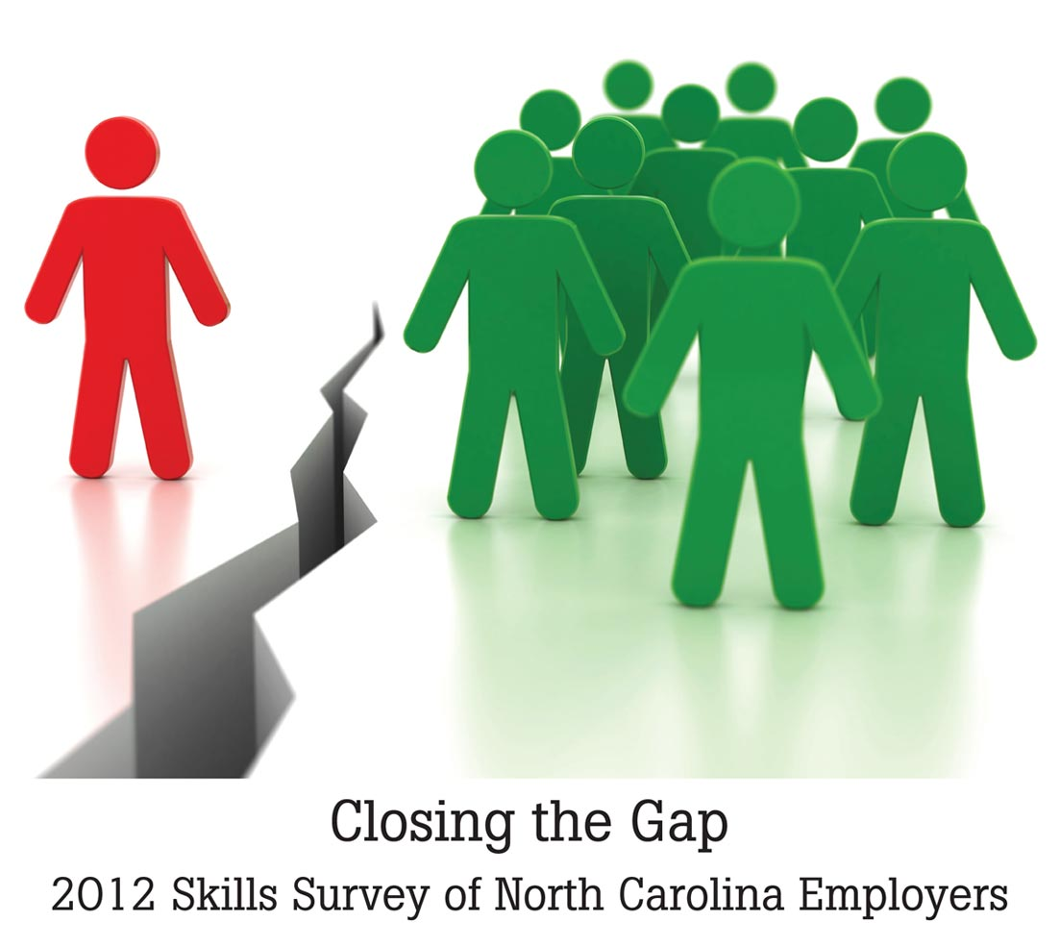
Notes:
The North Carolina Association of Workforce Development Boards surveyed employers in all of our 100 counties.
=======
Survey Conducted by North Carolina Business Services Representatives representing the Workforce Development Boards of North Carolina
They surveyed employers in all 100 counties.
Skills Survey
http://www.agreatworkforce.com/newsstory.cfm?NewsID=13
news article, news video
http://triangle.news14.com/content/top_stories/652523/survey-shows-n-c--workforce-skills-lacking

Slide 32
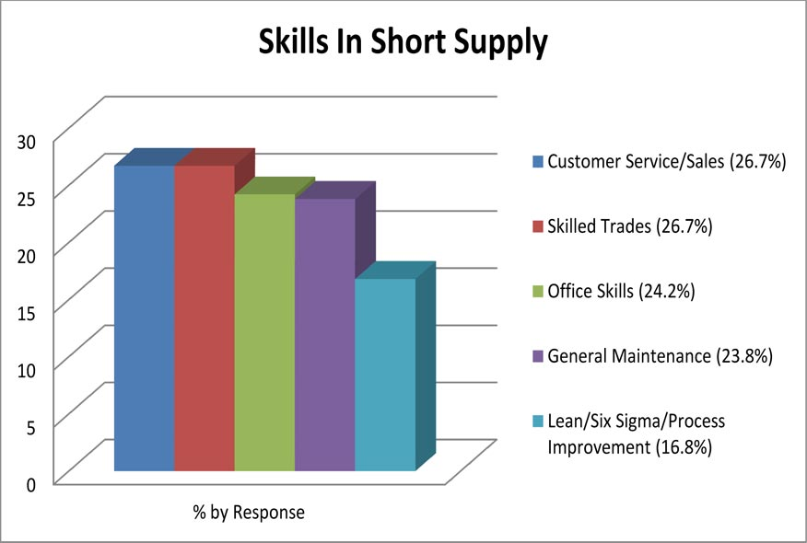
xx
Notes:
Here is what the employers say are the skills lacking in their new recruits.
Where do people go to learn these skills for which employers are looking?
We are fortunate in North Carolina to have a great community college system where these skills are taught.
=======
Skills Survey
http://www.agreatworkforce.com/newsstory.cfm?NewsID=13
news article, news video
http://triangle.news14.com/content/top_stories/652523/survey-shows-n-c--workforce-skills-lacking

Slide 33
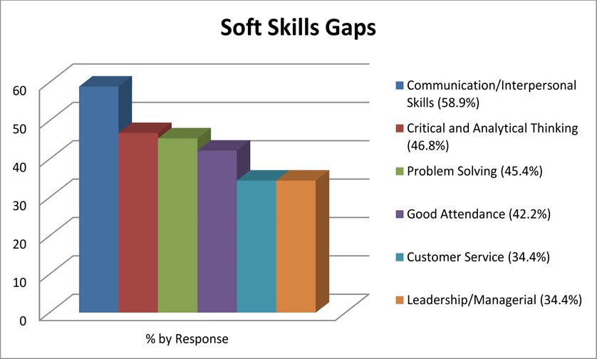
xx
Notes:
And as far as soft skills go – the new recruits don’t seem to know how to communicate.
An employer told me that when interviewing new recruits, he determines if this would be someone with whom he would like to have lunch.
His reasoning was that if you can’t hold up your end of a casual lunch conversation, then you probably can’t communicate on the job.
How do people learn these soft skills?
These skills are not easily taught in a class. They must be learned through personal experiences, interactions with other people.
This is where dinner table conversations are important. The family discussing what they did that day and what they planned to do the following day is a great way of learning communication skills necessary in the business environment.
Unfortunately, not enough families these days are sitting down to dinner and teaching these important skills to their children.
If we are not in a position to help the youth practice and learn these vital sills, we at least need to let them know that these are important skills to learn if they want to get and keep a job.
=======
Skills Survey
http://www.agreatworkforce.com/newsstory.cfm?NewsID=13
news article, news video
http://triangle.news14.com/content/top_stories/652523/survey-shows-n-c--workforce-skills-lacking

Slide 34
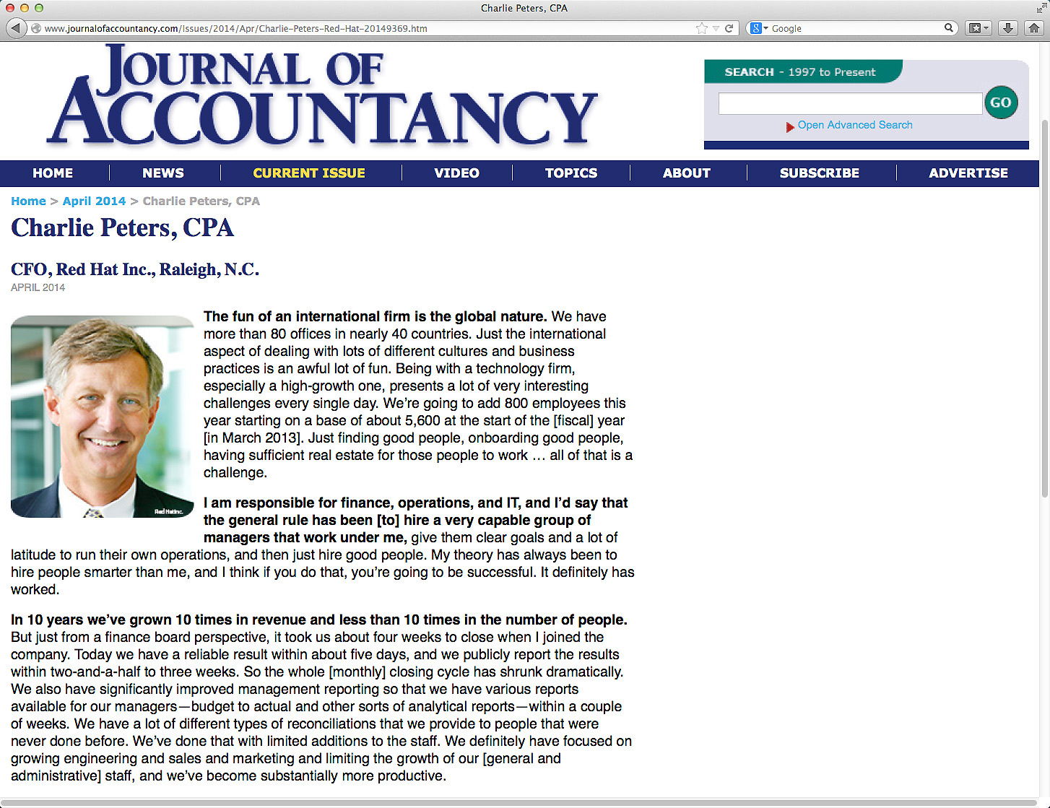
Notes:
Charlie Peters is the Chief Financial Officer at Red Hat. In this recent article he said that many people in technical fields lack good communication skills right out of school.
He says “It’s great to be a technician, but if you can’t deal with people, then it’s not going to help your career in the long run.”
How do we get job seekers to become better communicators. First, we need to become better communicators ourselves, and then get the job seekers to practice communicating.
==========
http://www.journalofaccountancy.com/Issues/2014/Apr/Charlie-Peters-Red-Hat-20149369.htm
Charlie Peters, CPACFO, Red Hat Inc., Raleigh, N.C.
April 2014
We hire a lot of the younger folks here. The thing that many people in technical professions seem to lack straight out of school is good communication skills, whether it is written communication skills, oral communication skills, [or] public speaking skills. These skills generally aren’t taught in accounting programs or business schools, and I think it’s an oversight. I would say, “Make sure you focus on some of those soft skills, even people skills.” It’s great to be a technician, but if you can’t deal with people, then it’s not going to help your career in the long run.

Slide 35
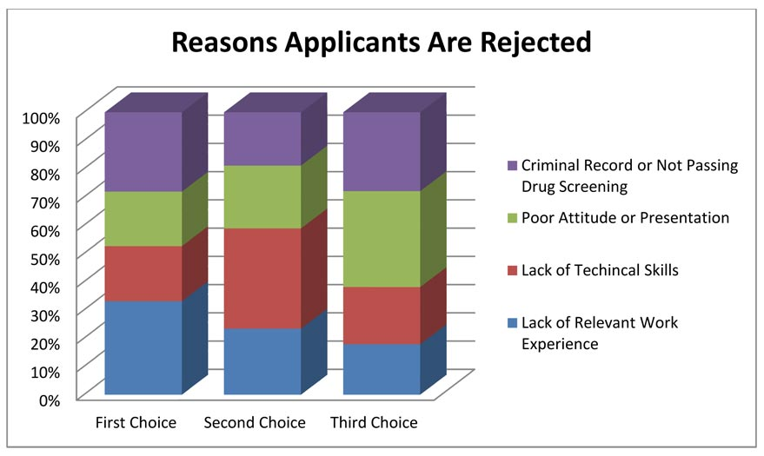
xx
Notes:
- Over forty-six percent of the business respondents indicated the primary reason for rejecting job applications was due to Lack of Relevant Work Experience.
High schools are promoting their work-based-learning programs like job shadowing and internships. Whatever it takes to get the kids in the workplace, applying what they learn in school.
Apprenticeship programs are gaining in this state.
- Lack of Technical Skills was indicated more frequently as a second choice at 46 percent.
People are applying for jobs without the prerequisite skills. Where can they go to get the skills they need to be hired?
- Businesses indicated a strong third choice at 44 percent as being Applicants with Poor Attitude or Presentation.
That means more practice standing in front of the classroom or other groups of people giving presentations. When I was in high school I hated presenting before the class, and I was not very good at it.
But through repeated attempts, and lots of constructive criticism, this shy introvert has become a decent public speaker. We have to create opportunities for our youth to practice communicating in front of other.
- Criminal record is an often overlooked item. A single drug conviction can lock you out of the entire healthcare industry, and that’s were most of the jobs are.
- Even the military is not recruiting anyone with a criminal background. I know several ex-offenders who are having a hard time finding employment. Our youth need to know that their actions now can radically alter the rest of their life.
- One thing you don’t see on this list is high school or college grade point average or class rank, because that is not important to the employers.
=======
Skills Survey
http://www.agreatworkforce.com/newsstory.cfm?NewsID=13
news article, news video
http://triangle.news14.com/content/top_stories/652523/survey-shows-n-c--workforce-skills-lacking

Slide 36
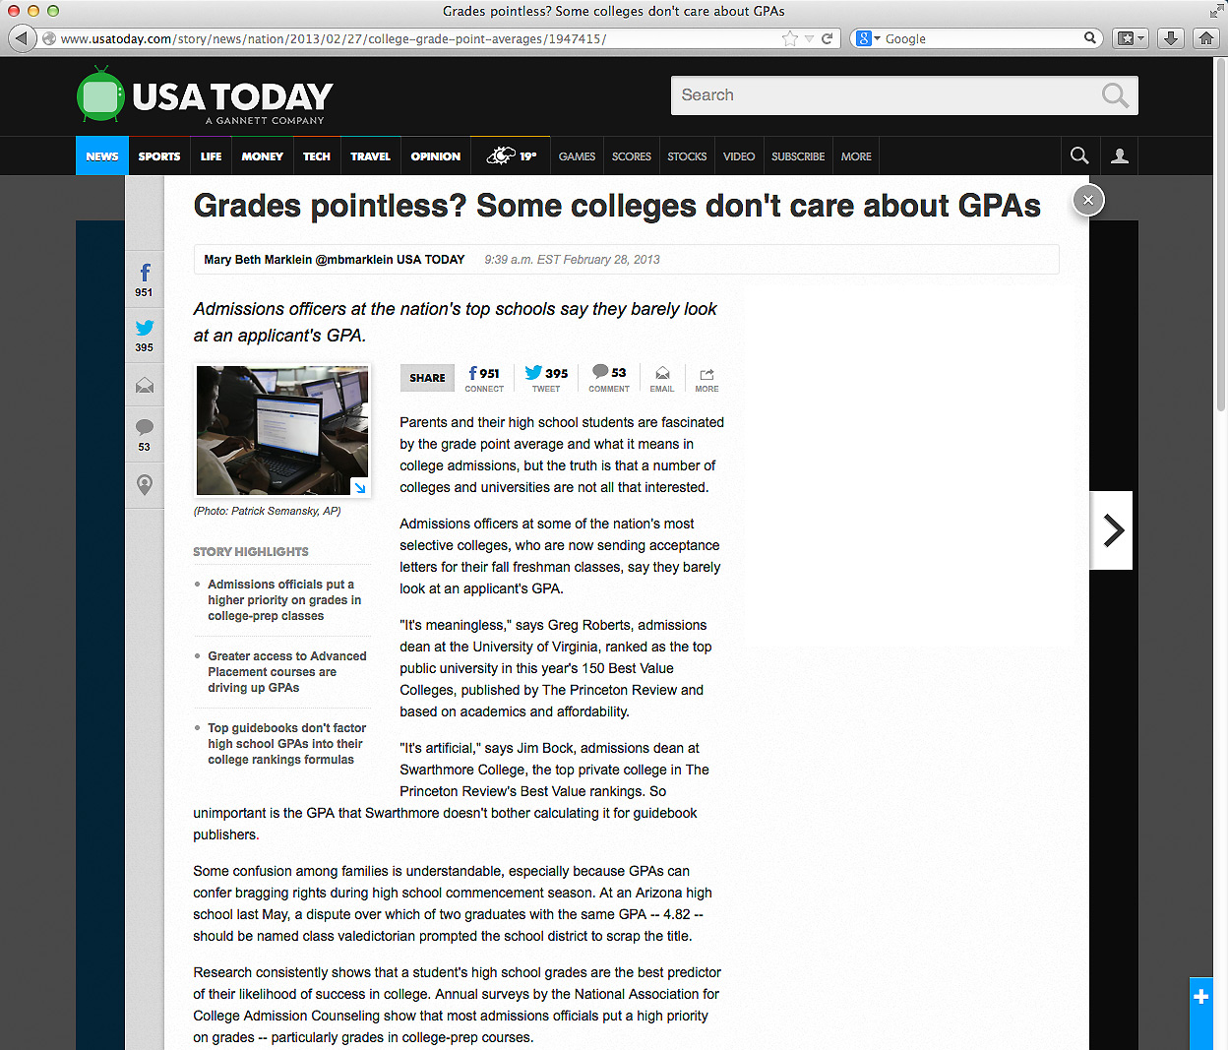
Notes:
We educators place a great emphasis on grades, class rank, and being valedictorian.
These create parental bragging rights for the parents, but what do they mean outside of high school and college?
Many colleges are saying that GPA, that’s grade point average, and high school grades are not important when deciding to accept a student.
======
http://www.usatoday.com/story/news/nation/2013/02/27/college-grade-point-averages/1947415/

Slide 37
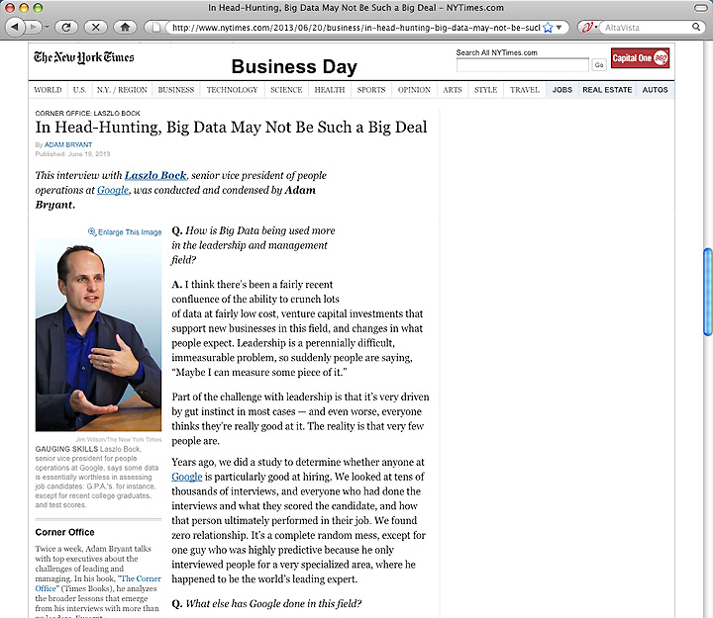
Notes:
Google has crunched the numbers and found that GPA is a worthless criteria for hiring. They compared the GPA of the new recruits -- with how well they were performing years later -- and found no correlation.
You can imaging how well this news goes over in our high schools and colleges where grades appear to be everything.
=======
http://www.nytimes.com/2013/06/20/business/in-head-hunting-big-data-may-not-be-such-a-big-deal.html?pagewanted=all&_r=1&
In Head-Hunting, Big Data May Not Be Such a Big Deal
June 19, 2013
One of the things we’ve seen from all our data crunching is that G.P.A.’s are worthless as a criteria for hiring, and test scores are worthless — no correlation at all except for brand-new college grads, where there’s a slight correlation. Google famously used to ask everyone for a transcript and G.P.A.’s and test scores, but we don’t anymore, unless you’re just a few years out of school. We found that they don’t predict anything.
What’s interesting is the proportion of people without any college education at Google has increased over time as well. So we have teams where you have 14 percent of the team made up of people who’ve never gone to college.
After two or three years, your ability to perform at Google is completely unrelated to how you performed when you were in school, because the skills you required in college are very different. You’re also fundamentally a different person. You learn and grow, you think about things differently.
Another reason is that I think academic environments are artificial environments. People who succeed there are sort of finely trained, they’re conditioned to succeed in that environment. One of my own frustrations when I was in college and grad school is that you knew the professor was looking for a specific answer. You could figure that out, but it’s much more interesting to solve problems where there isn’t an obvious answer. You want people who like figuring out stuff where there is no obvious answer.
===
Google no longer hires based on GPA or test scores
"One of the things we’ve seen from all our data crunching is that G.P.A.’s are worthless as a criteria for hiring, and test scores are worthless"
Google also said that "academic environments are artificial environments." Students are "conditioned to succeed in that environment ... looking for a specific answer." Google wants "people who like figuring out stuff where there is no obvious answer."
These problem-solving skills that Google and others are looking for can be taught in our CTE classes, but the learning can be hard to measure, which makes it tough to convice the administration that these skills need to be taught.
http://www.nytimes.com/2013/06/20/business/in-head-hunting-big-data-may-not-be-such-a-big-deal.html?pagewanted=all&_r=1&

Slide 38
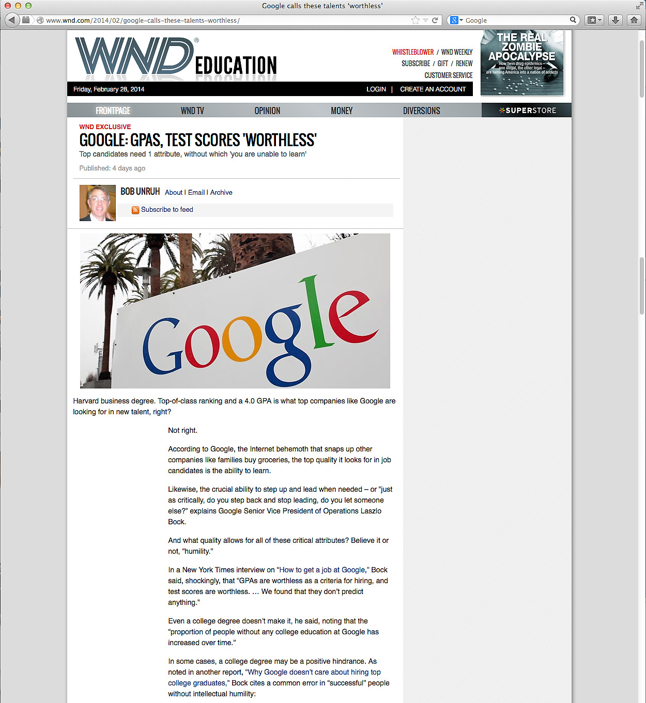
Notes:
Besides saying that GPAs are a worthless hiring criteria, Google says that test scores, and even college degree don’t matter much when hiring.
Google says the No. 1 thing they look for is general cognitive ability, and that’s not I.Q. It’s learning ability. It’s the ability to process on the fly. It’s the ability to pull together disparate bits of information and form a conclusion.
Businesses want people who can grab a bunch of data, quickly turn it into useful information, and use that information to solve a problem.
Google says the second thing they are looking for is leadership – --in particular, emergent leadership as opposed to traditional leadership. Traditional leadership is if you were president of the chess club? That’s not what they are looking for.
What they are looking for is: -- when faced with a problem, and you’re a member of a team, -- do you, -- at the appropriate time, -- step in and lead.
And just as critically, -- do you step back at the right time and stop leading, -- and let someone else lead?
An effective leader is willing to relinquish power at the right time.
How do people learn to take the leadership reigns when necessary -- and to relinquish when it’s time for someone else to lead?
Google also said that underlying these qualities are humility and ownership.
“It’s feeling the sense of responsibility, the sense of ownership, to step in,” to try to solve any problem – and the humility to step back and embrace the better ideas of others.
The end goal is group problem-solving. How do people learn that?
======
http://www.wnd.com/2014/02/google-calls-these-talents-worthless/

Slide 39
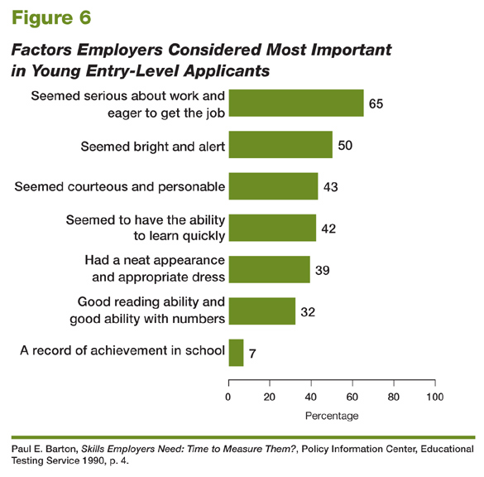
Educational Testing Service, 2006
Notes:
39
39
Even here you see student grades at the bottom of the list of factors considered when hiring. Only seven percent of these business respondents even mentioned it.
How did you learn that these are important?
Can we help our youth with these important employment factors?
====
High School Reform and Work: Facing Labor Market Realities
Written by Paul E. Barton, Educational Testing Service, 2006
http://www.ets.org/research/researcher/PIC-HSWORK.html

Slide 40
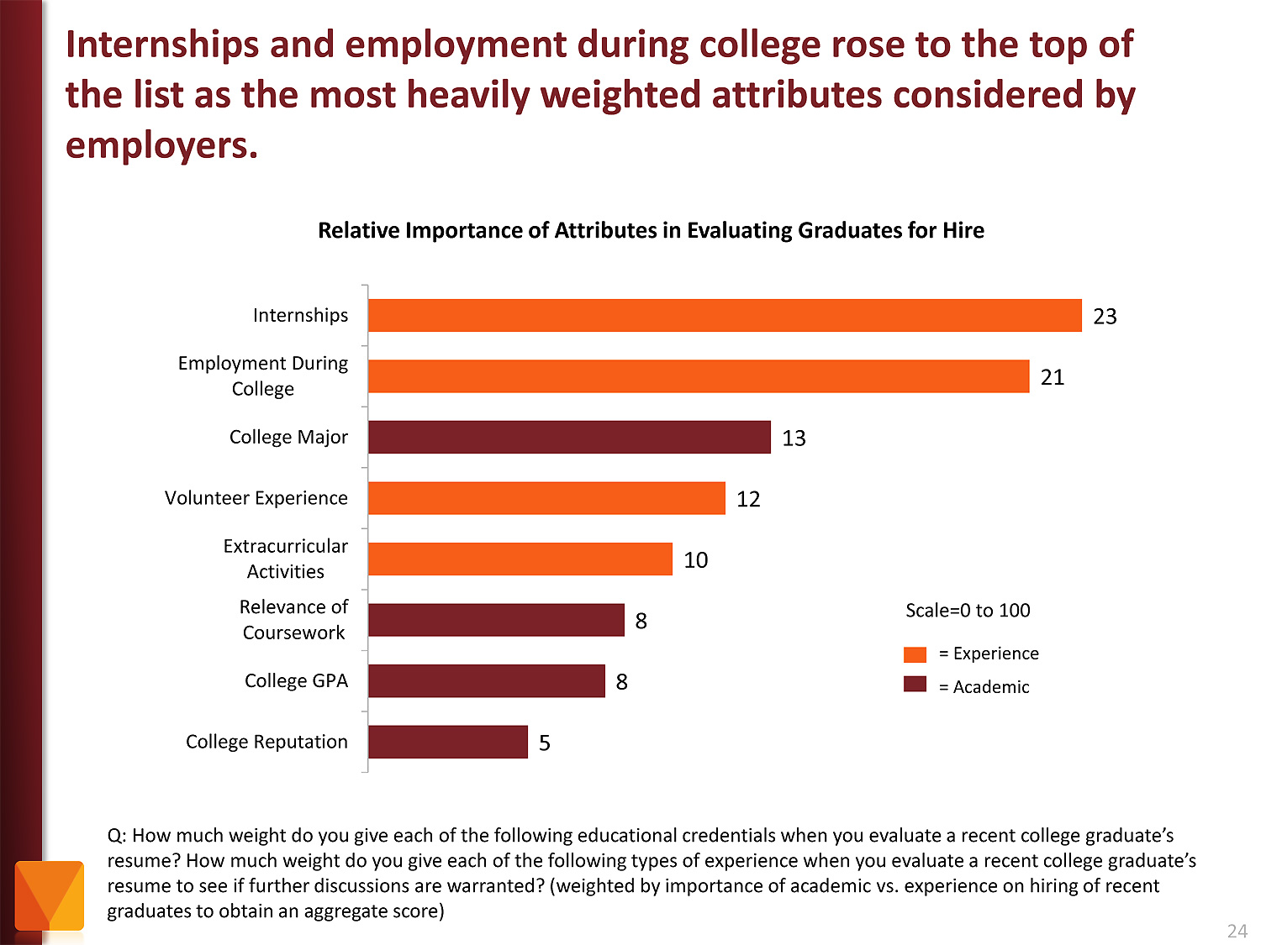
Notes:
Employers value Internships and other employment while in school as more important than college major and GPA.
Even volunteer work and extra-curricular activities are more important to the business community than grades.
Yet, -- most students are too focused on getting good grades -- and are missing out on the work experiences that really matter.
======
http://chronicle.com/article/The-Employment-Mismatch/137625/#id=overview
The Employment Mismatch: A College Degree Sorts Job Applicants, but Employers Wish It Meant More
Employers value a four-year college degree, many of them more than ever.
Yet half of those surveyed recently by The Chronicle and American Public Media's Marketplace said they had trouble finding recent graduates qualified to fill positions at their company or organization. Nearly a third gave colleges just fair to poor marks for producing successful employees. And they dinged bachelor's-degree holders for lacking basic workplace proficiencies, like adaptability, communication skills, and the ability to solve complex problems.
The report
The Role of Higher Education in Career Development: Employer Perceptions
http://chronicle.com/items/biz/pdf/Employers%20Survey.pdf

Slide 41
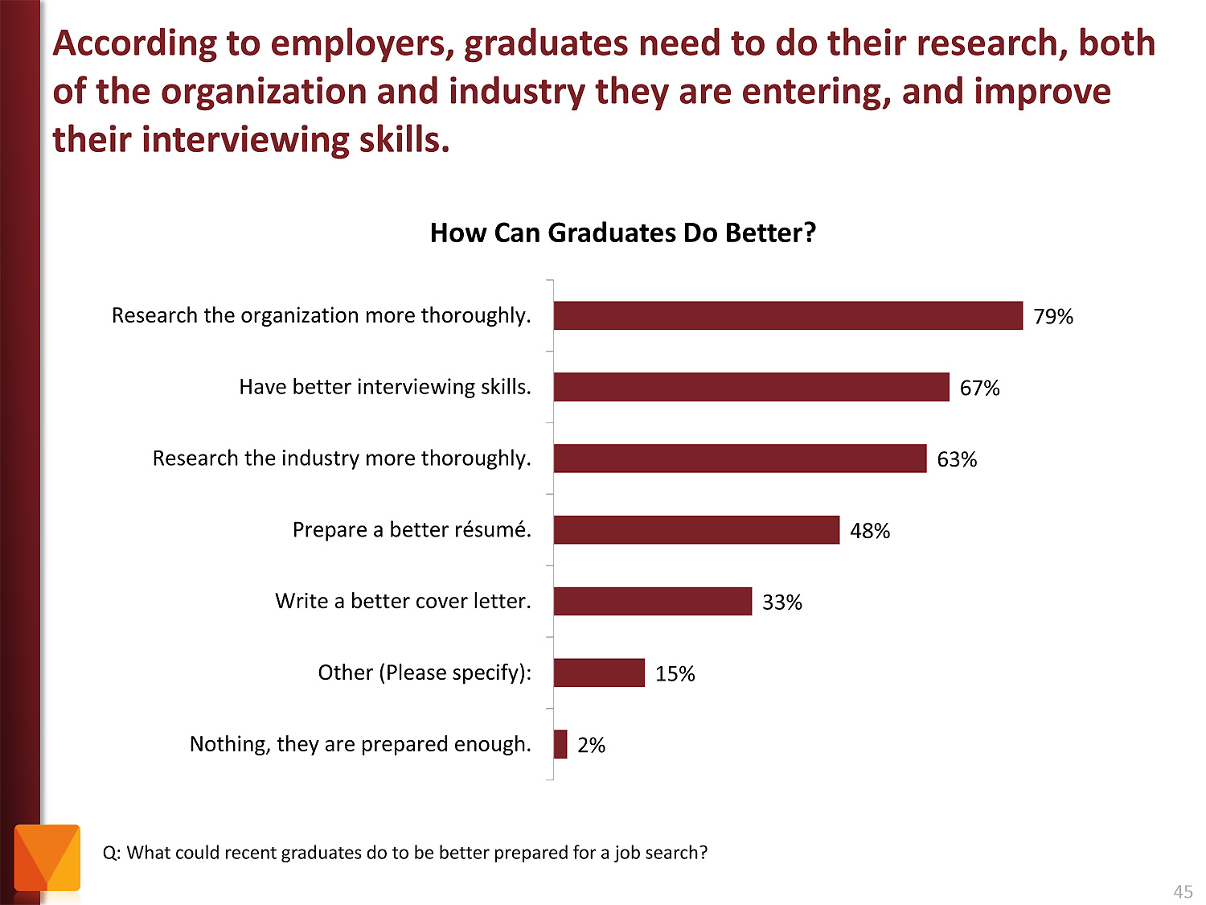
Notes:
Tell the kids to research the companies where they are applying for work. And learn about the interview process.
It just amazes me that folks would try to get a job at a company they know nothing about.
The focus of the job interview should be on what you can do for the company, not on how to get a paycheck.
======
http://chronicle.com/article/The-Employment-Mismatch/137625/#id=overview
The Employment Mismatch: A College Degree Sorts Job Applicants, but Employers Wish It Meant More
Employers value a four-year college degree, many of them more than ever.
Yet half of those surveyed recently by The Chronicle and American Public Media's Marketplace said they had trouble finding recent graduates qualified to fill positions at their company or organization. Nearly a third gave colleges just fair to poor marks for producing successful employees. And they dinged bachelor's-degree holders for lacking basic workplace proficiencies, like adaptability, communication skills, and the ability to solve complex problems.
The report
The Role of Higher Education in Career Development: Employer Perceptions
http://chronicle.com/items/biz/pdf/Employers%20Survey.pdf

Slide 42
Notes:
42
Here is a recent publication from the US Chamber of Commerce
===
http://icw.uschamber.com/publication/life-21st-century-workforce-national-perspective
Life in the 21st Century Workforce: A National Perspective
Posted September 27, 2011

Slide 43
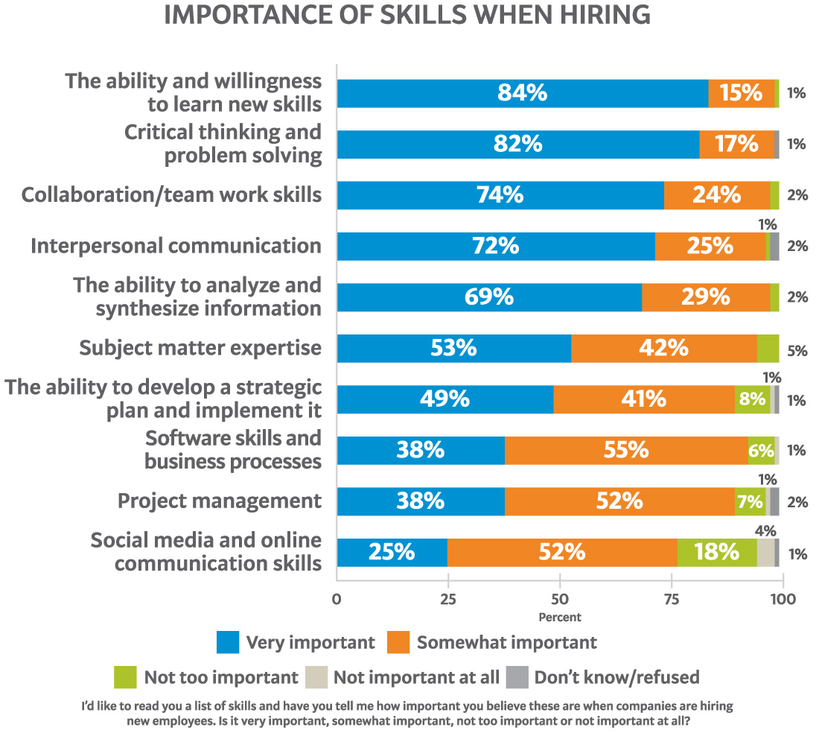
Notes:
43
Here is their list of skills that employers said were important when hiring their new recruits. Do you think our youth should know this information?
Where in our K-12 schools and colleges are we teaching these skills that the employers say are the most important when hiring new employees?
===
http://icw.uschamber.com/publication/life-21st-century-workforce-national-perspective
Life in the 21st Century Workforce: A National Perspective
Posted September 27, 2011

Slide 44
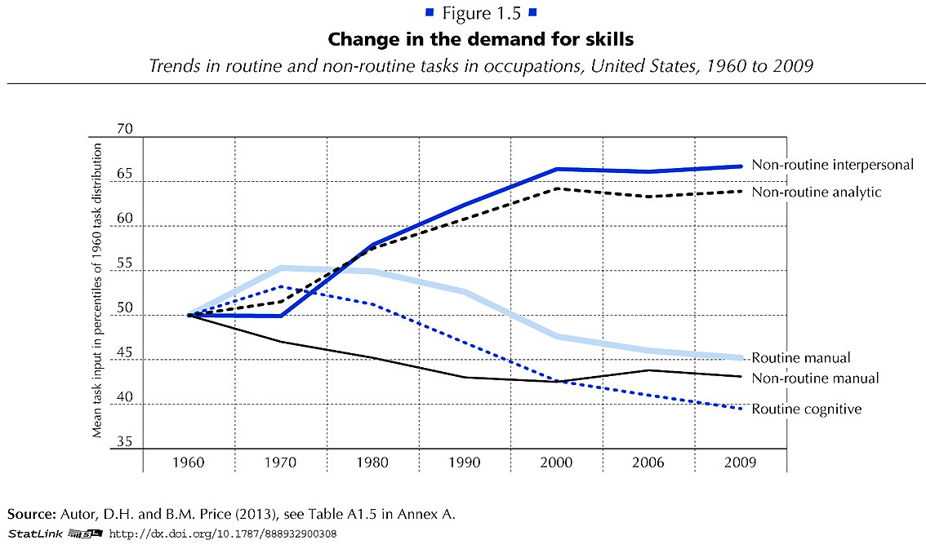
Notes:
Employers want employees that can do non-routine work. They want folks that can identify and solve new problems.
Gone are the jobs that required routine manual labor.
The computers and robots can take care of that.
===
http://www.oecd.org/site/piaac/
https://www.oecd.org/site/piaac/
-----
OECD Skills Outlook 2013
http://skills.oecd.org/skillsoutlook.html
First Results from the Survey of Adult Skills
OECD_Skills_Outlook_2013.pdf
Key Findings
SkillsOutlook_2013_KeyFindings.pdf
Summary
9789264204256-sum-en.pdf
-----
PIAAC Results Released
On Oct. 8, 2013, the Organization for Economic Cooperation and Development (OECD) released the results of the Program for International Assessment of Adult Competencies, (PIAAC). This direct assessment was conducted with nationally representative samples from 23 countries from adults ages 16 through 65. It is an international household survey to assess the cognitive and workplace skills needed for success in the 21st-century global economy. The results are designed to help public, private, educational, and philanthropic sectors work with a shared language and set of benchmarks to enhance cooperation around the development and implementation of economic, education, and social policies that strengthen adult skills. The survey is intended to be administered every 10 years, making this a baseline report to set benchmarks against which countries and sectors can measure their improvement efforts. Multiple reports, datasets, and several data tools were released with the results, including:
The OECD Skills Outlook 2013: First Results from the Survey of Adult Skills, a freely available book in PDF form;
a summary, Skilled for Life? Key Findings;
a brief U.S. report, Survey of Adult Skills, First Results: United States; and
a report from the U.S. Department of Education’s National Center for Educational Statistics, Literacy, Numeracy, and Problem Solving in Technology-Rich Environments Among U.S. Adults: Results from the Program for the International Assessment of Adult Competencies 2012: First Look, was published on Oct. 18, once the U.S. federal government was re-opened. This report highlights the U.S. performance in the international data and unique U.S. demographic characteristics.
On Nov. 12, 2013, the OECD-authored report, Time for the United States to Reskill? What the Survey of Adult Skills Says, will be released. This report was funded by OVAE to offer a more detailed profile of low-skilled adults in the U.S. It will also identify policy implications and offer broad policy recommendations for the U.S.
Links to all of these resources, as well as events and press coverage, may be found at www.piaacgateway.com.
This article relies heavily on data included in the NCES “First Look” report. Further analysis of the PIAAC data will appear in future issues of OVAE Connection.
The Survey
The PIAAC assessment focuses on the working-age adult population, and measures cognitive and workplace skills necessary for successful participation in the 21st century society and global economy. In the U.S., as in all of the countries participating, 5,000 individuals were surveyed to create a nationally representative dataset. An additional 5,000 people will be surveyed for a supplement that will be added to the data set in 2015.
Drawing from a rich background questionnaire, the PIAAC measures relationships among respondents’ educational background, parental educational attainment, work history and skills, occupational attainment, use of information and communications technology, and cognitive skills in the domains of literacy, numeracy, and problem solving in technology-rich environments.
Findings are presented in the First Look report as country averages, and tables are used to place countries’ performances above, at, or below the international average. Within each domain, performance is also reported as a percentage of the population that performs in five levels of proficiency: Below Level 1, Level 1, Level 2, Level 3, and combined Levels 4/5, Level descriptors can be found in the First Look report in Exhibit B-1 for literacy, B-3 for numeracy, and B-5 for problem-solving in a technology-rich environment. Performance below Level 2 is considered “weak” or “low.”
The assessment is unique in that it is the first international literacy survey that is both adaptive and administered on a laptop computer. Given as a household survey, respondents were allowed to choose whether to take the assessment on a laptop or with pencil and paper. In the U.S., nearly 80 percent of respondents completed the survey on the computer, which means that they passed an initial screening test on basic computer use and navigation.
The direct measure of cognitive and workplace skills in this study creates a much more nuanced perspective on skills than the more commonly reported measure of educational attainment. For example, the attainment category of “some college,” which appears on many surveys of adult skills, says very little about the knowledge, skills, and abilities of an individual, and is rarely accompanied by information on the courses taken, training completed, and skills gained. Having more information about skills, including where they are learned and how they are used, as this survey provides, will inform educators, workforce development stakeholders, human resource personnel, employers, and policymakers about the mechanisms that are effective in increasing the skill and talent inventory in regions, sectors, and across the country.
Key Findings
On three domains (literacy, numeracy, and problem-solving in a technology-rich environment) the U.S. average performance is significantly lower than the international average. Within domains, the U.S. profile shows a large portion of adults with skills below Level 2, and small percentages of adults with strong skills in the upper level.
In the literacy domain, the U.S. average percentile performance is 270; the international average is 273. Within the domain, the U.S. profile shows 4 percent at Below Level 1, 14 percent at Level 1, 34 percent at Level 2, 36 percent at Level 3, and 12 percent at the combined Level 4/5. The U.S. has an equivalent percentage of adults in the highest level as the international average, 12 percent (see First Look, Figure 2A).
In the numeracy domain, the U.S. average performance is 253; the international average is 269. Within the domain, the U.S. profile shows 10 percent at Below Level 1, 20 percent at Level 1, 34 percent at Level 2, 27 percent at Level 3, and 9 percent at the combined Level 4/5. The U.S. has a lower percentage of adults in the highest level than the international average, which is 12 percent (see First Look, Figure 2B).
In problem-solving in a technology-rich environment, the U.S. average performance is 277; the international average is 283. Within the domain, which reports only four levels, the U.S. profile shows 20 percent at Below Level 1, 41 percent at Level 1, 33 percent at Level 2, and 6 percent at Level 3. The U.S. has a lower percentage of adults in the highest level than the international average, which is 8 percent (see First Look, Figure 2C).
The PIAAC item framework is aligned to previous international literacy assessments, allowing trend analysis for the past 20 years. The First Look report shows that the average U.S. literacy score for adults on the PIAAC is not significantly lower than it was in 2003-08 as reported on the International Adult Literacy Survey (IALS), but is lower than the average score was in 1994-98 as reported on the Adult Literacy and Lifeskills Survey (ALL) (Tables 1-A and 1-B). The average U.S. numeracy score on the PIAAC is lower than it was in 2003-08 as reported in the IALS.
Implications
These survey findings show that the U.S. has significant basic skill weaknesses within the adult working-age population in comparison to other industrialized countries. This skill profile has negative implications for the growth and strength of the U.S. economy and middle class. Although two-thirds of the low-skilled respondents in the U.S. sample are employed, they are not employed in jobs with high wages.
The findings show that work tasks influence skills. Adults who report frequently using literacy, numeracy, and problem-solving skills in their daily work routines have greater proficiencies in those skills. The reverse is also shown in the data: Workers in low-skilled jobs may have fewer opportunities to use and enhance their skills (see First Look, Figures 8 A, B, and C).
Weak skills have implications for civic life as well, as has been demonstrated in previous surveys of adult literacy. Adults with weak skills are less likely to vote or volunteer in their communities, and more likely to suffer poor health. In fact, adults with low skills are four times more likely to report “fair” or “poor” health than those with strong skills (see First Look, Figures 10 A, B, and C). This relationship is twice as strong as the international average.
Moreover, a concerning trend emerges in this data set. Unlike most other countries surveyed, in the U.S., younger cohorts’ skills are not surpassing the older cohorts’ skills. This has serious implications for the future of our workforce and underscores the need for continuing education and training.

Slide 45
Myth # 1
All of the manufacturing is moving to China.
Notes:
45
If you read the front page of the newspaper you might still believe this.
But if you read the Business section like I do …
=====
http://www.honestfilms.net/wp-content/uploads/burtynsky_manufacturing.jpg

Slide 46
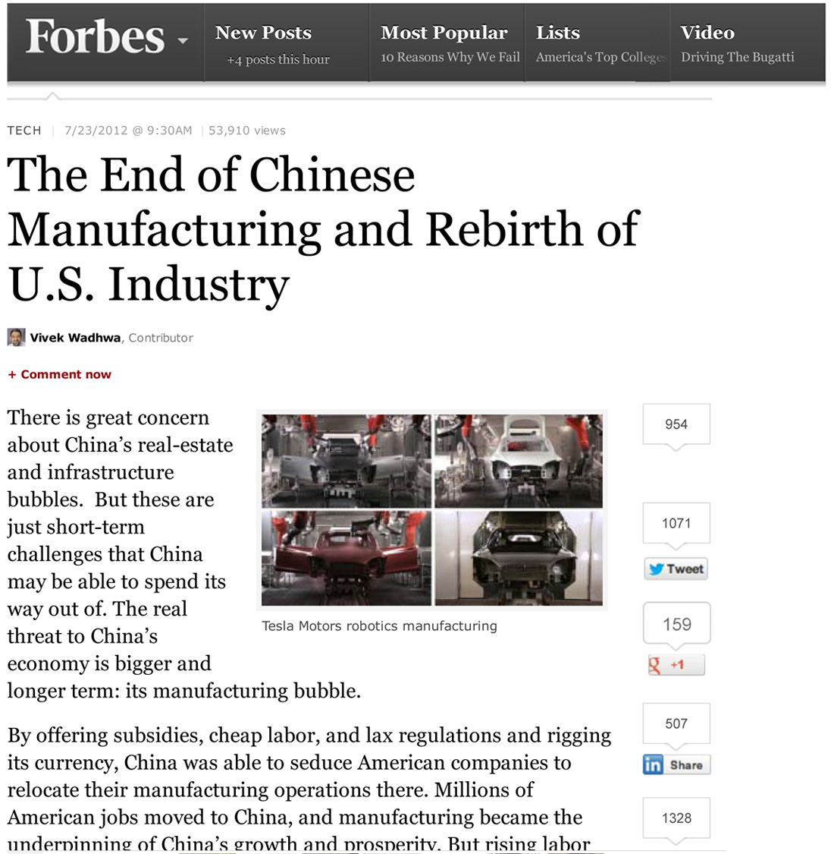
Notes:
… you will find that times have changed -- and the manufacturing is coming back home.
=====
http://www.forbes.com/sites/singularity/2012/07/23/the-end-of-chinese-manufacturing-and-rebirth-of-u-s-industry/
The End of Chinese Manufacturing and Rebirth of U.S. Industry

Slide 47
Notes:
People don’t believe me when I tell them that Chinese companies have moved some of their manufacturing to North Carolina.
=====
http://money.cnn.com/2012/04/24/smallbusiness/china-us-manufacturing/index.htm
China offshores manufacturing to the U.S.

Slide 48
Notes:
48
Here we have a Chinese all-terrain vehicle company that is building a manufacturing plant in North Carolina that will hire 600, and maybe 1,000 workers by the time they complete the facility.
====
China-based RATO to open U.S. HQ in Lincoln County, hire up to 600 (maybe 1000 jobs)
Feb 16, 2012
http://www.bizjournals.com/charlotte/blog/outside_the_loop/2012/02/chinese-company-to-open-in-lincoln.html

Slide 49
Notes:
Another Chinese company is bringing their solar panel factory to Charlotte, North Carolina.
====
International company will bring up to 36 jobs; site will serve as main manufacturing
plant.
http://www.charlotteobserver.com/2011/06/24/2402136/solar-panel-jobs-coming-to-charlotte.html#storylink=misearch
49

Slide 50
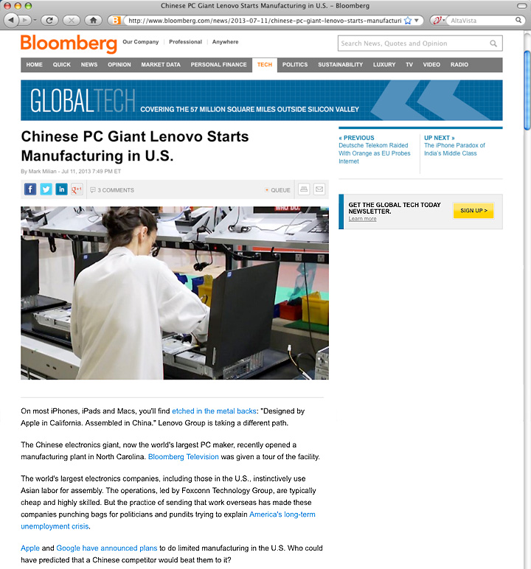
Notes:
And Lenovo, who makes the IBM ThinkPads, is setting up manufacturing in the United States.
=====
http://www.bloomberg.com/news/2013-07-11/chinese-pc-giant-lenovo-starts-manufacturing-in-u-s-.html
Chinese PC Giant Lenovo Starts Manufacturing in U.S.
The Chinese electronics giant, now the world's largest PC maker, recently opened a manufacturing plant in North Carolina. Bloomberg Television was given a tour of the facility.
The world's largest electronics companies, including those in the U.S., instinctively use Asian labor for assembly. The operations, led by Foxconn Technology Group, are typically cheap and highly skilled. But the practice of sending that work overseas has made these companies punching bags for politicians and pundits trying to explain America's long-term unemployment crisis.

Slide 51
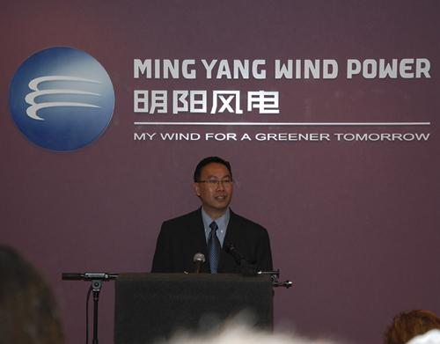
Notes:
51
And Wind Power technologies coming to Raleigh.
What should we be doing to prepare our youth for these jobs, and the jobs that will follow?
How are we preparing people to work for a company with cultural norms that our different from ours?
===
China Ming Yang Wind Power Group Limited, a wind turbine manufacturer in China, opened a North American research and development center on N.C. State’s Centennial Campus on Tuesday.
The center will focus on offshore wind turbine research and development. Shu Ching Quek, president of Ming Yang Wind Power USA Inc. (NYSE: MY), will lead the center.
Initially, the company will employ about five people at Centennial Campus, according to Gene Pinder, the campus’ marketing director. It has leased space formerly occupied by WebAssign in the Venture Center IV building at Centennial Campus.
http://www.bizjournals.com/triangle/news/2012/03/13/ncsus-centennial-campus-lands-new.html

Slide 52
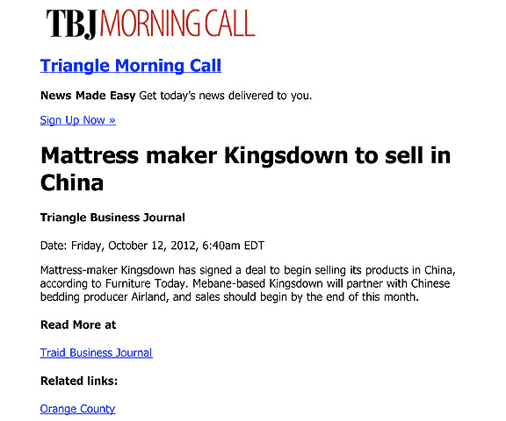
Notes:
And here it works the other way around.
Here is an American manufacturing company in North Carolina that is shipping it’s high-quality mattresses to China.
Yes, products made in America being sold in China.
===
http://www.bizjournals.com/triangle/morning_call/2012/10/mattress-maker-kingsdown-to-sell-in.html?ana=e_trig_rdup&s=newsletter&ed=2012-10-12
52

Slide 53
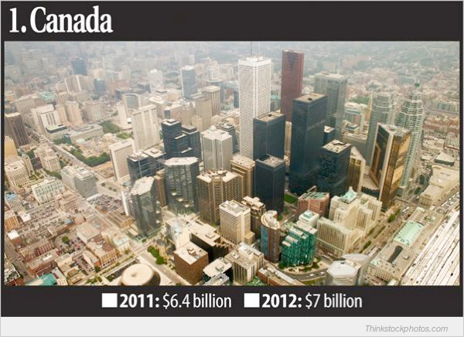
Who’s Buying North Carolina’s Goods
Notes:
The country that buys the most goods made in North Carolina is Canada.
They buy Seven billion dollars of stuff from us each year.
=====
Who’s Buying North Carolina’s Goods
Feb 26, 2013
Triangle Business Journal
http://www.bizjournals.com/triangle/news/2013/02/26/slideshow-whos-buying-north.html

Slide 54
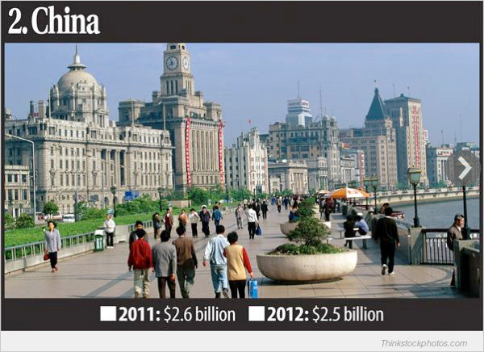
Who’s Buying North Carolina’s Goods
Notes:
And number two is China, buying two and a half billion dollars worth of stuff from North Carolina each year.
Who knew that?
And we need skilled workers to keep making this stuff that the Chinese, and others are buying from us.
=====
Who’s Buying North Carolina’s Goods
Feb 26, 2013
Triangle Business Journal
http://www.bizjournals.com/triangle/news/2013/02/26/slideshow-whos-buying-north.html

Slide 55
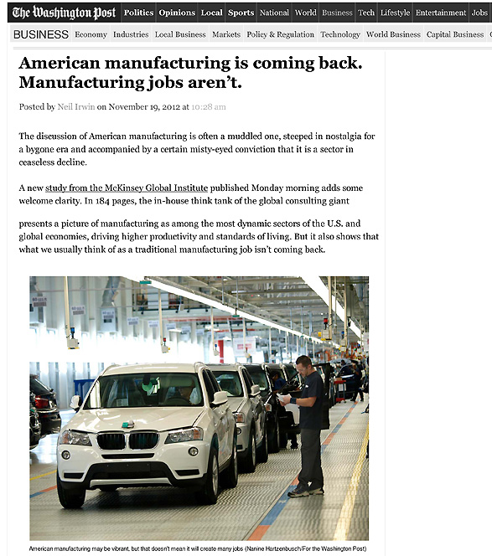
Notes:
As American manufacturing is making its comeback, we find that the old Manufacturing jobs that required a strong back and no education are not coming back.
=====
http://www.washingtonpost.com/blogs/wonkblog/wp/2012/11/19/american-manufacturing-is-coming-back-manufacturing-jobs-arent/
55

Slide 56
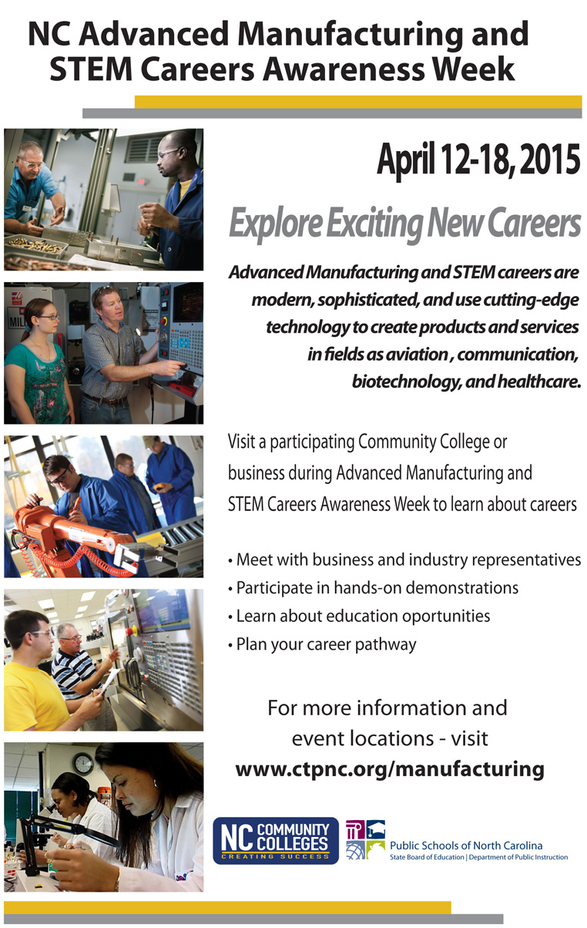
Notes:
Make sure your students and clients know about these Manufacturing and STEM open houses in April.
They might find they want to redirect their career pathway.
The online calendar of events should be filling up at the end of March, so check it out in early April.
The web address is at the bottom of your handout.
======
www.ctpnc.org/manufacturing

Slide 57
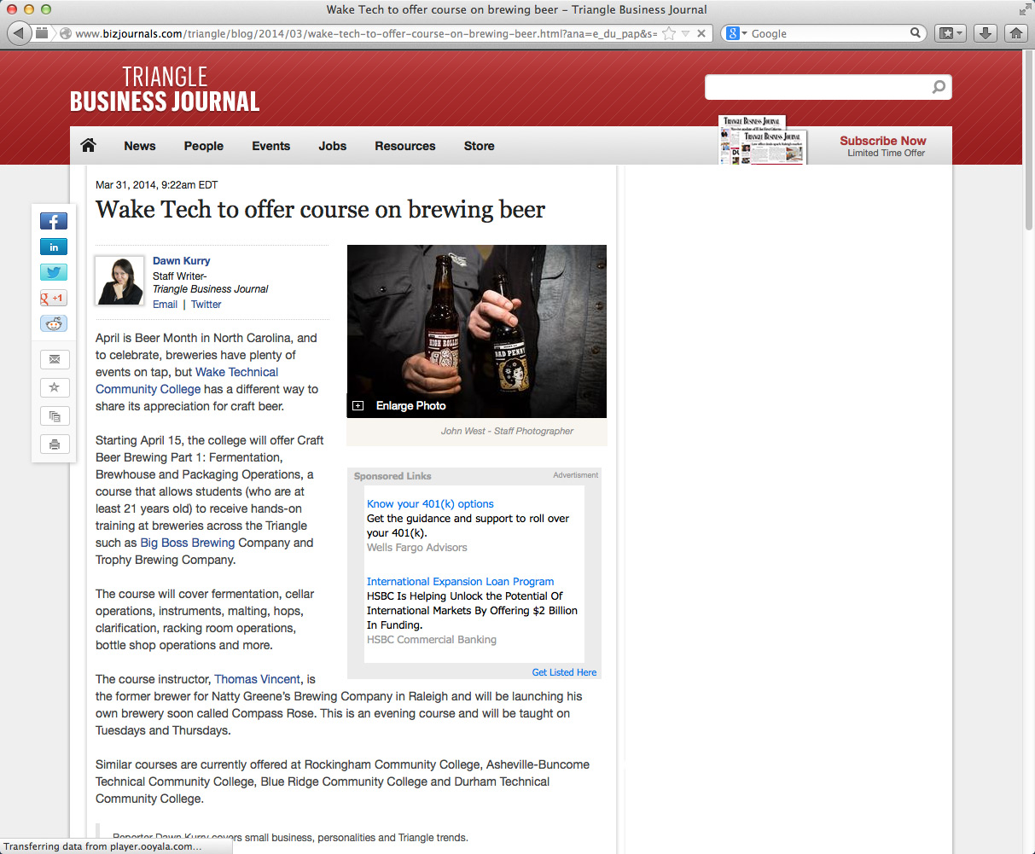
Notes:
We giggle when we think that college students are taking classes to learn how to make beer.
What’s next, classes on how to drink beer?
======
http://www.bizjournals.com/triangle/blog/2014/03/wake-tech-to-offer-course-on-brewing-beer.html?ana=e_du_pap&s=article_du&ed=2014-03-31
Mar 31, 2014, 9:22am EDT
Wake Tech to offer course on brewing beer
Starting April 15, the college will offer Craft Beer Brewing Part 1: Fermentation, Brewhouse and Packaging Operations, a course that allows students (who are at least 21 years old) to receive hands-on training at breweries across the Triangle such as Big Boss Brewing Company and Trophy Brewing Company.

Slide 58
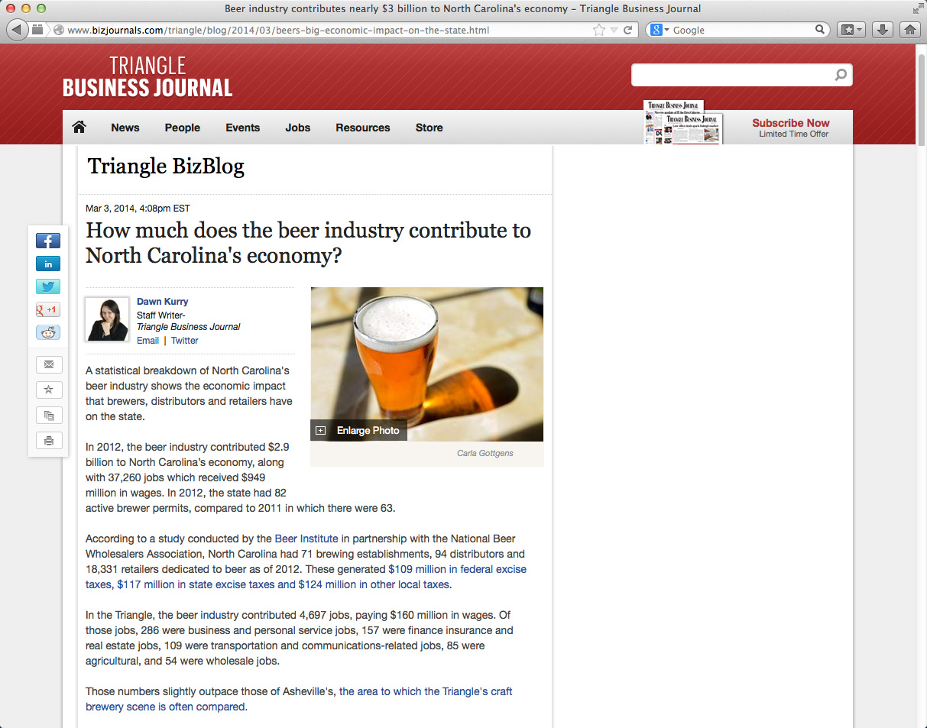
Notes:
Seriously though, beer making is becoming big business in North Carolina, especially in the Triangle region and in Asheville.
In 2012 the beer industry contributed 2.9 billion dollars to North Carolina’s economy, which included over 30,000 jobs (37,260 jobs)
In federal, state and local taxes, North Carolina beer contributed 350 million dollars.
This is manufacturing, and it is not like the beer making factories of old.
=============
http://www.bizjournals.com/triangle/blog/2014/03/beers-big-economic-impact-on-the-state.html
Mar 3, 2014, 4:08pm EST
How much does the beer industry contribute to North Carolina's economy?
In 2012, the beer industry contributed $2.9 billion to North Carolina’s economy, along with 37,260 jobs which received $949 million in wages. In 2012, the state had 82 active brewer permits, compared to 2011 in which there were 63.
According to a study conducted by the Beer Institute in partnership with the National Beer Wholesalers Association, North Carolina had 71 brewing establishments, 94 distributors and 18,331 retailers dedicated to beer as of 2012. These generated $109 million in federal excise taxes, $117 million in state excise taxes and $124 million in other local taxes.

Slide 59
Does it matter if your child is blue-collar or white-collar?
white-collar
The real questions should be :
Are they happy?
Can they support themselves and their family?
Gold-collar means that they earn enough to maintain their standard of living.
Notes:
--
Does it matter?
Too many parents have bought into the notion that university degrees are the guarantee for their child’s future.
That has always been the middle-class mentality. “It’s all about Education.”
The blue-collar jobs of tomorrow are not like the blue collar jobs of yesterday.
Enjoying the work you do -- should be important.

Slide 60
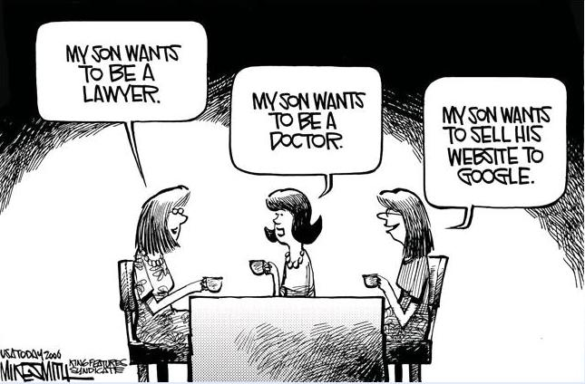
Notes:
--
It’s a different world.
Many moms want to wave their child’s university sheepskin high in the air at the country club and would not see eye to eye with the mom on the right.
====
http://www.kingfeatures.com/features/edcar/smith/bio.htm

Slide 61
The way of doing business is changing
Competitiveness is not working and is going away.
Collaboration is the way of the future. Businesses creating a niche market and working with other businesses to help each other.
We need to change the focus from self-centered learning to group-centered learning.
Notes:
We need more diversity of thought. With more women entering the higher levels of business, we are seeing a shift in the way of doing business. And I like it.
The traditional male version of running a business, built upon a platform of competitiveness, is now evolving.
Collaboration is the new way of life in the business world. Small businesses supporting each other rather than trying to buy out the competition or acquire the supply line.
So how does this affect what we are doing in the classroom?
Our education system is set up to encourage students to compete with each other for the best grades, class rank, and the honor of being the valedictorian. Is this preparing them for the future workplace?
In schools, we have traditionally called collaboration “cheating.”
Kids are collaborating with each other on their smart phones, but rather than trying to stop it, we should be encouraging it.
And we should be teaching them the proper way of using technology and the proper way of collaborating that brings about synergistic results.
We need to change the focus from self-centered learning to group-centered learning.
From individuals doing great on individualized assessments to students working together to solve a relevant problem.
We need to change our schools and other youth training programs to reflect this change in the work environment.
This is assuming that one of the purposes of education is to prepare kids for the workplace.
61

Slide 62
The 10 Key Skills for the Future of Work
Sense-making
Social intelligence
Novel and adaptive thinking
Cross-cultural competency
Computational thinking
New-media literacy
Transdisciplinarity
Design mind-set
Cognitive load management
Virtual collaboration
Notes:
Here are some broad skills that will help workers adapt to the changing career landscape:
Sense-making is the ability to determine the deeper meaning or significance of what is being expressed
Social intelligence is the ability to connect to others in a deep and direct way, to sense and stimulate reactions and desired interactions
Novel and adaptive thinking is proficiency at thinking and coming up with solutions and responses beyond that which is rote or rule-based
Cross-cultural competency is the ability to operate in different cultural settings
Download my PowerPoint and read the descriptions for the rest of these
------
Computational thinking is the ability to translate vast amounts of data into abstract concepts and to understand data-based reasoning
New-media literacy is the ability to critically assess and develop content that uses new media forms and to leverage these media for persuasive communication
Transdisciplinarity is literacy in, and ability to understand concepts across multiple disciplines
Design mind-set is the ability to represent and develop tasks and work processes for desired outcomes
Cognitive load management is the ability to discriminate and filter information for importance and to understand how to maximize cognitive functioning using a variety of tools and techniques, and
Virtual collaboration is the ability to work productively, drive engagement, and demonstrate presence as a member of a virtual team
Are we teaching these skills to our students? If not, then who will?
========
GigaOM
Dec. 16, 2011,
http://gigaom.com/collaboration/the-10-key-skills-for-the-future-of-work/?utm_source=General%20Users&utm_campaign=9bd9bdcde9-c%3Atec%20d%3A12-17&utm_medium=email
What are the jobs of the future? The demographics of an aging population suggests health care will be big, say some.
Broad skills that will help workers adapt to the changing career landscape:
Sense-making. The ability to determine the deeper meaning or significance of what is being expressed
Social intelligence. The ability to connect to others in a deep and direct way, to sense and stimulate reactions and desired interactions
Novel and adaptive thinking. Proficiency at thinking and coming up with solutions and responses beyond that which is rote or rule-based
Cross-cultural competency. The ability to operate in different cultural settings
Computational thinking. The ability to translate vast amounts of data into abstract concepts and to understand data-based reasoning
New-media literacy. The ability to critically assess and develop content that uses new media forms and to leverage these media for persuasive communication
Transdisciplinarity. Literacy in and ability to understand concepts across multiple disciplines
Design mind-set. Ability to represent and develop tasks and work processes for desired outcomes
Cognitive load management. The ability to discriminate and filter information for importance and to understand how to maximize cognitive functioning using a variety of tools and techniques
Virtual collaboration. The ability to work productively, drive engagement and demonstrate presence as a member of a virtual team

Slide 63
Questions ?
Chris Droessler
CTE Coordinator
NC Community Colleges
DroesslerC@NCCommunityColleges.edu
www.ctpnc.org/presentations
Get the PowerPoint
www.ctpnc.org/presentations
Notes:
Before I conclude my presentation, I will pause here to see if anyone has any questions.
I have a few more slides, and I want to let you in on what we will be talking about next month. But first I want to know if you have any questions.
Usually by this time most of the audience is overwhelmed and just need a break to digest what I’ve said.
Remember that you can download the PowerPoint and use it however you can.
Qs?

Slide 64
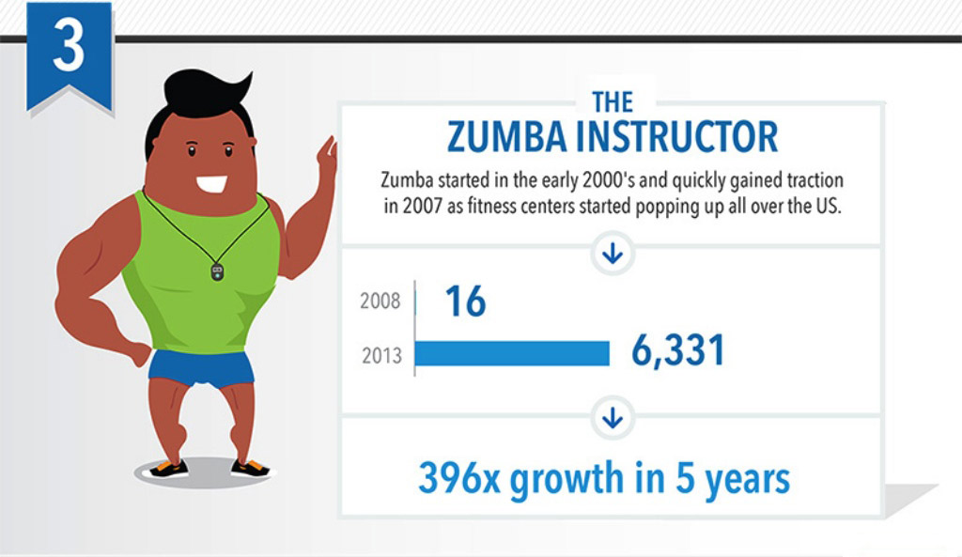
March 23 webinar
Job Titles That Didn’t Exist 5 Years Ago
Notes:
Here’s what we will be talking about next month on March 23.
We will be looking at the future job market, specifically jobs that are in high demand, and some great jobs that you have probably never heard of.
We are preparing the youth for jobs that don’t exist.
But first, let’s conclude this presentation. . .
=====
http://talent.linkedin.com/blog/index.php/2014/01/top-10-job-titles-that-didnt-exist-5-years-ago-infographic
Top 10 Job Titles That Didn’t Exist 5 Years Ago
Methodological details: We counted the frequencies of all English words and phrases used in job titles that were held in 2013 and compared the results to job titles that were held in 2008. We then took the top titles that saw the largest growth in frequency in that 5 year period and ranked them by their relative size in 2013. “Big data” and “cloud services” were the root phrases used to determine frequencies for “big data architect” and “cloud services manager” (which had many permutations, e.g. “big data architect/analyst/engineer” etc.). For simplicity’s sake, the titles you see above were used as examples. Data is current as of November 26, 2013.

Slide 65
Passion and Purpose
Thriving in your work, not just surviving.
Leaving the world a little better off because you cared to make a difference in your work.
Helping people discover their passion and then helping them turn that passion into an educational pathway that will lead to a rewarding career.
Notes:
---- What makes you want to get up in the morning?
→ --- Are you passionate about your own career?
→ --- How can we help our students and clients discover their passion, -- and put them on an education pathway, -- to turning their passion into a career?
--
======
Chris Droessler

Slide 66
Help people discover their passion, then help them get on a pathway where they can turn that passion into a career.
CLD
Notes:
Though the term “vocational” has earned a bad reputation in the last few decades, the original meaning of the term is clear that your “vocation” is your life’s calling.
Our vocation as educators and workforce professionals is preparing folks for careers.
What is your student’s or client’s vocation?
What is life calling them to do?
What is their purpose in life?
We need to help people discover their passion.
What makes them get up in the morning and want to learn something new?
It’s more than just working for a paycheck.
It’s doing satisfying work, making a difference in the world, feeling needed.
And we need to help them to turn that passion into a rewarding career.
--
In the future -- when the youth with whom we work are employed, and someone asks them what they do for a living, --
wouldn’t it be great if they could say –
“I get to make a difference in the world.”
“I get to make a difference”
===
Chris Droessler
66

Slide 67
Thanks for listening!
Chris Droessler
CTE Coordinator
NC Community Colleges
DroesslerC@NCCommunityColleges.edu
www.ctpnc.org/presentations
Get the PowerPoint
www.ncPerkins.org
Notes:
Thanks for tuning in today.
I hope to see you right here next month.

