Slide 1
Integrating Work-Based Learning (WBL) Data to Measure Student Outcomes
Dwayne Hobbs, Career, Technical and Agricultural Education Program Manager, Georgia Department of Public Instruction
Chris Droessler, Career and Technical Education Coordinator, North Carolina Community College System
Notes:
Olivia
====
Data Quality Institute
October 28, 2016
10:30 a.m.

Slide 2
Why collect WBL Data?
Identify gaps in program delivery
Design effective professional development
Match needs of business and industry
Adjust focus of the program (dynamic vs. static)
Provide completer status by cluster/pathway
Comply with local, state, federal policies and laws
Monitor how special populations are served
Continuous program improvement
“What gets measured gets done”
Notes:
We are not here today to discuss the merits of work-based learning.
There might be other reasons why you collect work-based learning data in your state,
But - That could be a separate conference topic.
We are here today to talk about the data related to work-based learning.

Slide 3
Overview of Session
Secondary CTE WBL Data – Georgia
Post-Secondary CTE WBL Data – North Carolina
Small group discussions: Discuss objectives and challenges of collecting WBL data
Whole group discussion: Share key points with the room
Notes:
Here is how we will spend the next 58 minutes.
We’ll talk about secondary data in Georgia
And then both secondary and postsecondary data from North Carolina.
Then we’ll get you all to talk about all of this, and hopefully we’ll come up with a revolutionary plan that will change the world.
→ And now, to tell you how they do things down in Georgia, here is Dwayne Hobbs.

Slide 4
WBL in Georgia
Dwayne Hobbs

Slide 5
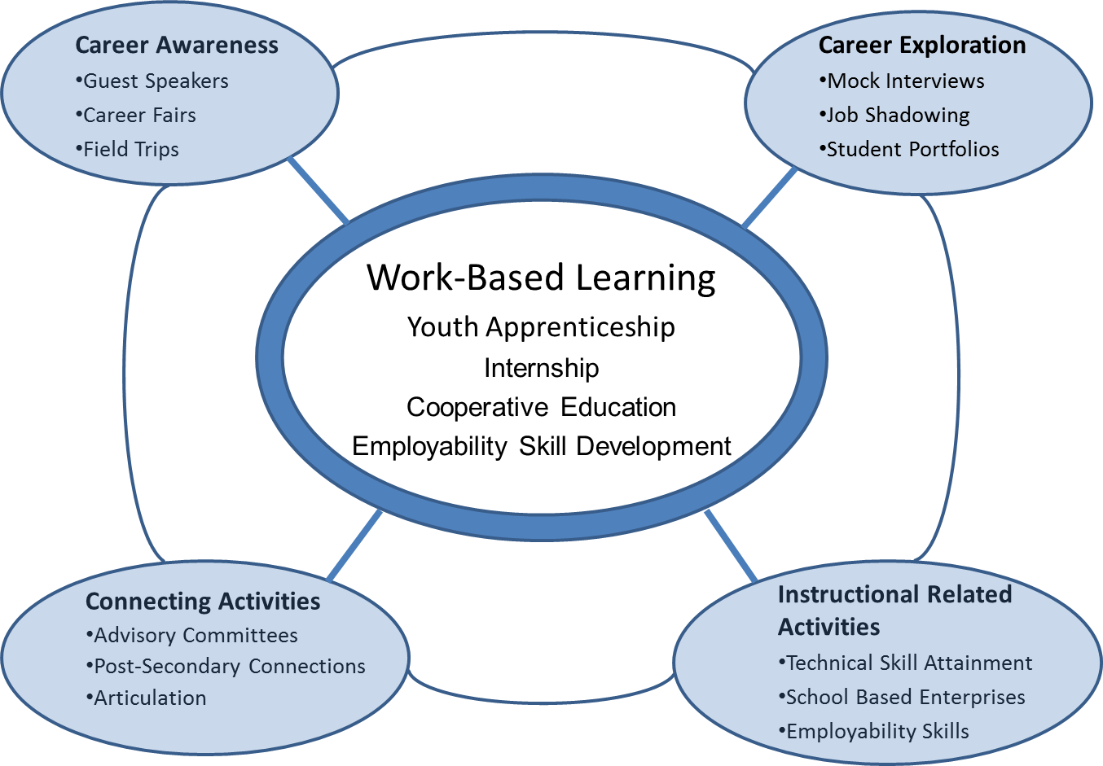
Career Related Education

Slide 6
WBL Classifications
Students in Work-Based Learning are classified in one of four ways according to the alignment of their career-tech coursework with job placement and future postsecondary/career plans:
Youth Apprenticeship (YAP)
Internship
Cooperative Education (Co-op)
Employability Skills Development (ESD)

Slide 7
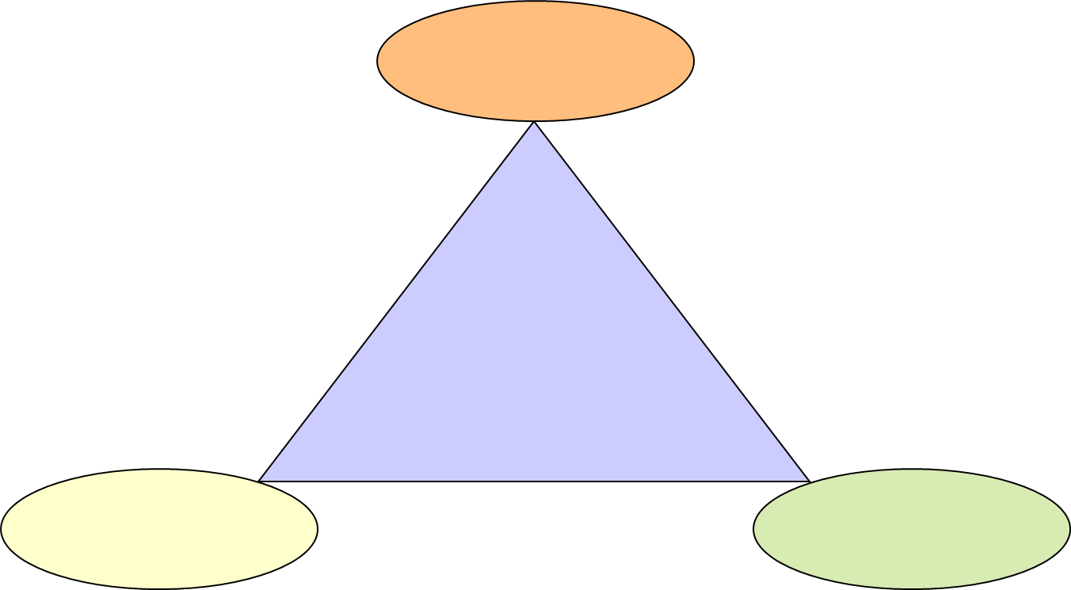
WBL Criteria
Student’s Career Goal
The
Three
Interlocking
Components of
Work-Based Learning
Related Coursework
Structured Work Experience

Slide 8
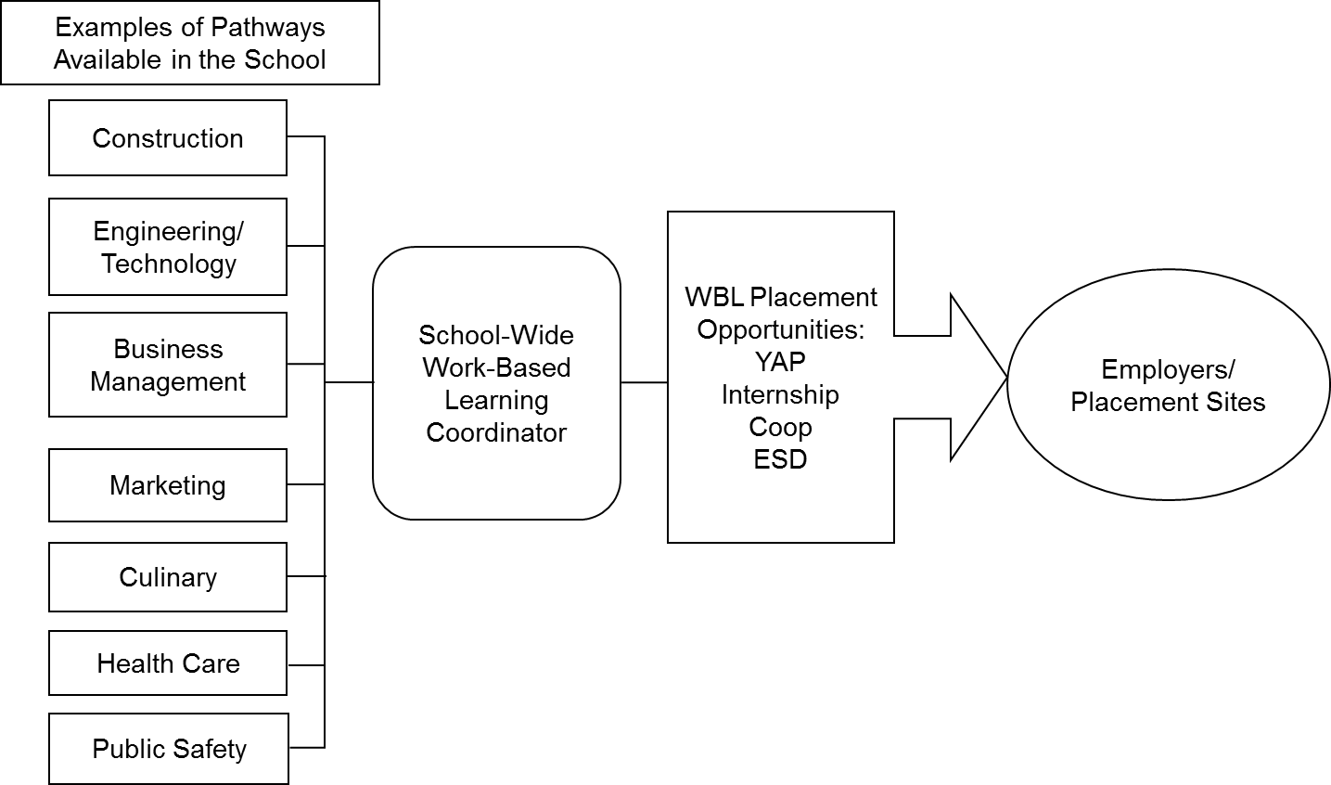
Georgia WBL Delivery Model
Notes:
Make this slide about the WBL policy and administration in GA:
i.e. HB 402
This graphic

Slide 9
Georgia Work Based Learning Manual
www.gawbl.org
24 standards/Sections in the manual
Standards page
Explanation of all matters related to the section
Sample forms
Self evaluation (Section 24)

Slide 10
WBL Standards

Slide 11
Georgia Annual WBL Data Report
Data element for each standard
Numerous data points for each standard
On-line collection via CTAE Resource Network
Automatic tabulation and extensive reporting
State Averages
Awards program based on points attached to selected items
Professional development needs based results
“Top Gun” selection

Slide 12
The Data
Worked-Based Learning Assessment - FY2016
Standard 1. A wide array of Career Related Education activities1 are integrated into au CTA E classes to support the school to career transition and work based placements.
Coordinators who serve multiple schools should enter totals for au high schools served)
S1-A Total number of high schools served by the Coordinator.
S1-B Total school{s) population.
S1-C Total number of CTAE teachers in the school(s).
S1-D Estimated number of students enrolled in at least one CTAE class.
Standard 2. Age appropriate Career Awareness Activities in the CTAE class are designed to make students aware of career choices and promote the school to career transition. Estimate the total number of students who participated in the following Career Awareness activities which you arranged or help coordinate:
S2-A Guest Speakers for CTAE classes
S2-B Field trips
S2-C Industry tours
S2-D Career Day/Career Fair
Standard 3. Age appropriate Career Exploration activities in the CTAE class a.re conducted with individual or small groups of students to explore Career options.
Estimate the total number of students who participated in the following Career Exploration activities which you arranged or helped coordinate:
S3-A Individual Advisement/Guidance Sessions/Planning the Individual Career Plan
S3-B Mock Interviews
S3-C Job Shadowing
S3-D Student Portfolios/Journals
S3-E Conferences/seminars (including CT SO participation)
Standard 4. Instructional Related activities in the CTAE class promote understanding of the business and work environment and help students develop employability skills. Estimate the number of your WBL students who participated in the following instructional Related Activities. This number should not be greater than your reported WBL enrollment.
S4-A Students participating in a school based enterprise activity ie: school store
S4-B Total number of paid WBL students employed by the school based enterprise
S4-C Enter the number of your WBL students that are members of a CTSO.
Standard 5. CTAE personnela.re actively involved in the planning1 coordinating1 and implementing of connecting activities between the school and the business community.
S5-A Total number of prospective employers (not current employers of WBL students) you
have visited.
SS.B Total number of community meetings attended (ie: Chamber of Commerce, Rotary, etc.).
SS.C Total number of businesses you consider partners with your program (employer,

Slide 13
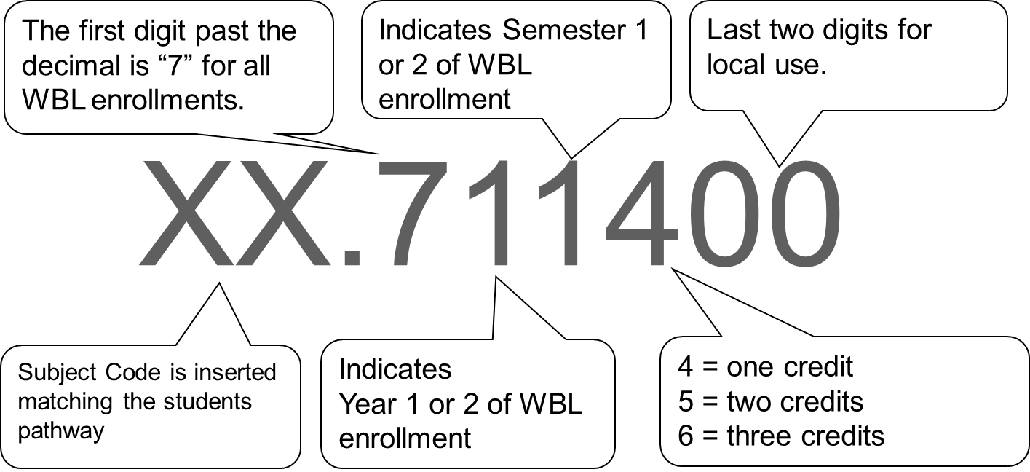
WBL Update
Work Based Learning numbers require insertion of the subject CIP code.
Notes:
The course numbering system for enrollment in Work-Based Learning involves inserting the subject code for the students pathway in the two digits to the left of the decimal.

Slide 14
Subject Codes
CIP | Cluster/Pathway Title | Funding Weight
01. | Agriculture | K
02. | AgriScience | K
03. | Natural Resources | K
06. | Business Management | K
07. | Business Computer Science | K
08. | Marketing | K
10. | Communication Technologies | K
11. | Information Technology | K
12. | Personal Services Occupations | K
13. | Education | K
20. | Family and Consumer Sciences | K
20. | Culinary Arts | K
21. | Engineering and Technology | K
25. | Healthcare Science | K
28 | Junior ROTC | K
35 | Great Promise Partnership (GPP) | K
43. | Public Safety | K
46. | Construction Technology | K
47. | Architecture, Construction, Communication & Transportation | K
48. | Precision Production Occupations | K
49. | Manufacturing & Engineering Sciences | K
26. | Life Sciences | K
40. | Physical Sciences | K
23. | Language Arts | K
27. | Mathematics | K
45. | Social Sciences | K
50. | Visual Arts | K
51. | Dance | K
52. | Theatre Arts | K
53. | Music | K
63. | Spoken Languages | K
for WBL Course Numbers...
Notes:
The subject codes for WBL include all CTAE pathway categories plus three academic codes that were added for special situations.

Slide 15
Student Enrollment in WLB FTE Segments

Slide 16
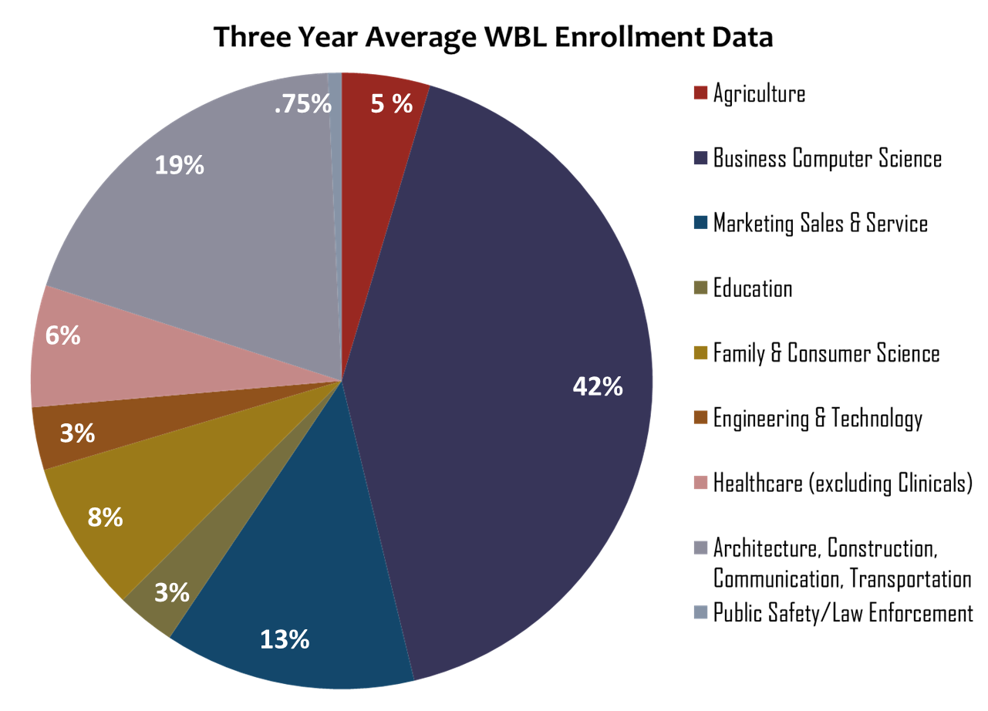
WBL Enrollment by Cluster

Slide 17
Work-Based Learning Enrollment Compared to Youth Apprenticeship

Slide 18
Employer Feedback
Georgia Youth Apprenticeship Program Customer Satisfaction Survey
A survey is created on survey monkey.com
The link is provided to all coordinators statewide
Each WBL Coordinator personally gives the link to employers and explains the purposes of the survey
This data has been collected since the inception of Youth Apprenticeship funding in the state in 1995
Data is provided on the website, to legislators, and used with coordinators to identify needs improvement.

Slide 19
Georgia Youth Apprenticeship Program Customer Satisfaction Survey Results
Results of the annual a state-wide survey, conducted of employers participating in the Youth Apprenticeship Program.

Slide 20
Georgia Youth Apprenticeship Program Customer Satisfaction Survey Results
Results of the annual a state-wide survey, conducted of employers participating in the Youth Apprenticeship Program.

Slide 21
Georgia Youth Apprenticeship Program Customer Satisfaction Survey Results
Results of the annual a state-wide survey, conducted of employers participating in the Youth Apprenticeship Program.

Slide 22
Georgia Youth Apprenticeship Program Customer Satisfaction Survey Results
Results of the annual a state-wide survey, conducted of employers participating in the Youth Apprenticeship Program.

Slide 23
Georgia Youth Apprenticeship Program Customer Satisfaction Survey Results
Results of the annual a state-wide survey, conducted of employers participating in the Youth Apprenticeship Program.

Slide 24
WBL in North Carolina Chris Droessler
Career and Technical Education Coordinator North Carolina Community College System
NCperkins.org/presentations
Notes:
That’s good stuff Dwayne.
Now let’s go North a little to North Carolina.
We post all of our presentations on the NC Perkins dot org website.
I recently did a presentation on forming business partnerships for work-based learning.
And another presentation that goes into depth explaining work-based learning.
Feel free to use anything you find there to educate your community.
====
DQI 2016
Chris Droessler
droesslerc@nccommunitycolleges.edu
NCperkins.org/presentations

Slide 25
What is Work-Based Learning in NC
High School:
Job Shadowing (also middle school)
Apprenticeship
Business/Industry Field Trip
Cooperative Education
Entrepreneurial Experiences
Internship
Mentorship
School-based Enterprises
Service Learning
Community College:
Apprenticeship
Cooperative Education
Internship
Notes:
Here are the kinds of work-based learning we have in North Carolina.
At the high school level, we promote more kinds of work-based learning than we do at the college level.
Getting the students out into the workforce is important for them to see why education is important.
=====
http://www.ncpublicschools.org/cte/curriculum/work-based/

Slide 26
Secondary WBL Data 2006-2007 (district level)
2,608 Job Shadowing
21 Cooperative Education
4 Short Term Work Experience (mini Internship)
653 Internship
5 Apprenticeship
576 Community-Based Vocational Training (CBVT) (internship for OCS)
515 Occupational Course of Study (OCS) Work Experience
Notes:
This is the Work-based learning data from Wake County Public Schools in North Carolina for the 2006-2007 school year.
Back then I was in charge of work-based learning for the largest school district in the state.
There were 54 middle and high schools. The only thing the middle schools could have reported was Job Shadowing.
Our Occupational Course of Study students were those who had a special modified graduation plan, since they did not have the capacity to complete the standard graduation standards.
Their special graduation plan required a certain amount of hours in the workplace. Those are the last two items on this list.
We did not used to count these, because we did not know about them.
Do you count the work experiences for your students on a special graduation track?
They are not CTE hours, but they are work-based learning.
====
Wake County Public School System
School-to-Career work-based learning data
2006-2007 school year

Slide 27
Secondary WBL Data 2006-2007 (district level)
Why collect the WBL data?
Liability insurance on the student
Evidence of career preparation
Inform the business community
Notes:
One reason we collected work-based learning data was to have the data for liability insurance for the following year.
Students had to be listed in my records before they went out to the work site.
This ensured the student was covered at the work site with a million dollar liability insurance policy.
These data were evidence that supported the part of the school district mission to prepare students for a career.
But, when we started reporting work-based learning data to our business community, and explained the types of jobs that these students typically performed, and the benefits for both the student and the employer, we found more employers willing to take our students.

Slide 28
Secondary WBL Data 2006-2007
What we did with the data
Annual county-wide breakfast meeting to thank the business volunteers
Most business volunteers volunteered at a specific school
Notes:
We held an annual breakfast meeting with the business volunteers, where hundreds of them would come to hear the superintendent and myself extol the virtues of our School-to-Career program.
Many principals and other education leaders would also come to hear about how we were preparing the students a future career.
Most of the business volunteers volunteered at a specific school through a business-education partnership, or alliance as we called them. Some business volunteers were on county-wide committees as part of the School-to-Career Council.
Not only did we share the work-based learning data, but we usually had a student talk about their work-based learning experience.

Slide 29
Secondary WBL Data for North Carolina
Students @ Work 2015-2016
State-wide Middle School job shadowing program
30,917 students from 45 of the 100 counties
ncbce.org/students-at-work
Notes:
I then moved to the state education office and was in charge of work-based learning among other things.
We did not collect much work-based learning data at the state level other than the number of high school students who took an internship or cooperative education course.
We did keep track of one specific job shadowing program called Students at Work, which is a program by the North Carolina Business Committee for Education, a nonprofit comprised of North Carolina’s corporate leaders.
They sponsor a campaign every year to get middle school students out into business for job shadowing.
Last year, we had over thirty thousand middle school students across the state watching people work for the day.
======
http://ncbce.org/students-at-work/

Slide 30
Secondary WBL Data for North Carolina
2015-2016 School Year
High School Students
 | 2010-2011 | 2015-2016
CTE Internship | 3,931 | 4,305
Cooperative Education | 2,463 | 1,176
Apprenticeship | 172 | 33
Notes:
Here is the state-wide high school data for two years.
We changed the way we record Apprenticeships.
We now categorize all official Apprenticeships as Internships, and use the internship course number for both.
So, the 33 listed for apprenticeships should really be 0.
What do you do when folks use the wrong course number?
And how do you compare data across time when the parameters change?

Slide 31
Course Credit
Cooperative Education, Internship, Apprenticeship
College:
1 semester hour credit for 160 hours of WBL
High School:
1 course credit for 135 hours on block schedule
1 course credit for 150 hours on traditional calendar
Notes:
Both our high schools and community colleges give course credit for cooperative education, internships and apprenticeships.
You can see that our colleges require more hours than do our high schools for work-based learning that earns course credit.
And in the high schools, the hours depend on whether the school is operating on a block schedule or on a traditional year-long calendar.
====
State Board of Community Colleges Code
http://www.nccommunitycolleges.edu/sbcccode
Captive or co-opted groups of students are defined as inmates in a correctional facility; clients of sheltered workshops, domiciliary care facilities, nursing facilities, mental retardation centers; substance abuse rehabilitation centers; and in-patients of psychiatric hospitals.

Slide 32
North Carolina Community Colleges
Associate Degree - Major hours may include up to 8 semester hours credit for WBL.
Selected Registered-Apprenticeship programs allow up to 16 semester hours of WBL
Diploma – up to 4 semester hours of WBL
Certificate– up to 2 semester hours of WBL
No WBL for Captive or co-opted groups
Notes:
Over the last decade I moved from a school district to the state office, -- and now, less than a year ago, I moved to working at the Community College state office.
So I tell everyone that in my professional life,-- I have finally graduated to college.
Work-based learning is listed as an elective for many of our college programs.
Depending on the certificate, diploma or degree,-- there are certain maximums for the number of credits earned for work-based learning.
Students in correctional facilities, psychiatric hospitals, and similar institutions do not participate in our work-based learning courses.
====
State Board of Community Colleges Code
http://www.nccommunitycolleges.edu/sbcccode
Captive or co-opted groups of students are defined as inmates in a correctional facility; clients of sheltered workshops, domiciliary care facilities, nursing facilities, mental retardation centers; substance abuse rehabilitation centers; and in-patients of psychiatric hospitals.

Slide 33
North Carolina Community Colleges
Offered Spring, Summer, Fall semesters
In 2013, all COE-xxx, Co-Op Education courses were renamed WBL-xxx, Work-Based Learning.
Notes:
Our work-based learning courses are offered in all three of our semesters.
In 2013, we changed the name of our work-based learning course from Cooperative Education to Work-Based Learning.
Things like that always makes data comparison over time a little trickier.

Slide 34
North Carolina Community Colleges
31 different WBL courses
6 different levels of courses
Course number indicates 1, 2, 3, or 4 credits
Additional seminar course at each level
Notes:
There are 31 different course numbers for work-based learning in the colleges.
The first is an academic course that covers basic knowledge necessary for gaining and maintaining employment. It is not really work-based learning, but preparation for work-based learning.
There are six levels of WBL courses, so the students can have multiple work-based learning experiences without having to use the same course number.
There are six sets of four course numbers -- each with a different number of credits -- depending on the number of hours worked.
Additionally, there is a seminar course at each level where work-based learning students could have a classroom experience that accompanies their work-based learning course at the job site.
It’s a little confusing, so let’s jump to the data.

Slide 35
WBL-110 World of Work
WBL Academic Course
2012 – 1,165 students – 0.20% of all
2013 – 1,188 students – 0.21% of all
2014 – 1,166 students – 0.21% of all
2015 – 1,049 students – 0.20% of all
Notes:
This is the academic course that covers basic knowledge necessary for gaining and maintaining employment.
Two tenths of a percent of all of the curriculum students across the entire state take this course.
In my opinion, it’s one of those courses that everyone should take, but nobody wants to if they don’t have to.
====
Course enrollment data
Total enrollment for all curriculum programs by year
2012 – 571,466
2013 – 570,375
2014 – 552,924
2015 – 531,930

Slide 36
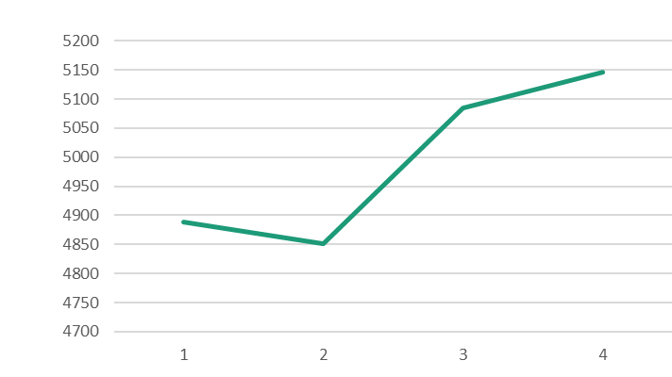
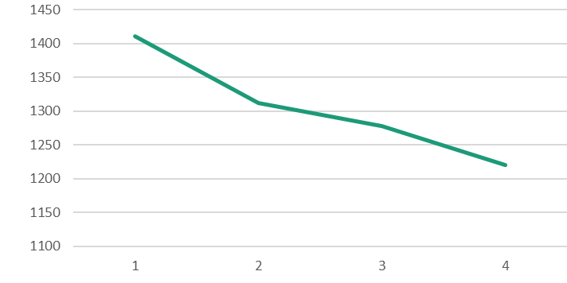
WBL Courses
WBL-xx1, xx2, xx3, xx4 Work Experience course
2012 – 4,889
2013 – 4,852
2014 – 5,085
2015 – 5,247
WBL-xx5 WBL Seminar course
2012 – 1,411
2013 – 1,312
2014 – 1,278
2015 – 1,220
Notes:
In the top chart you see the number of credits earned in the work experience courses. It has had a steady increase over the last four years.
At the bottom is the Seminar course, which is used to gather the students on campus to discuss their experiences at the worksite.
We have seen a decrease in the credits earned over the last four years.
What you see is about 5,000 our of a half-million students participating in work-based learning. Only one percent of our college students are participating in work-based learning.
One of our 58 colleges has had no work-based learning course completions in the last four years.
=====
Total enrollment for all curriculum programs by year
2012 – 571,466
2013 – 570,375
2014 – 552,924
2015 – 531,930

Slide 37
WBL Courses
Clinical hours in Health Science courses?
Nursing courses require 3-12 clinical hours
Early Childhood Education has their own work-based learning course.
Notes:
Some of our courses have clinical hours, which requires a certain number of hours in the workplace as part of the course, rather than using a separate work-based learning course.
In North Carolina, these are not considered to be work-based learning, since the instructor is always present.
Early Childhood Education has created their own work-based learning course, which is similar to student teaching.
They do not use the standard work-based learning courses.

Slide 38
2016 NC Employer Needs Survey
Notes:
This report was just released a few weeks ago
The North Carolina Department of Commerce surveyed businesses all across the state earlier this year.
For 2016, they collected nineteen hundred surveys.
This included companies of all sizes from all 100 counties.
=====
2016 NC Employer Needs Survey
http://www.nccommerce.com/Portals/47/Publications/Industry%20Reports/2016-Employer-Needs-Survey.pdf

Slide 39
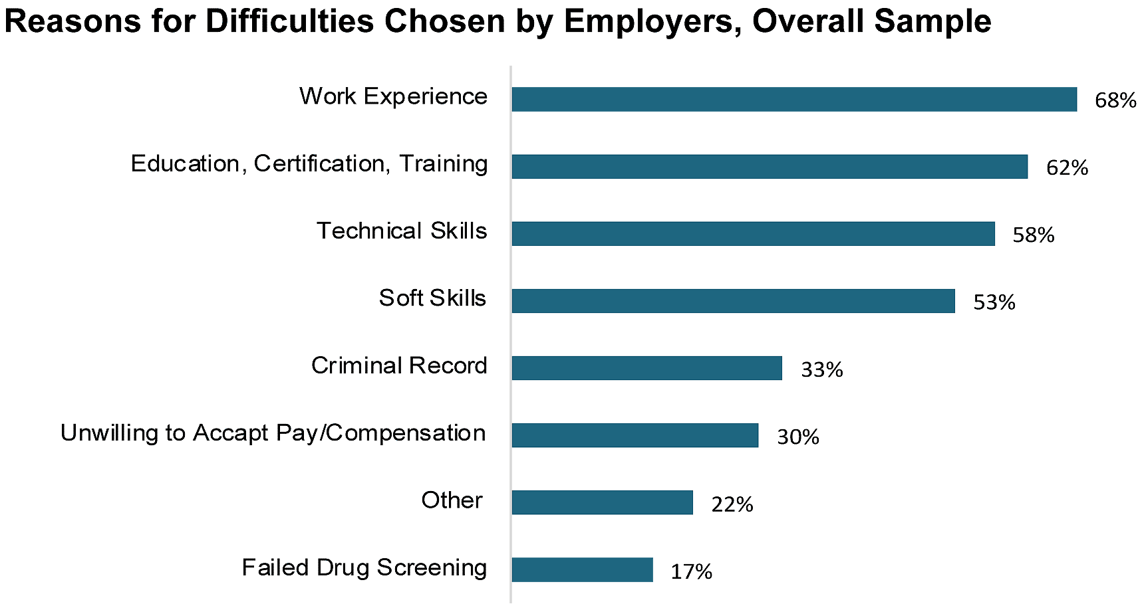
Hiring Difficulties
Notes:
Here are the reasons employers gave for having difficulty in hiring.
On top of the list is work experience.
It’s a classic conundrum.
You can’t get work experience without a job -- and you can’t get a job without work experience,
This is work-based learning data from the business community. This is data to promote our cause.
We take this data to the employers and promote the concept of work-based learning.
We have the solution to their employment difficulty, but they don’t know it until we tell them.
Many employers like the idea of being able to shape their future employees before they actually hire them.
They look at the work-based learning program as a trial period with a potential employee.
=====
2016 NC Employer Needs Survey
http://www.nccommerce.com/Portals/47/Publications/Industry%20Reports/2016-Employer-Needs-Survey.pdf

Slide 40
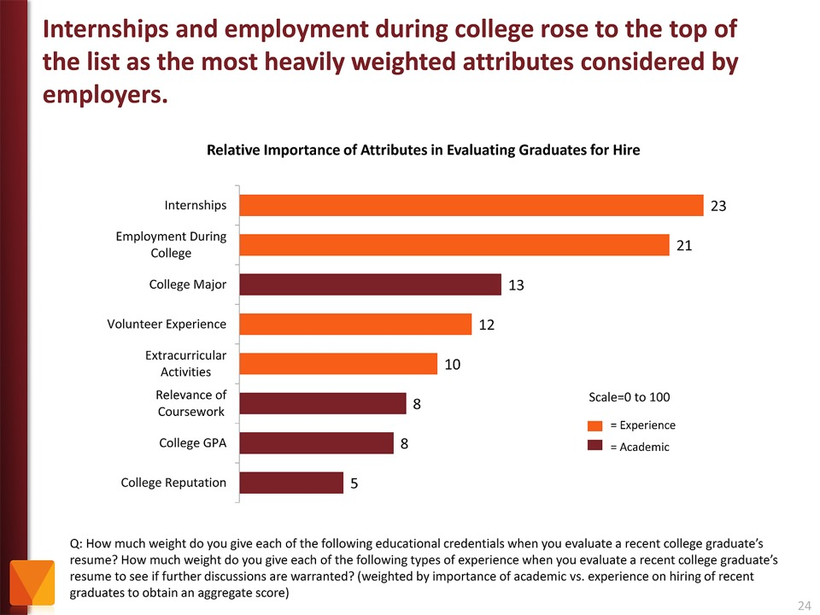
Notes:
This is from a national survey that asked employers about hiring.
In this chart you see that employers value Internships and other employment while in school as more important than college major and GPA.
Even volunteer work and extra-curricular activities are more important to the business community than grades.
Yet, -- most students are too focused on getting good grades -- and are missing out on the experiences that really matter.
If you “begin with the end in mind,” then our students should ask the businesses what they will want in their new recruits, rather than focusing on something like grades that the business community could care less about.
→ It’s time to get you all involved. Olivia – come on up here and let’s get this activity started.
======
http://chronicle.com/article/The-Employment-Mismatch/137625/#id=overview
The Employment Mismatch: A College Degree Sorts Job Applicants, but Employers Wish It Meant More
Employers value a four-year college degree, many of them more than ever.
Yet half of those surveyed recently by The Chronicle and American Public Media's Marketplace said they had trouble finding recent graduates qualified to fill positions at their company or organization. Nearly a third gave colleges just fair to poor marks for producing successful employees. And they dinged bachelor's-degree holders for lacking basic workplace proficiencies, like adaptability, communication skills, and the ability to solve complex problems.
The report
The Role of Higher Education in Career Development: Employer Perceptions
http://chronicle.com/items/biz/pdf/Employers%20Survey.pdf

Slide 41
Activity – Individual think time
Individually, consider the following questions:
What types of WBL data does your state currently collect?
What have been your challenges around collecting WBL data?
What innovative practices have you heard about related to WBL data?
Notes:
Olivia

Slide 42
Activity – Small Groups
At your tables, share your answers to the following questions on the chart paper:
What types of WBL data does your state currently collect?
What have been your challenges around collecting WBL data?
What innovative practices have you heard about related to WBL data?
Notes:
Olivia

Slide 43
Activity – Whole Group
Now, let’s share back:
What types of WBL data are your states currently collecting?
What have been your challenges around collecting WBL data?
What innovative practices have you heard about related to WBL data?
Notes:
Olivia

Slide 44
Integrating Work-Based Learning (WBL) Data to Measure Student Outcomes
Dwayne Hobbs Career, Technical and Agricultural Education Program Manager Georgia Department of Public Instruction DHobbs@doe.k12.ga.us
Chris Droessler Career and Technical Education Coordinator North Carolina Community College System DroesslerC@nccommunitycolleges.edu
Notes:
Thanks.

