Slide 1
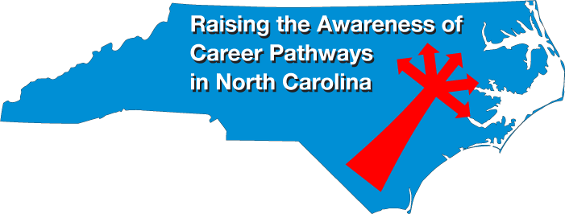
January 16, 2020
Dr. Bob Witchger
Chris Droessler
NC Community Colleges
Cheryl Cox
NC Department of Public Instruction
www.ncperkins.org/presentations
Notes:
We are here to help promote the great jobs, often unknown, in the great state of North Carolina.
Through these monthly meetings, we are going to let you know about some great career opportunities in North Carolina.
Bring in special guests to let you know about the great career opportunities in North Carolina.
Please download this PowerPoint file and use it anyway you can to help get folks on a career pathway.
The reference showing from where the information was found, as well as the contact information for our guests is in the Notes section under each slide.
Get the PowerPoint on our NCPerkins.org website on our Presentations and Webinars page.
Here is the direct address on the screen.
====
Dr. Bob Witchger
919-807-7126
witchgerb@nccommunitycolleges.edu
Chris Droessler
919-807-7068
droesslerc@nccommunitycolleges.edu
Cheryl Cox
919-807-3814
cheryl.cox@dpi.nc.gov

Slide 2
Notes:
www.ncperkins.org/presentations

Slide 3
Notes:
https://www.apprenticeshipnc.com/events/apprenticesipnc-annual-conference-march-5-6-2020

Slide 4
Notes:
Phil Vice, Senior Administrator
pvice@wcpss.net
Career and Technical Education Wake County Public School System
5625 Dillard Dr.
Cary, NC 27518
919.533-7065
919.589-6196 Fax # NEW NUMBER

Slide 5
Notes:
www.ncperkins.org/nceta

Slide 6
Notes:
www.ncperkins.org/presentations

Slide 7
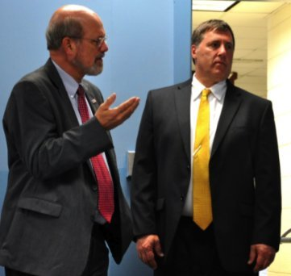
Frank Scuiletti
Program Coordinator: Construction, Engineering, Industrial, Transport, Criminal Justice, Fire Protection, & Work-Based Learning NCCCS
Notes:
Frank Scuiletti <scuilettif@nccommunitycolleges.edu>

Slide 8
Notes:
www.ncperkins.org/presentations

Slide 9
David Allgood
Forsyth Tech CC - Toyota Instructor
Notes:
David Allgood Forsyth Tech - Toyota Instructor
dallgood@forsythtech.edu – 336-734-7279 office 336-466-1941

Slide 10
Notes:
www.ncperkins.org/presentations

Slide 11
Jeff Faircloth
Dean/Department Chair – Transportation Guilford Technical Community College
Notes:
Jeff Faircloth –Dean/Department Chair – Transportation Gilford Technical Community College
jafaircloth@gtcc.edu 336-454-1126-50184

Slide 12
Notes:
www.ncperkins.org/presentations

Slide 13
Eric Rhom
Department Chair – Gaston College
Notes:
Eric Rhom - Department Chair – Gaston College
erhom@gaston.edu; rhom.eric@gaston.edu; 704-922-6386

Slide 14
Notes:
www.ncperkins.org/presentations

Slide 15
Robert Radillo
McKenney Chevrolet – Service Manager and Adjunct Professor at Gaston College
Notes:
Robert Radillo – McKinney Chevrolet – Service Manage and Adjunct Professor at Gaston College.
rradillo@mckenneychevrolet.com
(704) 823-1040
951-833-6904
https://www.mckenneychevrolet.com

Slide 16
Notes:
www.ncperkins.org/presentations

Slide 17
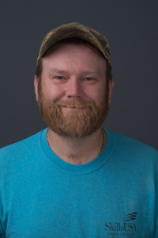
Hardin Kennedy
Transportation Technology Department Chair – Wilkes Community College
Notes:
Hardin Kennedy – Department Chair – Wilkes Community College
Hckennedy819@wilkescc.edu 336-838-6219

Slide 18
Notes:
www.ncperkins.org/presentations

Slide 19
Mike Evans
Parts and Service Director Carolina Automotive, McNeill Nissan and Chevrolet
Notes:
Mike Evans - Parts and Service Director, Carolina Automotive, McNeill Nissan and Chevrolet
Mevans@carolinaautomotive.com 336-838-2191
https://carolinaautomotive.com/

Slide 20
Notes:
www.ncperkins.org/presentations

Slide 21
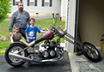
Ben Vance
Service Manager
Bill Black Chevrolet-Cadillac
Notes:
Ben Vance
Service Manager
(336) 387-3660
bvance@billblackauto.com
Greensboro

Slide 22
Notes:
www.ncperkins.org/presentations

Slide 23
James Pressly
High School Automotive Programs
Notes:
919-807-3887
james.pressly@dpi.nc.gov

Slide 24
Raising the Awareness of Career Pathways in North Carolina
Next meeting is February 20, 2020
www.ncperkins.org/presentations
Notes:
Our next meeting like this one will be on ------.
(We will skip December and be back in January.)
(We will skip June, July and August and be back in September.)
We will be talking about the great events happing during Construction Careers Week
You can go to the NCPerkins website to register for that meeting.
We'll also send you a reminder, since you are now on our mailing list.
So go ahead and sign up for all the meetings, and you'll be reminded the day before.
If you liked something you saw here, send folks to the recording. Find it at that same web page.

