Slide 1
North Carolina Career Clusters Guide
Chris Droessler Career and Technical Education Coordinator NC Community College System
DroesslerC@NCCommunityColleges.edu
Get the PowerPoint
www.ncperkins.org
Notes:
I am Chris Droessler – A Coordinator for the Career and Technical Education programs with the North Carolina Community College System.
Today we are going to look at the North Carolina Career Clusters Guide.
Download a copy of this PowerPoint by going to NC Perkins dot ORG and click on the “presentations” link.
Feel free to use all -- or part of any of my presentations. If it can help get someone on a path toward a rewarding career, then you can take and use anything I have to give.
I have documented my information sources in the notes section of each slide in the PowerPoint to allow you to further research anything that you see here.
I am standing between you and lunch, so I hope to get you out of here early, so you can take time to digest what I have said.
====
NCCCS System Conference
Monday, October 10, 2016 @ 11:15 – 12:15

Slide 2
16 Career Clusters
Agriculture, Food & Natural Resources
Architecture & Construction
Arts, A/V Technology & Communications
Business, Management & Administration
Education & Training
Finance
Government & Public Administration
Health Science
Hospitality & Tourism
Human Services
Information Technology
Law, Public Safety, Corrections & Security
Manufacturing
Marketing, Sales & Services
Science, Technology, Engineering & Mathematics
Transportation, Distribution & Logistics
Notes:
For many years, -- educators have been using these 16 Career Clusters to help us classify careers.
It’s a good first step to get folks to choose a broad career cluster -- before narrowing down to a specific career.
======
https://www.careertech.org/career-clusters

Slide 3
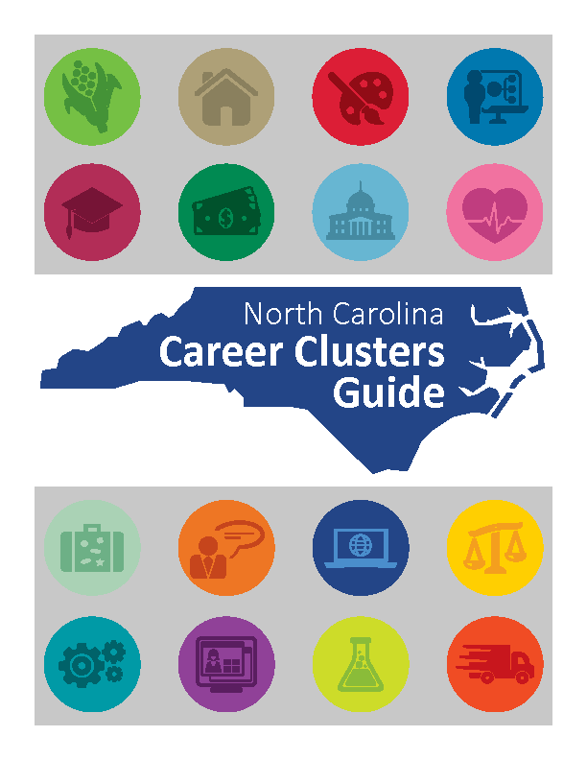
Notes:
We published a new North Carolina Career Clusters Guide in 2015.
You might have seen the one we created back in 2009.
This guide has updated data and fresh stories.
Copies have been distributed to the community colleges, high schools, and other locations across the state.
And we have run out of guides.
We want to ensure that everyone has both timely and accurate career information, thus promoting informed decisions about choosing a career path.
The North Carolina Department of Public Instruction and the North Carolina Community College System are committed to supporting the state’s workforce system by preparing the future workforce.
This guide will assist anyone in identifying the available career options by using individual interests, clearly defined career pathways, and timely employment projections.
I am going to walk you through the Career Clusters Guide, then show off the interactive website that has everything the book has -- and more.
=====
http://ncperkins.org/careers/

Slide 4
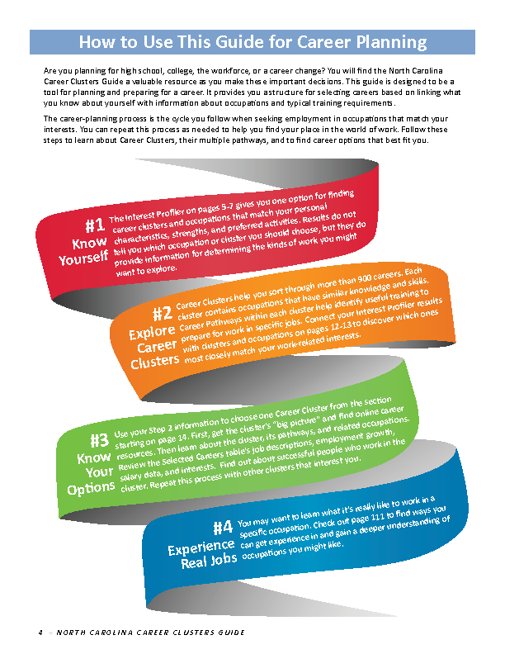
Notes:
At the beginning of the book you will find the "How-To-Use-This-Guide" page.
It is assumed that folks using this guide are looking to start a career -- or possibly to change careers.
Step one -- is to Know Yourself.
Too often people pick a career based solely on information from their parents -- or from what they see on Television.
Unfortunately, this often leads to people choosing a career that they see only as a job that pays the bills, rather than a true career.
We have found that discovering your personal career interests can help in matching you to an occupation that you may have never heard of, and one where you actually look forward to going to work on Monday morning.
=====
http://ncperkins.org/careers/

Slide 5
Notes:
Step two -- is to explore the careers. This is the time to match your interests and skills with careers that you may have never heard of.
This book is not intended to discern the perfect career for each person.
It is only a guide that will help you match your particular career interests to various occupations -- in the hopes that through further research, you will be able to get on a career pathway towards your perfect career.
In step three -- you explore the options. –
Look at the salaries of the careers that match your interests.
What are the education requirements, and most importantly, what are the job projections for that occupation?
There is no sense in preparing for an occupation where there will be no job openings when you are ready to apply.
In step four -- you get to experience the job first-hand. It might start with job shadowing, where you just watch someone work for a day, --
and internships where you get to spend a few weeks to a few months actually performing the tasks for that occupation, --
to apprenticeships where you are learning both on the job and in the classroom leading to full-time employment.
=====
http://ncperkins.org/careers/

Slide 6
Notes:
So we start here at step one, -- which I like to call – “Getting to know yourself.”
We think we know who we are, -- but most of us just stumble into that information -- and can go our whole lives without ever discovering our career interests and skills.
These five pages contain a simple interest profiler that will let you discover your career interests.
=====
http://ncperkins.org/careers/

Slide 7
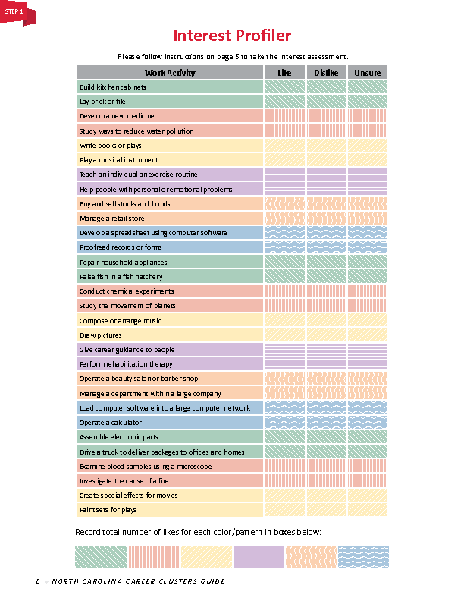
Notes:
It starts with a list of simple statements about specific job tasks. You just simply decide if each item sounds like something you would enjoy doing.
There are no right or wrong answers. Everyone has different interests.
This interest profiler will help you discover your interests and give you the data you need to help you discover great occupations that match you.
Don’t worry about your friends right now or how they would answer the questions, -- the focus here is on you, and you alone.
=====
http://ncperkins.org/careers/

Slide 8
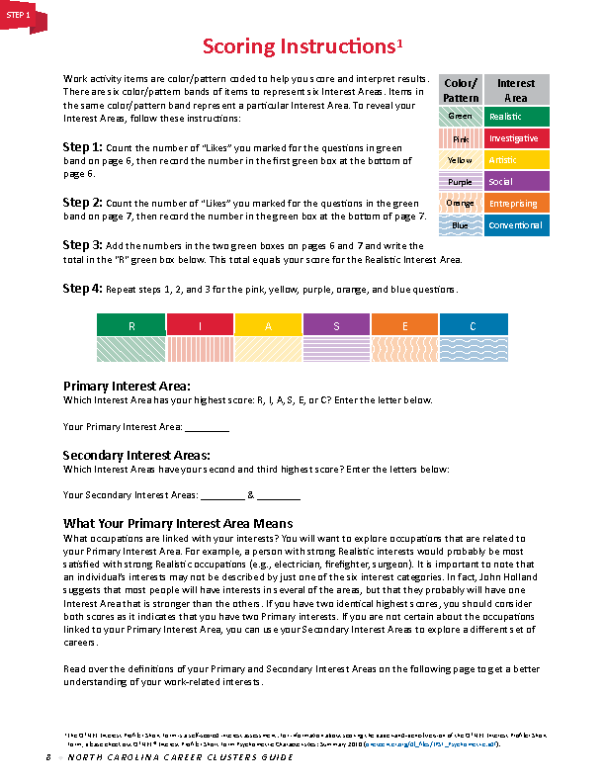
Notes:
The scoring instructions assist you in discovering your interests.
You will end up with a number for each of six different career interest areas.
You will use your primary and secondary interest areas, which are the largest two numbers, throughout the rest of the guide to match you to potential careers.
=====
http://ncperkins.org/careers/

Slide 9
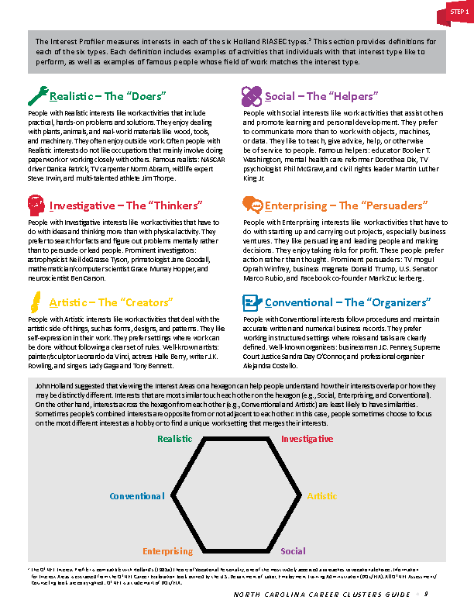
Notes:
page 9 describes the six career interest areas and explains how they relate to each other.
Reading these paragraphs will confirm the results of the interest assessment.
=====
http://ncperkins.org/careers/

Slide 10
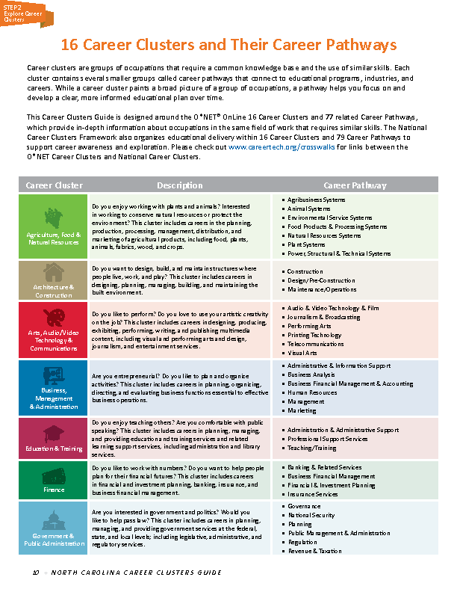
Notes:
Pages 10 and 11 list the 16 career clusters.
There is a description of each cluster and a list of the career pathways, which breaks down each career cluster into smaller collections of occupations.
=====
http://ncperkins.org/careers/

Slide 11
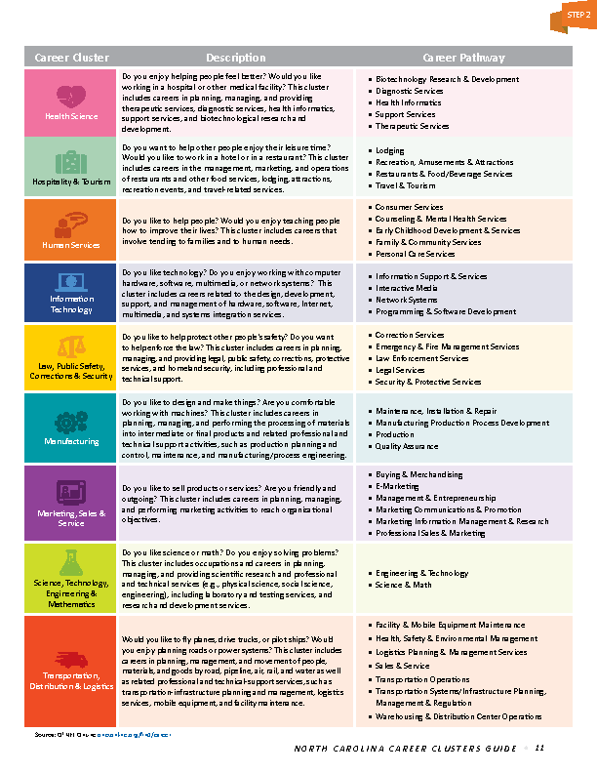
Notes:
Some may wish to skip the career interest profiler and jump right to the career clusters.
Choosing a career cluster is like declaring a major in college.
Everyone using this book to explore careers needs to know that they can change their career cluster at anytime.
Remember, -- this book is a guide. Not a magic career predictor.
=====
http://ncperkins.org/careers/

Slide 12
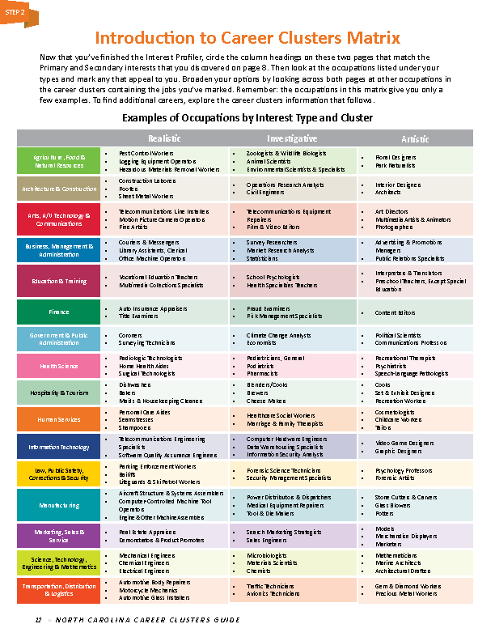
Notes:
On pages 12 and 13 is our career clusters matrix.
This is the place where career interests on the horizontal axis intersect with career clusters on the vertical axis.
If you have the results from the career interest profiler, and if you have decided on a career cluster or two, you can use this chart to cross reference the two items to get a short list of occupations that match both your career interests and your choice in a career cluster.
=====
http://ncperkins.org/careers/

Slide 13
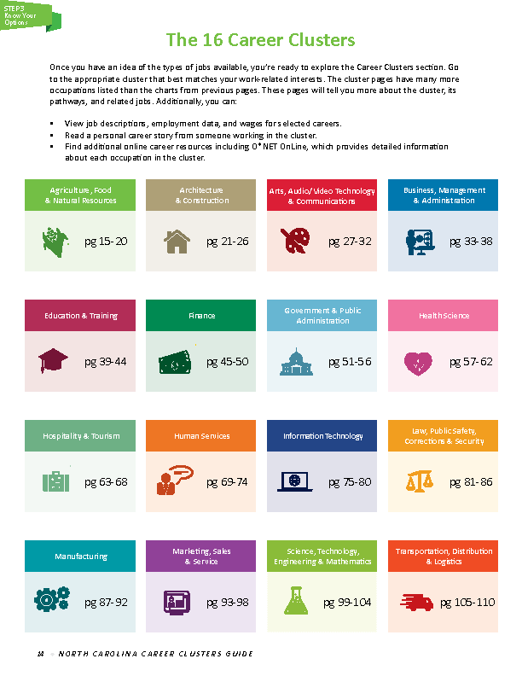
Notes:
Page 14 is the table of contents for the largest section of this guide.
The next one hundred pages are divided by career cluster.
=====
http://ncperkins.org/careers/

Slide 14
Notes:
First up is the Agriculture, Food and Natural Resources career cluster.
The opening page for each career cluster section is a description of the work settings in which you will find the occupations for this cluster.
The Career Research section on the right side of the page contains internet sites for more information.
It might be a trade association, a student organization, or government information about occupations in this career cluster.
=====
http://ncperkins.org/careers/

Slide 15
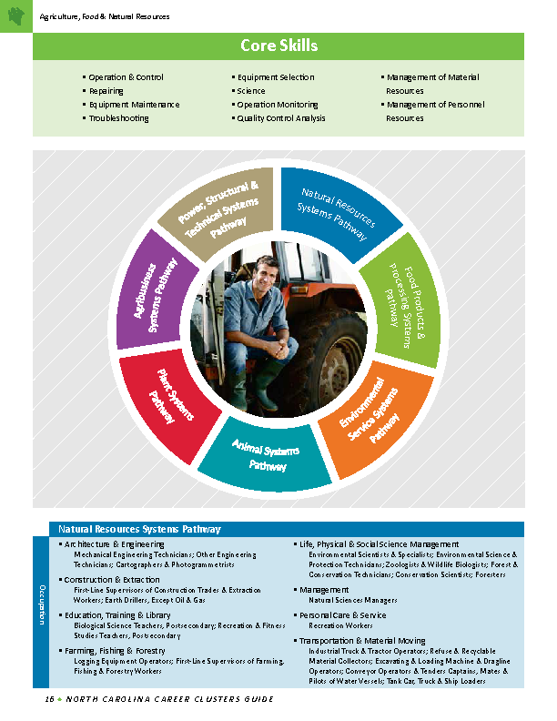
Notes:
The second page for each career cluster has the core skills listed at the top of the page.
These are the basic skills that apply to the occupations in the cluster.
In the center is a graphical representation of the career pathways, or subdivisions of the career cluster.
You can see that this career cluster is divided into seven career pathways.
At the bottom -- and continuing on the following page -- is a list of the occupations within each career pathway within that career cluster.
=====
http://ncperkins.org/careers/

Slide 16
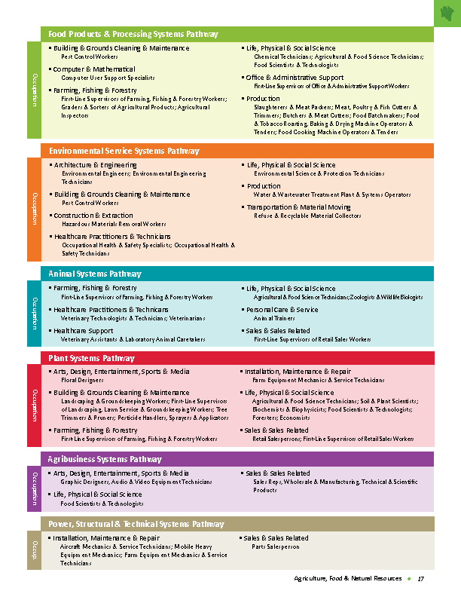
Notes:
You might find that you are drawn to occupations in a certain career pathway within a certain cluster.
If so, check out the other occupations in that same career pathway, since they might be similar, or might be an occupation of which you are not familiar.
=====
http://ncperkins.org/careers/

Slide 17
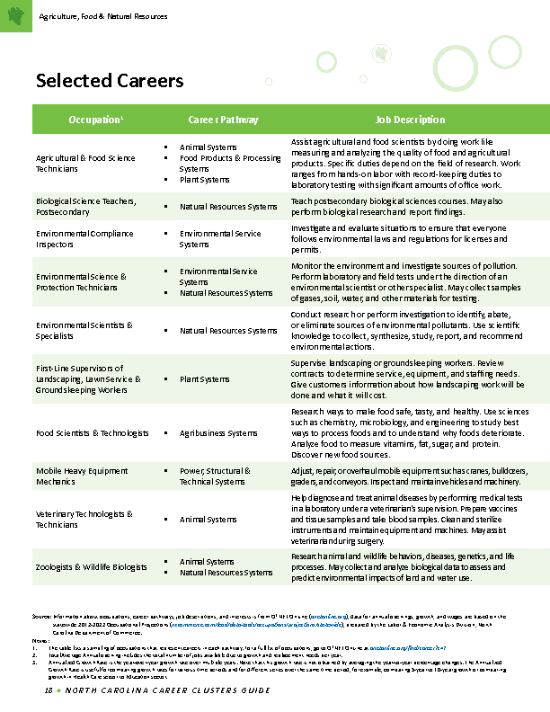
Notes:
The next two pages are a chart that shows a selection of occupations in that career cluster.
Each occupation lists the description of that occupation.
This will help you to get a quick understanding of each occupation -- and help you decide which occupations to further research.
=====
http://ncperkins.org/careers/

Slide 18
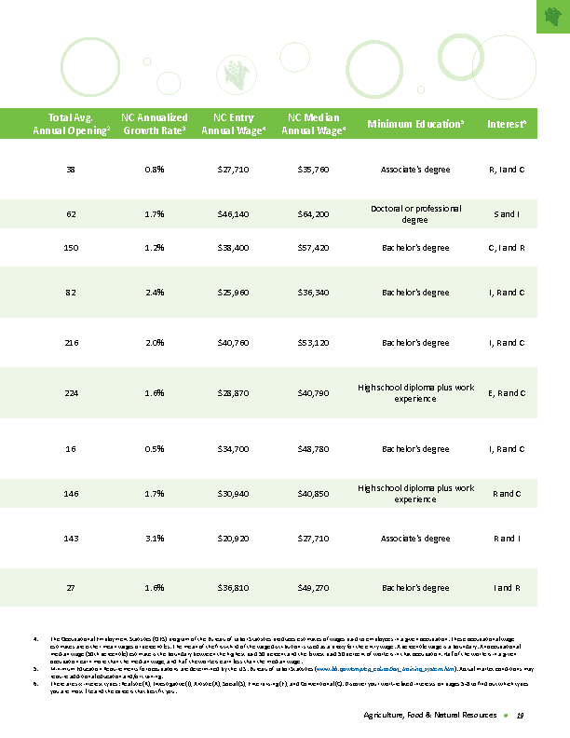
Notes:
Here you see the two pages of this table side-by-side.
The first column on the right-hand page has the total Average Annual Openings for each occupation.
This is the number of job openings projected per year.
A large number here means there will be lots of job openings in the near future when you are ready to apply for one of these jobs.
A low number here would indicate that the competition might be tight, since the prospect of job openings might be low.
The second column is the Growth Rate. This is similar to the first column, but indicates a percentage of growth for that particular occupation.
A high number here indicates that that occupation is experiencing growth. Low numbers indicate low growth.
If there is a large number of people employed in that occupation, then a low number here might not indicate low growth.
You have to take the first two columns together and look for trends to determine the true projected job openings.
=====
http://ncperkins.org/careers/

Slide 19
Notes:
The next column is the annual wage for entry-level employees. This is the average starting salary for everyone across the state in that occupation.
The next column is the Median Annual Wage, which you could consider as the average salary for all North Carolinians in that occupation.
The next column is the Minimum Education Required .
This is the minimum level of education required to be hired for this occupation. Some employers may require a higher level of education or the possession of certain industry certifications.
And the last column is the career interests. They gave similar career interest assessments to people who are already employed -- and found some common career interests, which are listed here.
The thinking is that certain career interests match up with certain occupations.
Here you can scan down the column and discover the ones that match you.
=====
http://ncperkins.org/careers/

Slide 20
Notes:
The last page in each career cluster section is a Career Story featuring someone who graduated from a North Carolina community college and are now employed in that career cluster.
Reading these stories helps you realize that you are not alone in your quest for a career.
=====
http://ncperkins.org/careers/

Slide 21
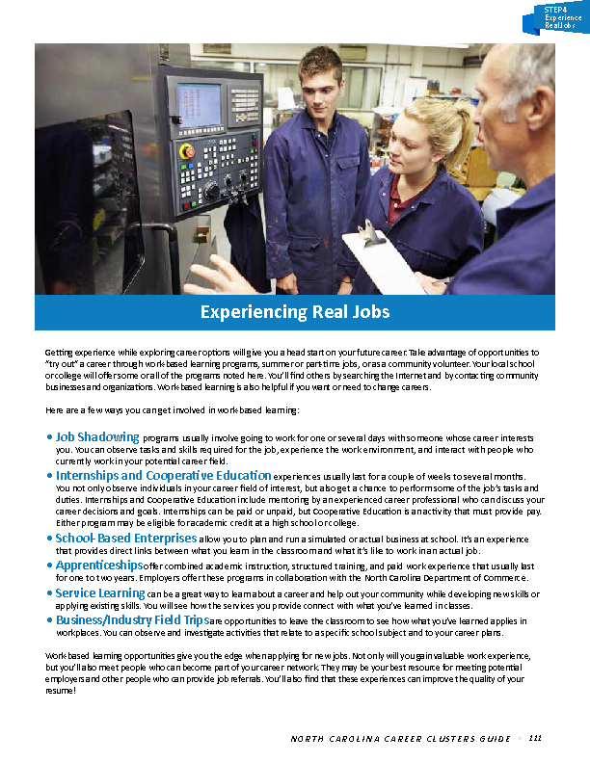
Notes:
After you get past all of the sections of the guide on Career Clusters, you get to the “Experiencing Real Jobs” section.
Here we are on page 111.
This page explains the various kinds of work-based learning -- from job shadowing and field trips to internships and apprenticeships.
These are ways to get out of the classroom into the workplace - and start connecting what you are learning in the classroom to what is happening in the workplace.
=====
http://ncperkins.org/careers/

Slide 22
Notes:
The next two pages are stories about folks who participated in work-based learning while in college.
Read their stories to see how they got on their career pathway and how work-based learning contributed to their career success.
=====
http://ncperkins.org/careers/

Slide 23
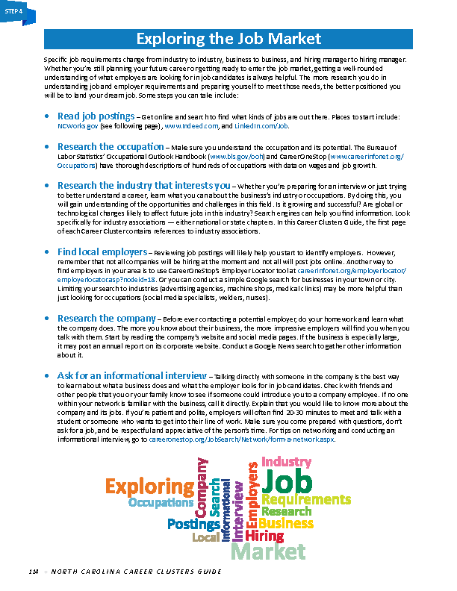
Notes:
And then there is a page about how to look for jobs.
So far, everything in this Career Cluster Guide is about finding out who you are and then finding the occupations that you would like to pursue, getting the right education and certifications, --
and now, near the end of the book, is the information about where to look for actual jobs, and how to prepare for a job interview.
This is the same kind of information given by the Career Development Coordinators in the high schools across the state and at our NCWorks Career Centers.
=====
http://ncperkins.org/careers/

Slide 24
Notes:
And speaking of NCWorks -- Inside the back cover is information about NCWorks Online.
When you are ready to look for a job, NCWorks Online is the place to go.
=====
http://ncperkins.org/careers/

Slide 25
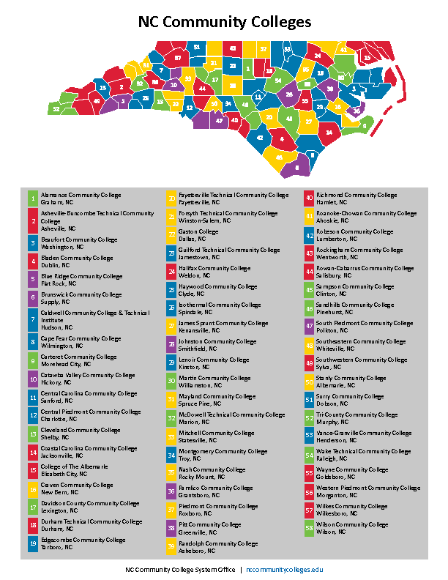
Notes:
And on the back cover is a map and list of all of the community colleges in North Carolina.
As you see on the map, many of the colleges serve multiple counties.
You do not have to go to the college that serves your county, you can go to any of the colleges and get a fine education.
=====
http://ncperkins.org/careers/

Slide 26
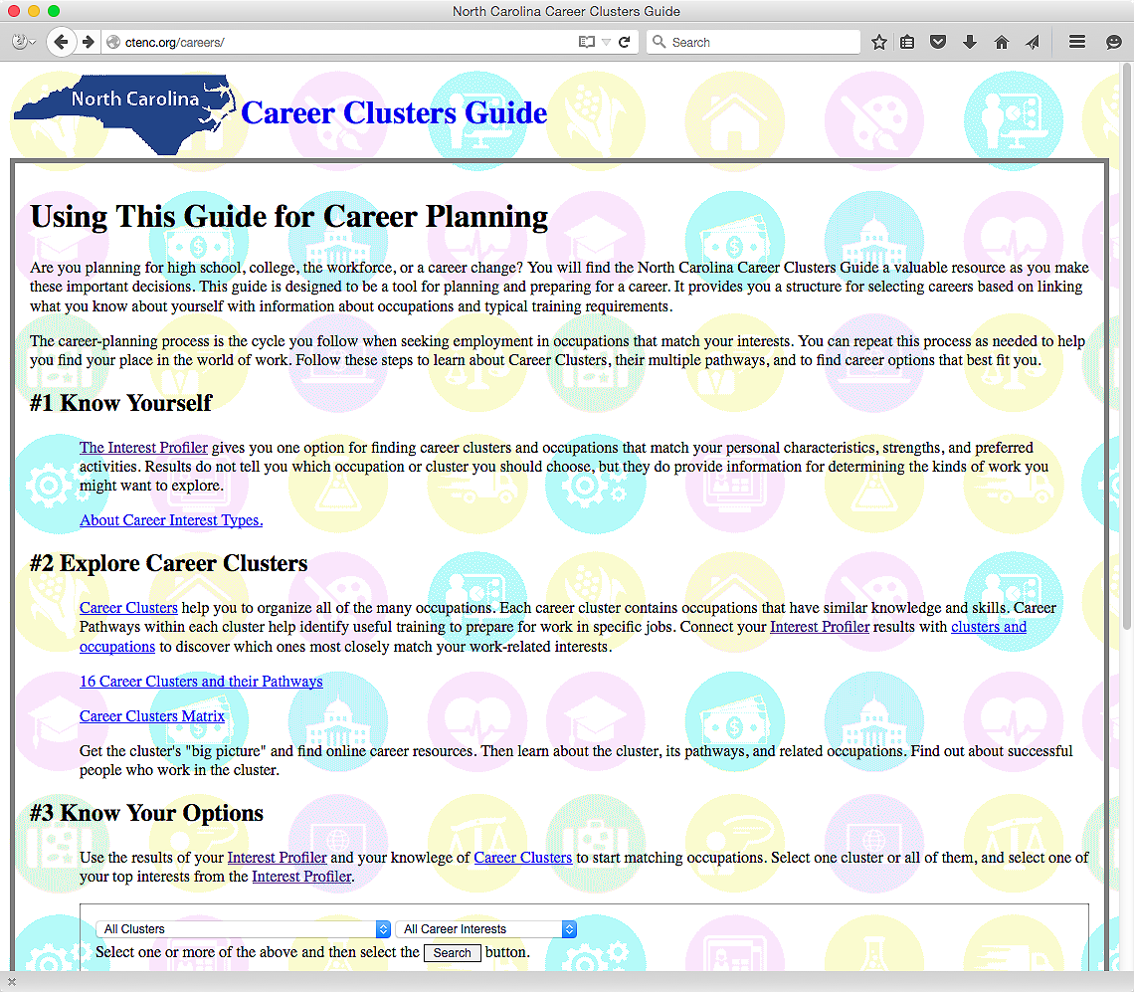
NCperkins.org/careers
Notes:
And now look. We took the career cluster guide and made it into an interactive website. How cool is that?
Here is the web address. NC Perkins dot org is the same website where you can find the PowerPoint file for this presentation.
Besides the interactive web pages, a PDF of the printed book is available at the bottom of the main page.
Let’s start here at step number one, Know Yourself -- and select the link to the Interest Profiler.
=====
http://ncperkins.org/careers/

Slide 27
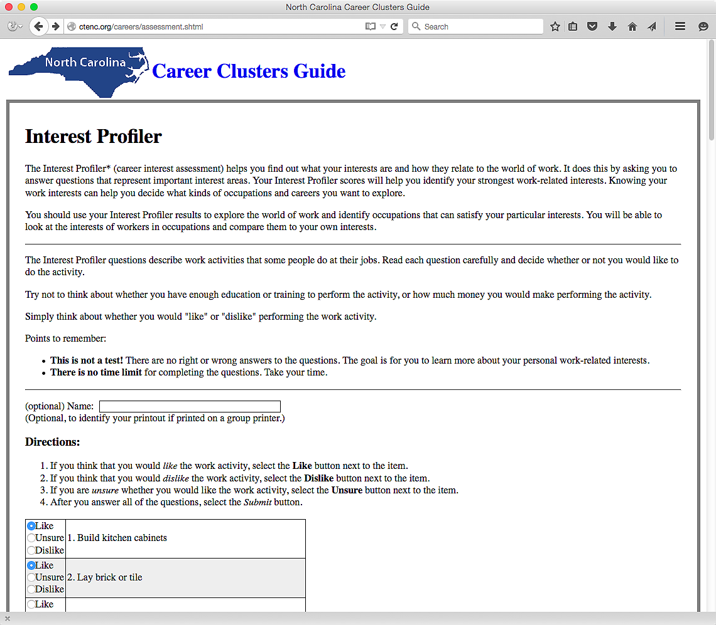
Notes:
This is the same interest assessment that is on the O*NET and what is in the printed version of the Career Clusters Guide.
There is an optional place here to enter a name, which makes it handy if the results are printed on a common classroom printer.
After all the questions are answered . . .
=====
http://ncperkins.org/careers/

Slide 28
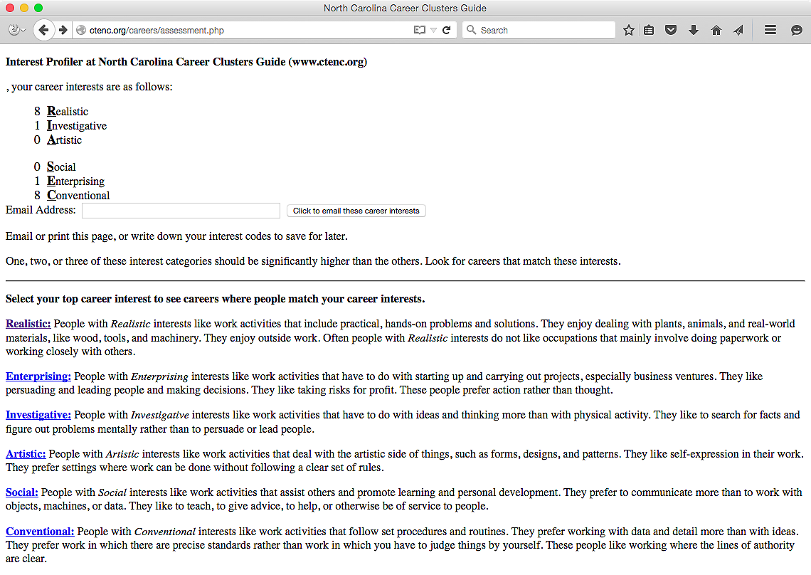
Notes:
Unlike the paper version of the guide, this web-based version will score the interest profiler automatically.
You get a number in six career interest areas. The high numbers indicate a personal preference for that kind of activity.
→ Here are my results.
I am a Realistic, Conventional kind of guy.
((hide))
Notice there is a place to enter an email address, so the results can be emailed for further use.
Since I rank high in Realistic interests, I select the link to Realistic Careers …
=====
http://ncperkins.org/careers/

Slide 29
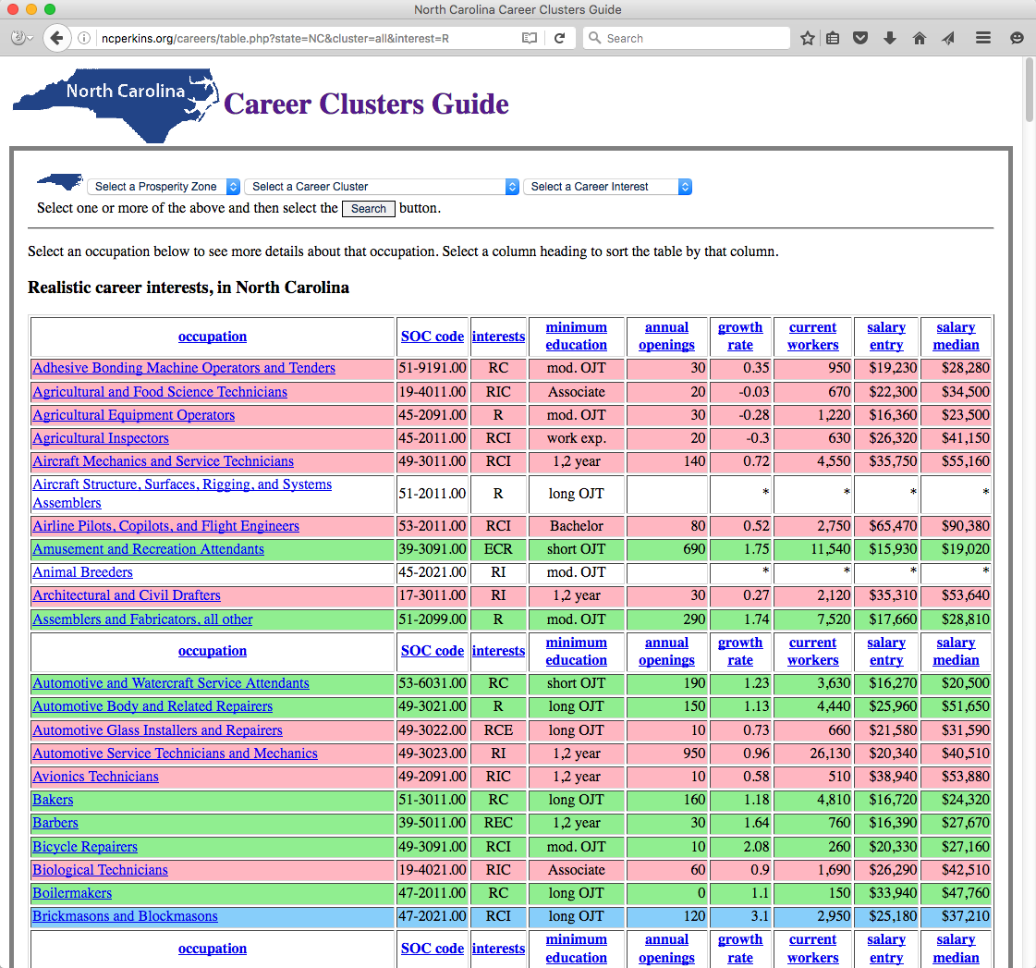
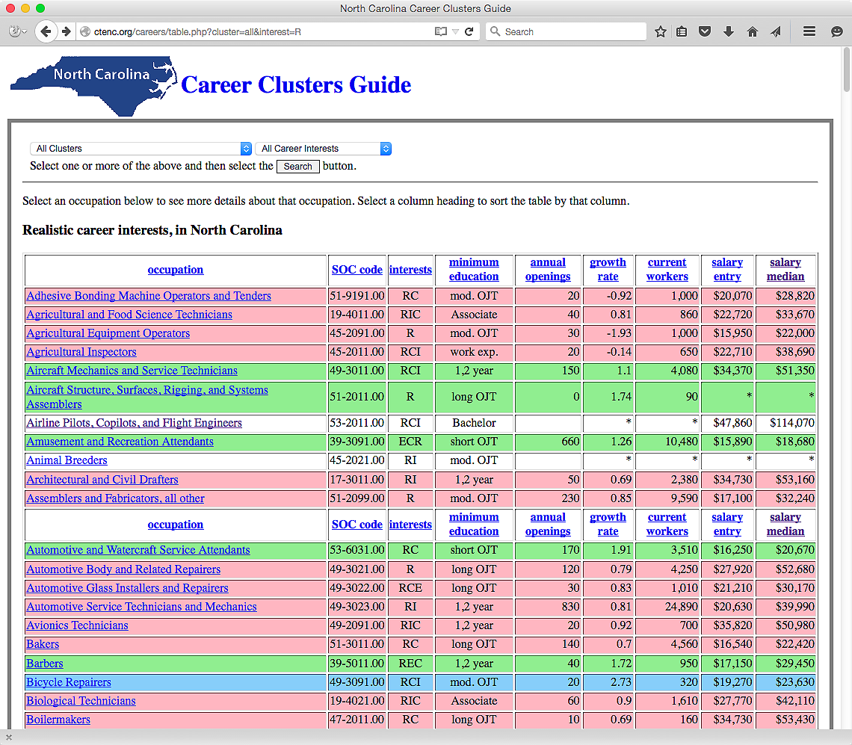
Notes:
Which takes me to this page, where we now see all of the occupations in North Carolina where the workers have a predominate Realistic career interest.
Realistic career interests is about working with your hands.
The color coding corresponds to the projected growth rate of that occupation over a ten-year period.
Blue is projected high demand, red is low demand, and green is average demand.
For each occupation in this table we have the Career Interests, minimum education required, projected annual openings, and starting and average salary. Just like in the book.
If you select the name of an occupation.
I am selecting “Aircraft Mechanic” …
=====
http://ncperkins.org/careers/

Slide 30
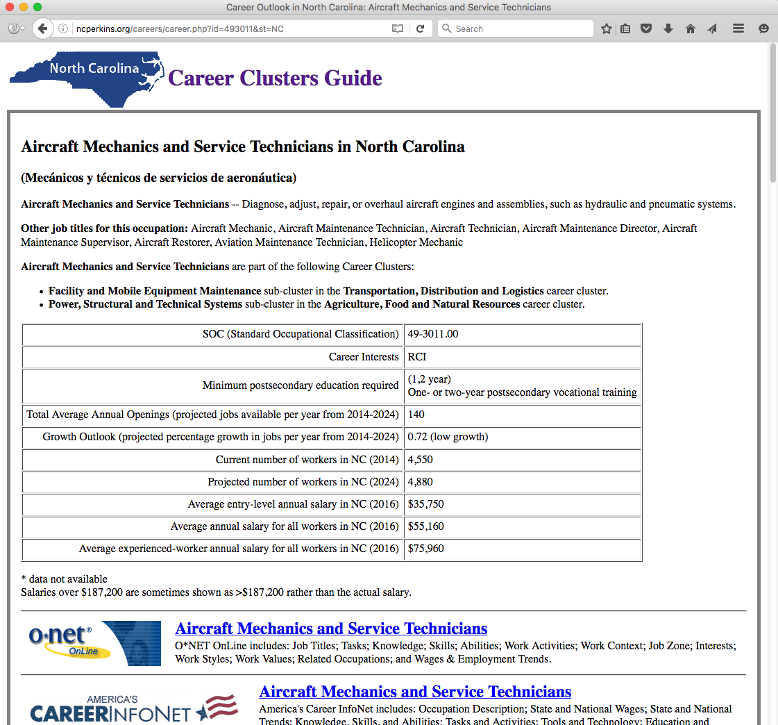
Notes:
It takes you to this web page where you can learn all about the occupation of aircraft mechanic.
And If you scroll down the page, …
=====
http://ncperkins.org/careers/

Slide 31
Notes:
… you see direct links to the O*NET, --
America’s Career Info Net, --
and the Occupational Outlook Handbook.
Select any of those to find more information about Aircraft Mechanics.
Scroll down the page a little further-- and you see career videos …
=====
http://ncperkins.org/careers/

Slide 32
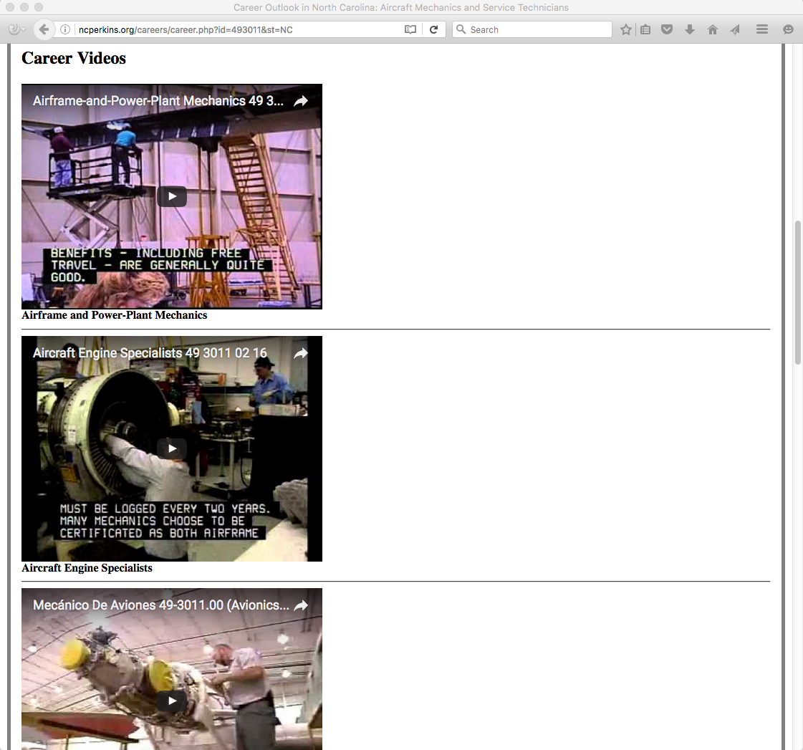
Notes:
In this case there are three career videos.
One for the Airframe and Power Plant Mechanics, and another video about the Aircraft Engine Specialists.
The third video is a Spanish language video about Aircraft Mechanics.
=====
http://ncperkins.org/careers/

Slide 33
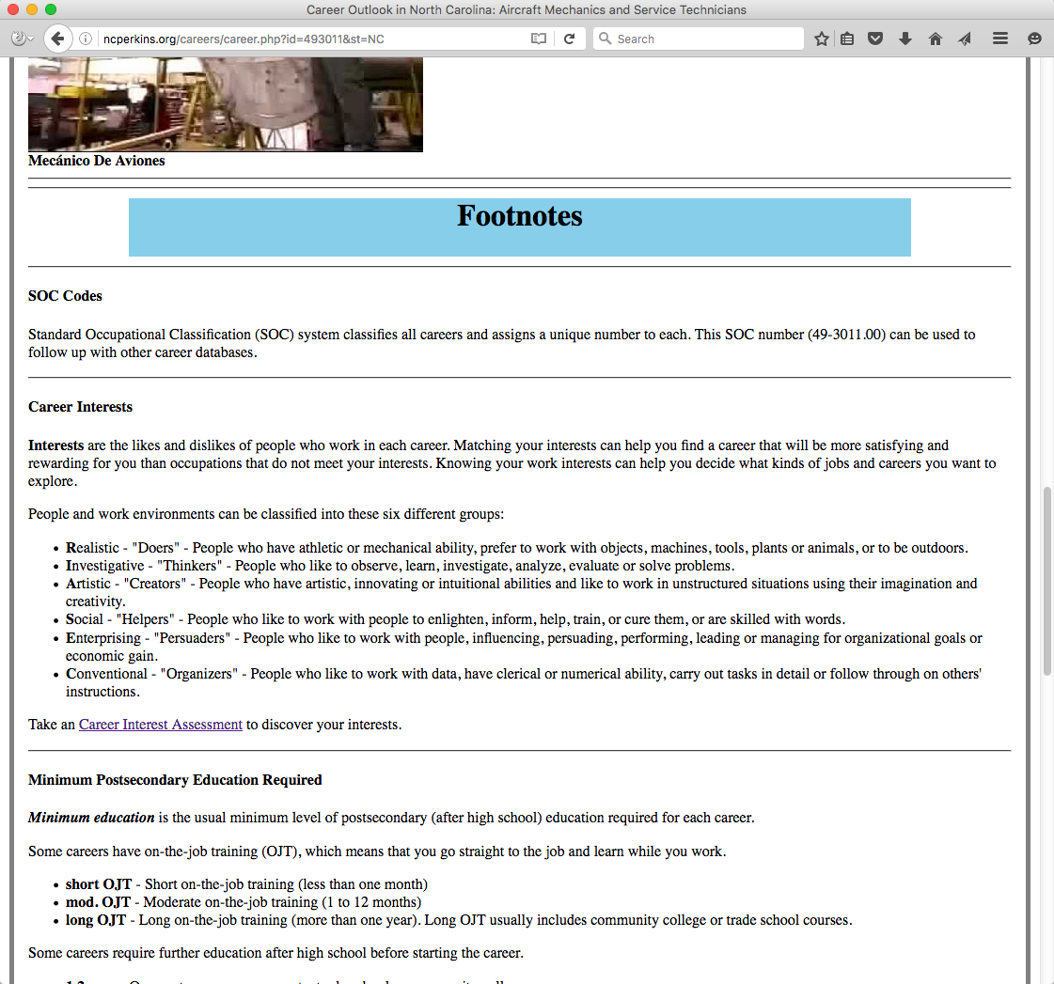
Notes:
The Footnotes at the bottom of the page explains from where all of the data come.
=====
http://ncperkins.org/careers/

Slide 34
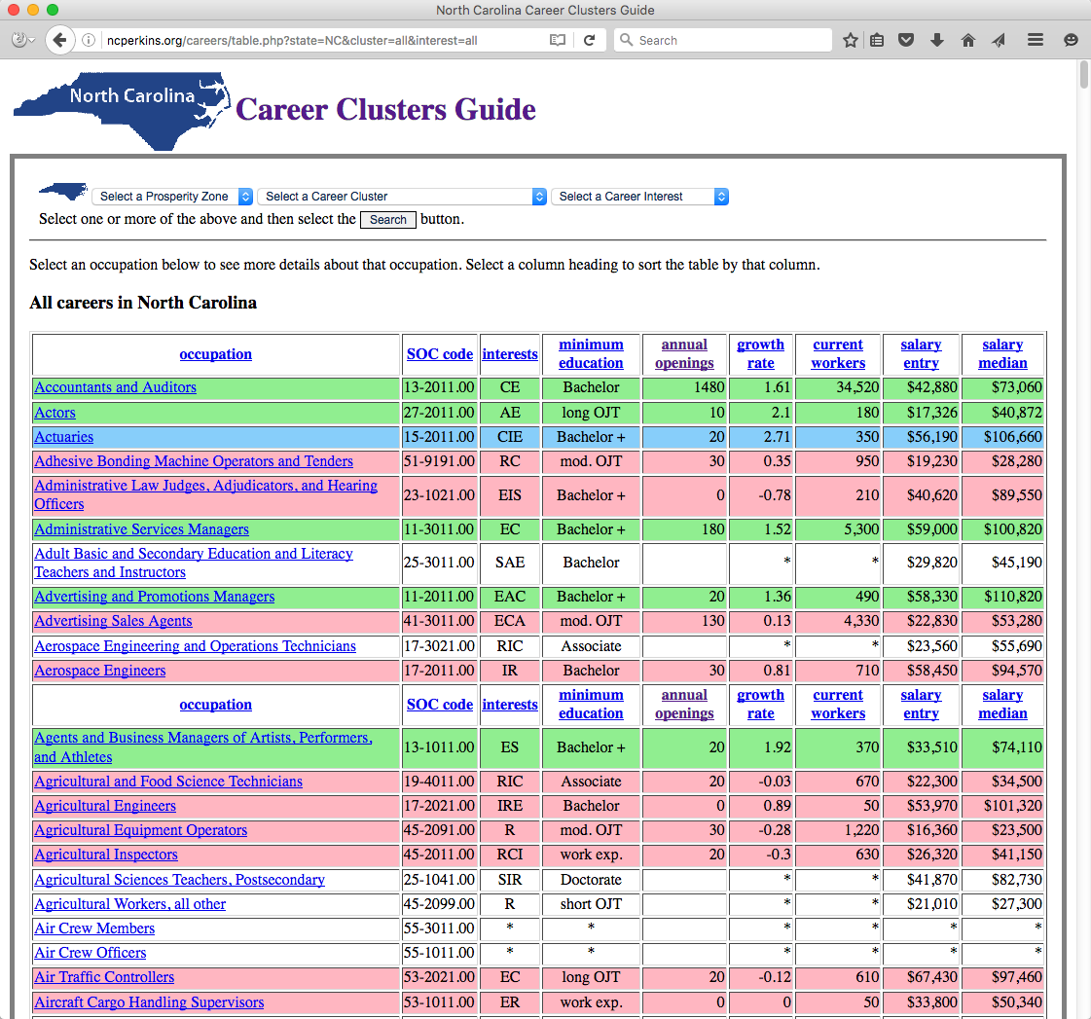
Notes:
I showed you this page earlier.
Right now it shows all occupations in North Carolina.
→ The drop-down menus let you select a prosperity zone, career cluster -- or a career interest -- or all three.
=====
http://ncperkins.org/careers/

Slide 35
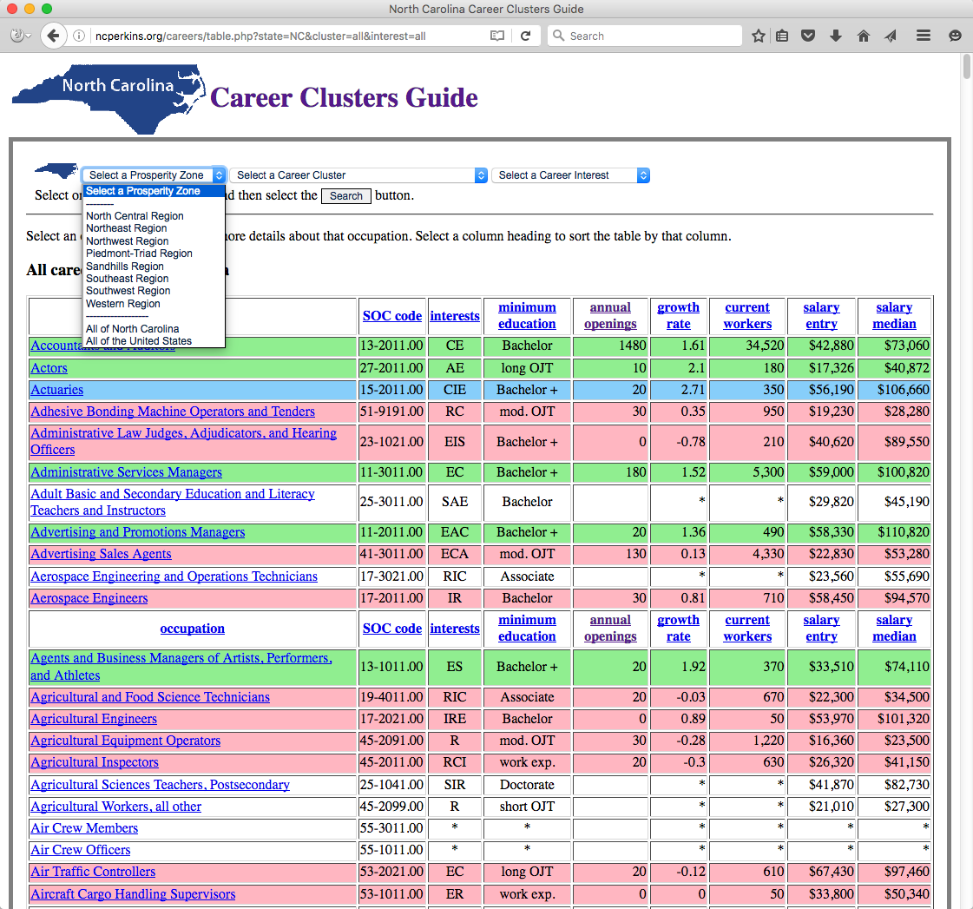
Notes:
Here is the menu to select one of the eight prosperity zones.
The salaries and job projections are listed by prosperity zone, so you can see which pays more or has the highest future demand.
You can also look at the data for the entire state or look at the data for the entire country.
=====
http://ncperkins.org/careers/

Slide 36
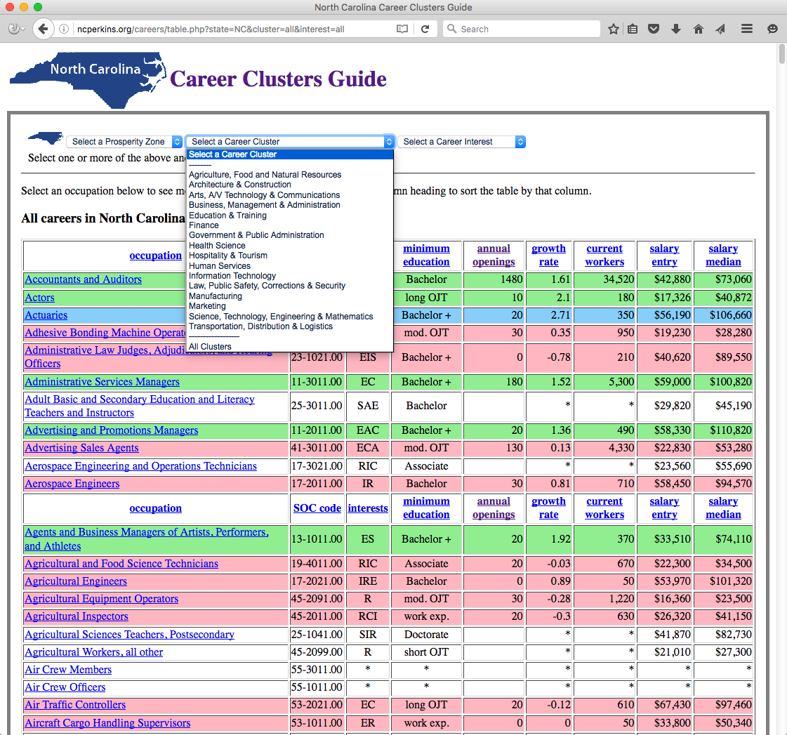
Notes:
Here is the menu to select one of the sixteen career clusters.
=====
http://ncperkins.org/careers/

Slide 37
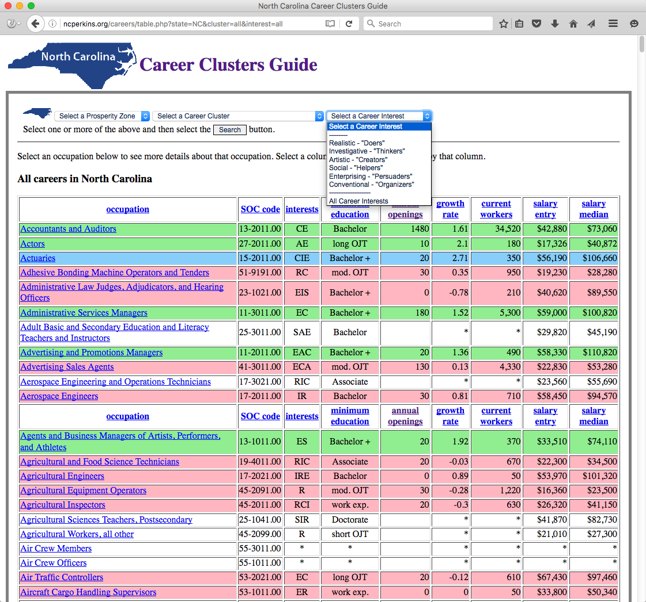
Notes:
And the drop-down menu to select a career interest.
So - Select a prosperity zone, cluster and an interest, -- or just select one or the other -- and then select the Search button.
=====
http://ncperkins.org/careers/

Slide 38
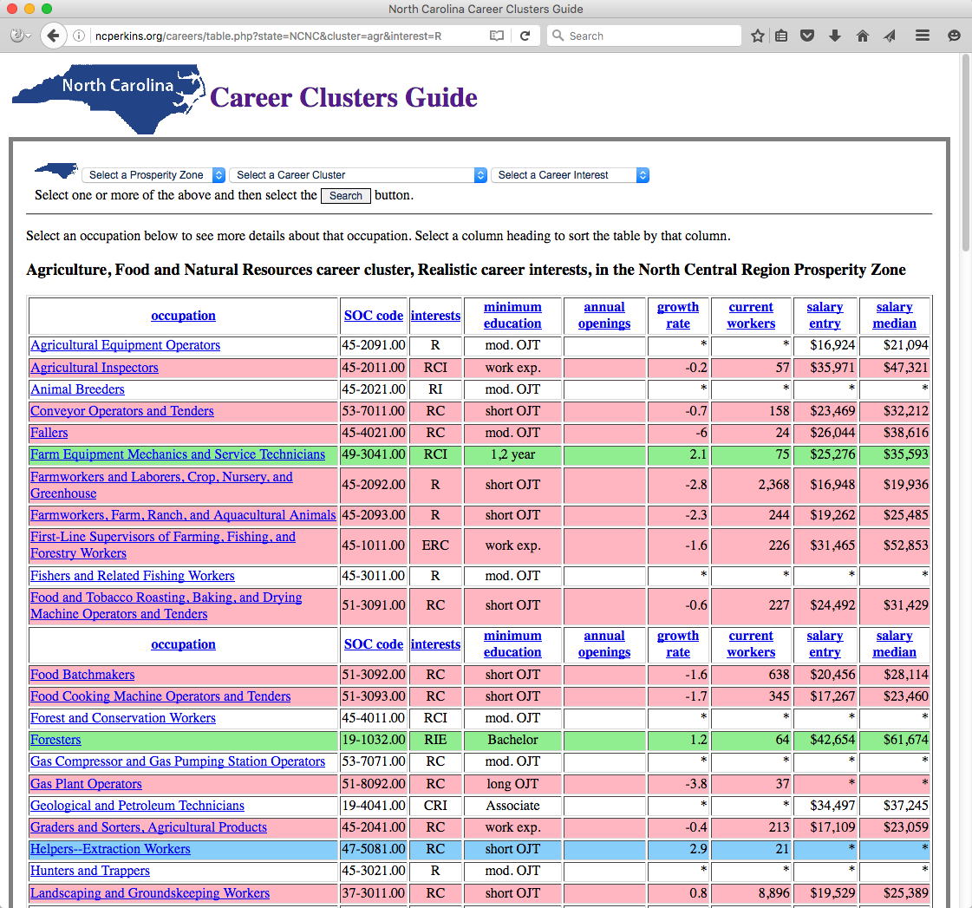
Notes:
In this case we are looking at all of the careers in the North Central Prosperity Zone, in the Agriculture, Food and Natural Resources career cluster -- for people who have Realistic Career interests.
This data represents the salaries and job projections in this particular part of the state.
From here you can select a column to sort the data-- and select an occupation to see more details.
You could spend days looking at all of the occupations and watching the videos.
=====
http://ncperkins.org/careers/

Slide 39
Notes:
Once you take time to discover who you are and what you like, you can start narrowing down your career choices. Without this guide -- the task to choose a career would be a daunting task.
Can you see where you can use this Career Clusters Guide, -- both the printed version as well as the online version -- with our students?
All of the information in the new North Carolina Career Clusters Guide is here in an interactive website, -- plus much more.
You get all 900 occupations, not the 160 in the printed book.
You get a self-scoring interest assessment, And you get to look at the salaries and the projected job openings in each of the eight prosperity zones across the state.
=====
http://ncperkins.org/careers/

Slide 40
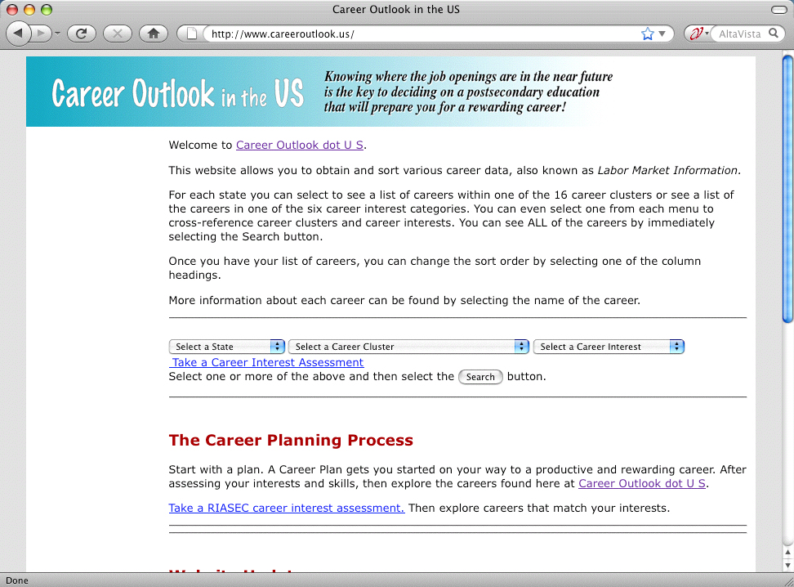
www.CareerOutlook.US
Notes:
If you want to look at other states. Especially if you are in a county that borders another state, then Career Outlook dot US is the place to go.
There you can see the job projections and salaries for each occupation for each state.
There is also the same career interest assessment to help you get started.
--
We have to help our youth discover who they are first -- before we can help them find the career that is best suited for them.
Tools like this can help get everyone on the right pathway to a productive and rewarding career.
====
www.CareerOutlook.US
40

Slide 41
Chris Droessler
CTE Coordinator
NC Community Colleges
DroesslerC@NCCommunityColleges.edu
Get the PowerPoint
www.ncperkins.org
Notes:
It is my hope –
that the citizens of North Carolina can all benefit from the use of this North Carolina Career Clusters Guide –
and can all discover a career that they love.
Don't forget to download the PowerPoint, or any other PowerPoint I have posted.
Do you have any questions?
Thanks for participating today.

