Slide 1
Perkins Update
September 14, 2021

Slide 2
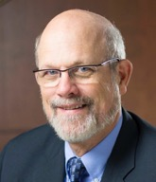
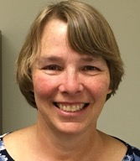
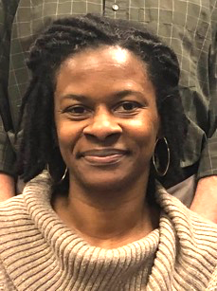
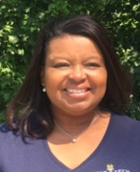
Team Perkins
Bob Witchger
Patti Coultas
Tony Reggi
Darice McDougald
Michelle Lair
Mary Olvera
Chris Droessler
Notes:
Dr. Bob Witchger
919-807-7126
WitchgerB@nccommunitycolleges.edu
Dr. Tony R. Reggi
919-807-7131
ReggiA@nccommunitycolleges.edu
Patti Coultas
919-807-7130
CoultasP@nccommunitycolleges.edu
Dr. Mary Olvera
919-807-7120
OlveraM@nccommunitycolleges.edu
Michelle Lair
919-807-72227
LairM@nccommunitycolleges.edu
Chris Droessler
919-807-7068
DroesslerC@nccommunitycolleges.edu
Darice McDougald
919-807-7219
McDougaldD@nccommunitycolleges.edu

Slide 3
Purpose of Perkins
Develop more fully the academic knowledge and technical and employability skills of secondary education students and postsecondary education students who elect to enroll in CTE programs and programs of study
Notes:
The Strengthening Career and Technical Education for the 21st Century Act reauthorized and updated the Carl D. Perkins Career and Technical Education Act of 2006 to become the current Carl D. Perkins Career and Technical Education Act of 2006 as amended by the Strengthening Career and Technical Education for the 21st Century Act (Perkins V)
This updated act stresses:
- Academic, Technical, and Employability Skills
- Funding Secondary and Postsecondary CTE
- Focusing on Students who elect to enroll in CTE Programs of Study

Slide 4
Promising Practice Video 2021
Wayne Community College
New pediatric simulator
https://www.ncperkins.org/video/video.php?v=Wayne-2021&y=2021
See all the videos:
https://www.ncperkins.org/video/
Notes:
August 2021
Wilson
Wilkes
September 2021
Wayne
Vance-Granville
October 2021
Stanly
Southeastern
November 2021
South Piedmont
Rowan-Cabarrus
Rockingham
Robeson
Pitt-Martin
Pamlico
Nash
Mayland
Lenoir
Johnston
James_Sprunt
Halifax
Gaston
Forsyth
Fayetteville
Edgecombe
Durham
Davidson
Craven
Coastal_Carolina
Central_Piedmont
Carteret
Cape_Fear
Caldwell
Brunswick
Blue_Ridge
Beaufort
AB_Tech

Slide 5
Perkins Update - Agenda
Promising Practice Videos
Career Pathway Systems
CORD
ESAP
Mid-Year Reviews
Upcoming events
Announcements

Slide 6
Career Pathway Systems
Building Career Pathways Beyond
9-14 Programs of Study

Slide 7
Career Pathway Systems
Career Pathway Systems are about the coordination of people and resources.
Notes:
Career Pathway Systems are about the coordination of people and resource.
Within education, it includes the k-12 system, postsecondary education, and in particular the career and technical education services provided within and across program providers.

Slide 8
Perkins V and WIOA Career Pathway Systems
WIOA includes an updated definition and overarching framework for the implementation of career pathways. Defined as a combination of rigorous and high-quality education, training, and other services to assist youth and adults with acquiring marketable skills and industry recognized credentials.
Notes:
WIOA includes an updated definition and overarching framework for the implementation of career pathways. Defined as a combination of rigorous and high-quality education, training, and other services that:

Slide 9
Career Pathway Systems
Education and Training
High School
WIOA TItle II
Assist Youth and Adults
Better Alignment of Education, Training, and Employment
Coordination with Human and Social Services among public agencies
Collaboration with Employers
Community College
University
Human and Social Services
Voc Rehab
Student Services
Department Social Services
Stakeholders
Notes:
Career Pathways to assist youth and adults with acquiring marketable skills and industry recognized credentials through a better alignment of education, training and employment, and human and social services among public agencies and employers

Slide 10
Perkins Career Pathway Systems
Planning Career Pathway Systems initially included White House National Economic Council, Office of Management and Budget and 13 federal agencies.
Notes:
Planning Career Pathway Systems initially included White House national economic council, office of management and budget and 13 federal agencies.

Slide 11
Perkins V Career Pathway Systems
Pathways provide for a customer-centered approach to training and education and include programs such as:
Adult Basic Education
Occupational Training
Postsecondary Education
Career and Academic Advising
Student Support Services
Notes:
Career pathways can offer an efficient customer centered approach to training and education by connecting the necessary adult basic education, occupational training, postsecondary education, career and academic advising, with student support to prepare help individuals obtain and progress in a career.

Slide 12
Perkins V Career Pathway Systems
Align Industry Skills Needs in the state and regional economy
Prepare individual for secondary and postsecondary options including apprenticeship
Include Counseling and Support to individual in achieving their education and career goals
Notes:
A. Aligns with the skill needs of industries in the economy of the state or region
B. Prepares individuals to be successful in any of a full range of secondary and postsecondary options, including registered apprenticeship
C. Includes counseling to support an individual in achieving their education and career goals

Slide 13
Perkins V Career Pathways Systems
Appropriate education programs offered concurrently within and in the same context as workforce preparation activities and training for specific occupations or occupational clusters
Organizes Education, Training and other Services to meet the particular needs of the individual in a manner that accelerated the education and career advancement of the individual
Enables attainment of secondary school diploma or equivalent, and at least one recognized postsecondary credential
Helps individual enter and advance in a specific occupation or occupational cluster
Notes:
D. Appropriate education offered concurrently with and in the same context as workforce preparation activities and training for a specific occupation or occupational cluster
E. Organizes education, training, and other services to meet the particular needs of the individual in a manner that accelerates the educational and career advancement of the individual to the extent practicable
F. Enables the individual to attain a secondary school diploma or it recognized equivalent, and at least one recognized Postsecondary credential
G. Helps the individual enter and advance in as specific occupation or occupational cluster

Slide 14
Perkins V Career Pathway Systems
Provide for greater Efficiency and Transparency to the routes from Adult Education, non-credit training, other starting points to credentials recognized by industry and postsecondary education institutions
Notes:
Pathways are designed to bring greater efficiency and transparency to the routes from adult education programs, non-credit training, or other starting points to credentials recognized by industry and postsecondary education institutions

Slide 15
Perkins V Career Pathways
Enable individuals to progress through a modular system of postsecondary credential that build upon each other leading to further credentials and improved employment prospects
Notes:
Career pathways enable individuals to progress through a modular system of postsecondary credentials that build upon each other, leading to further credentials and improved employment prospects.

Slide 16
Six Elements of Career Pathways
1. Build cross-agency partnerships with clarifying roles
Partnerships are at the heart of pathway systems and include
Political Leaders, Employers, State and Local Education Providers,
Human Services, Workforce Development Boards, Community Colleges,
Adult Basic Education Providers, Economic Development,
Community Based Organizations
Notes:
Six elements of Career Pathways
1. Build cross-agency partnerships with clarifying roles
a. Partnerships are at the heart of pathway systems and include political leaders, employers, state and local education providers, human services, workforce development boards, community colleges, adult basic education providers, economic development and community based organizations

Slide 17
Six Elements of Career Pathways
2. Identify Industry Sectors and Engage Employers
Real labor market information and active employer involvement are sought to ensure training and education programs meet the skill and competency needs of local employers.
Engaged employer involvement across the education and training spectrum have demonstrated better employment and earning outcomes for participants
Notes:
2. Identify industry sectors and engage employers
a. Real labor market information and active employer involvement are sought to ensure training and education programs meet the skill and competency needs of local employers. Engaged employer involvement across the education and training spectrum have demonstrated better employment and earning outcomes for participants

Slide 18
Six Elements of Career Pathways
3. Design education and training programs
Career pathways provide a clear sequence of education courses and credentials that meet the skill needs of high-demand industries.
Key design features include contextualized curricula, integrated basic education and occupational training, career counseling, support services, assessments, and credit transfer agreements that ease entry and exit and promote credential attainment.
Notes:
3. Design education and training programs
a. Career pathways provide a clear sequence of education courses and credentials that meet the skill needs of high-demand industries. Key design features include contextualized curricula, integrated basic education and occupational training, career counseling, support services, assessments, and credit transfer agreements that ease entry and exit and promote credential attainment.

Slide 19
Six Elements of Career Pathways
4. Identify funding needs and sources
Innovative funding strategies that braid funds from a variety of public and private sources are essential as pathways develop
Career Pathways blend and align services from different governmental agencies to support the individuals successful completion
Notes:
4. Identify funding needs and sources
a. Innovative funding strategies that braid funds from a variety of public and private sources are essential as pathway approached blend and align services from different governmental agencies to support the individuals successful completion

Slide 20
Six Elements of Career Pathways
5. Align policies and programs
Career pathway programs require significant alignment among workforce, education, and human services to ensure individuals can move seamlessly from school to work and earn in-demand credentials.
Notes:
5. Align policies and programs
a. Career pathway programs require significant alignment among workforce, education, and human services to ensure individuals can move seamlessly from school to work and earn in-demand credentials

Slide 21
Six Elements of Career Pathways
6. Measure system change and performance
Career pathway initiatives define
Desired system and program outcomes,
Establish how data will be collected, stored, and tracked
How shared data will be analyzed
Assessing ongoing progress toward achieving outcomes
Notes:
6. Measure system change and performance
a. Career pathway initiatives define desired system and program outcomes, establish how data will be collected, stored, tracked, and how shared data will be analyzed while assessing progress made toward achieving outcomes

Slide 22
CORD – Center for Occupational Research and Development
Pathway Mapping Process
Business and Industry Leadership Teams – B.I.L.T.
Hope Cotner
Notes:
https://www.nc-net.info/building-career-pathways/#

Slide 23
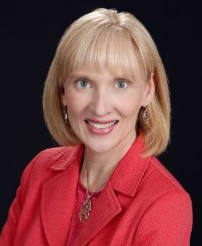
Hope Cotner
President/CEO
Center for Occupational Research and Development
Notes:
https://www.nc-net.info/building-career-pathways/#
Hope Cotner
President/CEO
Center for Occupational Research and Development
hcotner@cord.org

Slide 24
Employability Skills Alignment Project (ESAP)
Wilkes Community College
Employability Skills Alignment Project
video
Notes:
https://wilkescc-my.sharepoint.com/personal/jasitek917_wilkescc_edu/_layouts/15/onedrive.aspx?id=%2Fpersonal%2Fjasitek917%5Fwilkescc%5Fedu%2FDocuments%2FRecordings%2FESAP%20Wilkes%20Community%20College%2Emp4&parent=%2Fpersonal%2Fjasitek917%5Fwilkescc%5Fedu%2FDocuments%2FRecordings&originalPath=aHR0cHM6Ly93aWxrZXNjYy1teS5zaGFyZXBvaW50LmNvbS86djovZy9wZXJzb25hbC9qYXNpdGVrOTE3X3dpbGtlc2NjX2VkdS9FUVVta0RlZS1sQkNvVGlGNEpCUU43TUJHU245Ty1xejVzamR0dDlSYW5HMndBP3J0aW1lPTA0QWRiUmx1MlVn
Kristen Macemore, our Dean of BPST
Kim Bell
Programs Specialist/Senior Administrative Assistant
Office of Vice President of Instruction
Wilkes Community College
Wilkesboro, NC 28697
336-838-6127

Slide 25
CTE Programs of Study /Pathways
REMINDER:
December 18, 2021
9-14 CTE Pathways Due in Moodle

Slide 26
Elements of a 9-14 CTE Career Pathway
Aligned to labor market needs, which includes engaged employers
Secondary and postsecondary program of study linkage
Career advising - to develop an individual plan
Education and work-based learning offered concurrently with WIOA
Pathway designed to meet individual needs
Individual earns a postsecondary credential
Individuals enter and advance in a career
Perkins Sec 3(8) which references WIOA (29 U.S.C. 3102) Sec 3(7)

Slide 27
Mid-Year Review - Reminder
Power Point –
Update on Activities
Spending
Time Certifications
Semi-Annual Time Certification
Jan 12, 13, 14, 18, 19, 20, 21, 2022

Slide 28
Mid-Year Reviews January 12, 2022
Brunswick CC
College of The Albemarle
Halifax CC
James Sprunt CC
Martin & Roanoke-Chowan
Mayland CC
McDowell TCC
Montgomery CC
Piedmont CC
Tri-County CC

Slide 29
Mid-Year Reviews January 13, 2022
Beaufort County CC
Bladen CC
Blue Ridge CC
Carteret & Pamlico
Mitchell CC
Rockingham CC
Sampson CC
South Piedmont CC
Southeastern CC
Wilson CC

Slide 30
Mid-Year Reviews January 14, 2022
Caldwell CC and TI
Coastal Carolina CC
Craven CC
Haywood CC
Isothermal CC
Randolph CC
Southwestern CC
Western Piedmont CC
Wilkes CC

Slide 31
Mid-Year Reviews January 18, 2022
Cleveland CC
Johnston CC
Lenoir CC
Nash CC
Robeson CC
Sandhills CC
Surry CC
Vance-Granville CC
Wayne CC

Slide 32
Mid-Year Reviews January 20, 2022
Alamance CC
Asheville-Buncombe TCC
Catawba Valley CC
Davidson County CC
Durham TCC
Edgecombe CC
Gaston College
Richmond CC
Stanly CC

Slide 33
Mid-Year Reviews January 21, 2022
Cape Fear CC
Central Carolina CC
Central Piedmont CC
Fayetteville TCC
Forsyth TCC
Guilford TCC
Pitt CC
Rowan-Cabarrus CC
Wake TCC

Slide 34
Promising Practice Video 2021
Vance-Granville Community College
New program to improve learning for Black and Latin female population
https://www.ncperkins.org/video/video.php?v=Vance-Granville&y=2021
See all the videos:
https://www.ncperkins.org/video/
Notes:
August 2021
Wilson
Wilkes
September 2021
Wayne
Vance-Granville
October 2021
Stanly
Southeastern
South Piedmont
Rowan-Cabarrus
Rockingham
Robeson
Pitt-Martin
Pamlico
Nash
Mayland
Lenoir
Johnston
James_Sprunt
Halifax
Gaston
Forsyth
Fayetteville
Edgecombe
Durham
Davidson
Craven
Coastal_Carolina
Central_Piedmont
Carteret
Cape_Fear
Caldwell
Brunswick
Blue_Ridge
Beaufort
AB_Tech

Slide 35
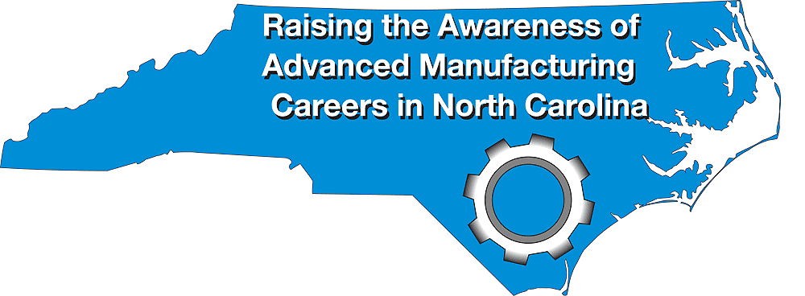
NC Advanced Manufacturing Careers Awareness Week
September 27 through October 1, 2021
National MFG Day - October 1, 2021 (first Friday in October)
Find an event: https://www.creatorswanted.org/find-events/
Register your event https://www.creatorswanted.org/register-event/
MFG Day Resources: https://www.creatorswanted.org/resources/
Notes:
https://creatorswanted.org/mfgday/

Slide 36
NC Advanced Manufacturing Careers Awareness Week - September 27 through October 1, 2021
Asheville: Mathis Electronics, electronics engineering and assembly to manufacturing tour
Charlotte: Centralina Virtual Career Marketplace, MFG Day Job Fair
Davidson: MSC Industrial Supply (innovative metalworking), virtual tour
Greensboro: PPG (powder coating industry), virtual event
Greensboro: Resco Products, open house tours
Mebane: Sandvik Coromant, open house tours
Salisbury: Power Curbers, virtual event
Sanford: Mertek Solutions, Inc, open house
Sanford: Cashion Fishing Rods, tour of manufacturing site
Plus many virtual events across the country
Notes:
https://creatorswanted.org/find-events/

Slide 37
Leadership Projects
Continuing Projects
Proposed
CORD
SkillsUSA-NC
Cyber Security
Apple Swift
Success Coach training with Student Services
BLET Curriculum Development
EDU Curriculum review and update
Distance Learning meetings
Career Clusters Guide
Addressing gaps in Equity and other statewide CLNA identified gaps
Marketing CTE
Other Ideas?

Slide 38
MOA
MOA = Ensuring accessible education programs for all
Monitoring this fall at Rockingham Community College
Follow-up with 15 colleges who were recently monitored

Slide 39
Talent Response Meetings
Sept 14 at 1:30 Eastern (Craven, James Sprunt, Pamlico, Coastal, Lenoir, Wayne, Carteret)
Sept 20 at 10 am Mountain Area (AB Tech, Blue Ridge)
Sept 21 at 1:30 Piedmont Triad (Forsyth, Surry, Davidson-Davie, Rockingham, Piedmont)
Sept 22 at 10 am River East (Beaufort, Pitt, Martin)
Sept 23 at 9:30 am Centralina (SPCC, RCCC, Stanly, Mitchell, Gaston)
Sept 24 at 10 am - Capital Area (Wake, Johnston)
Contact Alex Doles <dolesa@nccommunitycolleges.edu> for a Zoom link for each meeting.
Notes:
Contact Alex Doles <dolesa@nccommunitycolleges.edu> for a Zoom link for each meeting.
Sept
13 - 10 am - 11:30 – Triangle South (Central Carolina, Sampson)
14 - 1:30 - 3pm – Eastern (Craven, James Sprunt, Pamlico, Coastal, Lenoir, Wayne, Carteret)
20 - 10 am - 11:30 - Mountain Area (AB Tech, Blue Ridge)
21 - 1:30 - 3pm - Piedmont Triad (Forsyth, Surry, Davidson-Davie, Rockingham, Piedmont)
22 - 10 am - 11:30 - River East (Beaufort, Pitt, Martin)
23 - 9:30 - 11am - Centralina (SPCC, RCCC, Stanly, Mitchell, Gaston)
24 - 10 am - 11:30 - Capital Area (Wake, Johnston)

Slide 40
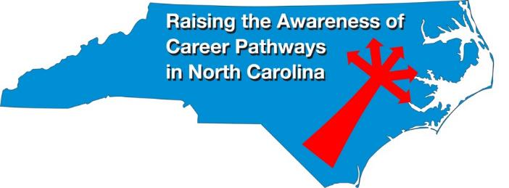
Raising the Awareness of Career Pathways Webinars
September 15, 2021 @ 9am
Come explore careers in Paralegal and Legal Assistant
https://register.gotowebinar.com/register/8824784091524847120
See all upcoming and past webinars at https://www.ncperkins.org/presentations/

Slide 41
Perkins Updates
2nd Tuesday of the month
9 am
Via GoToWebinar
Find the registration links at NCperkins.org/presentations
Notes:
Register now and let the system remind you.

Slide 42
CTE Training
Training online - www.ncperkins.org
Perkins Update Webinars - Second Tuesday
Career Pathways Webinars - Third Wednesday
Additional webinars on popular topics:
CLNA
Programs of Study
Career Pathways
At your College by request
https://www.ncperkins.org/presentations/
Notes:
https://www.ncperkins.org/presentations/

Slide 43
Technical assistance is available
We are here to help!
Team Perkins is available by phone, email, TEAMS, etc.
Your CTE Coordinator will be traveling to your college throughout the year.

Slide 44
Perkins/CTE State Staff
Dr. Bob Witchger Director, Career & Technical Education WitchgerB@nccommunitycolleges.edu 919-807-7126
Dr. Tony R. Reggi Coordinator, Career & Technical Education ReggiA@nccommunitycolleges.edu 919-807-7131
Patti Coultas Coordinator, Career & Technical Education CoultasP@nccommunitycolleges.edu 919-807-7130
Dr. Mary Olvera Coordinator, Career & Technical Education OlveraM@nccommunitycolleges.edu 919-807-7120
Michelle Lair Coordinator, CCP and Career & Technical Education LairM@nccommunitycolleges.edu 919-807-7227
Chris Droessler Coordinator, Career & Technical Education DroesslerC@nccommunitycolleges.edu 919-807-7068
Darice McDougald CTE Administrative Assistant McDougaldD@nccommunitycolleges.edu 919-807-7219
Notes:
http://www.ncperkins.org/course/view.php?id=6

