Slide 1
Perkins – Mid Year Review

Slide 2
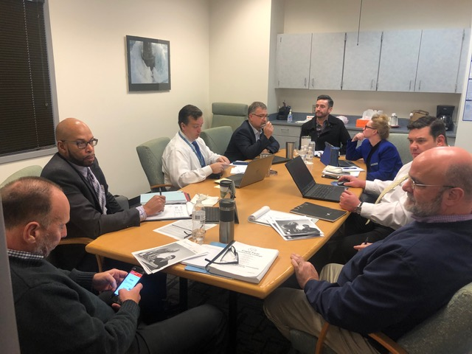
Mechatronics in Pender County Schools
Collaboration between CFCC and Pender County Schools.
Currently have 11 students in classes located at CFCC Burgaw Campus.
First Meeting December 2018

Slide 3
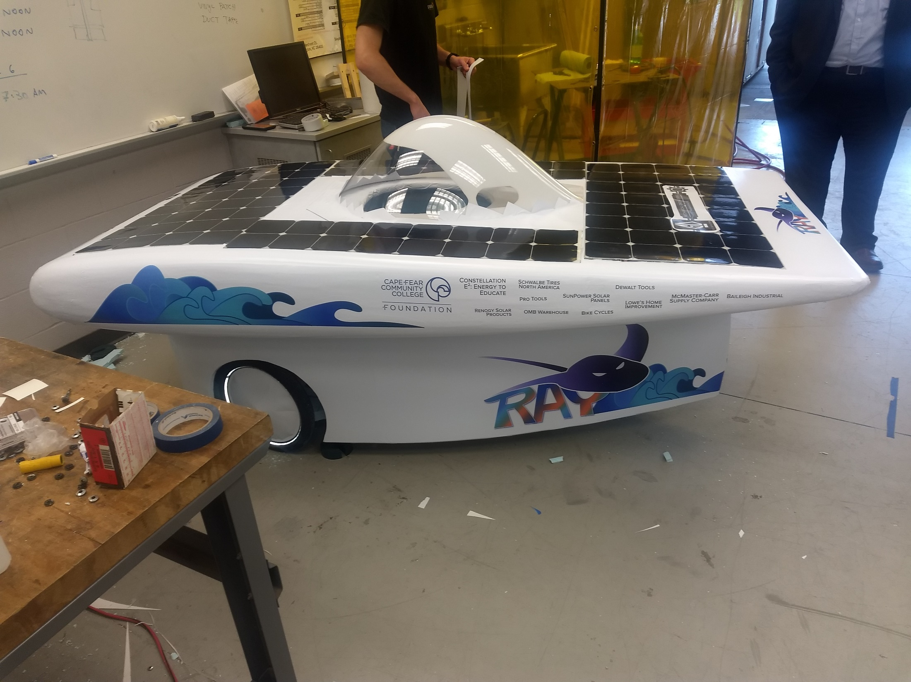
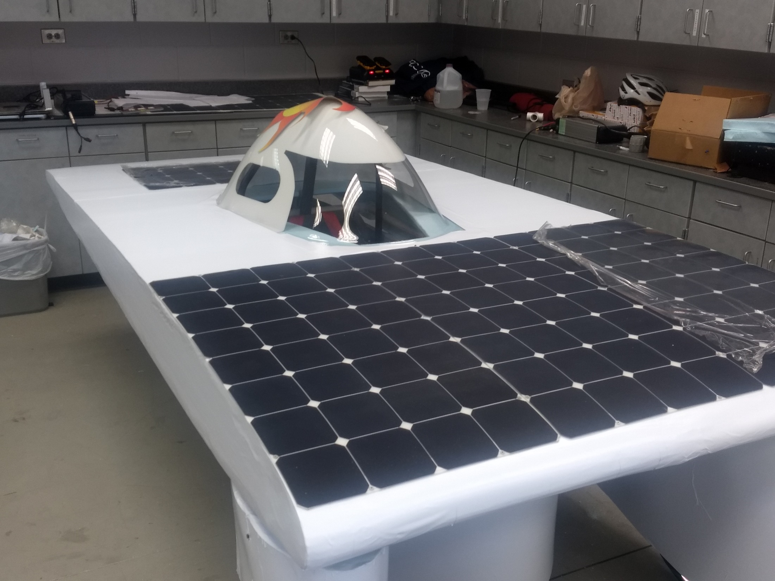
Student Lead Projects
Notes:
Manufacturing day – Date Change
Wilmington Grill
Low turnout

Slide 4
Digital & Social Media Marketing
Low enrolled/High Demand
Targeted Programs:
Marine Technology
Mechatronics
Computer Integrated Machining
Notes:
Manufacturing day – Date Change
Wilmington Grill
Low turnout

Slide 5
Digital & Social Media Marketing
Inquiries compared to 2018
Mechatronics: 680% Increase. Enrollment went from 16 to 32.
Marine Technology: 245% Increase. Enrollment for 1st year students at capacity.
CIM: 0 to 34 Inquiries. Enrollment for 1st year students at capacity.

Slide 6
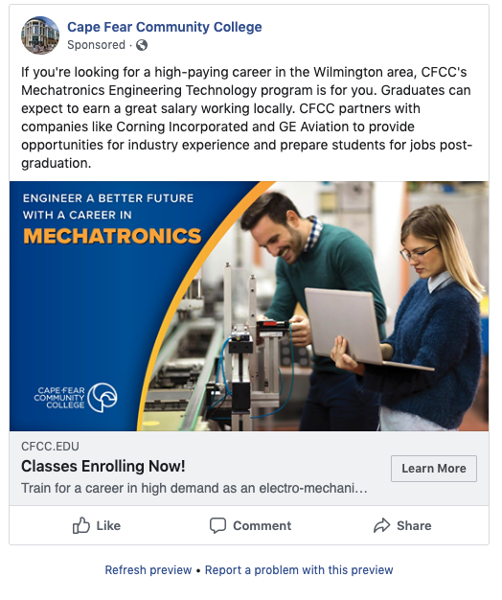

Slide 8
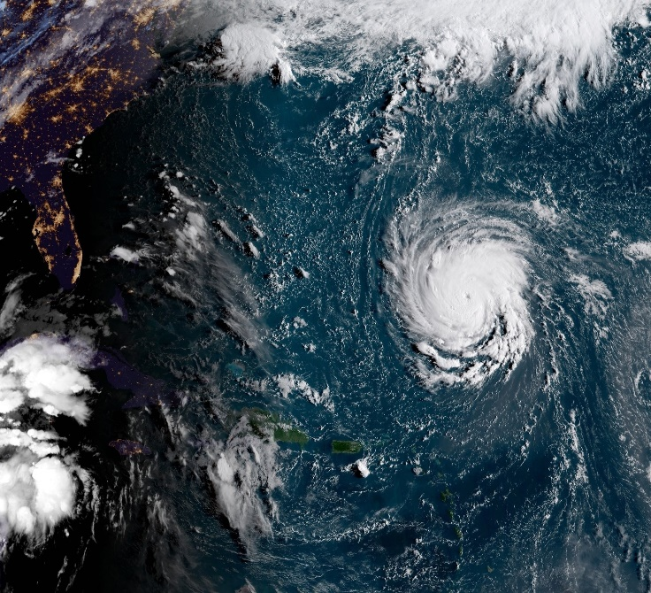
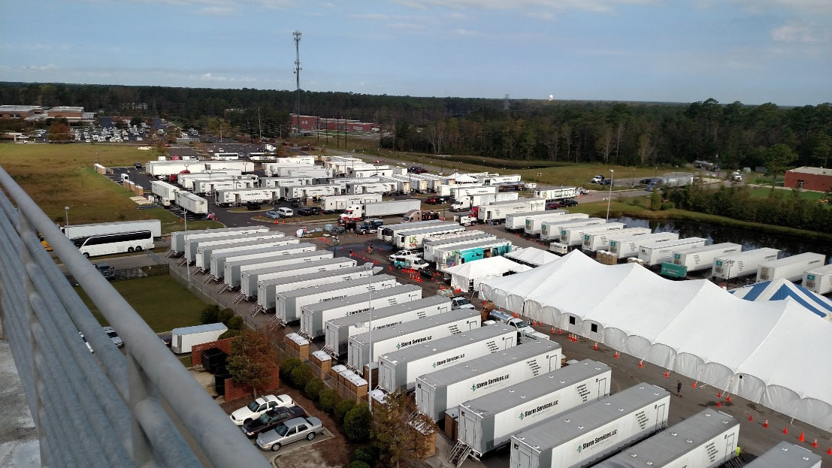
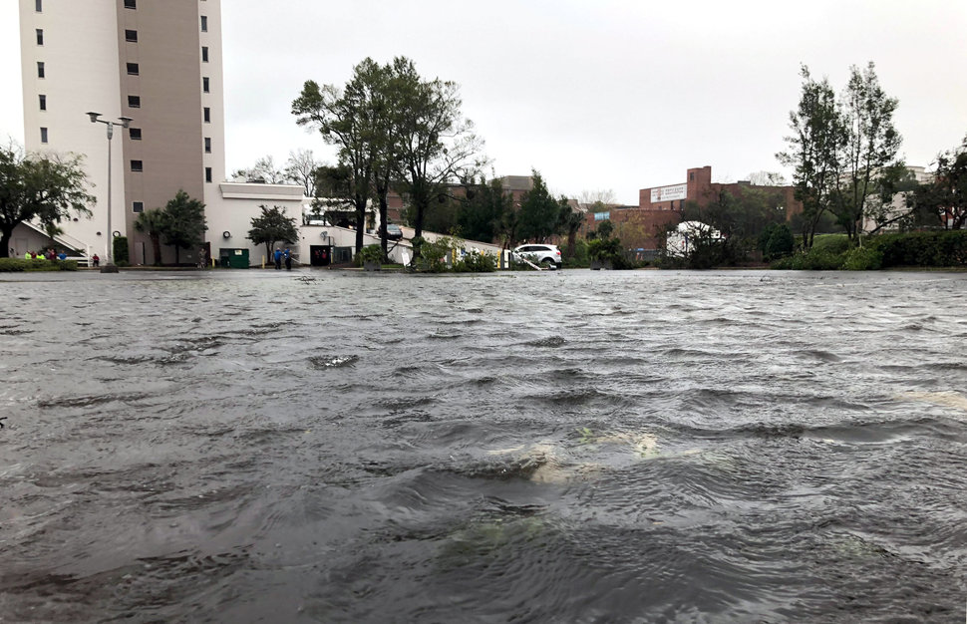
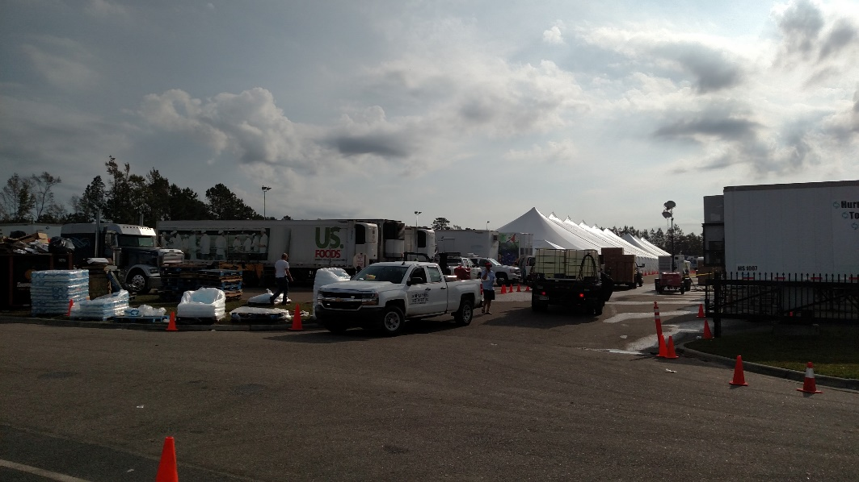
Hurricane Florence
No Hurricanes 2019
Notes:
Duke Energy on campus
20 days out of school = 25% of the semester
Hardships on Students and Faculty
Over $1 million in Hurricane relief funds distributed to over 1000 students
Pender country schools – Over 800 displaced many CFCC students.

Slide 9
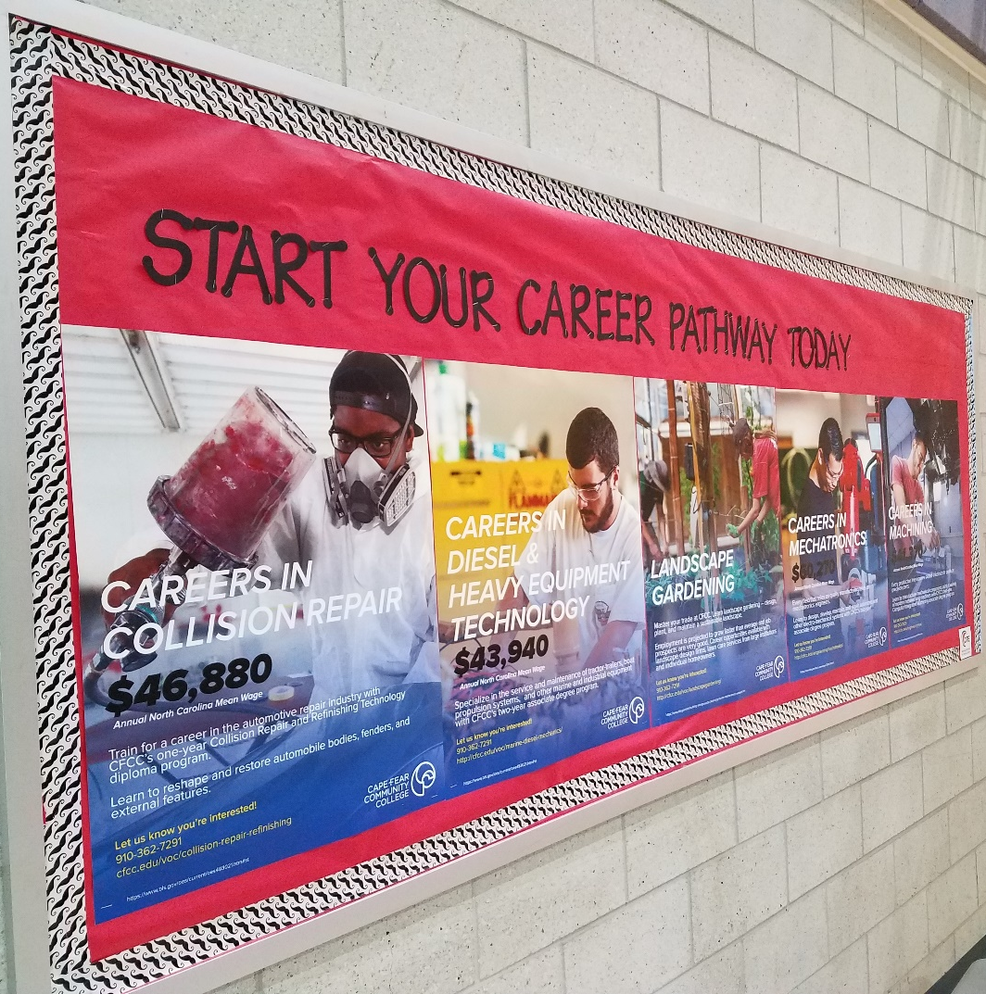
Any Questions?

