Slide 1
NC High School to Community College CTE Articulation Agreement
February 24, 2025

Slide 2
Current Agreement & Policies
Current Articulated Courses, see HERE
Approved in 2023, and revised in 2024
NC HS to CC Articulation Agreement Policies, see HERE
SACSCOC policy, see HERE
The accreditation standards of SACSCOC require member institutions to analyze credit accepted for transfer in terms of level, content, quality, comparability, and degree program relevance. While an institution may properly consider another institution’s accreditation as an indicator for acceptability of credit, accreditation should not be the only criterion used for acceptability nor should it be represented as a requirement of SACSCOC, which it is not.

Slide 3
Overview of Process
FALL 2024
NCCCS staff in collaboration with NCDPI
State-level staff review for recommended course - additional courses under review!
SPRING 2025
college Chief Academic Officers and Public-School Unit (PSU) CTE Directors will facilitate the local-level course-match review process.
teams of secondary and postsecondary faculty teaching will review and recommend matches.
The college will submit an analysis (Microsoft Forms link). One form per course, per college.

Slide 4
Overview of Process
SPRING 2025 continued.
NCCCS & DPI review data from the submitted analysis form.
The final recommendations will be reviewed and voted on by the College Chief Academic Officers.
Courses that receive a 2/3 majority vote or higher will be included on the statewide agreement.
SUMMER 2025
Approved list is sent to the NC State Board of Community Colleges for approval.

Slide 5
Criteria for Local Review
List of potential course matches reviewed by state-level staff ✔
Local teams will review potential matches by reviewing:
Course standards, descriptions, learning outcomes
Course hours/lab hours
Proof of Learning
CTE Post-assessment, Performance-based Measurement, Industry credential
Policies, and regulations of licensing, and other state information about courses are gathered.
Courses must be determined to represent an 80% match

Slide 6
Criteria for Articulation
To receive credit through the HS/CC AA, the articulated course(s) must be included in a selected program of study. Additionally, students must enroll in a NC community college within two years of high school graduation and meet the following criteria:
Final grade of B or higher in the high school course AND
Proof of Learning (POL)
CTE post assessment*
Score of 90 or higher
Performance-based Measurement (PBM)
Meets course proficiency
Industry credentials

Slide 7
Credit for Prior Learning Policies
Courses that have industry credentials as proof of learning will follow the procedure for Credit for Prior Learning as outlined in Curriculum Procedures Reference Manual – HERE
State Board Code: Credit for Prior Learning - HERE
Credit for Prior Learning ERP User Guide (ServiceNow) - HERE
Section 14/CCP Operating Procedures – HERE
“The evaluation of CPL is an academic evaluation process through which students document verifiable college-level learning acquired outside of the traditional learning environment for academic credit. Colleges are encouraged to award CPL where possible to prevent duplicative efforts, but rather maximize student success.
For more information regarding CPL and HS to CC Articulation Agreement, see HERE

Slide 8
Resources for Review
NCDPI CTE Course Management Link - HERE
Start entering the course number into the text box.
Click on the name of the course once it populates
Select Course Standards to see more detailed information

Slide 11
Resources for Review
NCCCS Combined Course Library - HERE
Under Curriculum Course Search, click on Faculty and Staff Search
Under Curriculum Courses, choose either:
Curriculum Courses by Subject
Choose the prefix for the course (this will show you all courses with that prefix)
OR
Search for Curriculum Courses
Enter the prefix and course number to view a single course

Slide 13
Resources for Review
NCCCS Curriculum Standards - HERE
Choose the area for the curriculum program
Click on the PDF of the program of study
2022 High School to Community College Articulation Agreement
www.ncperkins.org
Under CTE Resources, click on HS to CC CTE Articulation Agreement

Slide 15
Criteria for Course Match
Course content of the SLOs and HS course standards must have a minimum of 80% match
Comparable course standards
Acceptable assessment for competencies
Comparable hours – consider lab hours and contact hours
Course Competency and Recommendation worksheet, found HERE

Slide 16
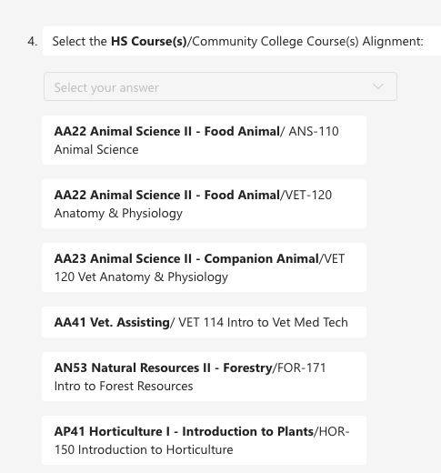
Review Submission

Slide 17
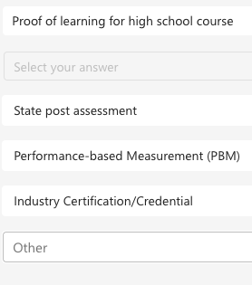
Review Submission

Slide 18
Summary of Reviews
A summary of each course review will be included in the vote (sent to the CAOs).
Each course must have 2/3rds votes from colleges approved to offer the courses.

Slide 19
NC Community College System Contacts
Dr. Seth Kamen, Director of Credit Mobility
kamens@nccommunitycolleges.edu
Aaron Mabe, Dual Enrollment Director
mabea@nccommunitycolleges.edu
Dr. Mary Olvera, Director of Education Programs
olveram@nccommunitycolleges.edu

Slide 20
NC Department of Public Instruction Contacts
Angela Lemay
angela.lemay@dpi.nc.gov
Linda Lay
Linda.Lay@dpi.nc.gov
Robert Van Dyke
robert.vandyke@dpi.nc.gov

