Slide 1
Credit for Prior Learning Sources and Assessment
North Carolina
Community College System
September 26, 2017

Slide 2
Career Credit - Group 1
Workforce Continuing Education → Curriculum Credit
Certifications/Licensure → Curriculum Credit
Apprenticeship → Curriculum Credit

Slide 3
Summary of Work
Credit for Prior Learning - Areas of Focus:
Workforce Continuing Education to Curriculum Credit
Credentials (Certification/Licensure) to Curriculum Credit
Apprenticeship to Curriculum Credit
Pending Changes to SACSCOC
What's already being done…
NC Community Colleges
Carteret CC
Fayetteville Tech CC
Forsyth Tech CC
South Piedmont CC
Wake Tech CC
Outside the State
Ivy Tech – Training & Certification Crosswalk
Florida Statewide Articulation Agreements
CAEL - Community College of Rhode Island TAACCCT Grant

Slide 4
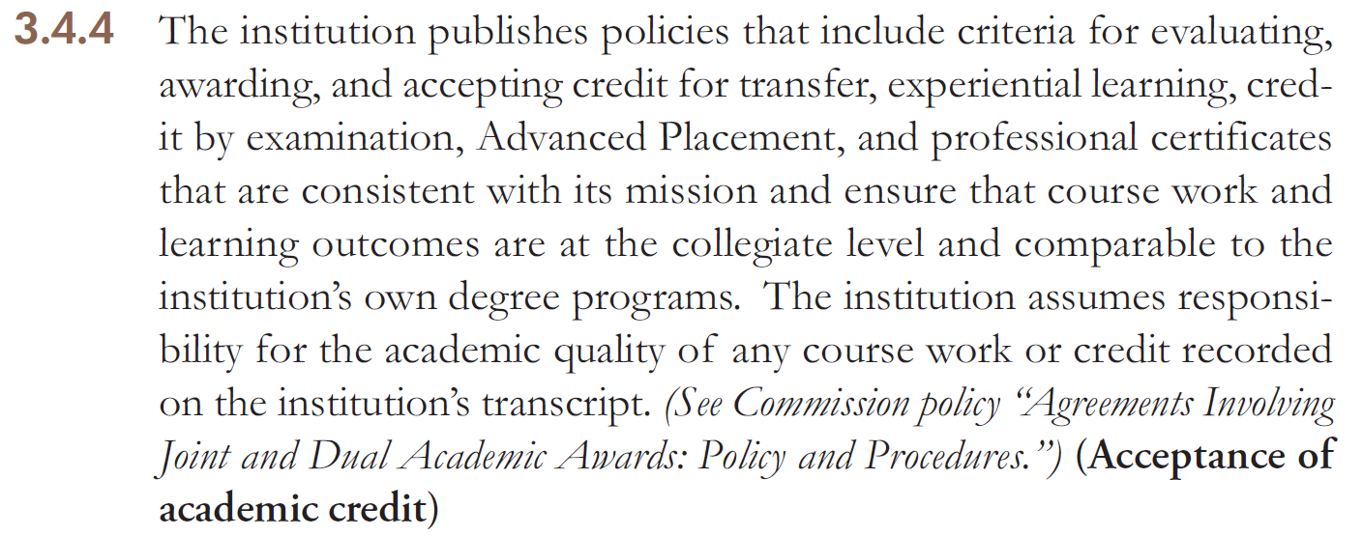
Summary of Work
Current: 3.4.4, 3.4.6, & 3.4.8:

Slide 5
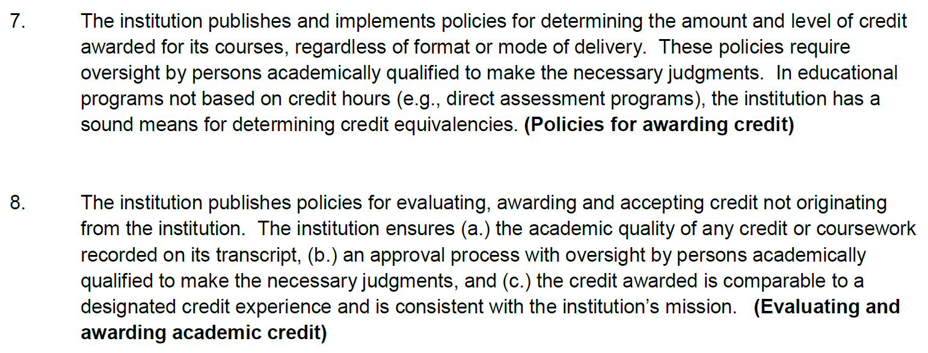
Summary of Work
Proposed: 10.7 & 10.8

Slide 6
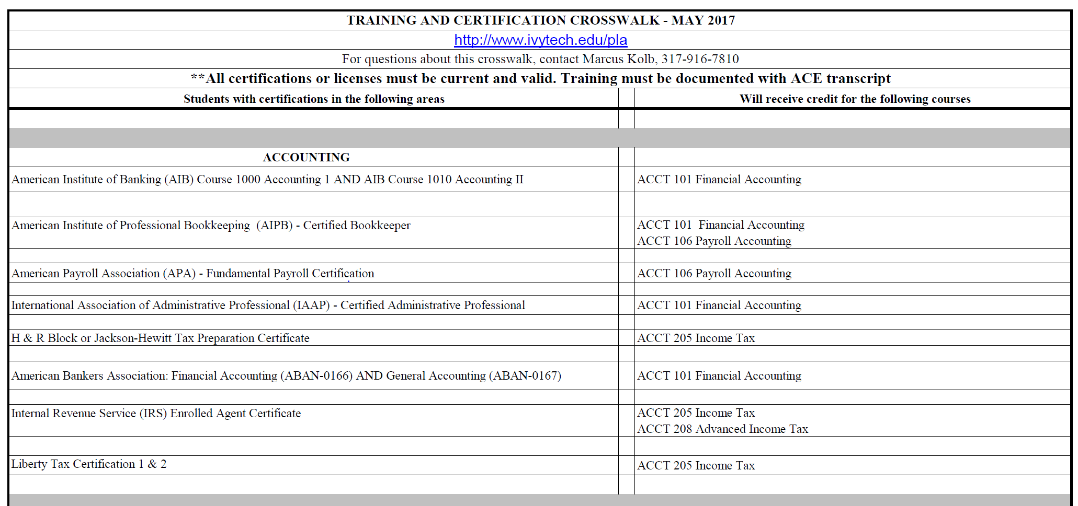
Summary of Work

Slide 7
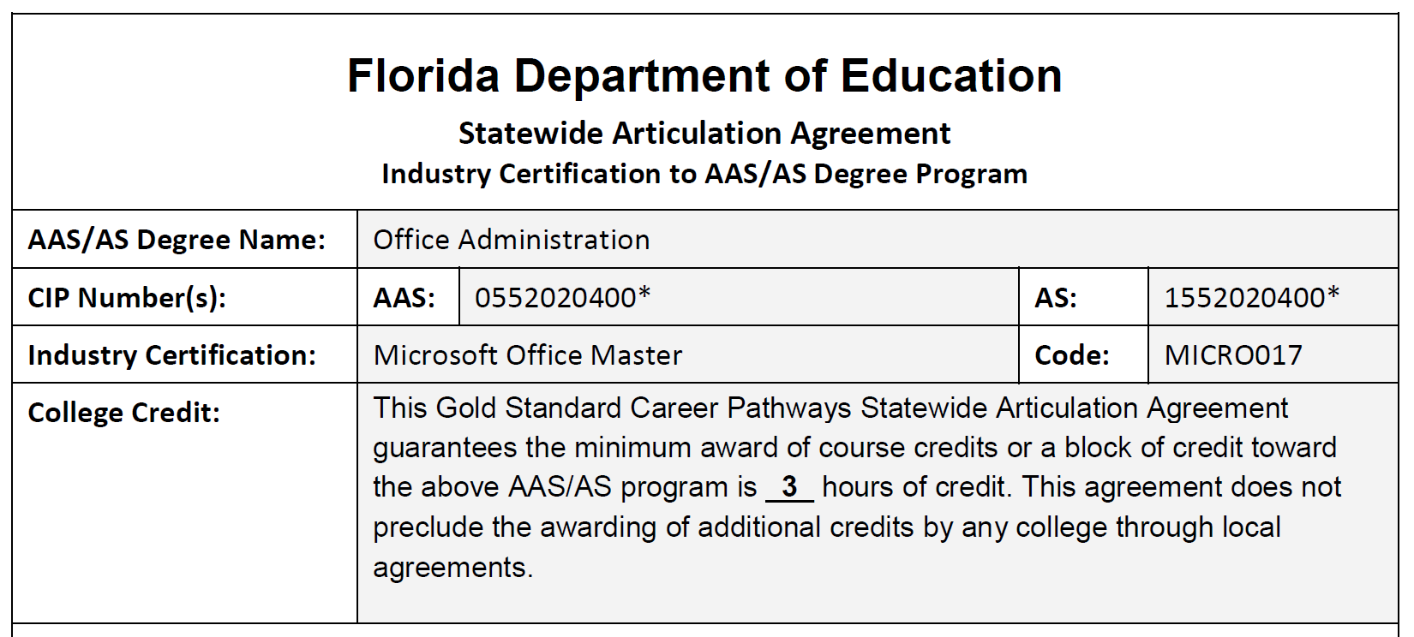
Summary of Work

Slide 8
Summary of Work

Slide 9
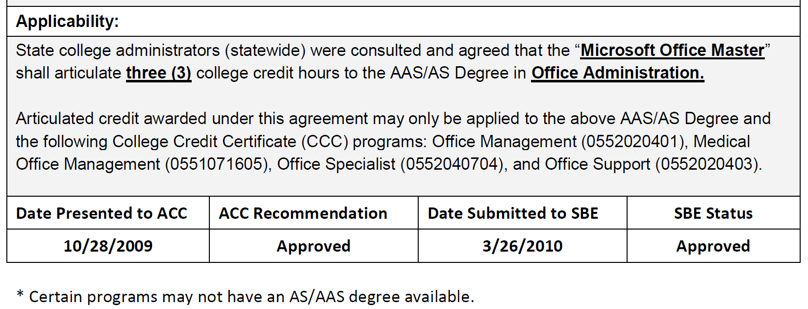
Summary of Work

Slide 10
Recommendations
Standardized Crosswalks:
Workforce Continuing Education → Curriculum Credit
Certifications/Licensure → Curriculum Credit
Apprenticeship → Curriculum Credit
Supporting documentation process that backs up the state-level crosswalk
Policy/procedure for crosswalk component:
Additions
Edits
Removal

Slide 11
Next Steps
Create a cross-walk of:
CE to CU
Industry certifications and licensure (based upon national best practice and work already initiated at NC CCs)
Approved Apprenticeship related training (those not affiliated with a CC) to curriculum courses/programs.
Develop the supporting documentation and process
Backs up the state-level crosswalk
Provides a policy/procedure for adding, editing, and removing crosswalk components.

Slide 12
Action Plan
Define & design documentation & framework for the supporting process that supports the state-level crosswalk. The framework would support a variety of articulated credit, inclusive of CE to CU, Credential to Credit, and Apprenticeship to Credit.
Framework Initial Draft by 10/25/17
Review existing credentials data based on programmatic areas
Create a pool of expertise on the various program areas.
Crosswalk Recommendations Initial Drafts by 11/22/17
Complete a draft credential crosswalk fully utilizing developed documentation & framework
~50 credentials cross-walked with supporting documentation by 1/24/18
Define & Design an implementation plan for colleges
Initial Draft by 12/13/17
Create a draft NCCCS WCE to CU, Credential to Credit, and Apprenticeship to Credit policy
Initial Draft by February 2018

Slide 14
Standardized Exams & Credit by Exam – Group 2

Slide 15
Membership
Dr. Wanda White – NCCCS (Co-Lead)
John Bakken – Wake Technical CC (Co-Lead)
Amy Bruining – Central Piedmont CC
Walter Calabrese – Craven CC
Abe Dones – Durham Technical CC
Dr. Hilmi Lahoud – NCCCS
Dr. April Jones – Central Piedmont CC

Slide 16
Exploratory Work
Sub-committee members collected information from each of the 58 community colleges
Attempted contact with Registrar or student services
Pulled information from website if no contact could be made
Examined PLSA available at each college
AP Credit
CLEP
International Baccalaureate
Other PLSA

Slide 17
Exploratory Work

Slide 18
Findings
No common language for PLSA across the system
All community colleges provide some kind of PLSA
Mostly AP and CLEP
Information on PLSA not easily located at most colleges

Slide 19
Recommendations - 1
Adopt a policy that standardizes the acceptance of specific standardized tests across the system
AP and CLEP
Adopt a set of guidelines for the evaluation of emerging PLSA standardized tests and exams
IB & Cambridge programs

Slide 20
Recommendations - 2
Adopt a procedure for reviewing the recommended credits in the reverse transfer process.
Adopt a policy that allows the waiver of ACA-122 for Reverse Transfer Students, when ACA- 122 is the only required course remaining to complete.
Adopt a procedure for reviewing the recommended credits in the IB and Cambridge programs.

Slide 21
Next Steps - 1
Review policies regarding credit for prior learning in standardized exams in other education systems
Develop list of standardized exams, scores, and awarded credit based on existing college policies
Identify best practices that can be used in drafting a standardized exams policy

Slide 22
Next Steps - 2
Draft policy
Requirements for communication of PLSA opportunities
Standardizes acceptance of some exams across the system
Recommendations for emerging PLSA standardized exams

Slide 23
Next Steps - 3
International Credit Recommendations
Draft recommended guidelines for the awarding of PLSA credit for international transcripts
Reverse Transfer
Draft procedure for updating recommended credits in reverse transfer
Draft policy to waive ACA-122 for reverse transfer students

Slide 24
Action Plan - 1
Draft standardized exam questions to be included in a joint survey to colleges – 10/20/17
Identify models – 10/30/17
Standardized Exams
International Credit
Emerging PLSA Standardized Exams
Identify personnel that can assist with drafting policy statements – 11/30/17

Slide 25
Action Plan - 2
Review existing AP & CLEP awards – 12/30/17
Schedule policy drafting retreat – 12/30/17
Draft policy ready for submission – 2/28/2018

Slide 26
Thank You Questions

Slide 28
Apprenticeship Team Group 3

Slide 29
Apprenticeship Team – Group 3
Group Co-Leads:
Dr. Matt Meyer, Assoc. Vice President for STEM Innovations, NCCCS
Johnathan Thill, Dean of Continuing Education, Montgomery CC
Group Members:
Zomar Peters, Dean of Enrollment Management, Craven CC
Aaron Cook, STEM Department Chair, Caldwell TCC
Dennis Seagle, Dean of Enrollment Management, Caldwell TCC
Dr. Luanna Castleman, Director of Admissions, Fayetteville TCC

Slide 30
Apprenticeship Team
Key Actions
Identification of Model Template/Policy – Reviewed all CC sites, Faytech’s Guide and Website are a good model
Receipt of Approved Registered Apprenticeship Programs Information
Identification that two types of Registered Apprenticeships exist – Those affiliated with a College, and those that are not.
Re-organization of team – Ensure no duplication of effort and to address OJT

Slide 31
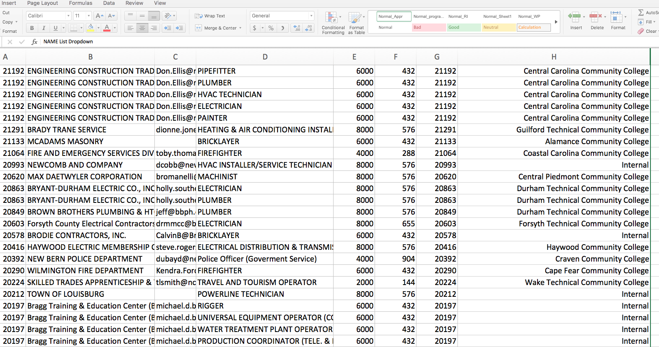
Apprenticeship Team
Receipt of Approved Registered Apprenticeship Programs Information

Slide 32
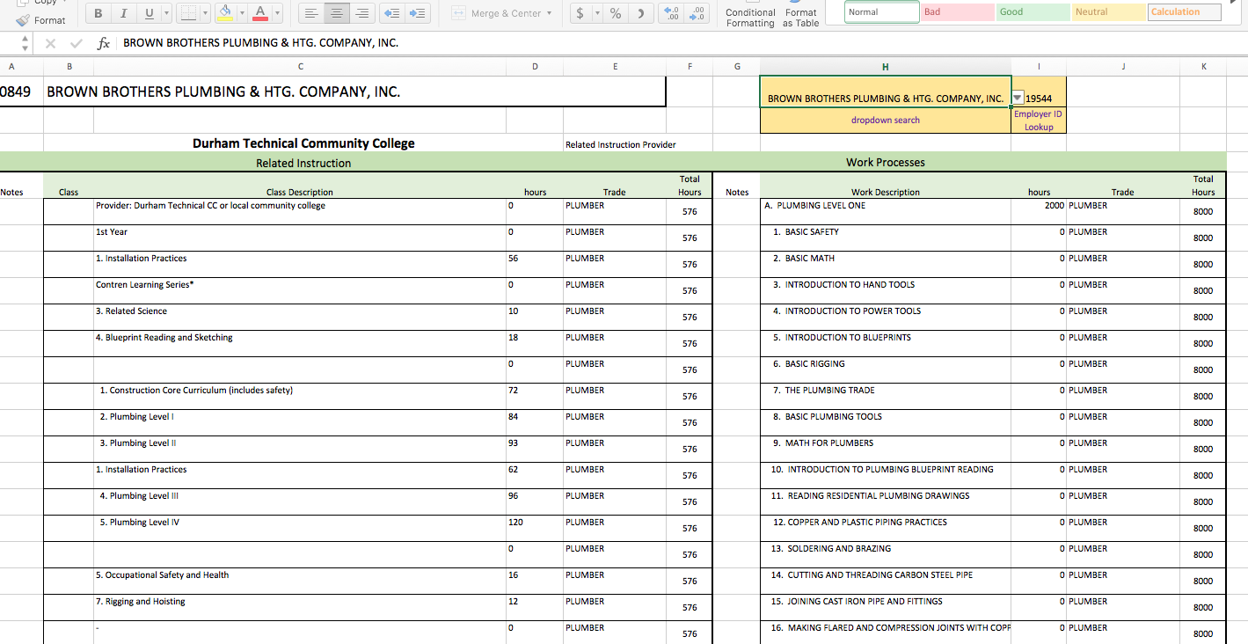
Apprenticeship Team

Slide 33
Apprenticeship Team
Re-organization of team – Ensure no duplication of effort and to address OJT
Back-Design to get at Competencies and Equivalent Hours on the Job…
Portfolio
Process &
Procedures
Program Staff or Administrator for evaluation
Competencies & Equivalent Hours Matrix
Program SME’s

Slide 35
Challenge Exams Group 4

Slide 36
Challenge Exams
Co-Leads:
Dr. Frank Scuiletti, NCCCS
Ben Willis, Caldwell TCC*
Group Members:
Yuko Boyd, Craven CC
Dalanda Bond, Edgecombe CC
Channing Jones, Robeson CC
Kelly Plumley, Catawba Valley CC
Becky Porter, Cape Fear CC*
*PLSA Advisory Committee Members

Slide 37
Challenge Exams
Information gathered by random sampling:
College catalogs
Webpages
Word of mouth
Student Services

Slide 38
Challenge Exams
Where do students go if interested?
Student Services
Admissions
Registrars Office
Department Chair
Lead Instructor
College Website

Slide 39
Challenge Exams
When are exams available?
Where are students directed?
What is the process? Is it Transparent?
Adult learners may be discouraged if they have to start over. How many hoops must they jump through?

Slide 40
Challenge Exams
Recommendations:
Standard Terminology
Standard Definition
Common Criteria for Awarding Credit
Outline Processes
Include in Best Practices Manual
Recommendations in Progress

Slide 41
Challenge Exams
Plan of Action
September 2017
Review policies, criteria and processes
Agree upon common, baseline ones

Slide 42
Challenge Exams
Plan of Action
October 2017
Review findings to date
Continue fine-tuning

Slide 43
Challenge Exams
Plan of Action
November 2017
Begin drafting best practices chapter
Address criteria, guidelines and processes for awarding credit

Slide 44
Challenge Exams
Plan of Action
December 2017—January 2018
Provide draft chapter to colleges/agencies/associations for feedback

Slide 45
Challenge Exams
Plan of Action
February-March 2018
Finalize chapter
Prepare submission to PLA Committee for feedback

Slide 46
Challenge Exams
Plan of Action
April-May 2018
Edit and submit final version

Slide 48
Transcript Pilot Project - Group 5
Notes:
Group five was tasked with looking at ways that high school credits can be transferred to college credit.
September 26, 2017

Slide 49
Group 5
Chris Droessler, CTE Coordinator, NC Community College System
Beth Carmical, Registrar, Robeson Community College
Dr. Gene Loflin, Assoc. Vice President Instructional Services & SACSCOC Liaison, A-B Tech Community College
Bryan McCullough, Director Student Records & Registration, Davidson County Community College
Jeff Link, Career Technical Education Department Chair, Caldwell Technical Community College
Lauren George Cole, Vice President of Academic Affairs, Southeastern Community College
Patricia Gould, Director of Public Schools Program, Student Learning and Support Development, Durham Technical Community College
Dr. Lisa Eads, Program Coordinator Early Childhood, Public Service Technologies, Career and College Promise, NC Community College System
Notes:
We have a great diverse group of folks on our team.

Slide 50
Work Completed
Several committee meetings
Discussed dual enrollment options
Discussed HS to CC Articulation Agreement
Notes:
Our committee has held a few meetings, both informal exchanges of emails and a virtual meeting via GoToMeeting.
The two major topics we discussed were dual enrollment and the state Articulation Agreement.

Slide 51
High School Dual Enrollment
Career and College Promise
Formerly: Huskins and Dual Enrollment
Notes:
North Carolina has long had a great dual enrollment program where high school students can take college courses and earn both high school and college credit.
In the past, these programs went under many names like Huskins and dual enrollment.
Now they have all been combined into one program called “Career and College Promise.”
All high school students who are taking Career and College Promise courses are enrolled at the community college, and thus they are earning college credit like any other college student. The committee does not see a problem with the students earning their college credit.
It appears that some colleges and LEAs do not actively market their program, either due to overcrowding at the college,
or the school district sees this as a lot of extra work they do not have to do.
Marketing this program to the high school students and parents across the state could entice more high school students to want to earn these free college courses.
=======
Career and College Promise webpage:
http://www.nccommunitycolleges.edu/academic-programs/career-college-promise

Slide 52
HS to CC Articulation Agreement
State Agreement since 1999
Local Agreements
Do the students know?
Colleges recognizing credit
Industry certification vs. post assessment
Earned credit vs awarded credit?
Notes:
We are fortunate in this state to have the North Carolina High School to Community College Articulation Agreement.
This statewide articulation agreement comprises approximately 50 high school Career and Technical Education courses that match the knowledge and skills taught in similar community college courses.
The articulation agreement ensures that if a student is proficient in his/her high school course, the student can receive college credit for that course at any North Carolina community college.
Many colleges have created their own local articulation agreements to list course matches that are local to their part of the state that are not included in the state-wide agreement
Two major concerns discussed by the committee are that students do not know they have earned articulated credit, and the process for awarding the credit at the college.
A marketing program is needed to educate the high school students, teachers, counselors and parents about these credits and the potential to earn free college credits for completing certain high school courses.
Some LEAs present certificates to the students who earn the credit. Others mail a postcard to all students who meet the criteria for articulated courses.
Adding a statement of earned articulated credit to the high school transcript could help standardize the process of alerting the student as well as alerting the college admissions staff.
At the college, it is up to the student to mention that he/she has earned articulated credit. A state-wide K-16 student numbering system could help this.
For the past several years, High school students can optionally pass an industry certification exam rather than taking the post assessment exam. Without a post assessment test score, the student cannot earn the articulated credit. This moves the earned credit to another PLSA committee.
Colleges treat these courses as “transfer credit.” Students need to know that this credit will transfer to a community college, but will not later transfer from the college to a university.
It would be great to know how many students earn the articulated credits and how many students actually use the credit when they get to college.
=====
The Articulation Agreement website:
http://www.ncperkins.org/course/view.php?id=4

Slide 53
Recommendations
Market Career and College Promise program across the state.
Evaluate methods of establishing how students are informed that they earned articulated credit and how it is included on a transcript.
Work with DPI to get articulated credit on high school transcript.
Work with colleges to learn how they evaluate articulated credit and how it is recorded.
Notes:
Not everyone knows about these great programs we have in this state to allow high school students to earn college credit. We need to market these programs to the students, teachers, and parents.
We need to look at how students learn that they have earned college credit and what toe do to collect it.
Getting the earned articulated credit listed on the high school transcript would be beneficial to both the student as well as the college who will be awarding the credit.

Slide 54
Next Steps
Work with DPI to add articulated credit to the high school transcript.
Pilot transcript processes with a group of colleges
Identify best practices of creating awareness or marketing opportunities to HS students regarding earning credit.
Notes:
We need to work closely with the Department of Public Instruction to get the articulated credit added to the high school transcript.
We can work with a few colleges to pilot the process.
And we can identify best practices at our colleges for marketing these programs to the high school students.

Slide 56
Portfolio Assessment Life and Work Experience - Group 6

Slide 57
Group 6- Committee Members
Tammi McIlwaine, Stanly CC (Co-Leader)
Laura Bethea, Wake Tech CC
Laurie Weston, Pitt CC (Advisory Committee)
Lynn Kavcsak, Wake Tech CC
Cathy Collie-Robinson, Durham Tech CC
Lashima Galaspie, James Sprunt CC
Emily Brandenburg, Cape Fear CC
Cassandra Atkinson, NCCCS (Co-Leader)

Slide 58
Prior Learning Credit Defined
Prior Learning Credit is the result of a RIGOROUS process by which KNOWLEDGE and SKILLS are evaluated for college credit.

Slide 59
Portfolio Concept Defined
A portfolio is “a formal communication, presented by the student to the college, as part of a petition requesting credit or recognition for learning outside the college classroom. The portfolio must make its case by identifying learning clearly and succinctly, and it must provide sufficient supporting information and documentations so that faculty can use it, alone or in combination with other evidence, as the basis for their evaluation.
Lamdin, 1992, p. 84, From Earn College Credit for What you Know, Fifth Edition, by Janet Colvin, 2012. Kendall Hunt Publishing Company.

Slide 60
Recommendations and Action Plan Group 6: Portfolio Assessment for Life and Work Experience
Recommendations/ Proposed Strategies | Next Steps | Action Plan
Develop a Portfolio Assessment Policy-Life and Work Experience for Colleges to use as a guide for each college to develop their own local policy. Some colleges may want to develop an E-Portfolio Course. And we encourage them but this is not a priority for this initiative. Encourage the System Office and community colleges to contact or use resources, memberships and other support from CAEL as they have a long-established demonstrated effectiveness with Credit of Prior Learning and a wealth of resources to ensure that we are not re-inventing the wheel. Develop guidance for types of life and work experience that can be awarded credit using a Portfolio Assessment and include in policy that credit will be no more than 30 hours. | Develop items for the PLA Survey (to be administered by the System Office) querying colleges on the policy content, structure and technical questions they need on Portfolio Assessment. Continue to conduct research on Portfolio Assessments, write policy and guidance for colleges to use to develop their own Portfolio Assessment Policy for Life and work Experience. | Draft 2-3 survey questions and send to Credit for Prior Learning Leaders by October 1, 2017. Develop Policy no later than December 15, 2017. Policy Draft Handout 9/26/2017

Slide 61
Recommendations and Action Plan Group 6: Portfolio Assessment for Life and Work Experience
Recommendations/ Proposed Strategies | Next Steps | Action Plan
Develop a portfolio assessment process that guides colleges for identifying competencies students have obtained through life and work experience Develop a portfolio assessment process that details the competencies identified by employers. Credit earned from portfolio assessment that is approved must be transferrable to all NC colleges. This ensures consistency across all colleges. Within the portfolio, determine the number of hours of work or life experience that a student has that will equate or translate to credit. Develop a suggested rubric for portfolio assessment to be used by portfolio assessment evaluators. Clarify if this committee should work to develop portfolio evaluation strategy. | 1. Develop a recommended portfolio assessment process, rubric, and criteria that colleges may use to assess or evaluate portfolios. Use research from survey and secondary research. 2. Develop recommended content for professional development needed at the local level to implement and support Portfolio Assessments. | Develop a rubric/criterion and Portfolio Process that colleges may use as guides for developing their own Portfolio Assessment process by January 31, 2018. Develop guidance for professional development by February 28, 2018.

Slide 62
Local College Perspectives on Portfolios
Durham Technical Community College
James Sprunt Community College
Pitt Community College
Stanly Community College
Wake Technical Community College

Slide 63
Questions

Slide 65
Broad Recommendations & Next Steps Team - Group 7

Slide 66
Next Step Team Members
Co-Leads
Lisa Eads, Program Coordinator, NC Community College System Office
Greg Stanley, Dean, Admissions, Records, Registration and Graduation, Central Piedmont Community College
Patrick Holyfield , Dean of Enrollment Management, Stanly Community College
John Carrere, Recruitment and Orientation Specialist, Pitt Community College
Rodney Jackson, Dean of Business, Engineering & Technical Studies, Davidson County Community College

Slide 67
Next Step Team Short Term Action Items
Completed - Group members identified
Early October - Collaborate with Matt Meyers and other teams to develop and administer system wide survey
November 1 - First draft of terms/definitions and common language

Slide 68
Next Step Team Long Term Action Items
Develop PLSA chapter for Curriculum Procedures Reference Manual
Develop PLSA marketing plan
Develop PLSA training for faculty and administrators regarding available sources, tools, and methods to evaluate prior learning for credit

Slide 70
Credit for Prior Learning Sources and Assessment
North Carolina
Community College System
September 26, 2017

