Slide 1
Perkins Update
February 11, 2025

Slide 2
Purpose of Perkins V
Develop more fully the academic knowledge and technical and employability skills of secondary education students and postsecondary education students who elect to enroll in CTE curriculum programs and programs of study
Notes:
The Strengthening Career and Technical Education for the 21st Century Act reauthorized and updated the Carl D. Perkins Career and Technical Education Act of 2006 to become the current Carl D. Perkins Career and Technical Education Act of 2006 as amended by the Strengthening Career and Technical Education for the 21st Century Act (Perkins V)
This updated act stresses:
- Academic, Technical, and Employability Skills
- Funding Secondary and Postsecondary CTE
- Focusing on Students who elect to enroll in CTE Programs of Study

Slide 3
U.S. DOE Press Release

Slide 4
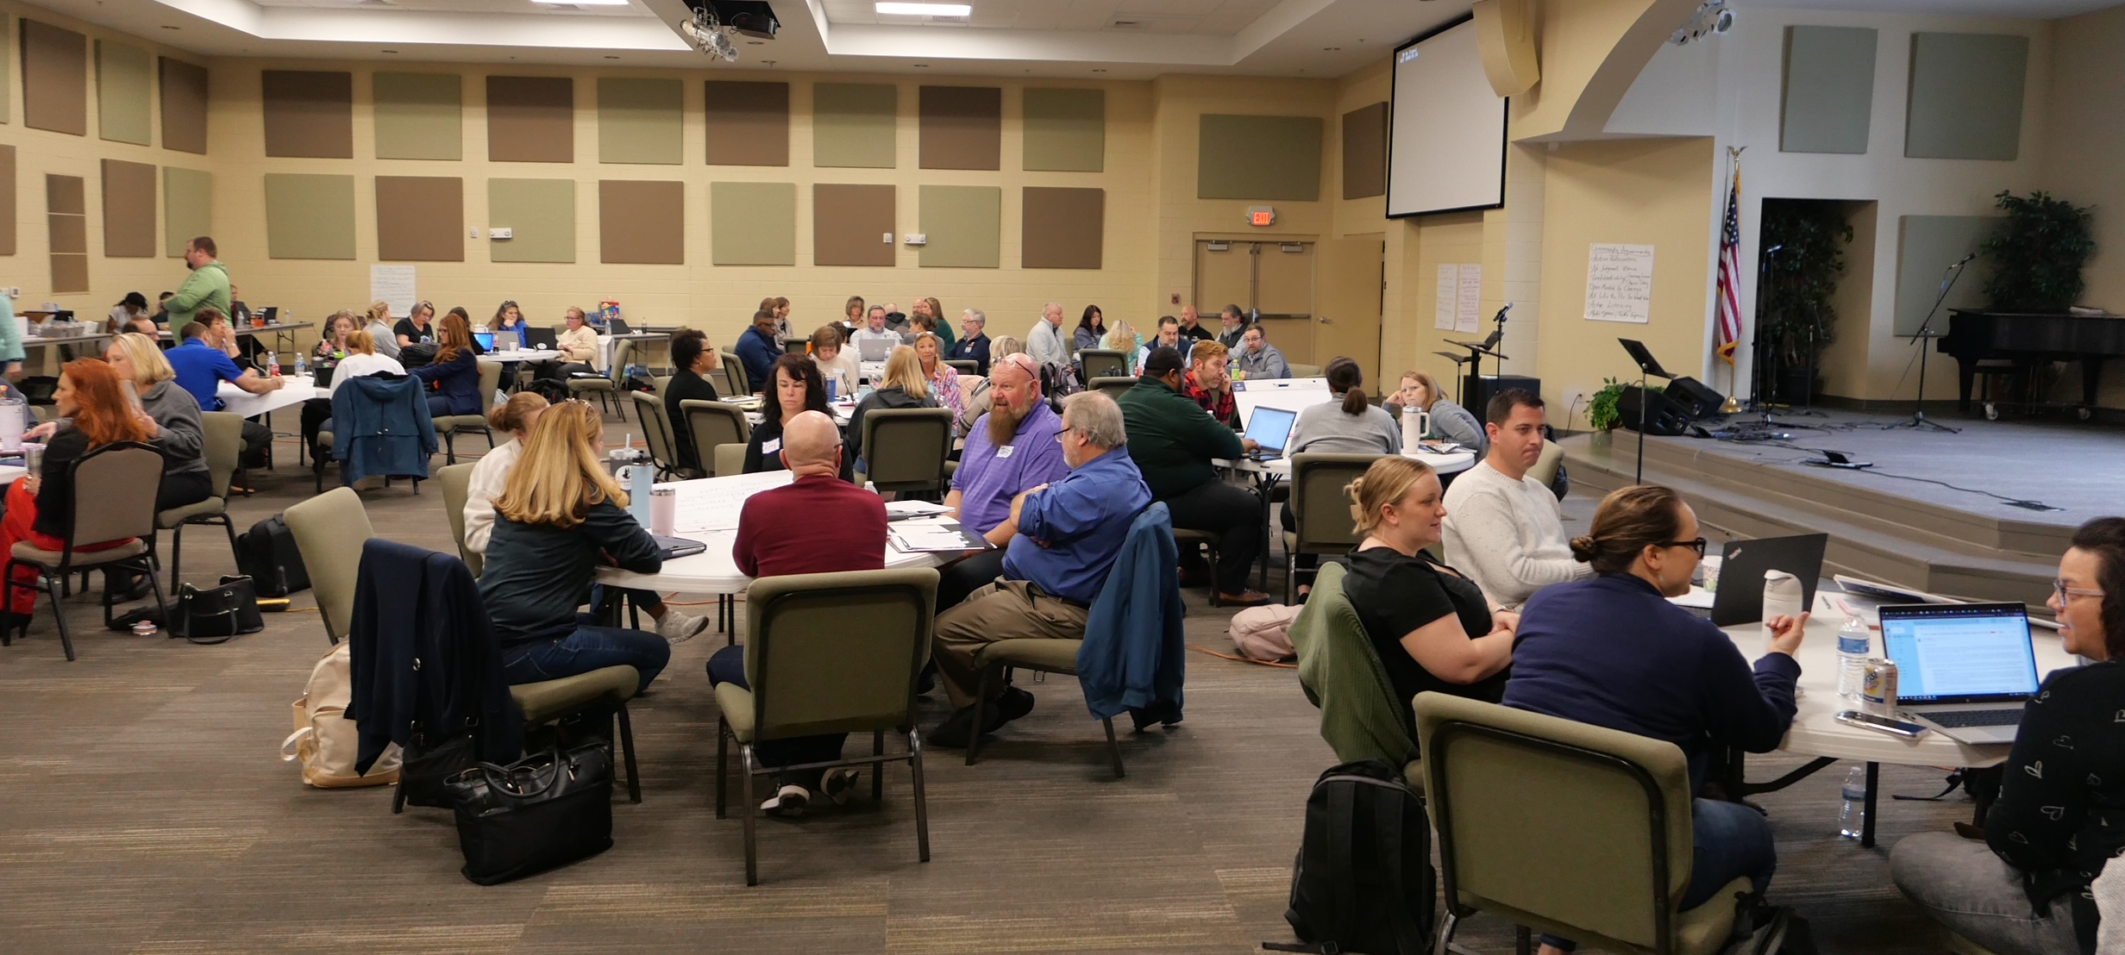
Mid-Year Meeting Reflections & Wrap-up

Slide 5
Bureau of Indian Affairs grant recipient numbers
Sent last Friday to Perkins Primary Contact and copied to College President
Submit to NCPerkins.org Due Date March 3, 2025

Slide 6
Perkins Annual Meeting for 2025-2026
April 9th Koury Convention Center, Greensboro
Registration coming in March
9am – 12pm Education Department General Administrative Regulations (EDGAR) presented by Bruman Group, LLC
12-1pm – Lunch on your own
1-4pm – Preparing for Perkins 2025-2026 year facilitated by Team Perkins

Slide 7
SKILLSUSANC Leadership Conference
April 8-10 Greensboro Convention Center, Greensboro
Post Secondary Competitions April 10
Visit : State Conference | skillsusanc
For last years results go to:
https://www.skillsusanc.org/_files/ugd/6b19e9_df933ba0fd9243fdaf2dca329da879a3.pptx?dn=Awards%20PPT%20SLSC%202024%20PS.pptx

Slide 8
Perkins Monthly Updates 2024-25
3/11/2025
4/8/2025 canceled
5/13/2025
6/10/2025
Attendance (or viewing the recording within 30 days) is recorded on the monitoring rubric. Recording may be accessed at the same link as the registration.
You can register for these now at
www.ncperkins.org/presentations
and put them on your calendar
Notes:
Register now and let the system remind you.

Slide 9
Technical Assistance is available
We are here to help!
Team Perkins is available by phone, email, virtually, or in-person

