Slide 1
Perkins Update
October 8, 2024

Slide 2
NCCCS Perkins/Programs Staff
Peyton Bell Director of Curriculum Management
Patti Coultas Assistant Director of Perkins CTE - East
Dr. Lisa Eads Associate Vice President of Programs
Dr. Lane Freeman Director of Online Learning Programs and Student Services
Dr. Trudie Hughes State Director of Disability Services and Title IX
Dr. Hilmi Lahoud Sr State Director of Business & IT and Academic Programs Operations
Aaron Mabe State Director of Dual Enrollment and Ag & Natural Resources Technology
Darice McDougald Perkins Program Specialist
Dr. Jennifer McLean State Director of Advising and Coaching
Dr. Mary Olvera State Director of Teacher Ed., Public Services, & Perkins Special Populations
Ashley Parrott State Director of College Ready Graduates and Developmental Education
Dr. Tony Reggi Associate Director of Perkins CTE
Reyna Rodriguez Director of Course Management and Credentialing
Todd Roth State Director of Skilled Trades and Work Based Learning
Stefanie Schroeder Assistant Director of Perkins CTE – West
Melissa Smith Senior State Director of Health Science Programs
Dr. Bob Witchger Executive Director of Perkins CTE

Slide 3
Western Colleges & Communities

Slide 4
Purpose of Perkins V
Develop more fully the academic knowledge and technical and employability skills of secondary education students and postsecondary education students who elect to enroll in CTE curriculum programs and programs of study
Notes:
The Strengthening Career and Technical Education for the 21st Century Act reauthorized and updated the Carl D. Perkins Career and Technical Education Act of 2006 to become the current Carl D. Perkins Career and Technical Education Act of 2006 as amended by the Strengthening Career and Technical Education for the 21st Century Act (Perkins V)
This updated act stresses:
- Academic, Technical, and Employability Skills
- Funding Secondary and Postsecondary CTE
- Focusing on Students who elect to enroll in CTE Programs of Study

Slide 5
Carry Over funds from 2023-24
Board item next week
Budget modifications
CLNA modifications

Slide 6
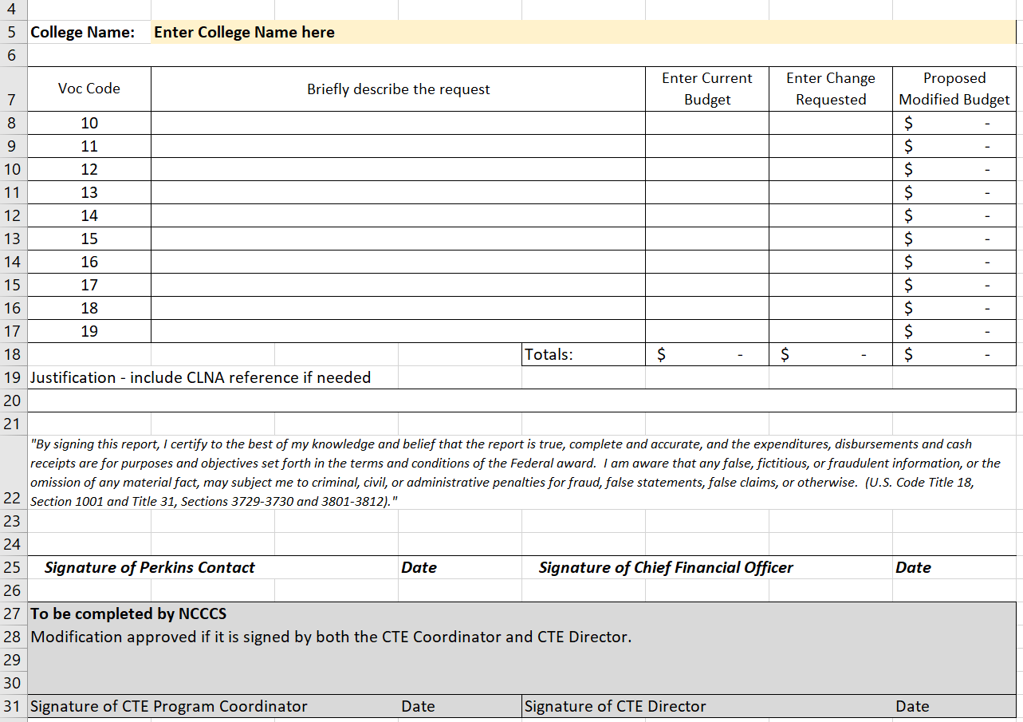
Budget Modification Form
Download from the current NCPerkins.org course

Slide 7
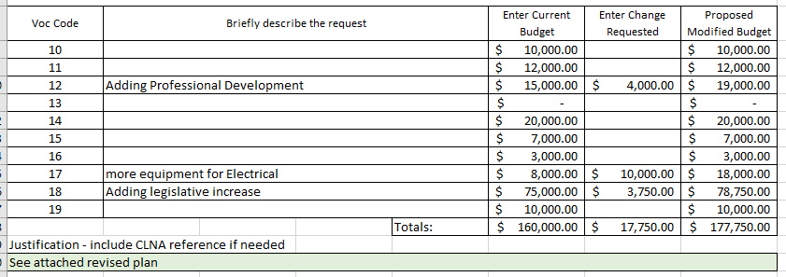
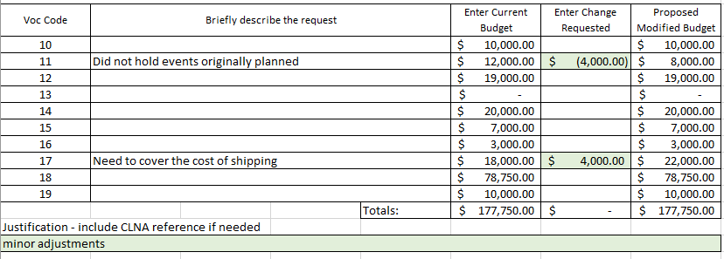
Enter Current Budget
Modification 1
for Carry-forward
Approved Planning Budget
Modification 2
Always start a new modification with the most recently approved budget

Slide 8
Is an updated Plan needed too?
An updated plan is required when making significant changes or adding carry-forward.
It must include the connection to a gap or need in your CLNA.
Enter a status so it is easier for the change to be identified and feel free to highlight that activity too.
The budget page of the plan does not have to be signed, just the modification form
Even if you don't submit it, update it internally so you can submit it in your mid-year or end-of-year plan update

Slide 9
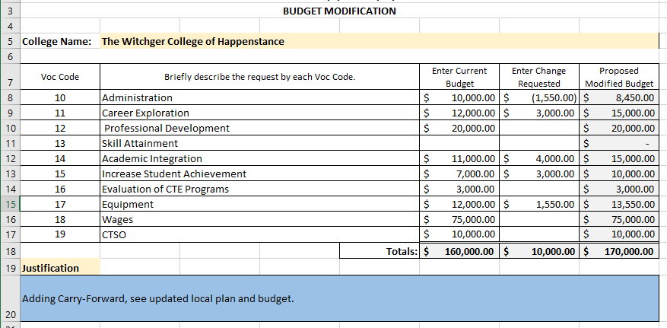
Modification adding Carry-over
Total Allotment
Must include updated plan
Change requested must total the difference between planning budget and total allotment

Slide 10
Plan for 2024-25
For each college to develop an ALL CTE Program Comprehensive Local Needs Assessment by May 2025

Slide 11
Managing the Perkins Grant
With the college’s administration, the Perkins Manager forms a Perkins Team that has knowledge of CTE programs, grant management, and federal compliance.
The Team plays a pivotal role in the successful implementation and management, of Perkins V Funding at their Community College. Under Perkins V, this team is important in strengthening your CLNA and ensuring compliance with federal and state regulations.
The Perkins Team contributes to the success of CTE programs and the achievement of educational and workforce development objectives at their college.
Grant Management and Compliance
Administrative Duties
Strategic Planning and Assessment
Stakeholder Collaboration

Slide 12
CLNA Training Topics
Tentative Dates | Topic
11/12/24 | Student Performance
12/10/24 | Size, Scope, Quality, and Labor Market Alignment
1/14/25 | Progress Toward Implementing Pathways
2/11/25 | CTE Educator Recruitment, Retention, and Training
At Mid-Year In February | Progress Toward Improving Equity and Access
3/11/25 | CLNA Results and Priorities
4/8/25 | Updating your Application
5/13/25 | Completing the Local Plan and Budget

Slide 13
Perkins Monthly Updates 2024-25
11/12/2024
12/10/2024
1/14/2025
2/11/2025
3/11/2025
4/8/2025
5/13/2025
6/10/2025
Attendance (or viewing the recording within 30 days) is recorded on the monitoring rubric. Recording may be accessed at the same link as the registration.
You can register for these now at
www.ncperkins.org/presentations
and put them on your calendar
Notes:
Register now and let the system remind you.

Slide 14
Mid-Year Review & CLNA Training
February 4-5, 2025
Caraway Conference Center
You may arrive the evening of Feb. 3rd
All expenses covered (lodging & meals) except travel (mileage & meals during travel)

Slide 15
Student Performance
Objective
Evaluate student performance against state and local levels, with a particular focus on special populations and subgroups.
Topics
Disaggregating student performance data
Using Power BI and Public Dashboards for analysis
Determine Gaps in student performance

Slide 16
Size, Scope, Quality & Labor Market Alignment
Objective
Ensure CTE programs of study are sufficient in size, scope, and quality and are aligned with the labor market.
Topics
Definitions of Size, Scope, and Quality
Collecting evidence of program gaps and needs
Assessing labor market information

Slide 17
Progress in implementing CTE Pathways
Objective
Ensure alignment between secondary and postsecondary CTE programs of study to eliminate barriers, provide seamless transitions for students, and offer credentials that provide economic value.
Topics
Funded Perkins Programs have an identified career pathway framework
Alignment of support systems across educational levels.
Opportunities for postsecondary credit through dual/concurrent enrollment or early college high schools, articulated credit, and credit for prior learning.
Inclusion of career development & work-based learning in the pathway.

Slide 18
CTE Educator Recruitment & Retention and Professional Development
Objective
Improve recruitment and retention of faculty and staff and provide comprehensive professional development.
Topics
Meeting certification and licensure requirements.
Increasing representation of underrepresented groups in the teaching profession.
Imcrease retention of CTE Faculty
Support College professional development plan.

Slide 19
Advancing Equity and Access for Special Populations
Objective
Remove barriers and close performance gaps for special populations.
Topics
Addressing performance gaps and disparities in access.
Preparing special populations for high-skill, high-wage or in-demand occupations.
Ensuring equal access to CTE programs for all students.

Slide 20
Virtual Office Hours for Technical Assistance
2nd Tuesday of the month 1-2pm
4th Wednesday of the month 9-10
** See the top of the NCPerkins.org/presentations page for TEAMS link
Need help?
Let's meet.
CTE Team Perkins
Virtual
Office Hours
Drop in to ask a CTE Coordinator your questions

Slide 21
Professional Development of Interest

Slide 22
NCCCS System Conference
https://events.lifelonglearning.ncsu.edu/ncccs/
Registration $299
Notes:
https://events.lifelonglearning.ncsu.edu/ncccs/

Slide 23
Promising Practice Video from 2023-2024
Rowan-Cabarrus Community College
Female students in engineering technology programs
The link to all EOY videos is www.ncperkins.org/video

Slide 24
9-14 PATHWAYS CONSULTATION
This training offers a deep dive into all secondary engagement opportunities by reviewing best practices, local data, and inter-office collaborations, e.g. career advising, articulation, and CCP pathways. Sessions typically last about 2-3 hours at no cost to the college.
If interested, please email Aaron Mabe,
mabea@nccommunitycolleges.edu

Slide 25
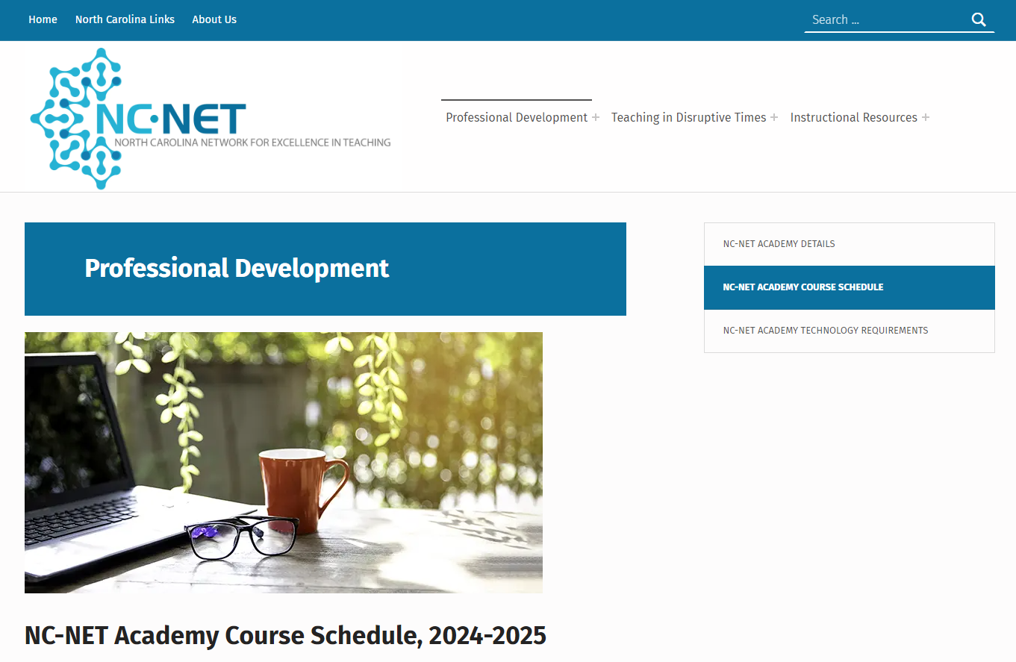
NC-NET – Free Professional Development
Always available!
NC-NET Academy for new faculty

Slide 26
2025 NCCCS Master Instructor Certification Program
Application Launch: September 2024; open to all instructors
Eligibility Requirements: Complete the online application, submit a supporting summary from CAO/Workforce Officer, and provide a personal statement.
Program Structure: Includes two in-person meetings, ten online asynchronous modules, and virtual support.
Timeline:
September 2024 – October 31st: Application Process
November: Candidate Applications Reviewed
December: Candidates Notified of Acceptance
January: In-person Kick-off Session
January – May: Online asynchronous with artifact submission and collaboration
May: In-person Capstone Event
Contact Lane Freeman with questions freeman@nccommunitycolleges.edu

Slide 27
Leveraging AI in Education Series
Introduction to AI and its relevance in higher education.
Practical applications in teaching, administration, and student services.
Ethical considerations and future AI trends.
Hands-on activities to experience AI tools.
Contact Lane Freeman to schedule the 90-minute session for your college freeman@nccommunitycolleges.edu

Slide 28
Technical Assistance is available
We are here to help!
Team Perkins is available by phone, email, virtually, or in-person

