Slide 1
Sandhills Community College
2019-2020 Midyear Perkins update

Slide 2
Best Practice – On campus Work-based learning experiences
Getting students ready for the work setting – practicum, clinical, actual work-based learning courses.
Need to have that experience to be successful when they start
What’s the job setting like? Is it for you? Get excited.
Put theory in practice sooner.

Slide 3
examples
Labs
Simulated clinicals
Live Projects
Needs – space, equipment, supplies and trained faculty

Slide 4
BLK360 3D Scanner
Architecture, Geomatics and Civil Engineering Programs

Slide 5
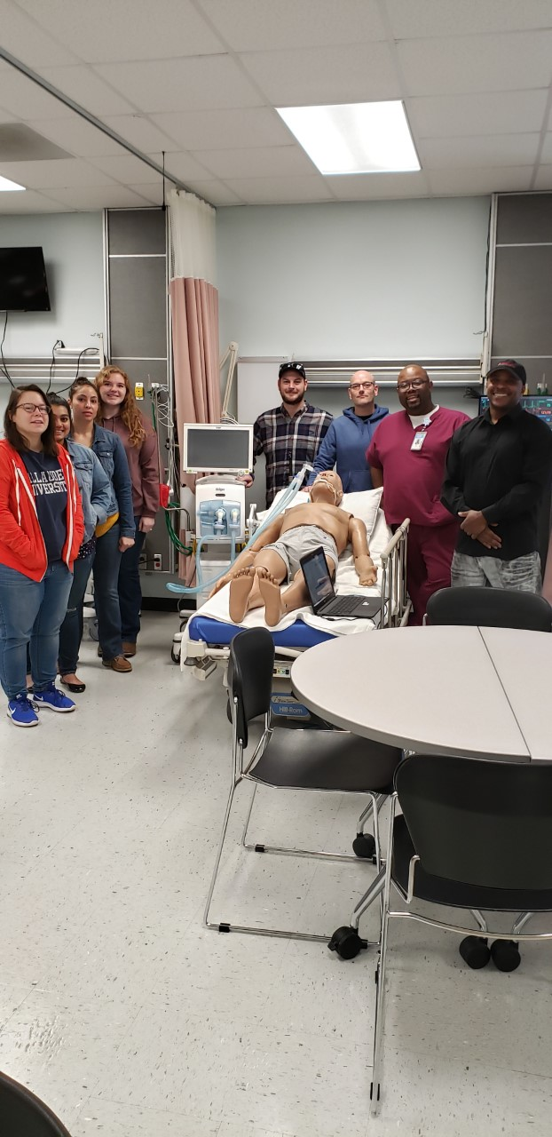
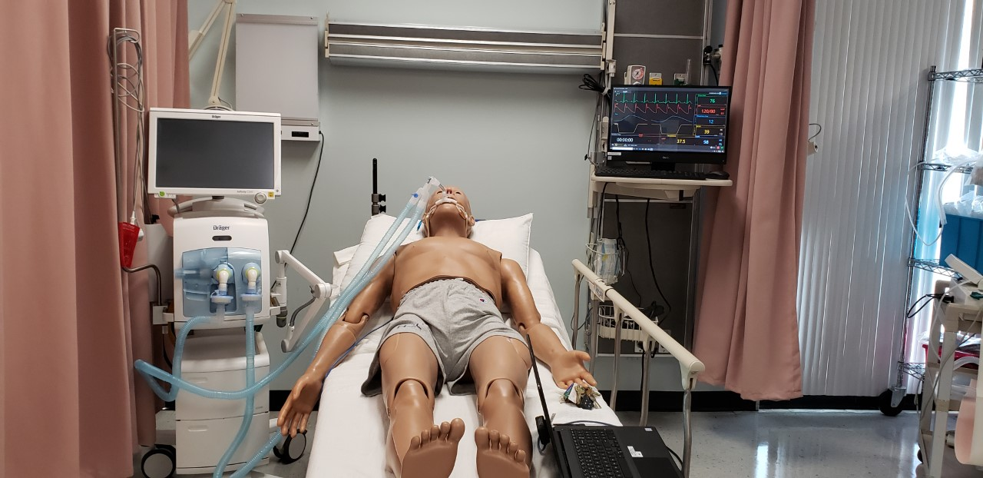
High Fidelity Manikin & Ventilator
Respiratory Therapy

Slide 6
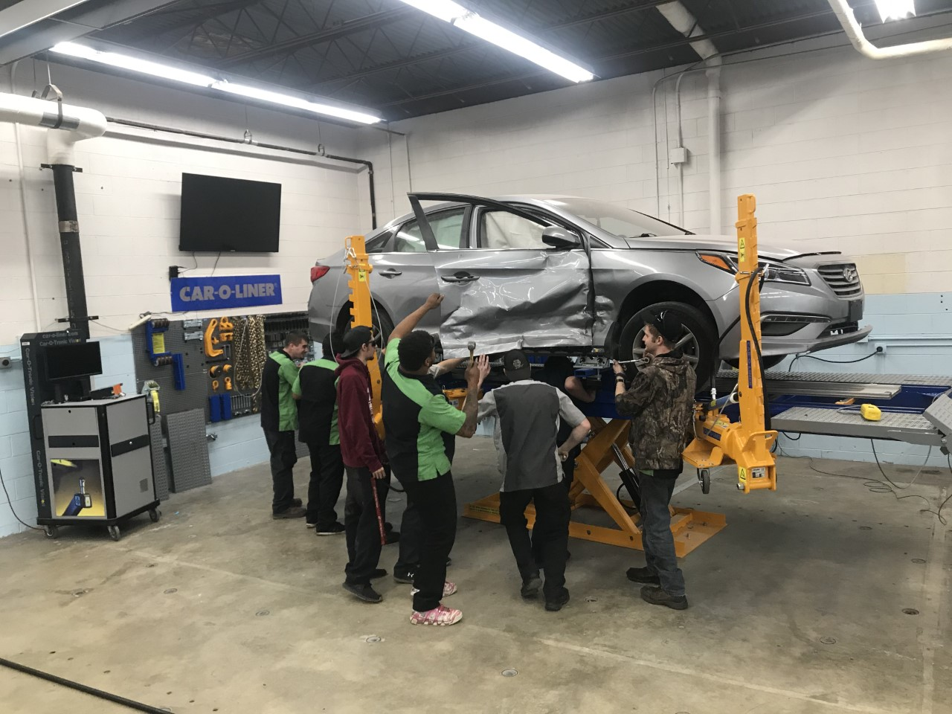
CAR-O-Liner Frame Rack and tools Collision and Repair

Slide 7
Best Practice - Special Population Outreach
Growing population of Latinx.
Many students speak English but families speak Spanish.
Invite them into our community.

Slide 8
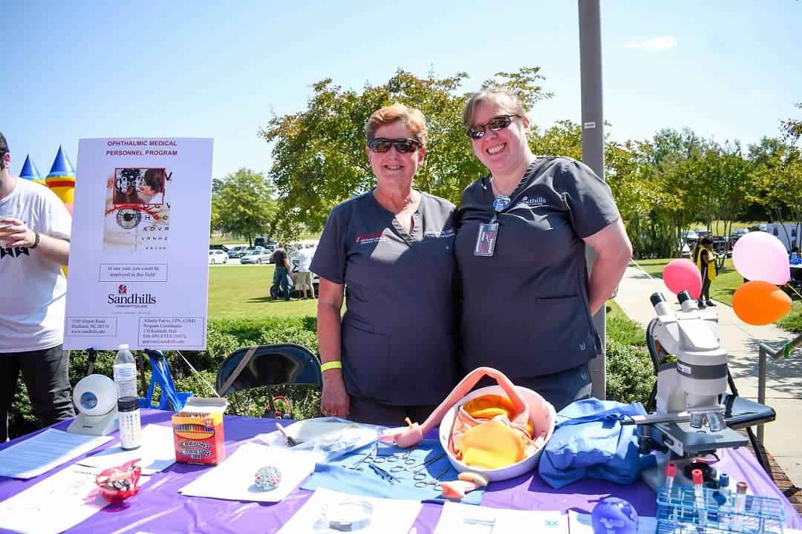
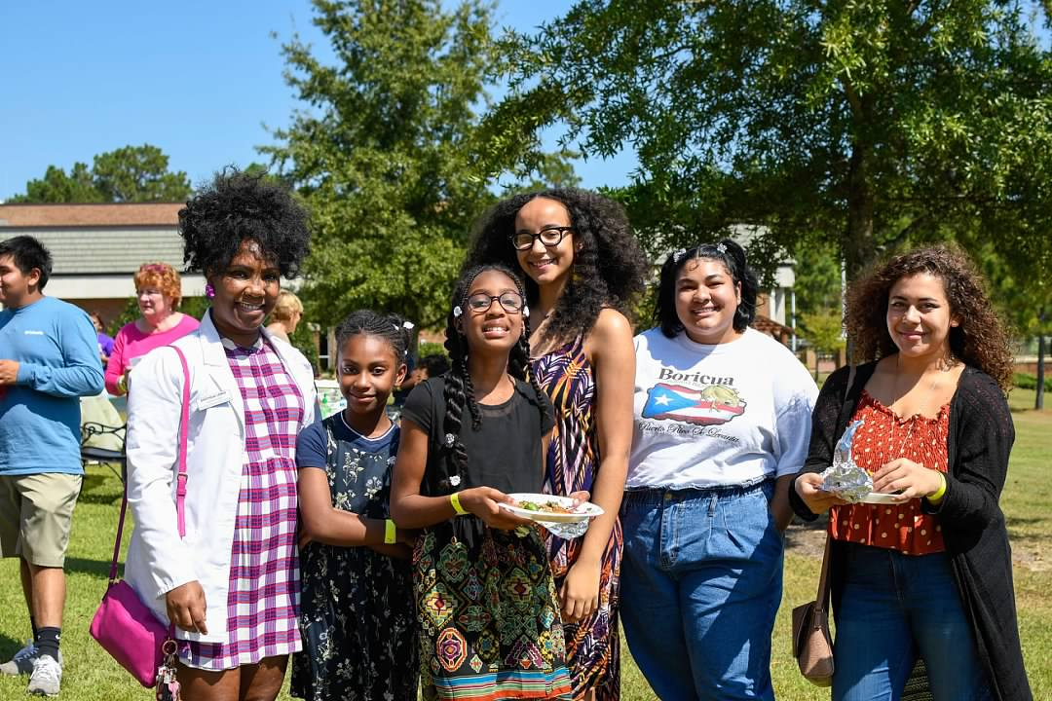
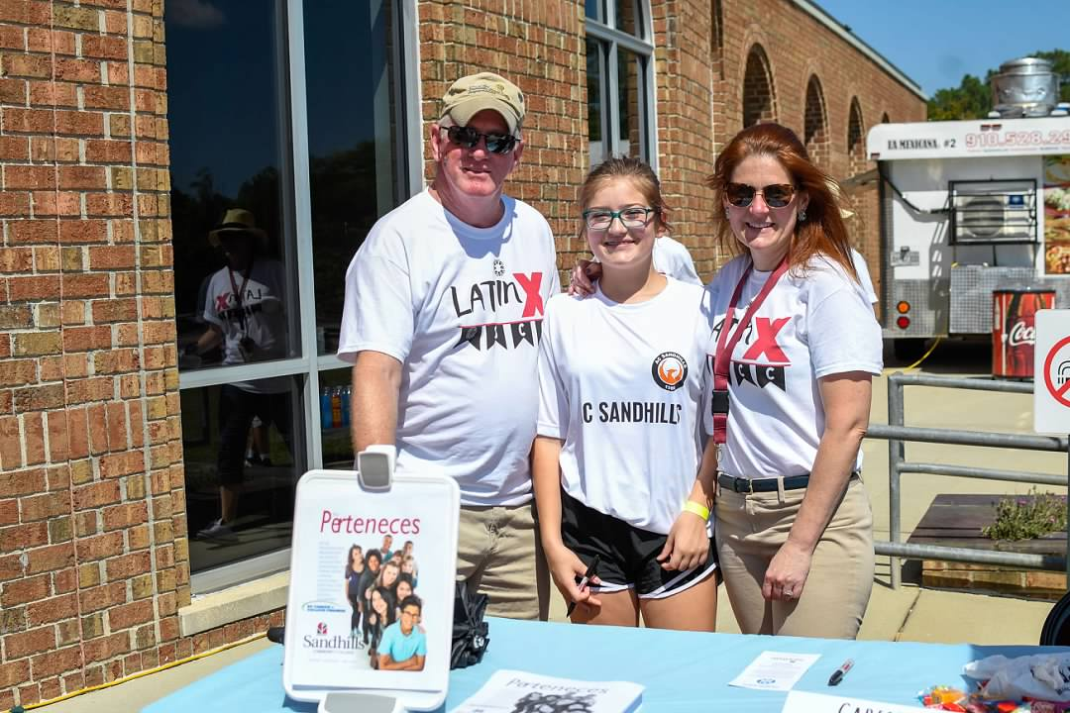
* Hispanic Community Outreach Committee * LatinX Club * Hispanic Day - SCC

Slide 9
CLNA
Advisory committees
Employment data from counties and state/national trends
Information from high schools
Major employers in counties
PROGRAMS
Transportation – Automotive Systems Tech; Collision and Repair, Aviation Management and Career Pilot
Health - Nursing, Medical Lab Tech, Respiratory Therapy, Surgical Tech, Paramedic, Radiography Tech
Computer Technologies – Computer Engineering Tech, Computer Programming, Networking and Security

