Slide 1
Digging Deeper at Forsyth Tech
2019-2020 Perkins Mid-Year Review
Forsyth Tech Transportation Center

Slide 2
Plumbing Program
Program Overview
Working with High School Students
Why the equipment was needed
Using Perkins Funds to enhance the program

Slide 3
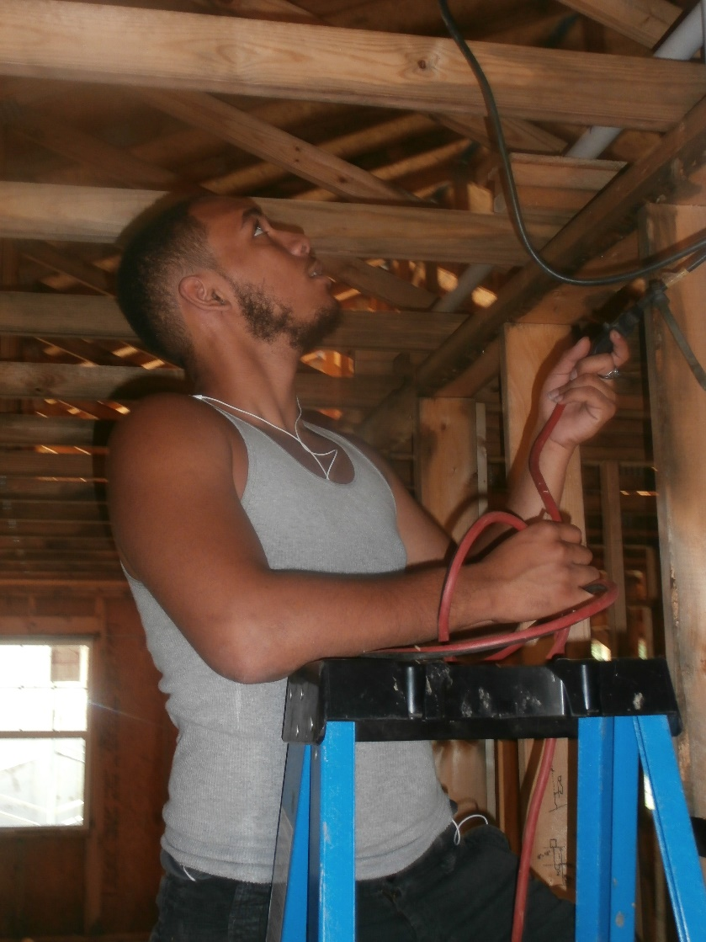
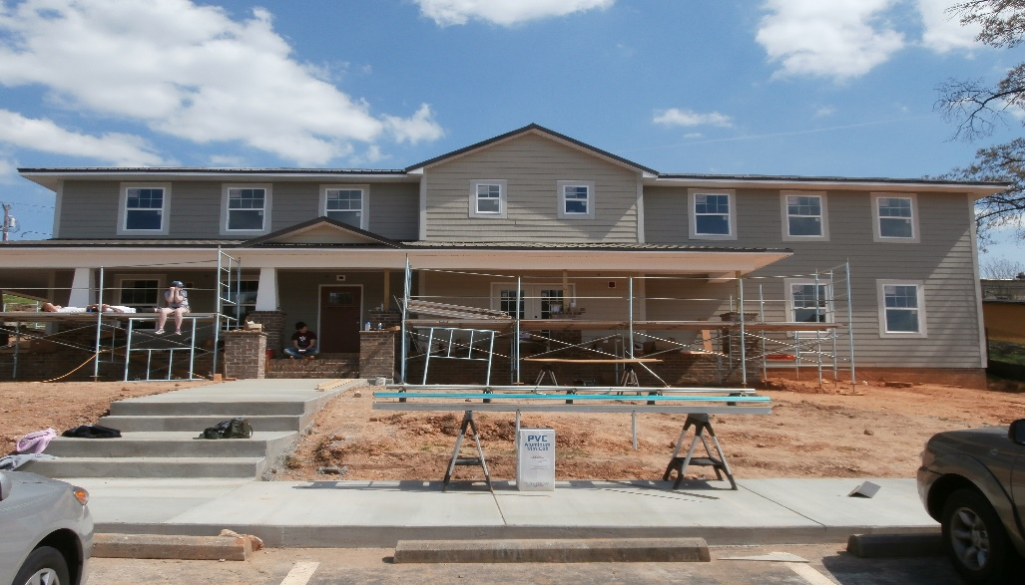
Program Overview
Habitat for Humanity Homes
15 homes per year/150 homes in 13 years
13 students a year, 3 CCP students
Non-traditional marketing brochure added

Slide 4
Working with High School Students
Participated in the Winston Salem Chamber of Commerce Construction Career Days- over 1,300 high school students attended.

Slide 5
Career And College Promise
3 CCP students
Have a Plumbing Diploma Pathway
Two 11th graders
One Senior
Came into the program later but will graduate with a certificate
Have mapped out plan to graduate with the diploma

Slide 6
Placement Rates
We are the only Plumbing Program in the area
100% of the students have job offers when the graduate or choose to obtain a stackable credential
Previous students are starting their own businesses and hiring graduates

Slide 7
No Excavator

Slide 8
Benefits for having an Excavator
Students were digging by hand at jobsites-excavator can do in two hours what it would take two days to hand dig
Advisory Board members, saying it was costing them time and money to train graduates
Excavator can be used in other construction programs as well: Carpentry, HVAC, Electrical and Horticulture
May be used at the Stokes Trades Building
Could allow the program to grow

Slide 9
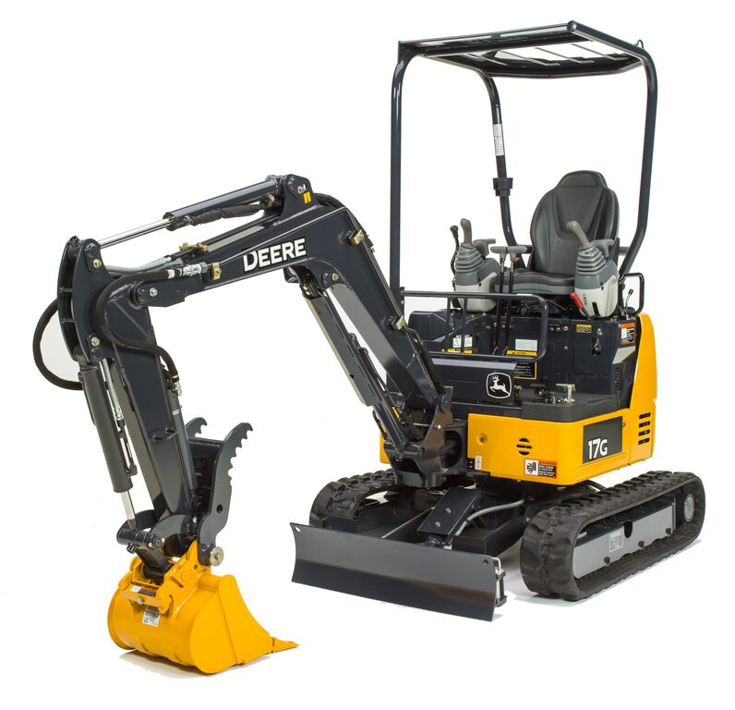
Funding the Excavator
John Deere Compact Excavator with Planetary Drive Auger and Mighty Mole and trailer
Requisition Completed

Slide 10
Summary
Excavator will allow our students to obtain new skills and be more competitive in the workforce
Will be able to use the excavator for multiple program areas
Will be used for outreach for high school students
May allow the plumbing program to grow

Slide 11
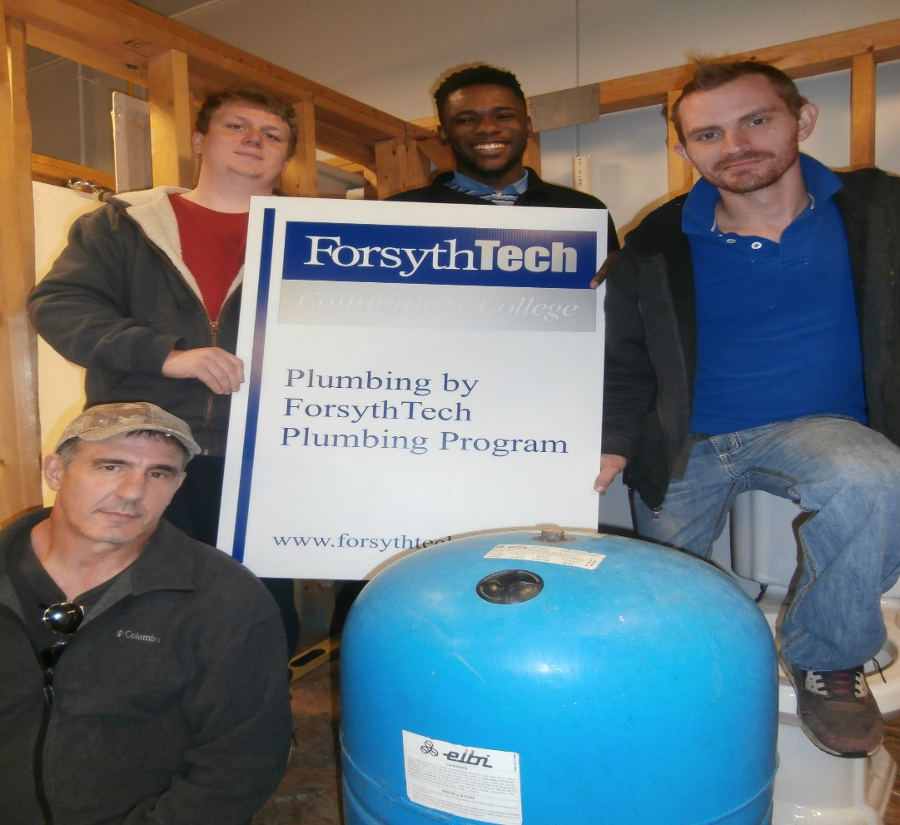
Will allow more of these:

Slide 12
Mid-Year Budget
Requisitions in place for all equipment
Software requisitions are in process
Budget Modifications have been done for vacant positions and the funds have been reallocated
What we have left-professional development in the Spring and Administrative Professionals Summit to be held in the Spring

