Slide 1
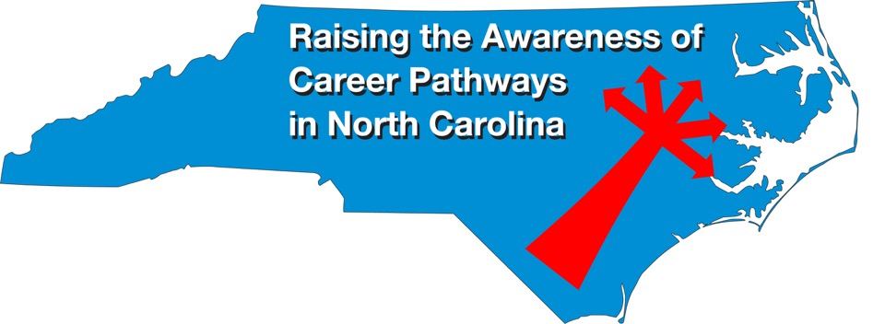
November 18, 2020 Exploring NCCareers.org
Download the PowerPoint and access the recording: www.ncperkins.org/presentations
Notes:
Chris
We are here to help promote the great jobs, often unknown, in the great state of North Carolina.
Through these monthly meetings, we are going to let you know about some great career opportunities in North Carolina.
And bring in special guests to let you know about the great career opportunities in North Carolina.
Please download this PowerPoint file and use it anyway you can to help get folks on a career pathway.
The reference showing from where the information was found, as well as the contact information for our guests is in the Notes section under each slide.
Get the PowerPoint on our NCPerkins.org website on our Presentations and Webinars page.
Here is the direct address on the screen.
-----
Many of the videos shown during this webinar can be found here:
https://www.ncperkins.org/video/

Slide 2
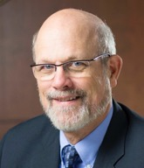
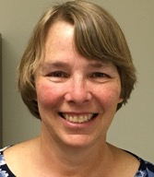
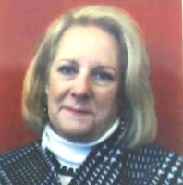
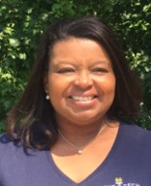
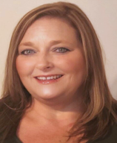
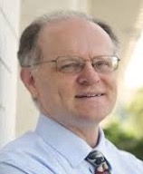
Raising the Awareness of Career Pathways in North Carolina
Bob Witchger
Patti Coultas
Tony Reggi
Cheryl Cox
NC Dept of Public Instruction
Michelle Lair
Mary Olvera
Chris Droessler
Notes:
Chris
I always say our webinars are like radio but with pictures.
And here are a few pictures of your hosts for these monthly explorations into career pathways.
(Why does the photographer have the best photo?)
Our contact information is in the notes section under this slide.
Dr. Bob Witchger
919-807-7126
WitchgerB@nccommunitycolleges.edu
Dr. Tony R. Reggi
919-807-7131
ReggiA@nccommunitycolleges.edu
Patti Coultas
919-807-7130
CoultasP@nccommunitycolleges.edu
Dr. Mary Olvera
919-807-7120
OlveraM@nccommunitycolleges.edu
Michelle Lair
919-807-72227
LairM@nccommunitycolleges.edu
Chris Droessler
919-807-7068
DroesslerC@nccommunitycolleges.edu
Cheryl Cox
919-807-3814
Cheryl.Cox@dpi.nc.gov

Slide 3
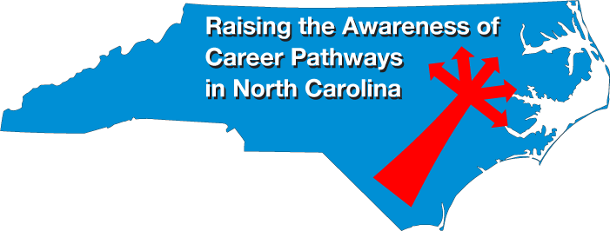
Notes:
www.ncperkins.org/presentations

Slide 4
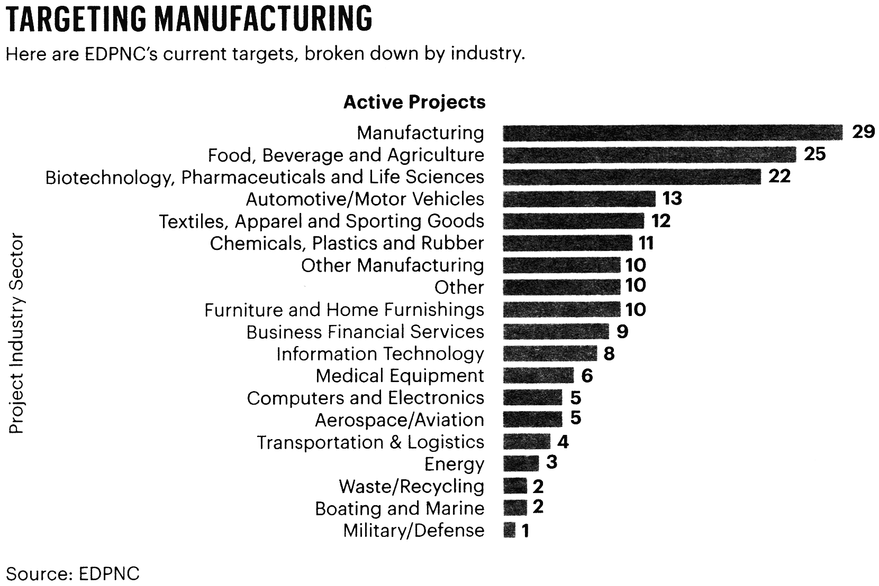
Notes:
Jeff and Jamie are about to tell you which occupations are projected to increase in NC based on input from the employers.
This chart, from the Economic Development Partnership of North Carolina, shows the kind of companies that North Carolina is trying to recruit to set up shop in our state.
Since these are the industries that our state is trying to bring into our state, there is a good likelihood there will be an increase in job openings in these areas.
Notice that Not all the manufacturing has gone to China!
=-------
From Triangle Business journal on November 6, 2020, page 4
Data are from the EDPNC, Economic Development Partnership of North Carolina

Slide 5
Notes:
www.ncperkins.org/presentations

Slide 6
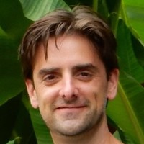
Jeff DeBellis
Director of Economic & Policy Analysis
NC Department of Commerce
Notes:
Jeff DeBellis
Director of Economic & Policy Analysis
NC Department of Commerce
Jeff.Debellis@nccommerce.com

Slide 7
Notes:
www.ncperkins.org/presentations

Slide 8
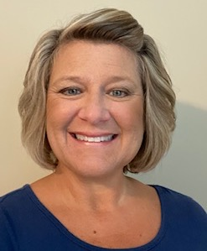
April Mitchell
Career Coach, Faculty Advisor, Global Career Development Facilitator, and Career Coach State Advisory Board member, adjunct instructor
Notes:
April Mitchell- Career Coach, Faculty Advisor, Global Career Development Facilitator, and Career Coach State Advisory Board member), adjunct instructor
ammitchell@johnstoncc.edu
April Mitchell serves at four of the eight high schools in Johnston County.
Dr. Teresa McDonald- Career Coach, Faculty Advisor, Career Development Facilitator – serves as the Career Coach at the other four high schools
Clayton HS, Cleveland HS, Corinth-Holders HS, North Johnston HS, Princeton HS, Smithfield-Selma HS, South Johnston, and West Johnston.

Slide 9
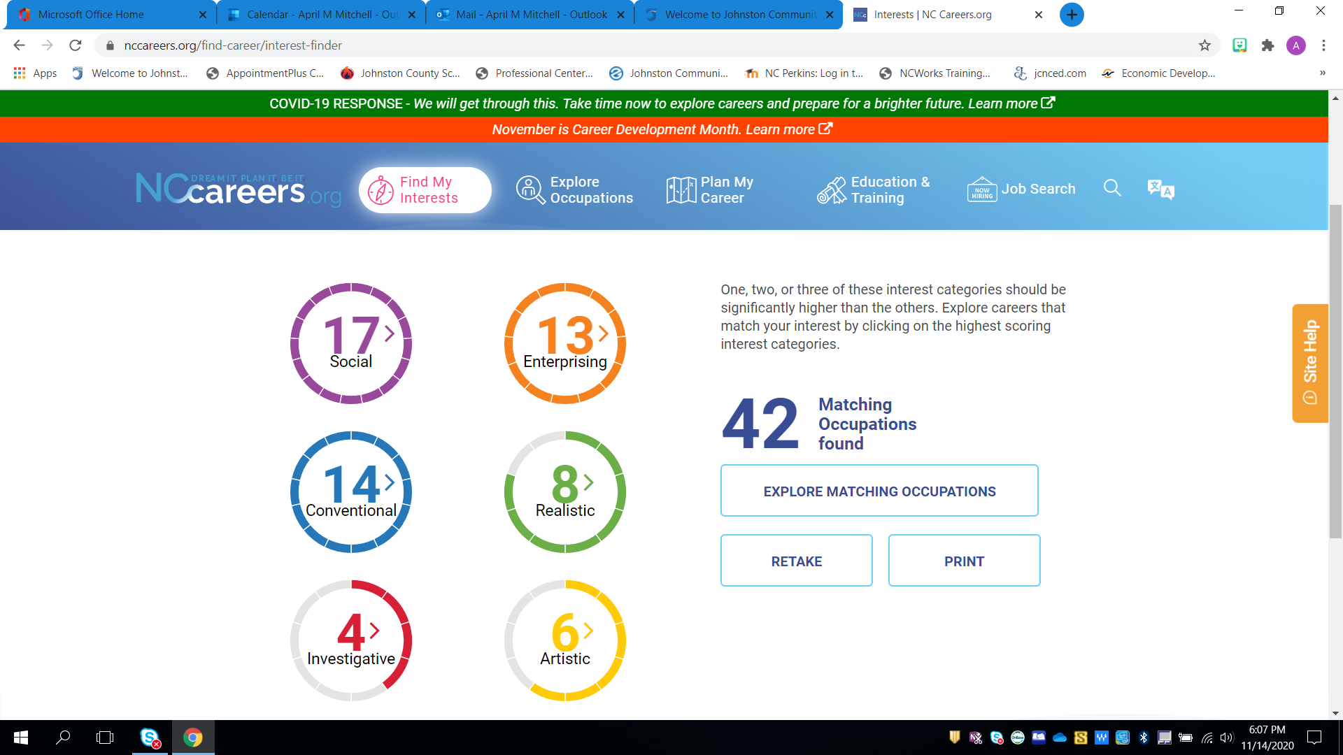
Notes:
April Mitchell- Career Coach, Faculty Advisor, Global Career Development Facilitator, and Career Coach State Advisory Board member), adjunct instructor
ammitchell@johnstoncc.edu
April Mitchell serves at four of the eight high schools in Johnston County.
Dr. Teresa McDonald- Career Coach, Faculty Advisor, Career Development Facilitator – serves as the Career Coach at the other four high schools
Clayton HS, Cleveland HS, Corinth-Holders HS, North Johnston HS, Princeton HS, Smithfield-Selma HS, South Johnston, and West Johnston.

Slide 10
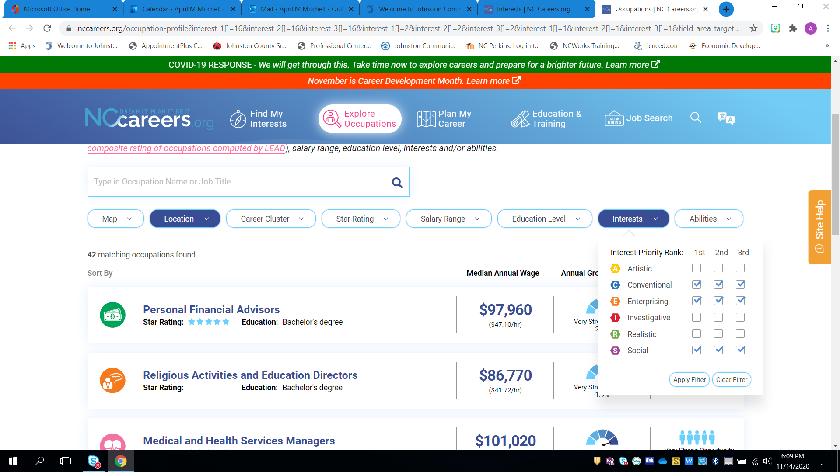
Notes:
April Mitchell- Career Coach, Faculty Advisor, Global Career Development Facilitator, and Career Coach State Advisory Board member), adjunct instructor
ammitchell@johnstoncc.edu
April Mitchell serves at four of the eight high schools in Johnston County.
Dr. Teresa McDonald- Career Coach, Faculty Advisor, Career Development Facilitator – serves as the Career Coach at the other four high schools
Clayton HS, Cleveland HS, Corinth-Holders HS, North Johnston HS, Princeton HS, Smithfield-Selma HS, South Johnston, and West Johnston.

Slide 11
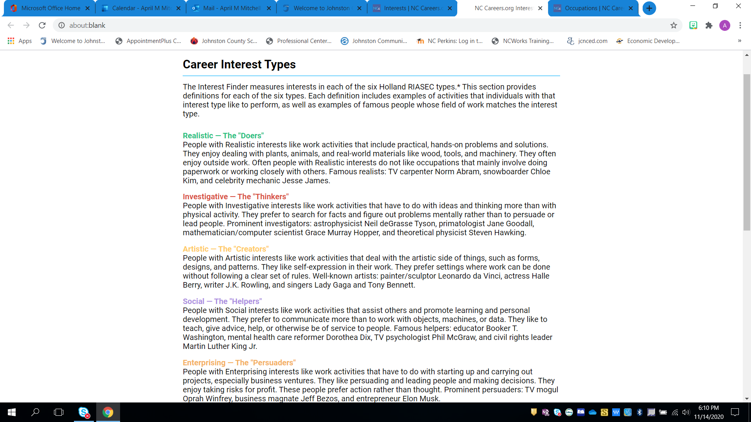
Notes:
April Mitchell- Career Coach, Faculty Advisor, Global Career Development Facilitator, and Career Coach State Advisory Board member), adjunct instructor
ammitchell@johnstoncc.edu
April Mitchell serves at four of the eight high schools in Johnston County.
Dr. Teresa McDonald- Career Coach, Faculty Advisor, Career Development Facilitator – serves as the Career Coach at the other four high schools
Clayton HS, Cleveland HS, Corinth-Holders HS, North Johnston HS, Princeton HS, Smithfield-Selma HS, South Johnston, and West Johnston.

Slide 12
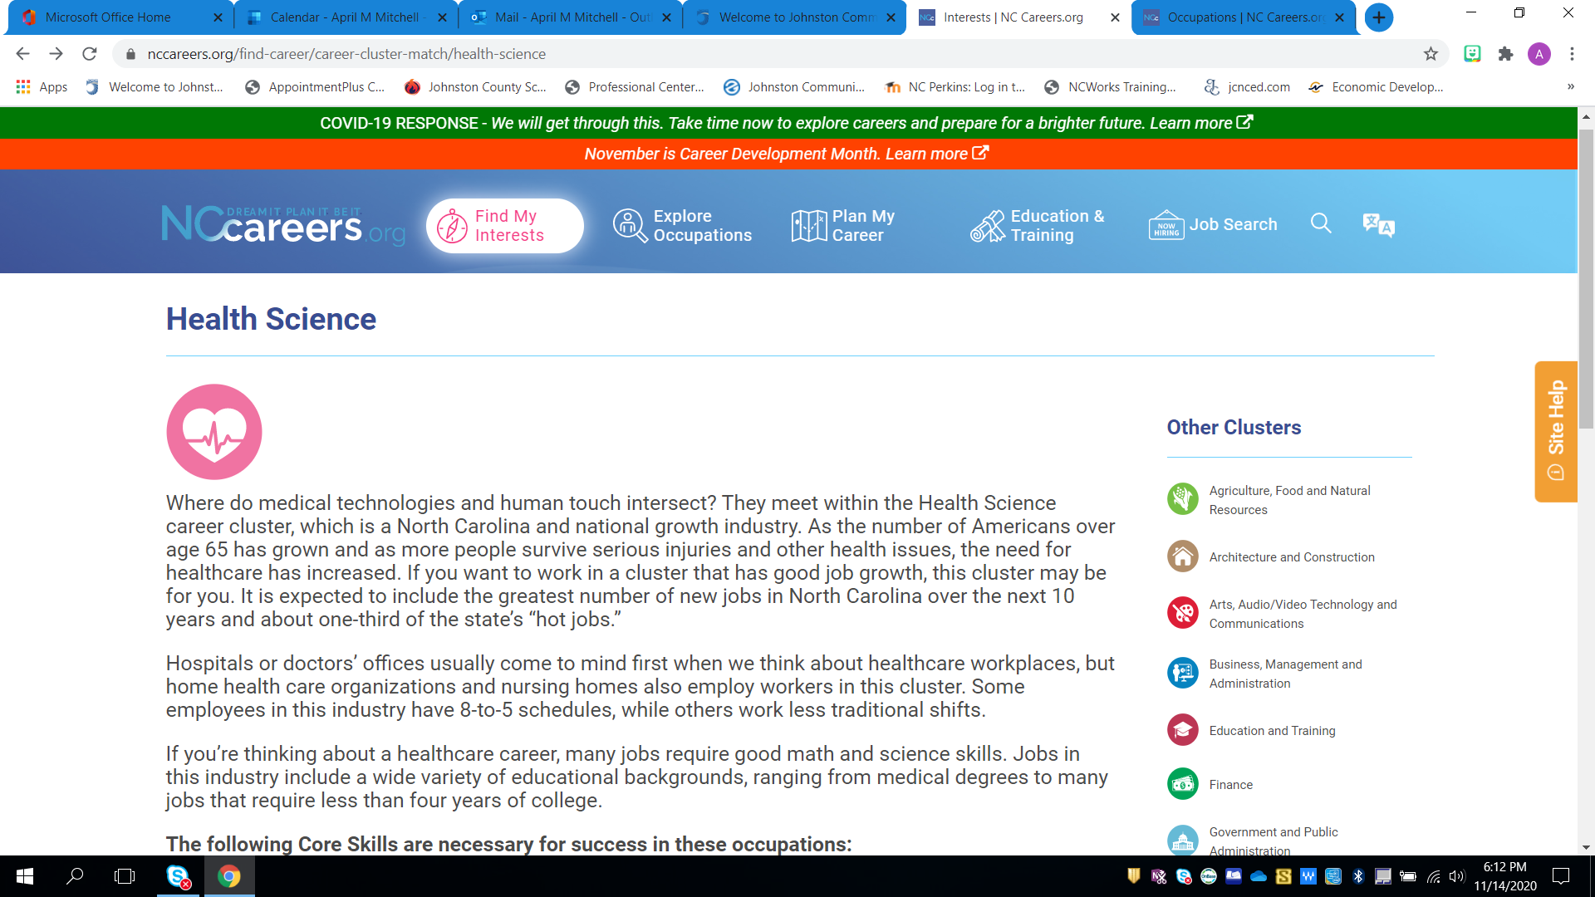
Notes:
April Mitchell- Career Coach, Faculty Advisor, Global Career Development Facilitator, and Career Coach State Advisory Board member), adjunct instructor
ammitchell@johnstoncc.edu
April Mitchell serves at four of the eight high schools in Johnston County.
Dr. Teresa McDonald- Career Coach, Faculty Advisor, Career Development Facilitator – serves as the Career Coach at the other four high schools
Clayton HS, Cleveland HS, Corinth-Holders HS, North Johnston HS, Princeton HS, Smithfield-Selma HS, South Johnston, and West Johnston.

Slide 13
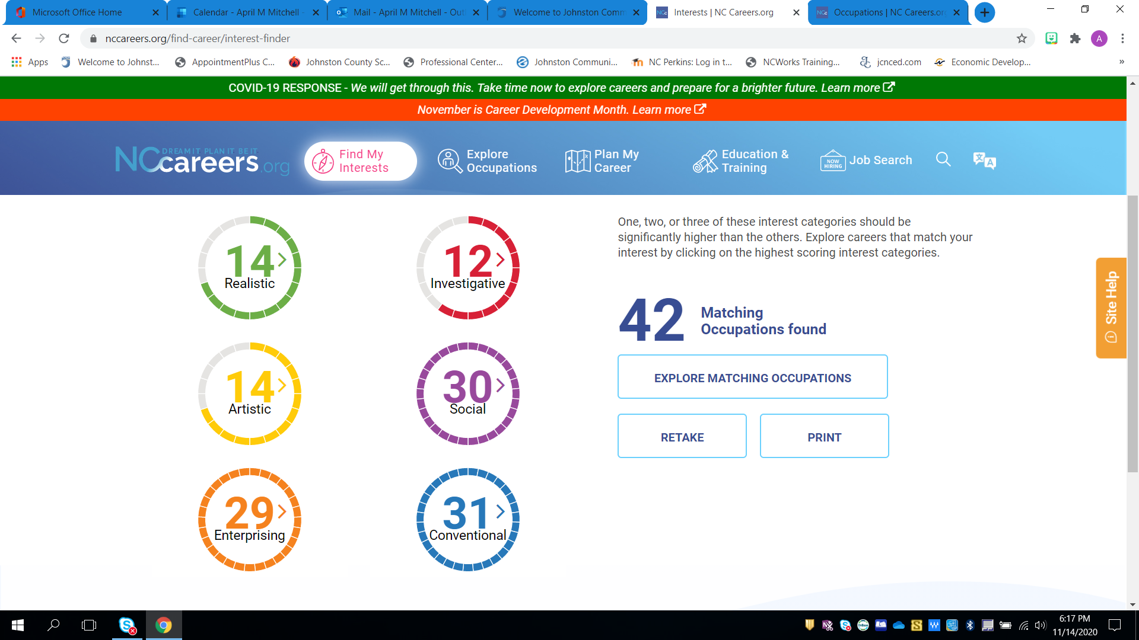
Notes:
April Mitchell- Career Coach, Faculty Advisor, Global Career Development Facilitator, and Career Coach State Advisory Board member), adjunct instructor
ammitchell@johnstoncc.edu
April Mitchell serves at four of the eight high schools in Johnston County.
Dr. Teresa McDonald- Career Coach, Faculty Advisor, Career Development Facilitator – serves as the Career Coach at the other four high schools
Clayton HS, Cleveland HS, Corinth-Holders HS, North Johnston HS, Princeton HS, Smithfield-Selma HS, South Johnston, and West Johnston.

Slide 14
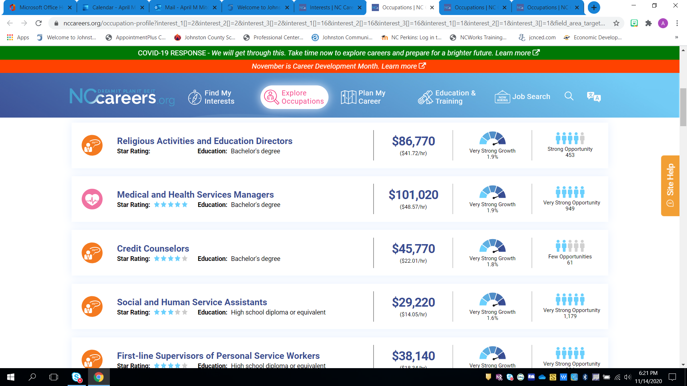
Notes:
April Mitchell- Career Coach, Faculty Advisor, Global Career Development Facilitator, and Career Coach State Advisory Board member), adjunct instructor
ammitchell@johnstoncc.edu
April Mitchell serves at four of the eight high schools in Johnston County.
Dr. Teresa McDonald- Career Coach, Faculty Advisor, Career Development Facilitator – serves as the Career Coach at the other four high schools
Clayton HS, Cleveland HS, Corinth-Holders HS, North Johnston HS, Princeton HS, Smithfield-Selma HS, South Johnston, and West Johnston.

Slide 15
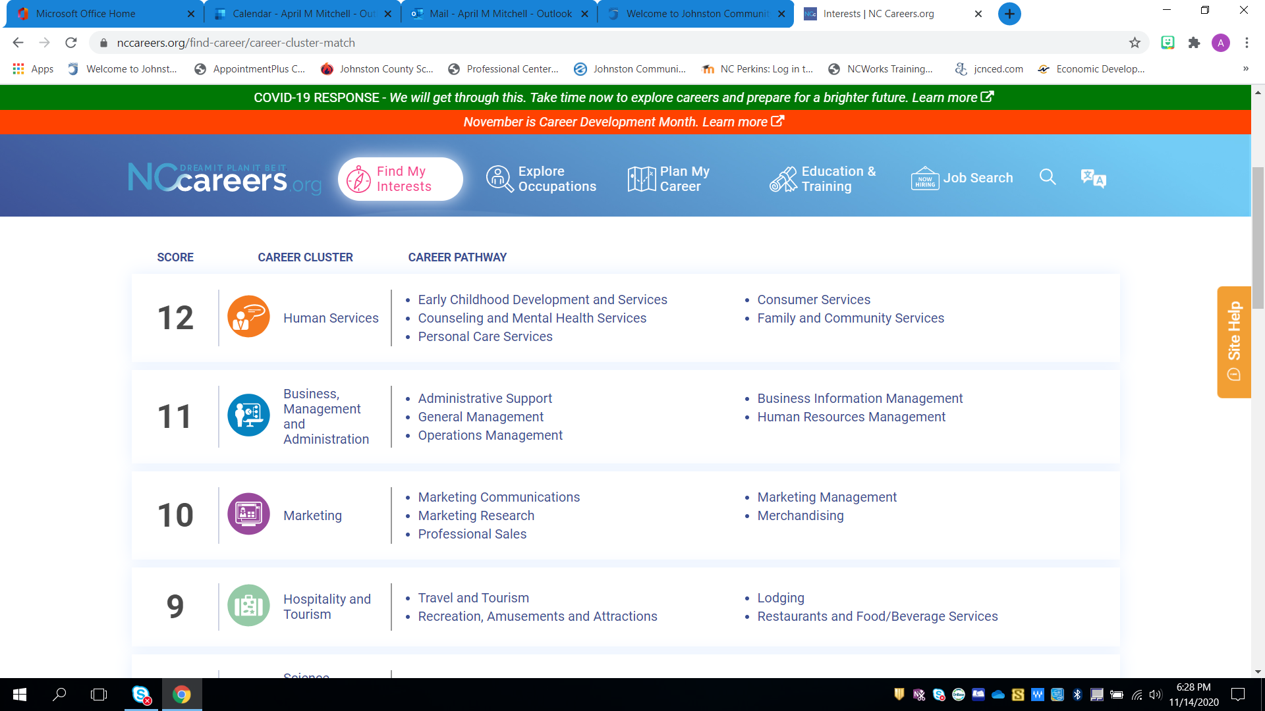
Notes:
April Mitchell- Career Coach, Faculty Advisor, Global Career Development Facilitator, and Career Coach State Advisory Board member), adjunct instructor
ammitchell@johnstoncc.edu
April Mitchell serves at four of the eight high schools in Johnston County.
Dr. Teresa McDonald- Career Coach, Faculty Advisor, Career Development Facilitator – serves as the Career Coach at the other four high schools
Clayton HS, Cleveland HS, Corinth-Holders HS, North Johnston HS, Princeton HS, Smithfield-Selma HS, South Johnston, and West Johnston.

Slide 16
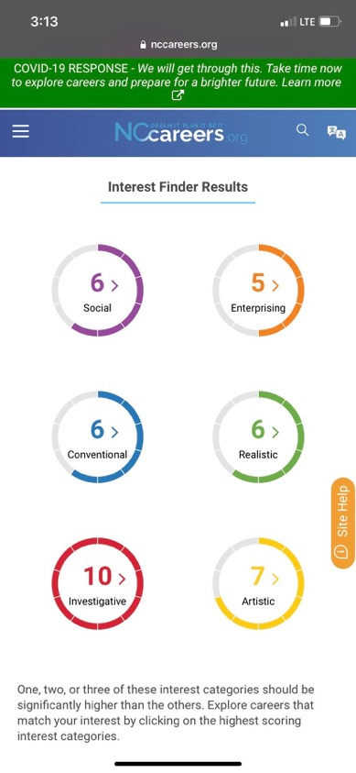
Notes:
April Mitchell- Career Coach, Faculty Advisor, Global Career Development Facilitator, and Career Coach State Advisory Board member), adjunct instructor
ammitchell@johnstoncc.edu
April Mitchell serves at four of the eight high schools in Johnston County.
Dr. Teresa McDonald- Career Coach, Faculty Advisor, Career Development Facilitator – serves as the Career Coach at the other four high schools
Clayton HS, Cleveland HS, Corinth-Holders HS, North Johnston HS, Princeton HS, Smithfield-Selma HS, South Johnston, and West Johnston.

Slide 17
Notes:
www.ncperkins.org/presentations

Slide 18
Notes:
https://www.jocoworks.net/
JOCO WORKS is an industry-led collaborative supported by education, business, civic, and government partners created to meet the Johnston County, North Carolina (JOCO) workforce needs of the future. The collaborative will culminate in a curriculum and experienced-based career exposition specifically for 8th grade students held annually at Johnston Community College. ​JOCO WORKS 2020 will be VIRTUAL for all Johnston County 8th grade students. Official 2020 dates and time coming soon!
====
Reno Palombit
Workforce Development Specialist Johnston County Public Schools
Career and Technical Education 211 East Rose Street (West Campus) Smithfield, NC 27577 (919) 980-4562 x1067
Pronouns: He, Him, His

Slide 19
Raising the Awareness of Career Pathways in North Carolina
Next meeting is January 20, 2021
Download the PowerPoint and access the recording: www.ncperkins.org/presentations
Notes:
Our next meeting like this one will be on ------.
(We will skip December and be back in January.)
You can go to the NCPerkins website to register for that meeting.
We'll also send you a reminder, since you are now on our mailing list.
So go ahead and sign up for all the meetings, and you'll be reminded the day before.
If you liked something you saw here, send folks to the recording. Find it at that same web page.

