Slide 1
Perkins Update
April 11, 2023

Slide 2
Career & Technical Education Team
Bob Witchger
Tony Reggi
Patti Coultas
Mary Olvera
Anne Bacon
Darice McDougald
Lane Freeman
Aaron Mabe

Slide 3
Purpose of Perkins
Develop more fully the academic knowledge and technical and employability skills of secondary education students and postsecondary education students who elect to enroll in CTE curriculum programs and programs of study
Notes:
The Strengthening Career and Technical Education for the 21st Century Act reauthorized and updated the Carl D. Perkins Career and Technical Education Act of 2006 to become the current Carl D. Perkins Career and Technical Education Act of 2006 as amended by the Strengthening Career and Technical Education for the 21st Century Act (Perkins V)
This updated act stresses:
- Academic, Technical, and Employability Skills
- Funding Secondary and Postsecondary CTE
- Focusing on Students who elect to enroll in CTE Programs of Study

Slide 4
2P1 Strategies
Credential, Certificate or Diploma: Section 113(b)(2)(B)(ii) states “The percentage of CTE concentrators who receive a recognized postsecondary credential during participation or within 1 year of program completion.”
NCCCS defines this as a certificate, diploma, or degree
Ms. Marianne Herring
Perkins Contact
Coastal Carolina Community College
Notes:
Ms. Marianne Herring
herringm@coastalcarolina.edu

Slide 5
State Articulation Agreement Update
85% of the vote letters are in and we are calculating votes
The item to go to SBCC in May
We will update the agreement and post it on the Perkins website after the May board meeting.

Slide 6
Next week! EDGAR and Perkins Annual Meeting
Tuesday, April 18th
Koury Convention Center, Greensboro
EDGAR specific to Perkins 9am – noon
Lunch on your own noon-1pm
Perkins Annual Meeting 1pm – 5pm
Bring your Purple EDGAR book!

Slide 7
SkillsUSA State Competition
Wednesday, April 19th
Greensboro Coliseum
Postsecondary Competition (starts at 9am)
Postsecondary Awards Ceremony (7:30pm)
Dr. Kimberly Gold, NCCCS Executive VP, Chief of Staff, will be speaking at the awards ceremony

Slide 8
Career Exploration Guides
The guides are being printed!
How to distribute them…
Available online at https://nccareers.org/printables-tools

Slide 9
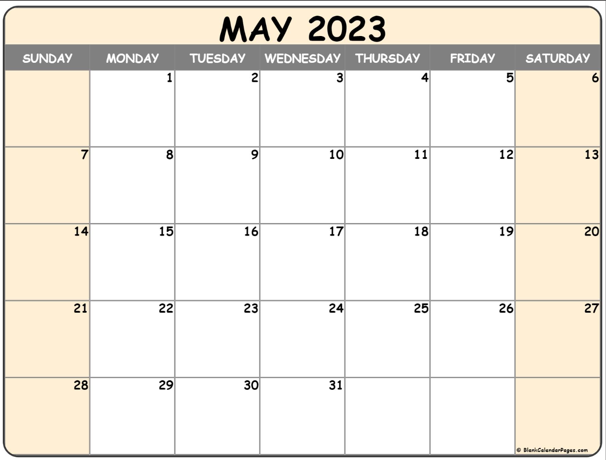
Final Perkins Modification
Modification Deadline
is May 15, 2023
DUE

Slide 10
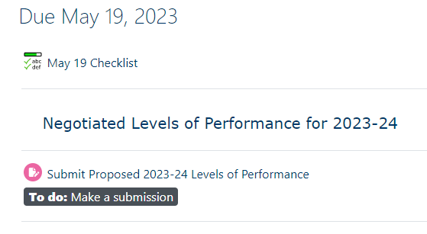
Negotiated Levels of Performance for 2023-2024 Due May 19th
The NLP form will be emailed to you this week.
Enter a level for each of the core indicators of performance and once signed, submit in NCPerkins. If we agree we will sign and return, if not, we will contact you to negotiate the level.
Submit here

Slide 11
End of Year – Due May 19th
Final Local Plan & Budget Status Update Make sure the plan reflects the last approved modified budget and complete the last two columns of the plan. Don’t forget to update the equipment and salaries tabs.
End of Year Report: The Questions are in NCPerkins.org
Promising Practice Video to share an activity that may be beneficial to other colleges in implementing Perkins V. Please plan to show it during our online session

Slide 12
EOY Reviews Online Meetings
June 5 – 9
8am – 4pm Monday – Friday (except noon on Friday)
Registration coming soon

Slide 13
Additional EOY Documents Due July 7th
XDBR for June 30, 2023
NOTE! The final XDBR must show the approved budget and expenditures, ask your budget office to print an XDBR before modifying the budget to meet expenditures (an EOY task)
Semi-annual Time Certifications January – June 2023

Slide 14
Planning for next year – Due June 2nd
Enter all 5 contacts
Submit Signed Allotment Options
Submit Signed Assurances
Submit local plan and budget
Submit job descriptions for all Perkins funded positions through payroll
This course is now live
in NCPerkins

Slide 15
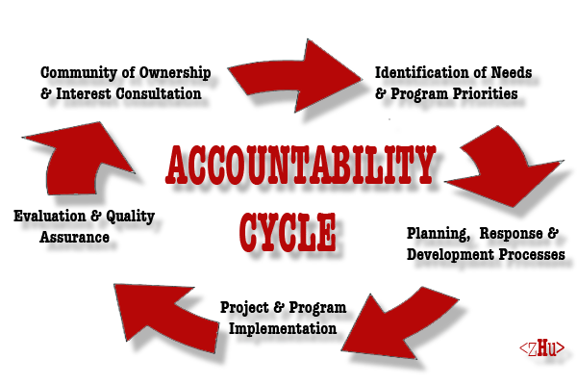
June/July in-person/virtual discussion
Discussion 2023-24 program year either in-person or virtually to
Review plan and budget
Discuss CLNA connections
Approve or revise and resubmit

Slide 16
Perkins Monthly Updates
2nd Tuesday of the month from 9-10 am
Register now for all of them https://www.ncperkins.org/presentations/
Upcoming dates:
May 9, 2023
June 13, 2023
Attendance (or viewing the recording within 30 days) is recorded on monitoring rubric. Recording may be accessed at the same link as the registration.
Notes:
Register now and let the system remind you.

Slide 17
Raising the Awareness of Career Pathways Webinars
April 19 Food Industry (SkillsUSA)
May 17 Entrepreneurship
June 21 Non-Profit Leadership and Management
Register for all webinars at
www.ncperkins.org/presentations

Slide 18
NCETA Spring Conference
May 3-5th
Hilton Raleigh, North Hills
www.nceta.org

Slide 19
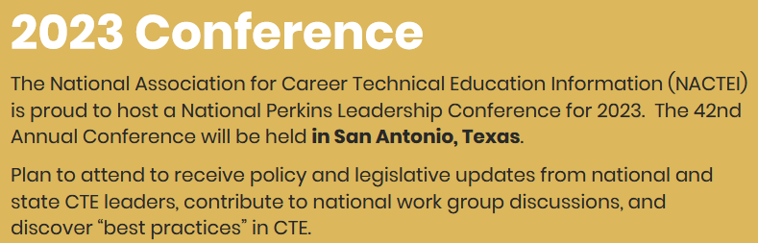
nactei National Perkins Leadership Conference
May 22-25th
https://nactei.org/conference/

Slide 20
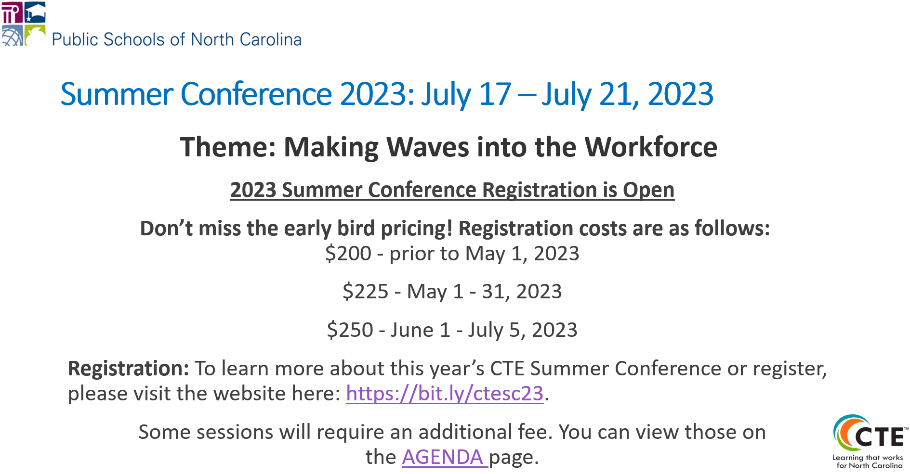
Secondary CTE Summer Conference Twin City Quarter, Winston-Salem
Notes:
https://na.eventscloud.com/website/45818/home/

Slide 21
ACTE
September 20-22
https://www.acteonline.org/postsecondarycteevent/

Slide 22
https://www.ncpn.info
Nov. 8 – 10 In Charlotte!

Slide 23
Technical Assistance is available
We are here to help!
Team Perkins is available by phone, email, virtually, or in-person

