Slide 1
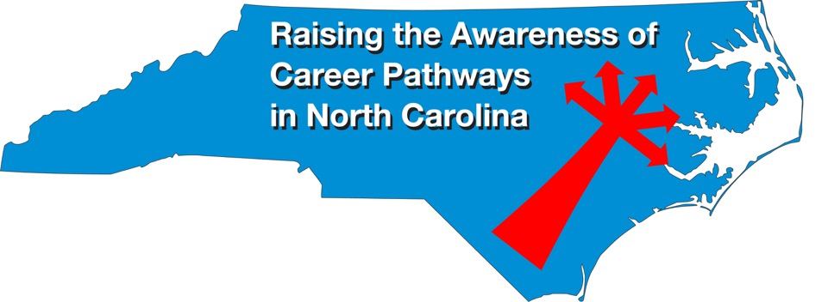
National Disability Employment Awareness October 18, 2023
Download the PowerPoint and access the recording: www.ncperkins.org/presentations

Slide 2
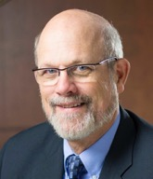
Dr. Bob Witchger
CTE Director, Team Perkins
Notes:
Dr. Robert (Bob) Witchger
NCCCS, CTE Director
919-807-7126
witchgerb@nccommunitycolleges.edu

Slide 3
Career & Technical Education Team
Bob Witchger
Tony Reggi
Patti Coultas
Mary Olvera
vacant
Darice McDougald
Lane Freeman
Jennifer McLean
Aaron Mabe

Slide 4
Dr. Tony Reggi
CTE Associate Director
Notes:
Tony Reggi
919-807-7131
reggia@nccommunitycolleges.edu

Slide 5
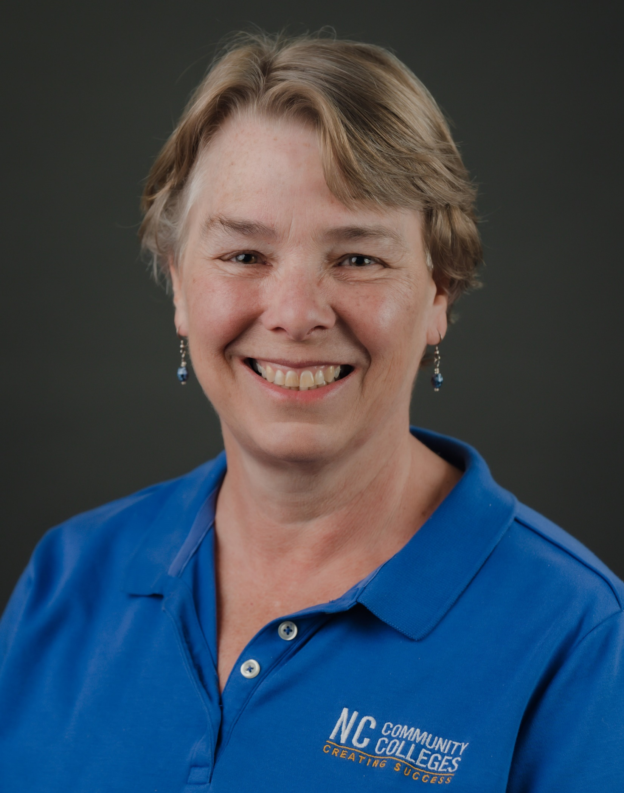
Patti Coultas
CTE Coordinator
Notes:
Patti Coultas
919-807-7130
coultasp@nccommunitycolleges.edu

Slide 6
Dr. Mary Olvera
CTE Coordinator and Program Administrator
Public Service Technologies, Agriculture and Natural Resources Technologies, and Commercial Artistic Productions
Notes:
Dr. Mary Olvera
Career and Technical Education Coordinator & Program Administrator
Public Service Technologies, Agriculture and Natural Resources Technologies, and Commercial Artistic Productions
North Carolina Community College System Office
919-807-7120
olveram@nccommunitycolleges.edu

Slide 7
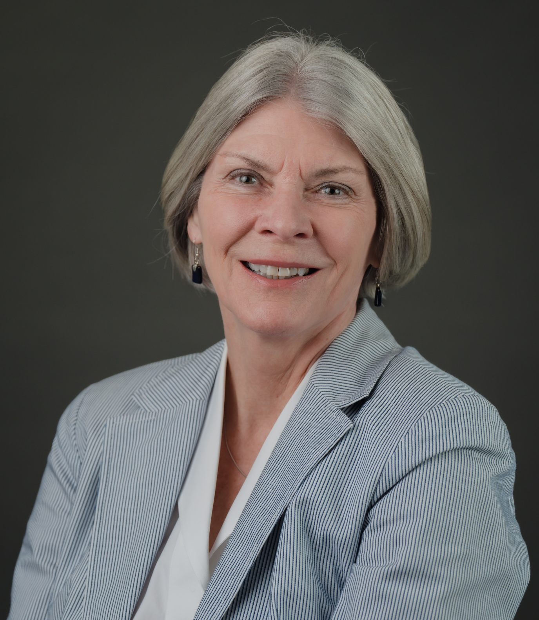
Dr. Trudie Hughes
Associate Director, Disability Services and Title IX ​
Notes:
Dr. Mary Olvera
Career and Technical Education Coordinator & Program Administrator
Public Service Technologies, Agriculture and Natural Resources Technologies, and Commercial Artistic Productions
North Carolina Community College System Office
919-807-7120
olveram@nccommunitycolleges.edu

Slide 8
Aaron Mabe
Coordinator for Career and College Promise
Notes:
Aaron Mabe
919-807-7098
mabea@nccommunitycolleges.edu

Slide 9
NCCCS Mission Statement
To open the door to high quality, accessible educational opportunities that minimize barriers to postsecondary education, maximize student success, develop a globally and multi-culturally competent workforce, and improve the lives and well-being of individuals by providing:
education, training, and retraining for the workforce, including basic skills and literacy education, occupational and pre-baccalaureate programs;
support for economic development through services to and in partnership with business and industry; and
services to communities and individuals which improve the quality of life.

Slide 10
NCCCS Strategic Plan Goal 2 alignment
Goal 2: Increase access and enrollment at North Carolina community colleges to meet the state’s educational attainment goal and expand postsecondary opportunities.
Objective 2.1: Increase marketing and outreach to prospective students and their influencers.
Strategy 2.1.1: Develop and utilize marketing strategies to increase enrollment. Increase emphasis on the enrollment of underrepresented and non-traditional students.
Notes:
https://www.nccommunitycolleges.edu/sites/default/files/a4ncw-basic-page/ncccs-strategicplan-2022_pages_final.pdf

Slide 11
NCCCS Strategic Plan Goal 3 alignment
Goal 3: Provide resources inside and outside the classroom for all students to successfully enroll, persist, and complete education or training in a chosen career path.
Strategy 3.1.1: Create a taskforce to identify strategies to mitigate barriers to student success, increase college completion, and reduce educational attainment gaps.
Strategy 3.1.2: Identify and deliver professional development for student support services that reduce the main barriers to completion facing students, especially underrepresented students.
Strategy 3.2.3: Provide programming that offers all students the interventions, advising, and support needed to succeed academically.
Strategy 3.3.1: Expand community collaboration with government and educational partners, non-profits, and businesses to connect all students with the wraparound services to support success and completion.
Notes:
https://www.nccommunitycolleges.edu/sites/default/files/a4ncw-basic-page/ncccs-strategicplan-2022_pages_final.pdf

Slide 12
Perkins V alignment
The purpose of this Act is to develop more fully the academic knowledge and technical and employability skills of secondary education students and postsecondary education students who elect to enroll in career and technical education programs and programs of study, by—
(8) increasing the employment opportunities for populations who are chronically unemployed or underemployed, including individuals with disabilities, individuals from economically disadvantaged families, out-of-workforce individuals, youth who are in, or have aged out of, the foster care system, and homeless individuals.

Slide 13
Special Populations – Perkins V, Section 3(48)
Individuals with disabilities;
Individuals from economically disadvantaged families, including low-income youth and adults;
Individuals preparing for non-traditional fields;
Single-parents, including single pregnant women;
Out-of-workforce individuals;
English learners;
Homeless individuals described in section 725 of the McKinney-Vento Homeless Assistance Act (42 U.S.C. 11434a);
Youth who are in, or have aged out of, the foster care system; and
Youth with a parent who –
Is a member of the armed forces (as such term is defined in section 101(a)(4) of title 10, U.S.C.); and
Is on active duty (as such term is defined in section 101(d)(10 of such title).

Slide 14
Did You Know?
61MM
63¢
2x
80%
Americans w/ Disabilities
More likely to live in poverty
Unemployment Rate
To the dollar
Notes:
Mary

Slide 15
Did You Know: Disabilities and Education
8%
22%
28%
Less than high school diploma
Some college or an associate degree
College graduates with Bachelor’s degree
75.5% of graduates without disabilities were employed after graduation. (U.S. Bureau of Labor Statistics, 2018)
Notes:
Mary

Slide 16
Top Sectors for People with Disabilities:
10% of people with a disability in the workforce are self-employed.
Business
Service Industries
Sales
Natural Resources
Construction
Maintenance
Production
Transportation

Slide 17
Employment for People with Disabilities in NC
According to 2019 data, there were:
232,875 people with all types of disabilities working in the North Carolina workforce (equates to a 33.8% employment rate)
North Carolina ranked 42nd in the nation for employing people with disabilities (Medina, 2019)
Notes:
John

Slide 18
Economic Impact
Nationally, people with disabilities, on average, earn 37% less than their peers without disabilities even with the same educational attainment and comparable demographic characteristics (Yin, Shaewitz, & Megra, 2020).
This pay gap is nearly twice as much as the 20% gender pay gap in the U.S. and has an economic impact on individuals, states, and the nation in terms of lost income taxes.
Notes:
John

Slide 19
Economic Impact continued
The U.S. economy would have received an additional $141 billion in 2011—roughly 1% of the gross domestic product—if people with disabilities were paid comparably to those without disabilities.
The earnings difference for people with disabilities would have translated into another $25 billion in federal taxes and $6.5 billion in state taxes.
Notes:
John

Slide 20
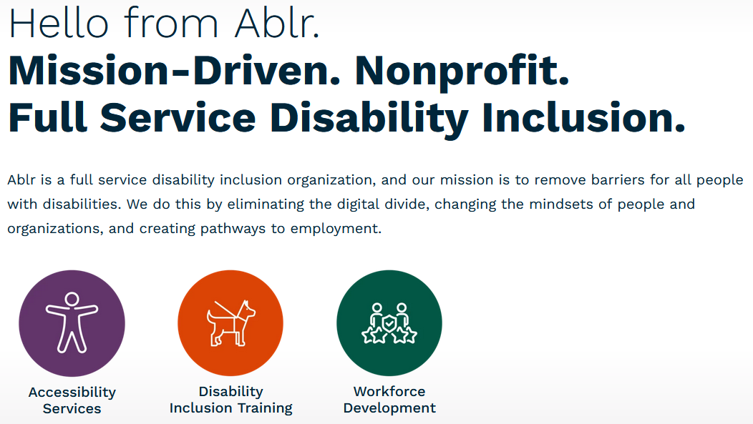
Full-service disability inclusion organization

Slide 21
John Samuel
ablr
CEO

Slide 22
Sarah Clark
ablr
Marketing Strategist

Slide 23
Angus Kola
ablr
Sr. Accessibility Analyst

Slide 24
Beaufort County Community College
Alexandra Shreve, M.Ed.
Accessibility Services Coordinator

Slide 25
Beaufort County Community College
Brandi Keehnle
Student Ambassador

Slide 26
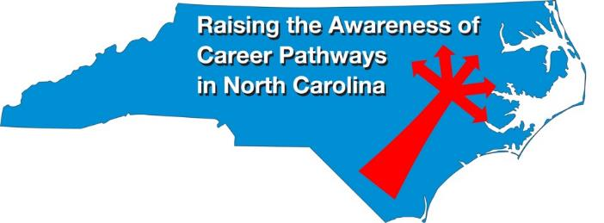
Raising the Awareness of Career Pathways Webinars
Nov. 15, 2023 – Dental Assisting and Hygiene
Jan. 17, 2024 – Engineering Technology vs Engineering careers
Feb. 21, 2024 – Biotechnology & Clinical Trails Research Associates
Mar. 20, 2024 – Business Administration
Apr. 17, 2024 – Public Safety
May 15, 2024 – Cyber Crime Technology
Register for all webinars at www.ncperkins.org/presentations

