Slide 1
Perkins Mid-Year Presentation
Blair Hancock

Slide 2
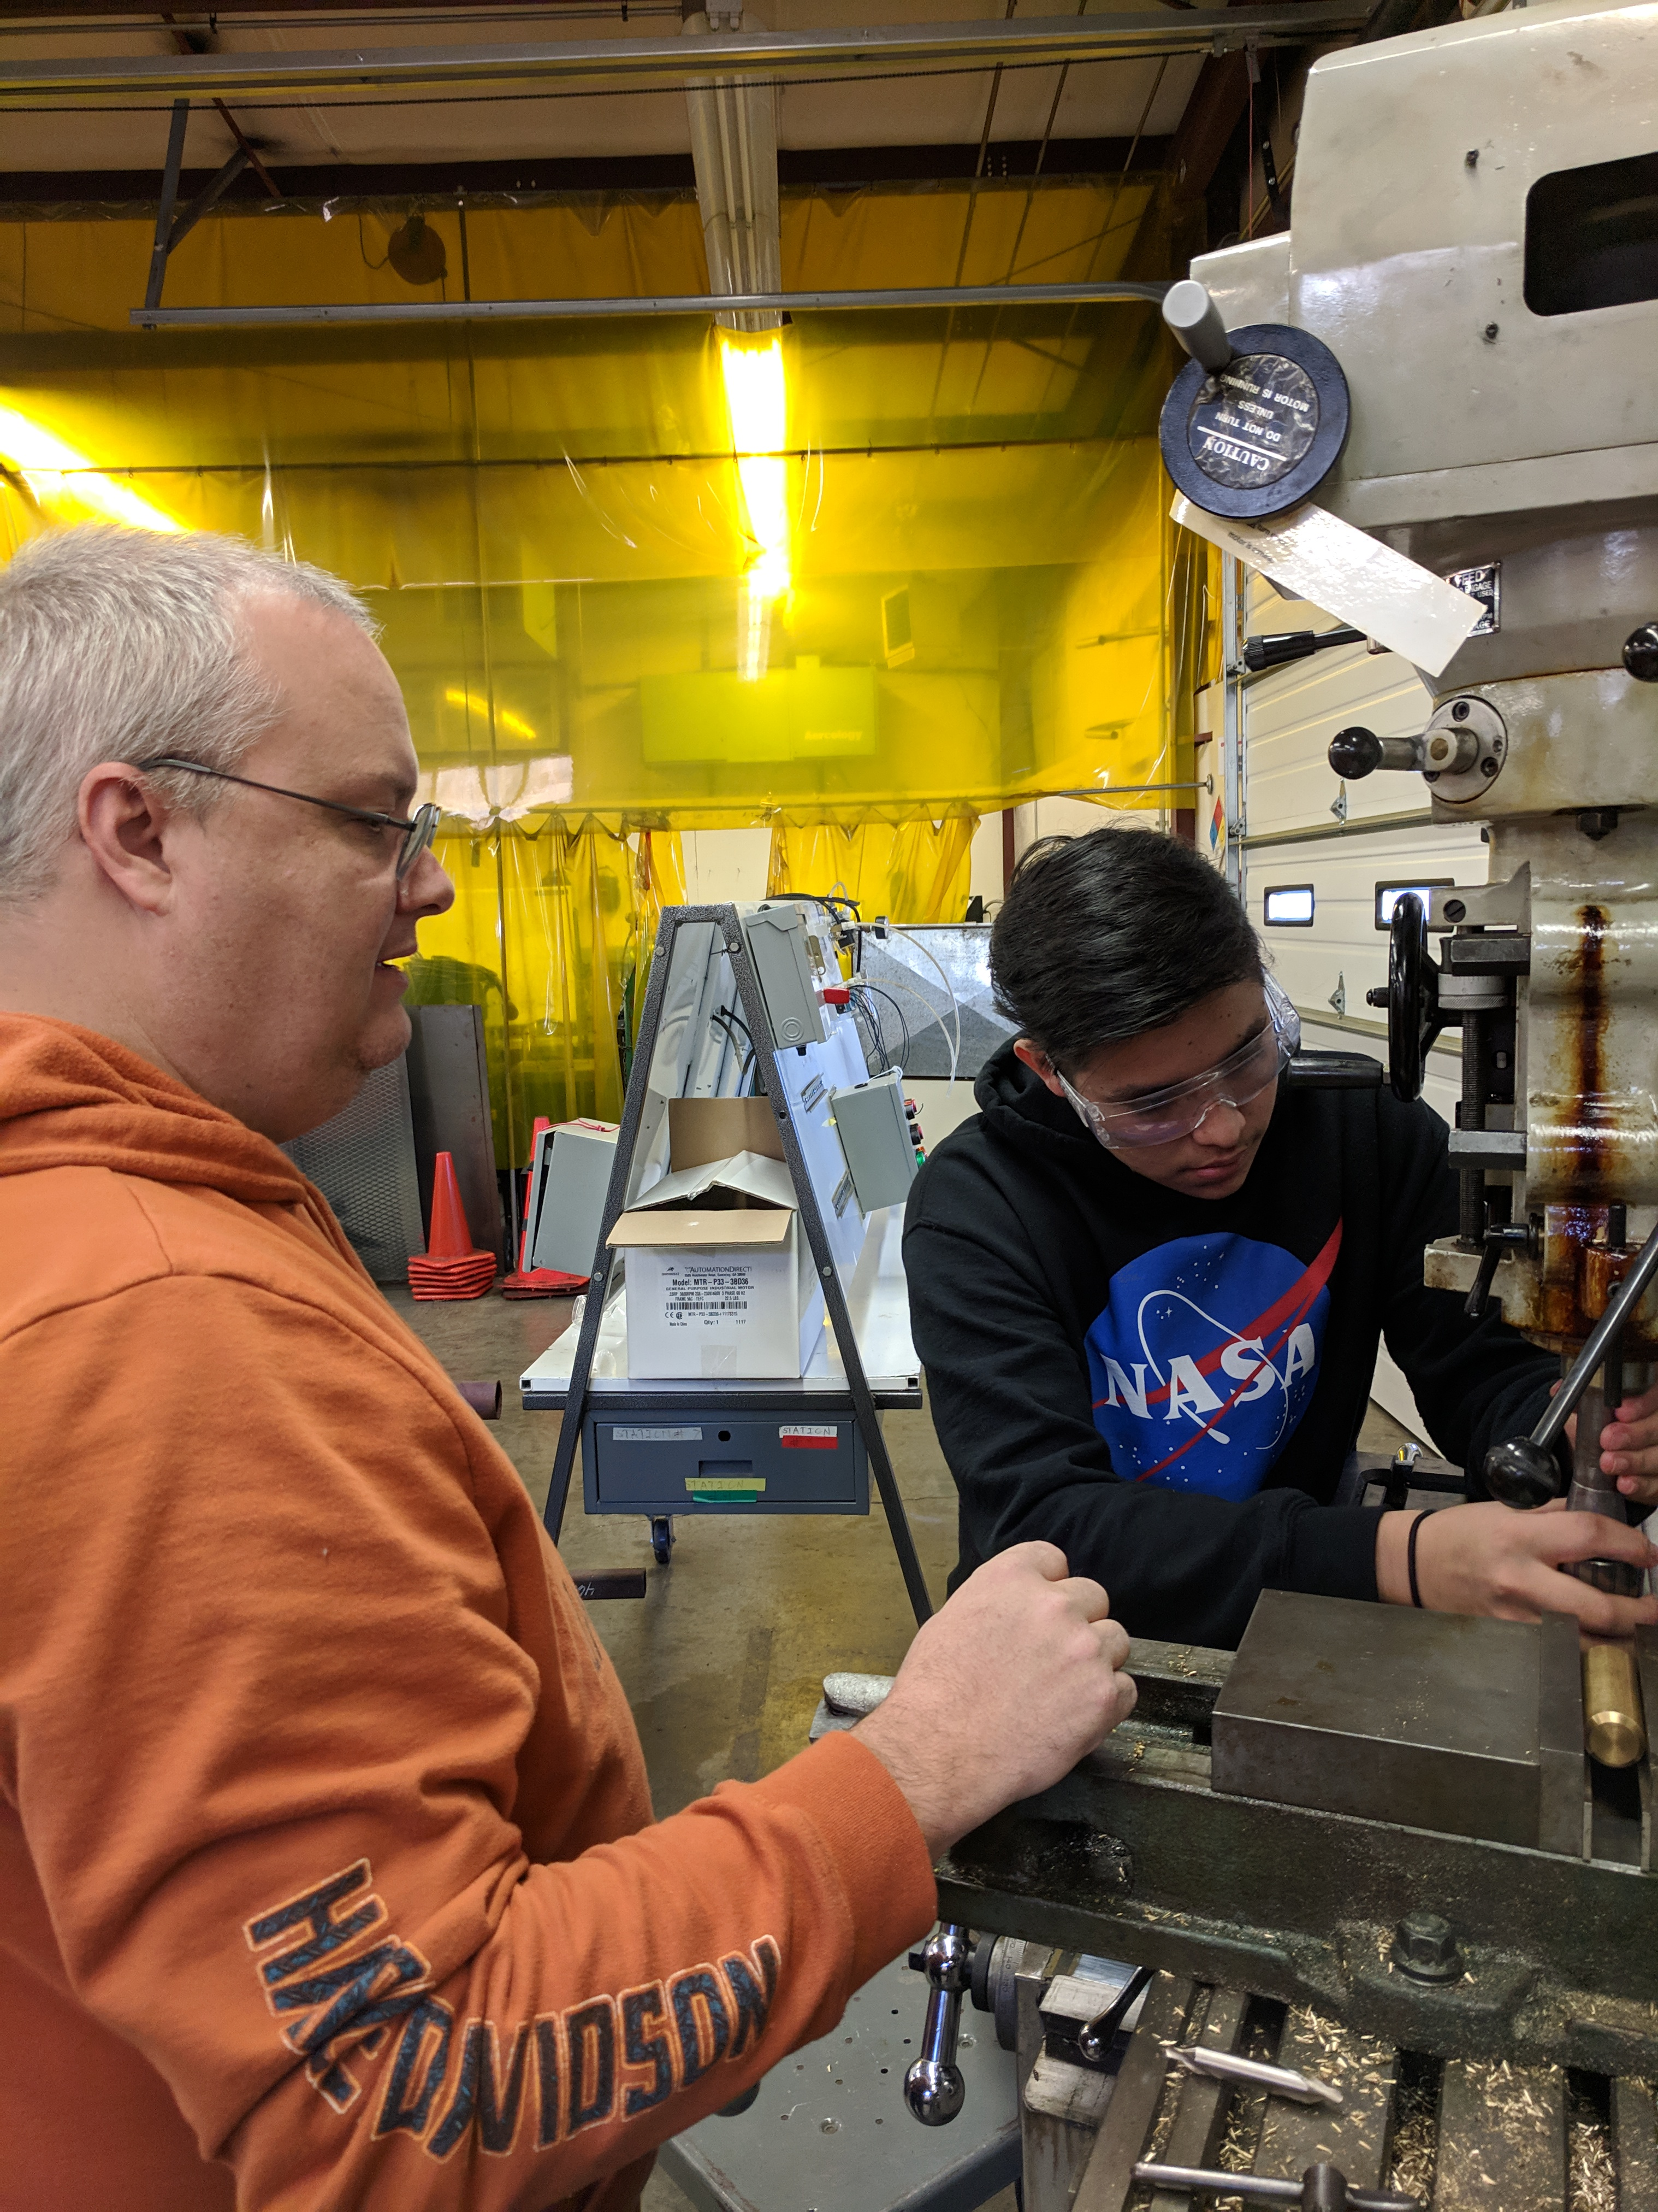
Perkins Makes a Difference - Personnel:
Medical Office Assisting
Perkins funds have allowed us to fund
.
A part-time assistant to the Director of Work-Based Learning to promote and grow the Apprenticeship Wilkes program and WBL.
A 10-month-faculty position on our Ashe Campus to teach Applied Engineering Courses in partnership with GE Aviation

Slide 3
Perkins Makes a Difference Applied Engineering
Enabled the purchase of 3 desktop 3D printers to use with Applied Engineering Students on our Ashe Campus
Upgraded WCC computer lab used for CADD and Solid Works Programs
Notes:
NCCIA stands for NC Computer Instruction Association

Slide 4
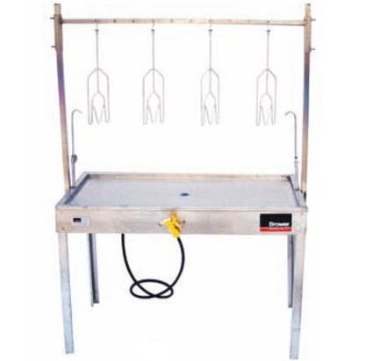
Perkins Makes a Difference:
Animal Science Program:
Advertising and Graphic Design
Eviscerating tables purchased and 7 Animal Science instructors received Artificial Insemination (AI) training.
Following recommendation of the Advisory Committee, revisions to the Advertising and Graphic Design Program are being made to increase an emphasis on video. This required the purchasing of cameras for student use.

Slide 5
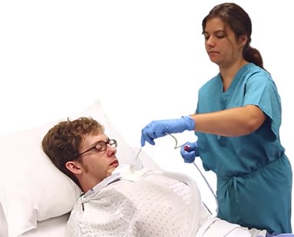
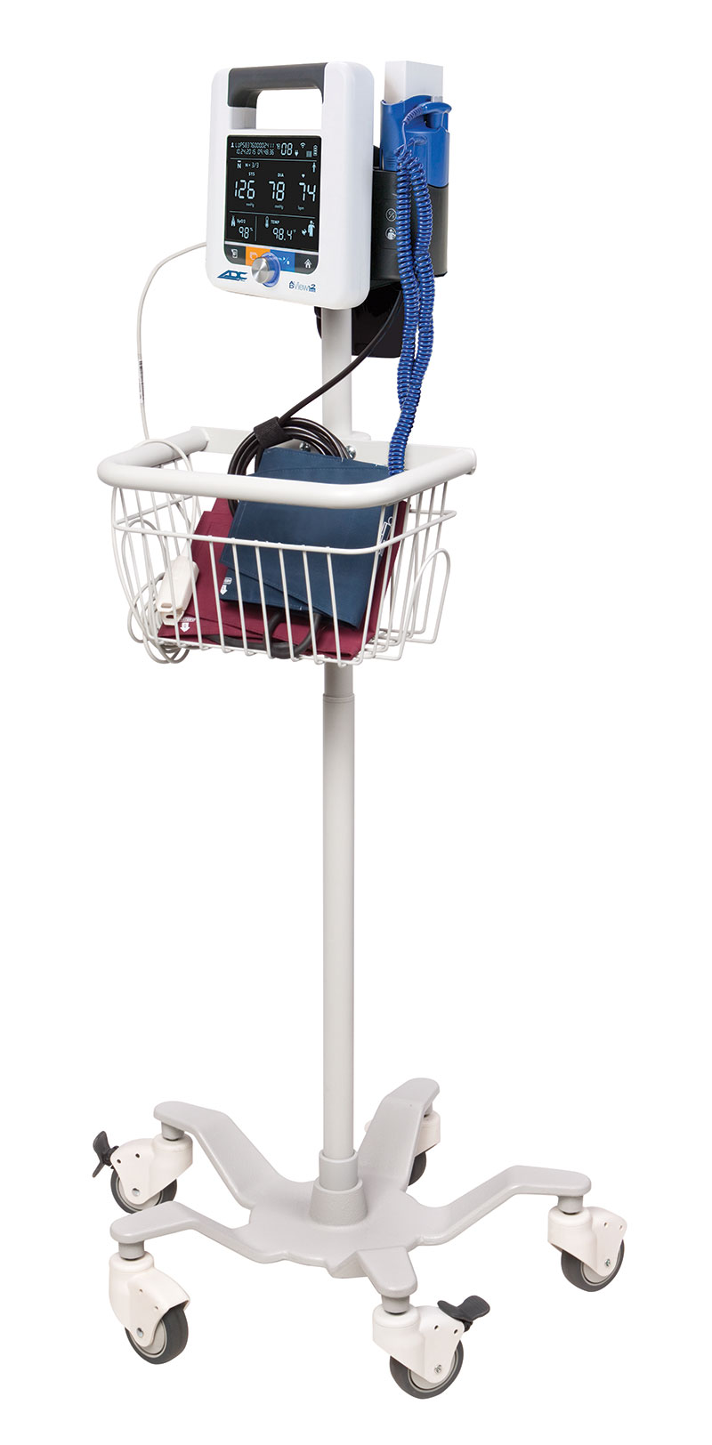
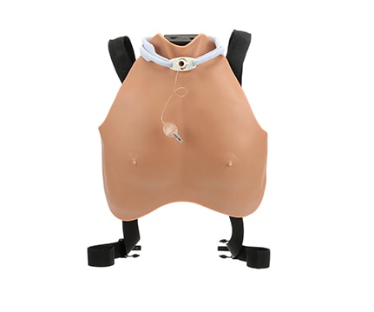
Perkins Makes a Difference:
Respiratory Therapy:
Medical Office Assisting
.
Perkins funds were used to purchase strongly recommended equipment for our Respiratory Therapy program from both the accrediting and advisory committees.
Permitted upgrade of diagnostic station vital signs Monitor and Mobile Stand for our Medical Assisting Program
Equipment Purchased:
Philips Respironics V60 Good, used
Drager Evita XL
Servo I Universal
KoKo Legend II PFT
Optiflow Airvo 2
Avkin Avtrach Task Traineer

Slide 6
Perkins Funded Professional Development
Perkins has enabled WCC faculty to attend professional development training with focus on industry certification attainment:
Certified Plant Professional (1)
Ornamental/Turf Pesticide (2)
Certified Concrete Paver (1)
Beef Artificial Insemination (7)
Autodesk University (Drafting) (1)
TPC-A/C Refrigeration (1)
NC3 Instructor Training (5)
ASE Training (2)
Leadership (5)
Notes:
NCCIA stands for NC Computer Instruction Association

Slide 7
Perkins Makes a Difference - Equity:
Medical Office Assisting
Perkins funds- Planned for Spring 2020
The NAPE Education Foundation will present Micromessaging to Reach and Teach Every Student™ for CTE faculty and staff—a high-quality, research-based, educator professional development program to address gender- and culturally based implicit biases that occur in the classroom and that are manifested through “micromessages.”
Wilkes Community College, May 14, 2020
.

Slide 8
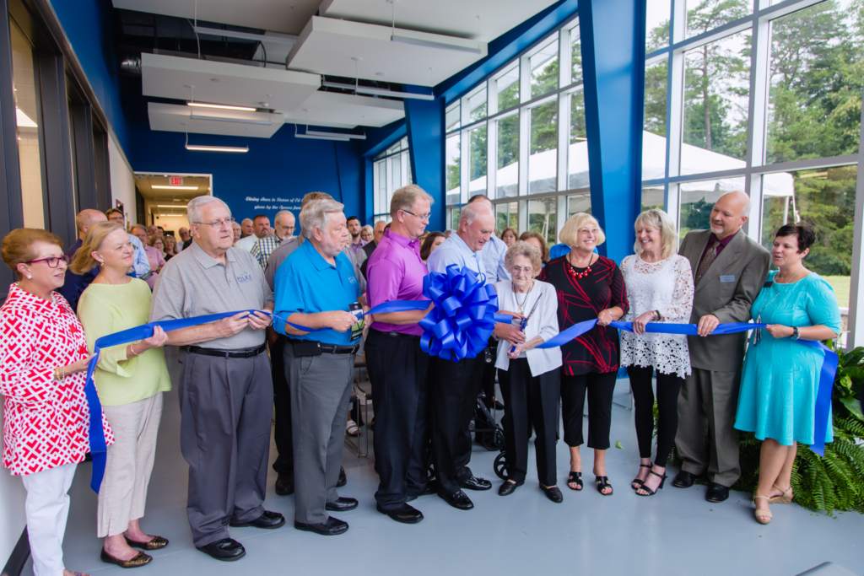
Dedication and Opening of the New Stone Culinary Center
The new facility includes a hot, cold, and bake lab, library, office space, and a dining room that gives students restaurant-style practical experience in set-up, preparation, and service of meals.

Slide 9
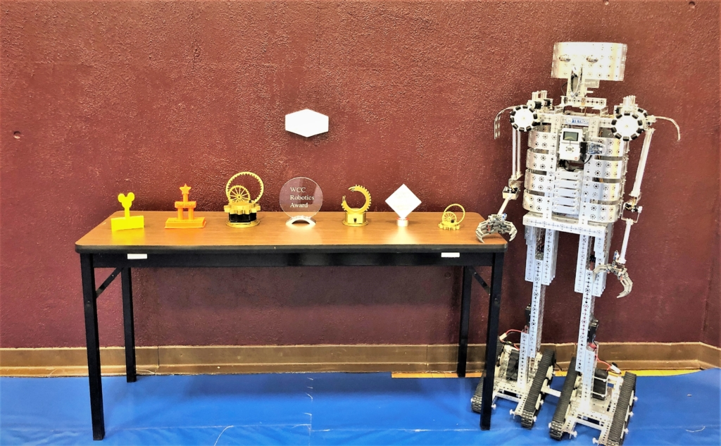
Promising Practices from Fall 2019:
Robotics Competition hosted by Applied Career Technologies Division Instructors
The event allows students to use problem-solving skills, teamwork, and critical thinking.
The students learn about careers in engineering, robotics, mechatronics, advanced manufacturing, and the degrees WCC offers in these high demand fields
WCC Carnival and Evening of Exploration
Carnival is a hosted two day event that provides area 10th graders, including home schoolers, tours of Wilkes Community College and provides them with the opportunity to explore WCC CTE programs by participating in fun interactive exhibits.
Evening of Exploration is an extension of the Carnival that is open to parents to learn about Career & College Promise and WCC Programs and invites them to participate in the hands on exhibits.

Slide 10
Promising Practices from Fall 2019:
High School Counselor Luncheon
Counselors and teachers, and administrators from the area are invited to Wilkes Community College where they are provided a luncheon, given new and updated information on our programs, and given an in-depth tour of our CTE facilities
Attendees learn about careers in engineering, robotics, mechatronics, advanced manufacturing, and the degrees WCC offers in these high demand fields
Feedback sought and received back from schools and will be used with next year’s event.
Wilkes County Partnership Transportation
WCC spearheaded a recently completed grant funded transportation study that identified workforce transportation challenges.
Assess existing transportation services
Conduct Surveys with residents and employers
Research Best Practices
Recommend transportation strategies.
Grant group included WCC, HCCOG, NCWorks, Goodwill Industries, DSS, NW Housing Authority, Wilkes Economic Development, NC Vocational Rehabilitation
Initiatives Launched
Aunt Bertha:
An online searchable directory of assistive agencies available in your area.
Completed recruitment of and input information on area participating agencies and non-profits
Conducted initial orientations to the program with agencies and WCC faculty and staff.
Currently piloting with students
Technical Standards for CTE programs:
All CTE programs have been reviewed and technical standards established for them.
Will be posted online with program information
Awaiting review of presenting format to ensure will be ADA compliant for online users.

Slide 11
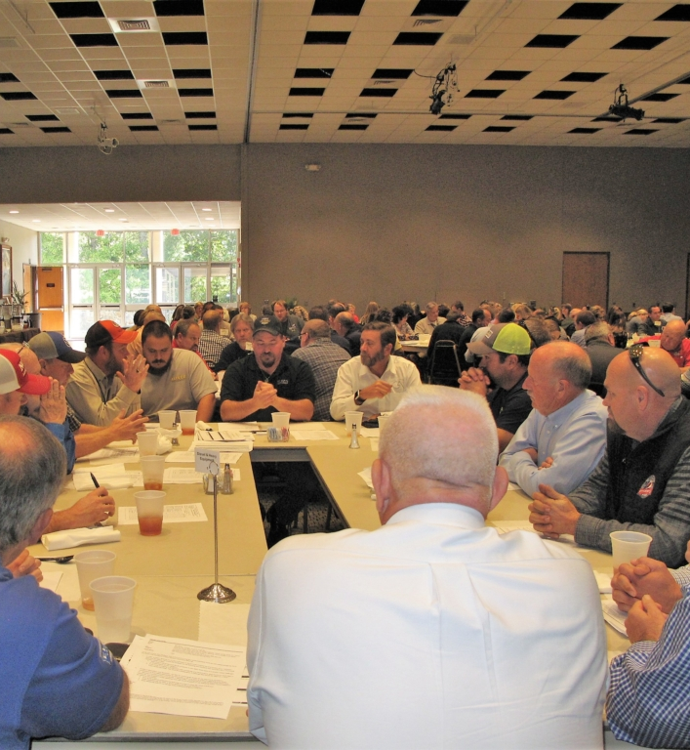
Wilkes Community College Program Advisory Committees Kickoff 2019-2020
A luncheon followed by Advisory Committee Meetings for all WCC CTE Programs.
Business and industry leaders, local educators, workforce development representatives, and WCC faculty attended
Committee input was sought for CLNAs and for the Guided Pathways initiative.
This year’s themes were
Preparation
Relevance
Improvement
Notes:
NATEF stands for National Automotive Technicians Education Foundation

Slide 12
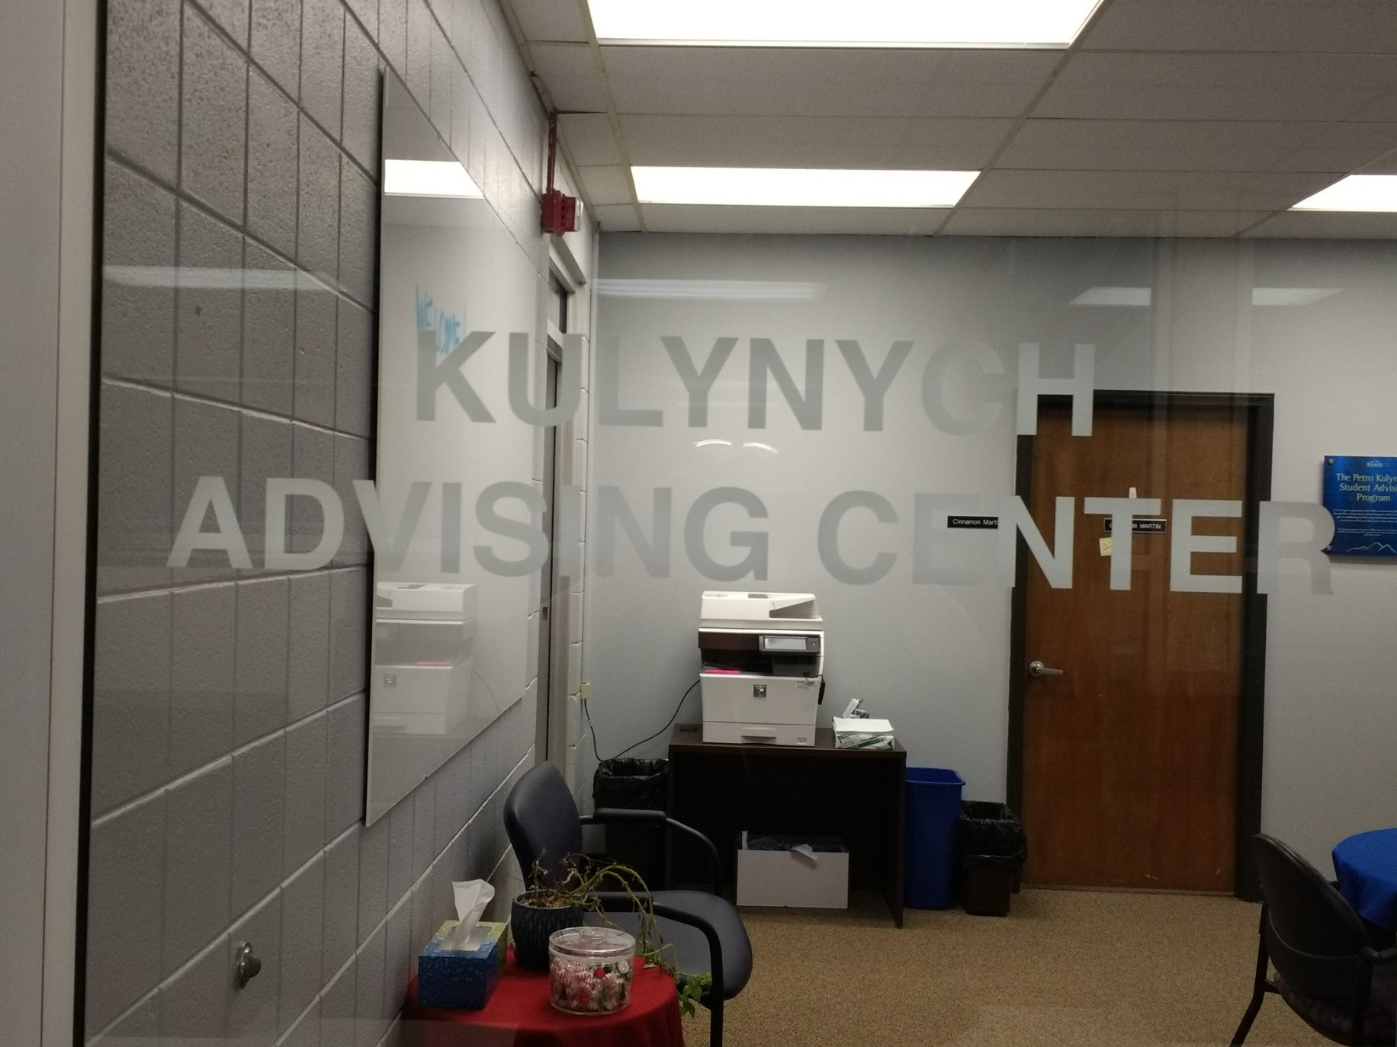
Kulynych Advising Center
The Kulynych Advising Center opened this fall and is dedicated to helping students choose and enter a program of study, track their progress, and facilitate their completion of a program of study that aligns to their life and career goals.
The Career Advisor schedules an one on one meeting with students where in addition to discussing the program(s) they are interested in, advising on courses to register for, and review WCC services, they
assess student risk factors that might affect completion
refer students to services and follow up on referrals
make sure all students are connected to their faculty advisor and mentor
Notes:
NATEF stands for National Automotive Technicians Education Foundation

Slide 13
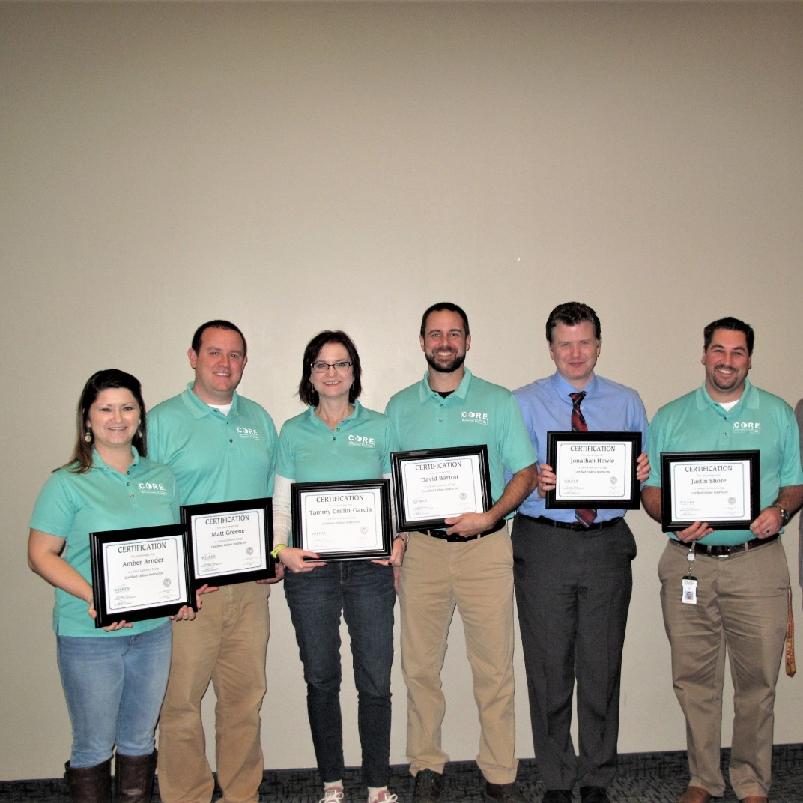
More CTE Instructors Complete CORE training
Four WCC instructors completed a semester of professional development entitled CORE (Collaborative Online Reflection Experience) during fall 2019. CORE is focused on best practices in online teaching and CORE sessions are led by WCC online instructors who serve as Peer Mentors. Once instructors complete CORE, they are eligible to present a course for certification of quality.
Instructors completing CORE during fall 2019 were: • Amber Arnder, Advertising and Graphic Design • Frank Blevins, Animal Science/Horticulture • Matthew Greene, Animal Science • Justin Shore, Business and Public Service Technologies

Slide 14
Budget Update
68% of regular funds have been expended or encumbered through December 31, 2019
91% of reserved funds have been expended or encumbered through December 31, 2019

