Slide 1
Perkins Update
January 9, 2024

Slide 2
Career & Technical Education Team
Bob Witchger
Tony Reggi
Patti Coultas
Mary Olvera
Stefanie Schroeder
Darice McDougald
Lane Freeman
Jennifer McLean
Aaron Mabe

Slide 3
Purpose of Perkins
Develop more fully the academic knowledge and technical and employability skills of secondary education students and postsecondary education students who elect to enroll in CTE curriculum programs and programs of study
Notes:
The Strengthening Career and Technical Education for the 21st Century Act reauthorized and updated the Carl D. Perkins Career and Technical Education Act of 2006 to become the current Carl D. Perkins Career and Technical Education Act of 2006 as amended by the Strengthening Career and Technical Education for the 21st Century Act (Perkins V)
This updated act stresses:
- Academic, Technical, and Employability Skills
- Funding Secondary and Postsecondary CTE
- Focusing on Students who elect to enroll in CTE Programs of Study

Slide 4
Documents Due January 12, 2024
Locally Articulated Course List (HS-CC)
9-14 Pathways
Mid-Year Local Plan Status Update (add status to most recent modified plan)
XDBR for December 31, 2023
Semi-Annual Time Certifications for July – December 2023
Perkins 2023-24 Mid-Year Questions

Slide 5
Perkins Webinar for Business Office Staff*
Topics
What is Perkins?
Comprehensive Local Needs Assessment
Perkins V Required Uses & Voc Codes
Optional Voc Codes
Perkins Admin
WIOA Infrastructure contribution
Equipment
Wages/Payroll
CTSOs
Reserve/Special Projects
Perkins Process
Approved plans, budgets, and modifications
Budget Reports and what we review
Monday, January 22
2-3pm
*And anyone else who may find it beneficial

Slide 6
Mid-Year Written Questions
Template is in the NCPerkins Moodle.
In completing the questions, please take time to reflect on how your college conducted the:
CLNA
Career Development Services
Career Pathways and the HS to CC CTE Articulated Credit
Challenges on Implementing Perkins
Notes:
These are 3 key elements in the Act.
We want to learn about the college process in conducting these activities.
Please talk to others that assist in the activities and give it thoughtful consideration.
The work you do in completing this report will help others and much as you will learn from other.
You will discuss a summary of this report in your round tables and in presenting you 5 minute report on the second day
Remember we have 58 colleges and all will not be at your round table or summary report out, this is your college up date or state of Perking V at your college
Adult Education report

Slide 7
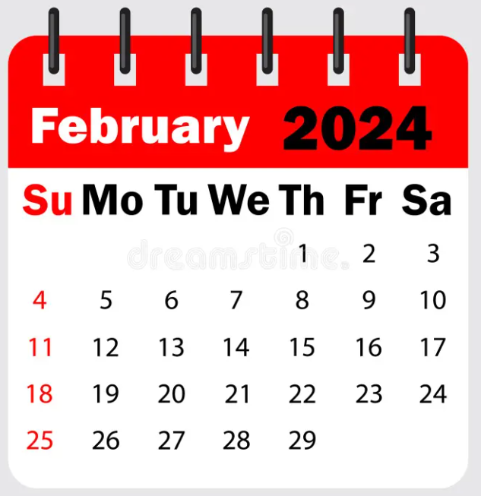
Mid-Year Review and Grant Technical Assistance
Caraway Conference Center
Room & dinner will be available starting February 5th
Please plan on staying the entire time to network and listen to other college’s promising practices.
Room and board paid by Perkins Leadership*
Colleges must pay for mileage

Slide 8
Logistics & Registration
NCCCS Perkins Leadership funds will pay for 1 room per college. Includes room for 3 nights (Mon, Tues. & Wed.) Monday is optional Also includes Monday dinner, Tuesday breakfast, lunch, & dinner, Wednesday breakfast, lunch & dinner and Thursday breakfast and lunch
NCCCS Perkins Leadership funds will pay for lunch for all participants
Additional rooms may be reserved separately through Caraway Conference Center or any area lodging
Registration: emailed 12/12/23 from Darice McDougald see notes for link
Notes:
https://forms.office.com/Pages/ResponsePage.aspx?id=KmtvYa_4JUW2yPdMaisYLVQQh7CrTrlKk4EcZRsSPs5UQUdBN1lXUEFTMjlXREVMOVJGOVNCUEZKOC4u

Slide 9
Overview of In-person Mid-year Review Activities
Day One: Round Tables and Summary Report Outs
Day Two: Five-minute summary of your college updates
Day Three: Technical Assistance Sessions
Notes:
Listening to Round Tables
Listening to College Summaries
Providing Technical Assistance
Your ideas can help other
Peer Learning
New Format
Update what will take place
Make sure we have the right
More time to network

Slide 10
Day One: Round table Session 1
Comprehensive Local Needs Assessment
To better understand the approaches colleges are using to conduct the CLNA and to share these ideas with other colleges
Looking at Student Performance and what data you are currently using to inform the CLNA
Notes:
To share with us how your college is implementing the CLNA

Slide 11
Day One: Round table Session 2
Accountability/ Performance Measures
We are asked to continuously improve our CTE programs.
How does your college look at the accountability measures
How might you modify the college implementation of Perkins V to ethically address the intent of the act
Notes:
Permissible, legal, and the intent of the ACT
Look at ways to improve how we obtain and report the data and how we might improve the report of performance measures
The 24-25 our performance goals based on a two-year average of each measure: ;
Employment, Postsecondary Credential, Nontraditional Participation

Slide 12
Day One: Round table Session 3
Career Development
Strategies your college uses to implement Career Development Services
The act requires career counseling is provided before enrolling and while participating in CTE programs of study
Notes:
We are interested in what is happening

Slide 13
Day One: Round table Session 4
Application
To understand the process the college uses to complete the application
Bring a Copy of your Application and Discuss your college’s process
Notes:
There are many ways colleges complete the application.
The legislation reads, eligible entities will conduct the CLNA and then use data from this needs assessment to Complete The Application.
NC uses a combination of the Application and Annually completed Plan and Budget
This plan or matrix is used to ensure required activities are met, to ensure activities tie back to the CLNA, to identify where federal and state funds are used, and to follow up at the mid year and end of year.

Slide 14
Day One: Round table Session 5
Pathways and Articulation Agreements
To get a general ideas of how colleges are implementing Pathways and Articulation Agreements
Illustrate and Communicate high school to community colleges pathways for students in programs of study
What elements to you include in your pathway materials?
What is the process for awarding articulated credits on student transcripts?
Notes:
Colleges have unique ways of communicating CTE pathway.
Colleges have CCP Pathways, CE Pathways, Basic Skills Pathways, CTE Pathways for HS Graduates and HS to CC Students.
We are looking at ways students and parents are informed about CTE programs of study.

Slide 15
Day One: Round table Session 6
Alignment to college goals
To discuss how colleges align the Goals and Objectives of Perkins V with the local college strategic plan.
How the colleges uses federal Perkins funds to intentionally address gaps identified in the CLNA, communicated on the Application, and spelled out in the local annual plan and budget.
Notes:
What we see at a gap is intentionality
Beyond allocation federal funds to CTE Departments.
Intentionally applying funds where there are gaps, gaps identified by your stakeholders,

Slide 16
Day two: College report out
Colleges will share innovative ideas of what they’re doing to strengthen CTE Programs
Maximum five-minute

Slide 17
Day two: Leveraging AI in Higher Education
Introduction to AI and its relevance in higher education.
Practical applications in teaching, administration, and student services.
Strategies for AI integration in curriculum and administration.
Ethical considerations and future AI trends.

Slide 18
Day Three: Technical Assistance Sessions
From Debriefing:
Look at College Challenges,
What we hear from the report outs
What we see on our 5x8 report out cards
How to effectively use the dashboard and Power BI data to identify student performance gaps as relates to the indicators

Slide 19
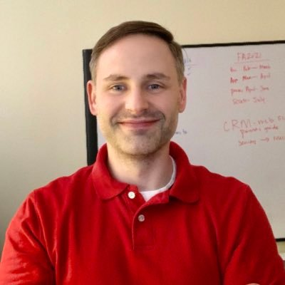
Aaron Mabe
Coordinator for Career and College Promise
Notes:
Aaron Mabe
919-807-7098
mabea@nccommunitycolleges.edu

Slide 20
Updates from Aaron Mabe
Dual Enrollment Conference
The NCCCS, in partnership with the NC DPI, the Early College Research Center at UNC-G, and the RAND Corp., would like to invite you to our virtual dual enrollment conference. "Unlocking Potential, Expanding Opportunity: The Role of Dual Enrollment".
Free to attend. Register now at de24.vfairs.com
Updated CCP Operating Procedures
The updated CCP Operating Procedures/Section 14 can be viewed HERE. Effective Spring 2024, depending on the student's career goals, CTE Pathways may be considered a primary pathway. To access the Operating Procedures, Curriculum Standards, or other information via the NCCCS website, visit HERE
Notes:
https://ncccsstg.wpengine.com/wp-content/uploads/2023/11/CCP-Operating-Procedures-SPRING-2024-FINAL-CPRM.pdf

Slide 21
Pathways Consultation
Reach out and schedule a meeting with Dr. Jennifer McLean, Dr. Mary Olvera, and Aaron Mabe to review your college’s 9-14 Pathways.
A consultation meeting will include reviewing all the elements of 9-14 Pathways and ideas to strengthen existing pathways and improve secondary partnerships.
Contact Aaron at mabea@nccommunitycolleges.edu to schedule a consultation.

Slide 22
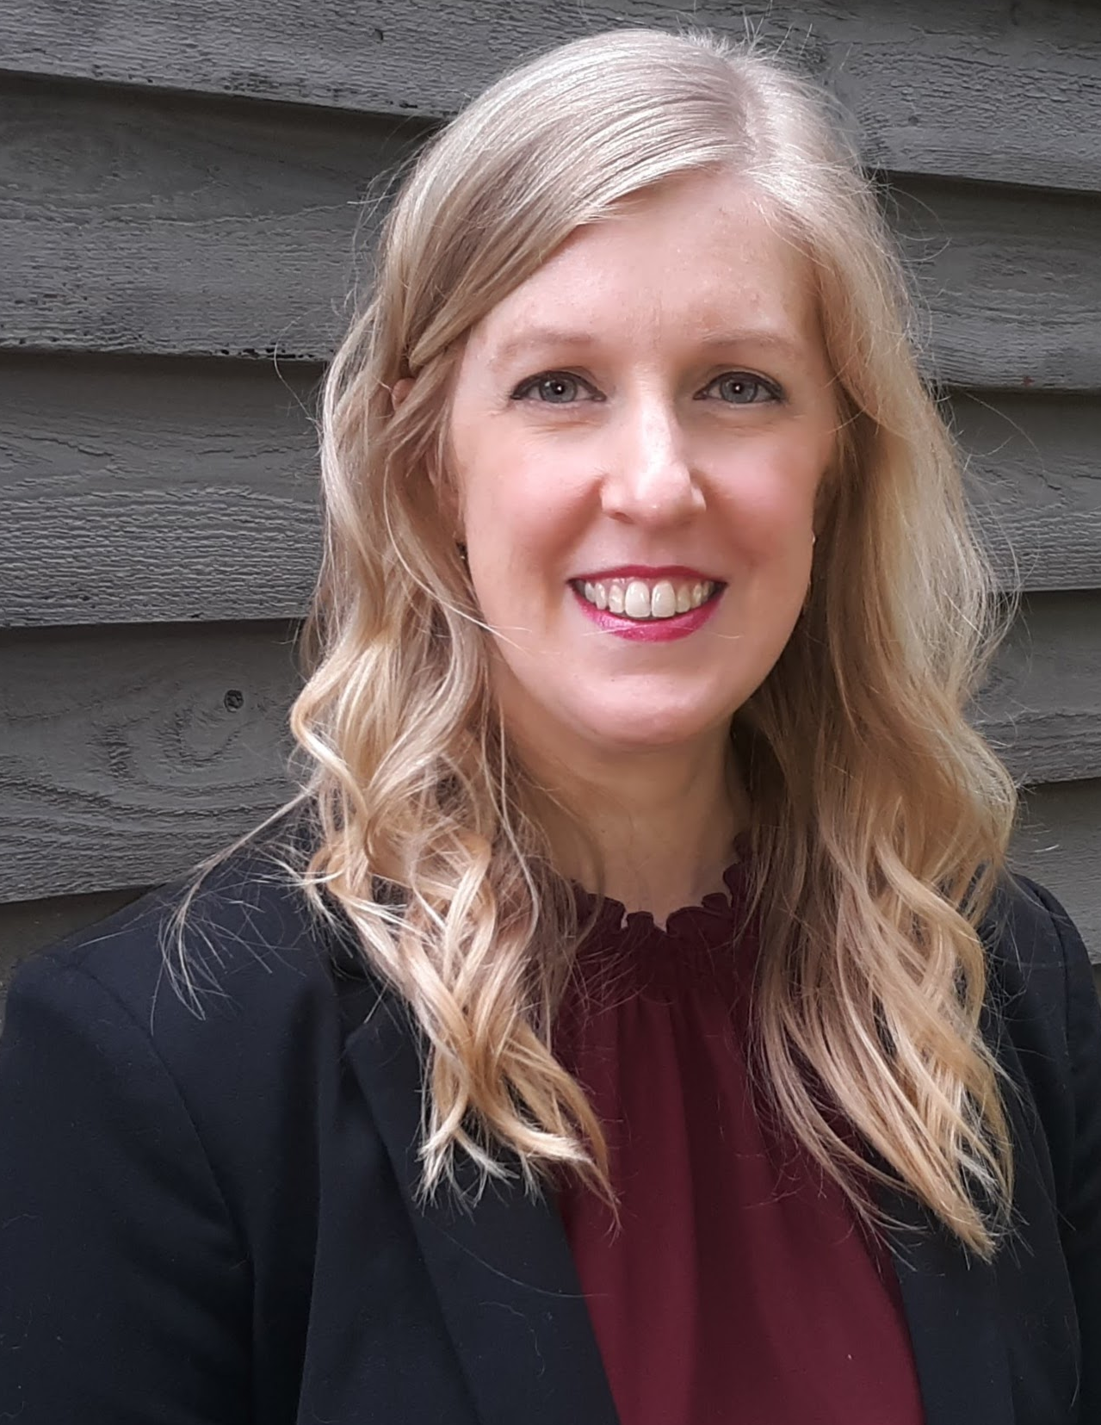
Jennifer McLean
Associate Director of Student Support
Notes:
Aaron Mabe
919-807-7098
mabea@nccommunitycolleges.edu

Slide 23
Digging Deep in Career Exploration Workshops
December 5 – Wayne Community College
TBD rescheduled Catawba Valley
Who should attend?
Career Coaches and Career Counselors
*Lunch $10 cash only at the door

Slide 24
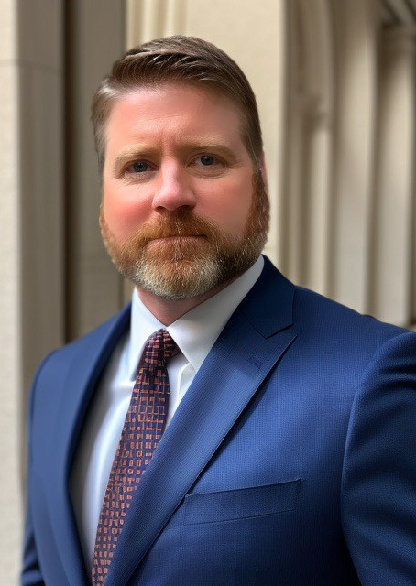
Lane Freeman
Director of Online Learning
Notes:
Aaron Mabe
919-807-7098
mabea@nccommunitycolleges.edu

Slide 25
Director of Online Learning Updates
2024 Immersive Learning Conference:
Career Coaches may apply now at the NCCCS Website under “Events.”
Priority Registration Deadline is January 31st for Career Coaches.
Perkins Leadership Funding covers room and food costs.
Individual institutions responsible for transportation.
Opportunity for networking and exploring technology in education.
Notes:
https://www.nccommunitycolleges.edu/events/copy-of-2024-immersive-learning-conference-for-career-coaches-and-counselors/

Slide 26
Director of Online Learning Updates continued
“Leveraging AI in Higher Education" Session:
Contact Lane Freeman to schedule the 90-minute session for you.
Introduction to AI and its relevance in higher education.
Practical applications in teaching, administration, and student services.
Strategies for AI integration in curriculum and administration.
Ethical considerations and future AI trends.
Hands-on activities to experience AI tools.
Targeted at faculty, staff, and student services, enhancing their work through AI.

Slide 27
2024 Master Instructor Candidates Selected
We are excited to introduce the 2024 NC3MI Candidates
There are 16 CTE faculty members representing 18 community colleges.
The kickoff session for the NC3MI program is scheduled for Friday, February 2nd, at Randolph Community College.
This event will be a valuable opportunity for them to connect with fellow cohort members and set the stage for growth and collaboration.
Congratulations to our candidates on this remarkable achievement, and we look forward to their active participation in shaping the future of this program.

Slide 28
Promising Practice Video from 2022-2023
Carteret Community Colleges
Videos of nontraditional participants

Slide 29
Virtual Office Hours for Technical Assistance
2nd Tuesday of the month 1-2pm
4th Wednesday of the month 9-10
** See NCPerkins course announcements for TEAMS link
Need help?
Let's meet.
CTE Team Perkins
Virtual
Office Hours
Drop in to ask a CTE Coordinator your questions

Slide 30
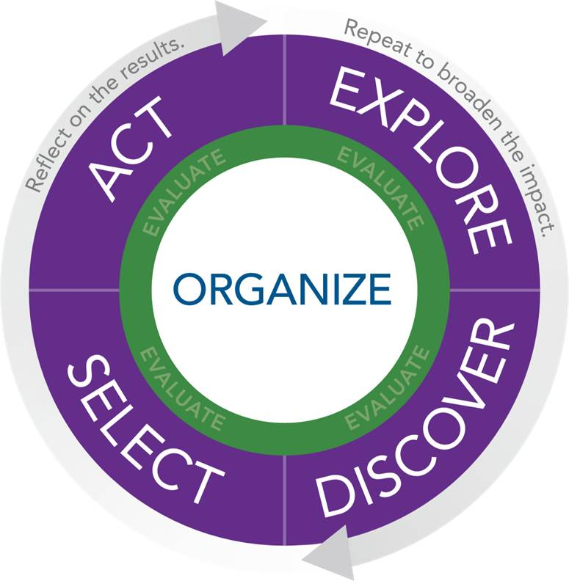
NAPE's Equity in Perkins V Workshop
NAPE's Equity in Perkins V engages educators in the foundational work of building an equity lens and provides guided learning experiences to apply equity principles to local data sets.
NAPE’s Equity in Perkins V workshop utilizes the NAPE PIPETM instructional improvement process as a model to scaffold institutional improvement to address the needs of marginalized student groups and the opportunities available within high-skill, high-wage, and in-demand fields. In this multi-day program, participants will develop the mindset, knowledge, and skills necessary to address the equity gaps in Career and Technical Education programs.
April 2 - 3, 2024 Caraway Conference Center
23 Colleges with teams of 3
More information coming soon
Example of Impact
“I so appreciate the introduction to so many crucial aspects of the work & the invitation/resources to explore more deeply”
~ Educator

Slide 31
Perkins Monthly Updates 2023-24
Feb 13, 2024
Mar 12, 2024
Apr 9, 2024
May 14, 2024
Jun 11, 2024
 Register now so they are on your calendar! www.ncperkins.org/presentations
Attendance (or viewing the recording within 30 days) is recorded on monitoring rubric. Recording may be accessed at the same link as the registration.
Notes:
Register now and let the system remind you.

Slide 32
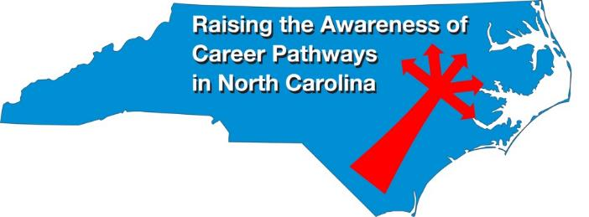
Raising the Awareness of Career Pathways Monthly Webinars
Jan. 17 – Engineering Technology
Feb. 21 – Biotechnology & Clinical Trials Research Associate
Mar. 20 – Business Administration
Apr. 17 – Public Safety
May 15 – Cyber Crime Technology
Register for all webinars at www.ncperkins.org/presentations

Slide 33
Technical Assistance is available
We are here to help!
Team Perkins is available by phone, email, virtually, or in-person

