Slide 1
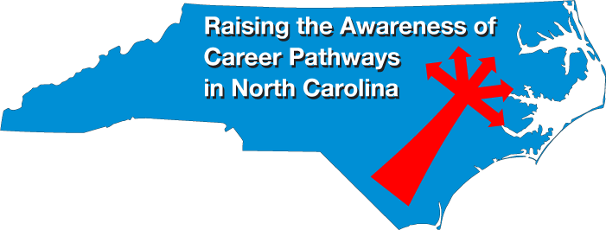
November 21, 2019
Dr. Bob Witchger
Chris Droessler
NC Community Colleges
Cheryl Cox
NC Department of Public Instruction
www.ncperkins.org/presentations
Notes:
We are here to help promote the great jobs, often unknown, in the great state of North Carolina.
Through these monthly meetings, we are going to let you know about some great career opportunities in North Carolina.
Bring in special guests to let you know about the great career opportunities in North Carolina.
Please download this PowerPoint file and use it anyway you can to help get folks on a career pathway.
The reference showing from where the information was found, as well as the contact information for our guests is in the Notes section under each slide.
Get the PowerPoint on our NCPerkins.org website on our Presentations and Webinars page.
Here is the direct address on the screen.
====
Dr. Bob Witchger
919-807-7126
witchgerb@nccommunitycolleges.edu
Chris Droessler
919-807-7068
droesslerc@nccommunitycolleges.edu
Cheryl Cox
919-807-3814
cheryl.cox@dpi.nc.gov

Slide 2
Notes:
www.ncperkins.org/presentations

Slide 3
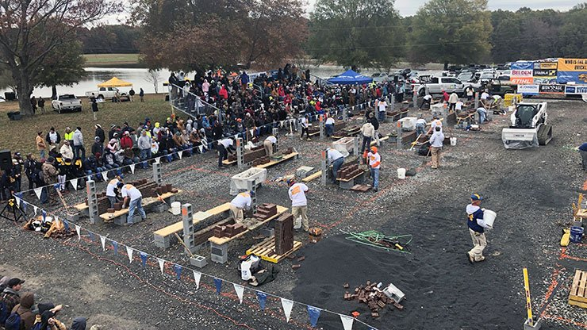
Masonry Education Day - Nov 14, 2019
Notes:
The North Carolina Masonry Contractors Association hosted this big career exploration event last week in
Gold Hill, North Carolina (between Greensboro and Charlotte)
They had mason competitions and information tents,
They did this to introduce high school students to the industry.
If an event like this is going to happen in your part of the state, please let us know.

Slide 4
Notes:
www.ncperkins.org/presentations

Slide 5
ENC Manufacturing Day - Lenoir County
November 13, 2019
Hands-on events at Lenoir County Fairgrounds
Tours of manufacturers
850 middle and high school students
50+ Manufacturers included:
Field Controls
Eaton
Mt Olive Pickles
Notes:
These are the kind of events we want to hear about.
https://www.kinston.com/news/20191118/regional-employers-future-workforce-come-together-on-manufacturing-day

Slide 6
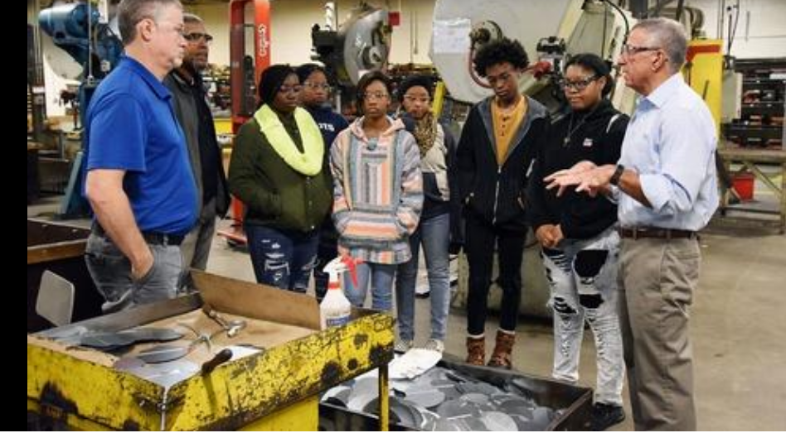
ENC Manufacturing Day - Lenoir County
Notes:
https://www.kinston.com/news/20191118/regional-employers-future-workforce-come-together-on-manufacturing-day

Slide 7
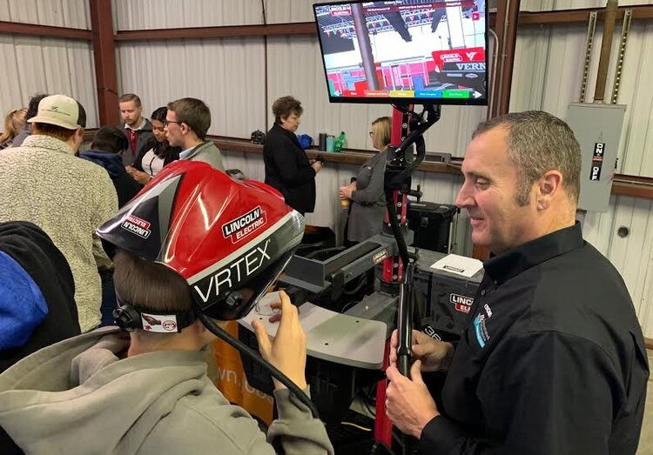
ENC Manufacturing Day - Lenoir County
Notes:
https://www.neusenews.com/index/2019/11/13/students-participate-in-annual-lenoir-county-manufacturing-day-2019

Slide 8
Notes:
www.ncperkins.org/presentations

Slide 9
Apprenticeship at the NC State Fair
Mon. Oct 21 - Masonry
Tue, Oct 22, Firefighter & Public Safety demos
Wed, Oct 23 - Electrical
Thu, Oct 24 - Carpentry
Fri, Oct 25 - HVAC-R
Fri, Oct 25 - Plumbing
Sat Oct 26 - Cosmetology, SkillsUSA Contest
Sun, Oct 27 - Mobile Robotics, SkillsUSA Contest
Notes:
For over 65 years, Registered Apprentice contests have been a part of the NC State Fair.
near the chickens at the NC State Fair
https://www.apprenticeshipnc.com/events/apprentice-contests-state-fair-oct-21-27-2019

Slide 10
Kathryn P. Castelloes
ApprenticeshipNC Director
NCCCS
Notes:
Kathryn P. Castelloes, ApprenticeshipNC
919.807.6991 - Office
Castelloesk@nccommunitycolleges.edu

Slide 11
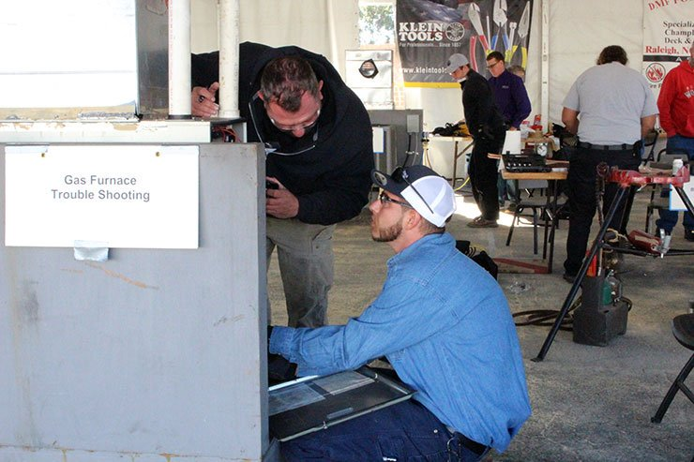
Apprenticeship at the NC State Fair
Notes:
Here is an apprentice competing in the HVAC competition at the state fair troubleshooting a gas furnace
For over 65 years, Registered Apprentice contests have been a part of the NC State Fair.
near the chickens at the NC State Fair
https://www.apprenticeshipnc.com/events/apprentice-contests-state-fair-oct-21-27-2019

Slide 12
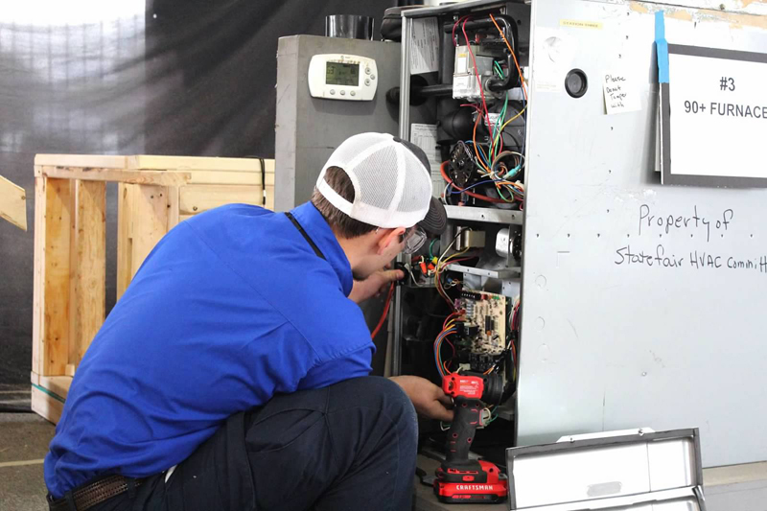
Apprenticeship at the NC State Fair
Notes:
Here is an apprentice competing in the HVAC competition at the state fair troubleshooting a gas furnace
For over 65 years, Registered Apprentice contests have been a part of the NC State Fair.
near the chickens at the NC State Fair
https://www.apprenticeshipnc.com/events/apprentice-contests-state-fair-oct-21-27-2019

Slide 13
Notes:
https://www.apprenticeshipnc.com/events/apprenticesipnc-annual-conference-march-5-6-2020

Slide 14
Notes:
www.ncperkins.org/presentations

Slide 15
Drury Fulcher
Director of Training and Development
Notes:
Dru
Drury Fulcher, M.Ed., SPHR Brady, Director of Training and Development
1915 N. Church St.
Greensboro, NC 27405 Mobile: (336) 317-9832
Fulcher, Drury <Drury.Fulcher@bradyservices.com>

Slide 17
Notes:
We have customers across multiple industries and markets, both in the public and private sector.
Colleges and universities
K-12 school systems
Healthcare and Pharma
Military
Commercial Real Estate

Slide 19
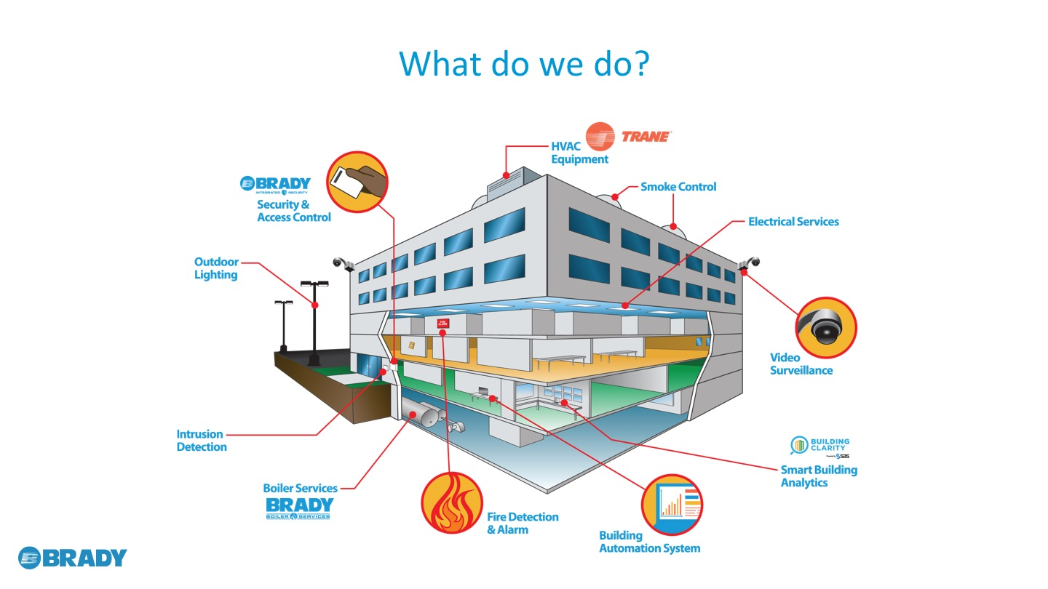
Notes:
Brady provides customers with a diverse range of HVAC and building solutions, including mechanical systems, building automation and controls, energy saving solutions, security, electrical services, and parts and supplies.

Slide 20
Notes:
Brady also partners with other best in class manufacturers to provide products that provide solutions to meet an array of customer needs.
We can provide specialized technology such as ice storage systems, swimming pool dehumidifiers, and UV lighting in addition to standard equipment and systems such as modular chillers, outside air, energy recovery units, and high efficiency boilers.
To support our clients, we have six Brady Parts Centers located throughout the state. We provide parts for all Trane equipment and needed service supplies for all preventative maintenance needs. Our parts locations have access to an extensive inventory and can help locate the parts needed to reduce equipment downtime.

Slide 21
Notes:
An extensive sales and engineering team in excess of xx members who will be trained and incentivized to sell various products
Brady has longstanding relationships with A & E firms across North and South Carolina, and will leverage those relationships in order to solidify preferred products where applicable.
Product support from our trained and experienced technician team.
Brady has the capability to provide in-house engineering, operational, technical, and end-user training to support products sold within our territory

Slide 22
Notes:
www.ncperkins.org/presentations

Slide 23
Michael Kendrick
Training and Development Manager
Newcomb and Company

Slide 24
Notes:
www.ncperkins.org/presentations

Slide 25
Margaret Thornton
ROC Associate Director
Central Piedmont Community College
Notes:
Margaret Thornton
Central Piedmont Community College
CTE Coordinator Harper Campus
ROC Associate Director
www.roccharlotte.org
704 – 330 -2722 ext. 7451
Mobile: 704-293-9839
cpcc.edu

Slide 27
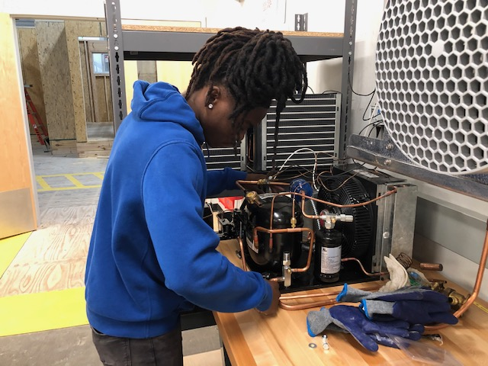

Slide 28
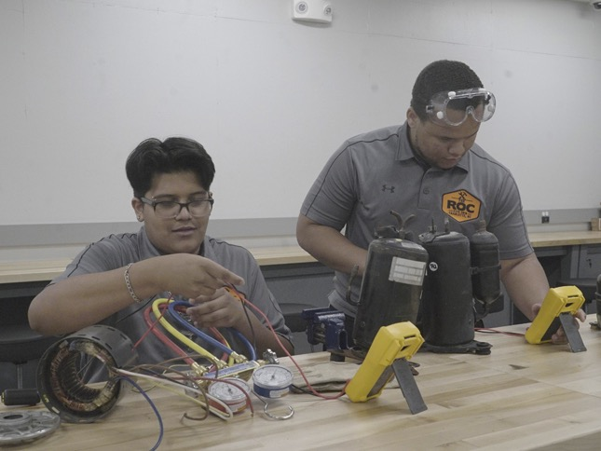

Slide 29
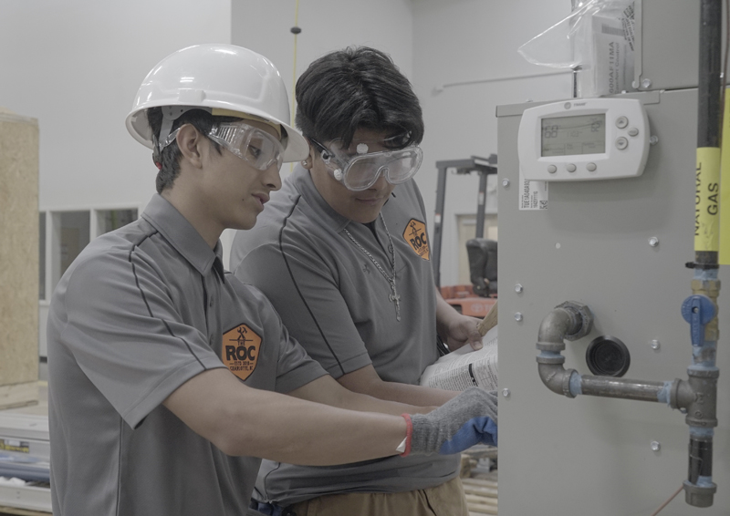

Slide 30
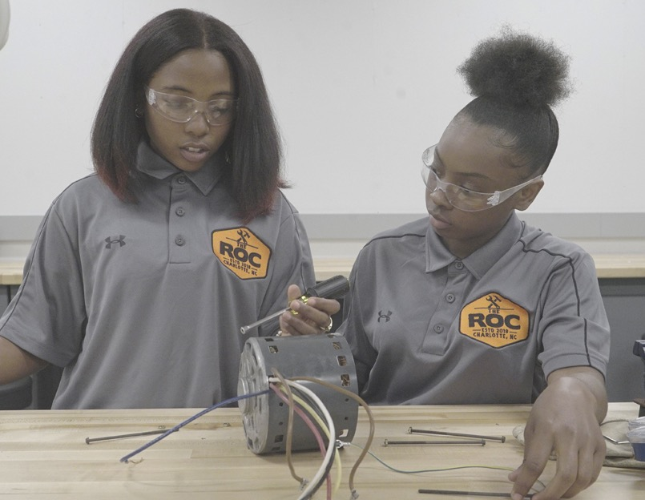

Slide 31
Notes:
www.ncperkins.org/presentations

Slide 32
Bruce Bowman
Air Conditioning, Heating & Refrigeration
Davidson County Community College
Notes:
======
Bruce Bowman Faculty Air Conditioning, Heating & Refrigeration
Davidson County Community College
P.O. Box 1287
Lexington, NC 27293-1287
(336)249-8186 EXT.6103 Office: Finch 111 bruce_bowman@davidsonccc.edu

Slide 33
Notes:
www.ncperkins.org/presentations

Slide 34
R. Gary Muller, MBA, CPA
Dean, School of Workforce Development and the Arts
Brandon Hensley
Senior Project Manager for Technical Programs
Catawba Valley
Community College
Notes:
R. Gary Muller, MBA, CPA Dean, School of Workforce Development and the Arts Catawba Valley Community College 828-327-7000 Ext 4672

Slide 35
Catawba Valley CC Workforce Solutions Complex
Notes:
80,400 Square Feet
Technology and engineering programs, including Computer Engineering Technology, Electrical Engineering Technology, Computer Integrated Machining, Electronics Engineering Technology, Automotive Systems Technology, Welding, Mechanical Engineering Technology, Mechatronics and Robotics, and Heating/Ventilation and Air Conditioning.
The building includes state-of-the-art classrooms, offices, HVAC lab/shop areas, welding lab/shop areas, automotive lab/shop areas, machining and CNC lab/shop area, and an engineering department, which includes: mechatronics/PLC lab, CET-EET lab, electrical wiring lab, robotics lab, 3D printing lab, computer labs, break alcoves, a lounge/media center, meeting rooms, and an open main lobby area for students to gather

Slide 36
Catawba Valley CC Workforce Solutions Complex
Officially Opened in February 2019
80,000+ Square Feet
Technology and Engineering Programs,
- Engineering Programs
- Computer Integrated Machining
- Automotive Systems Technology
- Welding Technology, and
- Heating/Ventilation and Air Conditioning
State-of-the-Art Equipment and Facility

Slide 37
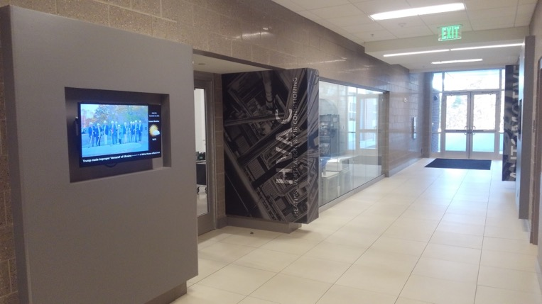
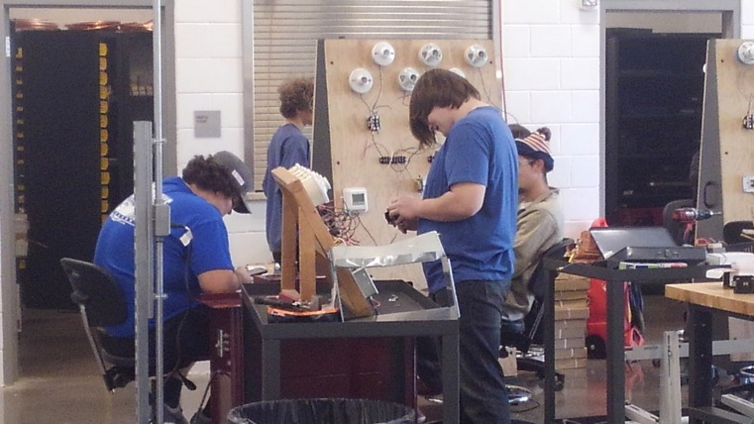
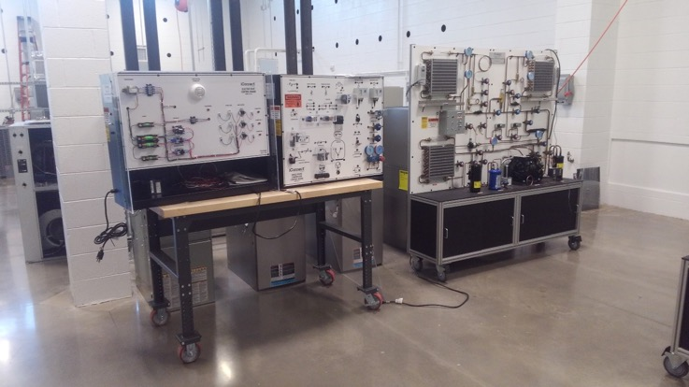
NEW HVAC Lab
Catawba Valley CC Workforce Solutions Complex
Notes:
25-30 full time student enrolled
Afternoon program

Slide 38
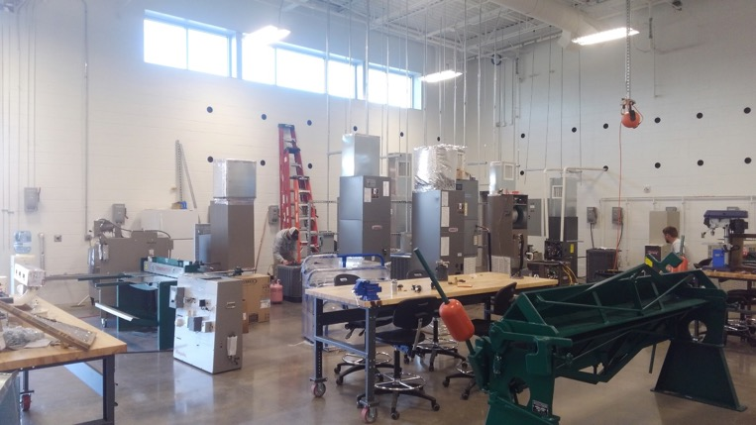
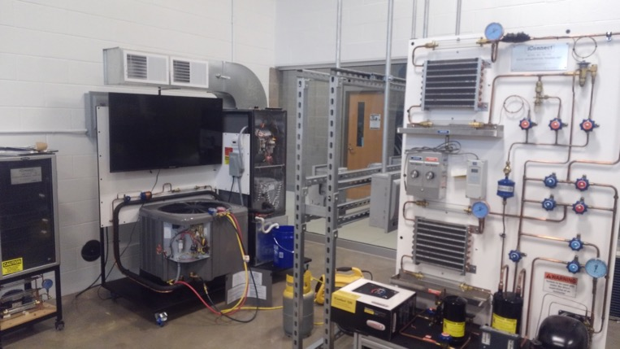
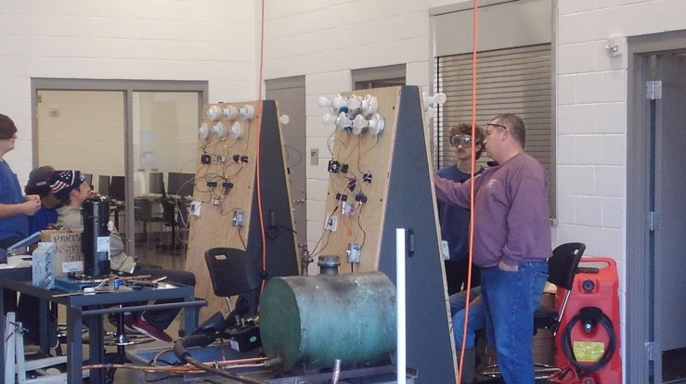
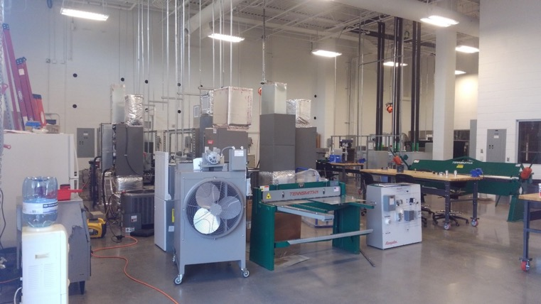
NEW HVAC Lab
Catawba Valley CC Workforce Solutions Complex
Notes:
25-30 full time student enrolled
Afternoon program

Slide 39
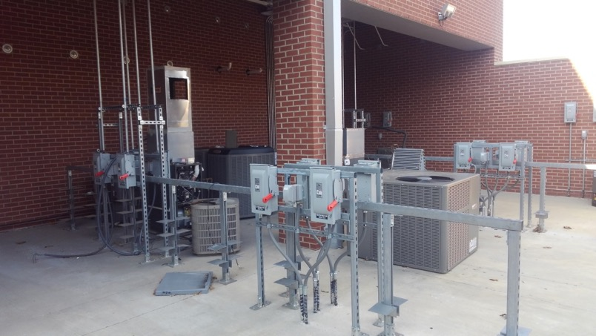
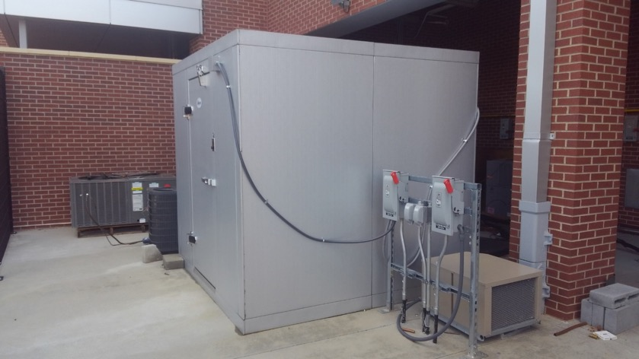
NEW Outside HVAC Lab
Catawba Valley CC Workforce Solutions Complex

Slide 40
- Current
Catawba Valley CC Workforce Solutions Complex
Steady Enrollment Growth with Room to Grow!!
Offer Diploma and Certificate Programs with a High School Pathway
Coordinating efforts with our Construction and Manufacturing Academies
Good Selection of New Residential Equipment and HVAC Trainers

Slide 41
Catawba Valley CC Workforce Solutions Complex
Continue to Grow Enrollment
Offer Day and Evening Classes
Career and College Promise
Explore 2-Year Degree Options
Investigate Commercial Refrigeration Options
Coordinate HVAC & Electrical Engineering Activities
Add Faculty to Support Growth
Build Strong Business Partner Relationships
- Future

Slide 42
Notes:
www.ncperkins.org/presentations

Slide 43
Frank Scuiletti
Program Coordinator: Construction, Engineering, Industrial, Transport, Criminal Justice, Fire Protection, & Work-Based Learning NCCCS
Notes:
Frank Scuiletti <scuilettif@nccommunitycolleges.edu>

Slide 44
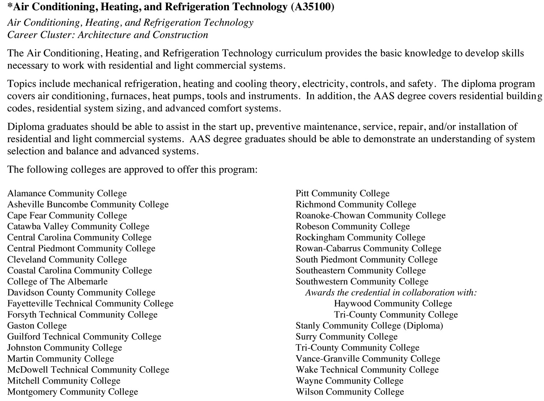
Notes:
36 of the 58 colleges offer HVAC-R programs
=====
education_catalog_18nov2019.pdf
NC Community College System Catalog (updated November 18, 2019), page 50

Slide 45
Craig Pendergraft
High School Construction Programs
Notes:
919-807-3881
craig.pendergraft@dpi.nc.gov

Slide 46
HVAC in High Schools
Dual enrollment through Career and College Promise
Currently a local course at 4 or more HS
Becoming a state-supported course.

Slide 47
Notes:
www.ncperkins.org/presentations

Slide 48
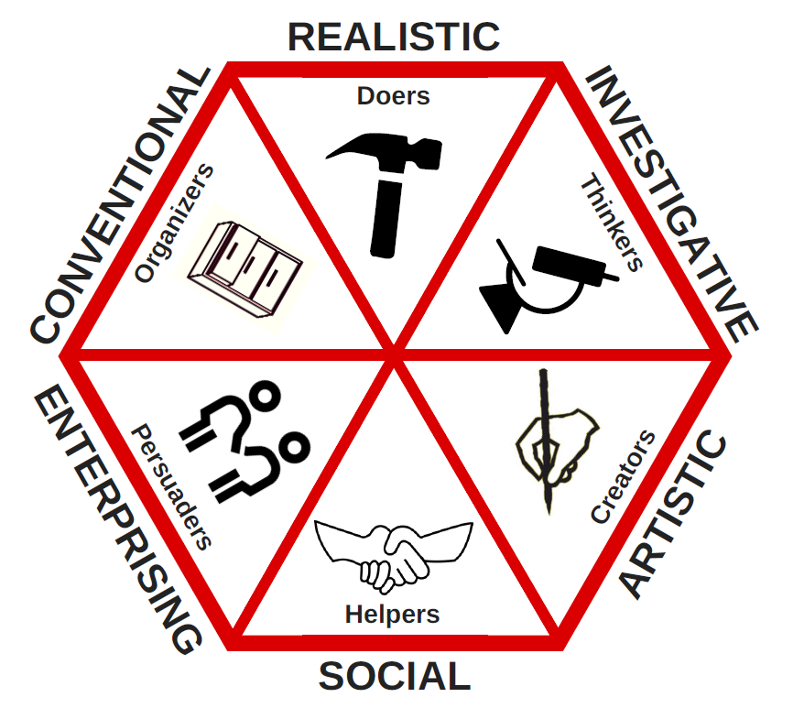
Career Interests - Holland Codes
Things
Data
Ideas
People
Notes:
You can also look at these four additional blue labels
Towards the top of the hexagon are people who prefer to work with things.
At the bottom are people who like to work with People
On the left, are people who like to work with Data
and on the right are people who like to work with Ideas
I fall between the Things and the Data
Bob is on the other side of the hexagon with the Ideas and the People.
=====
Holland theory of “Type”
Realistic -
Work - Physical Demands, Tools, Machines, Animals, Manipulative
People - Enjoy working with Tools, Hobbies, do not like abstract
Investigative -
Work - Searching fro Problems and Solutions, math, science, analytical thinking
People - Like puzzles, intellect, math, science, challenges
Artistic -
Work - open free environment, creative, personal expression, unconventional
People - Like expressing self in unconventional ways, art, music,
Social -
Flexible, understanding of other helping, teaching listening
Solve Problems with discussions team work, verbal and social skills idealism
Enterprising
Managing, persuading other, organizing goals, risks for rewards
Self Confident, to accomplish, wealth, convincing, persuading
Conventional
Record Keeping, File Papers, copy materials, organizing reports
Control situations, follow rules and regulations and guidelines
Congruence - Relationship between personality and environment
Differentiation -Dominant types

Slide 49
Raising the Awareness of Career Pathways in North Carolina
Next meeting is January 16, 2020
www.ncperkins.org/presentations
Notes:
Our next meeting like this one will be on ------.
(We will skip December and be back in January.)
(We will skip June, July and August and be back in September.)
We will be talking about the great events happing during Construction Careers Week
You can go to the NCPerkins website to register for that meeting.
We'll also send you a reminder, since you are now on our mailing list.
So go ahead and sign up for all the meetings, and you'll be reminded the day before.
If you liked something you saw here, send folks to the recording. Find it at that same web page.

