Slide 1
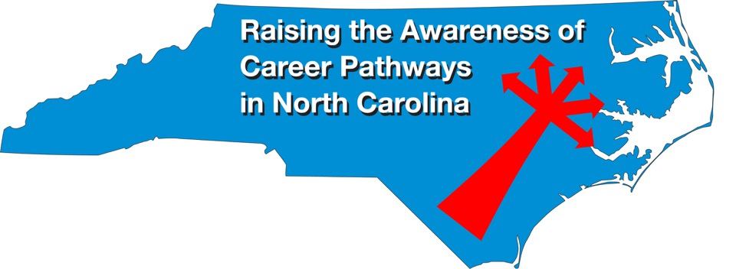
April 17, 2024 Career in Public Safety
Download the PowerPoint and access the recording: www.ncperkins.org/presentations
Notes:
Good morning. Welcome to our monthly career pathways webinar.
We are here to help promote the great jobs, often unknown, in the great state of North Carolina.
Through these meetings, we are going to let you know about some great career opportunities in North Carolina.
And bring in special guests talk about these opportunities.
Please download this PowerPoint file and use it anyway you can to help get folks on a career pathway.
In the notes section of the PowerPoint, you will find any reference from where the information was found, as well as the contact information for the speaker.
Get the PowerPoint on our NCPerkins.org website on our Presentations and Webinars page.
The direct address is on the screen, just scroll down to today’s date.
-----
Many of the videos shown during this webinar can be found here:
https://www.ncperkins.org/video/

Slide 2
Career & Technical Education Team
Bob Witchger
Tony Reggi
Patti Coultas
Mary Olvera
Stefanie Schroeder
Darice McDougald
Lane Freeman
Jennifer McLean
Aaron Mabe

Slide 3
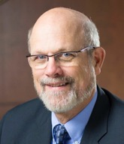
Dr. Bob Witchger
Director, Perkins Career and Technical Education
Notes:
Dr. Robert (Bob) Witchger
NCCCS, CTE Director
919-807-7126
witchgerb@nccommunitycolleges.edu

Slide 4
Dr. Tony Reggi
CTE Associate Director
Perkins Career and Technical Education
Notes:
Tony Reggi
919-807-7131
reggia@nccommunitycolleges.edu

Slide 5
Dr. Mary Olvera
State Director of Teacher Education, Public Services and Perkins Special Populations
Notes:
Dr. Mary Olvera
State Director
North Carolina Community College System Office
919-807-7120
olveram@nccommunitycolleges.edu

Slide 6
Patti Coultas
Assistant Director of Perkins Career and Technical Education
Notes:
Patti Coultas
919-807-7130
coultasp@nccommunitycolleges.edu

Slide 7
Stefanie Schroeder
Assistant Director of Perkins Career and Technical Education
Notes:
Stefanie Schroeder
919-807-7232
schroeders@nccommunitycolleges.edu

Slide 8
Aaron Mabe
State Director of Dual Enrollment and Agriculture & Natural Resources Technologies
Notes:
Aaron Mabe
919-807-7098
mabea@nccommunitycolleges.edu

Slide 9
Kenny Weatherington
Director of Public Safety Training Programs
Notes:
Kenny Weatherington
919-291-6341
weatheringtonk@nccommunitycolleges.edu

Slide 10
Josh Crisp
Gaston College
Director RESTC/Fire & Rescue Training
Notes:
704-922-6258
Crisp.josh@gaston.edu

Slide 11
Calvin Shaw
Gaston College
Director BLET & Criminal Justice Academy
Notes:
704-922-6270
Shaw.calvin@gaston.edu

Slide 12
Jeremiah Underwood
Guilford Technical Community College
Director of EMS Programs
Notes:
Jeremiah Underwood, MHS, CCP, Paramedic
Director of EMS Programs
Guilford Technical Community College
Public Safety Building, Room 237
601 E. Main St.
Jamestown, NC 27282
336-334-4822 ext. 50378

Slide 13
Public Safety Programs
911 Communication and Operations
Basic Law Enforcement Training
Emergency Management
Emergency Medical Services
Fire Protection Technology
Notes:
Associate Degree Program at NC Community Colleges
https://www.nccommunitycolleges.edu/academic-programs/nc-community-college-system-catalog

Slide 14
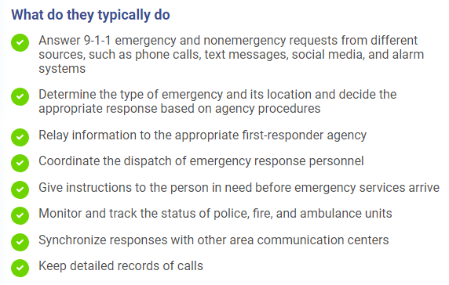
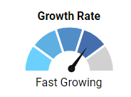
911 Communications and Operations

Slide 15
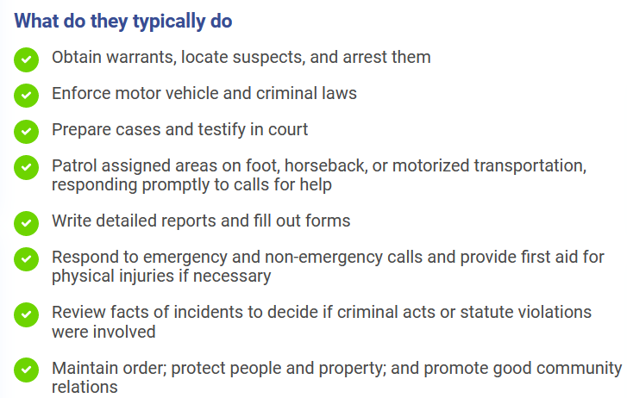
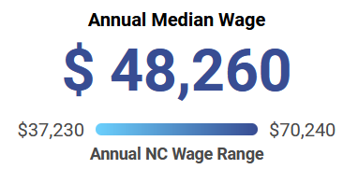
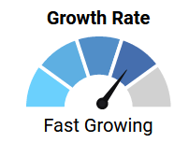
Law Enforcement Officer
Almost all NC Community Colleges offer the BLET program (either Continuing Education or Curriculum)

Slide 16
Emergency Management Technology
The Emergency Management curriculum is designed to provide students with a foundation of technical and professional knowledge needed for emergency services delivery in local and state government agencies. Study involves both management and technical aspects of law enforcement, fire protection, emergency medical services, and emergency planning.
Course work includes classroom and laboratory exercises to introduce the student to various aspects of emergency preparedness, protection, and enforcement. Students will learn technical and administrative skills such as investigative principles, hazardous materials, codes, standards, emergency agency operations, and finance.

Slide 17
Criminal Justice Technology
This curriculum is designed to provide practical knowledge of criminal justice systems and operations. Study will focus on local, state and federal law enforcement, judicial processes, corrections and security services. The criminal justice system's role within society will be explored.
Emphasis is on criminal justice systems, criminology, juvenile justice, criminal and constitutional law, investigative principles, ethics and community relations. Additional study may include issues and concepts of government, counseling, communications, computers and technology.
Employment opportunities exist in a variety of local, state and federal law enforcement, corrections and security fields. Examples include police officer, deputy sheriff, county detention officer, state trooper, intensive probation/parole surveillance officer, correctional officer and retail loss prevention officer.

Slide 18
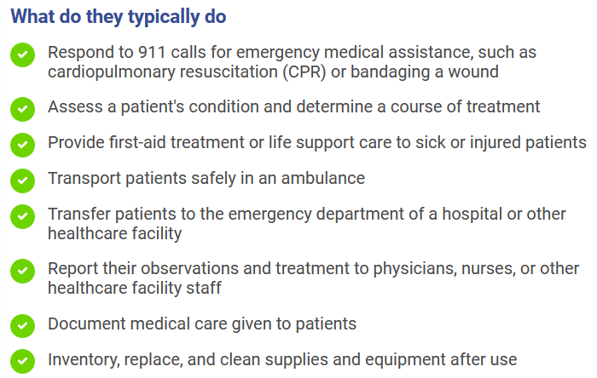
Emergency Medical Services & Paramedic
EMT – Advanced EMT – Paramedic

Slide 19
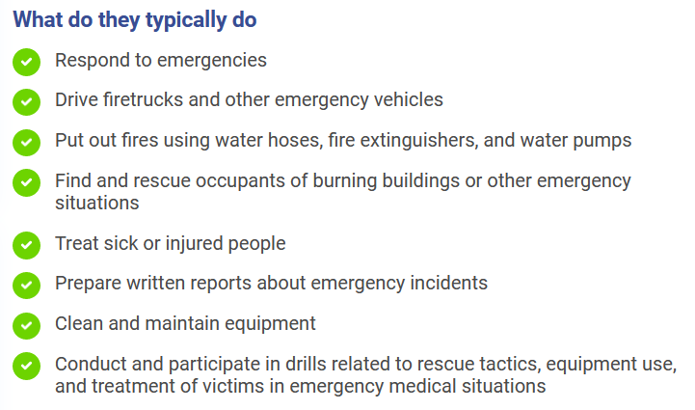
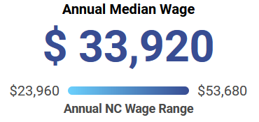
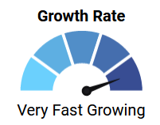
Fire Protection Technology
AAS Degree: 17 NC CCs
May also be offered as a nondegree program

Slide 20
Wilson Community College Summer Camp
Career awareness for rising 8th graders to graduating seniors

Slide 21
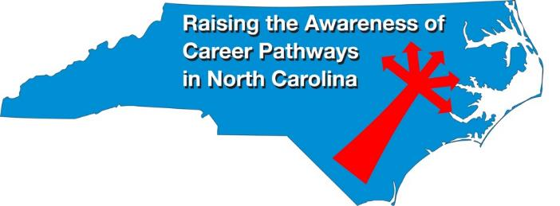
Raising the Awareness of Career Pathways Webinars
May 15, 2024 – Cyber Crime Technology
Register for all webinars at www.ncperkins.org/presentations

