Slide 1
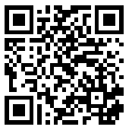
Preparing Young Adults for Careers of the Future
Chris Droessler
CTE Coordinator
NC Community Colleges
DroesslerC@NCCommunityColleges.edu
Get the PowerPoint → www.ncperkins.org/presentations
Notes:
The job market has changed considerably from when we graduated from high school.
Good afternoon. I am Chris Droessler, -- from the North Carolina Community College System.
If you have a smart phone, and you are smart enough to use it, you can capture that QR code, and your phone or tablet takes you to the webpage where you can download a copy of this PowerPoint file.
Or you can just go to NCperkins dot org and click on the “Presentations” link.
How many of you have already downloaded my presentation??
Warning: I talk fast and have lots of information to cover.
My today goal is not to entertain you, rather to get the information to you so that you can go back and digest it later.
I have documented my information sources in the notes section of the PowerPoint, to allow you to further research anything that you see here.
In fact, the notes from which I am reading are there as well.
(In some cases I am reading directly from an original source, because they said it so well.)
Download the PowerPoint and use it any way you wish -- if it will help people discover their perfect career. --
This presentation takes a hard look at where we are -- and where we should be -- in preparing people for the future job market.
=====
www.NCperkins.org/presentations
====
2019 SETA Conference
March 3, 2019
What are we doing to prepare young adults for careers that may not yet exist, in worlds that may not yet exist, solving problems that may not yet exist? When updating our training programs should we be listening to educators, politicians, employers, or the guy making this presentation? This eye-opening presentation examines job market trends, skills that employers are demanding, career pathways, career interests, changes in postsecondary education, and economic globalization. We’ll discuss scenarios that teens encounter that could put them in trouble with the law and could impact their education and employment choices. What are the legal consequences behind drinking and drugs, assaults, stealing, counterfeiting, fake IDs, and more? Working together we can prepare these young adults for a great life in a scary world that we know so little about. Let’s talk.

Slide 2
You can’t see the whole sky through a bamboo tube
Notes:
An Ancient Japanese proverb says “You can’t see the whole sky through a bamboo tube.”
We are trained from an early age to look at things through a tube.
Our education system is set up to train students to look at math, English, and other subjects in isolation from each other.
The focus is on doing just enough in those independent classes to make the grade you wish and move on.
If you are caught looking at the world outside your bamboo tube, -- you might be accused of -- cheating.
Just as you can not see the whole sky by looking through a bamboo tube, you can’t learn everything from me.
So I’ll show you what I have been looking at through my own bamboo tube.
And I’ll show you some of the things that I get to see when I put the bamboo tube aside -- and just look at the whole sky.
====
Quote
http://www.rodneyohebsion.com/japan.htm
http://www.worldofproverbs.com/2012/04/you-cant-see-whole-sky-through-bamboo.html
Panda photo
https://www.flickr.com/photos/kjdrill/148617834/sizes/z/

Slide 3
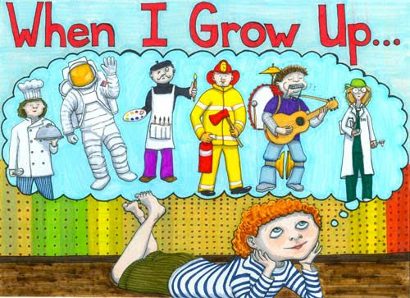
Notes:
When you were young, how many of you dreamed that you would have the job you have now?
How many of you even knew that this job existed?
====
https://nickysmom3.files.wordpress.com/2017/02/when_i_grow_up_small.jpg?w=500

Slide 4
About Chris
High School
Electronics, Drafting classes
Math, Science classes
Tech crew (sound, lights)
A/V guy
Car repair
Notes:
Let me start by telling you a little about my education pathway and how I got where I am today.
In high school I took drafting and electronics classes -- and liked them a lot.
I always liked math and science, especially applied physics.
This is one of the few things that differentiates me from Dr. Sheldon Cooper. He's stuck in theoretical physics, whereas I like to apply the physics to the real world.
Any time the school needed someone to run sound systems or stage lights, I was there. I also helped with the audio-visual needs around school, like threading a film projector.
Boy – if we only had DVDs back then!!
I also liked to work on my own cars. In part because I was cheap and would rather do the work myself than to pay someone to fix my car. But I also liked turning wrenches.
At the time, I had no idea that any of these, and many other interests, might lead someday to a career.
After high school, it was a family expectation that I was going to go on and get my four-year degree and wave that sheepskin high in the air until I got a job.

Slide 5
College
NC State
Electrical Engineering
11 years
Drafting
NC A&T SU
BS Industrial Arts/Technology Education
Indiana State
MS Technology Education
Notes:
So I go to NC State University in Electrical Engineering.
--- For 11 years!
I realized early on that engineers did not work with their hands, they sat a desk and designed things for others to build.
-- I wanted to be that other guy who got to build the things the engineers designed.
I loved the drafting courses more than anything and really enjoyed the drafting instructors, so I attempted to change majors to become an Industrial Arts teacher. --It's is a four-year degree after all! And in my family we were required to get a four-year degree before we got married.
I ran into lots of red tape trying to transfer from the school of Engineering to the school of Education.
My college advisor even told me to drop out of college, because I was wasting a seat for someone who really wanted to be an engineer.
I ended up transferring to the Technology Education program at North Carolina A&T State University in Greensboro.
By then I was ready to move ahead and complete my schooling. I graduated summa cum laude with an offer to further my studies -- for free -- at Indiana State.
So I went there and completed my Masters degree in Technology Education.

Slide 6
Post College
Technical Writing and MultiMedia for:
Exide Electronics
FAA
Imonics
IBM
John Deere
Exide Electronics
Nortel
Raleigh Chamber of Commerce
Notes:
I was a technical writer and MultiMedia developer for about ten years.
I worked for some big companies creating technical manuals.
You know -- the kind nobody really ever reads.
Seriously though, airplanes stay in the air thanks to me.

Slide 7
Post College
Taught at
UNC-CH
Enloe HS
Southeast Raleigh HS
Wake County Schools Central Office
NC Department of Public Instruction
NC Community College System
Notes:
then I got into the world of education teaching at UNC Chapel Hill and a few high schools.
Then I was the School-to-Career Coordinator for the Wake County Schools.
Eventually I went to work at the state level in public education and --
three years ago, I started working for the community college system, where I help to connect high school technical programs with community college technical programs.
And -- I get to do fun presentations like this.

Slide 8
Begin with the End in Mind
A Changing World: Helping people prepare for life in a scary world that we know little about
Notes:
Stephen Covey’s second habit of highly effective people says “Begin with the end in mind.”
To me the "end" was getting that four-year degree.
That was my big finish line. How little I knew back then.
Too often this Begin with the End in Mind habit is summed up with the phrase “What do you want to be when you grow up?”
This habit relies on using your imagination, -- which is something that is not often valued in our society, especially in education and training. We have become accustomed to allowing others tell us how to act -- and where to go.
You should be in charge of your own life.
…
=====
Steven Covey
https://www.stephencovey.com/7habits/7habits-habit2.php
Tortoise race
https://theleadershipwiki.wikispaces.com/Begin+with+the+End+in+Mind

Slide 9
Notes:
And we have to help others,
like the students, clients, customers with whom we work,
do the same,
or we all end up like riding in bumper cars without a steering wheel.
Always reacting to outside forces --
rather than creating our own career pathway.
====
http://www.gattitownlexington.com/wp-content/uploads/2011/05/bumper_cars_2.gif

Slide 10
A Changing World: Helping people prepare for life in a scary world that we know little about
Preparing Young Adults for Careers of the Future
Notes:
The end for this presentation is the future.
(About two hours into the future to be precise.)
What will the future look like?
(Not two hours from now, but like ten or twenty years in the future.)
The more important question is:
“What do we want our future to look like?”
=====
https://i.ytimg.com/vi/MFEw37uMQyM/maxresdefault.jpg

Slide 11
Notes:
We all got a glimpse of the future by watching the Jetsons.
But that was back in the early Nineteen Sixties.
That was over 50 years ago.
Most of you were not even alive.
Several years before we actually stepped foot on the moon, the Jetsons were showing us life in the future.
Is this the world we are preparing our youth to take over and run?
Have we asked them, the youth, what they want?
======
http://lovelace-media.imgix.net/uploads/315/297c6fd0-e98c-0131-6d32-0aa0f90d87b4.jpg?

Slide 12
Surprises Future Demand Legal Scenarios Changing World New Ideas Career Planning
www.ncPerkins.org/presentations
Notes:
Here is what we will be covering today.
Surprises in the job market,
Legal scenarios that we face every day,
Future Demand in occupations and the business world,
Our Changing World,
And some New Ideas about career preparation
And Career Planning
→
We will start with a few facts that might surprise you.

Slide 13
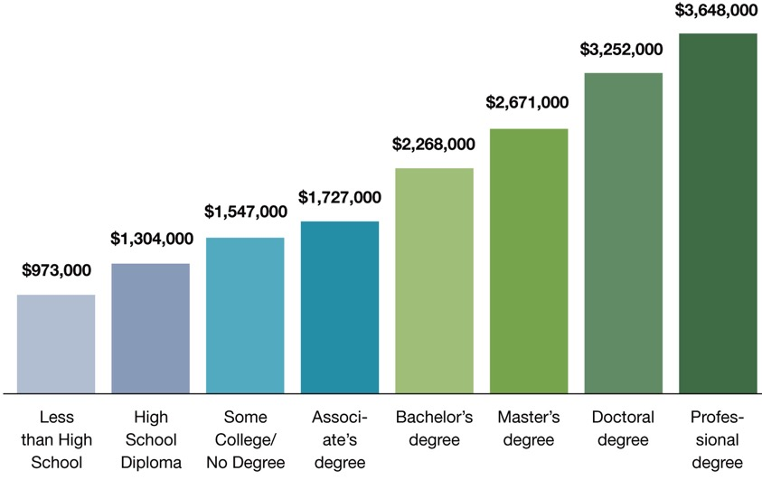
Degree Level Matters People with more education make more money than those with less education
Notes:
This chart shows that, on average, people earn more over their lifetime if they have a higher level of education.
There’s no surprise here.
But the reason I include this chart is to remind you that this chart shows people who are currently employed.
What does chart this say to our youth who will be employed a few years from now?
Will the chart look different for them?
What if lifetime education costs and student loan interest is figured in? Does that narrow the gap?
What about the cost of business attire, business social expenses, club memberships, and other expenses that might be different at different levels of employment?
What does this chart tell our youth about their future?
====
http://cew.georgetown.edu/collegepayoff/
http://www9.georgetown.edu/grad/gppi/hpi/cew/pdfs/collegepayoff-summary.pdf
Page 4, 5
13

Slide 14
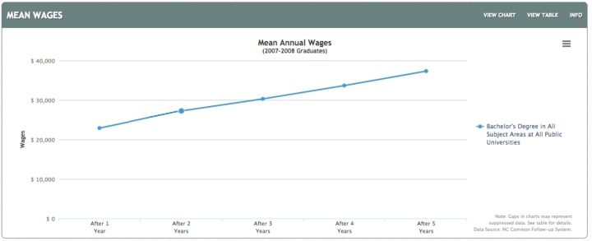
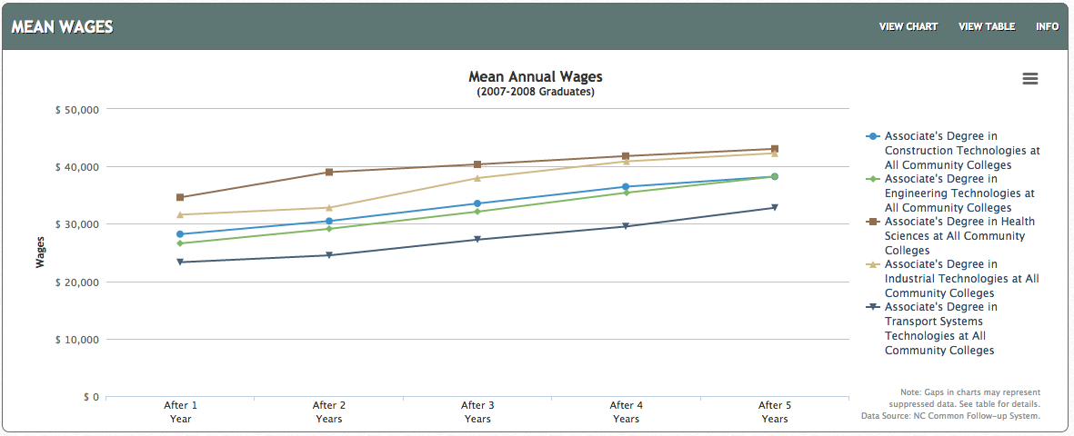
$37,318
$22,896
NC Bachelor Degree
$32,800- $43,062
$23,316- $34,619
NC Associate Degrees
Notes:
First – Apologies for the age of the data. This is the latest that has been released. And I want to show a progression of five years of data.
On the top you see the first five years of mean salaries for all graduates of all North Carolina Bachelor Degree programs. This is the Mean wage, which many refer to as the average.
The bottom chart shows graduates from Associate Degree programs from our North Carolina Community Colleges.
These are real wages gathered form employment records.
After five years of working, a bachelor degree graduate in North Carolina earned an average of 37 thousand, 3 hundred and 18 dollars.
Whereas an associate degree graduate earned between 32 and 42 thousand dollars depending on the program area.
-Health Science and Industrial Technologies are the two programs with the highest wages. Higher than the average 4-year degree graduate.
And not only do the graduates of the 2-year program make more money than the graduates of the 4-year programs, think about the student loans to pay back.
====
http://nctower.com/output/unc/7810/
2007-2008 Bachelor Degree graduates from All NC Universities
http://nctower.com/output/ncccs/4840-4946-4797-4887-5059/
2007-2008 graduates from selected Associate Degree programs in NC

Slide 15
$37,318
$22,896
NC Bachelor Degree
$32,800- $43,062
$23,316- $34,619
NC Associate Degrees
Notes:
A 4-year program at a state university costs about ten times as much as a 2-year program at a community college.
Considering the cost of the education, and the student loans to pay back, who will be able to buy that fancy sports car sooner?
The web addresses where you can find all of my data sources is in the Notes section under each slide.
At this particular website you can break it down by exact degree and specific college.
I assume that data like this exists for your state. If not, come join us.
You could look at the data for the technical programs offered at your specific high school and community college and share them with the students, parents, and school counselors.
Forget what you have been told in the past about education and salaries. – This is the new reality.
====
http://nctower.com/output/unc/7810/
2007-2008 Bachelor Degree graduates from All NC Universities
http://nctower.com/output/ncccs/4840-4946-4797-4887-5059/
2007-2008 graduates from selected Associate Degree programs in NC

Slide 16
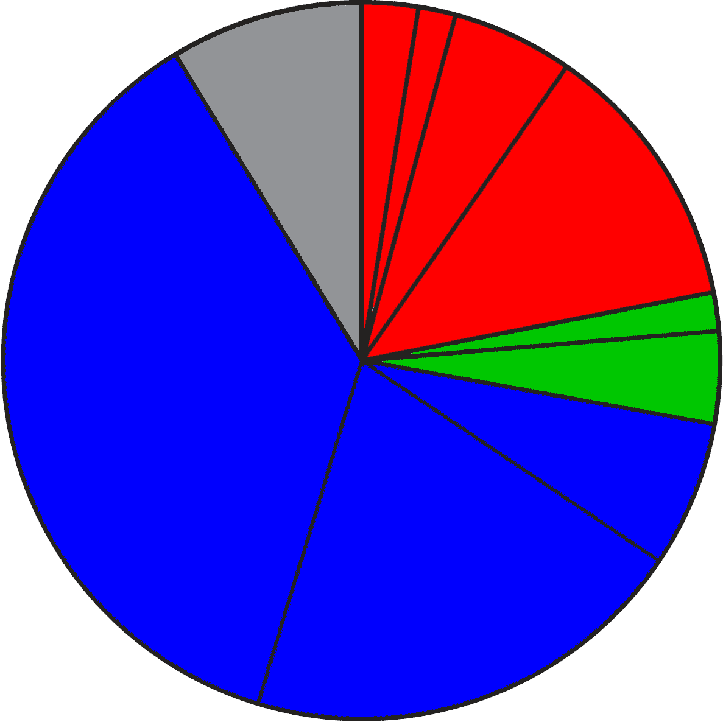
2024 Projected NC Employment: Education Required
Doctorate & Professional degree
work exp.
Master’s degree
8.0%
Bachelor + work exp.
4.8%
Bachelor’s degree
11.6%
4.8%
Associate degree
3.9%
37.0%
1,2 year college
short OJT
6.2%
long OJT
19.0%
moderate OJT
Notes:
Here is the breakdown of the minimum education required for all jobs projected in North Carolina in the year 2024.
The red jobs require four or more years of college.
Green jobs require one or two years of college.
You will notice that the largest portion, in blue, are the jobs that do not require any formal education past high school in order to get the job.
They require various amounts of On-The-Job Training.
====
NC Employment Security Commission data via www.CareerOutlook.US
http://careeroutlook.us/
These are for all jobs that get a paycheck, not for contracted positions, or small business owners who do not write themselves a paycheck.
NC Projections for 2024
2.61% Doctoral or professional degree
2.13% Master's Degree
4.77% Bachelor's Degree plus work experience
11.60% Bachelor's Degree
4.75% Associate Degree
3.92% One/two years of college
6.20% Long-term on-the-job (OJT) training
19.04% Moderate-term on-the-job (OJT) training
36.96% Short-term on-the-job (OJT) training
8.01% Work experience in a related occupation

Slide 17
2017 NC High School: Graduate Intentions
Other
Employment
11%
Military
Trade and
Business
Schools
4.4%
Public Senior
Institutions
36.0%
Private
Junior
Colleges
35.5%
Community and
Technical Colleges
9.7%
Private Senior
Institutions
Notes:
Here you see the breakdown of the postsecondary intentions of our North Carolina high school graduates.
The red shows that almost half of our high school graduates say they are going to a four-year college program.
The green is one or two years at a community college, junior college, or trade school.
The blue is joining the military or going directly into employment.
The Other category is the two percent of our recent high school graduates who plan to sit on Mom’s couch the rest of their lives watching YouTube videos.
=====
http://www.ncpublicschools.org/fbs/resources/data/
NC Public Schools Statistical Profile 2016-2017
Pupil Information
Table 12.1 High School Graduates by Intentions
Of the 102,945 graduates in the class of 2017, here is where they say they are going after high school.
36.0% Public Senior Institutions
9.7% Private Senior Institutions
35.5% Community/Technical College
0.4% Private Junior College
0.8% Trade/Business School
4.4% Military
11.0% Employment
2.1% Other

Slide 18
Postsecondary Intentions vs. Reality
Graduate Intentions
Education Required
8.0%
OJT
4 year
21.1%
4 year
8.7%
45.7%
1-2 year
1-2 year
OJT
36.7%
Notes:
Here we can compare these two charts.
On the left is where the high school students say they are going, and on the right is what kind of education the jobs require.
→almost 46 percent of our high school students say they are going to a four-year college program, which will prepare them for 21 percent of the job openings. Do you see that in the red part of the two charts?
If you do the math, it looks like half of them will be left holding a sheepskin with no job to show for it. We’ll discus that in a few minutes.
→Likewise, in green you see that almost 37 percent of our high school graduates say they are going to a one- or two-year program at a community college or private training facility.
This prepares them for almost 9 percent of the jobs.
Whether you use old math or new math, you still see that there is some disparity between the number of people going into a postsecondary education program and the number of jobs that will demand that kind of education.
=============
Education Required 2024
21.11% four or more years of college
8.67% 1-2 years of college
62.21% OJT - On the job training
8.01% Work experience in a related occupation

Slide 19
Postsecondary Intentions vs. Reality
Graduate Intentions
Education Required
8.0%
OJT
4 year
15.4%
21.1%
4 year
8.7%
45.7%
1-2 year
1-2 year
OJT
36.7%
62.2%
Notes:
Though the blue on the right shows that 62 percent of the jobs do not require postsecondary education (that means that you can get any of those blue jobs right out of high school), there are community college and technical school programs for most of these blue jobs, which means that the education is not required, but the postsecondary education is preferred, and you will be more likely to get hired, and might start at a higher salary.
→ But if you take into account the occupations that not only require community college training, but also heavily recommend community college training, you see that the green is actually one third of the overall pie. For these jobs, you can get the job first or get the training first. If you get the job first, then your employer will have to send you to school to get the education.
=============
Education Required 2024
21.11% four or more years of college
8.67% 1-2 years of college
62.21% OJT - On the job training
8.01% Work experience in a related occupation

Slide 20
Short OJT NC starting salaries - high-projected demand 2024
$27,900 Loan Interviewers and Clerks
$26,640 Costume Attendants
$22,000 Medical Equipment Preparers
$21,110 Healthcare Support Workers, all other
$20,850 Helpers--Brickmasons, Blockmasons, Stonemasons, and Tile and Marble Setters
$20,400 Occupational Therapist Aides
$20,170 Helpers--Carpenters
$19,850 Physical Therapist Aides
$18,470 Helpers--Painters, Paperhangers, Plasterers, and Stucco Masons
$17,530 Helpers--Roofers
$17,410 Nursing Assistants
$17,290 Veterinary Assistants and Laboratory Animal Caretakers
$16,990 Taxi Drivers and Chauffeurs
$16,410 Personal Care Aides
$16,410 Home Health Aides
Notes:
Let’s look at some salaries.
Here you see the jobs that require short O J T or on-the-job training.
And I am showing you only jobs that are projected to be in high demand over this 10-year projection period.
Short OJT means you can get one of these jobs right out of high school, and within a month you know all you need to know to do the job.
You do not see life-sustaining wages here, but these jobs could be a start on a pathway to a higher-paying occupation.
=====
CareerOutlook.us
These are all ”high demand” occupations, projected to have high growth over the 2014-2024 projection period.
Estimated average salary for all entry-level (first-year) workers in this occupation in North Carolina in 2016. Technically it is the annual 10th percentile wage.

Slide 21
Moderate OJT NC starting salaries - high-projected demand 2024
$29,300 Dental Assistants
$26,480 Computer-Controlled Machine Tool Operators, Metal and Plastic
$25,300 Mechanical Door Repairers
$25,270 Cement Masons and Concrete Finishers
$24,890 Roofers
$23,530 Medical Assistants
$23,110 Insulation Workers, Floor, Ceiling, and Wall
$20,770 Ambulance Drivers and Attendants, Except Emergency Medical Technicians
$18,670 Construction Laborers
$18,430 Floor Layers, Except Carpet, Wood, and Hard Tiles
Notes:
Moderate on-the-job training means you need more than a month of training, but within a year, you are ready to work by yourself.
There are community college programs for many of these jobs, but they are not required by the workforce for entry-level employment, but would make you more hirable.
We are looking only at high-demand occupations.
=====
CareerOutlook.us
These are all ”high demand” occupations, projected to have high growth over the 2014-2024 projection period.
Estimated average salary for all entry-level (first-year) workers in this occupation in North Carolina in 2016. Technically it is the annual 10th percentile wage.

Slide 22
Long OJT NC starting salaries - high-projected demand 2024
$34,650 Electrical Power-Line Installers and Repairers
$29,390 Computer Numerically Controlled Machine Tool Programmers, Metal and Plastic
$25,960 Opticians, Dispensing
$25,370 Brickmasons and Blockmasons
$21,940 Medical Appliance Technicians
$16,630 Cooks, Restaurant
Notes:
Long on-the-job training means you can get these jobs right out of high school, but it will take on-the-job training for over a year to get you completely trained.
Most of these jobs have training programs at our community colleges. Which means you could get the training first, and then probably start at a higher salary.
An Apprenticeship program could be the pathway to these occupations.
=====
CareerOutlook.us
These are all ”high demand” occupations, projected to have high growth over the 2014-2024 projection period.
Estimated average salary for all entry-level (first-year) workers in this occupation in North Carolina in 2016. Technically it is the annual 10th percentile wage.

Slide 23
1-2 Year Diploma/Certificate NC starting salaries - high-projected demand 2024
$32,610 Surgical Technologists
$25,070 Health Technologists and Technicians, all other
$23,400 Medical Secretaries
$20,870 Massage Therapists
$16,100 Gaming Dealers
Notes:
These jobs require one or two years at a community college or other training school.
You might end up with a diploma or a certificate, but not an Associate degree.
The starting salaries are not much better than the jobs that do not require any college work.
Some of these require a state license in order to work in these occupations.
=====
CareerOutlook.us
These are all ”high demand” occupations, projected to have high growth over the 2014-2024 projection period.
Estimated average salary for all entry-level (first-year) workers in this occupation in North Carolina in 2016. Technically it is the annual 10th percentile wage.

Slide 24
Associate Degree NC starting salaries - high-projected demand 2024
$56,130 Radiation Therapists
$52,050 Dental Hygienists
$49,640 Diagnostic Medical Sonographers
$44,960 Cardiovascular Technologists and Technicians
$43,910 Registered Nurses
$42,870 Occupational Therapist Assistants
$42,680 Physical Therapist Assistants
$42,540 Respiratory Therapists
$27,900 Medical and Clinical Laboratory Technicians
$21,520 Veterinary Technologists and Technicians
Notes:
Here is where you see the jump in salaries.
These are the jobs that are predicted to be in high-demand that require an Associate Degree.
Note that most of these occupations are the “helping” or “assisting”-type jobs in the Healthcare industry.
All of the “assisting”-type jobs in the Healthcare industry are in high demand, -- were in high demand throughout the recent recession, -- and should stay in high demand for many years to come -- to help support the aging baby boomers.
=====
CareerOutlook.us
These are all ”high demand” occupations, projected to have high growth over the 2014-2024 projection period.
Estimated average salary for all entry-level (first-year) workers in this occupation in North Carolina in 2016. Technically it is the annual 10th percentile wage.

Slide 25
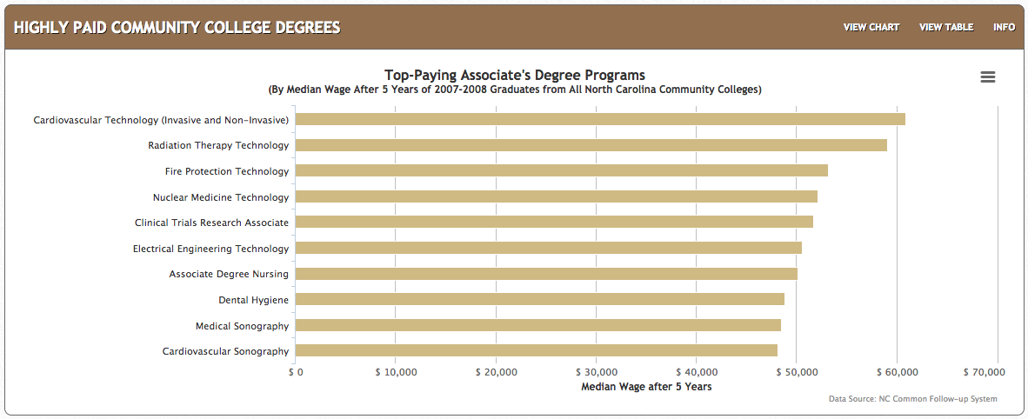
Top-Paying Associate Degrees
$60,869
$59,102
$48,160
Notes:
Here are the actual salaries for Associate Degree graduates from our North Carolina Community Colleges.
These are the highest paying jobs, five years after graduation.
- Cardiovascular Technicians make almost 61 thousand dollars, and the
- Radiation Therapy Technicians make 59 thousand dollars.
Keep an eye on the last two on this list.
I predict an increasing demand for Sonographers -- as many industries are finding more uses for this technology, -- and it’s not just in healthcare.
====
http://nctower.com/
2007-2008 graduates from All NC Community Colleges

Slide 26
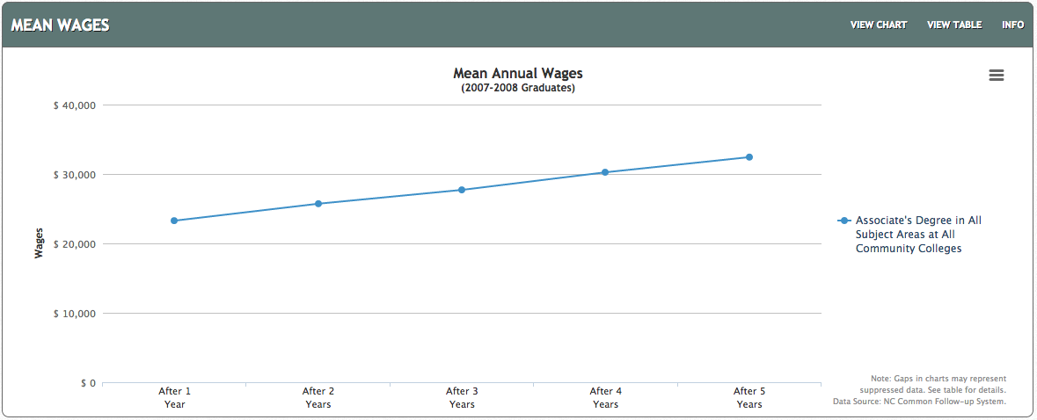
All NC Associate Degrees
$32,431
$23,277
Notes:
Average wage the first year out of college with a North Carolina Associate Degree is about 23 thousand dollars.
After 5 years, the average is about 32 thousand dollars.
That’s really good.
====
http://nctower.com/output/ncccs/4506/2008/
2007-2008 graduates from all Associate Degree programs in NC

Slide 27
Selected Associate Degrees by Program Area
$43,062
$34,619
$32,800
$23,316
Notes:
And here are the salaries for some specific technical program areas.
Five years out of college, the average salary for all Associate Degree graduates in Health Sciences and Industrial Technologies is about 43 thousand dollars.
Transport Systems is the low line on this chart making almost 33 thousand dollars after five years of work.
====
http://nctower.com/output/ncccs/4840-4946-4797-4887-5059/
2007-2008 graduates from selected Associate Degree programs in NC
The five year mark is the year 2013.

Slide 28
Bachelor Degree NC starting salaries - high-projected demand 2024
$76,020 Physician Assistants
$59,460 Software Developers, Applications
$56,610 Computer Systems Analysts
$55,560 Occupational Therapists
$49,710 Financial Analysts
$48,500 Financial Examiners
$47,180 Technical Writers
$46,710 Biomedical Engineers
$45,120 Personal Financial Advisors
$44,100 Credit Analysts
$41,550 Medical and Clinical Laboratory Technologists
$39,670 Cartographers and Photogrammetrists
$36,150 Healthcare Social Workers
$33,860 Orthotists and Prosthetists
$33,200 Therapists, all other
$31,530 Loan Officers
$29,800 Athletic Trainers
$29,190 Credit Counselors
Notes:
And now the Bachelor's degree – a four-year degree program at a college or university is required to get these jobs.
And this is showing only the jobs projected to be in high demand
The starting salaries are a little higher than most Associate degrees, but not all.
=====
CareerOutlook.us
These are all ”high demand” occupations, projected to have high growth over the 2014-2024 projection period.
Estimated average salary for all entry-level (first-year) workers in this occupation in North Carolina in 2016. Technically it is the annual 10th percentile wage.

Slide 29
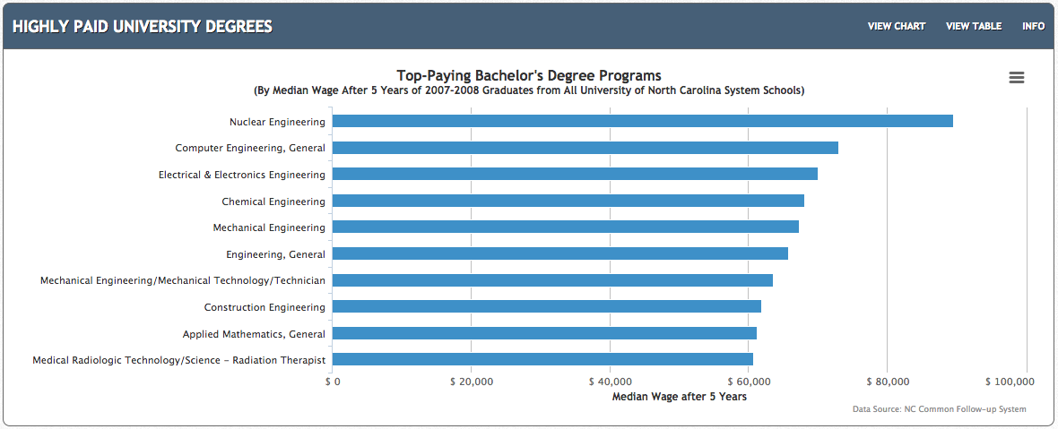
Top-Paying Bachelor Degrees
$89,537
$60,704
Notes:
Here are the actual salaries for Bachelor Degree graduates from our North Carolina public universities.
These are the average salaries after working for five years. These are actual North Carolina salaries, not just a projection.
Nuclear Engineering was the highest paying at 89 and a half thousand dollars.
You see lots of Engineers on this list because the pay is good, but how about the chances of getting a job?
We will look at that in a minute.
====
http://nctower.com/
2007-2008 graduates from All NC Universities

Slide 30
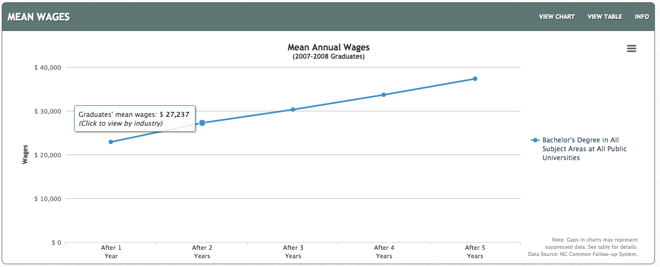
All NC Bachelor Degrees
$37,318
$22,896
Notes:
For the folks who graduated with a Bachelor’s Degree from a North Carolina Public University,
the average salary after five years of work is just above 37 thousand dollars.
But ---
====
http://nctower.com/output/unc/7810/
2007-2008 Bachelor Degree graduates from All NC Universities

Slide 31
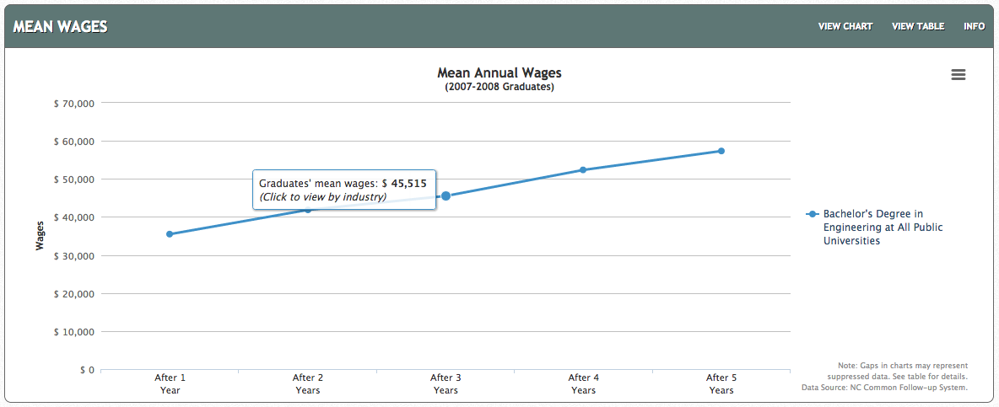
NC Engineering Bachelor Degrees
$57,338
$35,483
Notes:
But -- if you look at just the graduates with a Bachelor’s Degree in Engineering,
They started working at just 35 thousand dollars, and after five years jumped to 57 thousand dollars.
Later on we will see how only half of these graduates might be getting a regular paycheck.
====
http://nctower.com/output/unc/7901/
2007-2008 Bachelor Degree, Engineering graduates from All NC Universities

Slide 32
Masters Degree NC starting salaries - high-projected demand 2024
$59,250 Physical Therapists
$58,040 Statisticians
$54,180 Audiologists
$45,530 Speech-Language Pathologists
$42,170 Operations Research Analysts
$37,780 Survey Researchers
$35,610 Market Research Analysts and Marketing Specialists
$34,010 Health Specialties Teachers, Postsecondary
$33,420 Mental Health Counselors
$33,060 Mental Health and Substance Abuse Social Workers
$32,240 Substance Abuse and Behavioral Disorder Counselors
Notes:
These occupations require a Master’s Degree. That’s two more years beyond a Bachelor’s Degree,
But the salaries you see here are mostly lower than the occupations that require only a bachelor’s degree, and similar to the starting salaries for occupations that require only an Associate degree.
It does not always make sense.
Sometimes higher education does not mean higher salary. This is why folks need to explore these data to see what occupation meets all of their requirements.
=====
CareerOutlook.us
These are all ”high demand” occupations, projected to have high growth over the 2014-2024 projection period.
Estimated average salary for all entry-level (first-year) workers in this occupation in North Carolina in 2016. Technically it is the annual 10th percentile wage.

Slide 33
Doctorate/Professional Degree NC starting salaries - high-projected demand 2024
>$208,000 Oral and Maxillofacial Surgeons
>$208,000 Anesthesiologists
$191,820 Surgeons
$149,890 Orthodontists
$113,660 Psychiatrists
$113,150 Dentists, General
$73,390 Optometrists
$46,000 Law Teachers, Postsecondary
$45,000 Nursing Instructors and Teachers, Postsecondary
$42,060 Clinical, Counseling, and School Psychologists
$39,710 Criminal Justice and Law Enforcement Teachers, Postsecondary
Notes:
These occupations require a Doctorate or Professional Degree.
The federal government does not report salaries above 208 thousand dollars, so that is why you see the greater-than symbol.
Some of these high-demand occupations pay less than the occupations requiring an Associate Degree,
but they have the potential to raise much higher over the course of a career.
=====
CareerOutlook.us
These are all ”high demand” occupations, projected to have high growth over the 2014-2024 projection period.
Estimated average salary for all entry-level (first-year) workers in this occupation in North Carolina in 2016. Technically it is the annual 10th percentile wage.

Slide 34
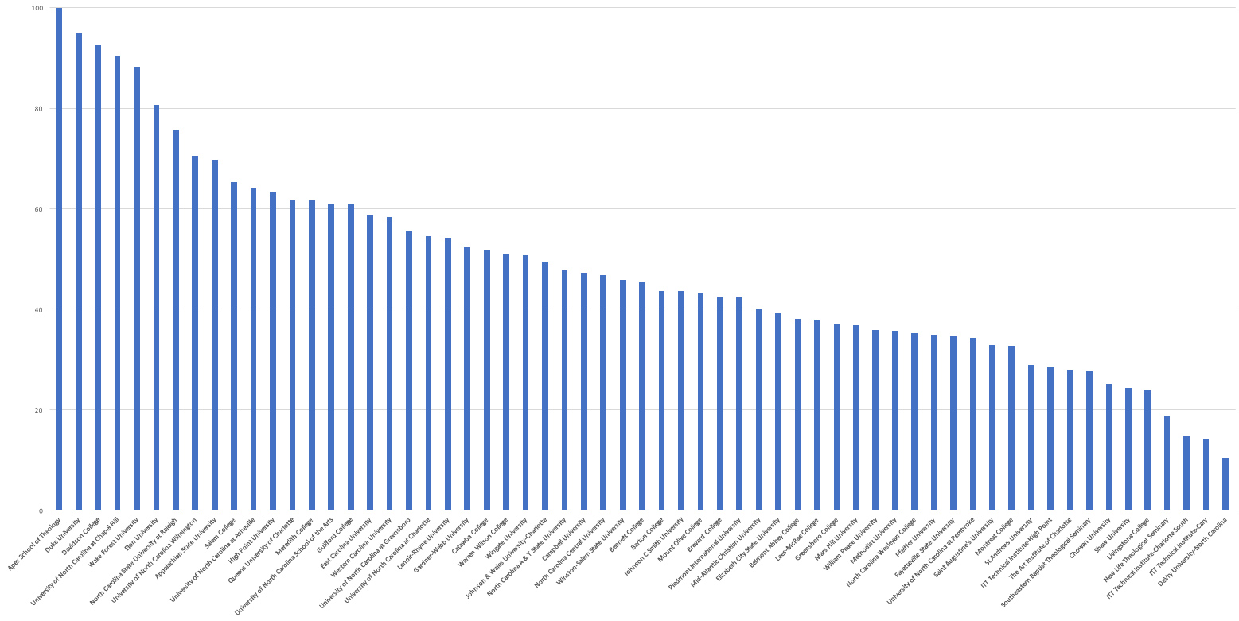
North Carolina
Bachelor Degree 6-year Graduation Rate 61.1% average
Notes:
34
Here’s a chart that shows the graduation rate for all of the four-year colleges in North Carolina.
This is the percentage of students who complete their four-year program in six years.
This shows that almost half of the students that we send to a four-year college program in North Carolina will drop out or take longer than 6 years to complete.
It took me 11 years to complete my four-year degree.
Duke’s graduation rate, second bar from the left, is very high, but they are also very picky about who they let in.
One drawback to this data is that it is showing how many start a four-year program and complete it within six years at the same institution.
Some of the smaller, private colleges have low graduation rates because students might start there, and then transfer to a larger state university.
This counts as a negative where the student started, and does not count at all where the student completed their degree.
Anytime you look at data, you have to take time to truly understand them, -- so you don’t jump to the wrong conclusion.
The main point I want to make here is that when we send someone to a four-year college, we need to make sure that they are truly ready for the work -- and are in the right education program for their chosen career pathway.
====
www.collegeresults.org
2014 data
Total number of students 229,307
Number of graduates 140,211
140,211 / 229,307 = 61 percent graduation rate in 6 years

Slide 35
It makes you think?
What happens to our 4-year program dropouts?
25% of all students in Community College have a 4-year degree.
Notes:
35
So, what happens to our college dropouts?
Remember that almost half do not complete their 4-year degree in 6 years.
Do they come back to high school – and say “That didn’t work out. What should I try next?”
→Many university graduates are going to community colleges to get the specific training they need for a job.
I’m not saying that four-year degrees are not important… I would not have my job without one. But for career purposes, (especially entry-level) it may not always be the best choice.
Wake Tech, Our state’s largest Community College claims to be the largest graduate school in North Carolina based on the number of students they have -- who already have a four-year degree.

Slide 36
Surprises Future Demand Legal Scenarios Changing World New Ideas Career Planning
www.ncPerkins.org/presentations
Notes:
Now --- let’s look towards the future.
Unfortunately I don’t have a budget code for a crystal ball, so I have to divine the future using Google.

Slide 37
Notes:
37
Four years ago year was 2015, -- the year to which Marty McFly traveled in Back to the Future part two.
How well did they predict the future?
For one thing -- The Hover Boards of today are nothing like the Hover Boards in the movie.
Today’s Hover Boards don’t really hover, they have wheels.
And Marty McFly never worried that his Hover Board would catch fire.
========
http://static6.businessinsider.com/image/54a8b647ecad040d3b68d5bc-1200/we-also-dont-have-automatic-dog-walkers-to-take-sparky-for-a-stroll-around-the-block.jpg
http://25.media.tumblr.com/tumblr_m13y12wUqk1qf7kwgo1_500.jpg
http://boxofficescoop.first.netdna-cdn.com/wp-content/uploads/2014/03/back-to-the-future-hoverboard.jpg
admintell.napco.com/ee/images/uploads/gadgetell/delorean-external-harddrive-02-640.jpg
https://sp.yimg.com/ib/th?id=HN.607990799156251306&pid=15.1&P=0
http://mentalfloss.com/sites/default/files/hill-valley.png
https://www.screenused.com/images/auction_nov13/13946_5.jpg

Slide 38
If we really want to prepare our students for successful careers, we need to know all we can about the rapidly changing job market.
Emil Barnabas
Notes:
38
The job market has changed considerably from when we graduated from high school.
People get most of their career guidance from their parents.
But, -- do our parents keep up with the rapidly changing job market?
What do the parents of our students know about bioinformatics and nanotechnology?
====
Emil Barnabas
CareerOutlook.us

Slide 39
Fastest Growing Occupations in NC Requiring Postsecondary Education (Total Change in Positions Projected from 2014 - 2024)
20,320 Registered Nurses
7,970 General and Operations Managers
5,550 Accountants and Auditors
4,990 Computer Systems Analysts
4,700 Software Developers, Applications
4,410 Carpenters
3,950 Business Operations Specialists, All Other
3,900 Market Research Analysts and Marketing Specialists
3,670 Management Analysts
3,320 Computer User Support Specialists
3,260 Elementary School Teachers, Except Special Education
3,150 Computer and Information Systems Managers
2,940 Financial Managers
2,800 Licensed Practical and Licensed Vocational Nurses
2,750 Personal Financial Advisors
2,530 Loan Officers
2,520 Automotive Service Technicians and Mechanics
2,510 Medical Secretaries
2,480 Electricians
2,290 Dental Assistants
2,270 Medical and Clinical Laboratory Technicians
2,260 Clergy
2,240 Physicians and Surgeons, All Other
2,130 Emergency Medical Technicians and Paramedics
2,040 Industrial Machinery Mechanics
Notes:
39
Not counting the occupations that require less than a year of on-the-job-training (OJT),
here are the high-demand occupations in North Carolina that require some kind of postsecondary education.
The number listed is the projected change in the number of positions in North Carolina over the ten-year projection period.
Does that top number stand out a little?
More about that on the next slide.
=========
These data are from www.CareerOutlook.US
http://www.bls.gov/emp/ep_table_112.htm
Education and training assignments
updated January 13, 2012

Slide 40
Fastest Growing Occupations in NC (Total Change in Positions Projected from 2014 - 2024)
29,310 Combined Food Preparation and Serving Workers, Including Fast Food
20,320 Registered Nurses
19,930 Retail Salespersons
16,840 Home Health Aides
15,190 Customer Service Representatives
13,510 Nursing Assistants
9,360 Waiters and Waitresses
9,080 Cooks, Restaurant
8,170 Laborers and Freight, Stock, and Material Movers, Hand
8,000 Cashiers
7,970 General and Operations Managers
6,560 Office Clerks, General
6,480 First-Line Supervisors of Office and Administrative Support Workers
6,430 First-Line Supervisors of Food Preparation and Serving Workers
6,080 Janitors and Cleaners, Except Maids and Housekeeping Cleaners
5,950 Stock Clerks and Order Fillers
5,820 Heavy and Tractor-Trailer Truck Drivers
5,550 Accountants and Auditors
5,520 First-Line Supervisors of Retail Sales Workers
5,230 Secretaries and Administrative Assistants, Except Legal, Medical, and Executive
4990 Computer Systems Analysts
4990 Construction Laborers
4850 Childcare Workers
4810 Landscaping and Groundskeeping Workers
4800 Maids and Housekeeping Cleaners
4780 Receptionists and Information Clerks
4700 Software Developers, Applications
4680 Sales Representatives, Wholesale and Manufacturing, Except Technical and Scientific Products
4540 Maintenance and Repair Workers, General
4470 First-Line Supervisors of Construction Trades and Extraction Workers
4410 Carpenters
3950 Business Operations Specialists, All Other
3950 Personal Care Aides
3900 Market Research Analysts and Marketing Specialists
3670 Management Analysts
3620 Medical Assistants
3400 Team Assemblers
3320 Computer User Support Specialists
3260 Elementary School Teachers, Except Special Education
3150 Computer and Information Systems Managers
3020 Managers, All Other
3020 Sales Representatives, Services, All Other
2940 Financial Managers
2900 Food Preparation Workers
2800 Licensed Practical and Licensed Vocational Nurses
2750 Personal Financial Advisors
2680 Teacher Assistants
2640 Packers and Packagers, Hand
2550 Billing and Posting Clerks
2540 Pharmacy Technicians
2530 Loan Officers
2520 Automotive Service Technicians and Mechanics
2510 Medical Secretaries
2480 Electricians
2290 Dental Assistants
2270 Counter Attendants, Cafeteria, Food Concession, and Coffee Shop
2270 Medical and Clinical Laboratory Technicians
2270 Security Guards
2260 Clergy
2240 Physicians and Surgeons, All Other
2140 Bartenders
2130 Emergency Medical Technicians and Paramedics
2040 Industrial Machinery Mechanics
2030 Amusement and Recreation Attendants
Notes:
40
Here I have added to the list the short and moderate on-the-job-training occupations in green so you can compare their demand with the others.
Thus the green jobs are the ones you can get right out of high school, whereas the blue ones require some college or postsecondary work.
This list shows all occupations in North Carolina that require the most new workers projected through 2024.
That’s the burger flippers at the top of the list. Lots of restaurants, lots of hungry customers, and lots of turnover.
Only one occupation on this list requires a 4-year degree! There are some more if you scroll past the bottom of the screen, which you can do when you download the PowerPoint file.
In 2024, North Carolina will need 20,320 more registered nurses than we had in 2014.
From Where will they all come?
Tell your students: “If you don’t know what you want to be when you grow up, -- consider nursing.”
--------
These data are from www.CareerOutlook.US

Slide 41
Fastest Growing Occupations in NC (Percent Change in Positions Projected from 2014 - 2024)
45.8 Statisticians
43.0 Credit Counselors
42.6 Cartographers and Photogrammetrists
39.7 Operations Research Analysts
39.4 Nurse Practitioners
39.1 Personal Financial Advisors
38.5 Orthotists and Prosthetists
38.2 Helpers--Brickmasons, Blockmasons, Stonemasons, and Tile and Marble Setters
37.9 Occupational Therapy Assistants
35.9 Hearing Aid Specialists
35.1 Physical Therapist Assistants
34.8 Physician Assistants
34.7 Home Health Aides
34.5 Biomedical Engineers
33.8 Diagnostic Medical Sonographers
33.4 Physical Therapist Aides
33.1 Phlebotomists
32.6 Veterinary Technologists and Technicians
32.2 Cardiovascular Technologists and Technicians
31.9 Occupational Therapy Aides
31.8 Web Developers
31 Brickmasons and Blockmasons
30.8 Electrical Power-Line Installers and Repairers
29.4 Taxi Drivers and Chauffeurs
29.1 Physical Therapists
29 Medical and Clinical Laboratory Technicians
28.9 Computer Systems Analysts
28.6 Market Research Analysts and Marketing Specialists
28.6 Mathematicians
28.1 Information Security Analysts
27.8 Health Technologists and Technicians, All Other
27.6 Therapists, All Other
27.4 Mental Health and Substance Abuse Social Workers
27.4 Helpers--Roofers
27.3 Costume Attendants
27.2 Audiologists
27.1 Mental Health Counselors
27.1 Actuaries
150 in 2014 :: 50 increase
48,520 in 2014 :: 16,840 increase
Notes:
41
Here you see the projected percentage change over the same ten-year period.
Sometimes you might have a small number of workers in a particular occupation, but the percentage change might be high, which means that the industry is expanding.
→ For example: There were only 150 Hearing Aid Specialists in North Carolina in 2014, so a 35.9 percent increase is an additional 50 positions.
But -- Compare that with the Home Health Aides with over 48 thousand positions in 2014, so a 34.7 percent increase is an additional 16 thousand positions.
When looking at the job projections, You need to look at both the numbers of positions and the percentage increase.
========
These data are from www.CareerOutlook.US

Slide 42
Fastest Declining Occupations in NC (Total Change in Positions Projected from 2014 - 2024)
-7,970 Farmers, Ranchers, and Other Agricultural Managers
-1,790 Farmworkers and Laborers, Crop, Nursery, and Greenhouse
-1,720 Bookkeeping, Accounting, and Auditing Clerks
-1,270 Postal Service Mail Carriers
-1,180 Farmworkers, Farm, Ranch, and Aquacultural Animals
-1,110 Switchboard Operators, Including Answering Service
-850 Molding, Coremaking, and Casting Machine Setters, Operators, and Tenders, Metal and Plastic
-780 Cutting, Punching, and Press Machine Setters, Operators, and Tenders, Metal and Plastic
-720 Postal Service Mail Sorters, Processors, and Processing Machine Operators
-580 Sewing Machine Operators
-530 Extruding and Drawing Machine Setters, Operators, and Tenders, Metal and Plastic
-520 Textile Knitting and Weaving Machine Setters, Operators, and Tenders
-500 Printing Press Operators
-480 Textile Winding, Twisting, and Drawing Out Machine Setters, Operators, and Tenders
-420 Cooks, Fast Food
-380 Executive Secretaries and Executive Administrative Assistants
-360 Mail Clerks and Mail Machine Operators, Except Postal Service
-350 Extruding, Forming, Pressing, and Compacting Machine Setters, Operators, and Tenders
-300 Grinding, Lapping, Polishing, and Buffing Machine Tool Setters, Operators, and Tenders, Metal and Plastic
-280 Extruding and Forming Machine Setters, Operators, and Tenders, Synthetic and Glass Fibers
-260 Paper Goods Machine Setters, Operators, and Tenders
-250 Lathe and Turning Machine Tool Setters, Operators, and Tenders, Metal and Plastic
-240 Postal Service Clerks
-230 Furnace, Kiln, Oven, Drier, and Kettle Operators and Tenders
-220 Welding, Soldering, and Brazing Machine Setters, Operators, and Tenders
-220 Prepress Technicians and Workers
-220 Photographic Process Workers and Processing Machine Operators
-210 Computer Operators
-200 Office Machine Operators, Except Computer
-180 Print Binding and Finishing Workers
-180 Reporters and Correspondents
-170 Tire Builders
-170 Food and Tobacco Roasting, Baking, and Drying Machine Operators and Tenders
-160 Textile Bleaching and Dyeing Machine Operators and Tenders
-160 Radio and Television Announcers
-140 Power Plant Operators
-140 Travel Agents
-140 Forging Machine Setters, Operators, and Tenders, Metal and Plastic
-140 Electronic Equipment Installers and Repairers, Motor Vehicles
-130 Insurance Underwriters
-130 Meter Readers, Utilities
-120 Graders and Sorters, Agricultural Products
-120 Milling and Planing Machine Setters, Operators, and Tenders, Metal and Plastic
-120 Plating and Coating Machine Setters, Operators, and Tenders, Metal and Plastic
-110 First-Line Supervisors of Farming, Fishing, and Forestry Workers
-110 Word Processors and Typists
-100 Probation Officers and Correctional Treatment Specialists
-100 Tool and Die Makers
-90 Data Entry Keyers
-90 Highway Maintenance Workers
-80 Order Clerks
-80 Surveying and Mapping Technicians
-80 Drilling and Boring Machine Tool Setters, Operators, and Tenders, Metal and Plastic
-70 Procurement Clerks
-70 Fallers
-70 Postmasters and Mail Superintendents
-60 Correctional Officers and Jailers
-60 Coin, Vending, and Amusement Machine Servicers and Repairers
-60 Cutters and Trimmers, Hand
-60 Tool Grinders, Filers, and Sharpeners
-60 Heat Treating Equipment Setters, Operators, and Tenders, Metal and Plastic
-60 Metal Workers and Plastic Workers, All Other
-50 Telecommunications Equipment Installers and Repairers, Except Line Installers
-50 Pressers, Textile, Garment, and Related Materials
-50 Floral Designers
-50 Broadcast Technicians
-50 Rolling Machine Setters, Operators, and Tenders, Metal and Plastic
-50 Locksmiths and Safe Repairers
-50 Desktop Publishers
-50 Manufactured Building and Mobile Home Installers
-40 Police, Fire, and Ambulance Dispatchers
-40 Textile, Apparel, and Furnishings Workers, All Other
-40 Jewelers and Precious Stone and Metal Workers
-30 Cutting and Slicing Machine Setters, Operators, and Tenders
-30 Separating, Filtering, Clarifying, Precipitating, and Still Machine Setters, Operators, and Tenders
-30 Chemical Equipment Operators and Tenders
-30 Editors
-30 Mechanical Drafters
-30 Agricultural Equipment Operators
-20 File Clerks
-20 Tax Examiners and Collectors, and Revenue Agents
-20 Conveyor Operators and Tenders
-20 Chemical Plant and System Operators
-20 Molders, Shapers, and Casters, Except Metal and Plastic
-20 Tailors, Dressmakers, and Custom Sewers
-20 Textile Cutting Machine Setters, Operators, and Tenders
-20 Forest and Conservation Technicians
-20 Nuclear Technicians
-20 Agricultural Inspectors
-20 Crushing, Grinding, and Polishing Machine Setters, Operators, and Tenders
-20 Administrative Law Judges, Adjudicators, and Hearing Officers
-20 Foundry Mold and Coremakers
-20 Pourers and Casters, Metal
-10 Woodworking Machine Setters, Operators, and Tenders, Except Sawing
-10 Electrical and Electronics Repairers, Powerhouse, Substation, and Relay
-10 Biological Scientists, All Other
-10 Labor Relations Specialists
-10 Credit Authorizers, Checkers, and Clerks
-10 Social Workers, All Other
-10 Air Traffic Controllers
-10 Fabric and Apparel Patternmakers
-10 Sewers, Hand
-10 Statistical Assistants
-10 Fish and Game Wardens
-10 Fabric Menders, Except Garment
-10 Log Graders and Scalers
-10 Correspondence Clerks
-10 Home Economics Teachers, Postsecondary
-10 Travel Guides
-10 Respiratory Therapy Technicians
-10 Motion Picture Projectionists
-10 Model Makers, Metal and Plastic
-10 Parking Enforcement Workers
0 Pile-Driver Operators
0 Explosives Workers, Ordnance Handling Experts, and Blasters
0 Mining and Geological Engineers, Including Mining Safety Engineers
0 Choreographers
0 Refractory Materials Repairers, Except Brickmasons
0 Agricultural Engineers
0 Rail-Track Laying and Maintenance Equipment Operators
0 Transit and Railroad Police
0 Musical Instrument Repairers and Tuners
0 Petroleum Pump System Operators, Refinery Operators, and Gaugers
0 Sociologists
0 Museum Technicians and Conservators
0 Dentists, All Other Specialists
0 Gas Plant Operators
0 Nuclear Power Reactor Operators
0 Atmospheric and Space Scientists
0 Legal Secretaries
0 Drafters, All Other
0 Aircraft Cargo Handling Supervisors
0 Historians
0 Pump Operators, Except Wellhead Pumpers
0 Agricultural and Food Science Technicians
0 Legal Support Workers, All Other
0 Embalmers
0 Patternmakers, Metal and Plastic
0 Layout Workers, Metal and Plastic
Notes:
42
This is the bottom of the list of all jobs in North Carolina based on projected demand.
We need this many less of each of these jobs over this 10-year projection period.
For most of these positions, machines are replacing humans.
It used to be that these were the jobs you could get easily if you dropped out of high school.
But the jobs you used to get without a high school education are going away.
A high school education plus additional training is now the new minimum for employment.
Simply put - These are the jobs to stay away from.
=======
These data are from www.CareerOutlook.US
Textiles – socks in NC
http://www.nctextileconnect.com/connect_detail.cfm?valuechain_catid=38
Socks made in USA
http://www.americansworking.com/socks.html

Slide 43
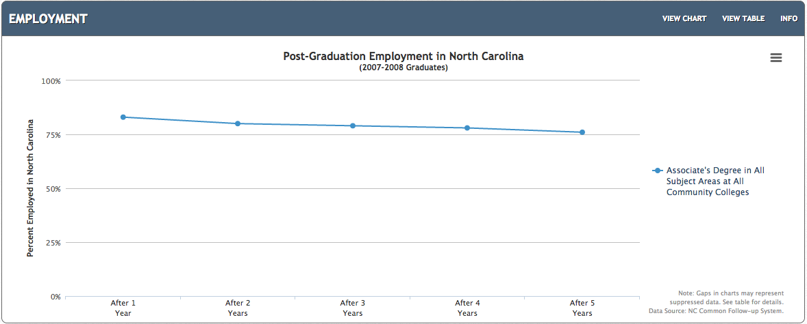
All NC Associate Degrees
83%
76%
Notes:
This shows employment for the first five years after graduation for folks who earned an Associate Degree in North Carolina.
This shows the graduates who are receiving a paycheck. It does not include independent contractors or self-employed.
Over 76 percent of the folks who earned an Associate Degree in North Carolina are still receiving a paycheck 5 years after graduation.
That’s really good.
====
http://nctower.com/output/ncccs/4506/2008/
2007-2008 graduates from all Associate Degree programs in NC

Slide 44
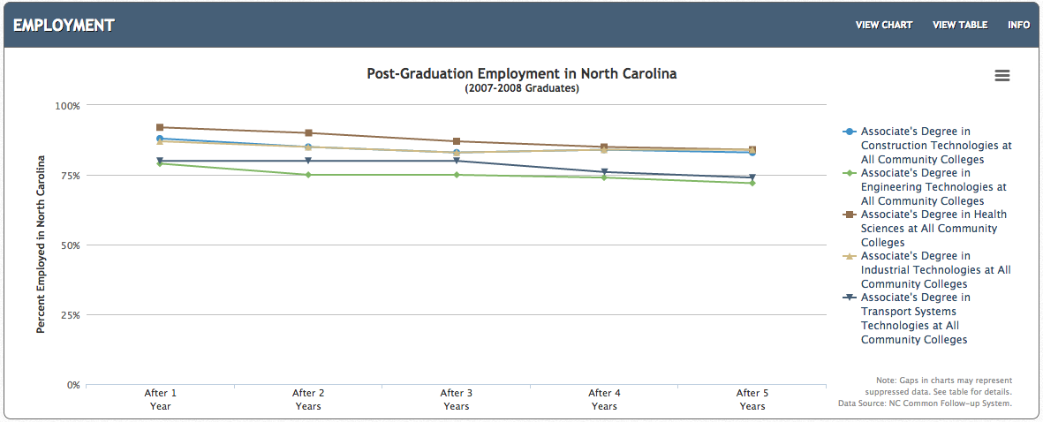
Selected NC Associate Degrees
92%
84%
79%
72%
Notes:
And if we look at some selected Associate Degree programs.
For the most part, -- they are all over 75 percent employed after five years.
Health Sciences, Construction, and Industrial Technologies are the three highest with 84 percent employment after 5 years.
Industrial Technologies is at 72 percent employment.
Still not bad.
====
http://nctower.com/output/ncccs/4840-4946-4797-4887-5059/
2007-2008 graduates from selected Associate Degree programs in NC

Slide 45
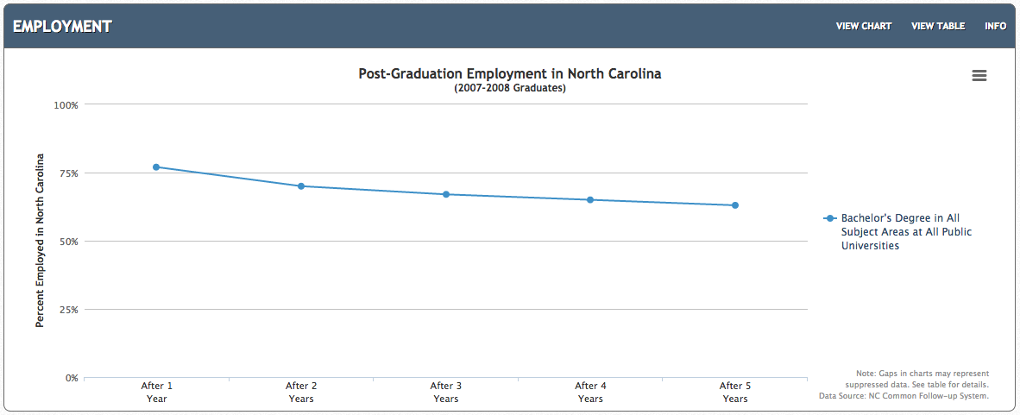
All NC Bachelor Degrees
77%
63%
Notes:
And here is the employment for the first five years out of college for Bachelor Degree graduates from our NC Public Universities.
After 5 years, 63 percent are receiving a paycheck.
====
http://nctower.com/output/unc/7810/
2007-2008 Bachelor Degree graduates from All NC Universities

Slide 46
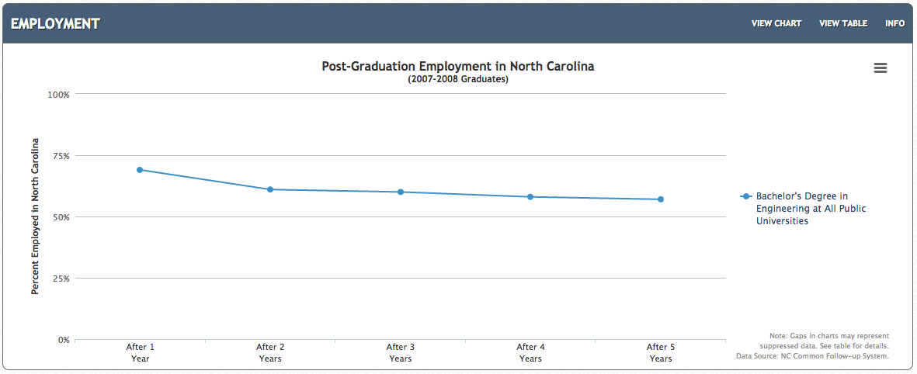
NC Engineering Bachelor Degrees
69%
57%
Notes:
If we focus just on Engineering. This is the data for all engineering graduates from all UNC campuses.
After five years of work, the employment is 57 percent. That means that almost half of the engineering graduates are not receiving a paycheck five years after graduation.
Does that mean we are graduating too many engineers, or are high schools funneling folks into engineering programs who probably should be doing something else?
Or are the engineering graduates taking jobs oversees and dropping out of the data pool?
Let’s compare this data to the folks earning the Associate Degrees.
====
http://nctower.com/output/unc/7901/
2007-2008 Bachelor Degree, Engineering graduates from All NC Universities

Slide 47
compare
69%
57%
NC Bachelor Degree – Engineering
1,297 graduates
79-92%
72-84%
NC Associate Degrees
5,310 graduates
Notes:
On top is the Bachelor of Engineering graduates
And on the bottom is the Associate Degree graduates in these five technical areas.
Notice the Bachelor of Engineering graduates start out at 69 percent employment, and after five years are at 57 percent employment.
But at the bottom of the slide -- you see that 79 to 92 percent of the graduates with an associate degree are employed right out of college.
And then after 5 years of employment, the rate is 72 to 84 percent.
This seems to indicate a high demand for folks with a technical associate degree. And less demand for graduates of a four-year engineering program.
====
http://nctower.com/output/unc/7901/
2007-2008 Bachelor Degree, Engineering graduates from All NC Universities
http://nctower.com/output/ncccs/4840-4946-4797-4887-5059/
2007-2008 graduates from selected Associate Degree programs in NC

Slide 48
77%
63%
NC Bachelor Degree
29,044 graduates
79-92%
72-84%
NC Associate Degrees
5,310 graduates
Notes:
Here at the top we see all Bachelor Degree graduates in North Carolina -- where the employment rate right out of college is 77 percent, and after five years, the employment rate is 63 percent.
On the bottom you see the same graph of our associate degree graduates.
Graduates with an Associate degree appear to stay employed at a much higher rate then the graduates with a Bachelors degree.
Be aware that this shows only folks who graduate from a North Carolina college and are employed in North Carolina, receiving a salary that pays into the unemployment insurance system.
Graduates who are self-employed, contracted employees, military or federal government employees, and people who get jobs in other states or countries, do not show up in these data.
This seems to indicate a high demand for folks with a technical associate degree. And less demand for graduates of a four-year program.
====
http://nctower.com/output/unc/7810/
2007-2008 Bachelor Degree graduates from All NC Universities
http://nctower.com/output/ncccs/4840-4946-4797-4887-5059/
2007-2008 graduates from selected Associate Degree programs in NC

Slide 49
States with Most New Jobs (Total Change in Positions Projected from 2016 - 2026)
Numeric Change
% Change
11,518,500 United States
2,136,100 Texas
1,933,100 California
1,423,390 Florida
1,219,520 New York
626,310 Washington
565,420 Colorado
542,790 Arizona
524,920 Georgia
463,610 North Carolina
433,700 Utah
417,700 Virginia
366,400 Illinois
355,760 Tennessee
352,730 New Jersey
342,030 Pennsylvania
320,910 Michigan
274,670 Massachusetts
268,690 Nevada
256,330 South Carolina
253,340 Ohio
246,590 Oregon
240,210 Indiana
219,990 Missouri
211,290 Maryland
210,170 Wisconsin
181,600 Minnesota
168,150 Louisiana
154,730 Iowa
146,970 Alabama
143,010 Arkansas
130,840 Oklahoma
128,930 Kentucky
111,160 Connecticut
100,490 Nebraska
93,870 Idaho
63,720 Kansas
63,240 Mississippi
60,280 District of Columbia
57,580 New Mexico
54,790 North Dakota
45,540 Hawaii
42,100 New Hampshire
41,890 West Virginia
39,890 Montana
33,070 South Dakota
30,470 Rhode Island
28,680 Delaware
27,700 Wyoming
17,010 Alaska
10,900 Guam
10,390 Vermont
100 Maine
-420 Virgin Islands
-12,660 Puerto Rico
29.1 Utah
20.4 Colorado
19.9 Nevada
18.6 Arizona
17.4 Guam
17.0 Washington
16.6 Texas
15.7 Florida
13.7 Idaho
12.4 Oregon
12.0 New York
11.7 Georgia
11.6 South Carolina
11.4 North Dakota
11.2 Tennessee
10.7 California
10.4 Arkansas
10.2 Virginia
10.1 North Carolina
9.4 Wyoming
8.9 Nebraska
8.5 Iowa
8.3 Louisiana
8.2 New Jersey
8.0 Montana
7.7 Maryland
7.6 Indiana
7.6 District of Columbia
7.4 United States
7.4 Massachusetts
7.4 Oklahoma
7.3 Missouri
7.0 Michigan
6.9 Alabama
6.8 Wisconsin
6.8 South Dakota
6.7 New Mexico
6.5 Kentucky
6.4 Hawaii
6.1 New Hampshire
6.1 Delaware
5.9 Minnesota
5.9 Connecticut
5.9 Rhode Island
5.8 Illinois
5.5 Pennsylvania
5.5 West Virginia
5.2 Mississippi
5.1 Alaska
4.4 Ohio
4.3 Kansas
2.8 Vermont
0.0 Maine
-1.2 Virgin Islands
-1.2 Puerto Rico
Notes:
Here you can compare the states with the most projected job openings.
On the left you see the number of job openings projected over the ten years for each state or territory.
On the right you see the percentage change in jobs over the ten years for each state or territory.
All of the states are listed, they just fall off the bottom of the slide.
Some states are predicting a large number of job openings, but for our highly populated states, it might not be a large percentage of jobs based on the size of the population.
You see states that I have highlighted in blue. They are near the top of both sides.
That means they are expecting a large number of job openings, which is also a large percentage of their current workforce. Those are the states that are growing the fastest.
You see my home state of North Carolina on the left. Projected to have the ninth most number of new jobs. We were ranked eighth last year.
Georgia jumped ahead of North Carolina this year. Who's from Georgia?
At the bottom of the list is the first time I have seen a negative number. In Puerto Rico they need 12 thousand less workers over the ten year projection period. The Virgin Islands also has a negative projection.
In reality they need the workers, there are just not any official job openings.
The state with the least job openings projected is Maine needing only 100 new workers over the ten-year period.
============
http://projectionscentral.com/Projections/LongTerm
“Total, All Occupations” for each state.
“Numeric Employment Change” is the number of new jobs projected over the ten year period.
www.projectionscentral.com/

Slide 50
Notes:
If you Google “Hot Jobs,” you will be overwhelmed with lots of lists of what someone considers to be jobs that are in high demand.
=====
http://hhstaffingservices.com/wp-content/uploads/2013/02/hot-jobs-icon.jpg
http://hhstaffingservices.com/job-seekers/hot-jobs-list-will-pay-cash-referral-bonus/

Slide 51
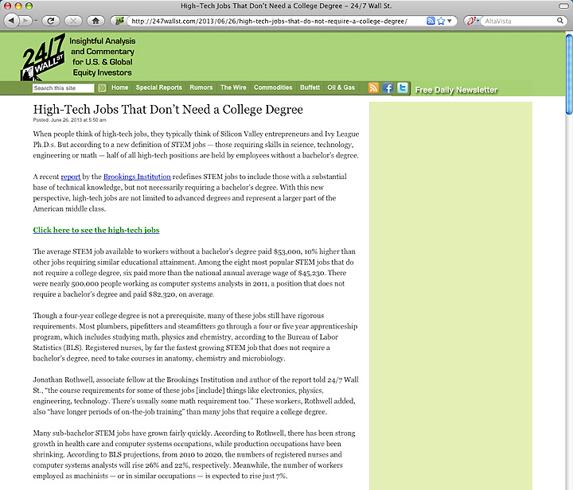
1. Registered Nurses
2. Automotive Service Technicians and Mechanics
3. Carpenters
4. Electricians
5. Computer Systems Analysts
6. Machinists
7. Plumbers, Pipefitters, Steamfitters
8. Welders, Cutters, Solderers and Brazers
Notes:
This hot job list shows the top jobs that don’t require a four-year degree.
====
The average STEM job available to workers without a bachelor’s degree paid $53,000, 10% higher than other jobs requiring similar educational attainment.
1. Registered Nurses
2. Automotive Service Technicians and Mechanics
3. Carpenters
4. Electricians
5. Computer Systems Analysts
6. Machinists
7. Plumbers, Pipefitters, Steamfitters
8. Welders, Cutters, Solderers and Brazers
====
http://247wallst.com/2013/06/26/high-tech-jobs-that-do-not-require-a-college-degree/
High-Tech Jobs That Don’t Need a College Degree
Read more: High-Tech Jobs That Don’t Need a College Degree - 24/7 Wall St. http://247wallst.com/2013/06/26/high-tech-jobs-that-do-not-require-a-college-degree/#ixzz2XQ7hpswB
June 26, 2013
The average STEM job available to workers without a bachelor’s degree paid $53,000, 10% higher than other jobs requiring similar educational attainment. Among the eight most popular STEM jobs that do not require a college degree, six paid more than the national annual average wage of $45,230. There were nearly 500,000 people working as computer systems analysts in 2011, a position that does not require a bachelor’s degree and paid $82,320, on average.
Though a four-year college degree is not a prerequisite, many of these jobs still have rigorous requirements. Most plumbers, pipefitters and steamfitters go through a four or five year apprenticeship program, which includes studying math, physics and chemistry, according to the Bureau of Labor Statistics (BLS). Registered nurses, by far the fastest growing STEM job that does not require a bachelor’s degree, need to take courses in anatomy, chemistry and microbiology.
Read more: High-Tech Jobs That Don’t Need a College Degree - 24/7 Wall St. http://247wallst.com/2013/06/26/high-tech-jobs-that-do-not-require-a-college-degree/#ixzz2XQ7ptbo3

Slide 52
10 Hardest to Fill Jobs in America
Notes:
Here is a list of the top ten hardest-to-fill jobs.
Teachers are on the list at number ten.
Teachers of all kinds are the occupation that requires a bachelor degree -- that is in the highest demand.
======
Forbes recently looked at the 10 Hardest to Fill Jobs in America
===
http://www.forbes.com/sites/jacquelynsmith/2013/05/28/the-10-hardest-jobs-to-fill-in-2013/

Slide 53
10 Hardest to Fill Jobs in America
Notes:
Mechanics are in high demand. We depend on our cars and want them fixed fast and correctly.
Top mechanics can make over $100,000 working at the large dealerships.
======
Forbes recently looked at the 10 Hardest to Fill Jobs in America
===
http://www.forbes.com/sites/jacquelynsmith/2013/05/28/the-10-hardest-jobs-to-fill-in-2013/

Slide 54
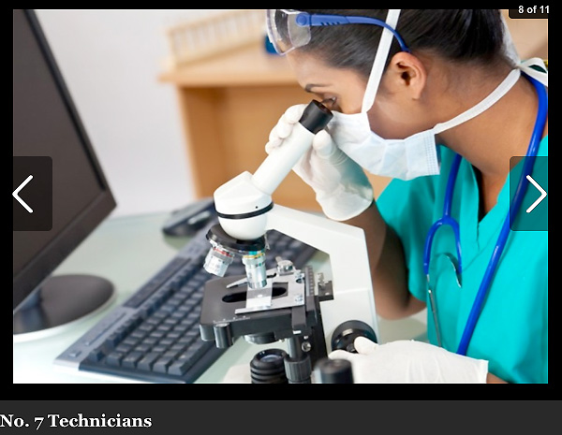
10 Hardest to Fill Jobs in America
Notes:
Technicians are in high demand.
This is the Science and Technology side of the STEM that we keep hearing about.
======
Forbes recently looked at the 10 Hardest to Fill Jobs in America
===
http://www.forbes.com/sites/jacquelynsmith/2013/05/28/the-10-hardest-jobs-to-fill-in-2013/

Slide 55
10 Hardest to Fill Jobs in America
Notes:
One reason that skilled trades are in high demand is because years ago we started discouraging kids from going into blue-collar jobs.
And now that we are coming out of the recession, -- the building boom is beginning with no one to do the work.
======
Forbes recently looked at the 10 Hardest to Fill Jobs in America
===
http://www.forbes.com/sites/jacquelynsmith/2013/05/28/the-10-hardest-jobs-to-fill-in-2013/

Slide 56
Notes:
Lots of folks left the construction industry during the recession.
Now the construction industry is working to rebuild their labor pool.
The problem is that there are not enough folks in the pipeline training for jobs in the construction industry.
Lots of high schools have dropped their construction programs, and most community colleges have moved construction to Continuing Education.
How do we get more folks to consider careers in construction?
===
http://constructionlabor.com/construction-demand-is-outpacing-skilled-labor/

Slide 57
Top 10 Job Titles that Didn’t Exist Five Years Ago
Notes:
You’ve heard about the cloud … Now someone has to maintain it and keep it going.
I found this list of Top Ten Job Titles that Didn’t Exist Five Years Ago.
My dad spent his whole career working on clouds, but then he was a meteorologist. The clouds have changed.
=====
http://talent.linkedin.com/blog/index.php/2014/01/top-10-job-titles-that-didnt-exist-5-years-ago-infographic
Top 10 Job Titles That Didn’t Exist 5 Years Ago
Methodological details: We counted the frequencies of all English words and phrases used in job titles that were held in 2013 and compared the results to job titles that were held in 2008. We then took the top titles that saw the largest growth in frequency in that 5 year period and ranked them by their relative size in 2013. “Big data” and “cloud services” were the root phrases used to determine frequencies for “big data architect” and “cloud services manager” (which had many permutations, e.g. “big data architect/analyst/engineer” etc.). For simplicity’s sake, the titles you see above were used as examples. Data is current as of November 26, 2013.

Slide 58
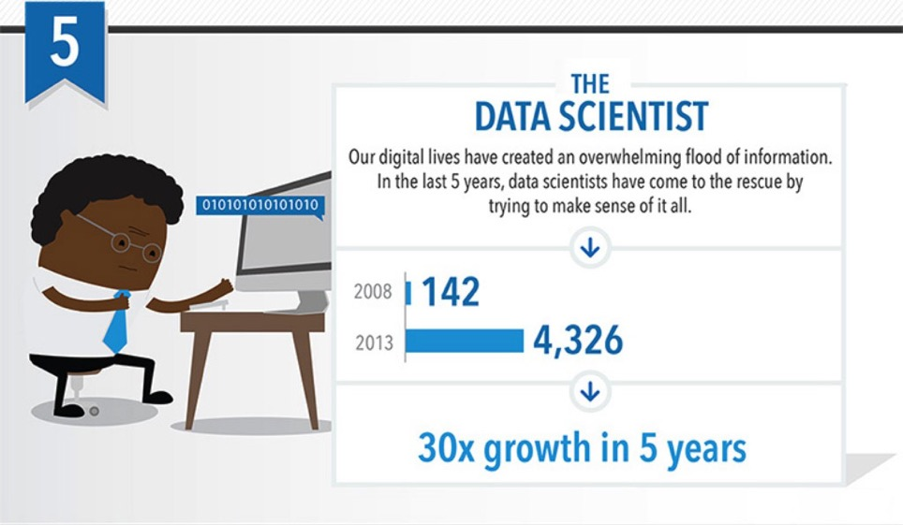
Top 10 Job Titles that Didn’t Exist Five Years Ago
Notes:
Someone needs to take all that data we’ve collected and turn it into information.
That’s the Data Scientist.
=====
http://talent.linkedin.com/blog/index.php/2014/01/top-10-job-titles-that-didnt-exist-5-years-ago-infographic
Top 10 Job Titles That Didn’t Exist 5 Years Ago
Methodological details: We counted the frequencies of all English words and phrases used in job titles that were held in 2013 and compared the results to job titles that were held in 2008. We then took the top titles that saw the largest growth in frequency in that 5 year period and ranked them by their relative size in 2013. “Big data” and “cloud services” were the root phrases used to determine frequencies for “big data architect” and “cloud services manager” (which had many permutations, e.g. “big data architect/analyst/engineer” etc.). For simplicity’s sake, the titles you see above were used as examples. Data is current as of November 26, 2013.

Slide 59
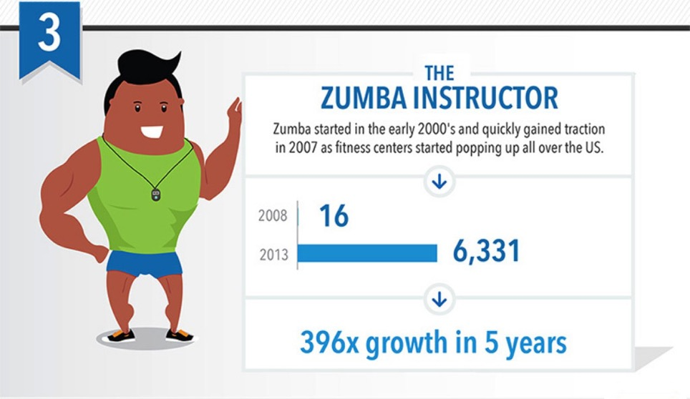
Top 10 Job Titles that Didn’t Exist Five Years Ago
Notes:
Look! It’s a high demand job that does not require a computer!
Raise your hand if you Zumba.
Sometimes we need to get away from our computers for a little while, and that’s why Zumba instructors are in high demand.
=====
http://talent.linkedin.com/blog/index.php/2014/01/top-10-job-titles-that-didnt-exist-5-years-ago-infographic
Top 10 Job Titles That Didn’t Exist 5 Years Ago
Methodological details: We counted the frequencies of all English words and phrases used in job titles that were held in 2013 and compared the results to job titles that were held in 2008. We then took the top titles that saw the largest growth in frequency in that 5 year period and ranked them by their relative size in 2013. “Big data” and “cloud services” were the root phrases used to determine frequencies for “big data architect” and “cloud services manager” (which had many permutations, e.g. “big data architect/analyst/engineer” etc.). For simplicity’s sake, the titles you see above were used as examples. Data is current as of November 26, 2013.

Slide 60
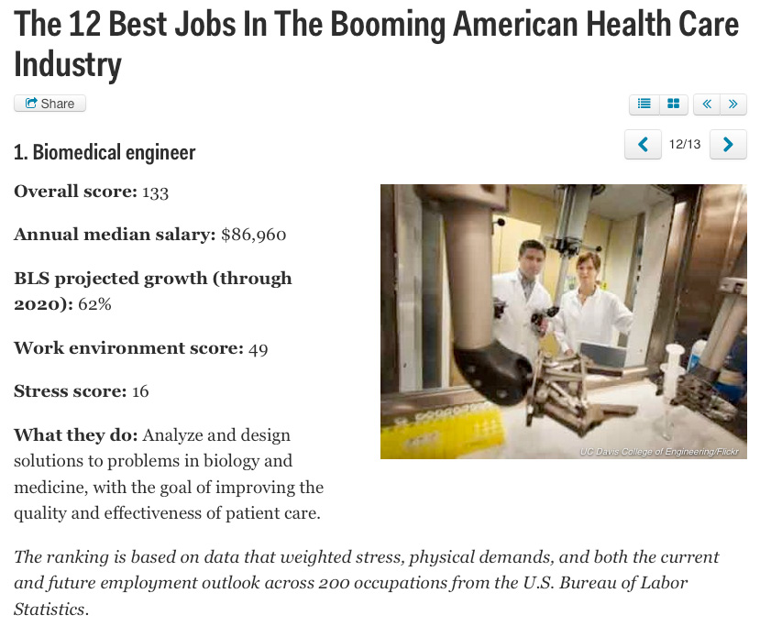
Notes:
New forms of engineering emerge every year.
The Biomedical Engineer combines engineering principals with medicine and biology to create better healthcare for all of us.
=====
http://www.businessinsider.com/best-health-care-jobs-2013-12
The 12 Best Jobs In The Booming American Health Care Industry
To find out which jobs offer the best opportunities in health care, job search site CareerCast analyzed survey data that weighed stress, physical demands, and both the current and future employment outlook of 200 occupations.
"What's similar for the jobs on this list, with the exception of biomedical engineer, is that they work individually one-on-one with another person," Tony Lee, publisher at CareerCast.com, tells Business Insider. "When you're working with someone else, the job satisfaction is pretty high because you see someone often and they're giving you feedback, as opposed to having very few people thanking you."
Lee predicts that the need for these professionals will last for years to come. "Baby boomers are entering retirement, and as our body ages, the type of medical professionals that are needed to help people deal with that are going to be in greater demand."
The overall score for each job takes into account the pay; hiring outlook; stress; emotional factors, including the level of competitiveness and degree of public contact; and physical demands, such as stamina required and work conditions, that normally come with a job. Once the categories are combined, a lower overall score signals that the job is more desirable to employees.
Definition: http://en.wikipedia.org/wiki/Biomedical_engineer

Slide 61
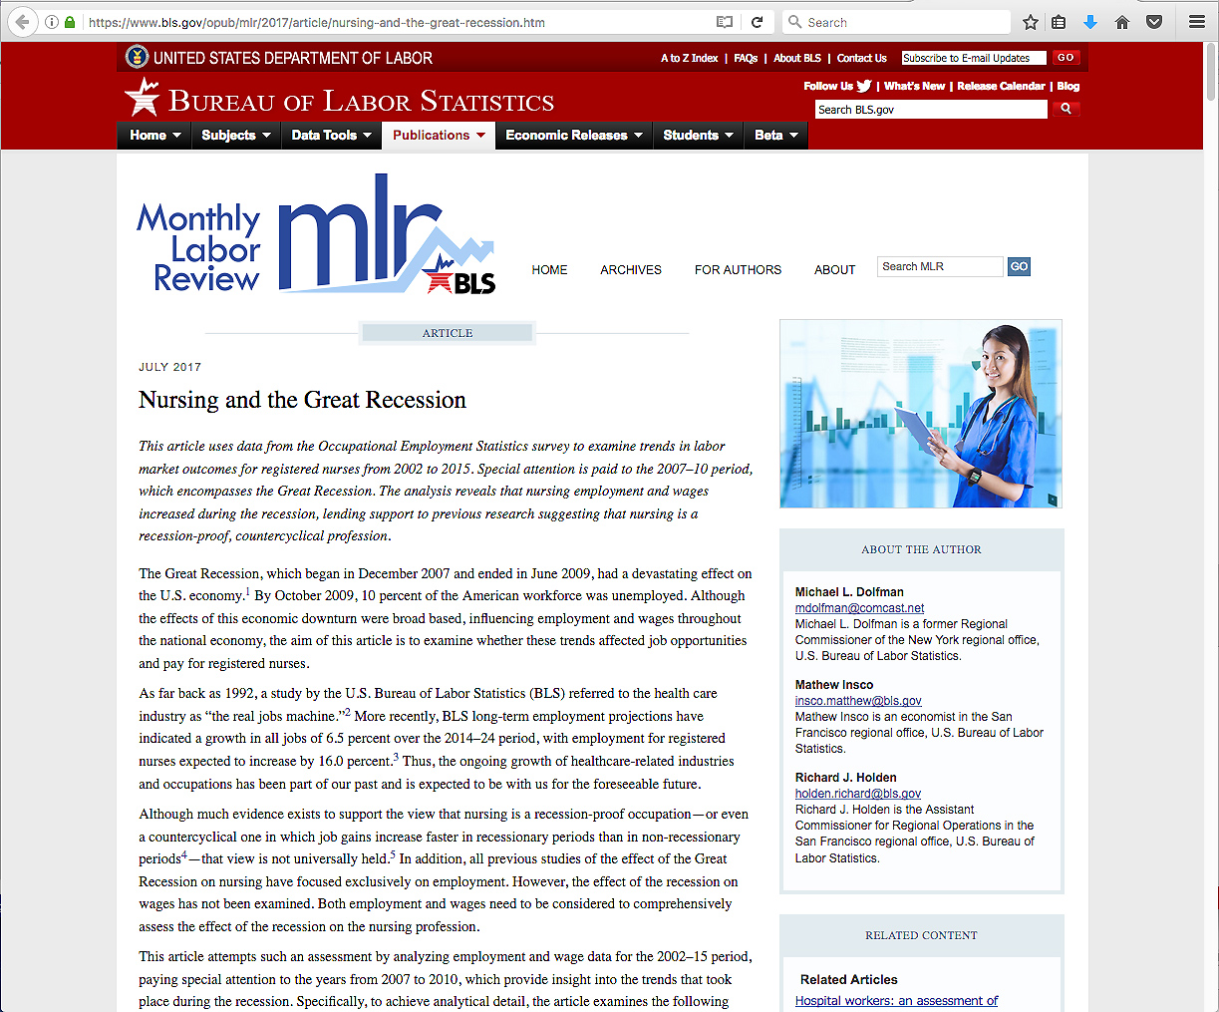
Notes:
Nursing, as well as the rest of the healthcare industry, weathered the recession better than any other segment of industry.
And the demand is great for Nursing and other allied health professionals.
====
https://www.bls.gov/opub/mlr/2017/article/nursing-and-the-great-recession.htm

Slide 62
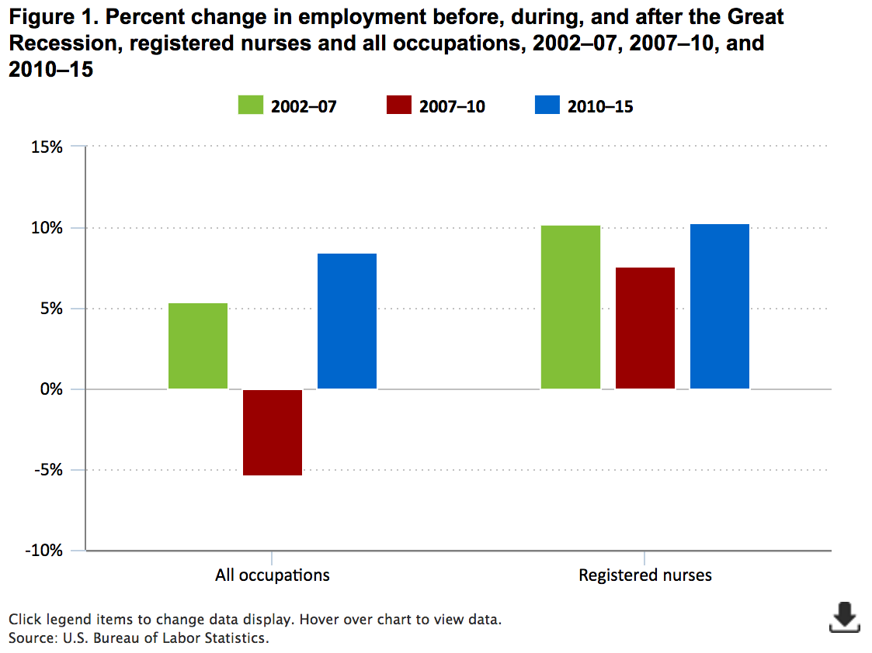
10.2%
10.3%
8.5%
7.6%
5.4%
-5.4%
Notes:
We are looking here at the change in employment over three time periods.
Green is before the recent recession, red is during the recession, and blue is after the recession.
On the left side of the screen you see the data for all occupations. On the right you see the data for registered nurses.
If you focus on the two red rectangles, which represent change in employment during the recession. You see that there was a negative 5.4 percent drop in employment overall, whereas there was a positive increase of 7.6 percent for Registered Nurses.
What this says, is that lots of folks lost their jobs during the recession, however folks employed in healthcare, specifically Registered Nurses, did not get hit hard by the recession. They kept hiring new employees.
The recession had little impact on the healthcare industry.
So if you ae working with folks who are looking for a stable career, healthcare might be their best choice.
=====
https://www.bls.gov/opub/mlr/2017/article/nursing-and-the-great-recession.htm
Nursing employment in the United States
During the 2002–15 period, employment of registered nurses across the nation increased by 689,280, or 30.8 percent. By contrast, over the same timeframe, the nation’s economy added 10,372,900 jobs—a growth rate of 8.1 percent. Thus, during this 13-year period, 6.6 percent of net national job growth (about 1 out of every 15 new jobs) was due to the increase in registered nursing employment.
In the national economy, however, job growth was anything but steady. National employment increased by 6,830,490 (5.4 percent) between 2002 and 2007, decreased by 7,257,090 (−5.4 percent) between 2007 and 2010, and increased by 10,799,500 (8.5 percent) between 2010 and 2015. (See figure 1.)
In contrast to the uneven national job picture, employment growth among registered nurses was steady, averaging more than 50,000 new jobs each year between 2002 and 2015. This increase, coupled with the marked fluctuation in national employment, affected the national job picture. In 2002, jobs for registered nurses represented 1.8 percent of the national job base. By 2015, this percentage had reached more than 2 percent, meaning that about 2 out of every 100 jobs in the country were in registered nursing.
As noted earlier, focusing only on the recessionary years between 2007 and 2010, which encompasses the Great Recession, suggests that the national economy lost 7,257,090 million jobs—an employment decline of 5.4 percent. By contrast, employment of registered nurses moved in the opposite direction, increasing by 186,680, or 7.6 percent, over the same period.

Slide 63
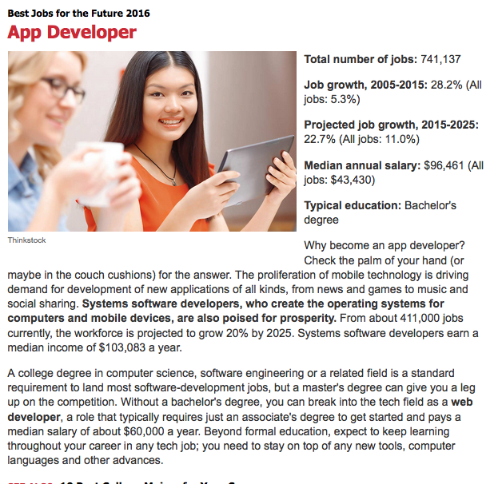
Notes:
We can’t get enough of those smart phone apps, -- and someone has to create them.
=======
http://www.kiplinger.com/slideshow/business/T012-S001-best-jobs-for-the-future-2016/index.html

Slide 64
Notes:
It seems that we hear about some kind of data breach every day.
Keeping up with the criminals is a job that is in high demand.
=======
http://www.kiplinger.com/slideshow/business/T012-S001-best-jobs-for-the-future-2016/index.html

Slide 65
Notes:
As the population gets older and lives longer, there is more potential for personal breakage.
And someone has to help us get back on our feet.
=======
http://www.kiplinger.com/slideshow/business/T012-S001-best-jobs-for-the-future-2016/index.html

Slide 66
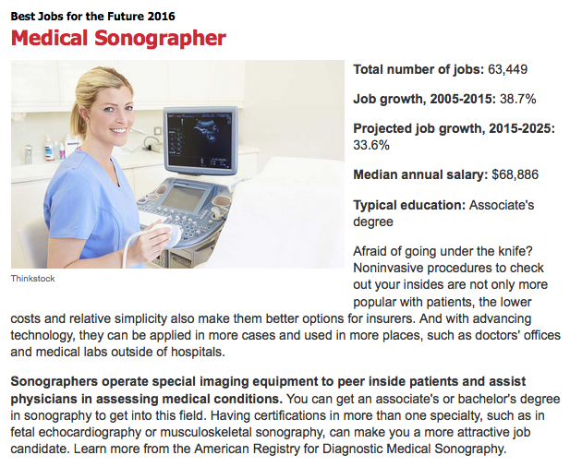
Notes:
The sonographer uses ultrasound, a process of sending sound waves through your body to allow the doctors to know what’s going on inside.
It’s not just for looking at unborn babies, there are many uses of sonography.
My doctor used it on me to look inside my head.
There were no babies in there!
I do predict a huge demand for sonographers in many industries other than Healthcare. Like looking into materials like steel and concrete.
=======
http://www.kiplinger.com/slideshow/business/T012-S001-best-jobs-for-the-future-2016/index.html

Slide 67
Notes:
For only two years of college, you can start at a very high salary.
That is, if you don’t mind putting your hands in other people’s mouths.
But you do have Fridays off.
And the dental hygienists will be in high demand for many years to come.
=======
http://www.kiplinger.com/slideshow/business/T012-S001-best-jobs-for-the-future-2016/index.html

Slide 68
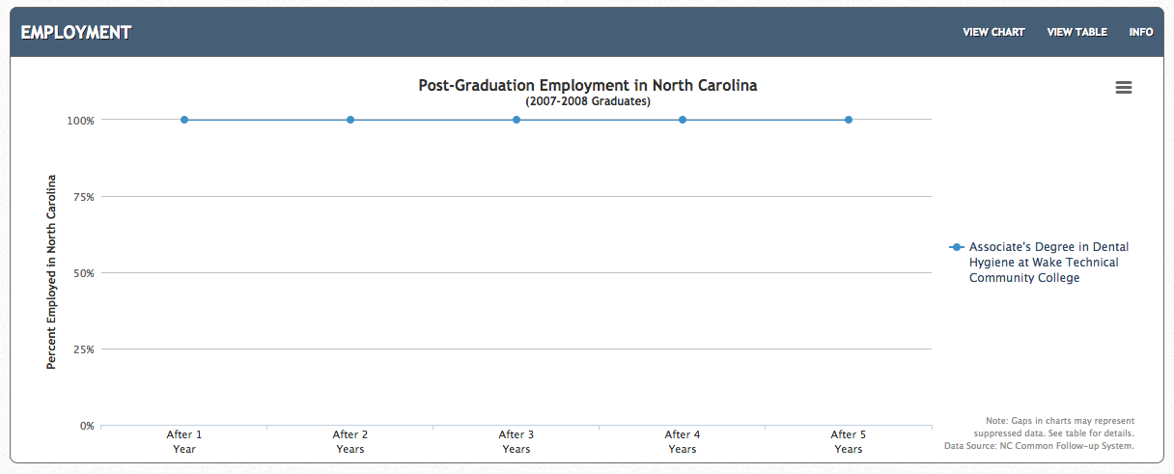
Associate Degree - Dental Hygiene Wake Tech CC
Notes:
Here is an example.
Wake Tech Community College
Associate Degree in Dental Hygiene
You might not see that line, since it is at the very top of the chart, but is says that
100 percent of the graduates are employed five years after graduation.
======
http://nctower.com/output/ncccs/6725/2008/

Slide 69
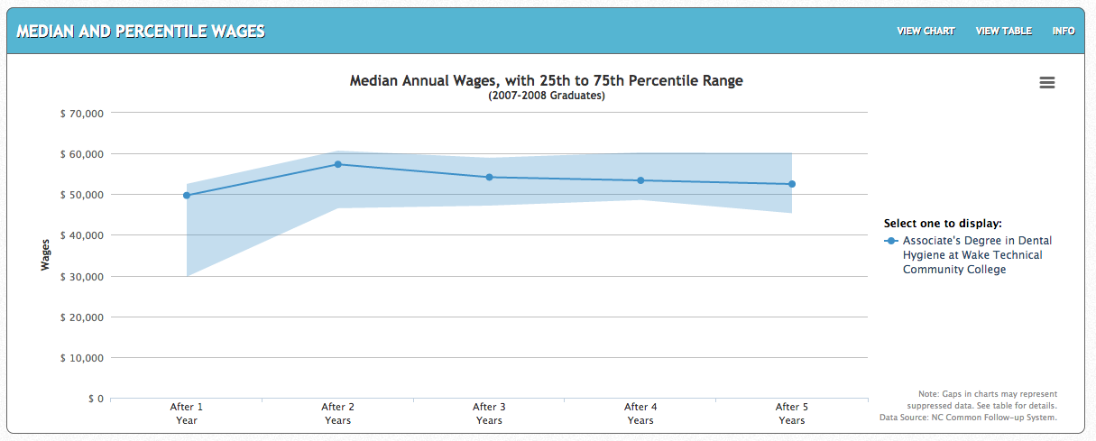
Associate Degree - Dental Hygiene Wake Tech CC
Notes:
Wake Tech Community College
Associate Degree in Dental Hygiene
Right out of college the median salary is right at 50 thousand.
The shaded area shows that many are making as much as 60 thousand dollars
Dental hygienists have been in high demand for many years.
And the pay is above average for an Associate Degree.
In the past most dental hygienists were hourly, working at multiple dentist offices to make up a full work week.
The trend now is to hire a full-time hygienist who now gets benefits.
And if you don't mind moving to Alaska, there the Dental Hygienists start at 82 thousand dollars, and the experienced Dental Hygienists make over 125 thousand dollars, and there is a high demand.
Not bad for a two-year degree from a community college.
======
Wake Tech data
http://nctower.com/output/ncccs/6725/2008/
Alaska data
http://www.careeroutlook.us/career.php?id=292021&st=AK

Slide 70
Surprises Future Demand Legal Scenarios Changing World New Ideas Career Planning
www.ncPerkins.org/presentations
Notes:
Let's talk about the law

Slide 71
Notes:
Let's look at some common youth offenses and their consequences.
A colleague developed this assessment about ten years ago, and we have tried to keep it up to date.
Today, we are going to look at only 15 of the 30 questions. I have posted another PowerPoint with all 30 questions that you can use with the folks with whom you work to educate them on consequences of actions.
I hope you download this PowerPoint and use it with your youth.
Their future depends on them knowing not just right from wrong, but that there are consequences to their actions.
Share this with the parents, teachers, community members. Everyone.
We used to share this with PTA groups and the phones lit up at the end of the presentation with parents telling their children to "stay home until I get there. We need to talk."
=====
photo
https://adam1cor.files.wordpress.com/2014/04/youth-offences.jpg

Slide 72
General Law
3. Which of the following is a misdemeanor?
Underage drinking charge
Use of marijuana
Shoplifting
Drinking and driving
(Some questions may have more than one answer)
Notes:
Question number 3
This assessment is based on federal as well as North Carolina laws. The laws of other states may be similar or may be very different.
In some of these questions, there will be more than one correct answer.
I'll give you about 30 seconds to talk amongst yourselves and select the correct answer or answers.
→
Correct answer(s): A,B,C,D
----
All of these are misdemeanors.
Misdemeanors are less-serious crimes that typically involve no prison time -- or prison terms less than a year and small fines. Felonies are more serious crimes, which involve prison terms over a year and larger fines.
On answer B. In North Carolina, you need 1.5 ounces of Marijuana to move from misdemeanor to felony. More on that in a later question.
=======
Special Thanks to:
Manning & Crouch, Attorneys at Law, Raleigh, NC
Megan Kirkpatrick
http://www.halecriminallaw.com/Criminal-Law/Felonies-Misdemeanors/Misdemeanors-Explained.shtml
http://www.ncdoj.gov/getdoc/60bb12ca-47c0-48cb-a0e3-6095183c4c2a/Class-B-Misdemeanor-Manual-2005.aspx
Felony
http://www.nccourts.org/courts/crs/councils/spac/documents/2003felonyoffenseclassificationlist.pdf
Chris Droessler
CTE Coordinator
NC Community Colleges
DroesslerC@NCCommunityColleges.edu

Slide 73
General Law
5.) An average attorney fee for a misdemeanor is approximately:
$ 500
$ 750
$1,250
$2,000
(Some questions may have more than one answer)
Notes:
Question number 5
→
Correct answer(s): C
This is the average fee, which of course could be higher or lower depending on where you are in the state, urban vs. rural, and the experience of the lawyer.
Many folks worry about the jail time or the court fines, but if you want to get the best representation in court, then you need to hire a competent lawyer to walk you through the legal process.
See if you can find a lawyer in your area who can help you to update these questions to match your local fees and laws.
======
Special Thanks to:
Manning & Crouch, Attorneys at Law, Raleigh, NC
Megan Kirkpatrick
Chris Droessler
CTE Coordinator
NC Community Colleges
DroesslerC@NCCommunityColleges.edu

Slide 74
General Law
6. Having a misdemeanor on your record could prevent you from being:
Accepted into college
Granted a loan
Hired by an employer
Accepted into the military
(Some questions may have more than one answer)
Notes:
Question number 6
→
Correct answer(s): A,B,C,D
If you have any criminal record, do not look at jobs in the military, healthcare, law enforcement, and education.
They do not want you, and typically don’t care how long you have been clean.
Public colleges can not discriminated due to criminal background.
Military can grant waivers if you ask.
Crimes committed before age 18 do not count.
Even a single misdemeanor on your record can hold you back the rest of your life.
====
Special Thanks to:
Manning & Crouch, Attorneys at Law, Raleigh, NC
Megan Kirkpatrick
Army disqualifiers
http://army.com/info/usa/disqualifiers
Federal student aid
https://studentaid.ed.gov/sa/eligibility/criminal-convictions
Employment
http://www.collegiatetimes.com/news/virginia_tech/misdemeanors-affect-job-prospects-study-shows/article_c2b13db8-ed70-5cfb-9c5f-3b9bb485cada.html
http://career.csi.edu/careerCenter/conviction.asp
Chris Droessler
CTE Coordinator
NC Community Colleges
DroesslerC@NCCommunityColleges.edu

Slide 75
General Law
7. Which of the following are considered a felony?
Breaking and entering into a motor vehicle or home
Growing marijuana or selling 1 or more grams of marijuana
Damaging mailboxes
Stealing anything having a value of $1,000 or more
(Some questions may have more than one answer)
Notes:
Question number 7
→
Correct answer(s): A,B,C,D
All of them
For A. B&E into a home is felony only if you intend to steal property or harm the occupant. If you break into a house just to watch the television, then it is a misdemeanor.
For answer B = In North Carolina you need 1.5 ounces (about 42 grams, which could be more than 50 joints) of Marijuana to move from misdemeanor to felony. This amount varies wildly from state to state.
Growing is a misdemeanor, but selling is a felony.
The key here is that selling of any amount of a controlled substance is a felony.
======
Special Thanks to:
Manning & Crouch, Attorneys at Law, Raleigh, NC
Megan Kirkpatrick
http://www.nccourts.org/courts/crs/councils/spac/documents/2003felonyoffenseclassificationlist.pdf
Mailbox
https://www.law.cornell.edu/uscode/text/18/1705
federal law (Title 18, United States Code, Section 1705)
https://www.gpo.gov/fdsys/pkg/USCODE-2011-title18/pdf/USCODE-2011-title18-partI-chap83-sec1705.pdf
Marijuana
http://www.drugtreatment.com/expose/marijuana-felony-amounts-by-state/
http://www.ncga.state.nc.us/enactedlegislation/statutes/html/bychapter/chapter_90.html
Stolen Goods
http://www.ncga.state.nc.us/enactedlegislation/statutes/html/bysection/chapter_14/gs_14-72.html
Athletics policy
http://youthjusticenc.org/2016/05/17/opportunity-lost-north-carolina-high-school-athletics-association-felony-ban/
Chris Droessler
CTE Coordinator
NC Community Colleges
DroesslerC@NCCommunityColleges.edu

Slide 76
General Law
7. Which of the following are considered a felony?
Breaking and entering into a motor vehicle or home
Growing marijuana or selling 1 or more grams of marijuana
Damaging mailboxes
Stealing anything having a value of $1,000 or more
(Some questions may have more than one answer)
Notes:
For answer C - mailbox vandalism
If we look at this in relation to answer D, we see that in North Carolina, the damage must be over $1,000 to be considered a felony. Take into account the cost of the mailbox, and the costs of replacing the mailbox, you may not hit the $1,000 mark for a single mailbox. But if you damage more then one mailbox in one night, you might hit the $1,000 mark.
While we have to buy our own mailboxes, once it is installed, it falls under the jurisdiction of the federal government, so federal postal laws apply. It is a federal offence to vandalize a mailbox. Violators can be fined up to $250,000 or imprisoned for up to three years for each act of vandalism. This is a case where the federal law may have a harsher penalty than the local laws.
For D. -- the amount varies from state to state, but in North Carolina if the value if the stolen goods is more than $1000, then it is a felony.
One penalty for being convicted of a felony in North Carolina -- is that you will be banned from high school athletics. It doesn’t matter at what age you commit the crime, a felony conviction eliminates you from all high school athletics.
Do our middle- and high-school students know that?
======
Special Thanks to:
Manning & Crouch, Attorneys at Law, Raleigh, NC
Megan Kirkpatrick
http://www.nccourts.org/courts/crs/councils/spac/documents/2003felonyoffenseclassificationlist.pdf
Mailbox
https://www.law.cornell.edu/uscode/text/18/1705
federal law (Title 18, United States Code, Section 1705)
https://www.gpo.gov/fdsys/pkg/USCODE-2011-title18/pdf/USCODE-2011-title18-partI-chap83-sec1705.pdf
Marijuana
http://www.drugtreatment.com/expose/marijuana-felony-amounts-by-state/
http://www.ncga.state.nc.us/enactedlegislation/statutes/html/bychapter/chapter_90.html
Stolen Goods
http://www.ncga.state.nc.us/enactedlegislation/statutes/html/bysection/chapter_14/gs_14-72.html
Athletics policy
http://youthjusticenc.org/2016/05/17/opportunity-lost-north-carolina-high-school-athletics-association-felony-ban/
Chris Droessler
CTE Coordinator
NC Community Colleges
DroesslerC@NCCommunityColleges.edu

Slide 77
General Law
8. Once you have a criminal record, you must list convictions for the rest of your life on:
College applications
Loan applications
Employment applications
Credit card applications
(Some questions may have more than one answer)
Notes:
Question number 8
→
Correct answer(s): A,C
You must report any criminal convictions on college applications and employment applications.
Except expungements, pardons, or certificate of relief. Those do not count.
If you want a car loan or a credit card, -- Most lenders do not do a criminal background check.
They won’t ask for it on the application, but they can deny a loan or credit card based on a criminal record if they discover it.
It is too easy these days to do a criminal background check on the Internet.
=======
Special Thanks to:
Manning & Crouch, Attorneys at Law, Raleigh, NC
Megan Kirkpatrick
Chris Droessler
CTE Coordinator
NC Community Colleges
DroesslerC@NCCommunityColleges.edu

Slide 78
Injury to Real Property
12. What you might consider a “prank” could actually be a misdemeanor crime.
Which of these actions could give you a criminal record?
Egging a house or car
Keying (scratching) a car’s paint
Slashing a tire
Toilet papering property
(Some questions may have more than one answer)
Notes:
Question number 12
→
Correct answer(s): A,B,C,D
All are illegal.
And depending on the car, the cost to repaint a car might cost more than $1,000, which would move the crime to a felony.
======
Special Thanks to:
Manning & Crouch, Attorneys at Law, Raleigh, NC
Megan Kirkpatrick
Chris Droessler
CTE Coordinator
NC Community Colleges
DroesslerC@NCCommunityColleges.edu

Slide 79
Drugs & Alcohol
13. A misdemeanor drug charge could prevent you from gaining employment in which of the following career paths?
Pilot
Nurse
A Federal Position
Law Enforcement
(Some questions may have more than one answer)
Notes:
Question number 13
→
Correct answer(s): A,B,C,D
Not just a nurse, but anything in the healthcare industry. Even the plumber at the hospital needs a clean drug record.
The military will not take you unles you apply for and are granted a wavier.
And be careful who you let ride in your car. If your friends stash their drugs in your car, then in the eyes of the law, the drugs belong to you.
======
Special Thanks to:
Manning & Crouch, Attorneys at Law, Raleigh, NC
Megan Kirkpatrick
Chris Droessler
CTE Coordinator
NC Community Colleges
DroesslerC@NCCommunityColleges.edu

Slide 80
Drugs & Alcohol
15. If you are under 21 and convicted of a DWI, what are the possible consequences?
Lose driving privileges for 1 year
Be able to drive to your job, only
Your car insurance could increase 200% for one year
Your car insurance could increase 400% for three years
(Some questions may have more than one answer)
Notes:
Question number 15
→
Correct answer(s): A,D
If you are under 21 and get stopped with any alcohol in your system, caught purchasing alcohol, help someone purchase alcohol, use a fake ID to purchase alcohol --
you loose your driver license immediately -- and then for one year after the trial.
And then there are the fines, court costs, and possible community service.
And your car insurance could skyrocket.
And even if you decide to not drive for three years to avoid the high rate, the insurance company will patiently wait and start charging you the higher rate when you decide to start driving again. Even if you change insurance companies.
======
Special Thanks to:
Manning & Crouch, Attorneys at Law, Raleigh, NC
Megan Kirkpatrick
http://www.dmv.org/nc-north-carolina/automotive-law/dui.php
Chris Droessler
CTE Coordinator
NC Community Colleges
DroesslerC@NCCommunityColleges.edu

Slide 81
Drugs & Alcohol
17. A typical speeding ticket averages approximately $200 in attorney fees.
However, an attorney fee for your first DWI could cost:
$ 500 - $1,000
$ 800 - $1,000
$1,500 - $2,500
$2,500 - $3,500
(Some questions may have more than one answer)
Notes:
Question number 17
→
Correct answer(s): C
This is just for the attorney fee.
On top of that are the fees for license restoration, limited-time driving privilege, ignition interlock, court fees, jail fees, community service fee, lab fees, probation supervision fee, assessments, treatments, and more.
All that verses a $20 cab ride.
===
Special Thanks to:
Manning & Crouch, Attorneys at Law, Raleigh, NC
Megan Kirkpatrick
http://www.kirkkirklaw.com/legal-resources/how-much-will-my-dwi-cost-me/
https://mathesonlawoffice.com/raleigh-dwi-lawyer/
http://www.minicklaw.com/dwi-costs-in-north-carolina/
Chris Droessler
CTE Coordinator
NC Community Colleges
DroesslerC@NCCommunityColleges.edu

Slide 82
Embezzlement
24. Larceny is a felony-level crime. Which of the following situations are considered larceny by employee?
Giving your friend last week’s sale price
Giving a friend a free pizza from your place of employment
Not charging your friends for popcorn when they come to the movies
Not ringing up a grocery item for your friend
(Some questions may have more than one answer)
Notes:
Question number 24
→
Correct answer(s): A,B,C,D
----
Even if you just slip a little extra peperoni on your friend’s pizza, that’s a felony.
Steeling from your employer, -- no matter how small, -- like a little paper clip, -- is considered a felony, which is much worse than a misdemeanor.
Now, if there is a written company policy that says it is OK to give something extra to your friends, then that is OK. But that is not likely.
The person to whom you gave the special deal, could be charged with accepting stolen goods and receive a misdemeanor charge.
======
Special Thanks to:
Manning & Crouch, Attorneys at Law, Raleigh, NC
Megan Kirkpatrick
Chris Droessler
CTE Coordinator
NC Community Colleges
DroesslerC@NCCommunityColleges.edu

Slide 83
Internet Hacking
25. Internet hacking is a Federal offense. If found guilty of this crime, the consequence(s) could mean:
Not having a career in the military
Never being able to get a loan for a car or home
Having your voting rights revoked
Notifying your employer that you are a convicted felon
(Some questions may have more than one answer)
Notes:
Question number 25
→
Correct answer(s): A,C,D
Hacking has become a big problem all around the world.
And the government wants you to know how serious they are about hacking by enforcing some strong penalties.
=====
Special Thanks to:
Manning & Crouch, Attorneys at Law, Raleigh, NC
Megan Kirkpatrick
Chris Droessler
CTE Coordinator
NC Community Colleges
DroesslerC@NCCommunityColleges.edu

Slide 84
Piracy
27. Which of the following is a Federal crime called piracy?
Downloading pirated music from the Internet
Making copies of DVDs or VHS videotapes and giving to a friend.
Making a copy of a CD you bought for an extra copy to use in your car.
Purchasing a CD and then burning a copy for a friend
(Some questions may have more than one answer)
Notes:
Question number 27
→
Correct answer(s): A,B,D
Making an electronic copy of a song to share with a friend is just as serious as if you stole a CD from a music store.
Technology makes it really easy, but it is still wrong.
You might do it a thousand times and never get caught, but it is still illegal.
====
Special Thanks to:
Manning & Crouch, Attorneys at Law, Raleigh, NC
Megan Kirkpatrick
Chris Droessler
CTE Coordinator
NC Community Colleges
DroesslerC@NCCommunityColleges.edu

Slide 85
Counterfeiting
28. Counterfeiting is a felony. An example is:
Creating a $20 bill using a scanner and printer
Creating a fake ID and then posing as this individual
Creating tickets to gain access to a concert
Creating fake IDs for friends
(Some questions may have more than one answer)
Notes:
Question number 28
→
Correct answer(s): A,C
----
A. Is a federal felony
C. Is a state felony
B & D are not felonies, but are considered Fraudulent Identification.
With modern technology it is too easy to counterfeit documents.
In fact, you can make documents look better than the originals.
Why is it illegal to counterfeit money? Whom does that impact?
If a fake ID gets me into a club, who cares?
======
Special Thanks to:
Manning & Crouch, Attorneys at Law, Raleigh, NC
Megan Kirkpatrick
Chris Droessler
CTE Coordinator
NC Community Colleges
DroesslerC@NCCommunityColleges.edu

Slide 86
Fraudulent Identification
29. If caught possessing a fake ID while trying to buy cigarettes or alcohol, you could be charged with a misdemeanor and lose your driver license for:
3 months
6 months
12 months
18 months
(Some questions may have more than one answer)
Notes:
Question number 29
→
Correct answer(s): C
If you use a fake ID with falsified information, it is a misdemeanor.
But if you sell a fake ID, it is a felony.
=====
Special Thanks to:
Manning & Crouch, Attorneys at Law, Raleigh, NC
Megan Kirkpatrick
http://nccriminallaw.sog.unc.edu/fake-ids-and-criminal-consequences/
http://archive.digtriad.com/news/article/154688/1/10-Laws-Every-NC-College-Student-Needs-To-Know
Chris Droessler
CTE Coordinator
NC Community Colleges
DroesslerC@NCCommunityColleges.edu

Slide 87
Fraudulent Identification
30. Posing as someone else using false identification becomes a felony when :
Using false documents to obtain a passport
Obtaining a driver license by posing as someone else
Using false documentation to obtain unemployment benefits
Using false representation to obtain something of value.
(Some questions may have more than one answer)
Notes:
Question number 30
→
Correct answer(s): A,B,C,D
Also if you use someone else’s ID – not a fake ID, -- but a real ID that is not yours -- You could be charged with a felony.
If you loan your real ID to someone else so they can pose as you, -- you could be charged with a misdemeanor and lose your driver license for a year.
======
Special Thanks to:
Manning & Crouch, Attorneys at Law, Raleigh, NC
Megan Kirkpatrick
Chris Droessler
CTE Coordinator
NC Community Colleges
DroesslerC@NCCommunityColleges.edu

Slide 88
Backgrounds and Employment
Criminal backgrounds are a barrier that can be overcome -- not an excuse that allows one to accept defeat
Employers must take a new and different look.
Notes:
For some of the youth with whom you are working, it might be normal in their family to break the law.
They might feel the law does not apply to them.
Or they can ignore it because they don't think it is fair.
This is a good time to discuss why we have laws.
And why it is important for everyone to follow the law.
Can a tendency to break the law be passed down through generations?
The "normal" you grew up with may not be the normal of the folks around you.
People have to see a compelling reason to change their normal and really want to change their normal before it can happen.
What if you don't like a law?
Help them investigate how laws are made and how they can be changed.
Too many citizens thin they have no power when it comes to laws.
You can empower them with the knowledge to change laws.
With the advent of the Internet and electronic records, it has become too easy to do a criminal record check on anyone.
Employers have to be ready to give folks a second chance if that former offender truly has turned their life around.
=======
Chris Droessler
CTE Coordinator
NC Community Colleges
DroesslerC@NCCommunityColleges.edu

Slide 89
Notes:
Whose head is spinning after all of this?
I hope you download this PowerPoint and use it with your youth.
Their future depends on them knowing not just right from wrong, but that there are consequences to their actions.
Share this with the parents, teachers, community members. Everyone.
=====
photo
https://adam1cor.files.wordpress.com/2014/04/youth-offences.jpg
Chris Droessler
CTE Coordinator
NC Community Colleges
DroesslerC@NCCommunityColleges.edu

Slide 90
Notes:
Somehow we have to get these youth from where they are -- to where they need to be.
It’s an awesome responsibility, -- but we are all awesome, caring people who care enough to help others.
If we don’t give up on them, -- hopefully they wont give up on themselves.
And our wonderful youth will take our great world -- and make it even better.
===
http://www.quoteslike.com/motivational-quotes-for-troubled-youth-google-search-BvlFHi-quote/
Chris Droessler
CTE Coordinator
NC Community Colleges
DroesslerC@NCCommunityColleges.edu

Slide 91
15-minute Break
1 minute
4 minutes
7 minutes
10 minutes
13 minutes
Break Is Over
3 minutes
6 minutes
9 minutes
12 minutes
2 minutes
5 minutes
8 minutes
11 minutes
14 minutes
NCperkins.org/presentations
Notes:
At this time we will take a 15-minute break

Slide 92
Surprises Future Demand Legal Scenarios Changing World New Ideas Career Planning
www.ncPerkins.org/presentations
Notes:
Next we will look at the rapidly changing world in which we are preparing folks to live and work.

Slide 93
Upsetting the Projection Data
Recession
Natural Disasters
Immigration
Automation / Technology
Job relocation
Elections
Notes:
All of that projection data I showed you earlier can be easily upset by a variety of conditions.
The recent recession changed what occupations were in high demand.
Natural disasters, such as hurricanes, can drastically change which jobs are in high demand and which ones are not.
There are no new jobs in Puerto Rico, but there is lots of work to be done.
And we don’t have to talk about how elections and politics can change the job market.

Slide 94
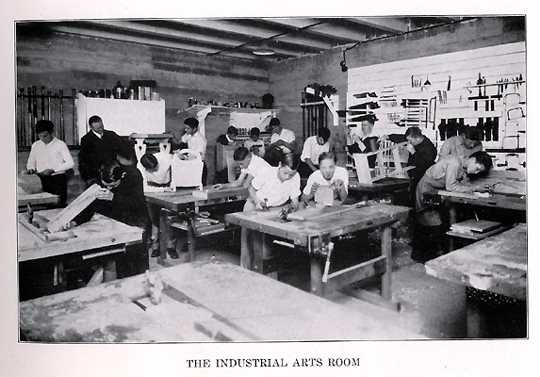
Notes:
I’m certified to teach Industrial Arts Education.
How many of you took Industrial Arts, or Shop class while in high school????
Unfortunately, some of our high schools are still teaching classes like this.
Some because of a lack of funds to modernize, and
Some because the same teacher is still there after 40 years.
=====
http://www.rootsweb.ancestry.com/~innwigs/ImageArchive/LibertyTownship/LibertyTwpPorterCoIndiana-LibertyCenterHighSchool-IndustrialArtsRoom-1931-SS.jpg

Slide 95
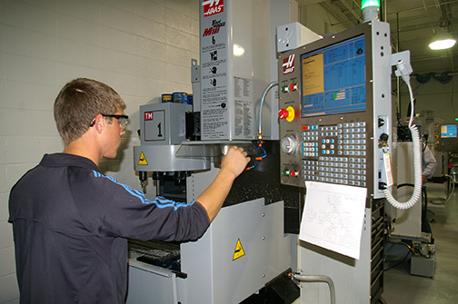
Notes:
But our modern shop classes should look like this. And many of them do.
We’ve had to modernize to keep up with business and industry.
Fortunately in North Carolina, we can send our high school students to a community college at no charge to learn in shops like this.
====
http://www.caboces.org/sites/default/files/images/John%20Gethicker/AMPBabb8744LR.jpg

Slide 96
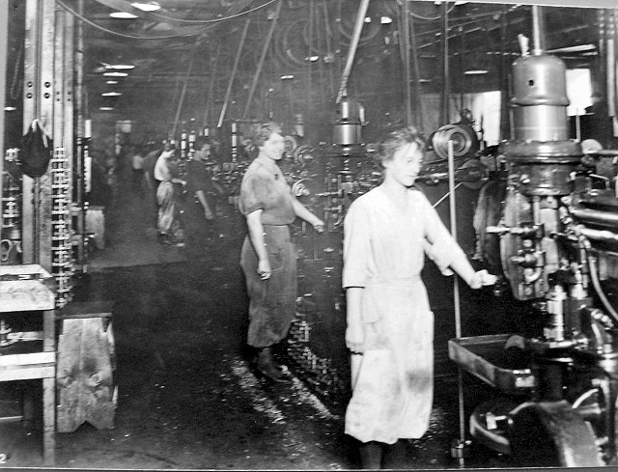
Notes:
Why would anyone want a young lady to take a manufacturing class knowing that she could end up with a job like this?
Compare the cleanliness of the work environment in this OLD picture with …
====
https://dwd.wisconsin.gov/dwd/dwdhistory/images/women_in_factory_big.jpg

Slide 97
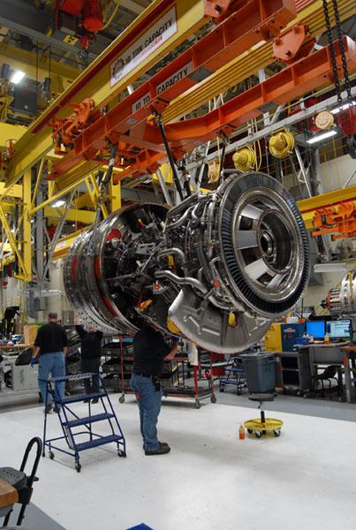
Notes:
…this one, where they are building jet engines in Durham, North Carolina.
You could eat off of that floor!
====
http://www.bizjournals.com/triangle/news/2012/08/03/slideshow-a-look-at-ge-aviations.html?ana=e_du_pap&s=article_du&ed=2012-08-03
Slideshow: A look at General Electric Aviation engine plant
The Durham plant, just off Miami Boulevard, is beginning to retool as the company triples its production of GEnx turbofan engines for Boeing Co.’s (NYSE: BA) new 787 Dreamliner. It has also recently expanded production of the giant GE90 engine and several lines of smaller engines, all of which are aimed at replacing older designs that are less fuel efficient.
photo shows:
A GE90 engine nears completion at the GE Aviation factory off South Miami Boulevard in Durham. The GE90 is used for large commercial aircraft such as the Boeing 777. More than 1,000 777s have been built over the years, incorporating a total of more than 2,000 engines from Boeing, Rolls-Royce and United Technologies' Pratt & Whitney division.

Slide 98
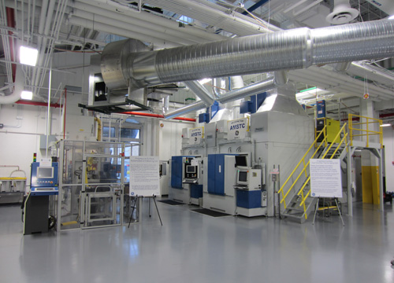
Notes:
The reality is that most educators, students, and their parents have no idea of what is happening in today’s factories.
Name one TV show that shows employees working in a modern factory.
How can students, teachers, and everyone else learn about modern industry?
Field trips, job shadowing, internships, open houses?
=====
http://files.gereports.com/wp-content/uploads/2012/04/AMSTC3.jpg

Slide 99
We are currently preparing people for jobs that don’t yet exist …
Notes:
You may have seen this quote that is spread across the next three slides.
It profoundly reminds us that we are preparing people for jobs that don’t yet exist…
=======
Shift Happens
Karl Fisch and Scott McLeod
http://shifthappens.wikispaces.com/

Slide 100
… using technologies that haven’t yet been invented …
Notes:
… Using technologies that have not yet been invented …
=======
Shift Happens
Karl Fisch and Scott McLeod
http://shifthappens.wikispaces.com/

Slide 101
… in order to solve problems we don’t even know are problems yet.
Notes:
… to solve problems that we do not yet know are problems.
Have we enabled the next generation with the knowledge and tools they will need to do this?
=======
Shift Happens
Karl Fisch and Scott McLeod
http://shifthappens.wikispaces.com/

Slide 102
Who predicted these?
Cell phones for everyone
iPads, Kindles
Smart phones
iPod - portable music and videos
Hand-held GPS
Text messaging
Blogs, Twitter
MySpace, FaceBook
Wikipedia
YouTube
Pinterest
Google Plus
Tumblr
Instagram
SUVs
Self-driving cars
Electric cars
Wearable tech - Fitbits
Cloud computing
“Reality” TV
3D printing
Presentations like this one !!
Notes:
Think back 20 years ago.
Would you have predicted any of these?
What’s next?
How soon will these become obsolete?
Yes, these will all become obsolete someday soon!

Slide 103
Old technologies making a comeback
Vegetable powered-Diesel engines
Electric cars
Wind power
Rain barrels
Recycling building materials
Biofuel (Moonshine)
Notes:
Some of the latest trends are actually old technologies making a comeback.
Over 100 years ago. When Rudolph Diesel first demonstrated his diesel engine, he powered it with peanut oil.
Then along came this cheap stuff called petroleum that even Jed Clampett didn't want at first, and Rudolph Diesel quickly switched over to the newly created Diesel fuel, because it was so cheap to make.
Now people are paying McDonalds to let them take away their waste cooking oil, so they can use it to fuel their Diesel-powered vehicle.
And Electric cars? Invented almost 200 years ago. Electric cars were very popular until the early 1900s when gasoline-powered engines took over, because -- at the time -- gasoline was very cheap.
And the Biofuels Center of North Carolina is helping people build government-approved stills to create legal moonshine that we can burn in our cars.
Yes, some old technologies are coming back around again.

Slide 104
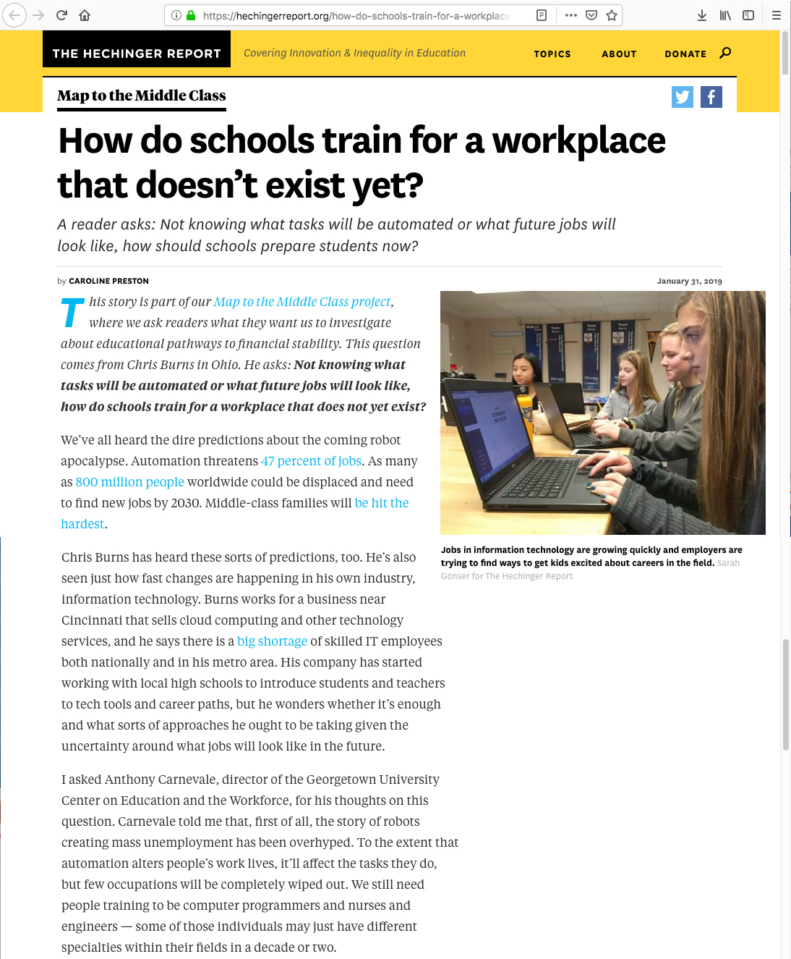
Notes:
People are worried that the robots will take all of our jobs,
Yet we also have a big shortage of IT professionals.
Schools will not be able to keep up with the latest technology, but can train students to be ready to use new technology when they get hired.
Internships will be the way to gain access to the new technology without the college having to purchase it.
But, over the last few decades there has been a steep drop in the number of high school and college students who have a part time job.
This leads to folks with a degree but know nothing about the workplace.
Employers say they want new hires with better soft skills.
The focus in education should be soft skills.
Good soft skills will make folks more hirable, and will help them stay employed.
=========
https://hechingerreport.org/how-do-schools-train-for-a-workplace-that-doesnt-exist-yet/?utm_source=The%20Hechinger%20Report&utm_campaign=1960019b4d-EMAIL_CAMPAIGN_2019_02_05_06_37&utm_medium=email&utm_term=0_d3ee4c3e04-1960019b4d-322707685&userId=18d575e62931429b85ae43cb1a543d07
How do schools train for a workplace that doesn’t exist yet?
A reader asks: Not knowing what tasks will be automated or what future jobs will look like, how should schools prepare students now?
by Caroline Preston
January 31, 2019
This story is part of our Map to the Middle Class project, where we ask readers what they want us to investigate about educational pathways to financial stability. This question comes from Chris Burns in Ohio. He asks: Not knowing what tasks will be automated or what future jobs will look like, how do schools train for a workplace that does not yet exist?
We’ve all heard the dire predictions about the coming robot apocalypse. Automation threatens 47 percent of jobs. As many as 800 million people worldwide could be displaced and need to find new jobs by 2030. Middle-class families will be hit the hardest.
Chris Burns has heard these sorts of predictions, too. He’s also seen just how fast changes are happening in his own industry, information technology. Burns works for a business near Cincinnati that sells cloud computing and other technology services, and he says there is a big shortage of skilled IT employees both nationally and in his metro area. His company has started working with local high schools to introduce students and teachers to tech tools and career paths, but he wonders whether it’s enough and what sorts of approaches he ought to be taking given the uncertainty around what jobs will look like in the future.
I asked Anthony Carnevale, director of the Georgetown University Center on Education and the Workforce, for his thoughts on this question. Carnevale told me that, first of all, the story of robots creating mass unemployment has been overhyped. To the extent that automation alters people’s work lives, it’ll affect the tasks they do, but few occupations will be completely wiped out. We still need people training to be computer programmers and nurses and engineers — some of those individuals may just have different specialties within their fields in a decade or two.
Burns’ industry, though, is one that’ll experience some of the biggest whiplash. “He’s sitting pretty close to the sun,” Carnevale says.
Advertisement
Schools just aren’t going to be able to keep up with every tech development — companies can’t always keep up — so a lot of the learning will have to take place on the job. Carnevale says that internships are a great way for companies to offer students a chance to get both a taste of a career and pick up new skills. Older workers will also need employers to step in and help them train on new tools.
For his part, Burns told me he suspects that “soft skills” — things like critical thinking, problem solving and communication — are going to be key and that those abilities will serve young people no matter how their jobs evolve with new technologies. The growing importance of soft skills is a topic we’ve written about here at Hechinger. And Carnevale says he shares this perspective.
“In the old days,” says Carnevale, “you took orders from the person above you and had a very fixed job.” Managers were the only people who needed to know how to write memos, organize people into teams or give instructions clearly. But as the economy has shifted from a manufacturing to a service economy, he says, “all those skills are necessary all the time.”
For educators, the big challenge is figuring out how best to teach students not just to receive knowledge but to apply it. Some states have begun mandating that schools teach soft skills. Educators are also experimenting with approaches like “project-based” and “student-centered” learning, that encourage collaboration and solving complex problems that have applications for the real world.
And schools are welcoming business leaders like Burns into their classrooms. In the Cincinnati area, Burns and his colleagues are taking mini computers into schools, introducing students and teachers to the power of information technology, and working with one school to develop an IT-focused career track. The precise contours of the IT workplace of the future aren’t yet known, but this seems clear: the industry still seems like a pretty safe bet for employment well into the future.
This story about the future of work was produced by The Hechinger Report, a nonprofit, independent news organization focused on inequality and innovation in education. Sign up for our Sign up for the Hechinger newsletter.

Slide 105
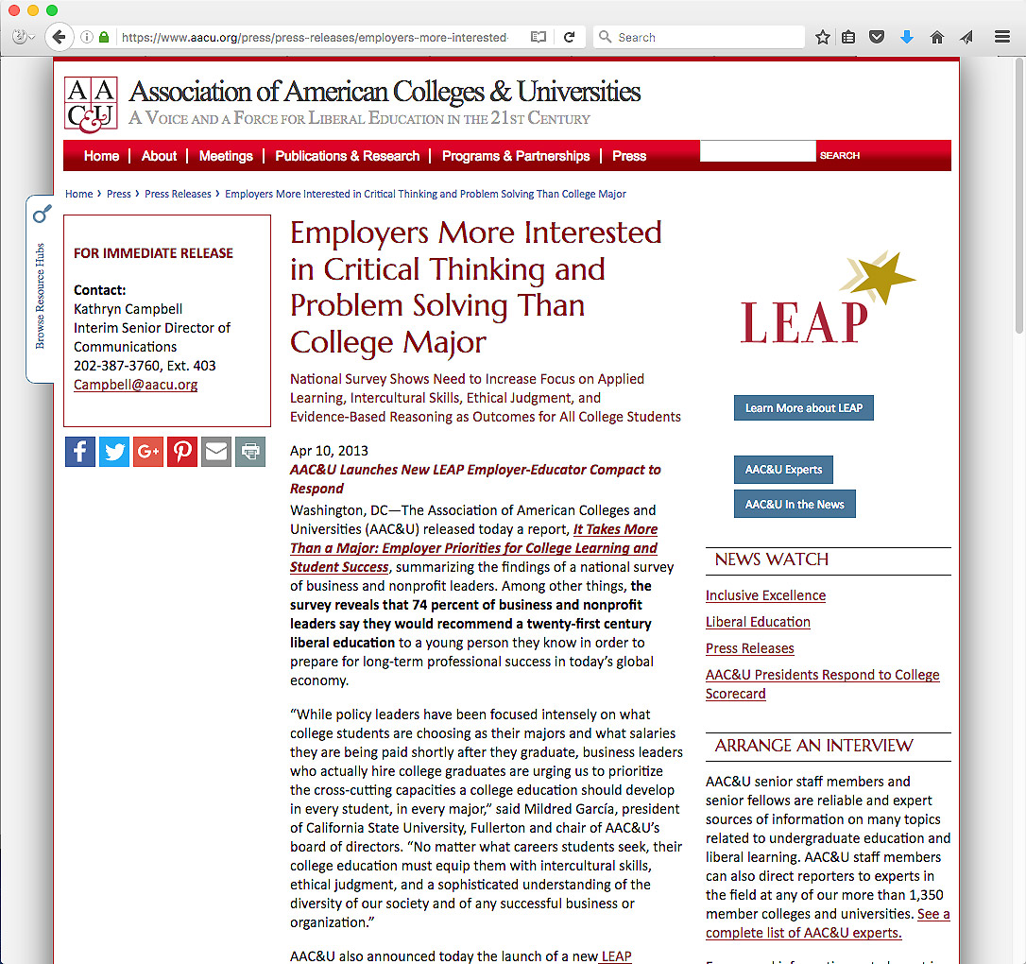
Notes:
The employers know what they want in their new recruits.
And it is not always what the education establishment is giving them.
Are we, as educators, listening?
Do we even know who the employers are -- where our students will be working in the near future.
=======
https://www.aacu.org/press/press-releases/employers-more-interested-critical-thinking-and-problem-solving-college-major

Slide 106
2016 NC Employer Needs Survey
Notes:
The North Carolina Department of Commerce surveys businesses all across the state every two years.
For 2016, they collected 19 hundred surveys.
This included companies of all sizes from all 100 counties.
=====
2016 NC Employer Needs Survey
http://www.nccommerce.com/Portals/47/Publications/Industry%20Reports/2016-Employer-Needs-Survey.pdf
2016 NC Employer Needs Survey - PowerPoint
http://www.ncga.state.nc.us/documentsites/committees/BCCI-6578/2015-16%20Session/Meeting%20Documents/March%201,%202016/Employer%20Needs%20Survey%202016%20-%20Leg%20Workforce%20Development%20Committee.pdf

Slide 107
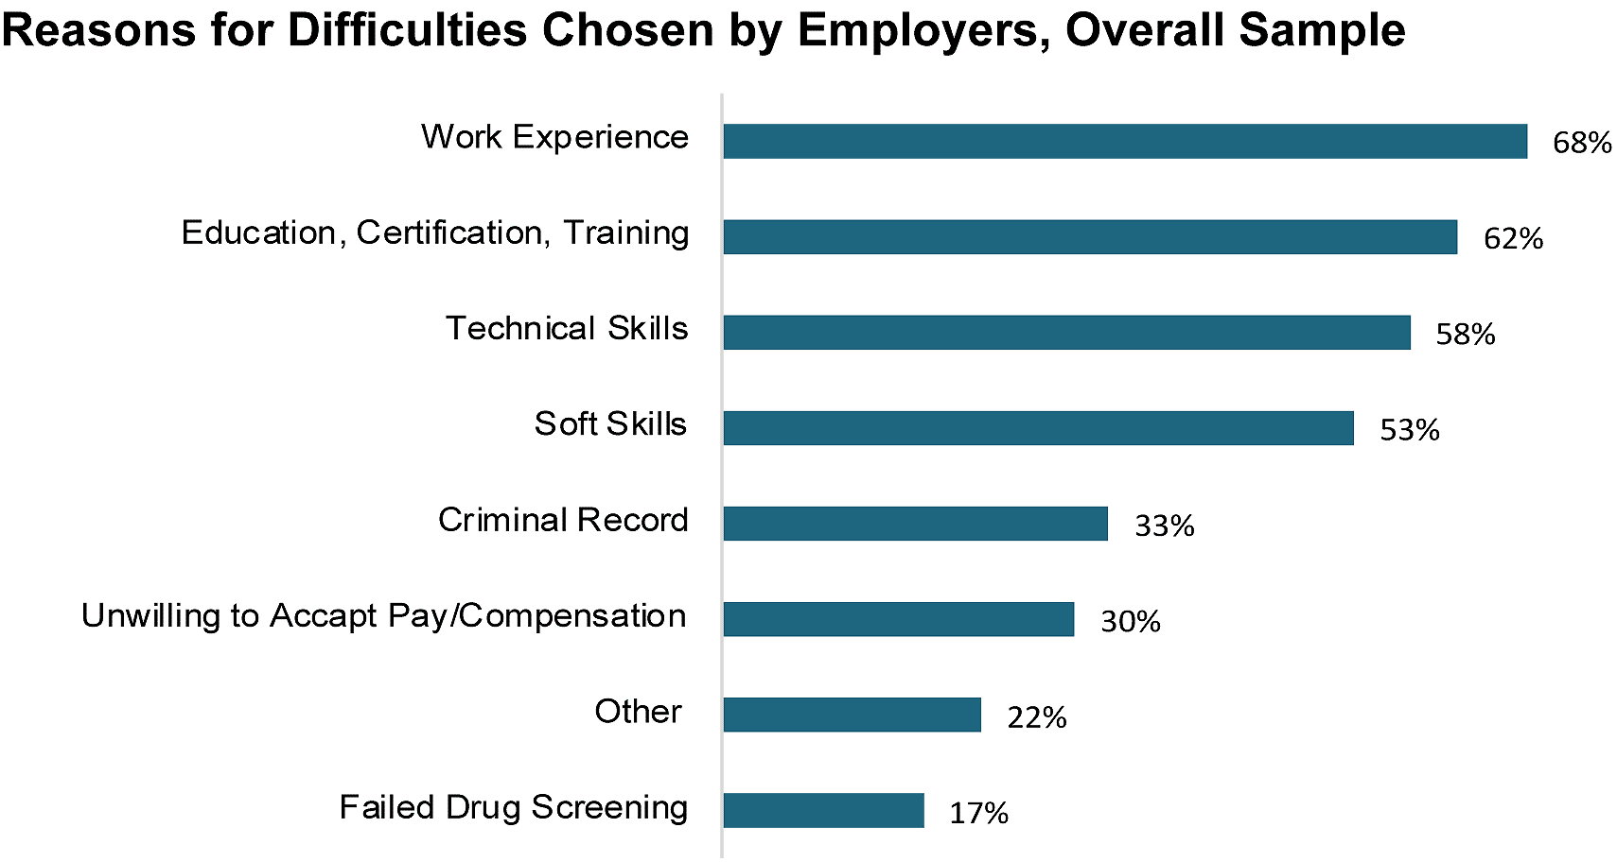
Hiring Difficulties
Notes:
This survey found that Four out of Ten employers who tried to hire in the past year had difficulty filling at least one position.
First on the list - The employers said their new recruits lacked work experience.
Well if that is true, you can show them how a good work-based learning program can help their future employees get the work experience they need.
And second -- is education and training. That’s why we are here to help educate their new recruits.
What else can we do to help prepare their new recruits?
Ask your local employers if this chart is true for their company.
Are there other items they think should be added to his list?
Ask them.
=====
2016 NC Employer Needs Survey
http://www.nccommerce.com/Portals/47/Publications/Industry%20Reports/2016-Employer-Needs-Survey.pdf
2016 NC Employer Needs Survey - PowerPoint
http://www.ncga.state.nc.us/documentsites/committees/BCCI-6578/2015-16%20Session/Meeting%20Documents/March%201,%202016/Employer%20Needs%20Survey%202016%20-%20Leg%20Workforce%20Development%20Committee.pdf

Slide 108
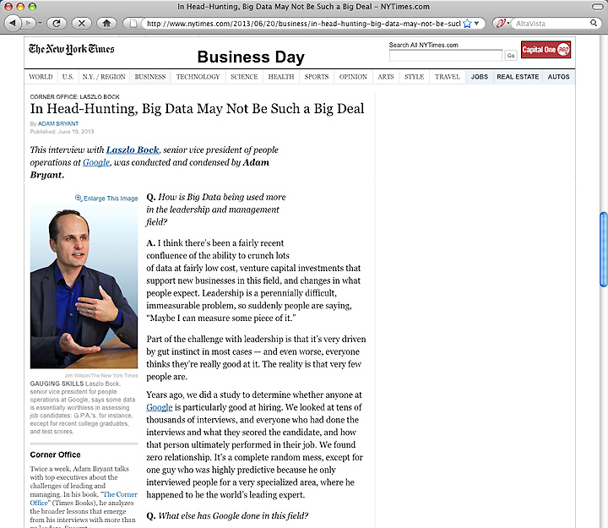
Notes:
We educators often place a great emphasis on grades, class rank, and being valedictorian.
These create parental bragging rights for the parents, but what do they mean outside of high school and college?
Google has crunched the numbers and found that GPA is a worthless criteria for hiring.
They compared the GPA of their new recruits with how well they were performing years later -- and found no correlation.
So they stopped asking their potential employees for their GPA.
You can imagine how well this news goes over in our high schools and colleges where grades appear to be everything.
=======
http://www.nytimes.com/2013/06/20/business/in-head-hunting-big-data-may-not-be-such-a-big-deal.html?pagewanted=all&_r=1&
In Head-Hunting, Big Data May Not Be Such a Big Deal
June 19, 2013
One of the things we’ve seen from all our data crunching is that G.P.A.’s are worthless as a criteria for hiring, and test scores are worthless — no correlation at all except for brand-new college grads, where there’s a slight correlation. Google famously used to ask everyone for a transcript and G.P.A.’s and test scores, but we don’t anymore, unless you’re just a few years out of school. We found that they don’t predict anything.
What’s interesting is the proportion of people without any college education at Google has increased over time as well. So we have teams where you have 14 percent of the team made up of people who’ve never gone to college.
After two or three years, your ability to perform at Google is completely unrelated to how you performed when you were in school, because the skills you required in college are very different. You’re also fundamentally a different person. You learn and grow, you think about things differently.
Another reason is that I think academic environments are artificial environments. People who succeed there are sort of finely trained, they’re conditioned to succeed in that environment. One of my own frustrations when I was in college and grad school is that you knew the professor was looking for a specific answer. You could figure that out, but it’s much more interesting to solve problems where there isn’t an obvious answer. You want people who like figuring out stuff where there is no obvious answer.
===
Google no longer hires based on GPA or test scores
"One of the things we’ve seen from all our data crunching is that G.P.A.’s are worthless as a criteria for hiring, and test scores are worthless"
Google also said that "academic environments are artificial environments." Students are "conditioned to succeed in that environment ... looking for a specific answer." Google wants "people who like figuring out stuff where there is no obvious answer."
These problem-solving skills that Google and others are looking for can be taught in our CTE classes, but the learning can be hard to measure, which makes it tough to convice the administration that these skills need to be taught.
http://www.nytimes.com/2013/06/20/business/in-head-hunting-big-data-may-not-be-such-a-big-deal.html?pagewanted=all&_r=1&

Slide 109
Notes:
Besides saying that GPAs are a worthless hiring criteria, Google says that test scores, and even college degree don’t matter much when hiring.
Google says the No. 1 thing they look for is general cognitive ability, and it’s not I.Q.
It’s learning ability. It’s the ability to process on the fly.
Businesses want people who can grab a bunch of data, quickly turn it into useful information, and use that information to solve a problem.
======
http://www.wnd.com/2014/02/google-calls-these-talents-worthless/

Slide 110
Notes:
Google says the second thing they are looking for is leadership. --in particular, emergent leadership as opposed to traditional leadership.
What they are looking for is: when faced with a problem, and you’re a member of a team, do you, at the appropriate time, step in and lead.
And just as critically, do you step back at the right time and stop leading, and let someone else lead?
How do people learn to take the leadership reigns when necessary and to relinquish when it’s time for someone else to lead?
Google said “It’s feeling the sense of responsibility, the sense of ownership, to step in,” to try to solve any problem – and the humility to step back and embrace the better ideas of others.
The end goal is group problem-solving. How do people learn that? Can we do more leadership training in our schools?
======
http://www.wnd.com/2014/02/google-calls-these-talents-worthless/
Photo
https://qph.ec.quoracdn.net/main-qimg-f789f6f600c4407198ce947708761ffe-c?convert_to_webp=true

Slide 111
Notes:
High Schools and Colleges with a Skills USA chapter find that Skills USA provides the extra stuff that turns an education program into a true career preparation program.
They teach the team skills, soft skills, problem-solving skills -- and much more.
Many of the SkillsUSA students get hired by employers right at SkillsUSA competitive events.
If you don’t have a SkillsUSA chapter at your college, then you need to look into getting one.
North Carolina is the fastest growing state in postsecondary student participation.
=====
North Carolina SkillsUSA
http://www.skillsusanc.org/
National SkillsUSA
https://www.skillsusa.org/

Slide 112
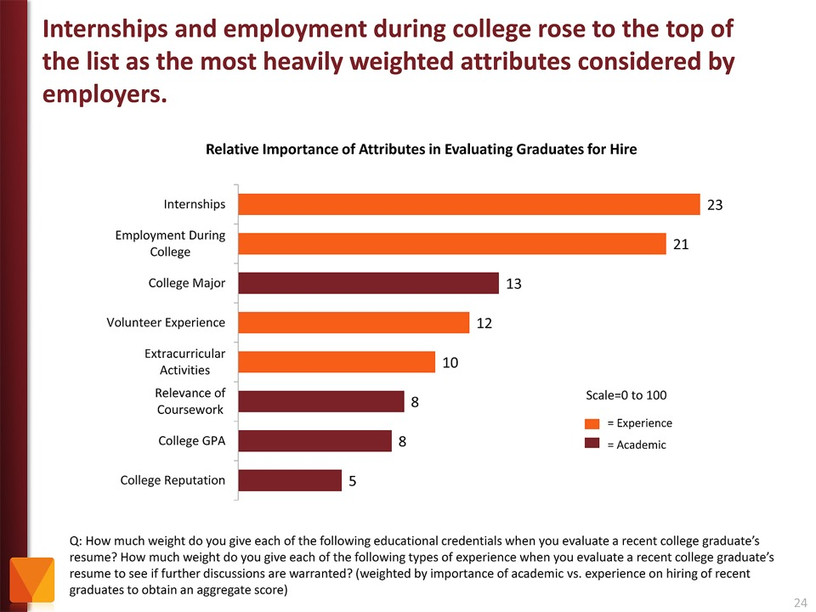
Notes:
Employers value Internships and other employment while in school as more important than college major and GPA.
Even volunteer work and extra-curricular activities are more important to the business community than grades.
Yet, -- most students are too focused on getting good grades -- and are missing out on the experiences that really matter.
If you “begin with the end in mind” like I said earlier, then students should ask the businesses what they will want in their new recruits, rather than focusing on something like grades that the business community could care less about.
======
http://chronicle.com/article/The-Employment-Mismatch/137625/#id=overview
The Employment Mismatch: A College Degree Sorts Job Applicants, but Employers Wish It Meant More
Employers value a four-year college degree, many of them more than ever.
Yet half of those surveyed recently by The Chronicle and American Public Media's Marketplace said they had trouble finding recent graduates qualified to fill positions at their company or organization. Nearly a third gave colleges just fair to poor marks for producing successful employees. And they dinged bachelor's-degree holders for lacking basic workplace proficiencies, like adaptability, communication skills, and the ability to solve complex problems.
The report
The Role of Higher Education in Career Development: Employer Perceptions
http://chronicle.com/items/biz/pdf/Employers%20Survey.pdf

Slide 113
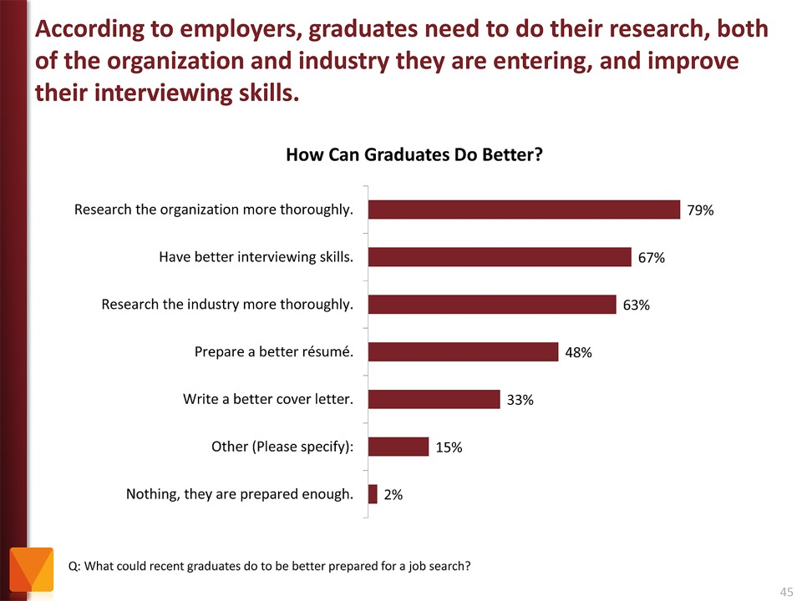
Notes:
Tell your students to research the companies where they are applying for work. And learn about the interview process.
It just amazes me that folks would try to get a job at a company they know nothing about.
The focus of the job interview should be on what you can do for the company.
======
http://chronicle.com/article/The-Employment-Mismatch/137625/#id=overview
The Employment Mismatch: A College Degree Sorts Job Applicants, but Employers Wish It Meant More
Employers value a four-year college degree, many of them more than ever.
Yet half of those surveyed recently by The Chronicle and American Public Media's Marketplace said they had trouble finding recent graduates qualified to fill positions at their company or organization. Nearly a third gave colleges just fair to poor marks for producing successful employees. And they dinged bachelor's-degree holders for lacking basic workplace proficiencies, like adaptability, communication skills, and the ability to solve complex problems.
The report
The Role of Higher Education in Career Development: Employer Perceptions
http://chronicle.com/items/biz/pdf/Employers%20Survey.pdf

Slide 114
Myth # 1
All of the manufacturing is moving to China.
Notes:
114
If you read the front page of the newspaper (or listen to the politicians), you might still believe this.
But if you read the Business section like I do …
=====
http://www.honestfilms.net/wp-content/uploads/burtynsky_manufacturing.jpg

Slide 115
Notes:
… you will find that -- not only is manufacturing alive and well in North Carolina, but
Chinese companies have moved some of their manufacturing to North Carolina.
=====
http://money.cnn.com/2012/04/24/smallbusiness/china-us-manufacturing/index.htm
China offshores manufacturing to the U.S.

Slide 116
Chinese Manufacturing in NC
RATO – engines, all-terrain vehicles – Lincoln Co.
Jetion Solar Corp – solar panels – Charlotte
Lenovo – ThinkPads – Greensboro
U-Play – sanitary products – Wayne Co.
Uniquetex – Textiles – Grover
Ming Yang Wind Power - Raleigh
Notes:
Here are a few Chinese manufacturing companies that have set up facilities in North Carolina.
This is just what I have seen in the news over the past 6 years. I am sure there are others.
We think all of the manufacturing has moved to China, when in fact, much of it has moved from China to North Carolina,
and they need local workers to make the products and to keep the production lines moving.
=====
http://www.bizjournals.com/charlotte/blog/outside_the_loop/2012/02/chinese-company-to-open-in-lincoln.html
http://www.charlotteobserver.com/2011/06/24/2402136/solar-panel-jobs-coming-to-charlotte.html#storylink=misearch
http://www.bloomberg.com/news/2013-07-11/chinese-pc-giant-lenovo-starts-manufacturing-in-u-s-.html
http://www.areadevelopment.com/newsItems/8-2-2016/u-play-corporation-wayne-county-north-carolina.shtml
http://www.bizjournals.com/triangle/blog/techflash/2016/08/chinese-firm-picks-north-carolina-over-south.html
https://edpnc.com/china-based-company-to-build-textile-plant-in-cleveland-county/
http://www.bizjournals.com/triangle/news/2012/03/13/ncsus-centennial-campus-lands-new.html

Slide 117
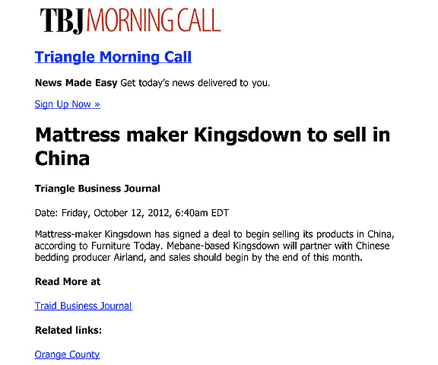
Notes:
And here it works the other way around.
Here is an American manufacturing company in North Carolina that is shipping it’s high-quality mattresses to China.
Yes, products made in America being sold in China.
===
http://www.bizjournals.com/triangle/morning_call/2012/10/mattress-maker-kingsdown-to-sell-in.html?ana=e_trig_rdup&s=newsletter&ed=2012-10-12
117

Slide 118
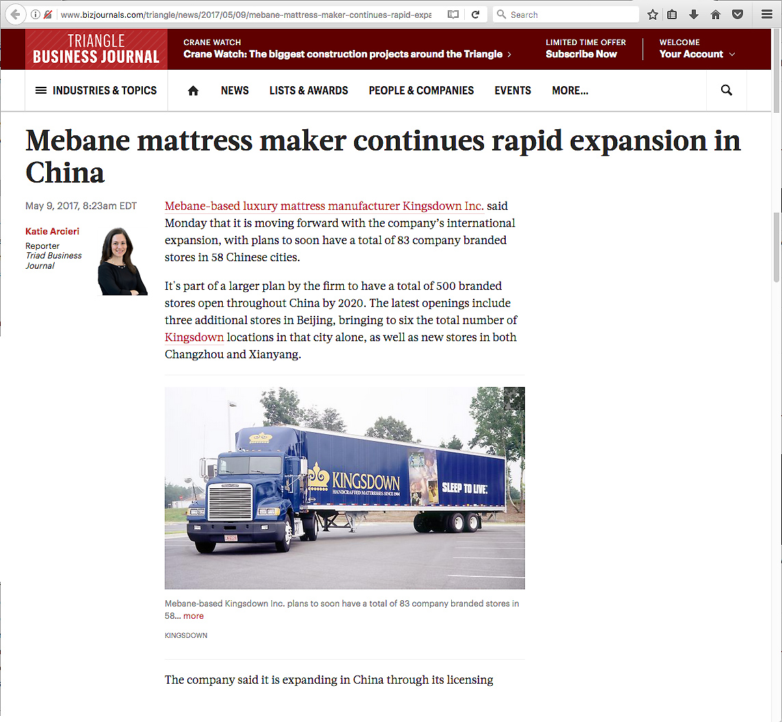
Notes:
Mattresses made in Mebane North Carolina, just west of the Research Triangle, are going to China.
The rising Chinese middle class wants the same great products we have come to enjoy here in the United States, and they are willing to import them.
They are planning to have 500 Kingsdown stores in China by the year 2020.
======
http://www.bizjournals.com/triangle/news/2017/05/09/mebane-mattress-maker-continues-rapid-expansion-in.html?ana=e_ae_set6&s=article_du&ed=2017-05-09&u=DFsejj4U8KnV9lBFgI8D1Q03b85e1a&t=1494359607&j=78132781
Mebane mattress maker continues rapid expansion in China
May 9, 2017, 8:23am EDT
Mebane-based luxury mattress manufacturer Kingsdown Inc. said Monday that it is moving forward with the company’s international expansion, with plans to soon have a total of 83 company branded stores in 58 Chinese cities.
It's part of a larger plan by the firm to have a total of 500 branded stores open throughout China by 2020. The latest openings include three additional stores in Beijing, bringing to six the total number of Kingsdown locations in that city alone, as well as new stores in both Changzhou and Xianyang.
Enlarge
Mebane-based Kingsdown Inc. plans to soon have a total of 83 company branded stores in 58… more
Kingsdown
The company said it is expanding in China through its licensing partnership with Hong Kong-based bedding producer and retailer, Roth Bedding Technology, which is also known as Kingsdown China.
“Our business in China is very strong and profitable,” said Frank Hood, president and CEO of Kingsdown, which formed its partnership with Roth in 2015. “The Chinese consumer is attracted to our more luxurious offerings and have helped position Kingsdown at the higher end of the market in the country. We continue to grow our market share with China’s luxury mattress consumer through our strategic plan and partnership with Roth."
Founded in 1904, Kingsdown houses its headquarters in Mebane, along with its research and development facilities, training and distribution locations and two manufacturing plants.The company's international offices are located in Tokyo, Japan and Melbourne, Australia.

Slide 119
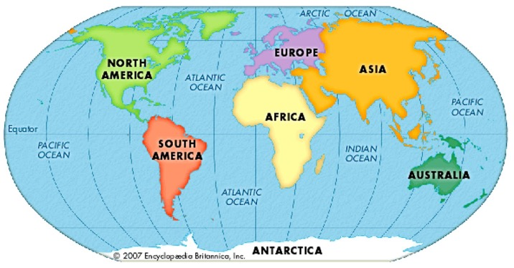
NC Exports to Countries in 2017
$32,622,500,000 World
$6,649,690,000 Canada
$3,560,210,000 Mexico
$2,361,530,000 China
$1,661,560,000 Saudi Arabia
$1,572,540,000 Japan
$1,443,650,000 France
$1,347,940,000 United Kingdom
$1,121,050,000 Germany
$1,007,970,000 Ireland
$930,070,000 Netherlands
$801,670,000 Honduras
$725,970,000 Belgium
$693,920,000 Hong Kong
$560,370,000 Korea, South
$557,450,000 Spain
$527,990,000 Australia
$446,360,000 Brazil
$406,670,000 India
$384,870,000 Singapore
$364,120,000 Dominican Republic
$322,870,000 Italy
$294,340,000 Taiwan
$287,900,000 Austria
$253,710,000 Sweden
$250,520,000 El Salvador
Get new data
Notes:
North Carolina has a healthy export business.
At the top of the list, you see that North Carolina sold over 32 million dollars worth of stuff to other countries in 2017.
Contrary to popular belief -- Not all things are made in China.
We sold over 2 million dollars worth of products last year to China.
====
https://www.census.gov/foreign-trade/statistics/state/data/nc.html
2016 data
Map
http://4.bp.blogspot.com/-_aOqG-WDaic/T91LXcUziPI/AAAAAAAAAQs/TZ9SqXv0XY8/s1600/KidsFlatGlobe2.jpg

Slide 120
NC Exports - Products 2016
$1,542,850,000 Civilian Aircraft, Engines, And Parts
$1,475,510,000 Immunological Products, In Measured Doese/Rtl Sale
$1,158,720,000 Medicaments Nesoi, Measured Doses, Retail Pk Nesoi
$1,068,570,000 Antisera And Other Blood Fractions
$804,910,000 Bomb Mines Ot Ammntion
$773,150,000 Chemical Woodpulp, Soda Etc. N Dis S Bl & Bl Conif
$619,090,000 Tobacco, Partly Or Wholly Stemmed/Stripped
$522,880,000 Parts Of Airplanes Or Helicopters, Nesoi
$351,390,000 Compression-Igntn Int Combust
$341,380,000 Cot Yarn, 85% Cot, No Retail, Ov 14nm Not
$322,350,000 Photosnsitve Semicndctr Dvice Inc Phtvltc Cell Etc
$292,290,000 Meat Of Swine, Nesoi, Frozen
$272,280,000 Parts Of Mach For Assmbl
$265,350,000 Supported Catalysts W Prec Metal/Prec Mtl Compnd
$254,990,000 Optical Fibers, Optical Fiber Bundles And Cables E
$251,090,000 Road Tractors For Semi-Trailers
$250,950,000 Auto Regulating Ins & Appr Ex Throstat,Mnstat, Et
$241,230,000 Insulated Optical Fiber Cables With Indvuly Sh Fbr
$231,440,000 Cot Yarn, 85% Cot, No Retail, Ov 43nm Not
$222,510,000 Yrn N Sw Th Syn St Fb N Rt Sl Ply S F Mix M/S
$221,900,000 Taps Cocks Etc F Pipe Vat Inc Thermo Control Neso
$221,600,000 Mech Front-End Shovel Loaders, Self-Propelled
$212,590,000 Drive Axles With Differential For Motor Vehicles
$209,100,000 Med Needles. Nesoi, Catherers Etc And Parts Etc
$194,820,000 Gears; Ball Or Roller Sc
Notes:
And in case you are wondering what the other countries are buying from us.
You see here that North Carolina exports lots of airplanes and aviation parts -- and pharmaceuticals.
And there is still a high demand around the world for some of our older products like tobacco and cotton yarn.
And look at number five on the list. North Carolina is the leading state in exporting bombs, mines, and grenades, with most of it going to the Middle East.
Who knew this?
We need lots of skilled workers to keep making this stuff that the Chinese, and others are buying from us.
======
https://www.census.gov/foreign-trade/statistics/state/data/nc.html
2016 data

Slide 121
Mountaire Farms in NC sells chicken feet to china. Chinese pay more for chicken feet than we pay for chicken tenders. Number one large chicken producer in world
Notes:
Chicken feet - --worth almost nothing in the American food market, but --
In China, chicken feet sell for more money than chicken breasts.
If it was not for the Chinese paying top dollar for our American chicken feet, that bucket of the Colonel's chicken might be double the price.
Mountaire Farms is the seventh largest chicken producer in the world, and they grow many of the chickens right here in North Carolina -- whose feet end up on a slow boat to China.
====
https://alaboroflove.org/wp-content/uploads/2014/10/chicken.jpg
https://alaboroflove.org/chicken-vs-courage/
https://en.wikipedia.org/wiki/Chicken_feet
https://www.ft.com/content/90ebf59a-80bb-11e7-a4ce-15b2513cb3ff

Slide 122
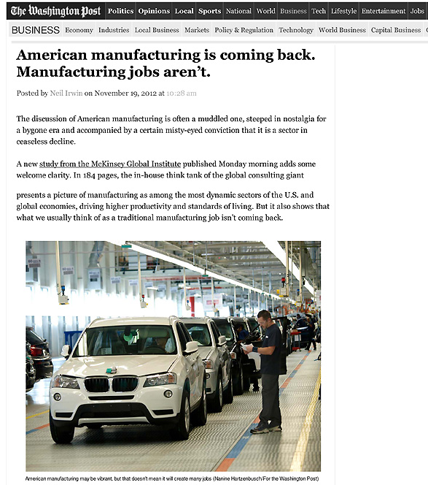
Notes:
As American manufacturing is making its comeback, we find that the old Manufacturing jobs that required a strong back and no education are not coming back.
=====
http://www.washingtonpost.com/blogs/wonkblog/wp/2012/11/19/american-manufacturing-is-coming-back-manufacturing-jobs-arent/
122

Slide 123
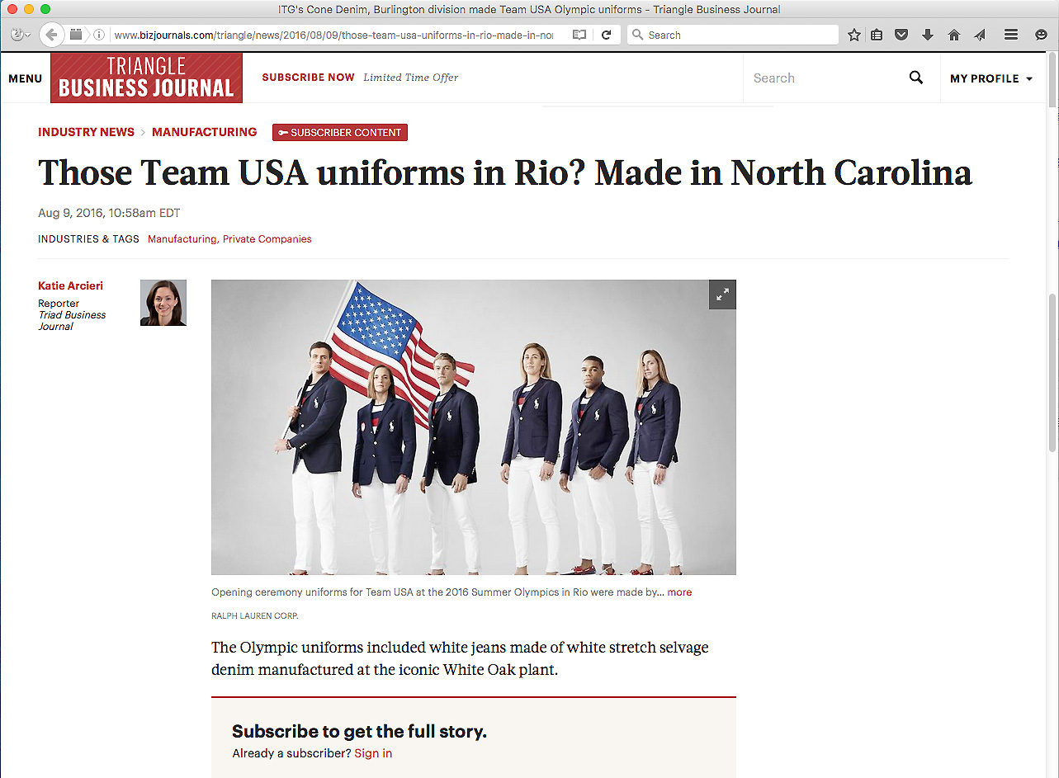
Notes:
The textile industry is alive and well in North Carolina. And folks around the world recently got a chance to see our textiles in action at the Olympics.
Textile shops in Rutherfordton, Greensboro, Burlington, Raeford, and Cordova, North Carolina all had a hand in making Olympic apparel.
There are no longer sweat shops in North Carolina with young ladies hunched over a manual sewing machine.
No -- these textile operations are high-tech and require smart folks to operate the equipment.
Advanced Manufacturing, including textile production, is big in North Carolina.
====
Opening Ceremony
http://www.bizjournals.com/triangle/news/2016/08/09/those-team-usa-uniforms-in-rio-made-in-north.html?ana=e_du_prem&s=article_du&ed=2016-08-09&u=DFsejj4U8KnV9lBFgI8D1Q03b85e1a&t=1470853007&j=75380092
Rowing Team
http://www.wcnc.com/sports/olympics/local-business-made-olympic-uniforms/280016944
White fabric
http://www.wyff4.com/sports/2016-olympics/upstate-company-helps-make-uniforms-for-us-olympians/41032828
Pants
http://www.twcnews.com/nc/triangle-sandhills/news/2016/08/6/usa-olympic-opening-ceremony-uniforms-made-in-nc.html
Blazers
http://www.twcnews.com/nc/triangle-sandhills/news/2016/08/6/usa-olympic-opening-ceremony-uniforms-made-in-nc.html

Slide 124
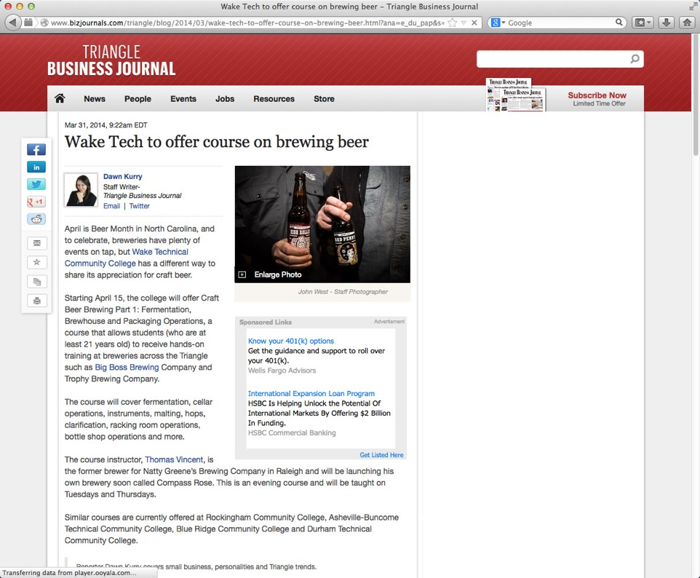
Notes:
We giggle when we think that college students are taking classes to learn how to make beer.
What’s next, classes on how to drink beer?
======
http://www.bizjournals.com/triangle/blog/2014/03/wake-tech-to-offer-course-on-brewing-beer.html?ana=e_du_pap&s=article_du&ed=2014-03-31
Mar 31, 2014, 9:22am EDT
Wake Tech to offer course on brewing beer
Starting April 15, the college will offer Craft Beer Brewing Part 1: Fermentation, Brewhouse and Packaging Operations, a course that allows students (who are at least 21 years old) to receive hands-on training at breweries across the Triangle such as Big Boss Brewing Company and Trophy Brewing Company.

Slide 125
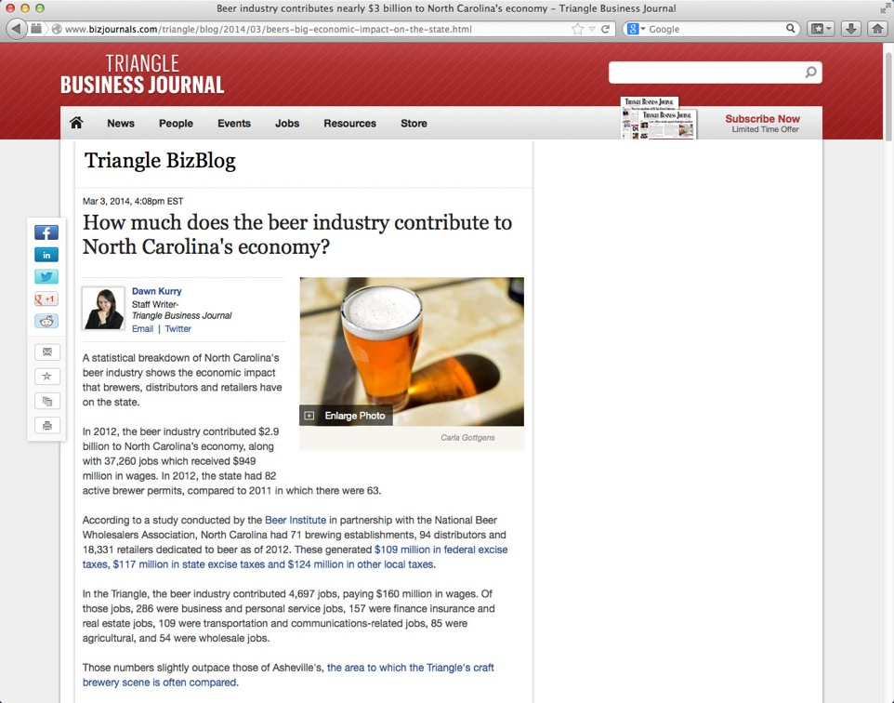
$2.9 billion contribution to NC economy in 2012
37,000 jobs in 2012
$350 million in taxes
Notes:
Seriously though, beer making is becoming big business in North Carolina, especially in the Triangle region and in Asheville.
In 2012 the beer industry contributed 2.9 billion dollars to North Carolina’s economy, which included over 37 thousand jobs.
In federal, state and local taxes, North Carolina beer contributed 350 million dollars.
This is manufacturing, and it is not like the beer making factories of old.
=============
http://www.bizjournals.com/triangle/blog/2014/03/beers-big-economic-impact-on-the-state.html
Mar 3, 2014, 4:08pm EST
How much does the beer industry contribute to North Carolina's economy?
In 2012, the beer industry contributed $2.9 billion to North Carolina’s economy, along with 37,260 jobs which received $949 million in wages. In 2012, the state had 82 active brewer permits, compared to 2011 in which there were 63.
According to a study conducted by the Beer Institute in partnership with the National Beer Wholesalers Association, North Carolina had 71 brewing establishments, 94 distributors and 18,331 retailers dedicated to beer as of 2012. These generated $109 million in federal excise taxes, $117 million in state excise taxes and $124 million in other local taxes.

Slide 126
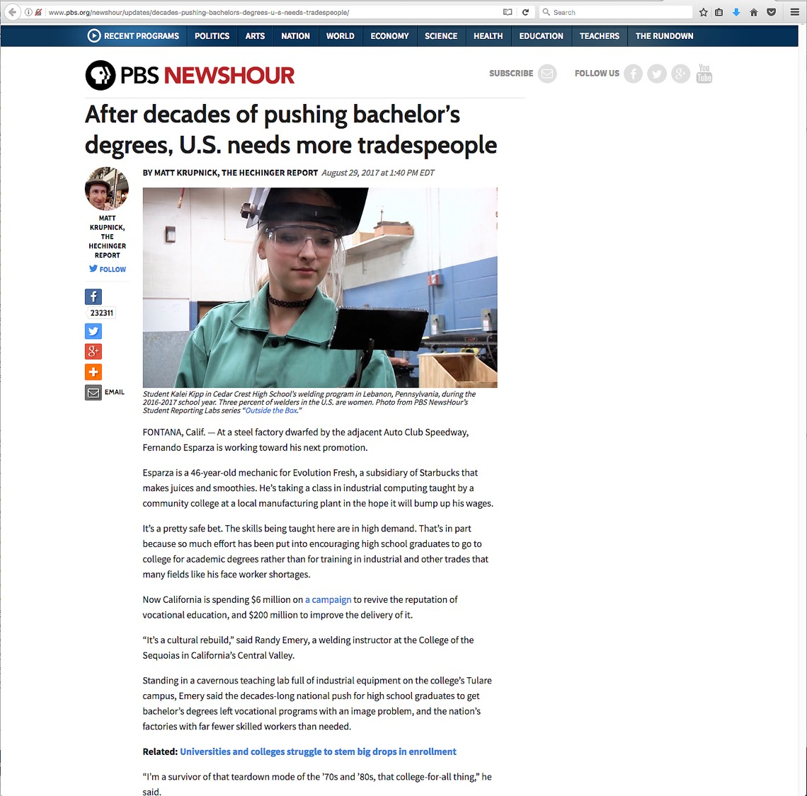
Notes:
Some of us have been preaching this for many years. Unfortunately the middle-class philosophy is that more education is important for success in life.
We have to get them to see that the Right education is the secret to success in life.
I promote our Community College programs as a possible first choice for everyone.
Too many high school counselors see the community colleges and other technical schools as second class colleges and try to get all of their students into four-year colleges, because they have bene told that they are better.
=====
http://www.pbs.org/newshour/updates/decades-pushing-bachelors-degrees-u-s-needs-tradespeople/

Slide 127
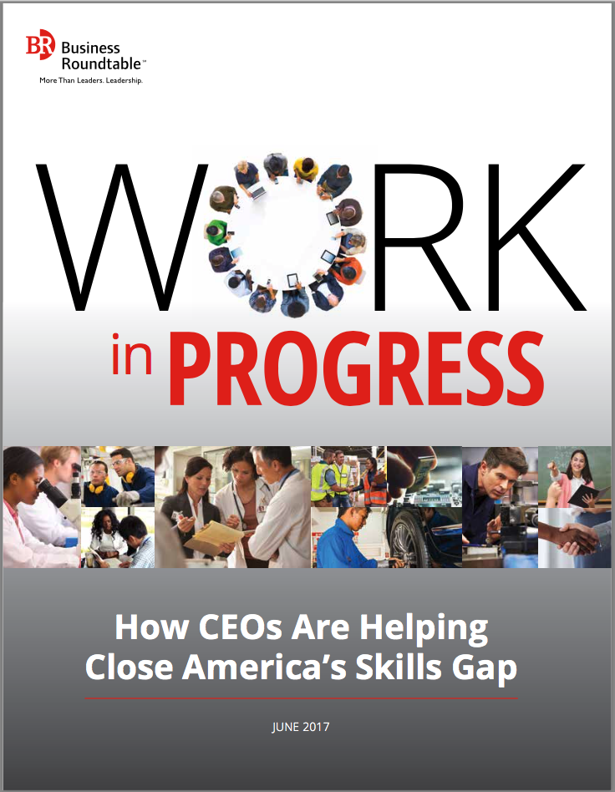
Notes:
Besides the usual information about what businesses are looking for in their new recruits,
this report also lists the individual needs and solutions from 68 large US companies, many of which have locations here in North Carolina.
See if any of them are in your part of the state, and see if your education programs are aligned with their needs.
Anyone have a CVS Pharmacy in your area? The CVS page in this book describes the apprenticeships program they are using with their new employees.
===
http://businessroundtable.org/sites/default/files/immigration_reports/BRT%20Work%20in%20Progress_0.pdf

Slide 128
Surprises Future Demand Legal Scenarios Changing World New Ideas Career Planning
www.ncPerkins.org/presentations
Notes:
Let’s look at some new ideas.

Slide 129
Notes:
There is a lot of high-tech going on in modern kitchens. The appliances are all talking to each other.
And when you are running low on milk, the refrigerator orders another gallon that could be delivered directly to your house.
When the milk arrives, your refrigerator could even unlock and open the front door of the house -- and let the drone in -- and have the drone put the milk in the refrigerator. It’s all possible now through current technology.
-- We still have to drink the milk ourselves. There’s no app for that!
=====
http://siliconangle.com/blog/2015/01/08/best-new-apps-for-apple-homekit-at-ces2015/

Slide 130
Notes:
This is all great of course -- until someone hacks your fridge –
and now you don’t have access to your own milk.
======
http://www.bizjournals.com/bizjournals/news/2016/11/23/tech-giants-recommend-rules-to-protect-your-fridge.html?ana=e_sjo_tf&s=newsletter&ed=2016-11-23&u=DFsejj4U8KnV9lBFgI8D1Q03b85e1a&t=1481121998&j=76545421

Slide 131
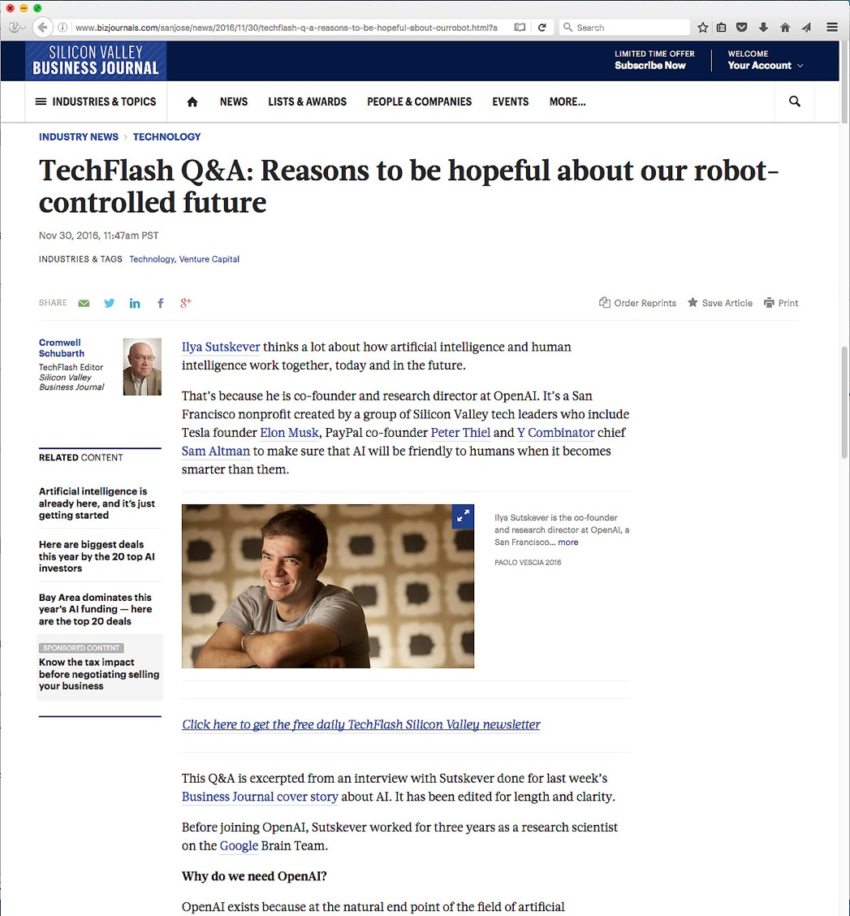
Notes:
But many are hopeful about letting robots and computers take over our lives.
My smart phone frustrates me quite often.
Recently I could not get the local weather -- and was perplexed as to whether to take an umbrella.
=====
http://www.bizjournals.com/sanjose/news/2016/11/30/techflash-q-a-reasons-to-be-hopeful-about-ourrobot.html?ana=e_sjo_tf&s=newsletter&ed=2016-11-30&u=DFsejj4U8KnV9lBFgI8D1Q03b85e1a&t=1481124453&j=76609931

Slide 132
Notes:
Sometimes we have to think outside the box.
This is not just for our us, but for our students as well.
====
http://cdn.elev8.com/files/2010/07/think-outside-the-box.jpg

Slide 133
Notes:
Soul Stix Surfboards had a problem like many other companies about what to do with it’s waste material when they cut a new surfboard from a block of polyurethane foam.
It creates plastic flakes like snowflakes that are hard enough just to capture out of the air, much less dispose of.
What they found is that this special plastic “saw dust” is very good at sopping up chemicals, like spilled oil in the ocean.
Yes -- what was once a waste product is now helping to clean up oil spills.
You know the saying – “One man’s trash is another man’s treasure.”
Are we teaching our students to recycle? and then to go one step further to look for new things to recycle?
In my house, the recycle bin always has more in it than the garbage bin.
Can we ever get to the point where everything is recyclable and nothing goes to the landfill?
We have to get people to get outside of the box and look for new ways to make money. One way is by selling trash.
=====
http://www.forbes.com/forbes/2011/1024/entrepreneurs-green-technology-surfboards-monarch-todd-woody.html
Photo
http://www.degree33surfboards.com/blog/surf-education/sell-surfboard-craigslist/

Slide 134
Notes:
This story is five years old (2014), but it is still a look at jobs of the future.
Pizza Hut has developed this new computer-topped table that allows you to see what your food will look like before you order.
You just decide how big you want your pizza, drag over the ingredients, pay with your smart phone, and hit send.
No need for a person to take your order.
After you order, you can use the table top to play games or read the newspaper while you wait.
Technology like this could eliminate many waiter and order-taker positions.
But it creates high-tech positions to design, build, install, and maintain these technologies.
And best of all for the guys --- this eliminates all reasons to have to talk on a date. Just point and click! ;-)
====
http://www.adweek.com/adfreak/pizza-huts-swipe-order-table-cool-and-useful-or-gross-and-inefficient-156080
https://www.cnet.com/news/pizza-hut-table-lets-you-touch-screen-your-toppings/
Pizza Hut's Swipe-to-Order Table: Cool and Useful, or Gross and Inefficient? When talking to a human just won't cut it
Video: http://www.youtube.com/watch?v=xvT0MCugb58#t=13

Slide 135
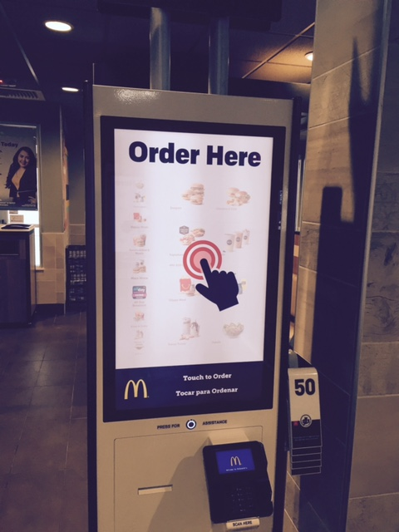
Notes:
A coworker took this picture at a McDonalds restaurant where you order from a big touch screen rather than talking to a person.
====
Frank took this picture

Slide 136
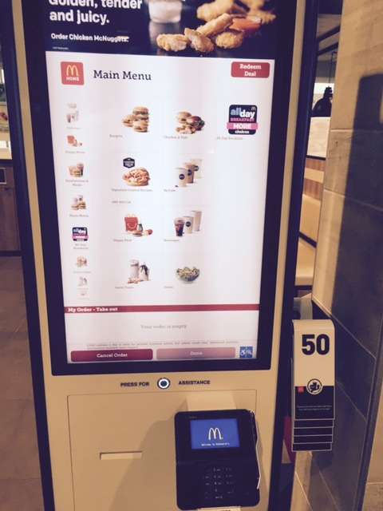
Notes:
Us introverts don’t mind this lack of human interaction, but this is going to drive you extraverts crazy.
====
Frank took this picture

Slide 137
Notes:
In the seventies, little Michael Jackson showed us all how to dance like a robot
=======
http://www.thebigdm.com/wp-content/uploads/2016/05/J5-Robot-Soul-Train.png

Slide 138
Notes:
Now we have Robots that dance like humans.
When are the robots going to realize that they don't really need us around?
======
https://www.bizjournals.com/triangle/news/2018/01/02/new-robots-make-sushi-mix-cocktails-and-build.html?ana=e_ae_set2&s=article_du&ed=2018-01-02&u=DFsejj4U8KnV9lBFgI8D1Q03b85e1a&t=1515168402&j=79435251
New robots make sushi, mix cocktails and build homes

Slide 139
Notes:
Digital pets never wet the carpet, -- but will these replace real dogs as man's best digital friend?
======
https://www.bizjournals.com/triangle/news/2018/01/02/new-robots-make-sushi-mix-cocktails-and-build.html?ana=e_ae_set2&s=article_du&ed=2018-01-02&u=DFsejj4U8KnV9lBFgI8D1Q03b85e1a&t=1515168402&j=79435251
New robots make sushi, mix cocktails and build homes

Slide 140
Notes:
A robotic bartender.
A robotic bartender that gets the drink right every time.
Now if they can just get these robots to react to my sad story as I sit at the bar.
======
https://www.bizjournals.com/triangle/news/2018/01/02/new-robots-make-sushi-mix-cocktails-and-build.html?ana=e_ae_set2&s=article_du&ed=2018-01-02&u=DFsejj4U8KnV9lBFgI8D1Q03b85e1a&t=1515168402&j=79435251
New robots make sushi, mix cocktails and build homes

Slide 141
Notes:
Robotic cheerleaders?
You think the Dallas Cowboys might replace theirs with these?
======
https://www.bizjournals.com/triangle/news/2018/01/02/new-robots-make-sushi-mix-cocktails-and-build.html?ana=e_ae_set2&s=article_du&ed=2018-01-02&u=DFsejj4U8KnV9lBFgI8D1Q03b85e1a&t=1515168402&j=79435251
New robots make sushi, mix cocktails and build homes

Slide 142
Atomo: We hacked the coffee bean - invented molecular coffee
We are food scientists, biochemists and entrepreneurs, and we reverse engineered the coffee bean to create a better cup of coffee.
Notes:
Coffee that is not made from coffee beans?
That's thinking outside the box.
Growing coffee can be expensive. It has to be grown at extremely high elevations, so in some cases, people climb mountains on foot to tend to the crops and pick the berries.
This company has figured out all of the chemical properties in coffee and found other organic substances to emulate a cup of coffee. The best thing is they can include all the good flavors and eliminate all the bad flavors. They hope to outsmart Mother Nature and produce a better cup of coffee.
We need people to dream up these ideas and chemists and physicists to figure out how to do it.. And in this case, they need lots of taste testers to try out the experimental coffee and see how it tastes.
We have to encourage people to dream big, rathe then forcing them to walk the straight and narrow.
======
https://atomocoffee.com/
https://www.kickstarter.com/projects/kleitsch/atomo-we-hacked-the-coffee-bean-invented-molecular

Slide 143
Notes:
You can take a course, pass a test and become a certified ScrumMaster.
Who knows what a ScrumMaster does?
Does anyone know the term “Scrum” from Rugby?
====
https://www.scrumalliance.org/get-certified/practitioners/csm-certification

Slide 144
Notes:
Search Monster dot com for ScrumMaster - and you find 6,698 job openings.
====
https://www.monster.com/jobs/search/?q=scrummaster&intcid=skr_navigation_nhpso_searchMain

Slide 145
Notes:
Indeed found 7,667 ScrumMaster jobs.
→ and check out this Scrum Master position in Charlotte that pays 135 thousand dollars.
Now, who wants to be a scrum master?
=====
https://www.indeed.com/jobs?q=Scrum+Master&l=

Slide 146
Notes:
And Zip Recruiter found 13,345 ScrumMaster job openings.
That’s a lot of job openings for a job most folks have never heard of.
===
https://www.ziprecruiter.com/candidate/search?search=Scrum+Master&location=

Slide 147
ScrumMaster
Manages the team process, not the team
Not a decision maker
Guide/coach the team
A servant leader
Promote sense of community
Notes:
Here is a few descriptors of the ScrumMaster.
I think the best word we have used up to now to describe this position is a facilitator.
The Scrum Master guides the team, but does not actively do the work of a team member.
They get each team member to vocalize what they are doing and to identify any road blocks they see.
They are not managing the team as a traditional manager, they are instead managing the process.
Ensuring a smooth process, regardless of the product being made.
How do people find out about these jobs that are in high demand?
How do we help our clients find out about these jobs -- and figure out if they are the right candidate to become a ScrumMaster?
=====
https://www.projectmanager.com/blog/what-is-a-scrum-master-everything-you-need
A Scrum Master might sound like a character in a role-playing game, but it’s a serious job that’s rooted in leadership. The Scrum Master is responsible for ensuring a true Scrum process over the course of a project. They hold together the Scrum framework, facilitating the process for the organization, product owner and Scrum team.
Scrum, according to Scrum.org, is a framework that allows teams to work on complex projects and deliver high-value products by approaching problems adaptively. It’s a simple, straightforward and easy-to-implement way to handle projects. It can pivot and encourages continuous feedback, which allows a project to more accurately fulfill a customer’s needs.
Thanks to its many benefits, Scrum continues to grow in popularity. According to the Scrum Alliance report last year on “The State of Scrum,” 89 percent of Agile users use the Scrum approach, where 62 percent of those polled have an in-house Scrum coach and 86 percent hold a daily Scrum meeting.
These statistics show the importance of the Scrum Master, for no Scrum team should be without one. So let’s take a closer look at the role of the Scrum Master.
What Is a Scrum Master?
The Scrum Master is the person on the team who is responsible for managing the process, and only the process. They are not involved in the decision-making, but act as a lodestar to guide the team through the Scrum process with their experience and expertise.
Not everyone on the team will have the same understanding of Scrum, and that’s especially true for teams new to the framework. Without a Scrum Master promoting and supporting the process, who can help team members understand the theory, practice, rules and values of Scrum, the project can flounder and fail.
Holistic Leadership
One way to look at the Scrum Master is as a servant leader. They’re not part of a hierarchy, barking orders or demanding ROI. Instead, they’re taking a more holistic approach to work, offering service to others while promoting a sense of community and supporting a shared decision-making power.
One thing the scrum master should be careful to stay away from is over-evangelizing, namely constantly pointing out to their team members when they are “doing scrum wrong”. This is counterproductive and does not fit into the description of what the scrum master should be doing. Rather, the scrum master should catch people doing things right; and then, in the spirit of a the best teachers, show them how things can be done better.
Scrum Master Role
The Scrum Master has several roles in the project. The Scrum Master serves the product owner by making sure that the goals, scope and product domain are clear to everyone on the Scrum team. They offer techniques and tools to manage the product backlog effectively and help the Scrum team know that there is a need to keep the product backlog items clear and concise.
They also know product planning in an empirical environment. Naturally, a Scrum Master is adept at being agile and can practice agility. They know Agile as a way of approaching a project and can set up meetings as needed to direct or pass on information about the process.
The Scrum Team
When it comes to the Scrum team, a Scrum Master acts as a coach, helping them to self-organize and work cross-functionally. They also assist with getting the team to create a high-value product by removing obstacles in their process and coaching them through meetings or other venues when help is needed.
An obstacle or impediment may be anything that slows the team down from getting their work done. This could include unnecessary approval processes, slow responsiveness from other departments, or maybe even updating outdated hardware or systems.
The Scrum team should be able to count on the scrum master to clear the path ahead of them. This will allow them to focus on the work that is currently on their plate to accomplish and get it done as efficiently and effectively as possible.
The Organization at Large
Finally, the Scrum Master also helps the organization by leading and coaching the transition into a Scrum framework. This includes helping the employees and stakeholders work in an empirical product development mode. In this capacity, the Scrum Master will lead change that increases the productivity of the team while working with other Scrum Masters to help foster Scrum throughout the organization.
Another big role that the scrum master plays is to constantly dispense information to project stakeholders about where the current sprint and development effort stand. This can be done via the various artifacts of scrum (i.e. backlogs to burn down charts) and just common-sense communication efforts.
What Does a Scrum Master Do?
While a Scrum Master is a crucial member of the Scrum team, they are not involved in planning the release. That’s done by the product owner and the team. A Scrum Master doesn’t manage; a Scrum team is self-organizing. In fact, a Scrum Master isn’t responsible for the success of the project’s result.
Yet, without a Scrum Master the whole thing would fall apart. The Scrum Master is the glue that holds the project together by facilitating, though not participating, in the daily standup meeting. They help the team maintain their burndown chart and set up retrospectives, sprint reviews and sprint planning sessions.
They also help the product owner by walking them through the more technical user stories and encourage collaboration between the product owner and Scrum manager. So, every part of the Scrum process is being helped by the guidance of the Scrum Master. A Scrum Master is like a mechanic, not driving the car but making sure that it’s in proper working order.
Is the Scrum Master a Dedicated Role?
There is some discussion about how involved the Scrum Master should be when it comes to the actual development work that is underway. One school of thought is that the Scrum Master should be exclusively dedicated to their role described above and not get buried in the day to day pressures, deadlines, and constraints that come from actually having to do the work themselves. Others feel as if the role described above may not consume 100% of the time that is available and any leftover time can be devoted to toward development work.
There are pros and cons to each approach. If a Scrum Master is involved in development activities, they could find themselves in the critical path of a project that is underway. This means that when the going gets tough or deadlines are looming, they will most likely default to getting their own work done. This is understandable based upon the pressure that is put upon their particular deliverable. But, it could also let the team suffer during a time that they especially need someone filling the role of Scrum Master.
The upside of a Scrum Master filling both roles is that the company may feel as if they are getting more for their money by not having to invest in two people to fill the roles.
On the other hand, a person that is a 100% dedicated Scrum Master focuses exclusively on the activities mentioned above. They are the person that constantly has the big picture in mind and is always looking ahead for what could be in the way of the project moving forward, or what opportunities could be taken advantage of to bring the sprint to a more expeditious completion.
The downside of this approach is that there may need to be more resources applied to the project from a technical perspective and may cost the company additional money.
How to Become a Scrum Master
What’s the pathway to becoming a Scrum Master? The most linear course to becoming a Scrum Master is through certification. The Scrum Alliance offers a Certified ScrumMaster (CSM) distinction that teaches the candidate how to get Scrum teams to work at their highest levels.
The certification process teaches the fundamentals of the Scrum framework and helps one become intimate with what the team roles are, what events are, what artifacts and rules are, and other terms and procedures of Scrum.
Having such certification on top of real-world work experience will place the certified ScrumMaster in a position to expand their career across many industries. A certification demonstrates a core knowledge of Scrum process and how to engage with other Scrum practitioners to further continuous improvement.
ScrumMaster Requirements
The requirements for CSM are fairly minimal. First, have some familiarity with the Scrum framework. Then there’s a two-day, 16-hour course, which is taught by a Certified Scrum Trainer, who provides an overview of how to organize and support a Scrum team.
After the course there is a CSM exam. If you pass and accept the license agreement, you will graduate with a two-year membership into the Scrum Alliance. There are other certifying bodies besides the Scrum Alliance which also offer a CSM exam, such as Mountain Goat Software.
ScrumMaster Certification Exam
The exam contains 35 multiple-choice questions, where 24 must be answered correctly for a passing grade. The test covers the history of Scrum and the basics of the process. Specific topics include product backlogs, planning releases, problems that can occur, scalability, Scrum roles, sprints, how to conduct daily Scrum meetings, tasks, reports and team organization.
While taking the test, test-takers can look at handouts and their notes. There is a time limit to the test, and you can pause it if you’re called away. But the test must be completed within 90 days of starting.
Results are posted immediately upon completing the test. If you pass, you’ll be able to see any wrong answers and the correct answers. However, if you do not pass, while you’ll see those questions that you missed, the answers will not be provided. If you fail, you can take the test one more time without further charge.
Certified ScrumMaster Salary
A Certified ScrumMaster makes on average, depending on industry and region, between $70,000 and $100,000 annually. Certification makes a Scrum Master a more viable candidate for the job, as it provides a unbiased third-party verification of skills.
Do you want to be a Scrum Master? It’s a cool title, but it’s more than a name. There’s a lot of responsibility and having the right tools to facilitate the Scrum process is key to any Scrum Master’s success. ProjectManager.com is a cloud-based project management software that works with the self-organizing teams and short tasks of a Scrum framework. Be a Scrum Master with ProjectManager.com by taking this free 30-day trial.

Slide 148
The 10 Key Skills for the Future of Work
Sense-making
Social intelligence
Novel and adaptive thinking
Cross-cultural competency
Computational thinking
New-media literacy
Transdisciplinarity
Design mind-set
Cognitive load management
Virtual collaboration
Notes:
Here are some broad skills that will help workers adapt to the changing career landscape:
Sense-making is the ability to determine the deeper meaning or significance of what is being expressed
Social intelligence is the ability to connect to others in a deep and direct way, to sense and stimulate reactions and desired interactions
Novel and adaptive thinking is proficiency at thinking and coming up with solutions and responses beyond that which is rote or rule-based
Cross-cultural competency is the ability to operate in different cultural settings
Download my PowerPoint and read the descriptions for the rest of these.
Where are we teaching these skills that the workforce needs?
==========
Computational thinking is the ability to translate vast amounts of data into abstract concepts and to understand data-based reasoning
New-media literacy is the ability to critically assess and develop content that uses new media forms and to leverage these media for persuasive communication
Transdisciplinarity is literacy in, and ability to understand concepts across multiple disciplines
Design mind-set is the ability to represent and develop tasks and work processes for desired outcomes
Cognitive load management is the ability to discriminate and filter information for importance and to understand how to maximize cognitive functioning using a variety of tools and techniques, and
Virtual collaboration is the ability to work productively, drive engagement, and demonstrate presence as a member of a virtual team
Are we teaching these skills to our students? If not, then who will?
========
GigaOM
Dec. 16, 2011,
http://gigaom.com/collaboration/the-10-key-skills-for-the-future-of-work/?utm_source=General%20Users&utm_campaign=9bd9bdcde9-c%3Atec%20d%3A12-17&utm_medium=email
What are the jobs of the future? The demographics of an aging population suggests health care will be big, say some.
Broad skills that will help workers adapt to the changing career landscape:
Sense-making. The ability to determine the deeper meaning or significance of what is being expressed
Social intelligence. The ability to connect to others in a deep and direct way, to sense and stimulate reactions and desired interactions
Novel and adaptive thinking. Proficiency at thinking and coming up with solutions and responses beyond that which is rote or rule-based
Cross-cultural competency. The ability to operate in different cultural settings
Computational thinking. The ability to translate vast amounts of data into abstract concepts and to understand data-based reasoning
New-media literacy. The ability to critically assess and develop content that uses new media forms and to leverage these media for persuasive communication
Transdisciplinarity. Literacy in and ability to understand concepts across multiple disciplines
Design mind-set. Ability to represent and develop tasks and work processes for desired outcomes
Cognitive load management. The ability to discriminate and filter information for importance and to understand how to maximize cognitive functioning using a variety of tools and techniques
Virtual collaboration. The ability to work productively, drive engagement and demonstrate presence as a member of a virtual team

Slide 149
Ambition
Notes:
Employers are willing to train their employees to learn new technical skills, but they do not have time to make their employees ambitious.
Cultivating ambition and an eagerness to learn and do well -- are really important.
Young people who show ambition are more employable,
Ambition is a good thing, -- however, -- too much ambition can be bad.
Remember that as a new employee you are ambitious to learn, not ambitious to take over.
Being overly ambitious could indicate an unwillingness to learn.
======
http://www.huffingtonpost.com/jennifer-kushell/how-to-prepare-young-peop_b_4593076.html
http://www.therecruitmentdesk.com/?tag=ronald-mcdonald
With the world changing as fast as it is - industries rising, evolving and crashing; technology leading to more efficient, effective ways of doing everything; globalization interconnecting us all; and a whole new generation emerging and entering the workforce - how do we best ensure young people are prepared for the world of work from here forward? Keep in mind that along with the jobs being phased out, countless more jobs don’t even exist yet.
In order to create employment for those who are graduating, it’s important for us to review a system that has become antiquated. Even more critical, however, is to note that our current models of education, career planning and job searching are not just in need of a facelift - we need a major paradigm shift in how we think about training our emerging workforce and the skills they need to have to be relevant, let alone have a chance at being wildly successful.
But we do not need to wait for this shift in order to start teaching the new rules of success every day, in every forum, and every possible platform and channel available to us. It can be done in simple conversations or formalized programs - everyone can play a role in training our young people; they are, after all, our kids, cousins, neighbors, friends, colleagues and employees. The bottom line is that we can all ensure this emerging generation is primed for success, and it’s in our best interest to do so. Our future depends on it.
The following 10 skills are most vital to young people entering the workforce:
Ambition Ambition changes the opportunity outlooks for a young person dramatically. Employers are increasingly looking to hire for attitude and train for skill, so cultivating ambition and an eagerness to learn and do well are really Step 1 toward a solid future. Young people who are hungry, interested and engaged are infinitely more employable, and when they have a passion for achievement, there are no limits to what they can do. Rather than just hire warm bodies, companies would much rather choose people who show promise and a solid foundation.
Value Understanding what it means to add value to a company or organization is a fundamental question that should be answered by anyone looking for work, along with appreciating why that’s an important question in the first place. Employment is an earned privilege, not a right - even with a fancy diploma in hand, there are no promises or guarantees. People are typically the biggest expense in any organization, and those who add most value have the best job security. Those who don’t usually don’t stay employed for very long. In a corporate world that is looking more than ever before at operating lean, it’s no longer possible to hide and not contribute to a company’s financial well-being.
Articulation The vast majority of young people struggle with explaining what they want to do, what work-related activities interest them, what transferable skills they have, and which industries or positions might best suit them. As a result, when they set out to market themselves, or interview with potential employers, they offer little useful information, and instead rely on those doing the hiring to find the right fit and figure it out. Recruiters are not career counselors - selling oneself in the job market is the responsibility of the seeker! Relying on our institutions or parents to “place” young people in jobs is a practice fraught with problems, and enabling entitlement or minimizing the importance of self-sufficiency - or the fortitude to secure meaningful work - are only a few of the drawbacks. Teaching people to pitch themselves effectively early in their working lives enables them to find employment on their own over a lifetime.
Skills The basis of any solid employment marketing campaign (job search) is the actual skill base a worker presents to potential employers. At the most fundamental level, soft skills like interpersonal communication, the ability to speak and write correctly and present ideas clearly, are the areas most often cited when employers discuss the downside of hiring young people. Dressing appropriately (highly subjective these days) is also considered a critical part of communication. So despite the constant “communication” through technology that has dominated young lives, they are at a massive disadvantage because in person those soft skills are not present.
Expertise Besides being a good person to work with and around, bringing some substantive expertise to the table cannot be urged enough. It doesn’t matter what the topic, as long as it’s valuable in the marketplace (remember the “Adding Value” piece above?). Ideally, expertise is transferable to other applications and industries too - and it’s important to note that attending specialty schools and formal training programs are not the only ways to acquire expertise. It can and should be cultivated constantly, with young people maximizing every opportunity to read, learn, volunteer, train, practice or work.
Terminology Every industry relies on its own lexicon of terminology to operate and communicate. Often these are technical concepts, processes or acronyms that sound foreign to people new to a field. Teaching young people to learn the language of a given workplace, industry or role is directly related to how smart they will sound and how well they will function in an environment, and dramatically improve their chance of securing jobs because companies will first choose someone who needs less time to be brought up to speed.
Curiosity When young people are supported in pursuing fields that are of true interest, they are more likely to want to learn more and become well-versed in those areas. Intellectual curiosity leads to better educated and more informed workers, who can quickly cultivate themselves into real talent with a little help. The more inspired and motivated they are, and the more space they are given to explore, create and innovate, the more their potential becomes unlimited. This is an important consideration given that school curriculum often focus on a core set of skills, and other programs such as art, music or other non-academics are eliminated.
Context The concept of context is a vital one to address with young people, from 4 key perspectives:
1) The working world operates by a different set of rules than most homes and schools. Training young people to acclimate to the adult world of work requires a dramatic shift in routines and expectations from a lifetime of studying and attending classes.
2) Different workplaces have different expectations about dress, attendance, communication, metrics for success and even use of personal technologies. Expectations that aren’t clearly understood are difficult to meet and that sets everyone up for failure. 3) It is a big problem that most young graduates don’t understand how business fundamentally works and is organized. For example, what is the difference between marketing and sales, or operations? What signs would signal that a company or industry is hiring, or worth studying or pursuing jobs in? How does one company fare in a market of other competitors (who happen to be other potential employers too)? What do industries look like? 4) How do we all fit into the bigger context of the world economy as global citizens? With a billion young people entering the workforce, there’s a lot of competition, but also plenty of untapped opportunity.
All of these conversations, if nothing else, break young people from the idea that they’re the center of the universe. Or, conversely, that their world is small, restricted and their options are limited.
Experience Students, unemployed people and those in jobs they hate are all missing opportunities to improve their circumstances and marketability by building experience, which can be acquired in countless ways. In many cases, they can do so simply by volunteering time to local organizations, businesses, campaigns and community events. The more relevant to the skills or the industries someone wants to use at work, the better. With countless organizations struggling to survive and grow, but desperate for help they cannot afford, volunteering or interning can be the perfect opportunity for people to gain practical experience and connections, and to seed future opportunities. Even if the opportunities are unpaid, by staying active and engaged makes the unemployed infinitely more marketable.
Resourcefulness Teaching young people to be solution-driven (rather than easily deterred by failure) makes them more valuable, competitive and self-sufficient. When people are resourceful, they will always entertain new ideas, approaches and possibilities. Entrepreneurship education and experience is an excellent way to drive this home and make young people more resourceful, as are hackathons, leadership activities and organizations. Cultivating resourcefulness as a skill prepares young people for jobs that may not yet exist; in fact, the more resourceful they are, the more likely the next generation will be to create their own jobs - and companies that will create jobs for others.

Slide 150
Value
Notes:
Understanding what it means to add value to a company or organization is a fundamental question that should be answered by anyone looking for work, along with appreciating why that’s an important question in the first place.
Employment is an earned privilege, not a right - even with a fancy diploma in hand, there are no promises or guarantees.
People are typically the biggest expense in any organization, and those who add the most value have the best job security.
Those who don’t add value usually don’t stay employed for very long.
What makes you a valuable person?
How can you convey that image to a potential employer?
======
http://www.huffingtonpost.com/jennifer-kushell/how-to-prepare-young-peop_b_4593076.html
http://www.therecruitmentdesk.com/?tag=ronald-mcdonald
http://worldofdtcmarketing.com/ensure-pharma-websites-add-value/health-information-online/
With the world changing as fast as it is - industries rising, evolving and crashing; technology leading to more efficient, effective ways of doing everything; globalization interconnecting us all; and a whole new generation emerging and entering the workforce - how do we best ensure young people are prepared for the world of work from here forward? Keep in mind that along with the jobs being phased out, countless more jobs don’t even exist yet.
In order to create employment for those who are graduating, it’s important for us to review a system that has become antiquated. Even more critical, however, is to note that our current models of education, career planning and job searching are not just in need of a facelift - we need a major paradigm shift in how we think about training our emerging workforce and the skills they need to have to be relevant, let alone have a chance at being wildly successful.
But we do not need to wait for this shift in order to start teaching the new rules of success every day, in every forum, and every possible platform and channel available to us. It can be done in simple conversations or formalized programs - everyone can play a role in training our young people; they are, after all, our kids, cousins, neighbors, friends, colleagues and employees. The bottom line is that we can all ensure this emerging generation is primed for success, and it’s in our best interest to do so. Our future depends on it.
The following 10 skills are most vital to young people entering the workforce:
Ambition Ambition changes the opportunity outlooks for a young person dramatically. Employers are increasingly looking to hire for attitude and train for skill, so cultivating ambition and an eagerness to learn and do well are really Step 1 toward a solid future. Young people who are hungry, interested and engaged are infinitely more employable, and when they have a passion for achievement, there are no limits to what they can do. Rather than just hire warm bodies, companies would much rather choose people who show promise and a solid foundation.
Value Understanding what it means to add value to a company or organization is a fundamental question that should be answered by anyone looking for work, along with appreciating why that’s an important question in the first place. Employment is an earned privilege, not a right - even with a fancy diploma in hand, there are no promises or guarantees. People are typically the biggest expense in any organization, and those who add most value have the best job security. Those who don’t usually don’t stay employed for very long. In a corporate world that is looking more than ever before at operating lean, it’s no longer possible to hide and not contribute to a company’s financial well-being.
Articulation The vast majority of young people struggle with explaining what they want to do, what work-related activities interest them, what transferable skills they have, and which industries or positions might best suit them. As a result, when they set out to market themselves, or interview with potential employers, they offer little useful information, and instead rely on those doing the hiring to find the right fit and figure it out. Recruiters are not career counselors - selling oneself in the job market is the responsibility of the seeker! Relying on our institutions or parents to “place” young people in jobs is a practice fraught with problems, and enabling entitlement or minimizing the importance of self-sufficiency - or the fortitude to secure meaningful work - are only a few of the drawbacks. Teaching people to pitch themselves effectively early in their working lives enables them to find employment on their own over a lifetime.
Skills The basis of any solid employment marketing campaign (job search) is the actual skill base a worker presents to potential employers. At the most fundamental level, soft skills like interpersonal communication, the ability to speak and write correctly and present ideas clearly, are the areas most often cited when employers discuss the downside of hiring young people. Dressing appropriately (highly subjective these days) is also considered a critical part of communication. So despite the constant “communication” through technology that has dominated young lives, they are at a massive disadvantage because in person those soft skills are not present.
Expertise Besides being a good person to work with and around, bringing some substantive expertise to the table cannot be urged enough. It doesn’t matter what the topic, as long as it’s valuable in the marketplace (remember the “Adding Value” piece above?). Ideally, expertise is transferable to other applications and industries too - and it’s important to note that attending specialty schools and formal training programs are not the only ways to acquire expertise. It can and should be cultivated constantly, with young people maximizing every opportunity to read, learn, volunteer, train, practice or work.
Terminology Every industry relies on its own lexicon of terminology to operate and communicate. Often these are technical concepts, processes or acronyms that sound foreign to people new to a field. Teaching young people to learn the language of a given workplace, industry or role is directly related to how smart they will sound and how well they will function in an environment, and dramatically improve their chance of securing jobs because companies will first choose someone who needs less time to be brought up to speed.
Curiosity When young people are supported in pursuing fields that are of true interest, they are more likely to want to learn more and become well-versed in those areas. Intellectual curiosity leads to better educated and more informed workers, who can quickly cultivate themselves into real talent with a little help. The more inspired and motivated they are, and the more space they are given to explore, create and innovate, the more their potential becomes unlimited. This is an important consideration given that school curriculum often focus on a core set of skills, and other programs such as art, music or other non-academics are eliminated.
Context The concept of context is a vital one to address with young people, from 4 key perspectives:
1) The working world operates by a different set of rules than most homes and schools. Training young people to acclimate to the adult world of work requires a dramatic shift in routines and expectations from a lifetime of studying and attending classes.
2) Different workplaces have different expectations about dress, attendance, communication, metrics for success and even use of personal technologies. Expectations that aren’t clearly understood are difficult to meet and that sets everyone up for failure. 3) It is a big problem that most young graduates don’t understand how business fundamentally works and is organized. For example, what is the difference between marketing and sales, or operations? What signs would signal that a company or industry is hiring, or worth studying or pursuing jobs in? How does one company fare in a market of other competitors (who happen to be other potential employers too)? What do industries look like? 4) How do we all fit into the bigger context of the world economy as global citizens? With a billion young people entering the workforce, there’s a lot of competition, but also plenty of untapped opportunity.
All of these conversations, if nothing else, break young people from the idea that they’re the center of the universe. Or, conversely, that their world is small, restricted and their options are limited.
Experience Students, unemployed people and those in jobs they hate are all missing opportunities to improve their circumstances and marketability by building experience, which can be acquired in countless ways. In many cases, they can do so simply by volunteering time to local organizations, businesses, campaigns and community events. The more relevant to the skills or the industries someone wants to use at work, the better. With countless organizations struggling to survive and grow, but desperate for help they cannot afford, volunteering or interning can be the perfect opportunity for people to gain practical experience and connections, and to seed future opportunities. Even if the opportunities are unpaid, by staying active and engaged makes the unemployed infinitely more marketable.
Resourcefulness Teaching young people to be solution-driven (rather than easily deterred by failure) makes them more valuable, competitive and self-sufficient. When people are resourceful, they will always entertain new ideas, approaches and possibilities. Entrepreneurship education and experience is an excellent way to drive this home and make young people more resourceful, as are hackathons, leadership activities and organizations. Cultivating resourcefulness as a skill prepares young people for jobs that may not yet exist; in fact, the more resourceful they are, the more likely the next generation will be to create their own jobs - and companies that will create jobs for others.

Slide 151
Articulation
Notes:
The vast majority of young people struggle with explaining what they want to do, what work-related activities interest them, what transferable skills they have, and which industries or positions might best suit them.
As a result, when they set out to market themselves, or interview with potential employers, they offer little useful information, and instead rely on those doing the hiring to help them find the right fit and figure it out.
But - Job Recruiters are not career counselors
Teaching people to pitch themselves effectively early in their working lives enables them to find employment on their own over a lifetime.
It takes practice to become an articulate speaker.
Be yourself. People want to hear what you have to offer.
Practice, practice, practice.
Getting Constructive criticism from folks you can trust is important.
======
http://www.huffingtonpost.com/jennifer-kushell/how-to-prepare-young-peop_b_4593076.html
http://www.therecruitmentdesk.com/?tag=ronald-mcdonald
http://prakovic.edublogs.org/2015/11/09/writing-about-articulation-in-a-progress-report/
With the world changing as fast as it is - industries rising, evolving and crashing; technology leading to more efficient, effective ways of doing everything; globalization interconnecting us all; and a whole new generation emerging and entering the workforce - how do we best ensure young people are prepared for the world of work from here forward? Keep in mind that along with the jobs being phased out, countless more jobs don’t even exist yet.
In order to create employment for those who are graduating, it’s important for us to review a system that has become antiquated. Even more critical, however, is to note that our current models of education, career planning and job searching are not just in need of a facelift - we need a major paradigm shift in how we think about training our emerging workforce and the skills they need to have to be relevant, let alone have a chance at being wildly successful.
But we do not need to wait for this shift in order to start teaching the new rules of success every day, in every forum, and every possible platform and channel available to us. It can be done in simple conversations or formalized programs - everyone can play a role in training our young people; they are, after all, our kids, cousins, neighbors, friends, colleagues and employees. The bottom line is that we can all ensure this emerging generation is primed for success, and it’s in our best interest to do so. Our future depends on it.
The following 10 skills are most vital to young people entering the workforce:
Ambition Ambition changes the opportunity outlooks for a young person dramatically. Employers are increasingly looking to hire for attitude and train for skill, so cultivating ambition and an eagerness to learn and do well are really Step 1 toward a solid future. Young people who are hungry, interested and engaged are infinitely more employable, and when they have a passion for achievement, there are no limits to what they can do. Rather than just hire warm bodies, companies would much rather choose people who show promise and a solid foundation.
Value Understanding what it means to add value to a company or organization is a fundamental question that should be answered by anyone looking for work, along with appreciating why that’s an important question in the first place. Employment is an earned privilege, not a right - even with a fancy diploma in hand, there are no promises or guarantees. People are typically the biggest expense in any organization, and those who add most value have the best job security. Those who don’t usually don’t stay employed for very long. In a corporate world that is looking more than ever before at operating lean, it’s no longer possible to hide and not contribute to a company’s financial well-being.
Articulation The vast majority of young people struggle with explaining what they want to do, what work-related activities interest them, what transferable skills they have, and which industries or positions might best suit them. As a result, when they set out to market themselves, or interview with potential employers, they offer little useful information, and instead rely on those doing the hiring to find the right fit and figure it out. Recruiters are not career counselors - selling oneself in the job market is the responsibility of the seeker! Relying on our institutions or parents to “place” young people in jobs is a practice fraught with problems, and enabling entitlement or minimizing the importance of self-sufficiency - or the fortitude to secure meaningful work - are only a few of the drawbacks. Teaching people to pitch themselves effectively early in their working lives enables them to find employment on their own over a lifetime.
Skills The basis of any solid employment marketing campaign (job search) is the actual skill base a worker presents to potential employers. At the most fundamental level, soft skills like interpersonal communication, the ability to speak and write correctly and present ideas clearly, are the areas most often cited when employers discuss the downside of hiring young people. Dressing appropriately (highly subjective these days) is also considered a critical part of communication. So despite the constant “communication” through technology that has dominated young lives, they are at a massive disadvantage because in person those soft skills are not present.
Expertise Besides being a good person to work with and around, bringing some substantive expertise to the table cannot be urged enough. It doesn’t matter what the topic, as long as it’s valuable in the marketplace (remember the “Adding Value” piece above?). Ideally, expertise is transferable to other applications and industries too - and it’s important to note that attending specialty schools and formal training programs are not the only ways to acquire expertise. It can and should be cultivated constantly, with young people maximizing every opportunity to read, learn, volunteer, train, practice or work.
Terminology Every industry relies on its own lexicon of terminology to operate and communicate. Often these are technical concepts, processes or acronyms that sound foreign to people new to a field. Teaching young people to learn the language of a given workplace, industry or role is directly related to how smart they will sound and how well they will function in an environment, and dramatically improve their chance of securing jobs because companies will first choose someone who needs less time to be brought up to speed.
Curiosity When young people are supported in pursuing fields that are of true interest, they are more likely to want to learn more and become well-versed in those areas. Intellectual curiosity leads to better educated and more informed workers, who can quickly cultivate themselves into real talent with a little help. The more inspired and motivated they are, and the more space they are given to explore, create and innovate, the more their potential becomes unlimited. This is an important consideration given that school curriculum often focus on a core set of skills, and other programs such as art, music or other non-academics are eliminated.
Context The concept of context is a vital one to address with young people, from 4 key perspectives:
1) The working world operates by a different set of rules than most homes and schools. Training young people to acclimate to the adult world of work requires a dramatic shift in routines and expectations from a lifetime of studying and attending classes.
2) Different workplaces have different expectations about dress, attendance, communication, metrics for success and even use of personal technologies. Expectations that aren’t clearly understood are difficult to meet and that sets everyone up for failure. 3) It is a big problem that most young graduates don’t understand how business fundamentally works and is organized. For example, what is the difference between marketing and sales, or operations? What signs would signal that a company or industry is hiring, or worth studying or pursuing jobs in? How does one company fare in a market of other competitors (who happen to be other potential employers too)? What do industries look like? 4) How do we all fit into the bigger context of the world economy as global citizens? With a billion young people entering the workforce, there’s a lot of competition, but also plenty of untapped opportunity.
All of these conversations, if nothing else, break young people from the idea that they’re the center of the universe. Or, conversely, that their world is small, restricted and their options are limited.
Experience Students, unemployed people and those in jobs they hate are all missing opportunities to improve their circumstances and marketability by building experience, which can be acquired in countless ways. In many cases, they can do so simply by volunteering time to local organizations, businesses, campaigns and community events. The more relevant to the skills or the industries someone wants to use at work, the better. With countless organizations struggling to survive and grow, but desperate for help they cannot afford, volunteering or interning can be the perfect opportunity for people to gain practical experience and connections, and to seed future opportunities. Even if the opportunities are unpaid, by staying active and engaged makes the unemployed infinitely more marketable.
Resourcefulness Teaching young people to be solution-driven (rather than easily deterred by failure) makes them more valuable, competitive and self-sufficient. When people are resourceful, they will always entertain new ideas, approaches and possibilities. Entrepreneurship education and experience is an excellent way to drive this home and make young people more resourceful, as are hackathons, leadership activities and organizations. Cultivating resourcefulness as a skill prepares young people for jobs that may not yet exist; in fact, the more resourceful they are, the more likely the next generation will be to create their own jobs - and companies that will create jobs for others.

Slide 152
Communication
Notes:
Families don’t sit around the dinner table and talk like they used to.
If they get together at all it is often at a fast-food restaurant on the way to soccer practice or dance lessons.
Often these days most of the folks around the table are busy texting or otherwise engaged in an off-table conversation.
Old-fashioned dinner-time conversations are an important part of family life that helps to build relationships.
These dinner-time conversations are an important way to learn how to communicate better with family, friends, in the classroom, and later on the job.
Simply reciting what you learned that day and what you are planning to do the following day is great practice for when your future boss wants to know why he should keep you around.
But it takes practice speaking in front of your supportive family --- that will give you the confidence to speak in front of others.
How can we encourage dinner-time conversations. Both at home and in the classroom.
======
Photo:
http://fatherhood.about.com/od/challenges/a/dinner_talk.htm

Slide 153
Skills
Notes:
Employers would like to see evidence that you possess a skill before they hire you.
Industry certifications are a good way of quickly showing that you have mastered certain skills.
Employers are willing to teach high-level technical skills that you do not have, in order to do your job.
But -- You have to be teachable -- and willing to learn.
Businesses do not want to teach you soft skills like communication, teamwork, collaboration, commitment, adaptability, and conflict resolution. They assume that you already have those skills.
Learning how to text message and update your FaceBook page are important ways of communicating, but talking face-to-face is the skill that will get you hired.
Technical skills may get you hired, but it is the soft skills that will keep you hired.
It is crucial that we teach in such a way as to perfect the soft skills in our youth. Some kids learn these skills at home, some don’t.
Many learn these skills taking part in a team-based extracurricular activity like athletics, band, chorus, or theater.
Team-based activities in our classrooms will help prepare the youth for a career, but unfortunately, those kinds of activities may not count towards evaluating the school’s performance.
======
http://www.huffingtonpost.com/jennifer-kushell/how-to-prepare-young-peop_b_4593076.html
http://www.therecruitmentdesk.com/?tag=ronald-mcdonald
http://lifehacker.com/diversify-your-skills-to-find-your-value-and-build-a-be-1708814777
With the world changing as fast as it is - industries rising, evolving and crashing; technology leading to more efficient, effective ways of doing everything; globalization interconnecting us all; and a whole new generation emerging and entering the workforce - how do we best ensure young people are prepared for the world of work from here forward? Keep in mind that along with the jobs being phased out, countless more jobs don’t even exist yet.
In order to create employment for those who are graduating, it’s important for us to review a system that has become antiquated. Even more critical, however, is to note that our current models of education, career planning and job searching are not just in need of a facelift - we need a major paradigm shift in how we think about training our emerging workforce and the skills they need to have to be relevant, let alone have a chance at being wildly successful.
But we do not need to wait for this shift in order to start teaching the new rules of success every day, in every forum, and every possible platform and channel available to us. It can be done in simple conversations or formalized programs - everyone can play a role in training our young people; they are, after all, our kids, cousins, neighbors, friends, colleagues and employees. The bottom line is that we can all ensure this emerging generation is primed for success, and it’s in our best interest to do so. Our future depends on it.
The following 10 skills are most vital to young people entering the workforce:
Ambition Ambition changes the opportunity outlooks for a young person dramatically. Employers are increasingly looking to hire for attitude and train for skill, so cultivating ambition and an eagerness to learn and do well are really Step 1 toward a solid future. Young people who are hungry, interested and engaged are infinitely more employable, and when they have a passion for achievement, there are no limits to what they can do. Rather than just hire warm bodies, companies would much rather choose people who show promise and a solid foundation.
Value Understanding what it means to add value to a company or organization is a fundamental question that should be answered by anyone looking for work, along with appreciating why that’s an important question in the first place. Employment is an earned privilege, not a right - even with a fancy diploma in hand, there are no promises or guarantees. People are typically the biggest expense in any organization, and those who add most value have the best job security. Those who don’t usually don’t stay employed for very long. In a corporate world that is looking more than ever before at operating lean, it’s no longer possible to hide and not contribute to a company’s financial well-being.
Articulation The vast majority of young people struggle with explaining what they want to do, what work-related activities interest them, what transferable skills they have, and which industries or positions might best suit them. As a result, when they set out to market themselves, or interview with potential employers, they offer little useful information, and instead rely on those doing the hiring to find the right fit and figure it out. Recruiters are not career counselors - selling oneself in the job market is the responsibility of the seeker! Relying on our institutions or parents to “place” young people in jobs is a practice fraught with problems, and enabling entitlement or minimizing the importance of self-sufficiency - or the fortitude to secure meaningful work - are only a few of the drawbacks. Teaching people to pitch themselves effectively early in their working lives enables them to find employment on their own over a lifetime.
Skills The basis of any solid employment marketing campaign (job search) is the actual skill base a worker presents to potential employers. At the most fundamental level, soft skills like interpersonal communication, the ability to speak and write correctly and present ideas clearly, are the areas most often cited when employers discuss the downside of hiring young people. Dressing appropriately (highly subjective these days) is also considered a critical part of communication. So despite the constant “communication” through technology that has dominated young lives, they are at a massive disadvantage because in person those soft skills are not present.
Expertise Besides being a good person to work with and around, bringing some substantive expertise to the table cannot be urged enough. It doesn’t matter what the topic, as long as it’s valuable in the marketplace (remember the “Adding Value” piece above?). Ideally, expertise is transferable to other applications and industries too - and it’s important to note that attending specialty schools and formal training programs are not the only ways to acquire expertise. It can and should be cultivated constantly, with young people maximizing every opportunity to read, learn, volunteer, train, practice or work.
Terminology Every industry relies on its own lexicon of terminology to operate and communicate. Often these are technical concepts, processes or acronyms that sound foreign to people new to a field. Teaching young people to learn the language of a given workplace, industry or role is directly related to how smart they will sound and how well they will function in an environment, and dramatically improve their chance of securing jobs because companies will first choose someone who needs less time to be brought up to speed.
Curiosity When young people are supported in pursuing fields that are of true interest, they are more likely to want to learn more and become well-versed in those areas. Intellectual curiosity leads to better educated and more informed workers, who can quickly cultivate themselves into real talent with a little help. The more inspired and motivated they are, and the more space they are given to explore, create and innovate, the more their potential becomes unlimited. This is an important consideration given that school curriculum often focus on a core set of skills, and other programs such as art, music or other non-academics are eliminated.
Context The concept of context is a vital one to address with young people, from 4 key perspectives:
1) The working world operates by a different set of rules than most homes and schools. Training young people to acclimate to the adult world of work requires a dramatic shift in routines and expectations from a lifetime of studying and attending classes.
2) Different workplaces have different expectations about dress, attendance, communication, metrics for success and even use of personal technologies. Expectations that aren’t clearly understood are difficult to meet and that sets everyone up for failure. 3) It is a big problem that most young graduates don’t understand how business fundamentally works and is organized. For example, what is the difference between marketing and sales, or operations? What signs would signal that a company or industry is hiring, or worth studying or pursuing jobs in? How does one company fare in a market of other competitors (who happen to be other potential employers too)? What do industries look like? 4) How do we all fit into the bigger context of the world economy as global citizens? With a billion young people entering the workforce, there’s a lot of competition, but also plenty of untapped opportunity.
All of these conversations, if nothing else, break young people from the idea that they’re the center of the universe. Or, conversely, that their world is small, restricted and their options are limited.
Experience Students, unemployed people and those in jobs they hate are all missing opportunities to improve their circumstances and marketability by building experience, which can be acquired in countless ways. In many cases, they can do so simply by volunteering time to local organizations, businesses, campaigns and community events. The more relevant to the skills or the industries someone wants to use at work, the better. With countless organizations struggling to survive and grow, but desperate for help they cannot afford, volunteering or interning can be the perfect opportunity for people to gain practical experience and connections, and to seed future opportunities. Even if the opportunities are unpaid, by staying active and engaged makes the unemployed infinitely more marketable.
Resourcefulness Teaching young people to be solution-driven (rather than easily deterred by failure) makes them more valuable, competitive and self-sufficient. When people are resourceful, they will always entertain new ideas, approaches and possibilities. Entrepreneurship education and experience is an excellent way to drive this home and make young people more resourceful, as are hackathons, leadership activities and organizations. Cultivating resourcefulness as a skill prepares young people for jobs that may not yet exist; in fact, the more resourceful they are, the more likely the next generation will be to create their own jobs - and companies that will create jobs for others.

Slide 154
Expertise
Notes:
You might have a skill that you can use to add value to the company, but are you an expert?
Expertise is having great skill or extensive knowledge in a particular area.
With a skill, you are following rote directions or pattern to complete a task within certain tolerances.
The Expert can not only demonstrate skill by performing a certain operation, but also knows why the work is done in a certain way.
It’s not just changing the oil, but knowing all about the lubrication properties of oil and how they protect various metal and plastic surfaces, and how heat, dust, and other environmental conditions can affect both the oil and the materials they are protecting. That’s the extra knowledge that turns a skilled person into an expert.
An expert could write reference book on changing oil, whereas a non-expert could change the oil correctly every time, but still have no idea how his actions truly affect the life of the engine.
Companies will pay more for expertise that they do not already have. Expertise adds value to you as an employee and adds value to the company for which you work.
Expertise should be cultivated constantly with young people by maximizing every opportunity to read, learn, volunteer, train, practice, or work.
======
http://www.huffingtonpost.com/jennifer-kushell/how-to-prepare-young-peop_b_4593076.html
http://www.therecruitmentdesk.com/?tag=ronald-mcdonald
http://chucksblog.typepad.com/.a/6a00d83451be8f69e201b8d0997c11970c-popup
With the world changing as fast as it is - industries rising, evolving and crashing; technology leading to more efficient, effective ways of doing everything; globalization interconnecting us all; and a whole new generation emerging and entering the workforce - how do we best ensure young people are prepared for the world of work from here forward? Keep in mind that along with the jobs being phased out, countless more jobs don’t even exist yet.
In order to create employment for those who are graduating, it’s important for us to review a system that has become antiquated. Even more critical, however, is to note that our current models of education, career planning and job searching are not just in need of a facelift - we need a major paradigm shift in how we think about training our emerging workforce and the skills they need to have to be relevant, let alone have a chance at being wildly successful.
But we do not need to wait for this shift in order to start teaching the new rules of success every day, in every forum, and every possible platform and channel available to us. It can be done in simple conversations or formalized programs - everyone can play a role in training our young people; they are, after all, our kids, cousins, neighbors, friends, colleagues and employees. The bottom line is that we can all ensure this emerging generation is primed for success, and it’s in our best interest to do so. Our future depends on it.
The following 10 skills are most vital to young people entering the workforce:
Ambition Ambition changes the opportunity outlooks for a young person dramatically. Employers are increasingly looking to hire for attitude and train for skill, so cultivating ambition and an eagerness to learn and do well are really Step 1 toward a solid future. Young people who are hungry, interested and engaged are infinitely more employable, and when they have a passion for achievement, there are no limits to what they can do. Rather than just hire warm bodies, companies would much rather choose people who show promise and a solid foundation.
Value Understanding what it means to add value to a company or organization is a fundamental question that should be answered by anyone looking for work, along with appreciating why that’s an important question in the first place. Employment is an earned privilege, not a right - even with a fancy diploma in hand, there are no promises or guarantees. People are typically the biggest expense in any organization, and those who add most value have the best job security. Those who don’t usually don’t stay employed for very long. In a corporate world that is looking more than ever before at operating lean, it’s no longer possible to hide and not contribute to a company’s financial well-being.
Articulation The vast majority of young people struggle with explaining what they want to do, what work-related activities interest them, what transferable skills they have, and which industries or positions might best suit them. As a result, when they set out to market themselves, or interview with potential employers, they offer little useful information, and instead rely on those doing the hiring to find the right fit and figure it out. Recruiters are not career counselors - selling oneself in the job market is the responsibility of the seeker! Relying on our institutions or parents to “place” young people in jobs is a practice fraught with problems, and enabling entitlement or minimizing the importance of self-sufficiency - or the fortitude to secure meaningful work - are only a few of the drawbacks. Teaching people to pitch themselves effectively early in their working lives enables them to find employment on their own over a lifetime.
Skills The basis of any solid employment marketing campaign (job search) is the actual skill base a worker presents to potential employers. At the most fundamental level, soft skills like interpersonal communication, the ability to speak and write correctly and present ideas clearly, are the areas most often cited when employers discuss the downside of hiring young people. Dressing appropriately (highly subjective these days) is also considered a critical part of communication. So despite the constant “communication” through technology that has dominated young lives, they are at a massive disadvantage because in person those soft skills are not present.
Expertise Besides being a good person to work with and around, bringing some substantive expertise to the table cannot be urged enough. It doesn’t matter what the topic, as long as it’s valuable in the marketplace (remember the “Adding Value” piece above?). Ideally, expertise is transferable to other applications and industries too - and it’s important to note that attending specialty schools and formal training programs are not the only ways to acquire expertise. It can and should be cultivated constantly, with young people maximizing every opportunity to read, learn, volunteer, train, practice or work.
Terminology Every industry relies on its own lexicon of terminology to operate and communicate. Often these are technical concepts, processes or acronyms that sound foreign to people new to a field. Teaching young people to learn the language of a given workplace, industry or role is directly related to how smart they will sound and how well they will function in an environment, and dramatically improve their chance of securing jobs because companies will first choose someone who needs less time to be brought up to speed.
Curiosity When young people are supported in pursuing fields that are of true interest, they are more likely to want to learn more and become well-versed in those areas. Intellectual curiosity leads to better educated and more informed workers, who can quickly cultivate themselves into real talent with a little help. The more inspired and motivated they are, and the more space they are given to explore, create and innovate, the more their potential becomes unlimited. This is an important consideration given that school curriculum often focus on a core set of skills, and other programs such as art, music or other non-academics are eliminated.
Context The concept of context is a vital one to address with young people, from 4 key perspectives:
1) The working world operates by a different set of rules than most homes and schools. Training young people to acclimate to the adult world of work requires a dramatic shift in routines and expectations from a lifetime of studying and attending classes.
2) Different workplaces have different expectations about dress, attendance, communication, metrics for success and even use of personal technologies. Expectations that aren’t clearly understood are difficult to meet and that sets everyone up for failure. 3) It is a big problem that most young graduates don’t understand how business fundamentally works and is organized. For example, what is the difference between marketing and sales, or operations? What signs would signal that a company or industry is hiring, or worth studying or pursuing jobs in? How does one company fare in a market of other competitors (who happen to be other potential employers too)? What do industries look like? 4) How do we all fit into the bigger context of the world economy as global citizens? With a billion young people entering the workforce, there’s a lot of competition, but also plenty of untapped opportunity.
All of these conversations, if nothing else, break young people from the idea that they’re the center of the universe. Or, conversely, that their world is small, restricted and their options are limited.
Experience Students, unemployed people and those in jobs they hate are all missing opportunities to improve their circumstances and marketability by building experience, which can be acquired in countless ways. In many cases, they can do so simply by volunteering time to local organizations, businesses, campaigns and community events. The more relevant to the skills or the industries someone wants to use at work, the better. With countless organizations struggling to survive and grow, but desperate for help they cannot afford, volunteering or interning can be the perfect opportunity for people to gain practical experience and connections, and to seed future opportunities. Even if the opportunities are unpaid, by staying active and engaged makes the unemployed infinitely more marketable.
Resourcefulness Teaching young people to be solution-driven (rather than easily deterred by failure) makes them more valuable, competitive and self-sufficient. When people are resourceful, they will always entertain new ideas, approaches and possibilities. Entrepreneurship education and experience is an excellent way to drive this home and make young people more resourceful, as are hackathons, leadership activities and organizations. Cultivating resourcefulness as a skill prepares young people for jobs that may not yet exist; in fact, the more resourceful they are, the more likely the next generation will be to create their own jobs - and companies that will create jobs for others.

Slide 155
Terminology
Notes:
Every industry relies on its own lexicon of terminology to operate and communicate.
Often these are technical concepts, processes or acronyms that sound foreign to people new to a field.
Teaching people to learn the language of a given workplace, industry or role is directly related to how smart they will sound and how well they will function in the work environment.
It will dramatically improve their chance of securing jobs, because companies would rather choose someone who needs less time to be brought up to speed.
======
http://www.huffingtonpost.com/jennifer-kushell/how-to-prepare-young-peop_b_4593076.html
http://www.therecruitmentdesk.com/?tag=ronald-mcdonald
https://shearsdirect.com/terminology
With the world changing as fast as it is - industries rising, evolving and crashing; technology leading to more efficient, effective ways of doing everything; globalization interconnecting us all; and a whole new generation emerging and entering the workforce - how do we best ensure young people are prepared for the world of work from here forward? Keep in mind that along with the jobs being phased out, countless more jobs don’t even exist yet.
In order to create employment for those who are graduating, it’s important for us to review a system that has become antiquated. Even more critical, however, is to note that our current models of education, career planning and job searching are not just in need of a facelift - we need a major paradigm shift in how we think about training our emerging workforce and the skills they need to have to be relevant, let alone have a chance at being wildly successful.
But we do not need to wait for this shift in order to start teaching the new rules of success every day, in every forum, and every possible platform and channel available to us. It can be done in simple conversations or formalized programs - everyone can play a role in training our young people; they are, after all, our kids, cousins, neighbors, friends, colleagues and employees. The bottom line is that we can all ensure this emerging generation is primed for success, and it’s in our best interest to do so. Our future depends on it.
The following 10 skills are most vital to young people entering the workforce:
Ambition Ambition changes the opportunity outlooks for a young person dramatically. Employers are increasingly looking to hire for attitude and train for skill, so cultivating ambition and an eagerness to learn and do well are really Step 1 toward a solid future. Young people who are hungry, interested and engaged are infinitely more employable, and when they have a passion for achievement, there are no limits to what they can do. Rather than just hire warm bodies, companies would much rather choose people who show promise and a solid foundation.
Value Understanding what it means to add value to a company or organization is a fundamental question that should be answered by anyone looking for work, along with appreciating why that’s an important question in the first place. Employment is an earned privilege, not a right - even with a fancy diploma in hand, there are no promises or guarantees. People are typically the biggest expense in any organization, and those who add most value have the best job security. Those who don’t usually don’t stay employed for very long. In a corporate world that is looking more than ever before at operating lean, it’s no longer possible to hide and not contribute to a company’s financial well-being.
Articulation The vast majority of young people struggle with explaining what they want to do, what work-related activities interest them, what transferable skills they have, and which industries or positions might best suit them. As a result, when they set out to market themselves, or interview with potential employers, they offer little useful information, and instead rely on those doing the hiring to find the right fit and figure it out. Recruiters are not career counselors - selling oneself in the job market is the responsibility of the seeker! Relying on our institutions or parents to “place” young people in jobs is a practice fraught with problems, and enabling entitlement or minimizing the importance of self-sufficiency - or the fortitude to secure meaningful work - are only a few of the drawbacks. Teaching people to pitch themselves effectively early in their working lives enables them to find employment on their own over a lifetime.
Skills The basis of any solid employment marketing campaign (job search) is the actual skill base a worker presents to potential employers. At the most fundamental level, soft skills like interpersonal communication, the ability to speak and write correctly and present ideas clearly, are the areas most often cited when employers discuss the downside of hiring young people. Dressing appropriately (highly subjective these days) is also considered a critical part of communication. So despite the constant “communication” through technology that has dominated young lives, they are at a massive disadvantage because in person those soft skills are not present.
Expertise Besides being a good person to work with and around, bringing some substantive expertise to the table cannot be urged enough. It doesn’t matter what the topic, as long as it’s valuable in the marketplace (remember the “Adding Value” piece above?). Ideally, expertise is transferable to other applications and industries too - and it’s important to note that attending specialty schools and formal training programs are not the only ways to acquire expertise. It can and should be cultivated constantly, with young people maximizing every opportunity to read, learn, volunteer, train, practice or work.
Terminology Every industry relies on its own lexicon of terminology to operate and communicate. Often these are technical concepts, processes or acronyms that sound foreign to people new to a field. Teaching young people to learn the language of a given workplace, industry or role is directly related to how smart they will sound and how well they will function in an environment, and dramatically improve their chance of securing jobs because companies will first choose someone who needs less time to be brought up to speed.
Curiosity When young people are supported in pursuing fields that are of true interest, they are more likely to want to learn more and become well-versed in those areas. Intellectual curiosity leads to better educated and more informed workers, who can quickly cultivate themselves into real talent with a little help. The more inspired and motivated they are, and the more space they are given to explore, create and innovate, the more their potential becomes unlimited. This is an important consideration given that school curriculum often focus on a core set of skills, and other programs such as art, music or other non-academics are eliminated.
Context The concept of context is a vital one to address with young people, from 4 key perspectives:
1) The working world operates by a different set of rules than most homes and schools. Training young people to acclimate to the adult world of work requires a dramatic shift in routines and expectations from a lifetime of studying and attending classes.
2) Different workplaces have different expectations about dress, attendance, communication, metrics for success and even use of personal technologies. Expectations that aren’t clearly understood are difficult to meet and that sets everyone up for failure. 3) It is a big problem that most young graduates don’t understand how business fundamentally works and is organized. For example, what is the difference between marketing and sales, or operations? What signs would signal that a company or industry is hiring, or worth studying or pursuing jobs in? How does one company fare in a market of other competitors (who happen to be other potential employers too)? What do industries look like? 4) How do we all fit into the bigger context of the world economy as global citizens? With a billion young people entering the workforce, there’s a lot of competition, but also plenty of untapped opportunity.
All of these conversations, if nothing else, break young people from the idea that they’re the center of the universe. Or, conversely, that their world is small, restricted and their options are limited.
Experience Students, unemployed people and those in jobs they hate are all missing opportunities to improve their circumstances and marketability by building experience, which can be acquired in countless ways. In many cases, they can do so simply by volunteering time to local organizations, businesses, campaigns and community events. The more relevant to the skills or the industries someone wants to use at work, the better. With countless organizations struggling to survive and grow, but desperate for help they cannot afford, volunteering or interning can be the perfect opportunity for people to gain practical experience and connections, and to seed future opportunities. Even if the opportunities are unpaid, by staying active and engaged makes the unemployed infinitely more marketable.
Resourcefulness Teaching young people to be solution-driven (rather than easily deterred by failure) makes them more valuable, competitive and self-sufficient. When people are resourceful, they will always entertain new ideas, approaches and possibilities. Entrepreneurship education and experience is an excellent way to drive this home and make young people more resourceful, as are hackathons, leadership activities and organizations. Cultivating resourcefulness as a skill prepares young people for jobs that may not yet exist; in fact, the more resourceful they are, the more likely the next generation will be to create their own jobs - and companies that will create jobs for others.

Slide 156
Curiosity
Notes:
When young people are supported in pursuing fields that are of true interest, they are more likely to want to learn more and become well-versed in those areas.
Intellectual curiosity leads to better educated and more informed workers who can quickly cultivate themselves into real talent with a little help.
The more inspired and motivated they are, and the more space they are given to explore, create and innovate, -- the more their potential becomes unlimited.
This is an important consideration given that school curriculum often focuses on a core set of skills, -- and other programs such as art, music or other non-academics -- where curiosity is actually encouraged and nourished -- are often eliminated.
======
http://www.huffingtonpost.com/jennifer-kushell/how-to-prepare-young-peop_b_4593076.html
http://www.therecruitmentdesk.com/?tag=ronald-mcdonald
http://thecontextofthings.com/2014/08/29/curiosity-quotient-is-the-next-big-thing/
With the world changing as fast as it is - industries rising, evolving and crashing; technology leading to more efficient, effective ways of doing everything; globalization interconnecting us all; and a whole new generation emerging and entering the workforce - how do we best ensure young people are prepared for the world of work from here forward? Keep in mind that along with the jobs being phased out, countless more jobs don’t even exist yet.
In order to create employment for those who are graduating, it’s important for us to review a system that has become antiquated. Even more critical, however, is to note that our current models of education, career planning and job searching are not just in need of a facelift - we need a major paradigm shift in how we think about training our emerging workforce and the skills they need to have to be relevant, let alone have a chance at being wildly successful.
But we do not need to wait for this shift in order to start teaching the new rules of success every day, in every forum, and every possible platform and channel available to us. It can be done in simple conversations or formalized programs - everyone can play a role in training our young people; they are, after all, our kids, cousins, neighbors, friends, colleagues and employees. The bottom line is that we can all ensure this emerging generation is primed for success, and it’s in our best interest to do so. Our future depends on it.
The following 10 skills are most vital to young people entering the workforce:
Ambition Ambition changes the opportunity outlooks for a young person dramatically. Employers are increasingly looking to hire for attitude and train for skill, so cultivating ambition and an eagerness to learn and do well are really Step 1 toward a solid future. Young people who are hungry, interested and engaged are infinitely more employable, and when they have a passion for achievement, there are no limits to what they can do. Rather than just hire warm bodies, companies would much rather choose people who show promise and a solid foundation.
Value Understanding what it means to add value to a company or organization is a fundamental question that should be answered by anyone looking for work, along with appreciating why that’s an important question in the first place. Employment is an earned privilege, not a right - even with a fancy diploma in hand, there are no promises or guarantees. People are typically the biggest expense in any organization, and those who add most value have the best job security. Those who don’t usually don’t stay employed for very long. In a corporate world that is looking more than ever before at operating lean, it’s no longer possible to hide and not contribute to a company’s financial well-being.
Articulation The vast majority of young people struggle with explaining what they want to do, what work-related activities interest them, what transferable skills they have, and which industries or positions might best suit them. As a result, when they set out to market themselves, or interview with potential employers, they offer little useful information, and instead rely on those doing the hiring to find the right fit and figure it out. Recruiters are not career counselors - selling oneself in the job market is the responsibility of the seeker! Relying on our institutions or parents to “place” young people in jobs is a practice fraught with problems, and enabling entitlement or minimizing the importance of self-sufficiency - or the fortitude to secure meaningful work - are only a few of the drawbacks. Teaching people to pitch themselves effectively early in their working lives enables them to find employment on their own over a lifetime.
Skills The basis of any solid employment marketing campaign (job search) is the actual skill base a worker presents to potential employers. At the most fundamental level, soft skills like interpersonal communication, the ability to speak and write correctly and present ideas clearly, are the areas most often cited when employers discuss the downside of hiring young people. Dressing appropriately (highly subjective these days) is also considered a critical part of communication. So despite the constant “communication” through technology that has dominated young lives, they are at a massive disadvantage because in person those soft skills are not present.
Expertise Besides being a good person to work with and around, bringing some substantive expertise to the table cannot be urged enough. It doesn’t matter what the topic, as long as it’s valuable in the marketplace (remember the “Adding Value” piece above?). Ideally, expertise is transferable to other applications and industries too - and it’s important to note that attending specialty schools and formal training programs are not the only ways to acquire expertise. It can and should be cultivated constantly, with young people maximizing every opportunity to read, learn, volunteer, train, practice or work.
Terminology Every industry relies on its own lexicon of terminology to operate and communicate. Often these are technical concepts, processes or acronyms that sound foreign to people new to a field. Teaching young people to learn the language of a given workplace, industry or role is directly related to how smart they will sound and how well they will function in an environment, and dramatically improve their chance of securing jobs because companies will first choose someone who needs less time to be brought up to speed.
Curiosity When young people are supported in pursuing fields that are of true interest, they are more likely to want to learn more and become well-versed in those areas. Intellectual curiosity leads to better educated and more informed workers, who can quickly cultivate themselves into real talent with a little help. The more inspired and motivated they are, and the more space they are given to explore, create and innovate, the more their potential becomes unlimited. This is an important consideration given that school curriculum often focus on a core set of skills, and other programs such as art, music or other non-academics are eliminated.
Context The concept of context is a vital one to address with young people, from 4 key perspectives:
1) The working world operates by a different set of rules than most homes and schools. Training young people to acclimate to the adult world of work requires a dramatic shift in routines and expectations from a lifetime of studying and attending classes.
2) Different workplaces have different expectations about dress, attendance, communication, metrics for success and even use of personal technologies. Expectations that aren’t clearly understood are difficult to meet and that sets everyone up for failure. 3) It is a big problem that most young graduates don’t understand how business fundamentally works and is organized. For example, what is the difference between marketing and sales, or operations? What signs would signal that a company or industry is hiring, or worth studying or pursuing jobs in? How does one company fare in a market of other competitors (who happen to be other potential employers too)? What do industries look like? 4) How do we all fit into the bigger context of the world economy as global citizens? With a billion young people entering the workforce, there’s a lot of competition, but also plenty of untapped opportunity.
All of these conversations, if nothing else, break young people from the idea that they’re the center of the universe. Or, conversely, that their world is small, restricted and their options are limited.
Experience Students, unemployed people and those in jobs they hate are all missing opportunities to improve their circumstances and marketability by building experience, which can be acquired in countless ways. In many cases, they can do so simply by volunteering time to local organizations, businesses, campaigns and community events. The more relevant to the skills or the industries someone wants to use at work, the better. With countless organizations struggling to survive and grow, but desperate for help they cannot afford, volunteering or interning can be the perfect opportunity for people to gain practical experience and connections, and to seed future opportunities. Even if the opportunities are unpaid, by staying active and engaged makes the unemployed infinitely more marketable.
Resourcefulness Teaching young people to be solution-driven (rather than easily deterred by failure) makes them more valuable, competitive and self-sufficient. When people are resourceful, they will always entertain new ideas, approaches and possibilities. Entrepreneurship education and experience is an excellent way to drive this home and make young people more resourceful, as are hackathons, leadership activities and organizations. Cultivating resourcefulness as a skill prepares young people for jobs that may not yet exist; in fact, the more resourceful they are, the more likely the next generation will be to create their own jobs - and companies that will create jobs for others.

Slide 157
Context
Notes:
The working world operates by a different set of rules than most homes and schools. Training young people to acclimate to the adult world of work requires a dramatic shift in routines and expectations from a lifetime of studying and attending classes.
Different workplaces have different expectations about dress, attendance, communication, metrics for success, and even use of personal technologies. Expectations that aren’t clearly understood are difficult to meet, -- and that sets up everyone for failure.
Getting youth out of the classroom into the workplace to learn the difference between school and work, and how one is preparing for the other is important. The contexts are very different, and the youth need to be able to understand how to operate in both contexts.
======
http://www.huffingtonpost.com/jennifer-kushell/how-to-prepare-young-peop_b_4593076.html
http://www.therecruitmentdesk.com/?tag=ronald-mcdonald
http://www.learntotradethemarket.com/forex-trading-strategies/context-is-king-in-price-action-trading
With the world changing as fast as it is - industries rising, evolving and crashing; technology leading to more efficient, effective ways of doing everything; globalization interconnecting us all; and a whole new generation emerging and entering the workforce - how do we best ensure young people are prepared for the world of work from here forward? Keep in mind that along with the jobs being phased out, countless more jobs don’t even exist yet.
In order to create employment for those who are graduating, it’s important for us to review a system that has become antiquated. Even more critical, however, is to note that our current models of education, career planning and job searching are not just in need of a facelift - we need a major paradigm shift in how we think about training our emerging workforce and the skills they need to have to be relevant, let alone have a chance at being wildly successful.
But we do not need to wait for this shift in order to start teaching the new rules of success every day, in every forum, and every possible platform and channel available to us. It can be done in simple conversations or formalized programs - everyone can play a role in training our young people; they are, after all, our kids, cousins, neighbors, friends, colleagues and employees. The bottom line is that we can all ensure this emerging generation is primed for success, and it’s in our best interest to do so. Our future depends on it.
The following 10 skills are most vital to young people entering the workforce:
Ambition Ambition changes the opportunity outlooks for a young person dramatically. Employers are increasingly looking to hire for attitude and train for skill, so cultivating ambition and an eagerness to learn and do well are really Step 1 toward a solid future. Young people who are hungry, interested and engaged are infinitely more employable, and when they have a passion for achievement, there are no limits to what they can do. Rather than just hire warm bodies, companies would much rather choose people who show promise and a solid foundation.
Value Understanding what it means to add value to a company or organization is a fundamental question that should be answered by anyone looking for work, along with appreciating why that’s an important question in the first place. Employment is an earned privilege, not a right - even with a fancy diploma in hand, there are no promises or guarantees. People are typically the biggest expense in any organization, and those who add most value have the best job security. Those who don’t usually don’t stay employed for very long. In a corporate world that is looking more than ever before at operating lean, it’s no longer possible to hide and not contribute to a company’s financial well-being.
Articulation The vast majority of young people struggle with explaining what they want to do, what work-related activities interest them, what transferable skills they have, and which industries or positions might best suit them. As a result, when they set out to market themselves, or interview with potential employers, they offer little useful information, and instead rely on those doing the hiring to find the right fit and figure it out. Recruiters are not career counselors - selling oneself in the job market is the responsibility of the seeker! Relying on our institutions or parents to “place” young people in jobs is a practice fraught with problems, and enabling entitlement or minimizing the importance of self-sufficiency - or the fortitude to secure meaningful work - are only a few of the drawbacks. Teaching people to pitch themselves effectively early in their working lives enables them to find employment on their own over a lifetime.
Skills The basis of any solid employment marketing campaign (job search) is the actual skill base a worker presents to potential employers. At the most fundamental level, soft skills like interpersonal communication, the ability to speak and write correctly and present ideas clearly, are the areas most often cited when employers discuss the downside of hiring young people. Dressing appropriately (highly subjective these days) is also considered a critical part of communication. So despite the constant “communication” through technology that has dominated young lives, they are at a massive disadvantage because in person those soft skills are not present.
Expertise Besides being a good person to work with and around, bringing some substantive expertise to the table cannot be urged enough. It doesn’t matter what the topic, as long as it’s valuable in the marketplace (remember the “Adding Value” piece above?). Ideally, expertise is transferable to other applications and industries too - and it’s important to note that attending specialty schools and formal training programs are not the only ways to acquire expertise. It can and should be cultivated constantly, with young people maximizing every opportunity to read, learn, volunteer, train, practice or work.
Terminology Every industry relies on its own lexicon of terminology to operate and communicate. Often these are technical concepts, processes or acronyms that sound foreign to people new to a field. Teaching young people to learn the language of a given workplace, industry or role is directly related to how smart they will sound and how well they will function in an environment, and dramatically improve their chance of securing jobs because companies will first choose someone who needs less time to be brought up to speed.
Curiosity When young people are supported in pursuing fields that are of true interest, they are more likely to want to learn more and become well-versed in those areas. Intellectual curiosity leads to better educated and more informed workers, who can quickly cultivate themselves into real talent with a little help. The more inspired and motivated they are, and the more space they are given to explore, create and innovate, the more their potential becomes unlimited. This is an important consideration given that school curriculum often focus on a core set of skills, and other programs such as art, music or other non-academics are eliminated.
Context The concept of context is a vital one to address with young people, from 4 key perspectives:
1) The working world operates by a different set of rules than most homes and schools. Training young people to acclimate to the adult world of work requires a dramatic shift in routines and expectations from a lifetime of studying and attending classes.
2) Different workplaces have different expectations about dress, attendance, communication, metrics for success and even use of personal technologies. Expectations that aren’t clearly understood are difficult to meet and that sets everyone up for failure. 3) It is a big problem that most young graduates don’t understand how business fundamentally works and is organized. For example, what is the difference between marketing and sales, or operations? What signs would signal that a company or industry is hiring, or worth studying or pursuing jobs in? How does one company fare in a market of other competitors (who happen to be other potential employers too)? What do industries look like? 4) How do we all fit into the bigger context of the world economy as global citizens? With a billion young people entering the workforce, there’s a lot of competition, but also plenty of untapped opportunity.
All of these conversations, if nothing else, break young people from the idea that they’re the center of the universe. Or, conversely, that their world is small, restricted and their options are limited.
Experience Students, unemployed people and those in jobs they hate are all missing opportunities to improve their circumstances and marketability by building experience, which can be acquired in countless ways. In many cases, they can do so simply by volunteering time to local organizations, businesses, campaigns and community events. The more relevant to the skills or the industries someone wants to use at work, the better. With countless organizations struggling to survive and grow, but desperate for help they cannot afford, volunteering or interning can be the perfect opportunity for people to gain practical experience and connections, and to seed future opportunities. Even if the opportunities are unpaid, by staying active and engaged makes the unemployed infinitely more marketable.
Resourcefulness Teaching young people to be solution-driven (rather than easily deterred by failure) makes them more valuable, competitive and self-sufficient. When people are resourceful, they will always entertain new ideas, approaches and possibilities. Entrepreneurship education and experience is an excellent way to drive this home and make young people more resourceful, as are hackathons, leadership activities and organizations. Cultivating resourcefulness as a skill prepares young people for jobs that may not yet exist; in fact, the more resourceful they are, the more likely the next generation will be to create their own jobs - and companies that will create jobs for others.

Slide 158
Experience
Notes:
You can’t get a job without experience, -- and you can’t get experience without a job. It’s a paradox, conundrum, or catch-22.
Sometimes you have to get creative and gain skills and experiences by volunteering.
Helping to build a Habitat for Humanity house is not just about training carpenters and plumbers, it’s learning about safety on the job, working as a team, communication skills, and sometimes just discovering which skills you do not have.
If you want to become an event planner, start by volunteering your services at a church or a community event. Same goes for running sound systems, stage lights, video systems, food service, greeters, photography, and even financial management. Churches and other non-profits would love the volunteer time, -- and you end up with resume items and skills.
Even if the opportunities are unpaid, by staying active and engaged makes the unemployed infinitely more marketable.
And most importantly, -- be willing to start at the bottom.
It takes time to prove you have the skills.
======
http://www.huffingtonpost.com/jennifer-kushell/how-to-prepare-young-peop_b_4593076.html
http://www.therecruitmentdesk.com/?tag=ronald-mcdonald
http://www.eastsidelumberaustin.com/2013-nari-housebuild-for-habitat-for-humanity/
With the world changing as fast as it is - industries rising, evolving and crashing; technology leading to more efficient, effective ways of doing everything; globalization interconnecting us all; and a whole new generation emerging and entering the workforce - how do we best ensure young people are prepared for the world of work from here forward? Keep in mind that along with the jobs being phased out, countless more jobs don’t even exist yet.
In order to create employment for those who are graduating, it’s important for us to review a system that has become antiquated. Even more critical, however, is to note that our current models of education, career planning and job searching are not just in need of a facelift - we need a major paradigm shift in how we think about training our emerging workforce and the skills they need to have to be relevant, let alone have a chance at being wildly successful.
But we do not need to wait for this shift in order to start teaching the new rules of success every day, in every forum, and every possible platform and channel available to us. It can be done in simple conversations or formalized programs - everyone can play a role in training our young people; they are, after all, our kids, cousins, neighbors, friends, colleagues and employees. The bottom line is that we can all ensure this emerging generation is primed for success, and it’s in our best interest to do so. Our future depends on it.
The following 10 skills are most vital to young people entering the workforce:
Ambition Ambition changes the opportunity outlooks for a young person dramatically. Employers are increasingly looking to hire for attitude and train for skill, so cultivating ambition and an eagerness to learn and do well are really Step 1 toward a solid future. Young people who are hungry, interested and engaged are infinitely more employable, and when they have a passion for achievement, there are no limits to what they can do. Rather than just hire warm bodies, companies would much rather choose people who show promise and a solid foundation.
Value Understanding what it means to add value to a company or organization is a fundamental question that should be answered by anyone looking for work, along with appreciating why that’s an important question in the first place. Employment is an earned privilege, not a right - even with a fancy diploma in hand, there are no promises or guarantees. People are typically the biggest expense in any organization, and those who add most value have the best job security. Those who don’t usually don’t stay employed for very long. In a corporate world that is looking more than ever before at operating lean, it’s no longer possible to hide and not contribute to a company’s financial well-being.
Articulation The vast majority of young people struggle with explaining what they want to do, what work-related activities interest them, what transferable skills they have, and which industries or positions might best suit them. As a result, when they set out to market themselves, or interview with potential employers, they offer little useful information, and instead rely on those doing the hiring to find the right fit and figure it out. Recruiters are not career counselors - selling oneself in the job market is the responsibility of the seeker! Relying on our institutions or parents to “place” young people in jobs is a practice fraught with problems, and enabling entitlement or minimizing the importance of self-sufficiency - or the fortitude to secure meaningful work - are only a few of the drawbacks. Teaching people to pitch themselves effectively early in their working lives enables them to find employment on their own over a lifetime.
Skills The basis of any solid employment marketing campaign (job search) is the actual skill base a worker presents to potential employers. At the most fundamental level, soft skills like interpersonal communication, the ability to speak and write correctly and present ideas clearly, are the areas most often cited when employers discuss the downside of hiring young people. Dressing appropriately (highly subjective these days) is also considered a critical part of communication. So despite the constant “communication” through technology that has dominated young lives, they are at a massive disadvantage because in person those soft skills are not present.
Expertise Besides being a good person to work with and around, bringing some substantive expertise to the table cannot be urged enough. It doesn’t matter what the topic, as long as it’s valuable in the marketplace (remember the “Adding Value” piece above?). Ideally, expertise is transferable to other applications and industries too - and it’s important to note that attending specialty schools and formal training programs are not the only ways to acquire expertise. It can and should be cultivated constantly, with young people maximizing every opportunity to read, learn, volunteer, train, practice or work.
Terminology Every industry relies on its own lexicon of terminology to operate and communicate. Often these are technical concepts, processes or acronyms that sound foreign to people new to a field. Teaching young people to learn the language of a given workplace, industry or role is directly related to how smart they will sound and how well they will function in an environment, and dramatically improve their chance of securing jobs because companies will first choose someone who needs less time to be brought up to speed.
Curiosity When young people are supported in pursuing fields that are of true interest, they are more likely to want to learn more and become well-versed in those areas. Intellectual curiosity leads to better educated and more informed workers, who can quickly cultivate themselves into real talent with a little help. The more inspired and motivated they are, and the more space they are given to explore, create and innovate, the more their potential becomes unlimited. This is an important consideration given that school curriculum often focus on a core set of skills, and other programs such as art, music or other non-academics are eliminated.
Context The concept of context is a vital one to address with young people, from 4 key perspectives:
1) The working world operates by a different set of rules than most homes and schools. Training young people to acclimate to the adult world of work requires a dramatic shift in routines and expectations from a lifetime of studying and attending classes.
2) Different workplaces have different expectations about dress, attendance, communication, metrics for success and even use of personal technologies. Expectations that aren’t clearly understood are difficult to meet and that sets everyone up for failure. 3) It is a big problem that most young graduates don’t understand how business fundamentally works and is organized. For example, what is the difference between marketing and sales, or operations? What signs would signal that a company or industry is hiring, or worth studying or pursuing jobs in? How does one company fare in a market of other competitors (who happen to be other potential employers too)? What do industries look like? 4) How do we all fit into the bigger context of the world economy as global citizens? With a billion young people entering the workforce, there’s a lot of competition, but also plenty of untapped opportunity.
All of these conversations, if nothing else, break young people from the idea that they’re the center of the universe. Or, conversely, that their world is small, restricted and their options are limited.
Experience Students, unemployed people and those in jobs they hate are all missing opportunities to improve their circumstances and marketability by building experience, which can be acquired in countless ways. In many cases, they can do so simply by volunteering time to local organizations, businesses, campaigns and community events. The more relevant to the skills or the industries someone wants to use at work, the better. With countless organizations struggling to survive and grow, but desperate for help they cannot afford, volunteering or interning can be the perfect opportunity for people to gain practical experience and connections, and to seed future opportunities. Even if the opportunities are unpaid, by staying active and engaged makes the unemployed infinitely more marketable.
Resourcefulness Teaching young people to be solution-driven (rather than easily deterred by failure) makes them more valuable, competitive and self-sufficient. When people are resourceful, they will always entertain new ideas, approaches and possibilities. Entrepreneurship education and experience is an excellent way to drive this home and make young people more resourceful, as are hackathons, leadership activities and organizations. Cultivating resourcefulness as a skill prepares young people for jobs that may not yet exist; in fact, the more resourceful they are, the more likely the next generation will be to create their own jobs - and companies that will create jobs for others.

Slide 159
Resourcefulness
Notes:
Young people are used to adults telling them how to do something. And they are expected to do it a certain way, in a certain amount of time, using certain materials.
Teaching young people to be solution-driven (rather than easily deterred by failure) makes them more valuable, competitive, and self-sufficient.
When people are resourceful, they will always entertain new ideas, approaches, and possibilities.
Cultivating “resourcefulness as a skill” prepares young people for jobs that may not yet exist; in fact, the more resourceful they are, the more likely the next generation will be to create their own jobs - and companies that will create jobs for others.
What else can you do with those 2-liter bottles -- other than making shoes.
I keep thinking - What would MacGyver do?
======
http://www.huffingtonpost.com/jennifer-kushell/how-to-prepare-young-peop_b_4593076.html
http://www.therecruitmentdesk.com/?tag=ronald-mcdonald
2-liter shoes
http://www1.ibys.org/index.php/category/resourcefulness/
MacGyver
http://www.boxtheorygold.com/blog/bid/102427/Systems-Thinking-What-We-Can-Learn-From-the-Legendary-MacGyver
With the world changing as fast as it is - industries rising, evolving and crashing; technology leading to more efficient, effective ways of doing everything; globalization interconnecting us all; and a whole new generation emerging and entering the workforce - how do we best ensure young people are prepared for the world of work from here forward? Keep in mind that along with the jobs being phased out, countless more jobs don’t even exist yet.
In order to create employment for those who are graduating, it’s important for us to review a system that has become antiquated. Even more critical, however, is to note that our current models of education, career planning and job searching are not just in need of a facelift - we need a major paradigm shift in how we think about training our emerging workforce and the skills they need to have to be relevant, let alone have a chance at being wildly successful.
But we do not need to wait for this shift in order to start teaching the new rules of success every day, in every forum, and every possible platform and channel available to us. It can be done in simple conversations or formalized programs - everyone can play a role in training our young people; they are, after all, our kids, cousins, neighbors, friends, colleagues and employees. The bottom line is that we can all ensure this emerging generation is primed for success, and it’s in our best interest to do so. Our future depends on it.
The following 10 skills are most vital to young people entering the workforce:
Ambition Ambition changes the opportunity outlooks for a young person dramatically. Employers are increasingly looking to hire for attitude and train for skill, so cultivating ambition and an eagerness to learn and do well are really Step 1 toward a solid future. Young people who are hungry, interested and engaged are infinitely more employable, and when they have a passion for achievement, there are no limits to what they can do. Rather than just hire warm bodies, companies would much rather choose people who show promise and a solid foundation.
Value Understanding what it means to add value to a company or organization is a fundamental question that should be answered by anyone looking for work, along with appreciating why that’s an important question in the first place. Employment is an earned privilege, not a right - even with a fancy diploma in hand, there are no promises or guarantees. People are typically the biggest expense in any organization, and those who add most value have the best job security. Those who don’t usually don’t stay employed for very long. In a corporate world that is looking more than ever before at operating lean, it’s no longer possible to hide and not contribute to a company’s financial well-being.
Articulation The vast majority of young people struggle with explaining what they want to do, what work-related activities interest them, what transferable skills they have, and which industries or positions might best suit them. As a result, when they set out to market themselves, or interview with potential employers, they offer little useful information, and instead rely on those doing the hiring to find the right fit and figure it out. Recruiters are not career counselors - selling oneself in the job market is the responsibility of the seeker! Relying on our institutions or parents to “place” young people in jobs is a practice fraught with problems, and enabling entitlement or minimizing the importance of self-sufficiency - or the fortitude to secure meaningful work - are only a few of the drawbacks. Teaching people to pitch themselves effectively early in their working lives enables them to find employment on their own over a lifetime.
Skills The basis of any solid employment marketing campaign (job search) is the actual skill base a worker presents to potential employers. At the most fundamental level, soft skills like interpersonal communication, the ability to speak and write correctly and present ideas clearly, are the areas most often cited when employers discuss the downside of hiring young people. Dressing appropriately (highly subjective these days) is also considered a critical part of communication. So despite the constant “communication” through technology that has dominated young lives, they are at a massive disadvantage because in person those soft skills are not present.
Expertise Besides being a good person to work with and around, bringing some substantive expertise to the table cannot be urged enough. It doesn’t matter what the topic, as long as it’s valuable in the marketplace (remember the “Adding Value” piece above?). Ideally, expertise is transferable to other applications and industries too - and it’s important to note that attending specialty schools and formal training programs are not the only ways to acquire expertise. It can and should be cultivated constantly, with young people maximizing every opportunity to read, learn, volunteer, train, practice or work.
Terminology Every industry relies on its own lexicon of terminology to operate and communicate. Often these are technical concepts, processes or acronyms that sound foreign to people new to a field. Teaching young people to learn the language of a given workplace, industry or role is directly related to how smart they will sound and how well they will function in an environment, and dramatically improve their chance of securing jobs because companies will first choose someone who needs less time to be brought up to speed.
Curiosity When young people are supported in pursuing fields that are of true interest, they are more likely to want to learn more and become well-versed in those areas. Intellectual curiosity leads to better educated and more informed workers, who can quickly cultivate themselves into real talent with a little help. The more inspired and motivated they are, and the more space they are given to explore, create and innovate, the more their potential becomes unlimited. This is an important consideration given that school curriculum often focus on a core set of skills, and other programs such as art, music or other non-academics are eliminated.
Context The concept of context is a vital one to address with young people, from 4 key perspectives:
1) The working world operates by a different set of rules than most homes and schools. Training young people to acclimate to the adult world of work requires a dramatic shift in routines and expectations from a lifetime of studying and attending classes.
2) Different workplaces have different expectations about dress, attendance, communication, metrics for success and even use of personal technologies. Expectations that aren’t clearly understood are difficult to meet and that sets everyone up for failure. 3) It is a big problem that most young graduates don’t understand how business fundamentally works and is organized. For example, what is the difference between marketing and sales, or operations? What signs would signal that a company or industry is hiring, or worth studying or pursuing jobs in? How does one company fare in a market of other competitors (who happen to be other potential employers too)? What do industries look like? 4) How do we all fit into the bigger context of the world economy as global citizens? With a billion young people entering the workforce, there’s a lot of competition, but also plenty of untapped opportunity.
All of these conversations, if nothing else, break young people from the idea that they’re the center of the universe. Or, conversely, that their world is small, restricted and their options are limited.
Experience Students, unemployed people and those in jobs they hate are all missing opportunities to improve their circumstances and marketability by building experience, which can be acquired in countless ways. In many cases, they can do so simply by volunteering time to local organizations, businesses, campaigns and community events. The more relevant to the skills or the industries someone wants to use at work, the better. With countless organizations struggling to survive and grow, but desperate for help they cannot afford, volunteering or interning can be the perfect opportunity for people to gain practical experience and connections, and to seed future opportunities. Even if the opportunities are unpaid, by staying active and engaged makes the unemployed infinitely more marketable.
Resourcefulness Teaching young people to be solution-driven (rather than easily deterred by failure) makes them more valuable, competitive and self-sufficient. When people are resourceful, they will always entertain new ideas, approaches and possibilities. Entrepreneurship education and experience is an excellent way to drive this home and make young people more resourceful, as are hackathons, leadership activities and organizations. Cultivating resourcefulness as a skill prepares young people for jobs that may not yet exist; in fact, the more resourceful they are, the more likely the next generation will be to create their own jobs - and companies that will create jobs for others.

Slide 160
How to Prepare Young People for Jobs of the Future
Ambition
Value
Articulation
Skills
Expertise
Terminology
Curiosity
Context
Experience
Resourcefulness
Notes:
What sets one person apart from the sea of other applicants?
How can our students learn these valuable skills?
With the world changing as fast as it is - industries rising, evolving and crashing; technology leading to more efficient, effective ways of doing everything; -- globalization interconnecting us all; -- and a whole new generation emerging and entering the workforce -- how do we best ensure young people are prepared for the world of work from here forward?
In order to create employment for those who are graduating, it’s important for us to note that our current models of education, career planning, and job searching are not just in need of a facelift - we need a major paradigm shift in how we think about training our emerging workforce and the skills they need to have -- to be relevant, -- let alone have a chance at being wildly successful.
The bottom line is that we can all ensure this emerging generation is primed for success, and it’s in our best interest to do so.
-- Our future depends on it.
======
http://www.huffingtonpost.com/jennifer-kushell/how-to-prepare-young-peop_b_4593076.html
http://www.therecruitmentdesk.com/?tag=ronald-mcdonald
With the world changing as fast as it is - industries rising, evolving and crashing; technology leading to more efficient, effective ways of doing everything; globalization interconnecting us all; and a whole new generation emerging and entering the workforce - how do we best ensure young people are prepared for the world of work from here forward? Keep in mind that along with the jobs being phased out, countless more jobs don’t even exist yet.
In order to create employment for those who are graduating, it’s important for us to review a system that has become antiquated. Even more critical, however, is to note that our current models of education, career planning and job searching are not just in need of a facelift - we need a major paradigm shift in how we think about training our emerging workforce and the skills they need to have to be relevant, let alone have a chance at being wildly successful.
But we do not need to wait for this shift in order to start teaching the new rules of success every day, in every forum, and every possible platform and channel available to us. It can be done in simple conversations or formalized programs - everyone can play a role in training our young people; they are, after all, our kids, cousins, neighbors, friends, colleagues and employees. The bottom line is that we can all ensure this emerging generation is primed for success, and it’s in our best interest to do so. Our future depends on it.
The following 10 skills are most vital to young people entering the workforce:
Ambition Ambition changes the opportunity outlooks for a young person dramatically. Employers are increasingly looking to hire for attitude and train for skill, so cultivating ambition and an eagerness to learn and do well are really Step 1 toward a solid future. Young people who are hungry, interested and engaged are infinitely more employable, and when they have a passion for achievement, there are no limits to what they can do. Rather than just hire warm bodies, companies would much rather choose people who show promise and a solid foundation.
Value Understanding what it means to add value to a company or organization is a fundamental question that should be answered by anyone looking for work, along with appreciating why that’s an important question in the first place. Employment is an earned privilege, not a right - even with a fancy diploma in hand, there are no promises or guarantees. People are typically the biggest expense in any organization, and those who add most value have the best job security. Those who don’t usually don’t stay employed for very long. In a corporate world that is looking more than ever before at operating lean, it’s no longer possible to hide and not contribute to a company’s financial well-being.
Articulation The vast majority of young people struggle with explaining what they want to do, what work-related activities interest them, what transferable skills they have, and which industries or positions might best suit them. As a result, when they set out to market themselves, or interview with potential employers, they offer little useful information, and instead rely on those doing the hiring to find the right fit and figure it out. Recruiters are not career counselors - selling oneself in the job market is the responsibility of the seeker! Relying on our institutions or parents to “place” young people in jobs is a practice fraught with problems, and enabling entitlement or minimizing the importance of self-sufficiency - or the fortitude to secure meaningful work - are only a few of the drawbacks. Teaching people to pitch themselves effectively early in their working lives enables them to find employment on their own over a lifetime.
Skills The basis of any solid employment marketing campaign (job search) is the actual skill base a worker presents to potential employers. At the most fundamental level, soft skills like interpersonal communication, the ability to speak and write correctly and present ideas clearly, are the areas most often cited when employers discuss the downside of hiring young people. Dressing appropriately (highly subjective these days) is also considered a critical part of communication. So despite the constant “communication” through technology that has dominated young lives, they are at a massive disadvantage because in person those soft skills are not present.
Expertise Besides being a good person to work with and around, bringing some substantive expertise to the table cannot be urged enough. It doesn’t matter what the topic, as long as it’s valuable in the marketplace (remember the “Adding Value” piece above?). Ideally, expertise is transferable to other applications and industries too - and it’s important to note that attending specialty schools and formal training programs are not the only ways to acquire expertise. It can and should be cultivated constantly, with young people maximizing every opportunity to read, learn, volunteer, train, practice or work.
Terminology Every industry relies on its own lexicon of terminology to operate and communicate. Often these are technical concepts, processes or acronyms that sound foreign to people new to a field. Teaching young people to learn the language of a given workplace, industry or role is directly related to how smart they will sound and how well they will function in an environment, and dramatically improve their chance of securing jobs because companies will first choose someone who needs less time to be brought up to speed.
Curiosity When young people are supported in pursuing fields that are of true interest, they are more likely to want to learn more and become well-versed in those areas. Intellectual curiosity leads to better educated and more informed workers, who can quickly cultivate themselves into real talent with a little help. The more inspired and motivated they are, and the more space they are given to explore, create and innovate, the more their potential becomes unlimited. This is an important consideration given that school curriculum often focus on a core set of skills, and other programs such as art, music or other non-academics are eliminated.
Context The concept of context is a vital one to address with young people, from 4 key perspectives:
1) The working world operates by a different set of rules than most homes and schools. Training young people to acclimate to the adult world of work requires a dramatic shift in routines and expectations from a lifetime of studying and attending classes.
2) Different workplaces have different expectations about dress, attendance, communication, metrics for success and even use of personal technologies. Expectations that aren’t clearly understood are difficult to meet and that sets everyone up for failure. 3) It is a big problem that most young graduates don’t understand how business fundamentally works and is organized. For example, what is the difference between marketing and sales, or operations? What signs would signal that a company or industry is hiring, or worth studying or pursuing jobs in? How does one company fare in a market of other competitors (who happen to be other potential employers too)? What do industries look like? 4) How do we all fit into the bigger context of the world economy as global citizens? With a billion young people entering the workforce, there’s a lot of competition, but also plenty of untapped opportunity.
All of these conversations, if nothing else, break young people from the idea that they’re the center of the universe. Or, conversely, that their world is small, restricted and their options are limited.
Experience Students, unemployed people and those in jobs they hate are all missing opportunities to improve their circumstances and marketability by building experience, which can be acquired in countless ways. In many cases, they can do so simply by volunteering time to local organizations, businesses, campaigns and community events. The more relevant to the skills or the industries someone wants to use at work, the better. With countless organizations struggling to survive and grow, but desperate for help they cannot afford, volunteering or interning can be the perfect opportunity for people to gain practical experience and connections, and to seed future opportunities. Even if the opportunities are unpaid, by staying active and engaged makes the unemployed infinitely more marketable.
Resourcefulness Teaching young people to be solution-driven (rather than easily deterred by failure) makes them more valuable, competitive and self-sufficient. When people are resourceful, they will always entertain new ideas, approaches and possibilities. Entrepreneurship education and experience is an excellent way to drive this home and make young people more resourceful, as are hackathons, leadership activities and organizations. Cultivating resourcefulness as a skill prepares young people for jobs that may not yet exist; in fact, the more resourceful they are, the more likely the next generation will be to create their own jobs - and companies that will create jobs for others.

Slide 161
Global Youth Skills Toolkit
Notes:
The Institute for the Future just released this new Global Youth Skills Toolkit.
They looked into the future to look at working and learning in the future.
In case you have not noticed, the world is changing -- and it is changing fast.
====
http://www.iftf.org/globalyouthskills

Slide 162
Global Youth Skills Toolkit
Notes:
The toolkit describes nine Work & Learn Archetypes that describe ways to build new paths to the future.
They have an Innovators guide to help folks like yourselves host a future skills workshop.
They want you to future-ready the youth with whom you are working.
=====
archetype: 1) a guiding example 2) a mythic character who embodies an essential truth or life path 3) a model for action
====
http://www.iftf.org/globalyouthskills

Slide 163
Surprises Future Demand Legal Scenarios Changing World New Ideas Career Planning
www.ncPerkins.org/presentations
Notes:
Finally, we get to traditional Career Planning

Slide 164
People Need to Discover These
Interests
Skills
Passion
Job market
Lifestyle choice ($$)
Notes:
Here are a few things to discover along the way towards planning a career.
All of these can influence your choice of career.
Too many folks focus only on the lifestyle choice -- or the money.
. . .
First, we have to discover who we are.

Slide 165
Discover Your Interests
Realistic (Doers)
Investigative (Thinkers)
Artistic (Creators)
Social (Helpers)
Enterprising (Persuaders)
Conventional (Organizers)
Notes:
I hope you are all familiar with the Holland Codes or Holland career interest Types.
Most folks are high in two or three of these categories.
We placed a career interest assessment in our Career Cluster Guide in hard copy as well as on the web.
It’s not just using a computer to match you to a career, it’s finding out who you are, and realizing that you are not interested in everything, and that’s OK.
(handout)
Once you have discovered who you are through an interest assessment, then you can start looking at the careers that match your interests.
Discovering your career interests helps you to know who you are.
======
Our career interest assessment can be found in the NC Career Cluster Guide at nccareers.org
http://en.wikipedia.org/wiki/Holland_Codes

Slide 166
Discover Your Skills
Basic Skills (three Rs)
Problem Solving Skills
Resource Management Skills
Social Skills
Systems Skills
Technical Skills
Notes:
Most people do not know what skills they possess until they have had work experiences.
Arts Education courses, and Career and Technical Education courses in middle school and high school are a great place to try out these skills without making a formal work commitment.
But many skip those electives since they are focused on taking the AP courses.
-- You will not know you have a skill in some area until you try it out.
This is another way of finding out who you are.
======
http://www.onetonline.org/skills/

Slide 167
Discover Your Passion
Hobbies
Dreams
What gets you out of bed on Saturday
Notes:
Your passion is your hobbies, your dreams, it's what gets you out of bed on Saturday morning.
Your passion is another way of figuring out who you are.
Most people are not aware of their passion, because they have never taken the time to compare their passion with those of others.

Slide 168
The Job Market
Who is hiring?
How much are they paying $$?
Where are they hiring?
When are they hiring?
Notes:
Where are the jobs? When will they be available? What about salary?
There is no sense picking a career where the chance of getting a job is nonexistent.
We talked about the job market through the year 2024 on the earlier slides.
These are all good questions to ask before choosing a career pathway.

Slide 169
Lifestyle Choice
$$$$
Reality Check
Notes:
How much money do you need to make each year to satisfy your desired living requirements.
Reality Check is a great tool to look at how much it costs for various lifestyles. And it breaks down the cost of living conditions for each county in North Carolina.
Details on accessing the Reality Check program are in the notes section under this slide.
====
Reality Check at nccareers.org is a great tool to look at how much it costs for various lifestyles.

Slide 170
Questions before I conclude?
Chris Droessler, CTE Coordinator,
NC Community Colleges
NCperkins.org/presentations
Notes:
Before I conclude my presentation, I will pause here to see if anyone has any questions.
I have a few more slides to share.
But first I want to know if you have any questions.
Usually by this time most of the audience is overwhelmed and just need a break to digest what I’ve said.
Remember that you can download the PowerPoint and use it however you can.
Don’t forget to complete the session evaluation. If you have a smart phone you can use the QR code on the left on the handout.
Do we have any questions? Do we have time for questions?

Slide 171
Notes:
---
Too many people go through life not knowing who they are -- and why they are here on planet Earth.
For some -- the revelation comes late in life.
Somewhere along the way -- all of us found out that we cared about helping others–
and we were supposed to be right here – this very afternoon–
listening to an old high-school shop teacher talk about the future.
========
http://www.goodreads.com/quotes/505050-the-two-most-important-days-in-your-life-are-the
“The two most important days in your life are the day you are born and the day you find out why.”
― Mark Twain
http://www.huffingtonpost.com/karen-ann-kennedy/the-two-most-important-days-of-your-life_b_5229311.html
Photo
http://myincrediblewebsite.com/mark-twain-on-the-days-of-your-life/

Slide 172
Passion and Purpose
Thriving in your work, not just surviving.
Leaving the world a little better off because you cared to make a difference in your work.
Helping people discover their passion and then helping them turn that passion into an educational pathway that will lead to a rewarding career.
Notes:
Though the term “vocational” has earned a bad reputation in the last few decades, the original meaning of the term is clear that your “vocation” is your life’s calling.
Our vocation as workforce-development professionals is preparing our clients for careers.
What is the vocation of the clients with whom you work?
What is life calling them to do?
What is their purpose in life?
We need to help people discover their passion.
What makes them get up in the morning and want to learn something new?
It’s more than just working for a paycheck.
It’s doing satisfying work, making a difference in the world, feeling needed.
And we need to help them to turn that passion into a rewarding career.
--
In the future -- when our students or clients are employed, -- and someone asks them what they do for a living, --
wouldn’t it be great if they could say –
“I get to make a difference in the world.”
That’s what I do…
“I get to make a difference”
===
Chris Droessler

Slide 173
Preparing Young Adults for Careers of the Future
Chris Droessler
CTE Coordinator
NC Community Colleges
DroesslerC@NCCommunityColleges.edu
Get the PowerPoint → www.ncperkins.org/presentations
Notes:
Thank You

Slide 174
Preparing Young Adults for Careers of the Future
Chris Droessler
CTE Coordinator
NC Community Colleges
DroesslerC@NCCommunityColleges.edu
Get the PowerPoint → www.ncperkins.org/presentations
Notes:
Thank You

Slide 176
Notes:
This was released March 12.
According to research done by the Association for Career and Technical Education, -- In the center you see the top skills that employers need. These are skills that need to be learned, but are usually not emphasized at all in the classroom. Where do folks learn these skills?
====
CTE: Readiness for All Careers
http://www.acteonline.org/uploadedFiles/What_is_CTE/Fact_Sheets/ReadinessForAllCareers-FactSheet.pdf
http://www.acteonline.org/factsheets/

