Slide 1
Perkins Update
April 9, 2024

Slide 2
Career & Technical Education Team
Bob Witchger
Tony Reggi
Patti Coultas
Mary Olvera
Stefanie Schroeder
Darice McDougald
Lane Freeman
Jennifer McLean
Aaron Mabe

Slide 3
Purpose of Perkins
Develop more fully the academic knowledge and technical and employability skills of secondary education students and postsecondary education students who elect to enroll in CTE curriculum programs and programs of study
Notes:
The Strengthening Career and Technical Education for the 21st Century Act reauthorized and updated the Carl D. Perkins Career and Technical Education Act of 2006 to become the current Carl D. Perkins Career and Technical Education Act of 2006 as amended by the Strengthening Career and Technical Education for the 21st Century Act (Perkins V)
This updated act stresses:
- Academic, Technical, and Employability Skills
- Funding Secondary and Postsecondary CTE
- Focusing on Students who elect to enroll in CTE Programs of Study

Slide 4
Perkins V: Empowering Community Colleges through Career and Technical Education
Building a Future-Ready Workforce
Meeting industry needs
Equity for All
Enhancing Program Excellence
Strong Partnerships
Continuous Improvement & Accountability

Slide 5
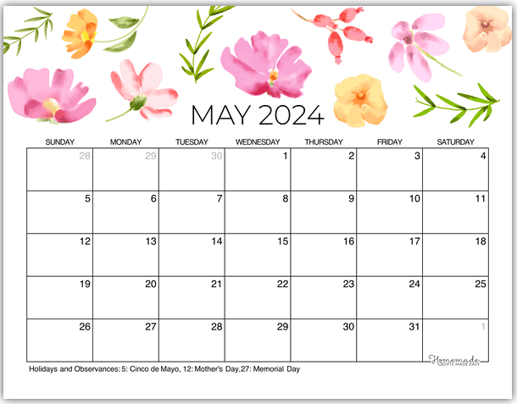
Final Perkins Modification
Modification Deadline
is May 17, 2024

Slide 6
End-of-Year Due Dates
Due May 17th
Accepted negotiated levels of performance (emailed on March 28)
Local Plan Status Update
End-Of-Year Questions answered
Best Practice Video emailed to Stefanie
Due July 10th
June 30 XDBR
Semi-annual Time Certifications

Slide 7
End-Of-Year Reviews
May 29-31 and June 3-5 (sign-up coming soon)
20-30 minute appointments on Microsoft TEAMS
Agenda
Review and discuss video (emailed to Stefanie in May)
Discuss EOY Questions (submitted in May)
Answer Questions

Slide 8
End-Of-Year Questions
1P1: What variety of support and resources does your college provide to help CTE students discover and engage in employment opportunities and/or navigate the application process for further education or service upon completion of their studies?
2P1: Summarize or outline your college’s procedure for issuing certificates, diplomas, and degrees to students in Associate of Applied Science (AAS) Programs? Does the college automate certificate issuance? How are advisors involved in overseeing and supporting students’ journey to completion, or does your college require students to independently manage their program completion through certificates, diplomas and degrees?
Effectiveness in Supporting Special Populations Describe your college’s strategies to increase access and support for special populations within your CTE programs. Please share success stories or areas for improvement identified through your efforts.

Slide 9
EOY Questions continued
Integration of Work-based Learning In what ways have work-based learning opportunities been integrated into your college’s CTE programs? How do you assess the impact of these opportunities on student learning and career readiness?
Progress Towards Implementing CTE Pathway Alignment Across Secondary & Post-Secondary Programs Describe the activities, processes, partnerships, or systems implemented by your college to create articulation or continuation of secondary CTE 9-14 pathways. How does your college assess the effectiveness of these efforts?

Slide 10
Site Monitoring Colleges
Basic understanding of Grant documents
Review of CLNA
Review of Local Plan and required use of funds
CTE Faculty and staff interviews to better understand how they are incorporated in Perkins V planning and implementation
Review XDBR

Slide 11
Planning for 2024-2025
Annual Meeting
April 23, 2024 9am-12pm
Virtual: GoTo Meeting link found in NCPerkins.org/presentations (and in notes below)
Print Handbook before the webinar
Anticipated Allotment
Notes:
https://register.gotowebinar.com/register/2380208915805242198

Slide 12
SkillsUSA State Postsecondary Competition
Wednesday, April 24th
Greensboro Coliseum
Postsecondary Competition (starts at 9am)
Postsecondary Awards Ceremony (7:30pm)
Dr. Jeff Cox, NCCCS President, will speak at the awards ceremony

Slide 13
NCDPI CTE Summer Conference
July 15-19, 2024, Twin City Quarter, Winston-Salem
See www.ctesummerconference.com for more information
What can you expect this year?
3 full days of content for all program areas
Collective sessions for collaboration across curricula
Hands-on experiences
Additional options for walking tours and networking events in the city
CTE Curriculum Resource showcase
Notes:
Discuss when you can pay for this.
$250 - prior to May 1, 2024 $300 - May 1 - 31, 2024 $350 - June 1 - July 5, 2024

Slide 14
NCETA Spring Conference

Slide 15
9-14 PATHWAYS CONSULTATION
This training offers a deep dive into all secondary engagement opportunities by reviewing best practices, local data, and inter-office collaborations, e.g. career advising, articulation, and CCP pathways. Sessions typically last about 2-3 hours at no cost to the college.
If interested, please email Aaron Mabe,
mabea@nccommunitycolleges.edu

Slide 16
Curriculum Alignment Projects
2023-2024 in progress:
Human Services Technologies
and multiple projects with EDU
Coming this spring:
Advertising Graphic Design
Information Technology
Health Management Technician, Medical Office Administration and Health Management Technician
Tentative next year
Cosmetology
Culinary
There is still time to get your faculty involved!

Slide 17
Director of Online Learning Updates
2024 Immersive Learning Conference:
Perkins Leadership Funding covers room and food costs.
Individual institutions responsible for transportation.
Opportunity for networking and exploring technology in education.
There may be a few openings due to some attendee cancelations. Contact Dr. Lane Freeman to see if there are any spots available.
For more information, visit:
www.ncccsimmersivelearningconference.com

Slide 18
Wake Technical Community College Promising Practice Video from 2022-2023

Slide 19
Virtual Office Hours for Technical Assistance
2nd Tuesday of the month 1-2pm
4th Wednesday of the month 9-10
** See NCPerkins course announcements for TEAMS link
Need help?
Let's meet.
CTE Team Perkins
Virtual
Office Hours
Drop in to ask a CTE Coordinator your questions

Slide 20
Perkins Monthly Updates 2023-24
May 14, 2024
Jun 11, 2024? This is after EOY Reviews
Attendance (or viewing the recording within 30 days) is recorded on monitoring rubric. Recording may be accessed at the same link as the registration.
Notes:
Register now and let the system remind you.

Slide 21
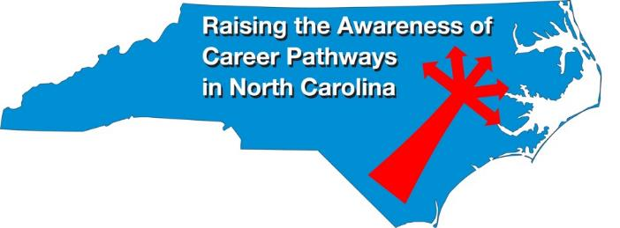
Raising the Awareness of Career Pathways Monthly Webinars
Apr. 17 – Public Safety
May 15 – Cyber Crime Technology
Register for all webinars at www.ncperkins.org/presentations

Slide 22
Technical Assistance is available
We are here to help!
Team Perkins is available by phone, email, virtually, or in-person

