Slide 1
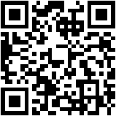
Creating a Work-Based Learning Partnership
Chris Droessler, CTE Consultant, NCCCS
www.ncPerkins.org/presentations
Notes:
Good day. I am Chris Droessler, an education consultant from the North Carolina Community College System.
If you have a smart phone, and you are smart enough to use it, you can capture that QR code, and your phone or tablet takes you to the webpage where you can download a copy of this PowerPoint file.
Or you can just go to ncPerkins dot org and click on the “presentations” link.
How many of you have already downloaded my presentation??
Warning: I talk fast and have lots of information to cover. My goal is to get the information to you so that you can go back and digest it later.
I have documented my information sources in the notes section of the PowerPoint, to allow you to further research anything that you see here.
In fact, the notes from which I am reading are there as well.
In some cases I am reading directly from an original source, because they said it so well.
Download the PowerPoint and use it any way you wish if it will help people discover their perfect career. --
This presentation takes a hard look at Creating a Work-Based Learning Partnership.
=====
www.ncPerkins.org/presentations
NCCCS System Conference
October 10, 2016

Slide 2
What is Work-Based Learning?
Notes:
First – what is work-based learning
Work-based learning (WBL) is an educational strategy that provides students with real-life work experiences where they can apply academic and technical skills and develop employability skills.
Work-based learning experiences occur in a work setting, typically at an employer's worksite.
The work-based learning activities are coordinated with school-based activities in an attempt to show students the "why" of what they are learning.
Work-based learning strategies provide career awareness, career exploration opportunities, career planning activities, and help students reach competencies such as positive work attitudes and employability skills.
=====
Graphic
http://www.proprofs.com/quiz-school/upload/yuiupload/1598763555.jpg
http://jacobjwalker.effectiveeducation.org/blog/2014/07/13/thought-of-the-day-why-career-technical-teachers-can-make-extraordinary-academic-teachers/#more-2412

Slide 3
What is Work-Based Learning in NC?
Exploratory
Exploring Work
Experiential
Fundamental Skills & Soft Skills
Engaged
Classroom learning applied on the job
Job Shadowing
Employer Videos
Employer Projects in Class
Industry Tours
Field Trips
Junior Achievement
Part Time Work
Volunteer
Internship
Service Learning
Junior Achievement
Entrepreneurial Experiences
Merit Badges
School-Based Enterprises
Cooperative Education
Apprenticeship
Internship
Structured Volunteer
Structured Service Learning
Notes:
Work-based learning can be organized into these three main categories.
The Exploratory category is usually emphasized in middle school and into high school, but it could occur at any age. In this stage you learning more about the world of work -- rather than a specific occupation.
Once you do the exploration, it is time for Experiential. This is a longer commitment to work-based learning where you explore specific occupations that might lead to a career. You get to try out different jobs, noting your preferences for each kind of work.
In the Engaged level, you have decided on a career pathway and are now learning what it takes to get you ready for entry-level employment. You are performing real tasks in a real work environment.

Slide 4
Why is WBL Important?
Students learn about the world of work
Workplace is different from school
Connect classroom learning with the workplace
Practice skills learned in school in a real setting
Notes:
Youth know how to go to school. We start them out young and do what ever we need to ensure that they are successful in school. Whether it is elementary through high school or even college.
That teaches them the important skill of how to learn. ----
But the workplace is different from the classroom.
Even though students will claim they do a lot of “work” -- that’s different from the workplace.
As a child, How many of you went to work with one of your parents? What did you learn? Anything?
Are any of you really good at something you have never tried? You have a great skill or special talent in something that you have never tried?
The reality is you might have a special gift or skill, but until you try out a lot of things, you will never know.
We have to let kids fail in a safe environment, so they can see if they have the aptitude or the desire to perform certain skills or to work at certain jobs.
It’s just important to put jobs on the “I’ll never do that” list -- as it is to put jobs on the “hey I might like that” list.

Slide 5
Begin with the End in Mind
Creating a Work-Based Learning Partnership
Notes:
Stephen Covey’s second habit of highly effective people says “Begin with the end in mind.”
What do you want out of a work-based learning partnership?
Don’t create a partnership with your local businesses just because I say so. Though you should do everything I tell you ’cause I know all the best stuff.
This habit of Beginning with the End in Mind relies on using your imagination, -- which is something that is not often valued in our society, especially in education and training. We have become accustomed to allowing others tell us how to act and where to go. Like I’m doing right now.
We need a clear vision of where we are headed so we will know when we get there. Actually, in a quest like this you will never get there. There will always be something to do -- to better your relationship with your local businesses.
=====
Steven Covey
https://www.stephencovey.com/7habits/7habits-habit2.php
Tortoise race
https://theleadershipwiki.wikispaces.com/Begin+with+the+End+in+Mind

Slide 6
2016 NC Employer Needs Survey
Notes:
The North Carolina Department of Commerce surveyed businesses all across the state earlier this year.
For 2016, they collected 19 hundred surveys.
This included companies of all sizes from all 100 counties.
=====
2016 NC Employer Needs Survey
http://www.nccommerce.com/Portals/47/Publications/Industry%20Reports/2016-Employer-Needs-Survey.pdf
2016 NC Employer Needs Survey - PowerPoint
http://www.ncga.state.nc.us/documentsites/committees/BCCI-6578/2015-16%20Session/Meeting%20Documents/March%201,%202016/Employer%20Needs%20Survey%202016%20-%20Leg%20Workforce%20Development%20Committee.pdf

Slide 7
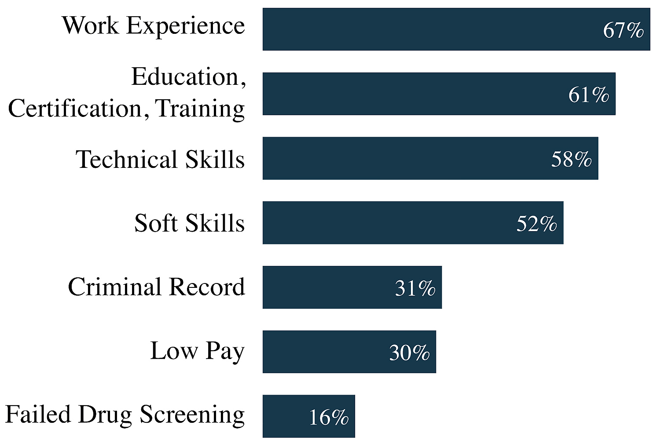
Hiring Difficulties
Notes:
This survey found that Four out of Ten employers who tried to hire in the past year had difficulty filling at least one position.
First on the list - The employers said their new recruits lacked work experience.
Well if that is true, you can show them how a good work-based learning program can help their future employees get the work experience they need.
A word about this data. This is the preliminary data for this report. I did not get a copy of the actual report until yesterday. Some of the numbers on the screen are off by 1 percent. Please download the real report to get the real data. Work Experience is really 68 percent, not the 67 percent you see here.
And the second one is education and training. That’s why we are here to help educate their new recruits.
What else can we do to help prepare their new recruits?
Ask your local employers if this chart is true for their company?
Are there other items they think should be added to his list?
Ask them.
=====
2016 NC Employer Needs Survey
http://www.nccommerce.com/Portals/47/Publications/Industry%20Reports/2016-Employer-Needs-Survey.pdf
2016 NC Employer Needs Survey - PowerPoint
http://www.ncga.state.nc.us/documentsites/committees/BCCI-6578/2015-16%20Session/Meeting%20Documents/March%201,%202016/Employer%20Needs%20Survey%202016%20-%20Leg%20Workforce%20Development%20Committee.pdf

Slide 8
Hiring Difficulties by Industry
Many Similarities Between Industries
Technical or Occupation-Related Skills
Relevant Work Experience
Education Level, Certification, or Training
Some Differences
Soft Skills - STEM
Failing a Drug Test - Manufacturing & Construction
Low Pay - Healthcare
Notes:
Again, all of the employers say their potential employees do not have the skills , work experience, or education necessary to get hired.
But we can make all of this happen by working together.
The STEM industry says their new recruits do not have the soft skills necessary.
Work-based learning is a great place to put to use the soft skills learned in school.
=====
2016 NC Employer Needs Survey
http://www.nccommerce.com/Portals/47/Publications/Industry%20Reports/2016-Employer-Needs-Survey.pdf
2016 NC Employer Needs Survey - PowerPoint
http://www.ncga.state.nc.us/documentsites/committees/BCCI-6578/2015-16%20Session/Meeting%20Documents/March%201,%202016/Employer%20Needs%20Survey%202016%20-%20Leg%20Workforce%20Development%20Committee.pdf

Slide 9
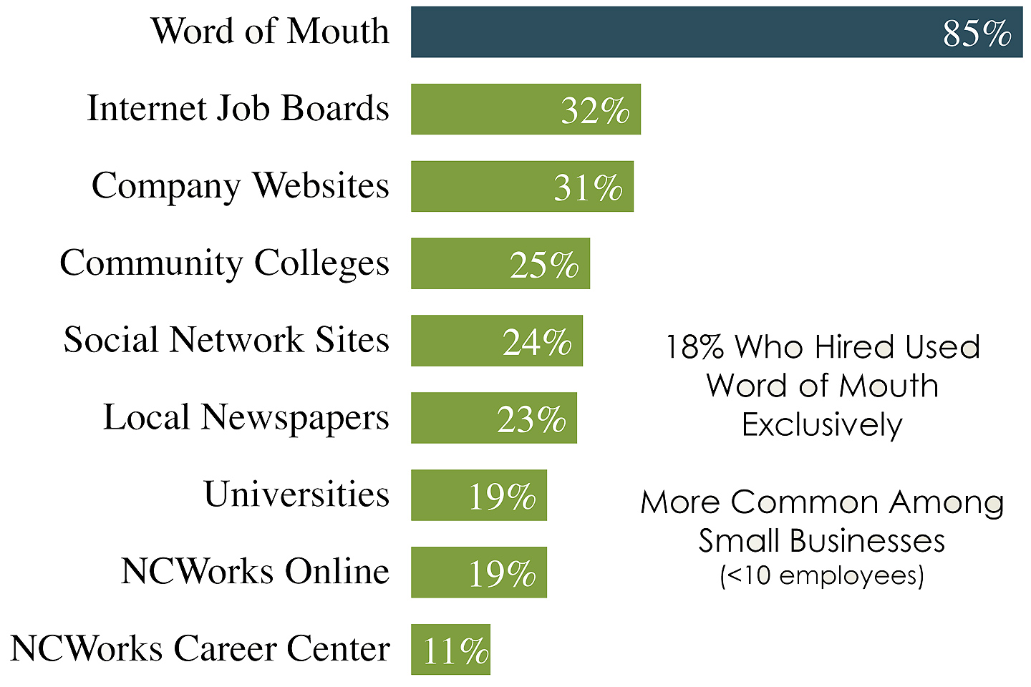
Recruiting Resources
Notes:
The vast majority of job postings are never posted. It’s all word of mouth. -- It’s who you know.
Many employers believe they will find better quality workers if they use word of mouth. They trust their current employees to recommend good quality workers.
What can we do to help the employers get the word out about job openings?
What can we do to help the employers see the talent that we are creating?
This Employer Needs Survey has lots of information broken down by industry. It might be a good starting place to start a discussion about industry and education working together.
=====
2016 NC Employer Needs Survey
http://www.nccommerce.com/Portals/47/Publications/Industry%20Reports/2016-Employer-Needs-Survey.pdf
2016 NC Employer Needs Survey - PowerPoint
http://www.ncga.state.nc.us/documentsites/committees/BCCI-6578/2015-16%20Session/Meeting%20Documents/March%201,%202016/Employer%20Needs%20Survey%202016%20-%20Leg%20Workforce%20Development%20Committee.pdf

Slide 10
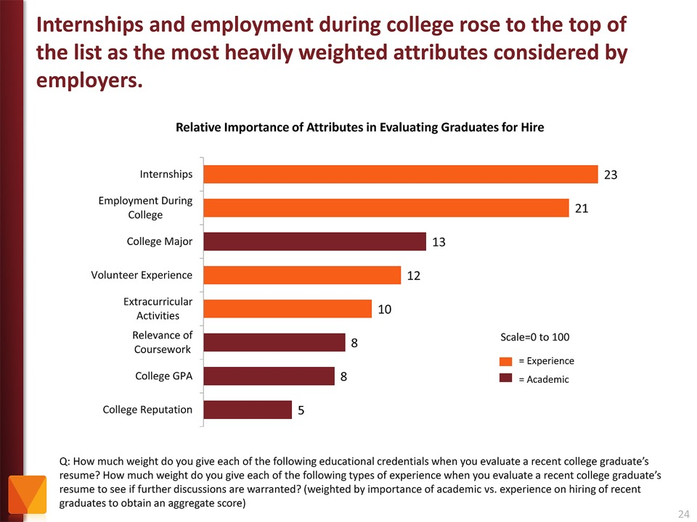
Notes:
Here is another study by the Chronicle of Higher Education where they asked employers what they were looking for in their recent hires.
Look where Internships and “other employment during college” are at the top of the chart.
Employers valued that as more important than the college major and even GPA.
Even volunteer work and extra-curricular activities are more important to the business community than grades.
Yet, -- most students are too focused on getting good grades -- and are missing out on the experiences that really matter.
If you “begin with the end in mind” like I said earlier, then high school students should ask the businesses what they will want in their new recruits, rather than focusing on something like grades that the business community could care less about.
Show this to the businesses in your area and see if they agree.
======
http://chronicle.com/article/The-Employment-Mismatch/137625/#id=overview
The Employment Mismatch: A College Degree Sorts Job Applicants, but Employers Wish It Meant More
Employers value a four-year college degree, many of them more than ever.
Yet half of those surveyed recently by The Chronicle and American Public Media's Marketplace said they had trouble finding recent graduates qualified to fill positions at their company or organization. Nearly a third gave colleges just fair to poor marks for producing successful employees. And they dinged bachelor's-degree holders for lacking basic workplace proficiencies, like adaptability, communication skills, and the ability to solve complex problems.
The report
The Role of Higher Education in Career Development: Employer Perceptions
http://chronicle.com/items/biz/pdf/Employers%20Survey.pdf

Slide 11
Partners
School/college
Any employer
Could be non-profit
Government
Religious
Civic (museum)
Could be volunteer
Habitat for Humanity
House of worship
Notes:
The partnership should include the school or college and any employers.
Could be non-profit o even volunteer work.

Slide 12
Local and Regional Employment Services
Workforce Boards
NCWorks Career Centers
Chambers of Commerce
For-profit Schools
Labor Unions
Professional Associations
Philanthropic Organization
Human Service Agencies
Vocational Rehabilitation
Independent Living Centers
Faith-based Organizations
Notes:
You can also involve these local and regional employment and training services.
Depending on your region, these might make a great addition to your partnership.

Slide 13
Be Proactive
Offer suggestions, strategies, and opportunities for work-based learning (WBL)
Ask the employers what they want. What is lacking in their new recruits?
Start small with field trips and guest speakers. Work your way up to apprenticeships.
Show a “win-win” result
Working together we can build the economy!
Notes:
The businesses do not know what you can do to help them.
You have to let them know.
Ask the employers what they want.
Start small and work your way up.
Be sure they see the benefit to their business in working with you.
Approach the employer with a win-win situation where everyone benefits from the relationship.

Slide 14
Start
Start with parents of the students
Professional associations & unions
School/college advisory board
Notes:
Where to begin?
All schools and colleges should have some kind of advisory board. It might be called a education/business alliance.
Businesses helping the schools to improve. You might find partners there.
Who is already hiring your students? Start there. Let them know that you want to help them by preparing better, new employees.

Slide 15
Strategies for Engaging Employers
Develop key relationship with CEO or other company leadership.
Build database of employers, opportunities available by employer, goals & objectives.
Maintain constant contact with student, employer engaged in work-based learning.
Develop work plan with employer to alleviate any trepidation in working with student. Ways to increase Employer Engagement/Work-Based Learning.
Make it easy for employer to reduce documentation, time or other effort.
Give employers advance notice of when you need their involvement.
Help employers see long-term benefit to them in terms of future talent pool.
Notes:
Here are some strategies to consider.
These may or may not work depending on your local circumstances.

Slide 16
Strategies for Engaging Employers
Encourage employers and schools to be flexible in scheduling.
Give employers specifics about what is expected to build mutual understanding (Who, what, when, where, why).
Encourage meaningful experiences. For example, instead of field trip or tour, add a hands-on learning experience to make it a field study. Instead of guest speaker, facilitate a class project.
Be flexible with industry and take what they offer.
Be persistent; do not give up.
Success breeds success. Use willing partners. Publicize and spotlight their effort.
Notes:
And more.
Do you see anything that might work in your community?

Slide 17
Be Aware of
Communications: Education jargon vs workforce jargon
Academic calendar
Course credit, timing, and internship hour requirements
Student availability
Lack of employability skills by students
Notes:
A few things to be aware of.
Watch out for education jargon. We have too much of it.
All of these need to be worked out to have a great partnership.

Slide 18
Be Aware of
Fear of liability issues
Time constraints on the part of industry or education
Employer with bad previous experience
Adaptability of different generations in the workforce
Confidentiality (HIPA) / proprietary industry information
Notes:
And a few more things to be aware of.
Liability is a tough one. I know that high school students are covered for one million dollars in liability insurance in case they break anything or anyone while in a school-sponsored work-based learning activity. That is, of course, if the school or school district opted to pay for the optional work-based learning insurance.
I do not know if the college students have any such coverage.
The HIPA laws keep our students out of most of the health care industry. Working together with the industry, you might come up with a situation that works.

Slide 19
Questions?
Chris Droessler
CTE Coordinator
NC Community Colleges
DroesslerC@NCCommunityColleges.edu
Get the PowerPoint
www.ncPerkins.org/presentations
Notes:
Do you have any questions?
Usually by this time most of the audience is overwhelmed and just need a break to digest what I’ve said.
Remember that you can download the PowerPoint and use it however you can.
Do we have any questions?

Slide 20
Thanks for listening!
Chris Droessler, CTE Consultant, NCCCS
www.ncPerkins.org/presentations
Notes:
Thanks for inviting me to come speak today.
=====
Chris Droessler, Consultant, NCDPI
www.ncPerkins.org/presentations

Slide 22
Prosperity Zones
Notes:
We assume that many of our high school graduates will venture out beyond the borders of Wake County looking for work, so we will look at the data form the North Central prosperity zone, which includes Wake and 14 other counties.
====
http://nccareers.org/employmentprojections/images/Prosperity-Zones-Map.png

Slide 23
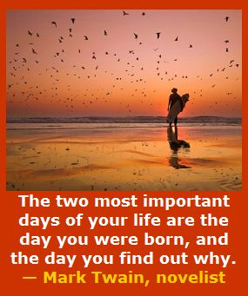
Notes:
---
Too many people go through life not knowing who they are -- and why they are here on planet Earth.
For some -- the revelation comes late in life.
Somewhere along the way -- all of us found out that we cared about helping others–
and we were supposed to be right here – this very morning –
listening to an old high-school shop teacher talk about the future.
========
http://www.goodreads.com/quotes/505050-the-two-most-important-days-in-your-life-are-the
“The two most important days in your life are the day you are born and the day you find out why.”
― Mark Twain
http://www.huffingtonpost.com/karen-ann-kennedy/the-two-most-important-days-of-your-life_b_5229311.html
Photo
http://myincrediblewebsite.com/mark-twain-on-the-days-of-your-life/

