Slide 1
Perkins Update Webinar
April 14, 2020

Slide 2
COVID-19 Follow Up
How are you all doing?
What’s happening at your College?
What can we do to assist you?

Slide 3
Purpose of Perkins
Develop more fully the academic knowledge and technical and employability skills of secondary education students and postsecondary education students who elect to enroll in CTE programs and programs of study
Notes:
The Strengthening Career and Technical Education for the 21st Century Act reauthorized and updated the Carl D. Perkins Career and Technical Education Act of 2006 to become the current Carl D. Perkins Career and Technical Education Act of 2006 as amended by the Strengthening Career and Technical Education for the 21st Century Act (Perkins V)
This updated act stresses:
- Academic, Technical, and Employability Skills
- Funding Secondary and Postsecondary CTE
- Focusing on Students who elect to enroll in CTE Programs of Study

Slide 4
Promising Practice Videos 2019
Haywood Community College
Aviso helps the college engage with student populations with an early alert system.
https://www.ncperkins.org/video
Notes:
August 2019
Alamance CC
Sept 2019
Blue Ridge CC
Brunswick CC
Oct 2019
Caldwell CC & TI
Carteret CC
November 2019
AB-Tech CC
Coastal CC
January 2020
Pitt CC
Rowan-Cabarrus CC
February 2020
Craven CC
Fayetteville Tech CC
March 2020
Gaston CC
Halifax CC
April 2020
Haywood CC
Isothermal CC
May 2020
James Sprunt CC
Johnston CC
June 2020
Lenoir CC
Nash CC
2020
Southwestern CC
Stanly CC
Surry CC
Wilkes CC
Wilson CC

Slide 5
Local Application
Follow Up with colleges fine tuning their CLNA.
How is the update proceeding?
Can you identify needs in your program of study?
Do you need assistance from Team Perkins (State CTE Staff)?
Submit any revisions ASAP
How is the process of transferring information from the Comprehensive Local Needs Assessment (CLNA) developed by you and your stakeholders to the Local application coming

Slide 6
Getting Ready to Receive Funds
From our Website – Download and compete
CLNA – Completed and Filed
Assurances updated for 2020-21
Acceptance of Funds
Negotiated Levels of Performance
Local Application
Local Plan
Local Budget
Any questions?

Slide 7
Funding for 2020-21
Complete the Comprehensive Local Needs Assessment
Complete the Perkins 2020-24 Application - due May 1, 2020
Complete a Plan & Budget for 2020-21 - due May 29, 2020

Slide 8
Negotiated Levels of Performance
Data from Ashley
Use of Dashboards
Use of Perkins Data Portal
Chris on Procedures for getting the data to colleges

Slide 9
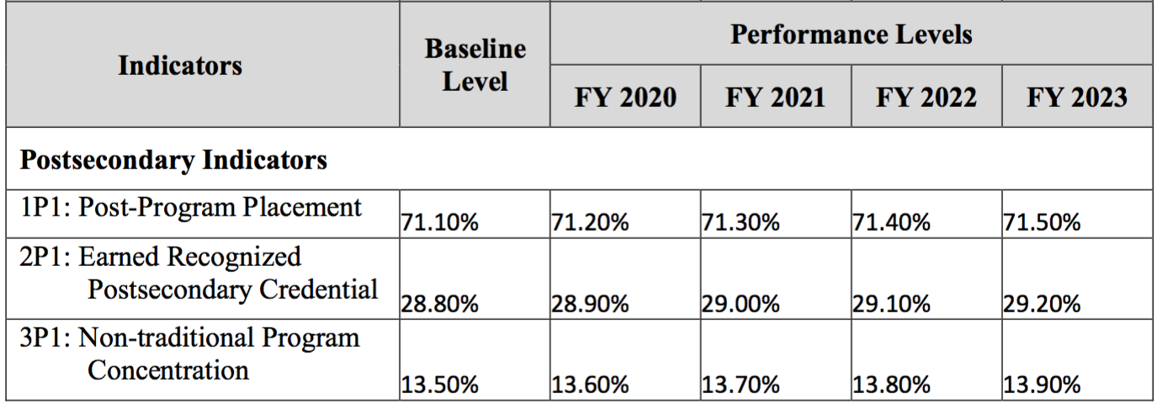
NC State Plan 2020-2023
79%
32%
15%

Slide 10
Upcoming Webinar
Thursday April 16, 2020 -- 9:00 AM to 10:00 AM
Discussion with Automotive and Machining Faculty
Sources for curriculum materials to use in online classes
What technology are you using to engage with and teach students?
How are you posting content for instruction– programs, resources?
Where do you need help?

Slide 11
Year-End Reviews
30-minute review
May 26 – June 12
Sign up at ncperkins.org/review (secret word = Pathways)
One-page summary
Promising practice video

Slide 12
Promising Practice Videos 2019
Isothermal Community College
New equipment in Nursing, Broadcast Production Technology, and Aesthetics.
New career pathways in Equine Science and Human Services Technology, Animal-Assisted Interactions.
https://www.ncperkins.org/video
Notes:
August 2019
Alamance CC
Sept 2019
Blue Ridge CC
Brunswick CC
Oct 2019
Caldwell CC & TI
Carteret CC
November 2019
AB-Tech CC
Coastal CC
January 2020
Pitt CC
Rowan-Cabarrus CC
February 2020
Craven CC
Fayetteville Tech CC
March 2020
Gaston CC
Halifax CC
April 2020
Haywood CC
Isothermal CC
May 2020
James Sprunt CC
Johnston CC
June 2020
Lenoir CC
Nash CC
2020
Southwestern CC
Stanly CC
Surry CC
Wilkes CC
Wilson CC

Slide 13
Raising the Awareness of Career Pathways - Webinar
Third Thursday @ 9am
April 23, 2020
Careers in various industries (Drones)
ncperkins.org/presentations

Slide 14
CTE Training
Training online - www.ncperkins.org
Perkins Update Webinars - Second Tuesday
Career Pathways Webinars - Third Thursday
At your College by request
https://www.ncperkins.org/presentations/

Slide 15
Perkins Updates
2nd Tuesday of the month
9 am
Via GoToWebinar
Find the registration links at NCperkins.org/presentations
Next Update: Tuesday, May 12, 2020
Notes:
Register now and let the system remind you.

Slide 16
Perkins/CTE State Staff
Dr. Bob Witchger Director, Career & Technical Education WitchgerB@nccommunitycolleges.edu 919-807-7126
Dr. Tony R. Reggi Coordinator, Career & Technical Education ReggiA@nccommunitycolleges.edu 919-807-7131
Patti Coultas Coordinator, Career & Technical Education CoultasP@nccommunitycolleges.edu 919-807-7130
Dr. Mary Olvera Coordinator, Career & Technical Education OlveraM@nccommunitycolleges.edu 919-807-7120
Michelle Lair Coordinator, Career & Technical Education LairM@nccommunitycolleges.edu 919-807-7227
Chris Droessler Coordinator, Career & Technical Education DroesslerC@nccommunitycolleges.edu 919-807-7068
Darice McDougald CTE Administrative Assistant McDougaldD@nccommunitycolleges.edu 919-807-7219
Notes:
http://www.ncperkins.org/course/view.php?id=6

Slide 18
Perkins V Performance Indicators
A Postsecondary CTE Participant is an non-inmate who completes not less than one credit-level course in a CTE program or program of study.
A Postsecondary CTE Concentrator is a CTE Participant who has earned at least 12 CTE credits within a CTE program or program of study.
Notes:
Perkins IV Participant - "attempted at least six credit hours of CTE courses"
Perkins IV Concentrator - "have completed twelve non-developmental credit hours, six of which are in CTE courses"

Slide 19
Perkins V Performance Indicators
1P1 Post-Program Placement
The percentage of CTE Concentrators who completed a CTE Program of Study the previous year and remained enrolled in postsecondary education or were placed or retained in employment.

Slide 20
Perkins V Performance Indicators
2P1 Earned Recognized Postsecondary Credential
The percentage of CTE Concentrators who received a recognized postsecondary credential during the reporting year

Slide 21
Perkins V Performance Indicators
3P1 Non-traditional Program Concentration
The percentage of CTE Concentrators in CTE programs and programs of study that lead to fields in which their gender is underrepresented.

