Slide 1
Perkins Update
November 9, 2021

Slide 2
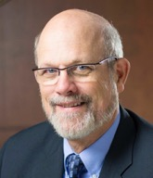
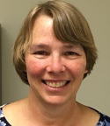
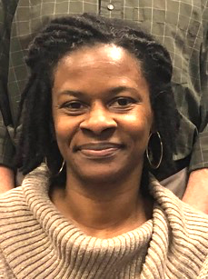
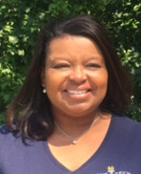
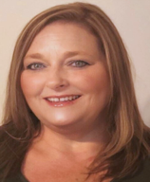
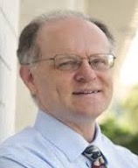
Team Perkins
Bob Witchger
Patti Coultas
Tony Reggi
Darice McDougald
Michelle Lair
Mary Olvera
Chris Droessler
Notes:
Dr. Bob Witchger
919-807-7126
WitchgerB@nccommunitycolleges.edu
Dr. Tony R. Reggi
919-807-7131
ReggiA@nccommunitycolleges.edu
Patti Coultas
919-807-7130
CoultasP@nccommunitycolleges.edu
Dr. Mary Olvera
919-807-7120
OlveraM@nccommunitycolleges.edu
Michelle Lair
919-807-72227
LairM@nccommunitycolleges.edu
Chris Droessler
919-807-7068
DroesslerC@nccommunitycolleges.edu
Darice McDougald
919-807-7219
McDougaldD@nccommunitycolleges.edu

Slide 3
Purpose of Perkins
Develop more fully the academic knowledge and technical and employability skills of secondary education students and postsecondary education students who elect to enroll in CTE curriculum programs and programs of study
Notes:
The Strengthening Career and Technical Education for the 21st Century Act reauthorized and updated the Carl D. Perkins Career and Technical Education Act of 2006 to become the current Carl D. Perkins Career and Technical Education Act of 2006 as amended by the Strengthening Career and Technical Education for the 21st Century Act (Perkins V)
This updated act stresses:
- Academic, Technical, and Employability Skills
- Funding Secondary and Postsecondary CTE
- Focusing on Students who elect to enroll in CTE Programs of Study

Slide 4
Promising Practice Video 2021
South Piedmont Community College
Videos about work-based learning.
https://www.ncperkins.org/video/video.php?v=South%20Piedmont-2021&y=2021
See all the videos:
https://www.ncperkins.org/video/
Notes:
August 2021
Wilson
Wilkes
September 2021
Wayne
Vance-Granville
October 2021
Stanly
Southeastern
November 2021
South Piedmont
Rowan-Cabarrus
January 2022
Rockingham
Robeson
February 2022
Pitt-Martin
Pamlico
March 2022
Nash
Mayland
April 2022
Lenoir
Johnston
May 2022
James_Sprunt
Halifax
Gaston
Forsyth
Fayetteville
Edgecombe
Durham
Davidson
Craven
Coastal_Carolina
Central_Piedmont
Carteret
Cape_Fear
Caldwell
Brunswick
Blue_Ridge
Beaufort
AB_Tech

Slide 5
Colleges Conduct Comprehensive Local Needs Assessment
November 2021
Briefing - Local Needs Assessment in 20 slides
Your Comprehensive Local Needs Assessment Guide
Conducting the needs assessment with stakeholders;
Summarize your work;
Seek funding in 2022-23 program year with data to support your updated application, local plan and budget.

Slide 6
Perkins V: Secondary - Postsecondary Partnership
Prepare students for work through education and training
High School
Grades 9,10,11,12
Begin Concentration
Postsecondary
Grades 13,14 & Beyond
Postsecondary Concentrator
Hone Skills - Credentials
Middle School
Grades 5,6,7,8
Informed
Adult High School
Adult Secondary Level 9+
Notes:
We have to resolve the Postsecondary Credential Definition.

Slide 7
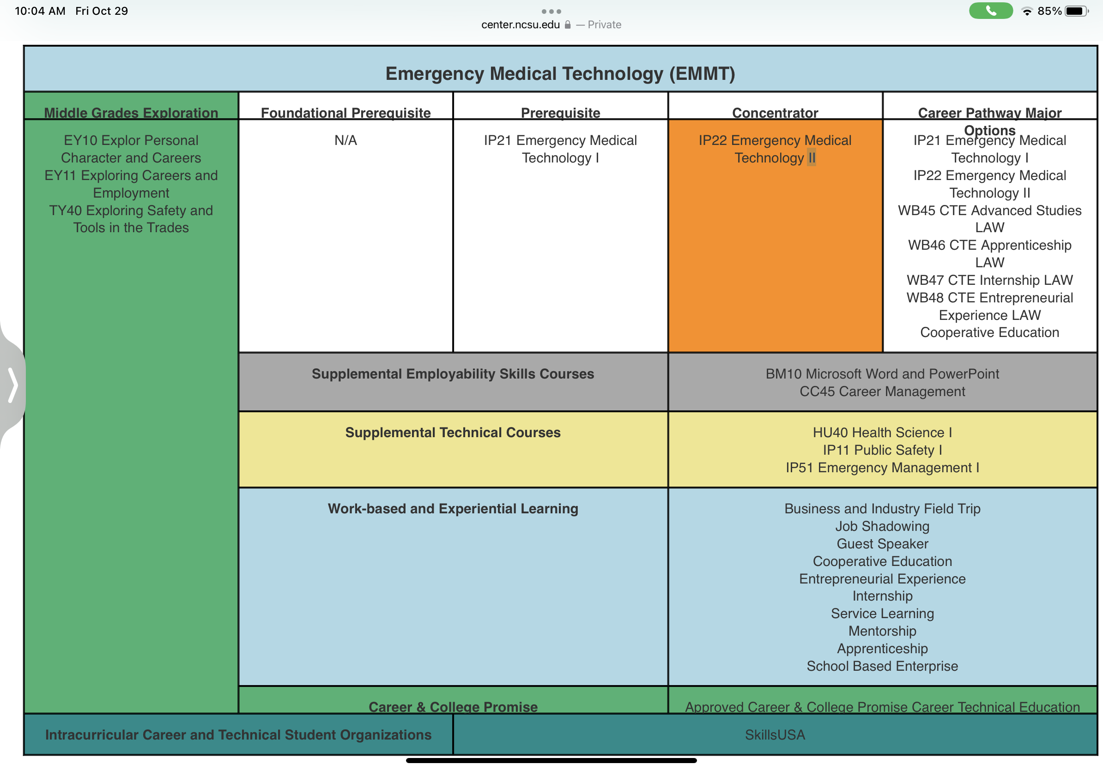
9-14 CTE Programs of Study
Secondary Options
Postsecondary Options
Non Degree Course Work with Postsecondary Credential
Curriculum Standards for
Certificate, Diploma, or
Associate Applied Science Degree
Aligned to Workforce Needs
Baccalaureate Degree
Title II Adult Education
And Adult High School

Slide 8
Process for Perkins Funding for 2022-23
Identify Local Labor Market Priorities
Use Perkins $$ To Enhance Your CTE Programs
Conduct Local Needs Assessment
Develop A Plan/ Complete The Application
In discussions with your stakeholders representing, students, faculty, and industries
Preparing students for jobs that are in demand or pay high wages with skills they have developed through the education system and in collaboration with all workforce stakeholders and their resources.
Notes:
Presidents Inform them
Here is a time line and projected plan under Perkins V for 2020-21.
We are starting early as we need to include many folks in enhancing our programs, Informing them what we do, gaining their support to assist us, and making modifications to our curriculum as needed to better prepare our students with postsecondary credentials and employed in jobs earning a sustainable wage.
Determine the need, Develop a plan, Use Perkins funds to enhance our CTE programs.

Slide 9
Summary of the Comprehensive Needs Assessment (part 1)
Aligned to
State, Region, Local
Need
Evaluation of the Performance of Students Served
Size, Scope, Quality
Review
Review
Check
Evaluate Program of Study:
On-Line Data
Student Technical Skill Attainment,
Earning Certificate, Diploma, Degrees,
Retention in Programs of Study
Participation in NonTraditional Careers
Employment
What other data sources are available at the College?
Review Programs of Study within NCCCS Curriculum Standards.
Do we offer enough classes?
Are our 9-14 programs adequately aligned?
Are students learning and employed?
Aligned Programs of Study meet Employer needs for hiring
Are Learning Outcomes in Curriculum Standards aligned?
Are Learning outcomes in faculty syllabus Aligned?
Notes:
Outlines steps to be taken in conducting Comprehensive Needs Assessment
Size, Scope and Quality Key Challenges - Same as DPI?
Colleges offering Size of college program sufficient enough to meet industry need.
College offering enough programs to meet the size of the industry demand
Are students learning,

Slide 10
Summary of the Comprehensive Needs Assessment (part 2)
Programs of Study
Professional Development
Special Populations
Review
Review
Check
Faculty, Counselors, Students and Parents are aware of 9-14 Programs of study support programs such as:
Career and College Promise
HS to CC Articulation Agreement
College Programs of Study
Employment Opportunities of Graduates
Well educated and credentialed faculty review:
Do faculty have required credentials?
Are faculty skill sets meeting the needs of Industry?
Review individual professional development plans
Understand Professional Development Definition
With our stakeholders:
How do we identify Special Population students?
How do we assist those interested in enrolling?
How do we support those Special Population Students enrolled in CTE?

Slide 11
Student Performance Analysis of Students Progressing in CTE Programs / Pathways
Career Coaches
Coordinators
Faculty/ Deans
Vocational Rehab
9-14 Programs of Study
Stakeholder Analysis
1.Technical Attainment
2. Completion
3. Retention
4. Nontraditional Participation
5. Employment
Employers
Parents/
Students
Synergy
Energy
Results
WIOA
Agencies
HS Teachers

Slide 12
Student Performance
NCCCS Perkins Data Dashboards
How are our students progressing in CTE Programs / Pathways
1. Technical Attainment
2. Completion
3. Retention
4. Serving Nontraditional Special Populations
Instructional Effectiveness Reports: College Data Dashboards
How do these reports inform student performance and identify gaps?
Identify gaps by Age, Gender, Ethnicity and Special Populations

Slide 13
Size, Scope, and Quality Are programs of study meeting employer demand?
Career Coaches
Faculty/ Deans
Vocational Rehab
9-14 Programs of Study / Curriculum Standards
Stakeholder Analysis
Capacity of College
Learning Objectives
Employment of Graduates
Work-based Learning informing Instruction
Employers
Parents/
Students
Synergy
Energy
Results
WIOA
Agencies
HS Teachers

Slide 14
Size, Scope, Quality
Perkins Program of Study
Are we offering: Sufficient Number of Programs of Study and Sufficient number of courses in each pathway?
Are we meeting employer and student needs in the Quality of Instruction leading students earning credentials for jobs with sustainable wages?
Instructional Effectiveness: College Program Evaluation, Curriculum Standards
How does that report inform us the Size, Scope, and Quality of Programs?
Share findings: enhance and add Programs of Study.

Slide 15
Aligned to State, Regional and Local Labor Market Needs How is the career cluster aligned to Labor Market Needs?
Career Coaches
NC Commerce
Faculty/ Deans
Vocational Rehab
9-14 Programs of Study
Stakeholder Analysis
State /Local Need for Program
Engaged Employers
Skilled for the Workforce
Employers
Parents / Students
Synergy
Energy
Results
Workforce Boards
HS Teachers

Slide 16
Aligned to State, Regional and Local Labor Market Needs
College Program Advisory Committees
How is this Career Cluster meeting labor market needs?
GAPS
Faculty Reporting on Programs of Study and Course Learning Objectives
Industry feed back on College Programs of Study and Graduates working in their companies.
Industry sharing Current and Future education and skill needs
How do we enhance programs and learning outcomes to meet the needs of industry ?
What equipment do we need to better prepare students for industry?
What additional skills do our faculty need to enhance programs of study?
Instructional Effectiveness: College Program Evaluation and Advisory Committees
How do these reports inform us on Program of Study Alignment with Industry Needs?
GAPS
Share findings by: Courses and or Programs of Study in Cluster

Slide 17
Programs of Study
Design of Postsecondary Programs of Study
How do we serve postsecondary students?
High School Students Taking College Classes
High School Graduates enrolling in CTE first time
College Graduates Enrolling in Technical Programs of Study
Dislocated Workers gaining skills through Postsecondary CTE
Certificate, Diplomas or Degrees , Other Workforce Credentials
Student Technical Skill Attainment, Job Placement with earned Credentials
Institutional Effectiveness: College Program Evaluation
How does this report inform on student enrollment and placement?
Findings : Programs of Study - Entry, Technical Attainment, and Placement

Slide 18
Recruitment, Retention, Development of Faculty How are faculty teaching in identified programs of study supported?
Career Coaches
Faculty/ Deans
Stakeholder Analysis
Improving Instruction through use of new technology
Enhancing Teaching: HS students enrolled in identified CCP - CTE courses; College Graduates, Older workers and dislocated workers
Improving course design learning new teaching strategies to improve student learning outcomes
Vocational Rehab
9-14 Programs of Study
Employers
Parents / Students
Synergy
Energy
Results
WIOA Agencies
HS Teachers

Slide 19
Recruitment, Retention, and Development of Faculty
College Professional Development Plan
How are faculty teaching in identified programs of study supported?
Improving Instruction through use of new technology
Enhancing Teaching: HS students enrolled in identified CCP - CTE courses; College Graduates, Older workers and dislocated workers
Improving course design learning new teaching strategies to improve student learning outcomes
Institutional Effectiveness: College Program Evaluation
Report on strategies for faculty skill development, recruitment, retention
Strategies for improving instruction and faculty credentials

Slide 20
Special Populations - Recruitment, Identification, and Support Nine Perkins Identified Special Populations who elect to enroll in CTE
Career Coaches
Vocational Rehab
Single Parents
English Learners
Out of Work Individuals
Individuals with Disabilities
Economically Disadvantaged
Preparing for Nontraditional Careers
Children of Active Duty Military
Children in Foster Care
Homeless
How do we identify Special Populations or what is our plan to identify these students?
In Planning, how did we reach out to support agencies serving these individuals and recruit them for our CTE Programs of Study?
How will we network with the support agencies to provide support and services for individuals enrolled in CTE Program of Study?
Employers
Parents / Students
HS/CC Faculty
Agencies
Workforce Boards
Synergy
Energy
Results
Share findings by : 9 Perkins Identified Populations

Slide 21
Special Populations
Identification and Support
Nine Perkins Identified Special Populations who elect to enroll in CTE
1. Students Preparing for Nontraditional Careers 2. Individuals with Disabilities 3. Homeless 4. Childrenof Active Duty Military Parents 5. Economically Disadvantaged 6. English Learners 7. Single Parents 8. Out of Work Individuals 9. Children in Foster Care
How do we identify Special Populations, or what is our plan to identify these students?
In planning, how did we reach out to support agencies serving these students?
How will we network with the support agencies for services for students enrolled in CTE Programs of Study?
Share findings by : 9 Perkins Identified Populations

Slide 22
Comprehensive Local Needs Assessment Summary
Who actively took part in the analysis, review, and offered suggestions?
What were the strengths, gaps, and strategies for improvement in each program of study reviewed?
Student Performance
Size, Scope, and Quality
Alignment to Labor Market
Implementation of 9-14 Curriculum Frameworks (Pathway Systems)
Recruitment, Retention and Training of Faculty
Improving Access and Equity for students enrolled in CTE

Slide 23
Local Plan and Budget
Needs and Gaps to be addressed with state or federal funding
Outlines activities for program year
Includes salaries and equipment to address gaps

Slide 24
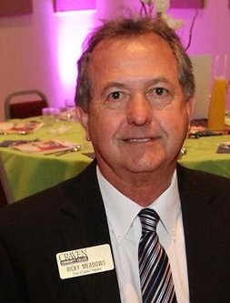
Ricky Meadows
Dean of Career Programs
Craven Community College
Notes:
(252) 638-4550
meadowsr@cravencc.edu

Slide 25
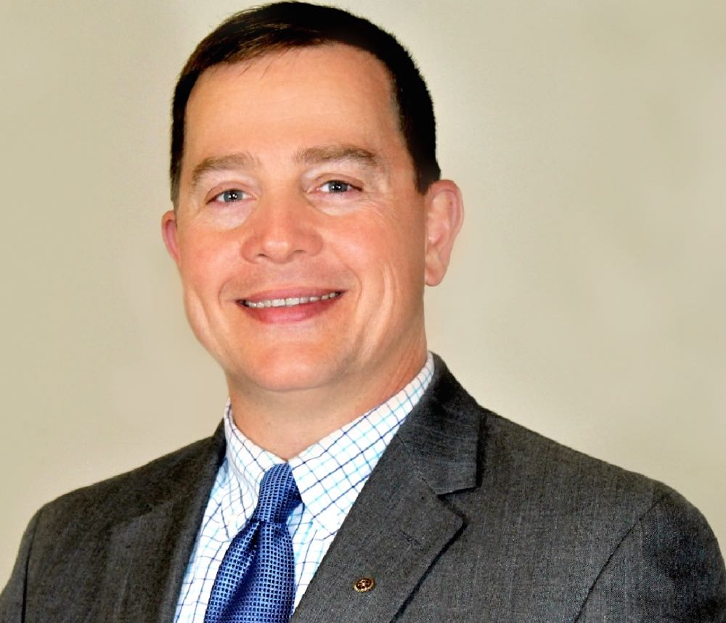
Dr. Jay Sullivan
Vice President Academic Affairs and Chief Academic Officer
Beaufort County Community College
Notes:
252-940-6417
jay.sullivan@beaufortccc.edu

Slide 26
Devin Baucom
Associate Vice President Advanced Manufacturing, Industry, Technology, and Trades Stanly Community College
Notes:
dbaucom0142@stanly.edu
704-991-0190

Slide 27
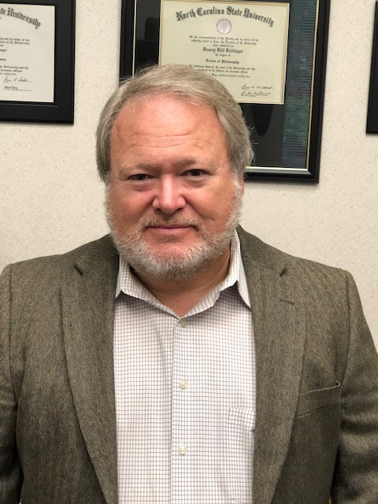
Dr. Dewey Dellinger
Executive Vice President for Academic and Student Affairs
Gaston College
Notes:
704.922.6239
dellinger.dewey@
gaston.edu

Slide 28
Tips on the CLNA
Updating existing CLNA
There must be modified content
If you continue an activity that addresses an existing gap, give evidence of how the activity is closing the gap or justification as to why more time and money are needed
You may address gaps in existing CLNAs that were not targeted in the last fiscal year(s)
Show evidence of how stakeholders were consulted for new gaps or ideas to address existing ones
Creating New CLNAs
Consult stakeholders listed in the guide
Identify and address gaps

Slide 29
Stakeholders (CLNA guide page 6)
CTE program representatives at the secondary and postsecondary levels including teachers, faculty, administrators, career guidance and advisement professionals, and other staff
State or local workforce development board representatives, chambers of commerce, economic development representatives
Representatives from a range of local businesses and industries, as well as non-profit agencies
Parents and students
Representatives of special populations
Representatives from agencies serving at-risk, homeless, and out-of-school youth
Representatives from Indian Tribes or Tribal organizations, where applicable

Slide 30
Technical Assistance Visits
Virtual vs in-person
Either works for us. We can travel and observe the college's protocols when we do.
Content to discuss
We are here (or there) to serve you
We also see state-wide issues and solutions we like to share
Promising practices are always on the table for discussion
Who should be at the table
Perkins Contact
CAO & CFO
CTE Deans and faculty
Workforce partners
Secondary partners
Other partners as the college deems fit

Slide 31
Perkins 101
Virtual vs hybrid?
We are leaning toward hybrid, with regional face-to-face broadcast via Go To Webinar.
Who should attend?
Perkins contacts who have been supervising Perkins for 2 years or less
Anyone who wants a refresher
When?
Date to be determined.

Slide 32
CTE Programs of Study /Pathways
REMINDER:
December 18, 2021
9-14 CTE Pathways due in Moodle

Slide 33
Elements of a 9-14 CTE Career Pathway
Aligned to labor market needs, which includes engaged employers
Secondary and postsecondary program of study linkage
Career advising - to develop an individual plan
Education and work-based learning offered concurrently with WIOA
Pathway designed to meet individual needs
Individual earns a postsecondary credential
Individuals enter and advance in a career
Perkins Sec 3(8) which references WIOA (29 U.S.C. 3102) Sec 3(7)

Slide 34
Mid-Year Review - Reminder
Power Point –
Update on Activities
Spending
Time Certifications
Semi-Annual Time Certification
Jan 12, 13, 14, 18, 20, 21, 2022
8am to 1pm

Slide 35
Mid-Year Reviews January 12, 2022
Brunswick CC
College of The Albemarle
Halifax CC
James Sprunt CC
Martin & Roanoke-Chowan
Mayland CC
McDowell TCC
Montgomery CC
Piedmont CC
Tri-County CC

Slide 36
Mid-Year Reviews January 13, 2022
Beaufort County CC
Bladen CC
Blue Ridge CC
Carteret CC & Pamlico CC
Mitchell CC
Rockingham CC
Sampson CC
South Piedmont CC
Southeastern CC
Wilson CC

Slide 37
Mid-Year Reviews January 14, 2022
Caldwell CC and TI
Coastal Carolina CC
Craven CC
Haywood CC
Isothermal CC
Randolph CC
Southwestern CC
Western Piedmont CC
Wilkes CC

Slide 38
Mid-Year Reviews January 18, 2022
Cleveland CC
Johnston CC
Lenoir CC
Nash CC
Robeson CC
Sandhills CC
Surry CC
Vance-Granville CC
Wayne CC

Slide 39
Mid-Year Reviews January 20, 2022
Alamance CC
Asheville-Buncombe TCC
Catawba Valley CC
Davidson-Davie CC
Durham TCC
Edgecombe CC
Gaston College
Richmond CC
Stanly CC

Slide 40
Mid-Year Reviews January 21, 2022
Cape Fear CC
Central Carolina CC
Central Piedmont CC
Fayetteville TCC
Forsyth TCC
Guilford TCC
Pitt CC
Rowan-Cabarrus CC
Wake TCC

Slide 41
Promising Practice Video 2021
Rowan-Cabarrus Community College
Three new vehicles for Automotive Technology department
https://www.ncperkins.org/video/video.php?v=Rowan-Cabarrus-2021&y=2021
See all the videos:
https://www.ncperkins.org/video/
Notes:
August 2021
Wilson
Wilkes
September 2021
Wayne
Vance-Granville
October 2021
Stanly
Southeastern
South Piedmont
Rowan-Cabarrus
Rockingham
Robeson
Pitt-Martin
Pamlico
Nash
Mayland
Lenoir
Johnston
James_Sprunt
Halifax
Gaston
Forsyth
Fayetteville
Edgecombe
Durham
Davidson
Craven
Coastal_Carolina
Central_Piedmont
Carteret
Cape_Fear
Caldwell
Brunswick
Blue_Ridge
Beaufort
AB_Tech

Slide 42
Leadership Projects
Continuing Projects
Proposed
CORD
SkillsUSA-NC
EDU Curriculum review and update
Cyber Security
Apple Swift
Success Coach training with Student Services
BLET Curriculum Development
Distance Learning meetings
Career Clusters Guide
Addressing gaps in Equity and other statewide CLNA identified gaps
Marketing CTE
Other Ideas?

Slide 43
MOA
MOA = Ensuring accessible education programs for all
Monitoring this week at Rockingham Community College
Follow-up with 15 colleges who were recently monitored

Slide 44
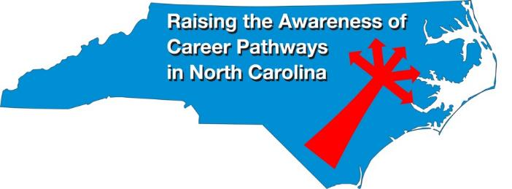
Raising the Awareness of Career Pathways Webinars
November 17, 2021 @ 9am
Come explore careers in Dental Hygiene
https://register.gotowebinar.com/register/647690826987315472
See all upcoming and past webinars at https://www.ncperkins.org/presentations/

Slide 45
Perkins Updates
2nd Tuesday of the month (not December)
9 am
Via GoToWebinar
Find the registration links at NCperkins.org/presentations
Notes:
Register now and let the system remind you.

Slide 46
CTE Training
Training online - www.ncperkins.org
Perkins Update Webinars - Second Tuesday
Career Pathways Webinars - Third Wednesday
Additional webinars on popular topics:
CLNA
Programs of Study
Career Pathways
At your College by request
https://www.ncperkins.org/presentations/
Notes:
https://www.ncperkins.org/presentations/

Slide 47
Technical assistance is available
We are here to help!
Team Perkins is available by phone, email, TEAMS, etc.
Your CTE Coordinator will be traveling to your college throughout the year.

Slide 48
Perkins/CTE State Staff
Dr. Bob Witchger Director, Career & Technical Education WitchgerB@nccommunitycolleges.edu 919-807-7126
Dr. Tony R. Reggi Coordinator, Career & Technical Education ReggiA@nccommunitycolleges.edu 919-807-7131
Patti Coultas Coordinator, Career & Technical Education CoultasP@nccommunitycolleges.edu 919-807-7130
Dr. Mary Olvera Coordinator, Career & Technical Education OlveraM@nccommunitycolleges.edu 919-807-7120
Michelle Lair Coordinator, CCP and Career & Technical Education LairM@nccommunitycolleges.edu 919-807-7227
Chris Droessler Coordinator, Career & Technical Education DroesslerC@nccommunitycolleges.edu 919-807-7068
Darice McDougald CTE Administrative Assistant McDougaldD@nccommunitycolleges.edu 919-807-7219
Notes:
http://www.ncperkins.org/course/view.php?id=6

