Slide 1
Perkins Update
September 10, 2024

Slide 2
NCCCS Perkins/Programs Staff
Peyton Bell Director of Curriculum Management
Patti Coultas Assistant Director of Perkins CTE - East
Dr. Lisa Eads Associate Vice President of Programs
Dr. Lane Freeman Director of Online Learning Programs and Student Services
Dr. Trudie Hughes State Director of Disability Services and Title IX
Dr. Hilmi Lahoud Sr State Director of Business & IT and Academic Programs Operations
Aaron Mabe State Director of Dual Enrollment and Ag & Natural Resources Technology
Darice McDougald Perkins Program Specialist
Dr. Jennifer McLean State Director of Advising and Coaching
Dr. Mary Olvera State Director of Teacher Ed., Public Services, & Perkins Special Populations
Ashley Parrott State Director of College Ready Graduates and Developmental Education
Dr. Tony Reggi Associate Director of Perkins CTE
Reyna Rodriguez Director of Course Management and Credentialing
Todd Roth State Director of Skilled Trades and Work Based Learning
Stefanie Schroeder Assistant Director of Perkins CTE – West
Melissa Smith Senior State Director of Health Science Programs
Dr. Bob Witchger Executive Director of Perkins CTE

Slide 3
Purpose of Perkins V
Develop more fully the academic knowledge and technical and employability skills of secondary education students and postsecondary education students who elect to enroll in CTE curriculum programs and programs of study
Notes:
The Strengthening Career and Technical Education for the 21st Century Act reauthorized and updated the Carl D. Perkins Career and Technical Education Act of 2006 to become the current Carl D. Perkins Career and Technical Education Act of 2006 as amended by the Strengthening Career and Technical Education for the 21st Century Act (Perkins V)
This updated act stresses:
- Academic, Technical, and Employability Skills
- Funding Secondary and Postsecondary CTE
- Focusing on Students who elect to enroll in CTE Programs of Study

Slide 4
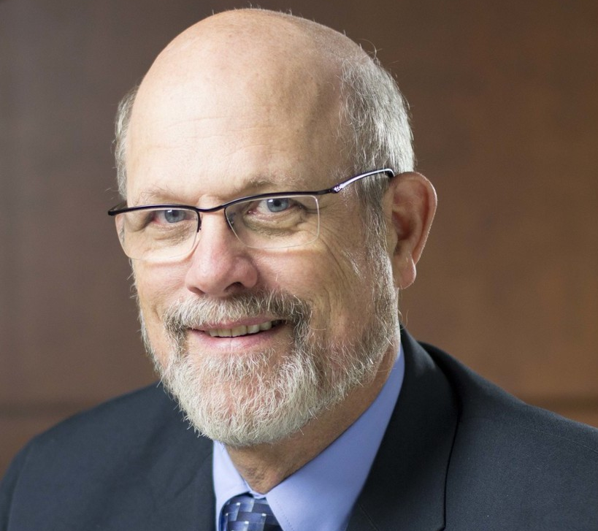
Message from Dr. Bob

Slide 5
Perkins Monthly Updates 2024-25
10/8/2024
11/12/2024
12/10/2024
1/14/2025
2/11/2025
3/11/2025
4/8/2025
5/13/2025
6/10/2025
Attendance (or viewing the recording within 30 days) is recorded on the monitoring rubric. Recording may be accessed at the same link as the registration.
You can register for these now at
www.ncperkins.org/presentations
and put them on your calendar
Notes:
Register now and let the system remind you.

Slide 6
Virtual Office Hours for Technical Assistance
2nd Tuesday of the month 1-2pm
4th Wednesday of the month 9-10
** See the top of the NCPerkins.org/presentations page for TEAMS link
Need help?
Let's meet.
CTE Team Perkins
Virtual
Office Hours
Drop in to ask a CTE Coordinator your questions

Slide 7
Training on the revised EDGAR
Education Department General Administrative Regulations (EDGAR)
Revisions approved on April 22, 2024
Spring Date TBD

Slide 8
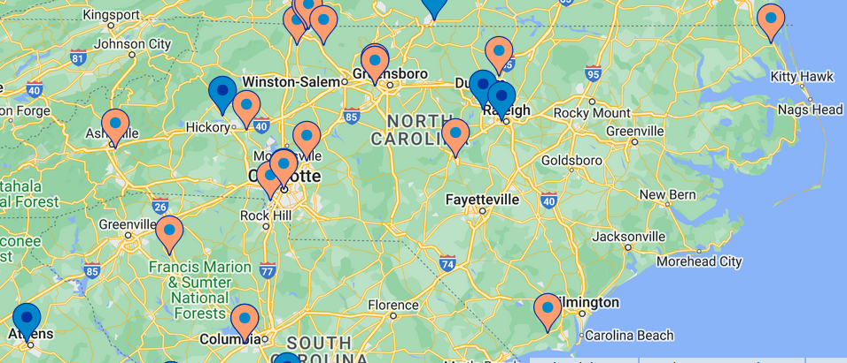
Manufacturing Day – Friday, October 4 (events all week)
View Events at
mfgday.com

Slide 9
9-14 PATHWAYS CONSULTATION
This training offers a deep dive into all secondary engagement opportunities by reviewing best practices, local data, and inter-office collaborations, e.g. career advising, articulation, and CCP pathways. Sessions typically last about 2-3 hours at no cost to the college.
If interested, please email Aaron Mabe,
mabea@nccommunitycolleges.edu

Slide 10
NCCCS System Conference
https://events.lifelonglearning.ncsu.edu/ncccs/
Registration:
Early Bird through September 24, 2024: $249
After September 24, 2024: $299
Notes:
https://events.lifelonglearning.ncsu.edu/ncccs/

Slide 11
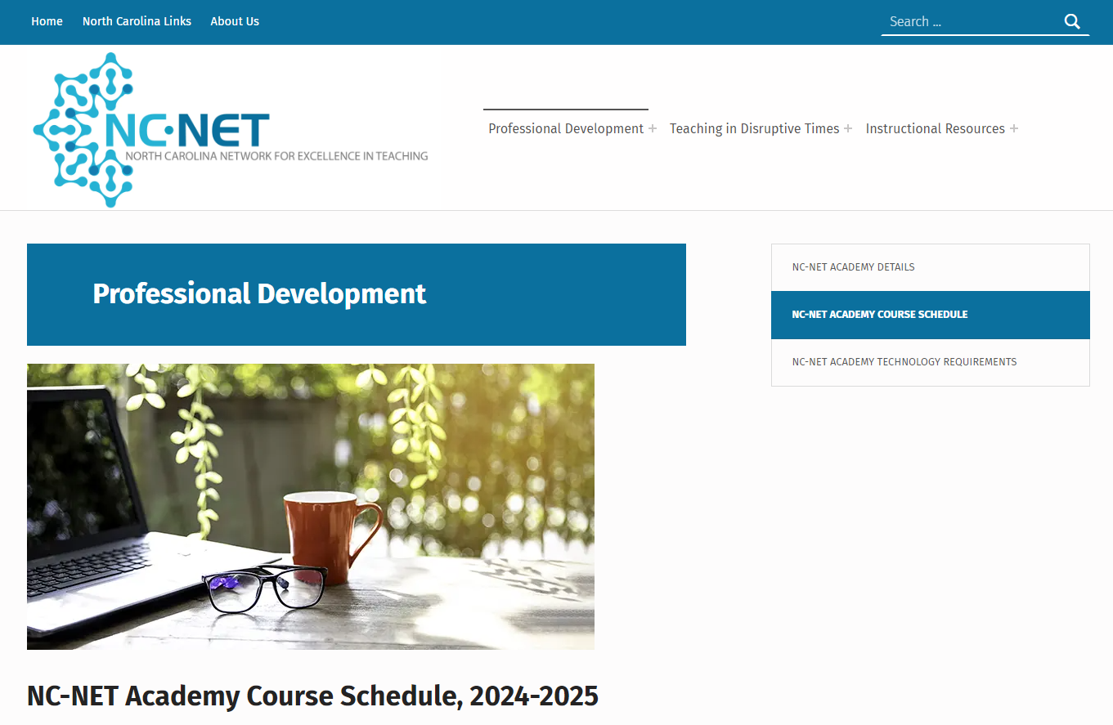
NC-NET – Free Professional Development
Always available!
NC-NET Academy for new faculty

Slide 12
2025 NCCCS Master Instructor Certification Program
Application Launch: September 2024; open to all instructors
Eligibility Requirements: Complete the online application, submit a supporting summary from CAO/Workforce Officer, and provide a personal statement.
Program Structure: Includes two in-person meetings, ten online asynchronous modules, and virtual support.
Timeline:
September 2024 – October 31st: Application Process
November: Candidate Applications Reviewed
December: Candidates Notified of Acceptance
January: In-person Kick-off Session
January – May: Online asynchronous with artifact submission and collaboration
May: In-person Capstone Event
Contact Lane Freeman with questions freeman@nccommunitycolleges.edu

Slide 13
Leveraging AI in Education Series
Introduction to AI and its relevance in higher education.
Practical applications in teaching, administration, and student services.
Ethical considerations and future AI trends.
Hands-on activities to experience AI tools.
Contact Lane Freeman to schedule the 90-minute session for your college freeman@nccommunitycolleges.edu

Slide 14
Promising Practice Video from 2023-2024
Nash Community College
CTE designated Success Coach
The link to all EOY videos is www.ncperkins.org/video

Slide 15
Professional Development of interest: ACTE Postsecondary Summit
https://www.acteonline.org/postsecondarycteevent/
Notes:
https://www.acteonline.org/postsecondarycteevent/

Slide 16
Professional Development of Interest: NCCCS Adult Learning Conference
Strategies for Serving the New Majority Learner
November 21 – 22, 2024 Sheraton Raleigh Hotel
2024 Conference Goals
Create a common understanding of the changing world of work for adult learners and the critical role community colleges play.
Facilitate a collaborative environment where practitioners exchange innovative strategies and proven methodologies to enhance adult engagement and learning.
Empower participants with knowledge and tools to support adult learners in a rapidly changing environment.
Accelerate progress towards achieving state education and workforce goals.
Click for the Conference Webpage (also in notes below)
Notes:
https://web.cvent.com/event/342c0ed4-176c-4060-aea4-8f175a4cbc6f/websitePage:1a48ccfd-c151-499b-879f-efb352d05016

Slide 17
Professional Development of interest: National Career Pathways Network
https://www.ncpn.info/
Notes:
https://www.ncpn.info/

Slide 18
Professional Development of interest: League of Innovation
https://www.league.org/
Notes:
https://www.league.org/

Slide 19
Professional Development of interest: nactei Spring 2025 conference
National Associate for Career & Technical Education Information
spring 2025 conference - Not yet on their website
https://nactei.org
Notes:
https://nactei.org

Slide 20
Technical Assistance is available
We are here to help!
Team Perkins is available by phone, email, virtually, or in-person

