Slide 1
Postsecondary Perkins Update
October 10, 2017
www.ncperkins.org

Slide 2
Understanding Pathways
Notes:
=====
NCWorks Partnership Conference
Tursday, October 6, 2016 @ 3:00 p.m.

Slide 3
I want to go into healthcare…where do I start?
Nurse
Respiratory Therapist
CNA
Dental Hygienist
Radiographer

Slide 4
What paths did you take to get where you are today?
You came to a fork in the road and you took one path? Have you ever thought of where you would be if you had taken another?
Do you know someone who changed directions, purposefully or because of particular circumstances?

Slide 5
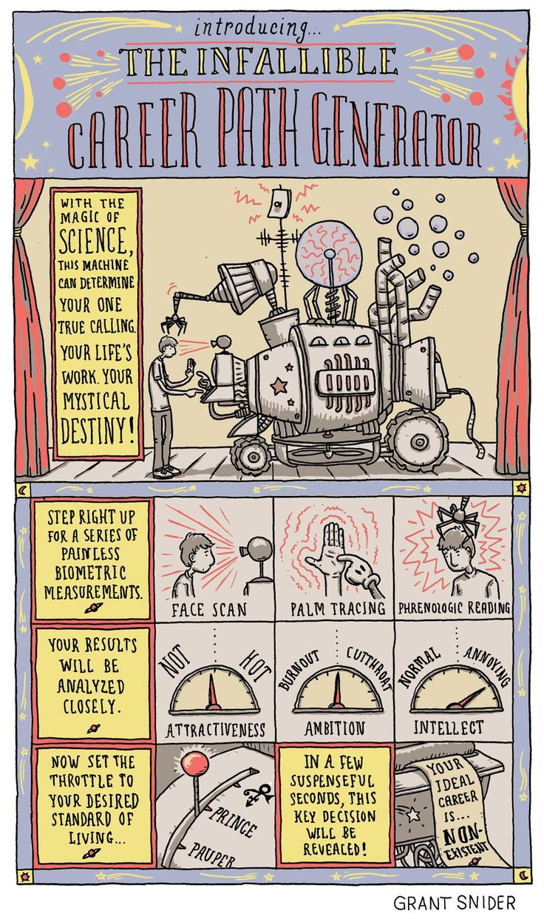

Slide 6
CAREER

Slide 7
Seamless Flow to Work
Student
Graduate
Dislocated Worker
Under- employed
Unemployed
Career Changer
Middle School
High School Diploma
WBL
Community College AAS
W O R K
Certificate
Diploma
Degree
Basic Skills Plus
Community College AA
Continuing Education
Customized Training
University
Proprietary School / Training
Apprenticeship
Notes:
Note work-based learning is integrated across and through all programs of study or training

Slide 8
Takeaways
The need for career pathways
The types of career pathways and their relationships with each other
Focus is on the Customer
The system works together to benefit the customer (aka the student & the employer)

Slide 9
Types of Pathways within the NCCCS
Basic Skills Pathways
Career & College Promise
Perkins CTE 9-14 Pathways
Certified Pathways
GPS (NC Student Success Center)

Slide 10
Basic Skills Plus Pathways
Understanding Pathways

Slide 11
Workforce Innovation & Opportunity Act (WIOA)
Title II Adult Education and Family Literacy Act
Signed into law July 22, 2014
Designed to help job seekers access:
Employment
Education
Training
Support services
Goal – Help job seekers succeed in the labor market and to match employers with the skilled workers they need to compete in the global economy.

Slide 12
Basic Skills Plus Pathways
Align with the skills needed by industries in the state or regional economy
Prepare individuals to succeed in a range of education options, including apprenticeships
Include counseling to support an individual in achieving the individual’s education and career goals
Include, as appropriate, concurrent education and training opportunities for a specific occupation or occupational cluster
Organize education, training, and support services to meet individual needs and accelerate the educational and career advancement
Enable individuals to attain a high school diploma or equivalent, and at least one recognized postsecondary credential
Help individuals enter or advance within an occupation or occupational cluster.

Slide 13
Basic Skills Plus Pathway Example Computer Integrated Machining
Entry Process
Recruiting
Screening
Assessments:
Service Delivery
Contextualized HS Equivalency and AHSD
ACA 115, BPR 111, MAC 121, DRE and/or DMAs
Orientation
TABE
Needs Assessments
Career Assessments
Dream Catcher’s Transitions Course
Career Assistance
Career Readiness Certification
Outcomes
HSE or AHSD
Machining or CNC Certificate
Computer Integrated Machining Diploma
Core Courses for AAS in Computer Integrated Machining

Slide 14
Basic Skills Plus Pathways
For more information:
Dr. Cassandra Atkinson College and Career Readiness Transitions Coordinator atkinsonc@nccommunitycolleges.edu 919-807-7144

Slide 15
Career and College Promise
Understanding Pathways

Slide 16
Career & College Promise
CCP Legislation
CCP Transfer Pathway
CCP Technical Pathway
Curriculum
Workforce Continuing Education (Fall 2018)
Leads to an Associate in Arts
Leads to an Associate in Science
Leads to an Associate in Engineering
Leads to Associate Degree Nursing
Leads to an Visual Arts Transfer
Legislation
Career & College Promise (CCP) – Session Law 2011-145
Updated in 2017 to allow Workforce Continuing Education pathways the lead to a recognized industry credential

Slide 17
Transfer Pathway
Associate in Arts
The CCP College Transfer Pathway Leading to the Associate in Arts is designed for high school juniors and seniors who wish to begin study toward the Associate in Arts degree and a baccalaureate degree in a non-STEM major.
Associate in Science
The CCP College Transfer Pathway Leading to the Associate in Science is designed for high school juniors and seniors who wish to begin study toward the Associate in Science degree and a baccalaureate degree in a STEM or technical major.
Associate in Engineering
The College Transfer Pathway (CCP) leading to the Associate in Engineering is designed for high school juniors and seniors who wish to begin study toward the Associate in Engineering degree and a baccalaureate degree in a STEM or technical major.

Slide 18
Transfer Pathway (Cont)
Associate Degree Nursing
The Career and College Promise (CCP) ADN Pathway is designed for high school juniors and seniors who wish to pursue a career in nursing. Student who complete this pathway are prepared to apply for admission into community college or university nursing programs.
Associate in Fine Arts in Visual Arts
The CCP College Transfer Pathway Leading to the Associate in Fine Arts in Visual Arts is designed for high school juniors and seniors who wish to begin study toward the Associate in Fine Arts in Visual Arts and a baccalaureate degree in Fine Arts-Visual Arts.

Slide 19
CCP Career & Technical Education Pathways
Curriculum
Workforce/Continuing Education
Must be in compliance with current curriculum standard
Must contain either a minimum of 12 SHC derived from core of curriculum standard or consist of courses in a local traditional certificate as listed in the college’s catalog.
Must be approved to offer the traditional program.
No course pick lists in any CTE program of study (including local certificates submitted as CTE programs of study).
Must have System Office approval prior to implementation. Local certificates submitted as CTE programs of study must include a statement that verifies the courses are listed in the college's catalog for a traditional certificate
Must be in compliance with State or industry-recognized training standards
Must have System Office approval prior to implementation
While changes have been made to CCP Procedures, State Board code still prevents colleges from developing instruction for high schools students.
Revision of State Board code is underway and it is anticipated that students may begin in the Spring 2018.
Colleges can begin the planning process now.

Slide 20
CCP Information
Career & College Promise Operating Procedures
http://www.nccommunitycolleges.edu/sites/default/files/basic-pages/academic-programs/attachments/section14_18aug2017_operating_procedures_v2.pdf
Career & College Promise FAQs for Parents
http://www.nccommunitycolleges.edu/sites/default/files/basic-pages/academic-programs/attachments/ccp_parent_faq_8.11.14v3.pdf
For more information:
Dr. Lisa Eads Program Coordinator Early Childhood, Public Service Technologies, Career & College Promise
eadsl@nccommunitycolleges.edu 919-807-7133
Workforce Continuing Education CCP
Margaret Roberton
Associate Vice President for Workforce Development – Continuing Education
robertonm@nccommunitycolleges.edu
919-807-7159

Slide 21
Perkins 9-14 CTE Pathways
Understanding Pathways

Slide 22
CTE 9-14 Pathways - Components
WBL
CCP
Employer Engagement
Career Development
Industry Credentials &
Articulation
Notes:
What do we my by each one of these area?
Discuss in Groups Report Out

Slide 23
Pathways - Characteristics
Seamless framework in demand-driven, data-informed clusters
Engage employers
Offer Career Development & Awareness
Coordinate training and Programs of Study that:
accept credit and articulate credit for prior leaning,
integrate work-based learning,
contain multiple entry and exit points,
award credentials, certificates, diplomas, and degrees that meet workforce needs
Place individuals in full-time jobs

Slide 24
Employer Engagement
Assist in developing the pathways
Offer suggestions, strategies, and opportunities for work-based learning (WBL)
Work with program designers in determining learning outcomes
Education and training for certificates and credentials
Provide for and serve as mentor
Interview and hire completers

Slide 25
Career Development
Integrated Career Counseling and Coaching
Coordinates intentional advising for middle school, high school, college, and career centers in a region to share labor market information and pathways to careers
Provides career assessments such as interest, abilities, and skills to assist in career planning
Provides career advising, coaching, and planning
Works with individuals to develop an integrated career plan leading to employment, including classroom training and on the job training, and training that is integrated into an existing pathway framework.

Slide 26
Education and Training
Rigorous Programs of Study
A comprehensive structured approach for delivering career and technical education to prepare students thorough secondary and postsecondary education for work
Typically a grade 9-14 framework of classroom and experiential learning
May include HS to CC articulated credit, opportunity for secondary students to earn postsecondary credit (CCP)
Programs of study may be aligned to regional industry needs, integrate technical and academic courses resulting in a certificate, diploma and/or degree
Programs of study within the pathway framework include intentional career advising, integrated work-based learning and accruing stackable credentials

Slide 27
Education and Training
Other Options to Build Into Framework
Multiple options for education and training are built into the Career Pathway Framework. These include and are not limited to:
Apprenticeship
Continuing Education Certificate Programs
Vendor Training
Short-Term Targeted Training
Basic Skills Plus

Slide 28
Rigorous Education and Training
A comprehensive, structured approach for delivering education and training to prepare individuals for work.
Typically a framework of classroom and on-the-job learning.
May include credit for previous life/work experience
Acknowledgement of certifications.

Slide 29
Certifications
Stackable - Certificates, Diplomas, Degrees, Credentials
Credentials can be gained from education, employers, and third-party vendors. The pathways leadership team will determine which credentials are appropriate for each pathway.
Certifications can be stackable and accruing allowing for open entry and open exit in the program of study of the pathway.
Recognizing the value of independent learning, OJT, and other forms of skill development in each pathway, Credit for prior learning can be acknowledged and credited to the individual within the framework of the pathway.

Slide 30
Work-Based Learning
Exploratory
Exploring Work
Experiential
Fundamental Skills & Soft Skills
Engaged
Classroom learning applied on the job.
Job Shadowing
Employer Videos
Employer Projects in Class
Industry Tours
Junior Achievement
Part Time Work
Volunteer
Projects in Class
Internship
Service Learning
Junior Achievement
CTSO
Cooperative Education
Apprenticeship
Internship
Structured Volunteer
Structured Service Learning

Slide 31
Individual Career or Employability Plan
Career Awareness
Career Plan
Assessment of Interests, Abilities, Skills
Assessment of Prior Learning, Credentials
Assessment of Pathway Identified Skills
Identification of Individual Career Goal
Articulation Coordination
Program of Study Academic and Techincal Training
Academic & Technical Courses
Education and/or Training Program
Credit for: Experiences, Articulated Course Plan, and Path Streamlined for Individual
Work-Based Learning
Exploratory - Shadowing, Mentoring
Experiential - Work Foundational Skills
Engaged - Supportive of Classroom Education
Career Goal
Work
Jobs within the Cluster
Ability to Engage in Work
Reengage in Education or Training
Continuous Education /Training to Meet Career Goal

Slide 32
Articulation and Coordination Program of Study / Training
Build to meet employer’s need
Stackable credentials
Open entry /exit
Exit to work
Articulate back to training
Stack toward a degree
Certificate
Diploma
Degree

Slide 33
Certified Pathways
Understanding Pathways

Slide 34
Pathway System vs Pathways
A Career Pathways System is about the coordination of people and resources. Within education, this includes aligning our country's K–12 and postsecondary education systems and, in particular, the career and technical education services provided within and across program providers.

Slide 35
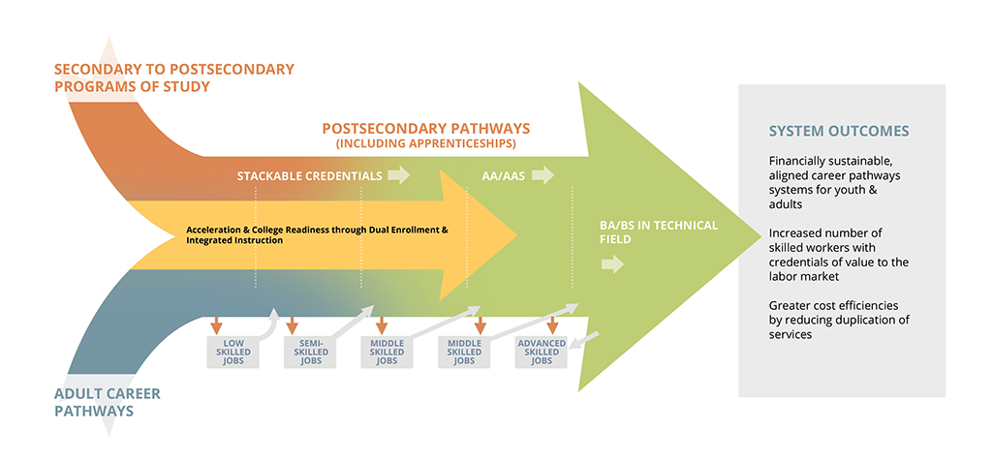

Slide 36
NCWorks Certified Career Pathways
What are Certified Career Pathways?
Seamless systems of education and workforce development programs, initiatives, and resources
Focused on matching worker preparation to employer need in high-demand occupations
Demand driven, employer led, collaborative, career aware, coordinated, work based, flexible, and evaluable
Designed to serve individuals from the most-entry level (middle and high school) to the most-senior level of career

Slide 37
NCWorks Certified Career Pathways Criteria
Demand-Driven and Data-Informed – meets documented workforce needs
Employer Engagement – employers provide curriculum input, work-based learning opportunities, and jobs to well-trained workers
Collaborative – education and workforce partners work together to develop and implement pathways
Career Awareness – students understand the pathway and the opportunities available

Slide 38
NCWorks Certified Career Pathways Criteria
Articulation and Coordination – encourage coordination of educational offerings and stackable credentials
Work-based Learning – students get practical, real-world experience
Multiple Points of Entry and Exit – reduce duplication of coursework and training
Evaluation – measure progress, chart success

Slide 39
NCWorks Certified Career Pathways
For more information visit https://www.nccommerce.com/wf/workforce-professionals/ncworks-certified-career-pathways

Slide 40
NC-GPS (Guided Pathways)
Understanding Pathways

Slide 41
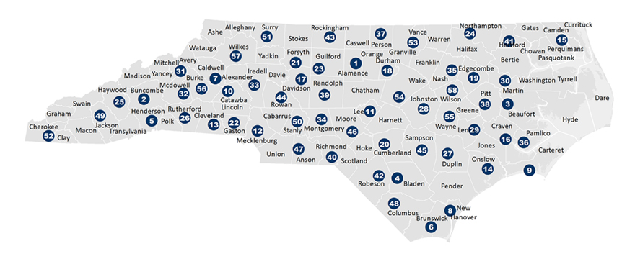
Serving 58 Community Colleges
The NC Student Success Center provides support for all 58 colleges to advance, scale, and sustain student success efforts.
The NC Student Success Center helps colleges align policies and practices to ensure access, equity, significant learning, and completion of credentials.
The NC Student Success Center represents the collective voice of NCCCS practitioners in state-level and national policy discussions.

Slide 42
NC-GPS: Coordinate 1
Clarify paths to student end goals

Slide 43
NC-GPS: Coordinate 2
Help students choose and enter a pathway

Slide 44
NC-GPS: Coordinate 3
Help students stay on path

Slide 45
NC-GPS: Coordinate 4
Ensure that students are learning

Slide 46
NC-GPS works to help 58 colleges. . .
align policies and practices with the NCCCS mission and our values to ensure
access
equity
significant learning
completion of credentials

Slide 47
NC-GPS
For more information:
Dr. Roxanne Newton Executive Director, NC Student Success Center newtonr@nccommunitycolleges.edu 919-807-7107

Slide 48
Postsecondary Perkins Update
October 10, 2017
www.ncperkins.org

Slide 49
Manufacturing Week 2017

Slide 50
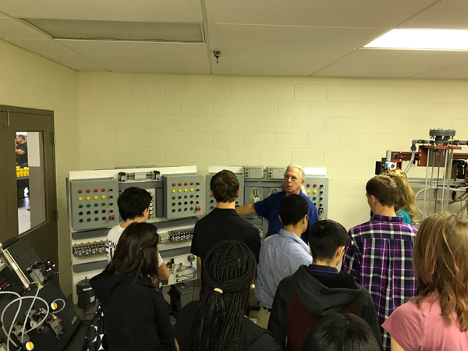
Central Carolina CC - Innovation Center

Slide 51
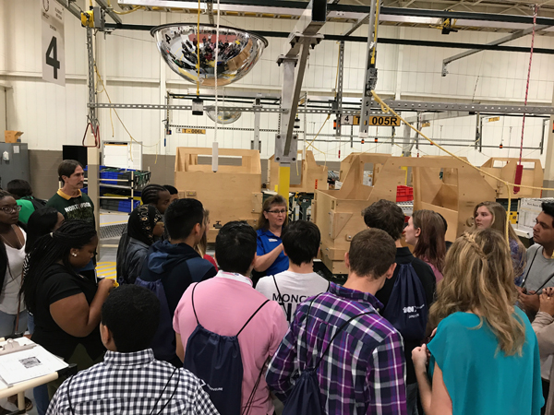
Central Carolina CC - Innovation Center

Slide 52
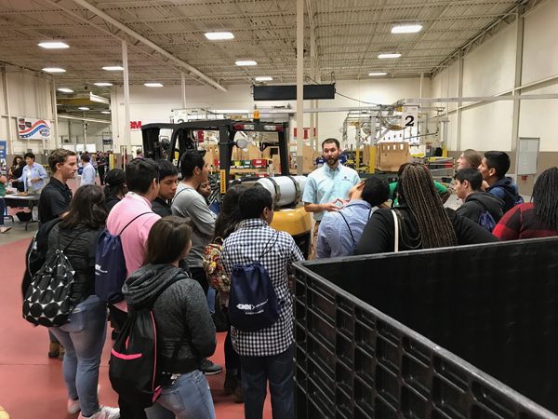
Central Carolina CC - Innovation Center

Slide 53
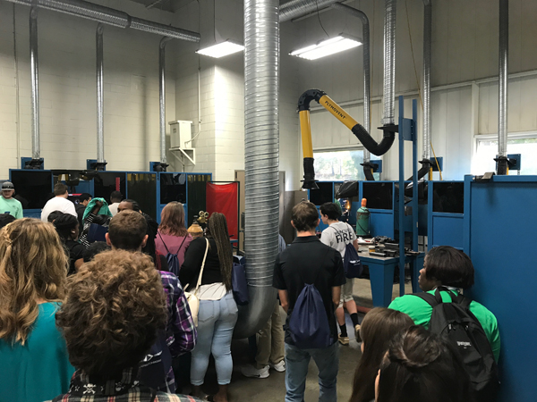
Central Carolina CC - Innovation Center

Slide 54
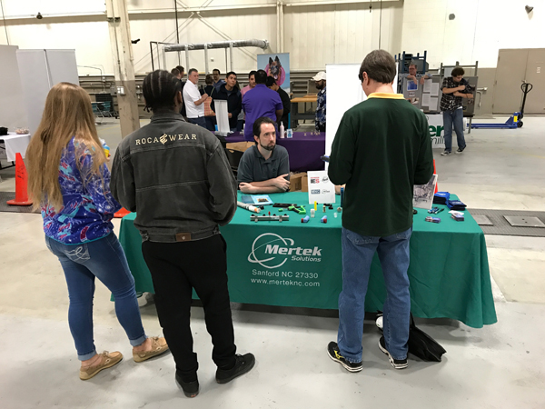
Central Carolina CC - Innovation Center

Slide 55
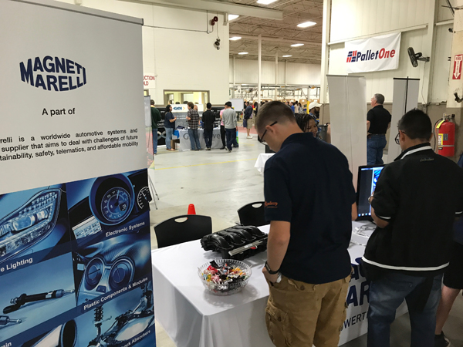
Central Carolina CC - Innovation Center

Slide 56
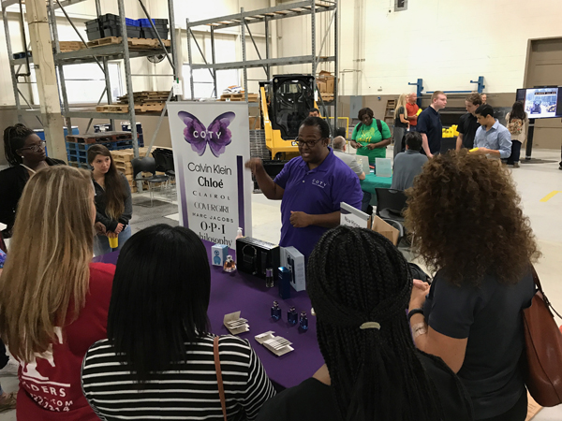
Central Carolina CC - Innovation Center

Slide 57
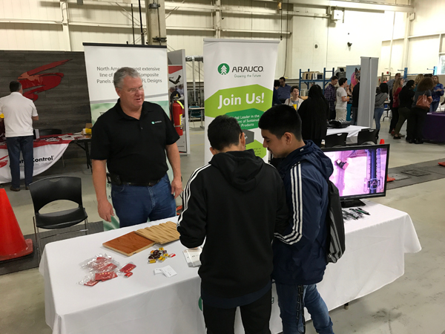
Central Carolina CC - Innovation Center

Slide 58
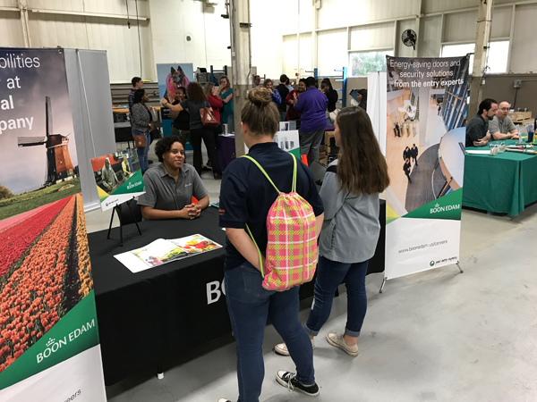
Central Carolina CC - Innovation Center

Slide 59
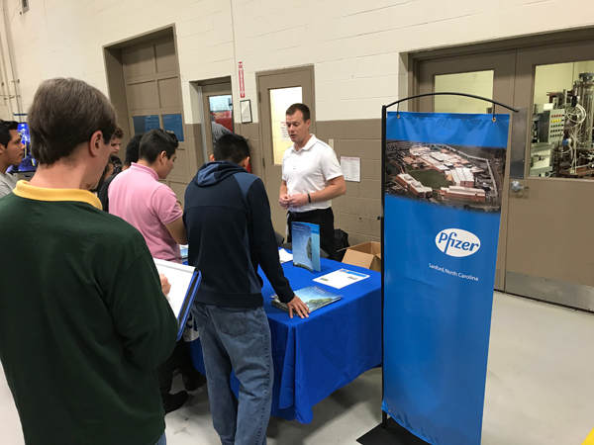
Central Carolina CC - Innovation Center

Slide 60
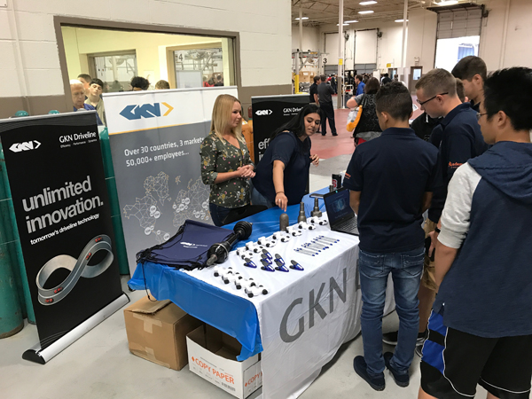
Central Carolina CC - Innovation Center

Slide 61
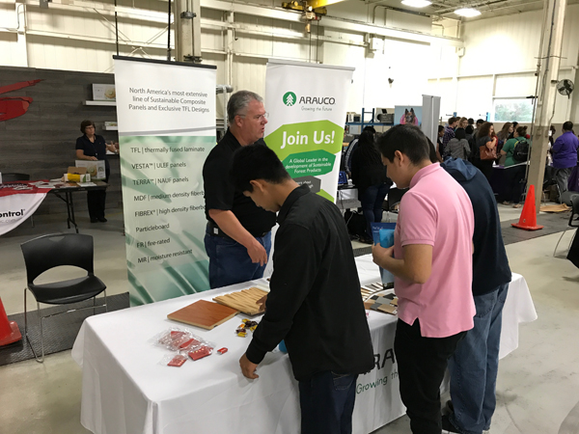
Central Carolina CC - Innovation Center

Slide 62
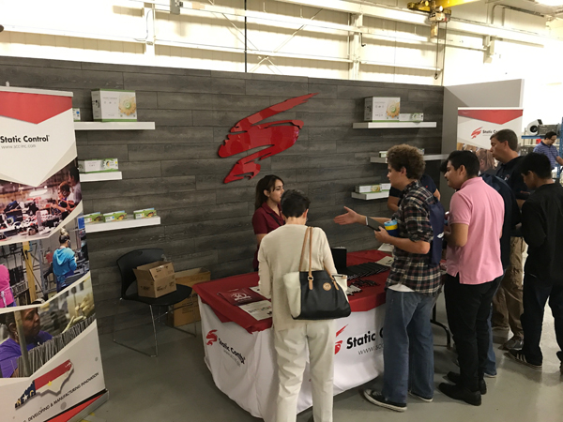
Central Carolina CC - Innovation Center

Slide 63
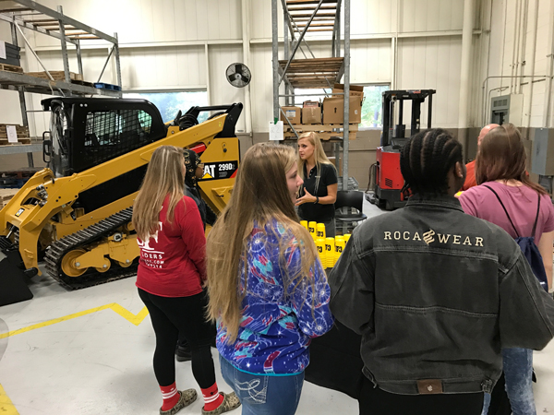
Central Carolina CC - Innovation Center

Slide 64
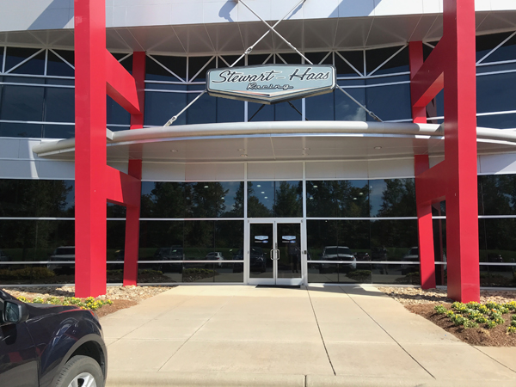
Stewart-Haas Racing - Concord, NC

Slide 65
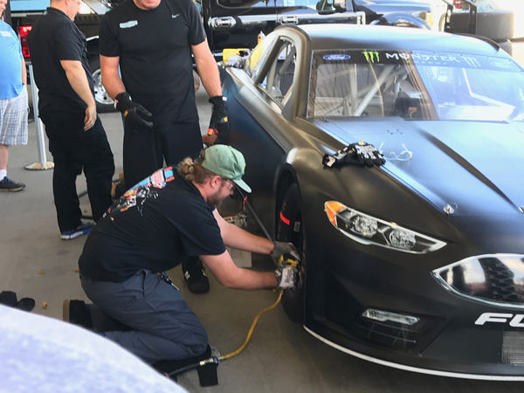
Stewart-Haas Racing - Concord, NC

Slide 66
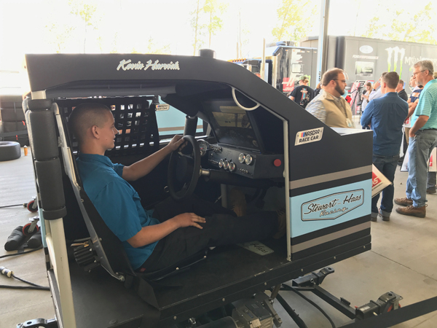
Stewart-Haas Racing - Concord, NC

Slide 67
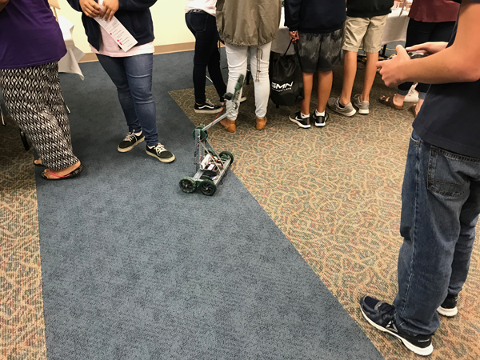
Make It in Union County Manufacturing Showcase - Monroe, NC

Slide 68
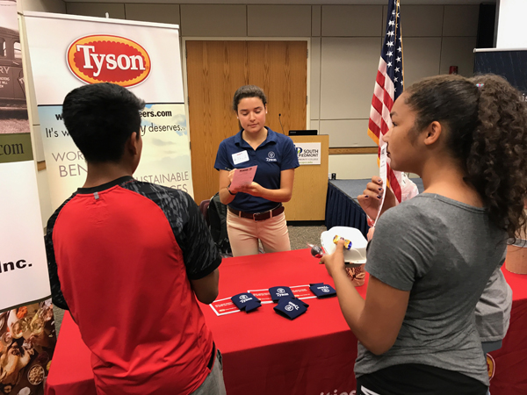
Make It in Union County Manufacturing Showcase - Monroe, NC

Slide 69
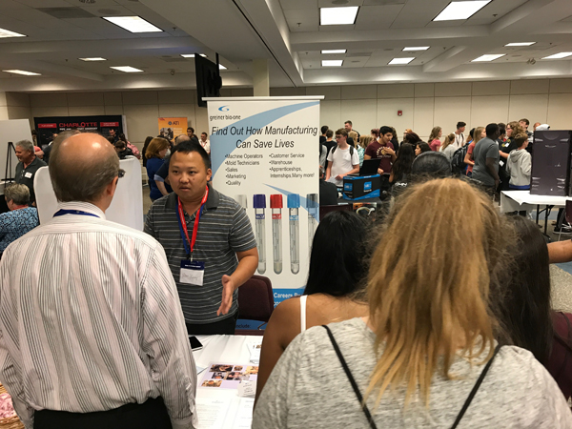
Make It in Union County Manufacturing Showcase - Monroe, NC

Slide 70
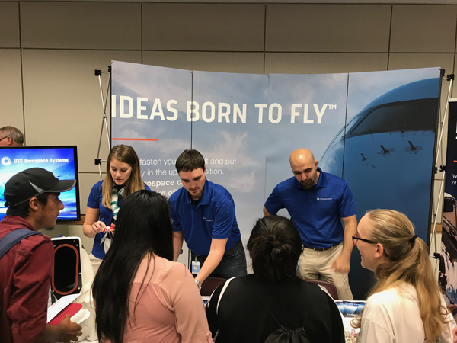
Make It in Union County Manufacturing Showcase - Monroe, NC

Slide 71
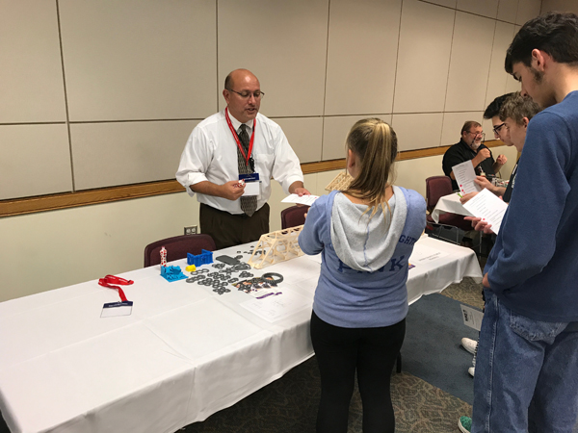
Make It in Union County Manufacturing Showcase - Monroe, NC

Slide 72
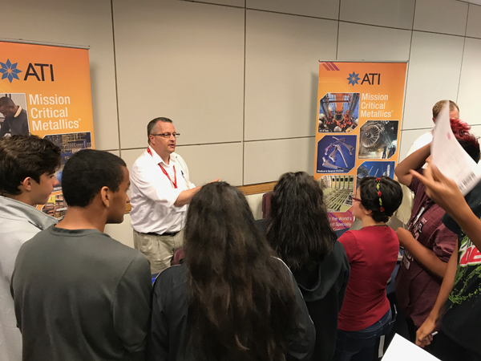
Make It in Union County Manufacturing Showcase - Monroe, NC

Slide 73
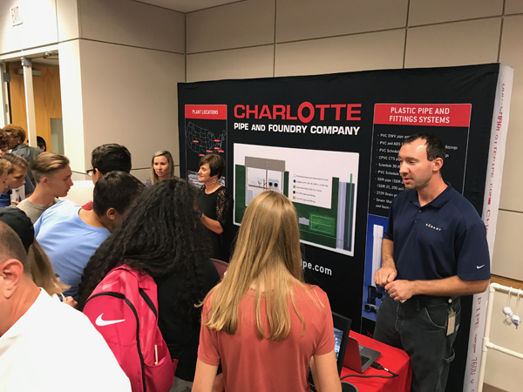
Make It in Union County Manufacturing Showcase - Monroe, NC

Slide 74
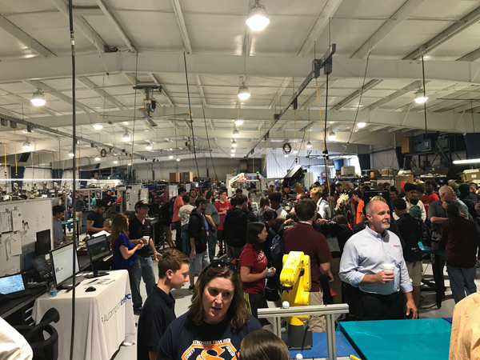
Mertek Solutions Inc, Sanford, NC

Slide 75
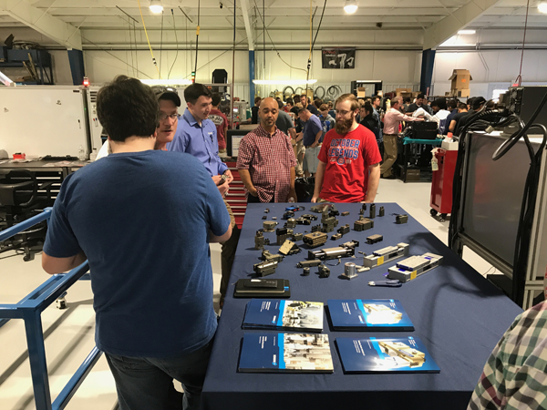
Mertek Solutions Inc, Sanford, NC

Slide 76
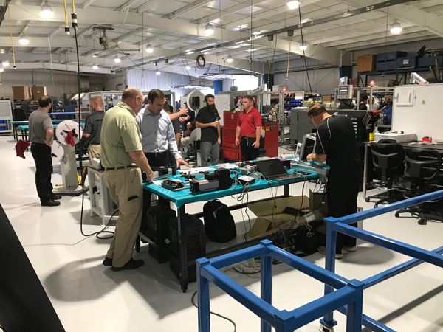
Mertek Solutions Inc, Sanford, NC

Slide 77
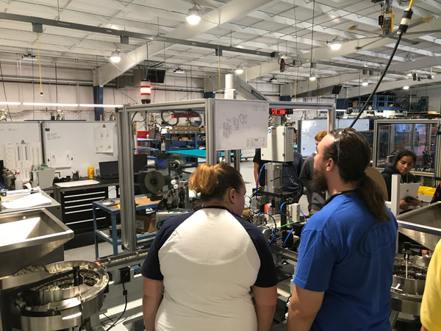
Mertek Solutions Inc, Sanford, NC

Slide 78
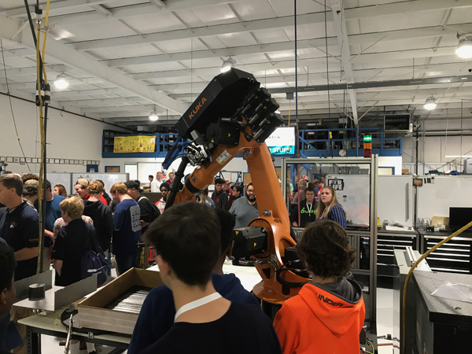
Mertek Solutions Inc, Sanford, NC

Slide 79
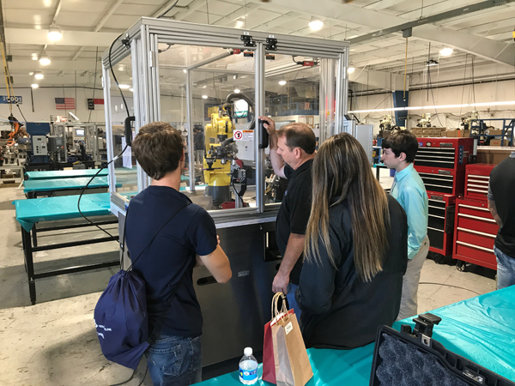
Mertek Solutions Inc, Sanford, NC

Slide 80
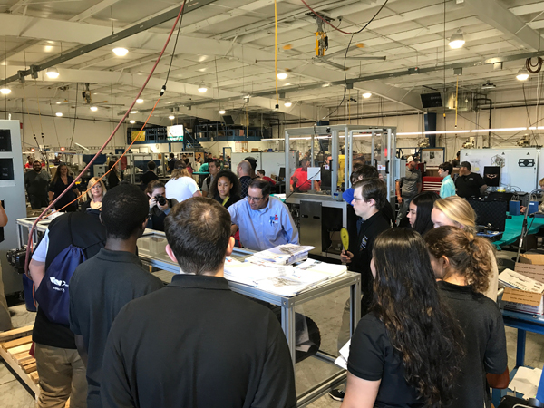
Mertek Solutions Inc, Sanford, NC

Slide 81
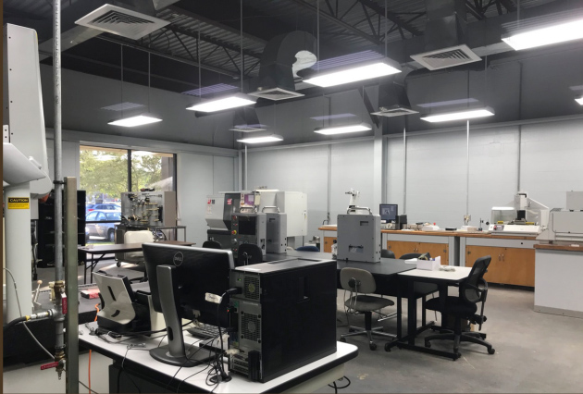
Beaufort CC

Slide 82
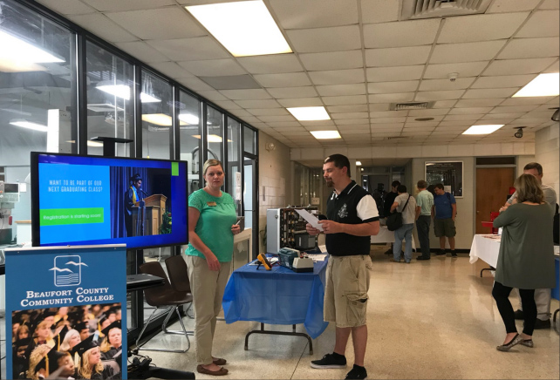
Beaufort CC

Slide 83
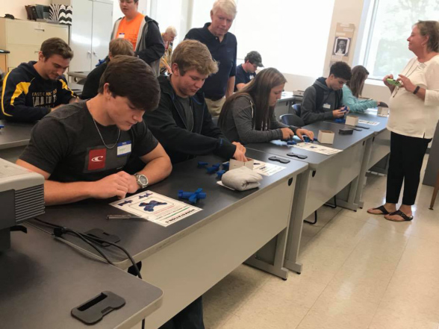
Carteret CC

Slide 84
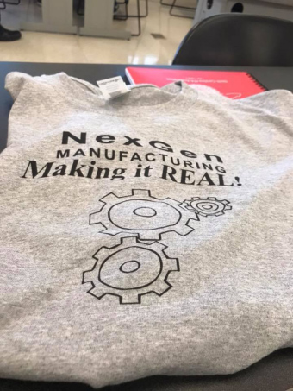
Carteret CC

Slide 85
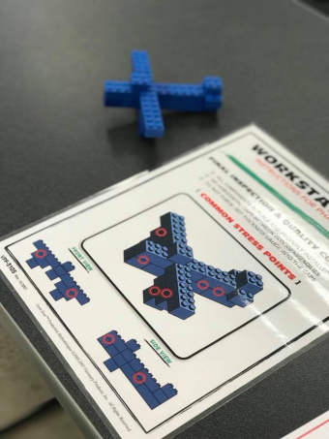
Carteret CC

Slide 86
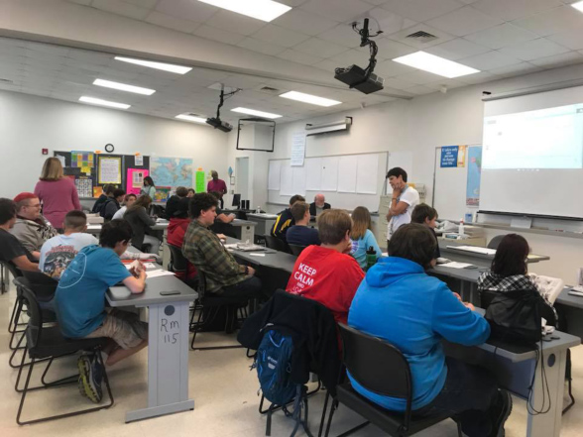
Carteret CC

Slide 87
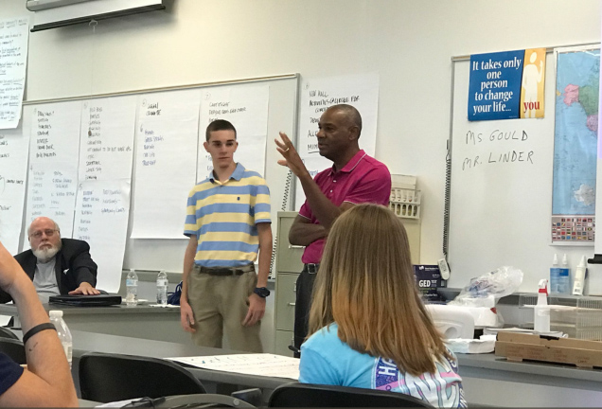
Carteret CC

Slide 88
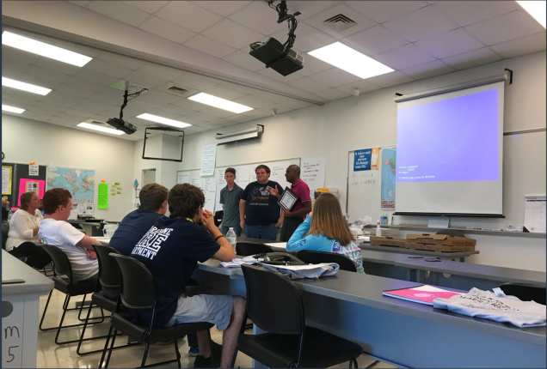
Carteret CC

Slide 89
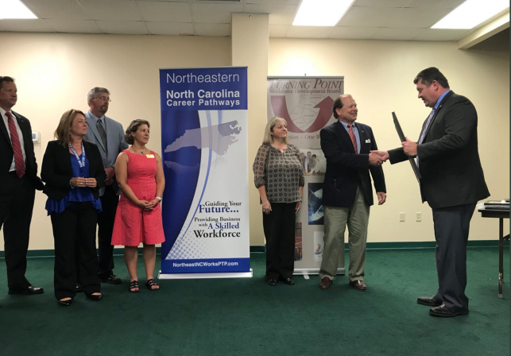
Nash CC

Slide 90
Postsecondary Perkins Update
October 10, 2017
www.ncperkins.org

Slide 91
Reminders
Initial Budgets are past due
Local Articulation course list
November 8 drive-in meeting in Raleigh
Cancel November 14 Perkins update webinar
Manufacturing Careers Awareness Week

Slide 92
Questions?
Bob Witchger Career and Technical Education Director
Jennifer Holloway Administrative Assistant
Julia Hamilton, Tony Reggi, & Chris Droessler Career and Technical Education Coordinators

Slide 93
Perkins/CTE State Staff
Dr. Bob Witchger Director, Career & Technical Education WitchgerB@nccommunitycolleges.edu 919-807-7126
Dr. Tony R. Reggi Coordinator, Career & Technical Education ReggiA@nccommunitycolleges.edu 919-807-7131
Dr. Julia Hamilton Coordinator, Career & Technical Education HamiltonJ@nccommunitycolleges.edu 919-807-7130
Chris Droessler Coordinator, Career & Technical Education DroesslerC@nccommunitycolleges.edu 919-807-7068
Jennifer Holloway CTE Administrative Assistant HollowayJ@nccommunitycolleges.edu 919-807-7129

