Slide 1
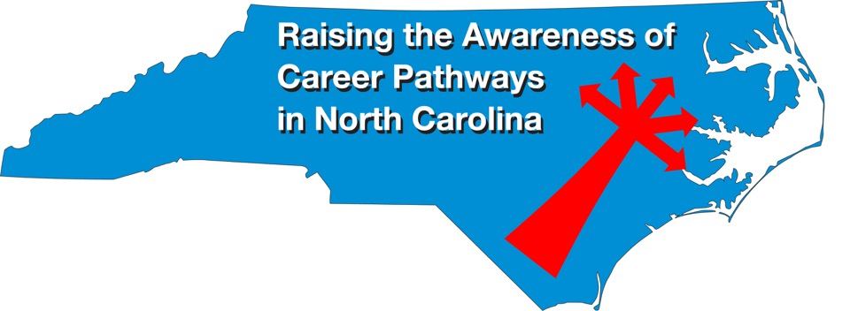
Educator Preparation Programs September 20, 2023
Download the PowerPoint and access the recording: www.ncperkins.org/presentations

Slide 2
Career & Technical Education Team
Bob Witchger
Tony Reggi
Patti Coultas
Mary Olvera
vacant
Darice McDougald
Lane Freeman
Jennifer McLean
Aaron Mabe

Slide 3
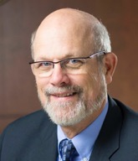
Dr. Bob Witchger
CTE Director, Team Perkins
Notes:
Dr. Robert (Bob) Witchger
NCCCS, CTE Director
919-807-7126
witchgerb@nccommunitycolleges.edu

Slide 4
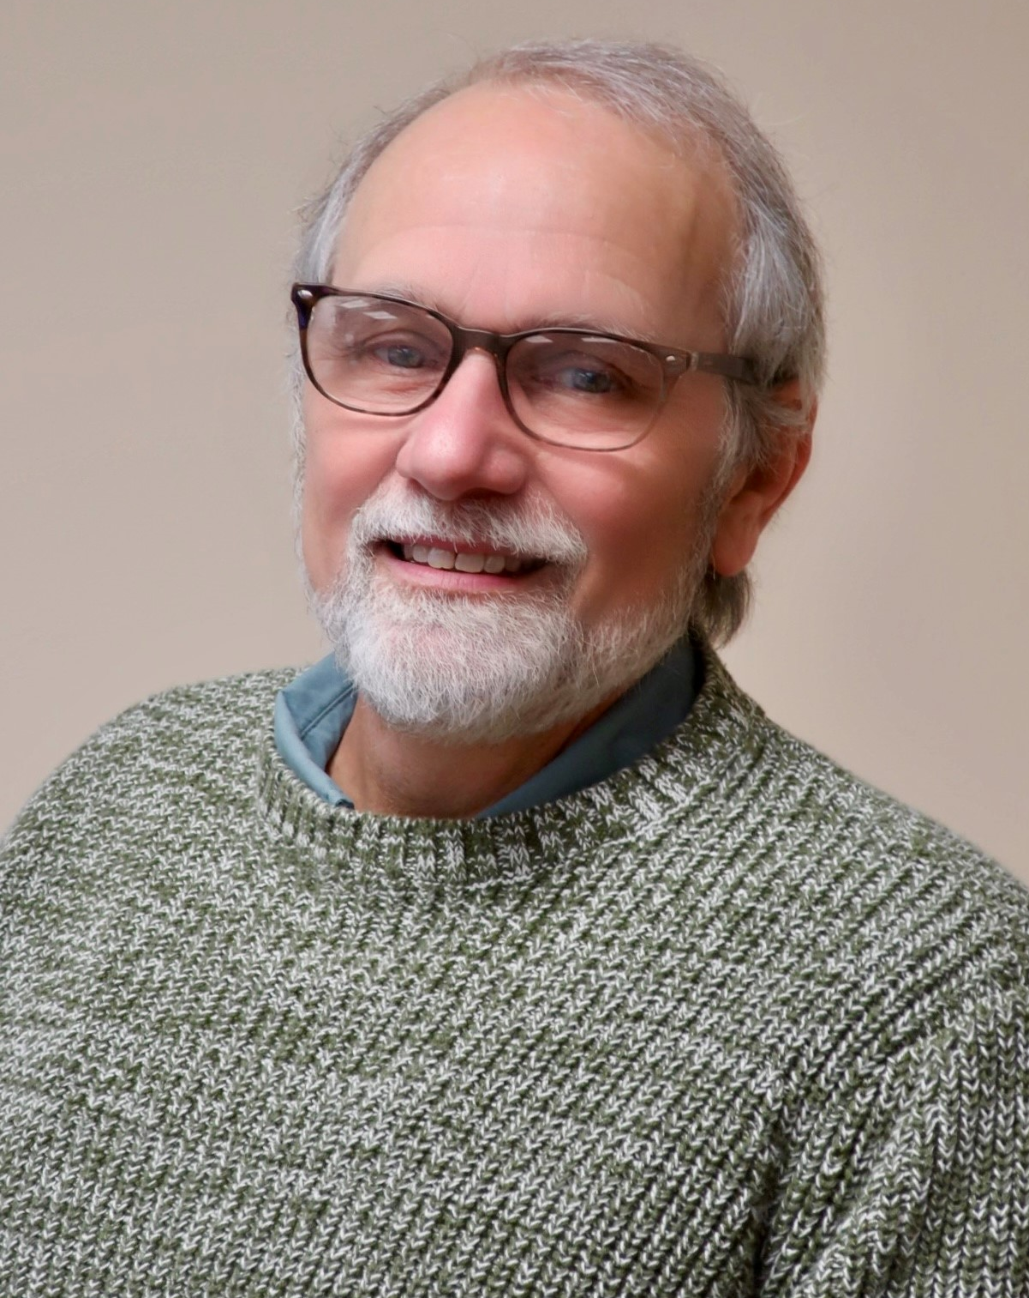
Dr. Tony Reggi
CTE Associate Director,
Notes:
Tony Reggi
919-807-7131
reggia@nccommunitycolleges.edu

Slide 5
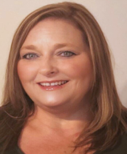
Dr. Mary Olvera
CTE Coordinator and Program Administrator
Public Service Technologies, Agriculture and Natural Resources Technologies, and Commercial Artistic Productions
Notes:
Dr. Mary Olvera
Career and Technical Education Coordinator & Program Administrator
Public Service Technologies, Agriculture and Natural Resources Technologies, and Commercial Artistic Productions
North Carolina Community College System Office
919-807-7120
olveram@nccommunitycolleges.edu

Slide 6
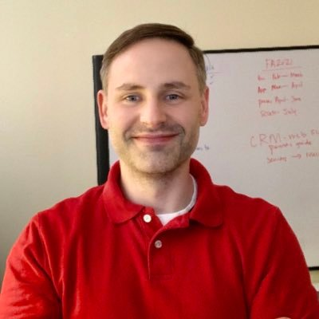
Aaron Mabe
Coordinator for Career and College Promise
Notes:
Aaron Mabe
919-807-7098
mabea@nccommunitycolleges.edu

Slide 7
Elementary Education Residency Licensure Certificate
Educator Preparation Program (EPP)
The Elementary Education Residency Certificate curriculum provides a course of study leading to the development of the general pedagogical competencies needed to become certified to teach by the North Carolina Department of Public Instruction.
Course work includes learning theory, instructional/educational technology, diverse learners, school policies and procedures, expectations and responsibilities of educators, teaching strategies/methods for specific content/specialty areas, formative/summative assessment, data informed practice, and classroom organization/management to enhance learning.
Graduates should meet general pedagogical competencies and demonstrate effective teaching practices. Additional requirements, such as pre-service training, passing the state required assessments, and the criteria included in the North Carolina Teacher Evaluation System, are required for licensure.

Slide 8
Colleges Approved to Offer Elementary Education Residency Licensure Certificate
Alamance Community College
Blue Ridge Community College
Brunswick Community College
Catawba Valley Community College
Central Carolina Community College
Central Piedmont Community College
Davidson-Davie Community College
Durham Technical Community College
Fayetteville Technical Community College
Forsyth Technical Community College
Johnston Community College
Lenoir Community College
McDowell Tech Community College
Pitt Community College
Richmond Community College
Robeson Community College
Sampson Community College
Stanly Community College
Western Piedmont Community College
Pitt Community College (pending SBE approval)
Robeson Community College (pending SBE approval)

Slide 9
Elementary Education Residency Licensure Certificate Program and Requirements
Courses:
EDU 270 Effective Instructional Environments
EDU 272 Technology, Data, and Assessments
EDU 277 Integrated Curriculum and Instructional Strategies: Math/Science
EDU 278 Integrated Curriculum and Instructional Strategies: Social Studies/ELA
EDU 279 Literacy Development and Instruction
EDU 283 Educator Preparation Practicum
Requirements:
Bachelor’s Degree
Minimum GPA 2.7
24 hours of general education coursework OR
Passed NCSBE Content Exam
Employed in public school classroom

Slide 10
Elementary Education Teachers
Notes:
From nccareers.org

Slide 11
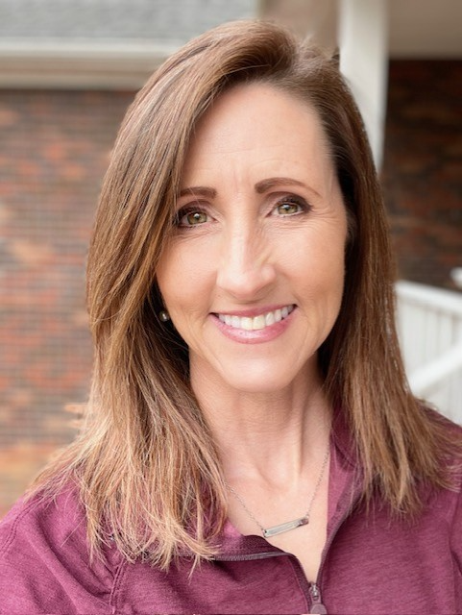
Sue Drake
Stanly Community College
Program Head K-12 Education
Stanly Community College
Notes:
Sue Drake
704-991-0286
sdrake3244@stanly.edu

Slide 12
Stanly Community College and Stanly County Schools MOU Signing Event

Slide 13
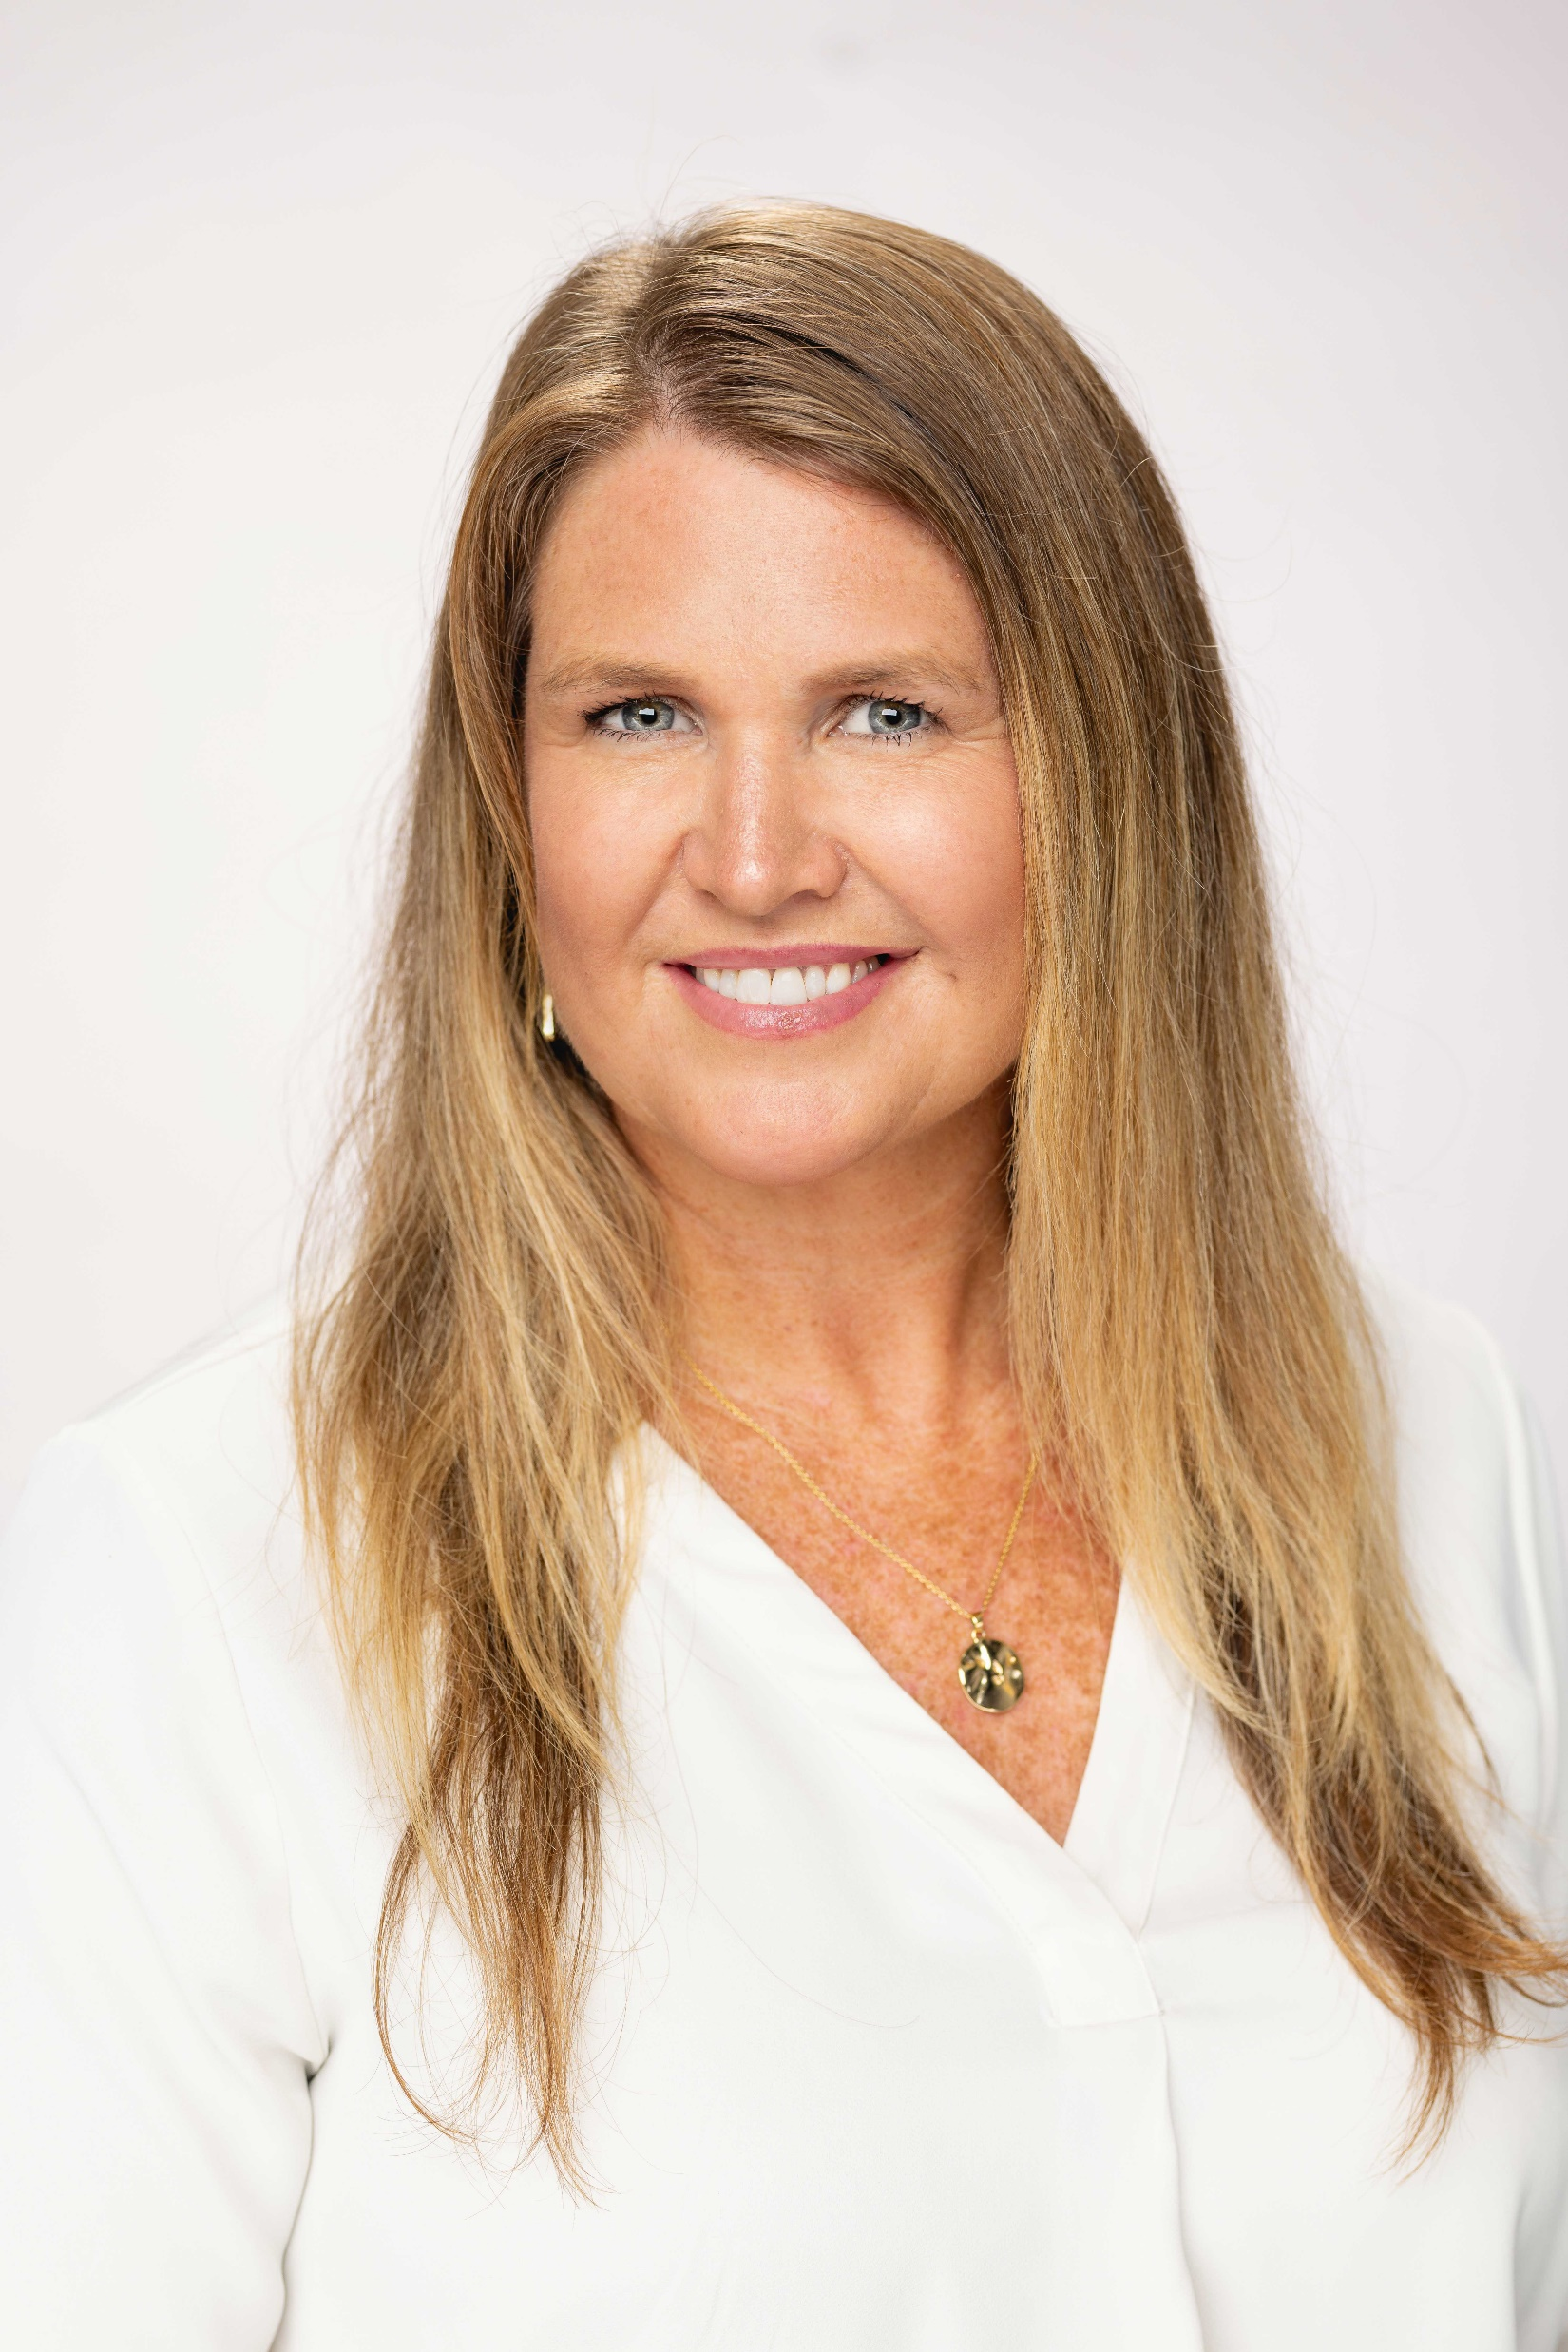
Jennifer Perkins
Central Piedmont Community
College
Program Chair
Education K-12 and EPP Director
Notes:
Jennifer Perkins
704-330-6753
Jennifer.perkins@cpcc.edu

Slide 14
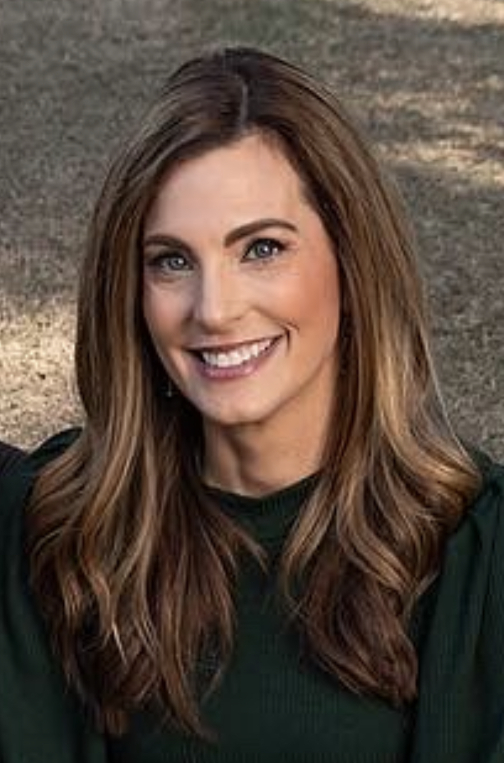
Heather Craven
Fayetteville Technical Community College
Program Director
Residency Licensure Certificate Program
Notes:
Heather Craven
910-678-9790
cravenh@faytechcc.edu

Slide 15
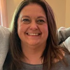
Kasey Gardner
Western Piedmont Community College
Coordinator
Early Childhood Education
Notes:
Kasey Gardner
828-448-3133
kgardner@wpcc.edu

Slide 16
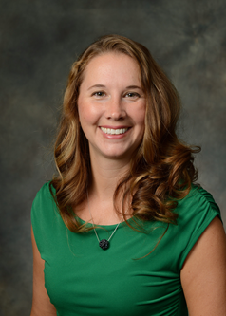
Lisa Daye
Burke County Public Schools
Beginning Teachers Coordinator
Assistant Principals Support Coordinator
Notes:
Lisa Daye
828-438-2954
ldaye@burke.k12.nc.us

Slide 17
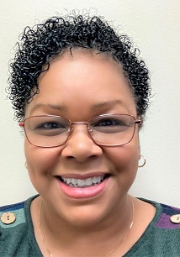
Juandalynn Freeman-Sankey
Sampson Community College
Director
Residency Licensure Certificate Program
Notes:
Juandalynn Freeman-Sankey
910-900-4115
jfreemansankey@sampsoncc.edu

Slide 18
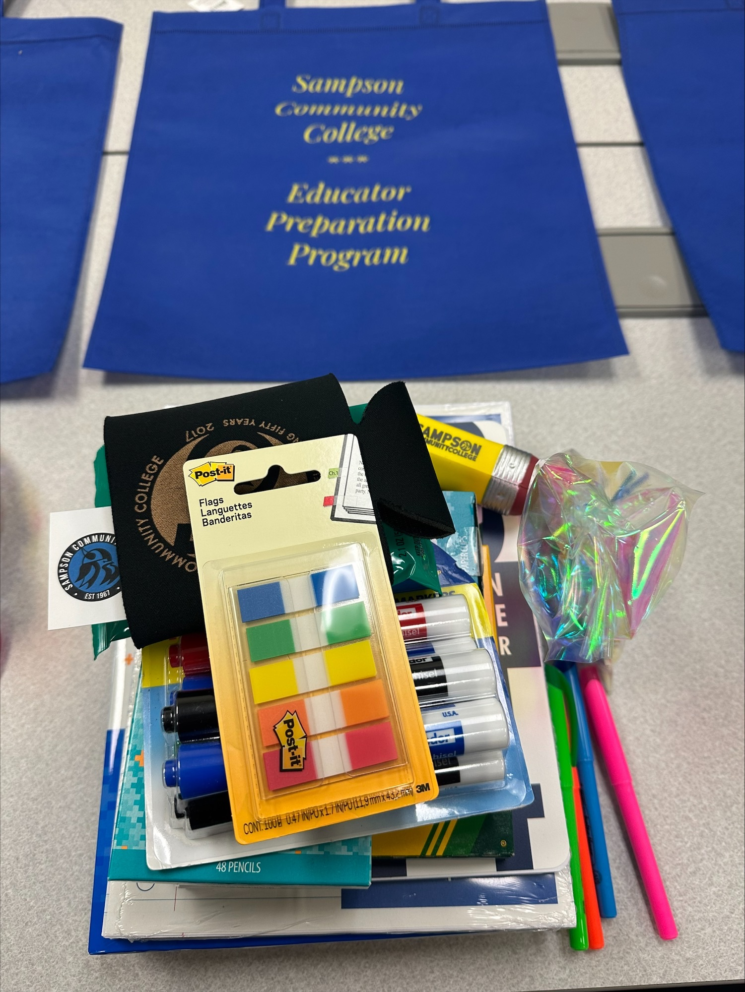
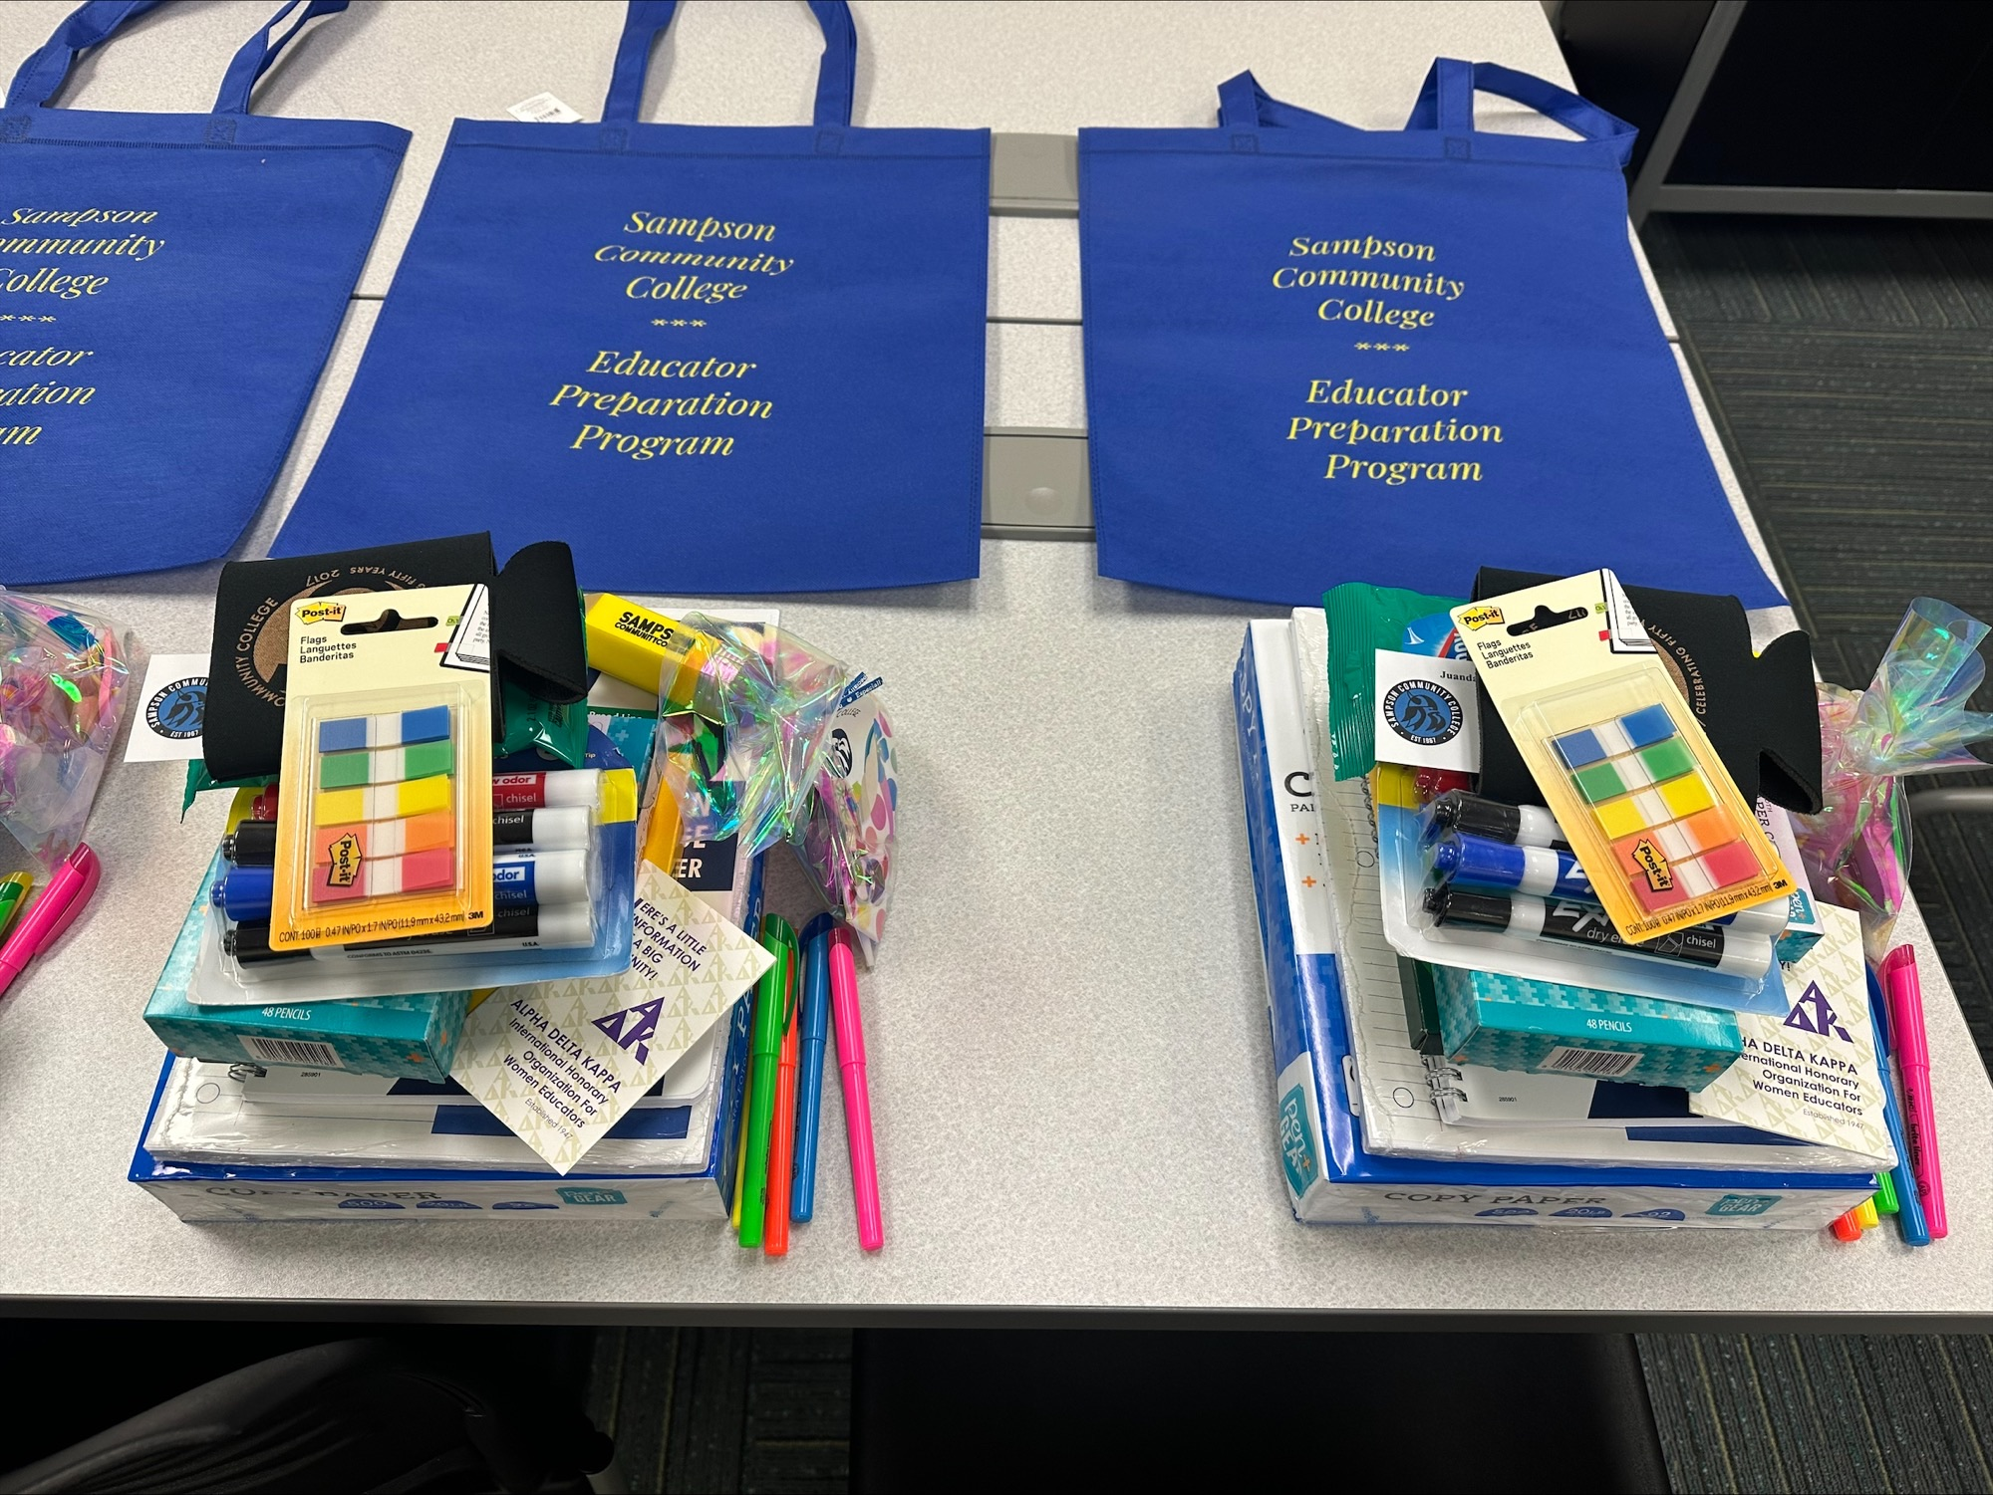
Sampson Community College Flyer and Open House

Slide 19
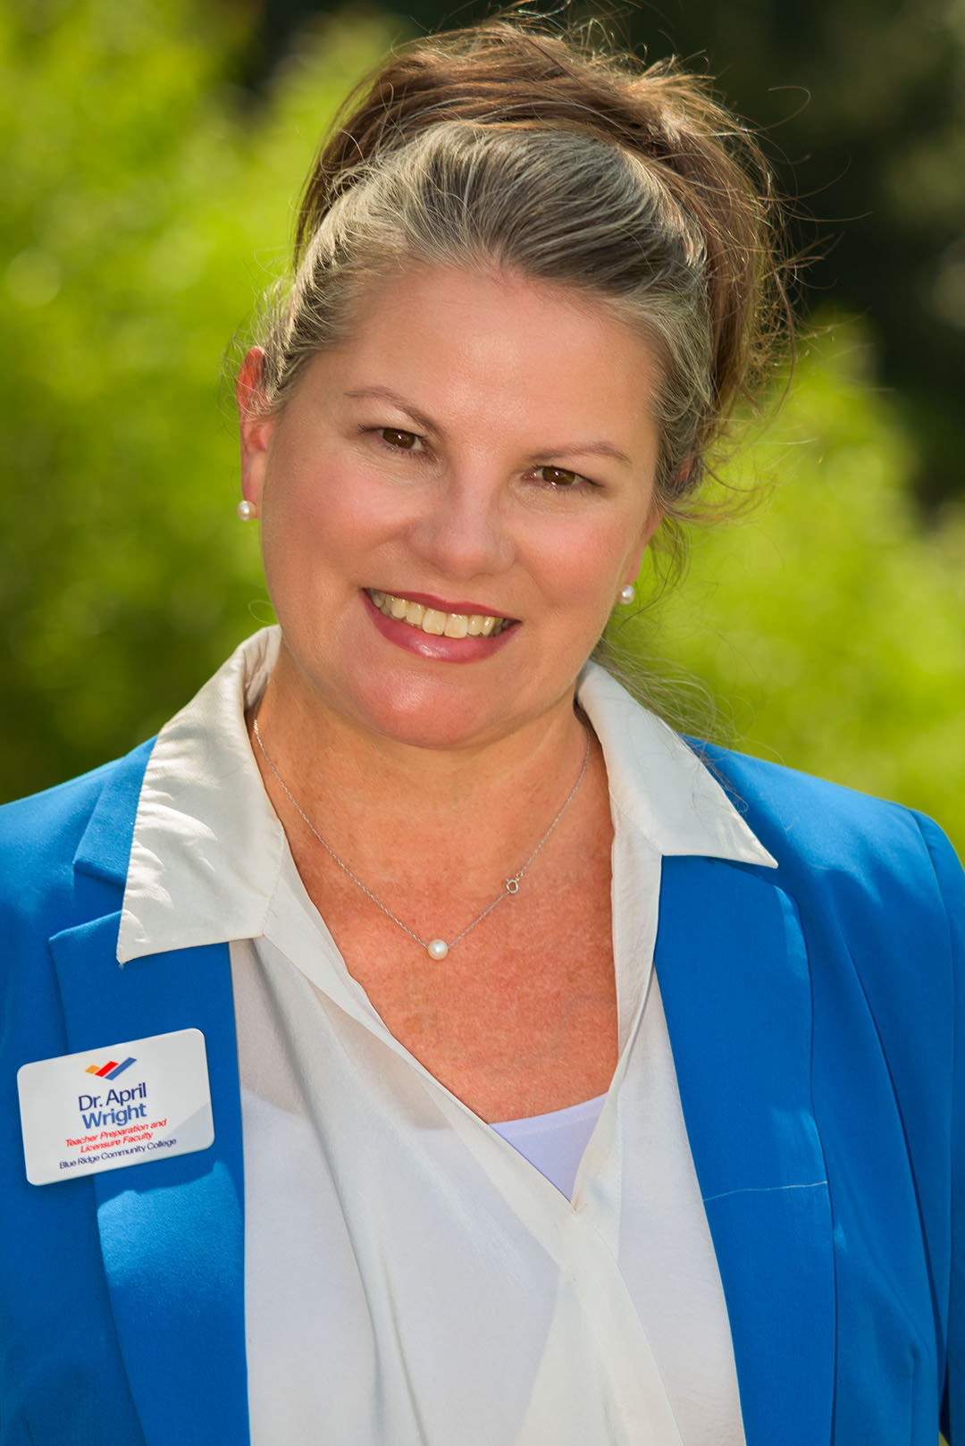
Dr. April Wright
Blue Ridge Community College
Teacher Preparation & Licensure Faculty
Notes:
Dr. April Wright
828-694-4706
a.wright1@blueridge.edu

Slide 20
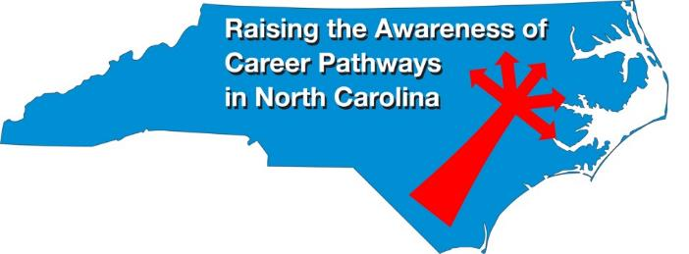
Raising the Awareness of Career Pathways Webinars
October 18, 2023 National Disability Employment Awareness Month
November 15, 2023
January 17, 2024
February 21, 2024
March 20, 2024
April 17, 2024
May 15, 2024
Register for all webinars at www.ncperkins.org/presentations

