Slide 1
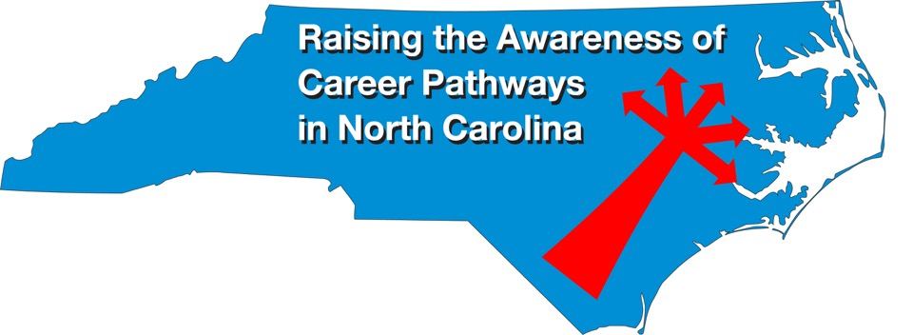
Biotechnology & Biopharma February 21, 2024
Download the PowerPoint and access the recording: www.ncperkins.org/presentations

Slide 2
Career & Technical Education Team
Bob Witchger
Tony Reggi
Patti Coultas
Mary Olvera
Stefanie Schroeder
Darice McDougald
Lane Freeman
Jennifer McLean
Aaron Mabe

Slide 3
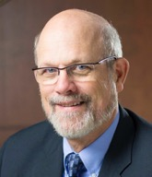
Dr. Bob Witchger
CTE Director, Team Perkins
Notes:
Dr. Robert (Bob) Witchger
NCCCS, CTE Director
919-807-7126
witchgerb@nccommunitycolleges.edu

Slide 4
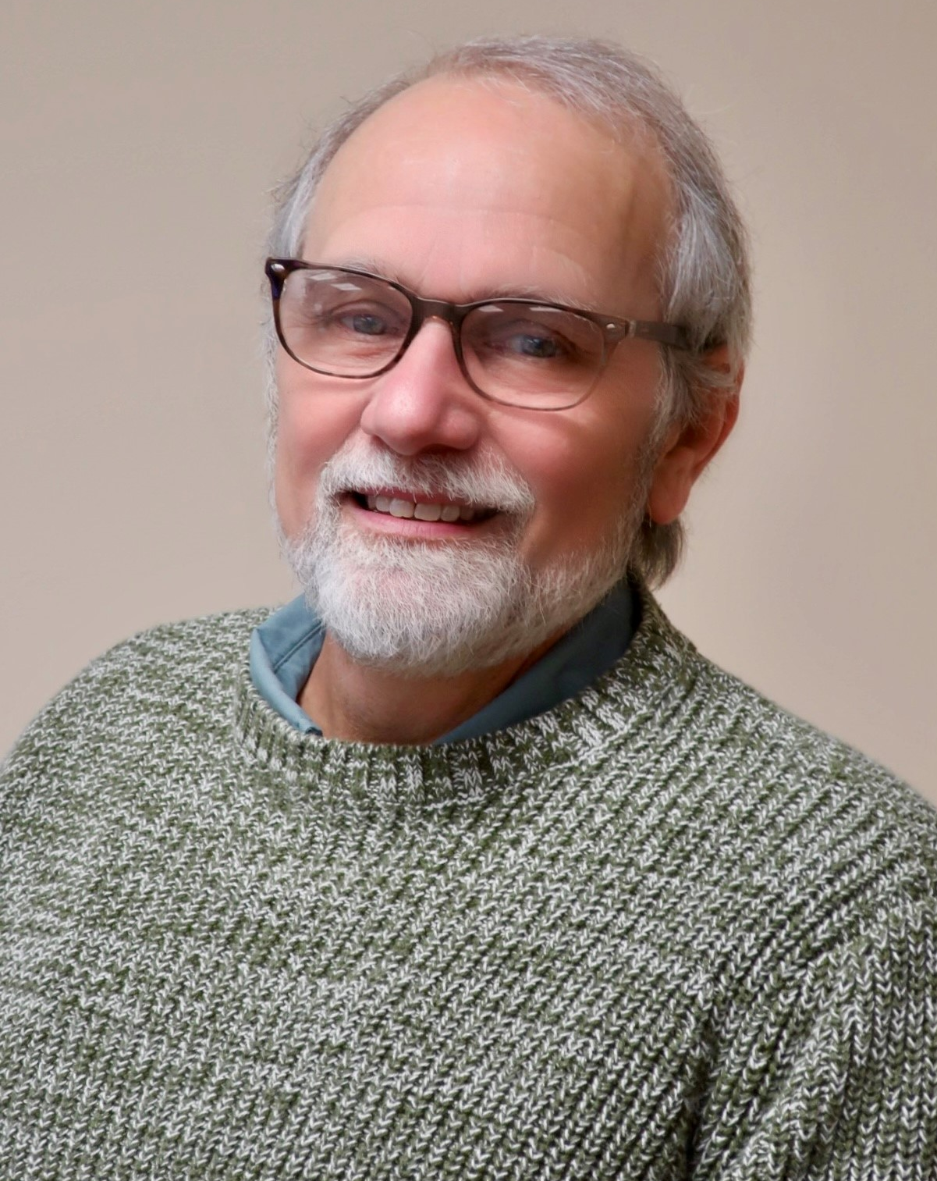
Dr. Tony Reggi
CTE Associate Director
Notes:
Tony Reggi
919-807-7131
reggia@nccommunitycolleges.edu

Slide 5
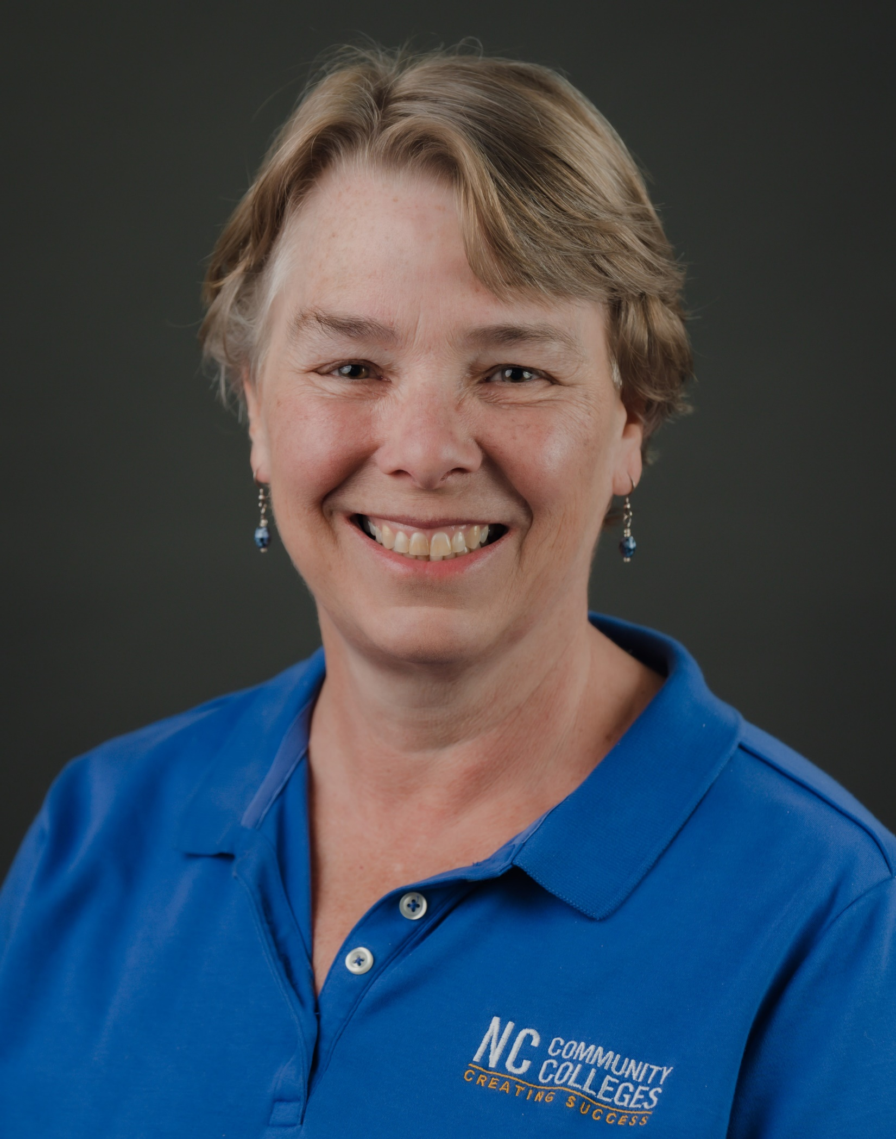
Patti Coultas
CTE Coordinator
Notes:
Patti Coultas
919-807-7130
coultasp@nccommunitycolleges.edu

Slide 6
Aaron Mabe
Coordinator for Career and College Promise
Notes:
Aaron Mabe
919-807-7098
mabea@nccommunitycolleges.edu

Slide 7
Dr. Mary Olvera
CTE Coordinator and Program Administrator
Public Service Technologies, Agriculture and Natural Resources Technologies, and Commercial Artistic Productions
Notes:
Dr. Mary Olvera
Career and Technical Education Coordinator & Program Administrator
Public Service Technologies, Agriculture and Natural Resources Technologies, and Commercial Artistic Productions
North Carolina Community College System Office
919-807-7120
olveram@nccommunitycolleges.edu

Slide 8
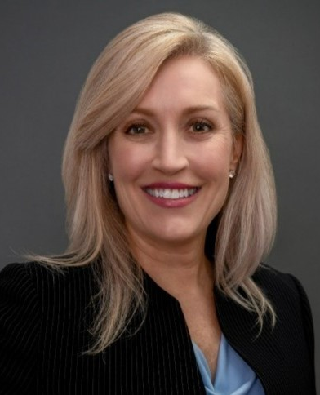
Stefanie Schroeder
CTE Coordinator
Notes:
Stefanie Schroeder
919-807-7232
schroeders@nccommunitycolleges.edu

Slide 9
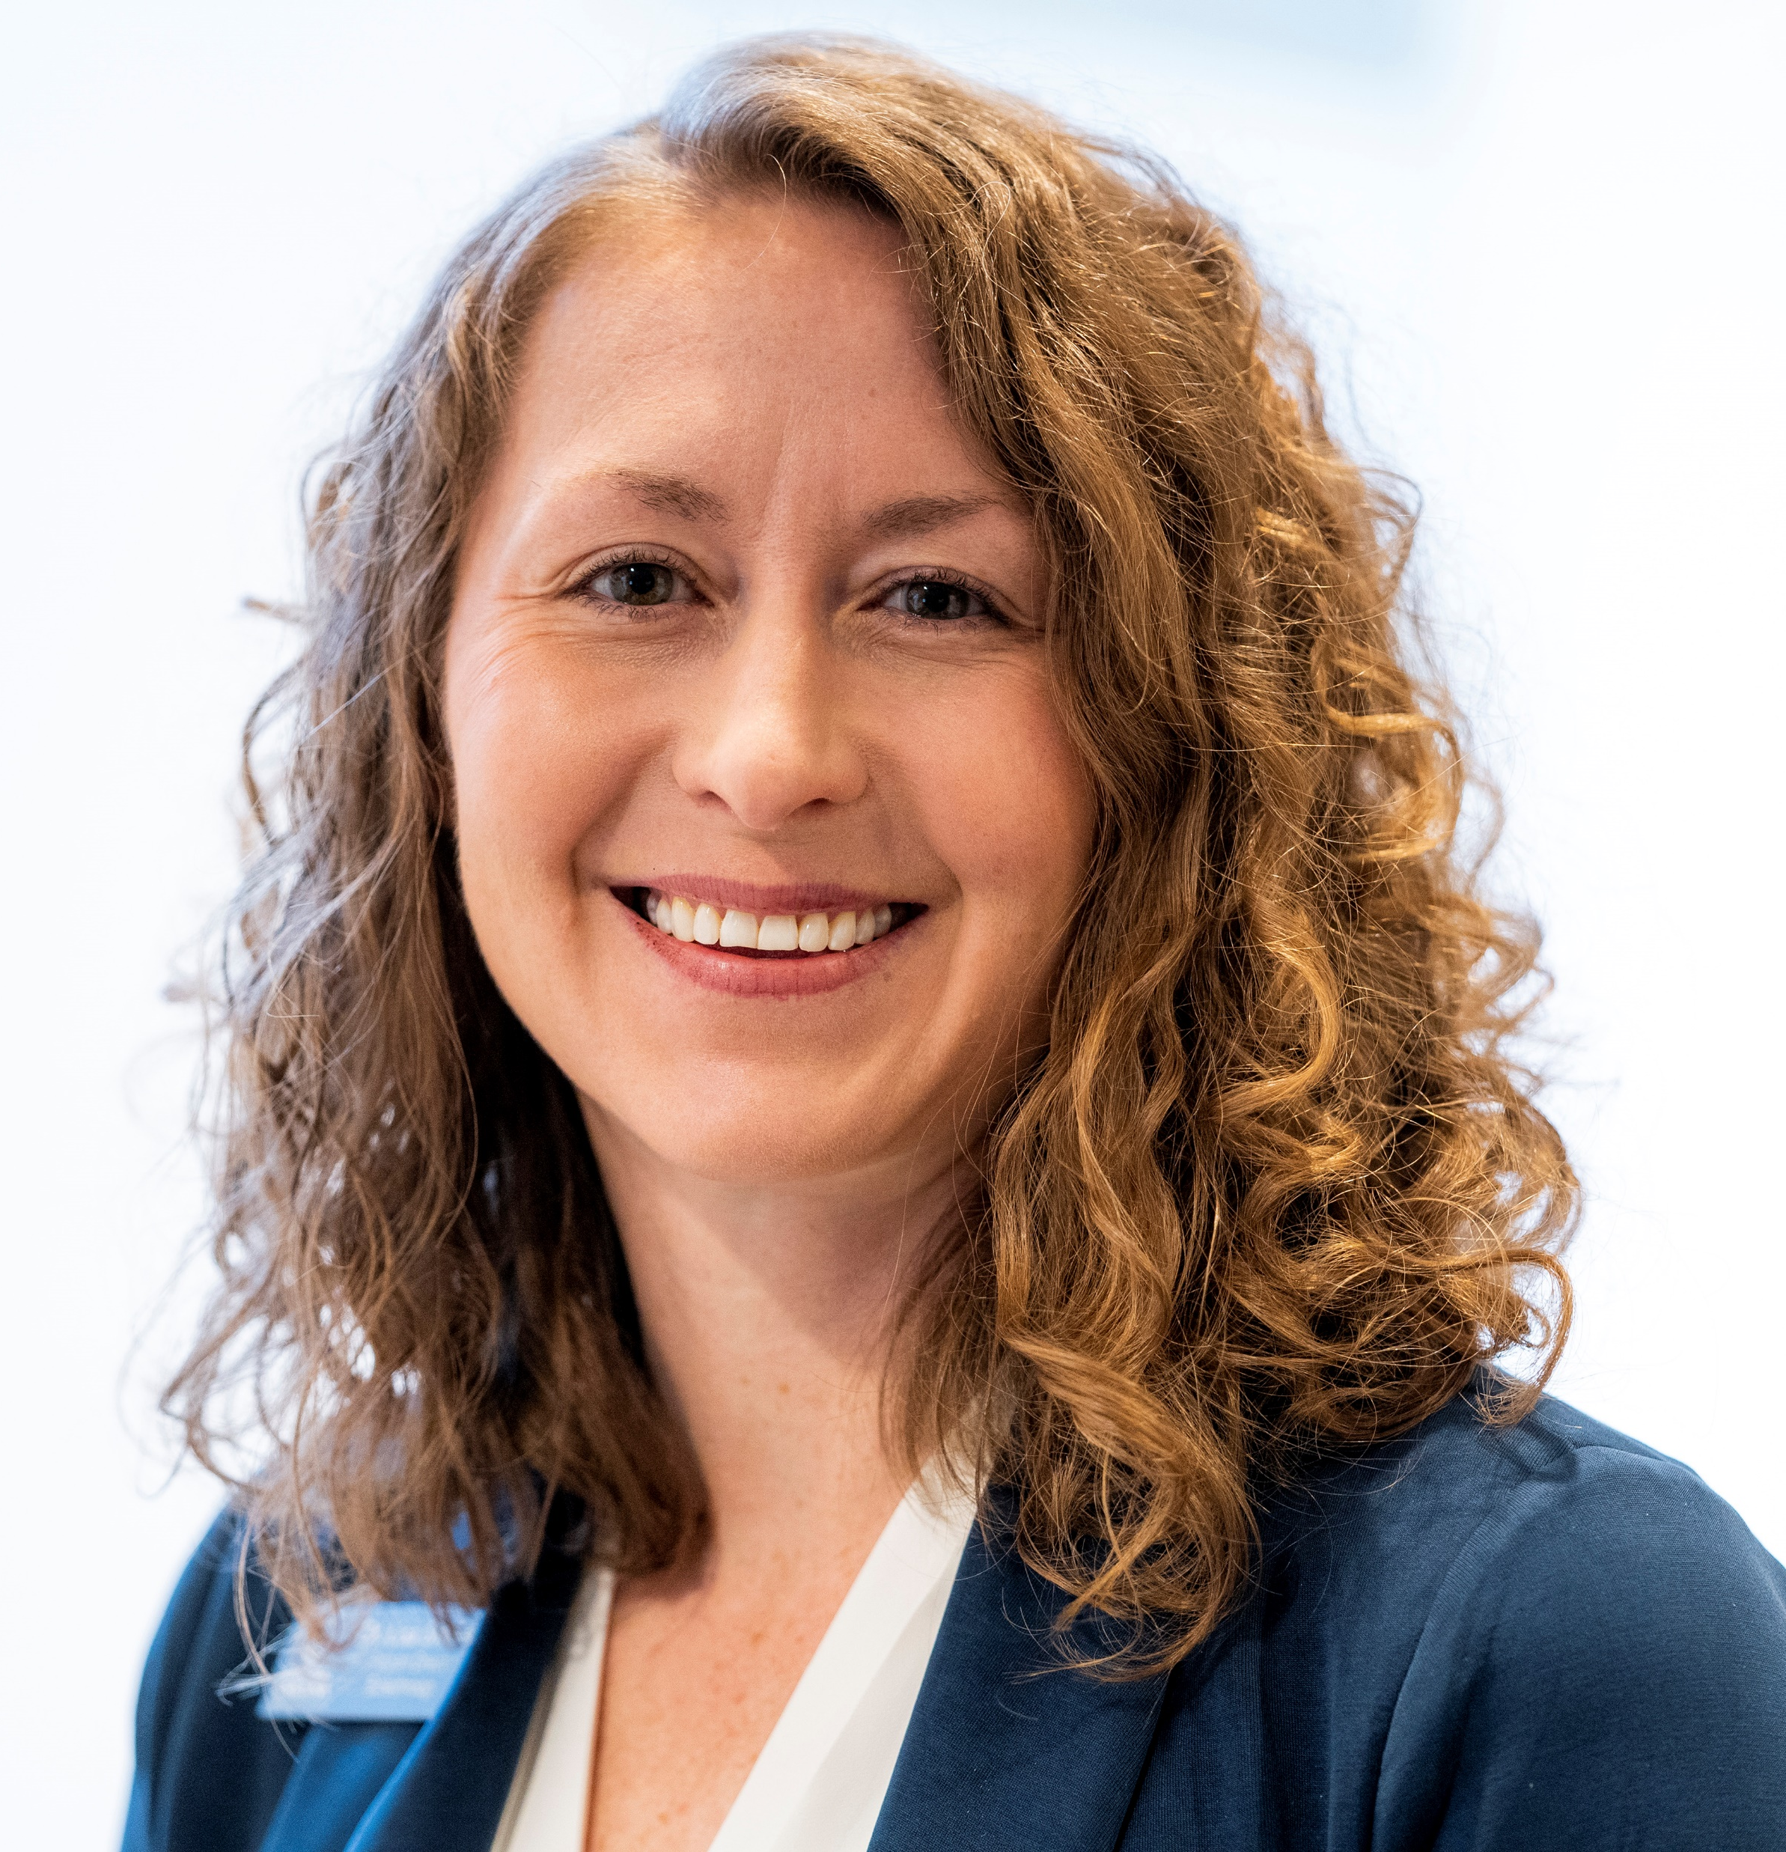
Central Carolina Community College
Lisa Smelser, EdD
Department Chair, Biotechnology
Notes:
Lisa Smelser, EdD
Department Chair, Biotechnology
Central Carolina Community College
Sanford, NC 27330
919-718-7305
lsmelser@cccc.edu

Slide 10
Central Carolina CC Alumni
Lashondia Taylor
Bioprocess Technician

Slide 11
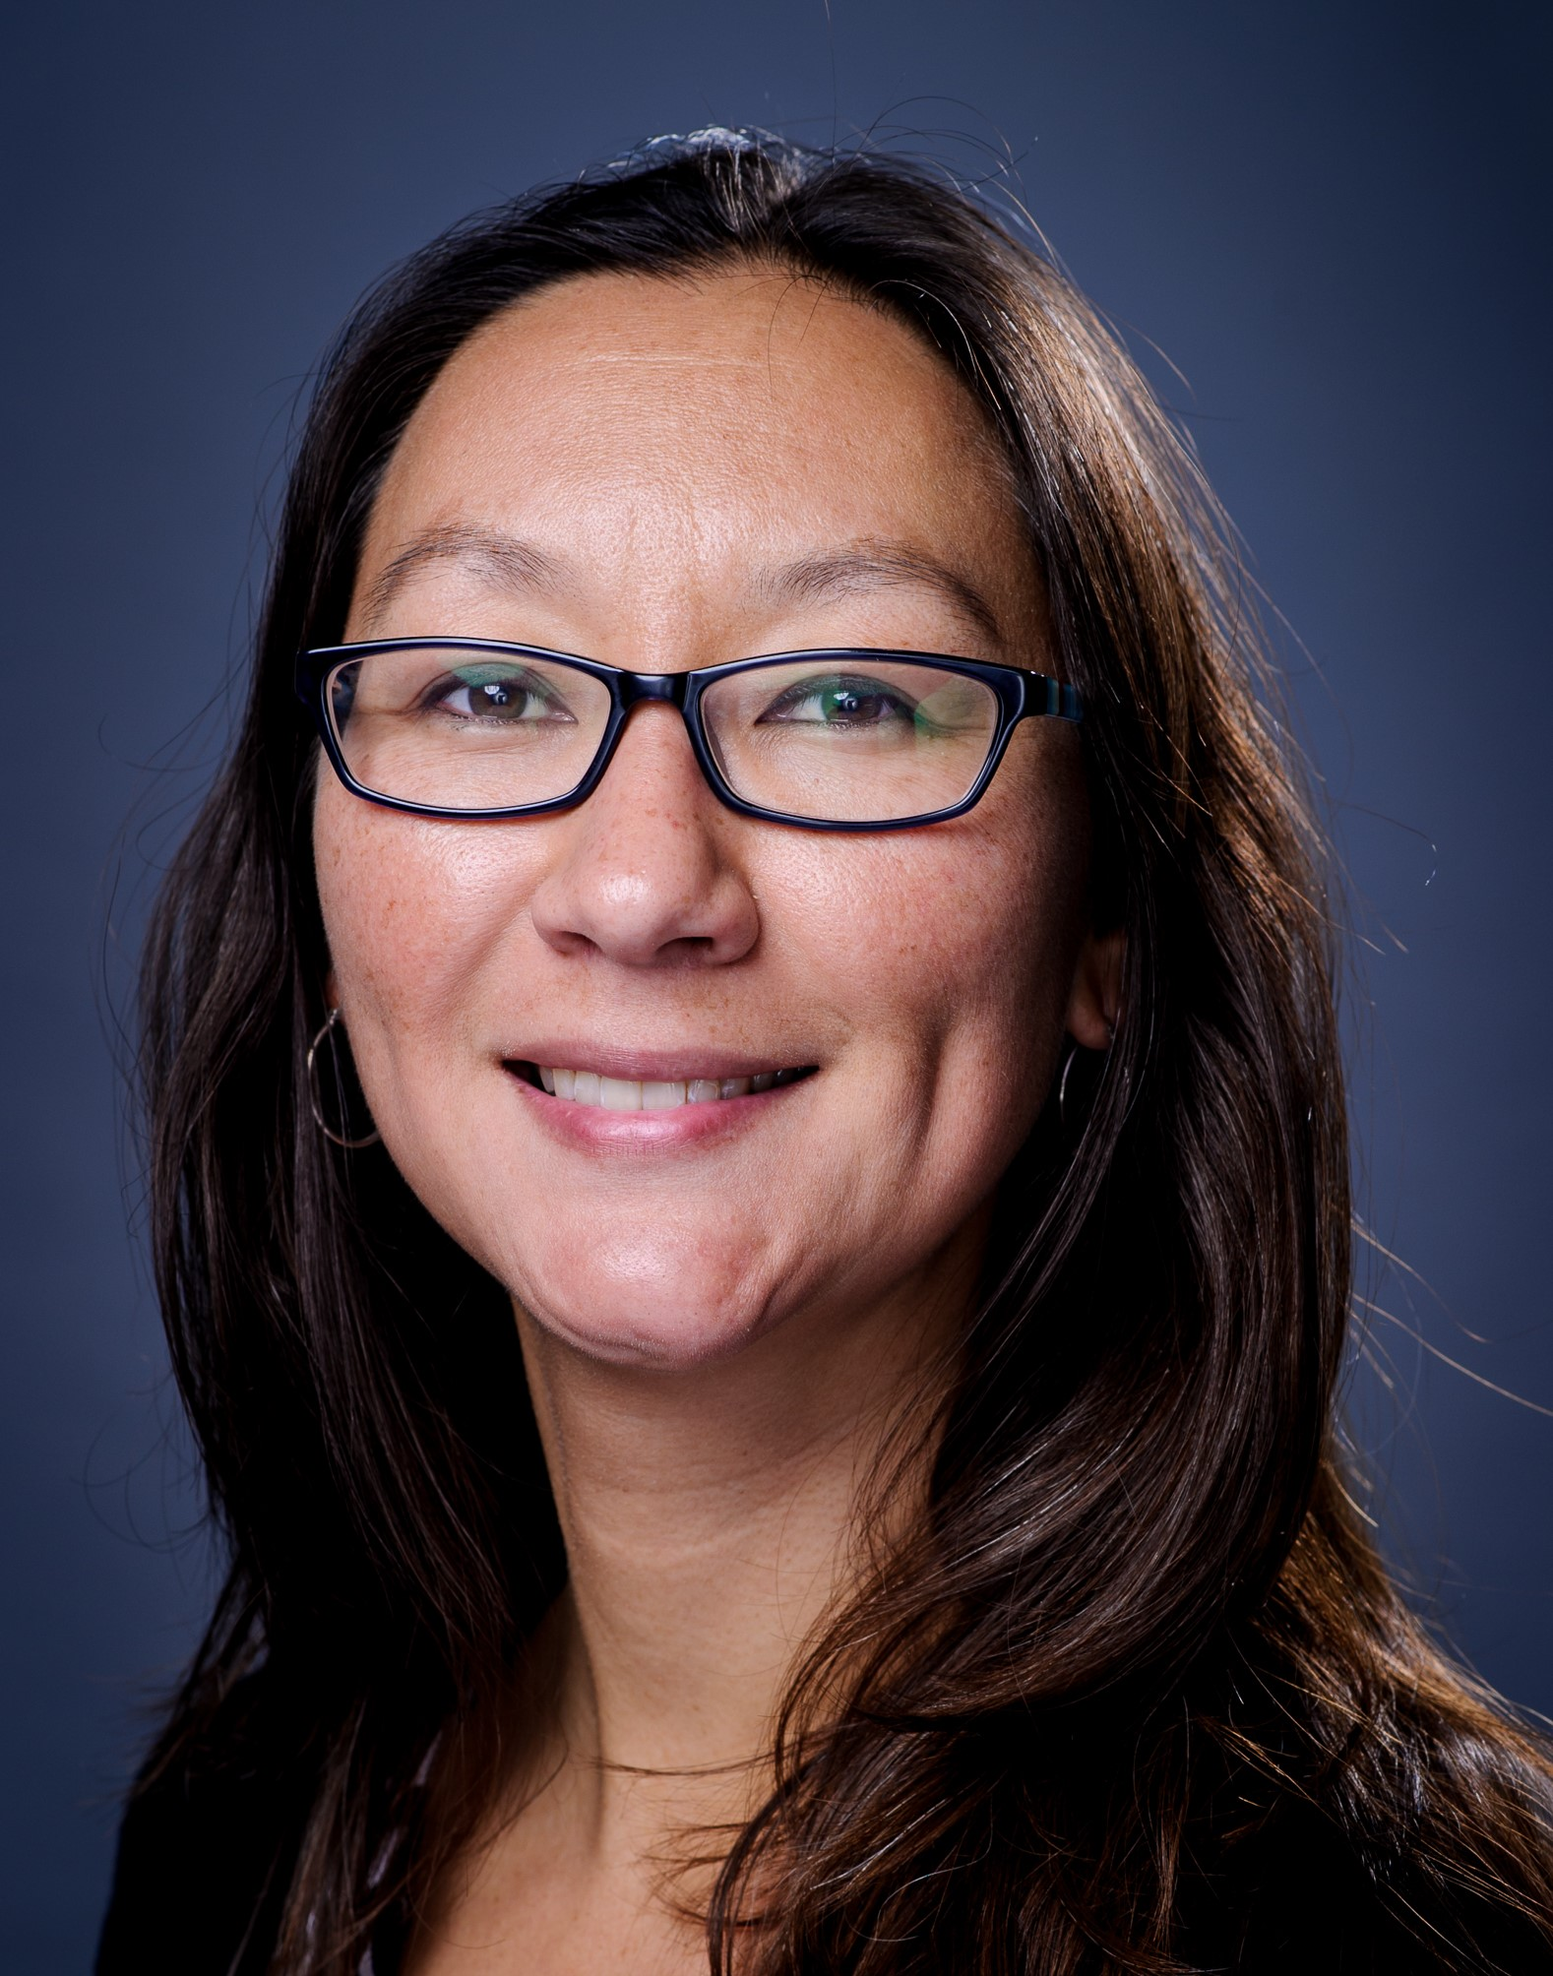
Durham Technical Community College
Sharleen Traynor, PhD, MPH, ACRP-CP
Director, Clinical Trials Research Associate Program
Notes:
Sharleen Traynor, PhD, MPH, ACRP-CP
Director, Clinical Trials Research Associate Program
Durham Technical Community College
Phone: (919) 536-7200 ext 8121
traynors@durhamtech.edu

Slide 12
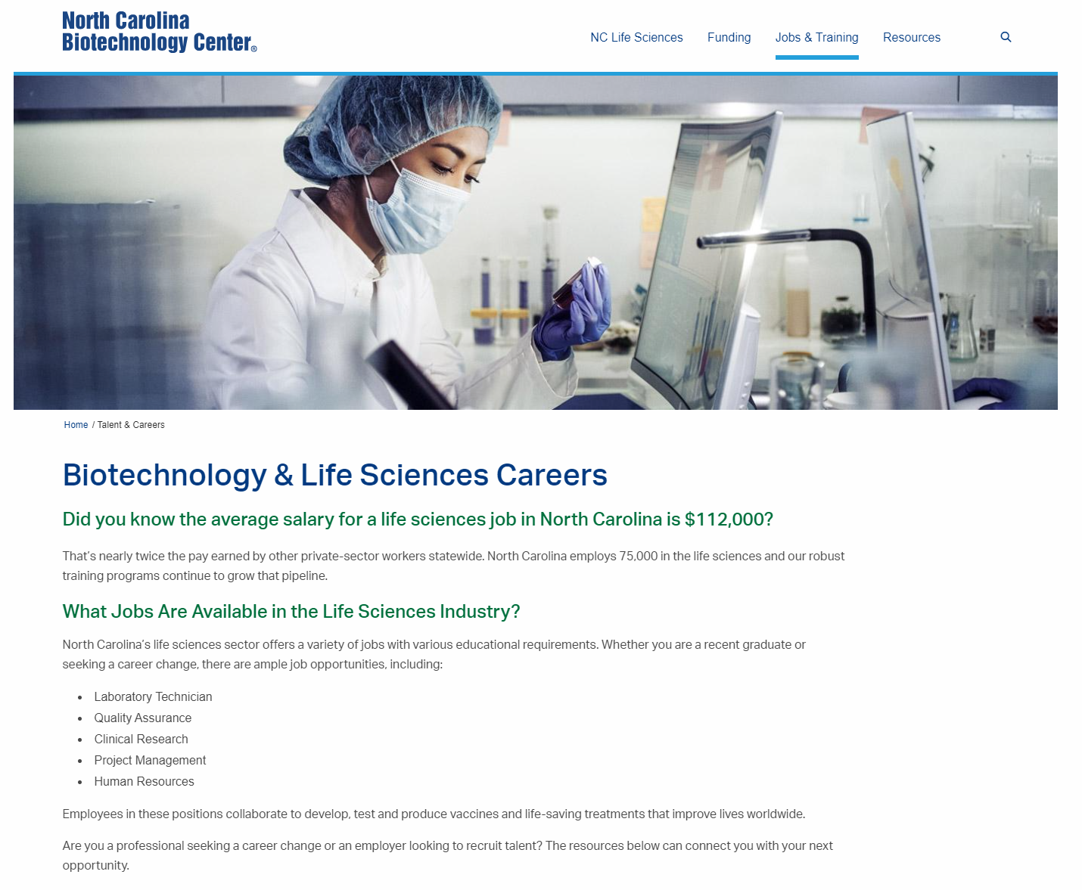
NC Biotechnology Center
A great resource!
www.ncbiotech.org

Slide 13
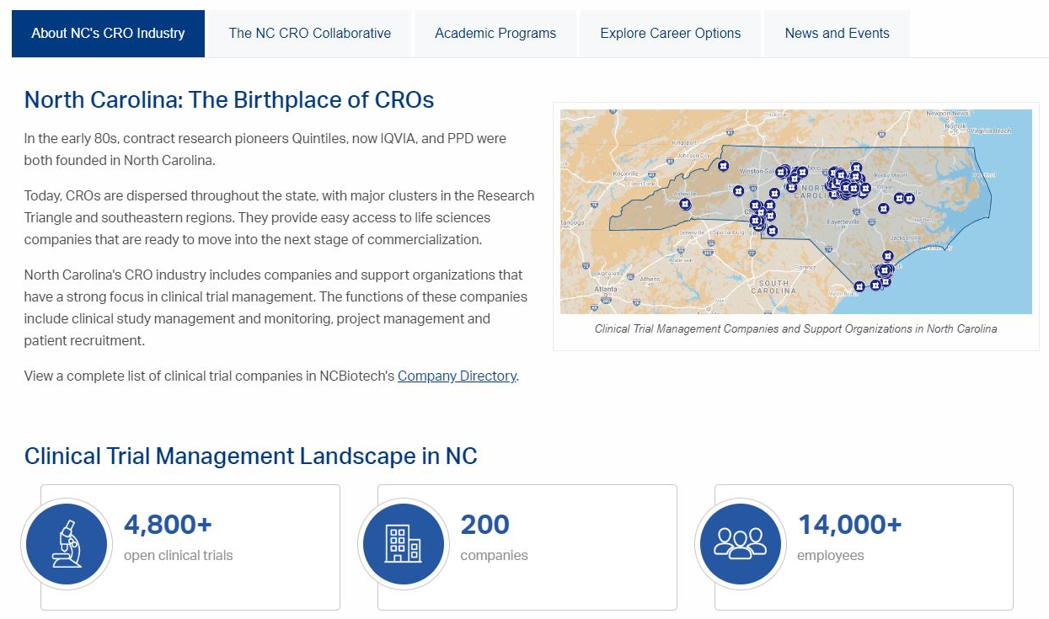
Clinical Research Employers in NC

Slide 14
Durham Technical Community College
Telicia Hunter
Life Science Program Director
Biopharma/Biowork Program
Notes:
Telicia Hunter
Durham Tech
huntert@durhamtech.edu
919-536-7200 ext 4408

Slide 15
Pitt Community College
Christina Weeks
Biotechnology Department Chair
Notes:
Christina Weeks
Pitt Community College
252-493-7861
cgweeks383@my.pittcc.edu

Slide 16
Curriculum Alignment to take effect Fall 2024
Agriculture Biotechnology
Bioprocess Technology
Biopharmaceutical Technology
Marine Biotechnology
Biotechnology
Select 1 Subject Area:
Bioprocess Manufacturing Technology
Bioanalytical Lab Technology

Slide 17
Biotechnology AAS (A20100)
The Biotechnology curriculum prepares individuals to apply scientific principles and technical skills in support of biologists and biotechnologists in research, industrial, and government settings.
Coursework, most of which is hands-on, includes topics such as fermentation technology, cell culturing, protein purification, biologic synthesis, assaying and testing, quality control, industrial microbiology, bioprocessing, chromatography and bioseparation, genetic technology, laboratory and hazardous materials safety, and computer applications.
Students select one of two subject area concentrations: Bioanalytical Lab Technology or Bioprocess Manufacturing Technology.
Graduates should be qualified for employment in various biotechnology-related laboratory and manufacturing areas of industry and government, including research and development, QA, QC, process technicians, sales, and customer service.
Notes:
https://nccareers.org/occupation-profile/291292/1284

Slide 18
Subject Area Description: Bioanalytical Lab Technology
Bioanalytical Lab Technology: Planning, managing, and providing scientific research and professional and technical services including laboratory and testing services, and research and development services. This subject area curriculum is designed to meet the increasing demands for skilled laboratory technicians in various fields of biological and chemical technology. Course work emphasizes biology, chemistry, mathematics, and communication skills.
The curriculum objectives are designed to prepare graduates to serve in three distinct capacities: research assistant, laboratory technician/instrumentation technician, and quality control/quality assurance technician.

Slide 19
Subject Area Description: Bioprocess Manufacturing Technology
Bioprocess Manufacturing Technology: The Bioprocess Manufacturing Technology curriculum is designed to prepare individuals to work as Process Operators in biological products manufacturing facilities. Students will develop knowledge and skills in basic sciences, communication, manufacturing technologies, and good manufacturing practices. Students will be expected to develop a strong basic science foundation with a sound understanding of the major technologies employed in the industry. They will also be expected to develop collaborative and disciplined work ethics while consistently practicing problem-solving skills. Upon successful completion of the program, individuals should possess the necessary skills to qualify for numerous positions in a variety of Bioprocessing and pharmaceutical manufacturing industries.
Employment opportunities include, but are not limited to, the following: Process Technician/Associate, Quality Assurance, Quality Control, Environmental Monitoring, Product Inspection, Documentation Review, Manufacturing, and Product/Process Validation.

Slide 20
Clinical Research Associate (A45190)
The Clinical Trials Research Associate curriculum prepares individuals to assist physicians and clinical researchers in the initiation, administration, coordination, and management of clinical research studies for the development of new drugs, clinical products, and treatment regimens.
Course work includes in-depth study of drug development, Federal regulations, and clinical research processes. Supervised fieldwork provides skill application in subject recruitment, regulatory compliance, accountability for drugs/devices, and documentation of subject involvement in clinical research studies.
Graduates may be eligible to sit for national certification examinations. Research employment opportunities may include medical centers, hospitals, pharmaceutical industries, clinics, research facilities, biotechnology or device companies, and physicians’ offices.

Slide 21
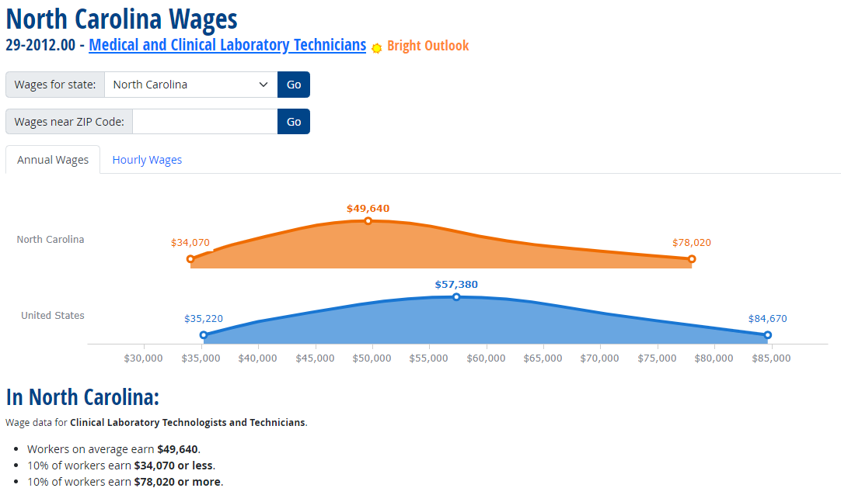
NC Career Outlook

Slide 22
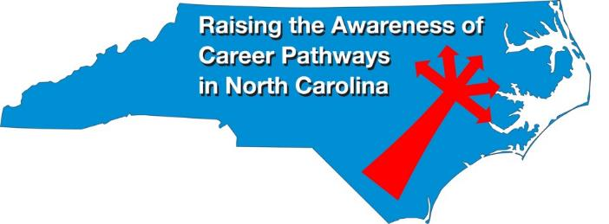
Raising the Awareness of Career Pathways Webinars
Mar. 20, 2024 – Business Administration
Apr. 17, 2024 – Public Safety
May 15, 2024 – Cyber Crime Technology
Register for all webinars at www.ncperkins.org/presentations

