Slide 1
Perkins Update Dr. Evonne Carter, Vice President of Learning

Slide 2
Perkins has made a difference at COA: Improved, enhanced and student-focused programs
Equipment upgrades
Faculty support for credentials and training
Recruitment support
Boot camps for CTE
Career Coach Software for students

Slide 3
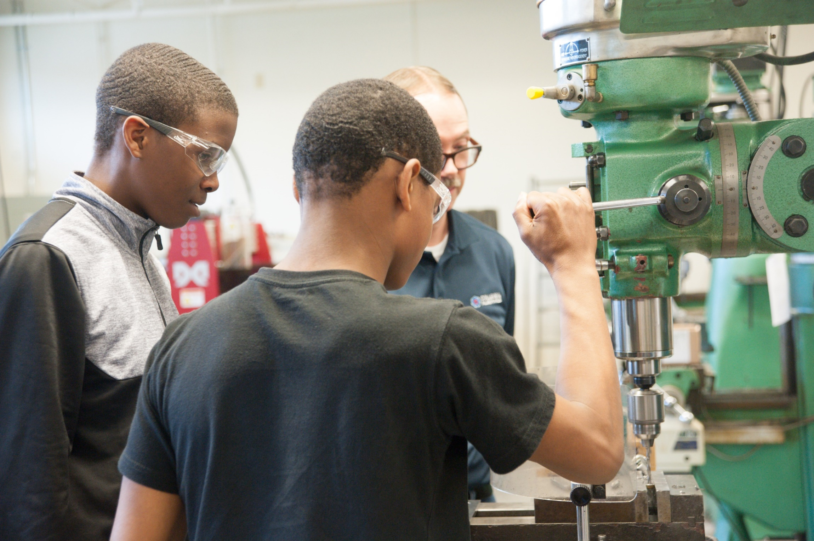

Slide 4
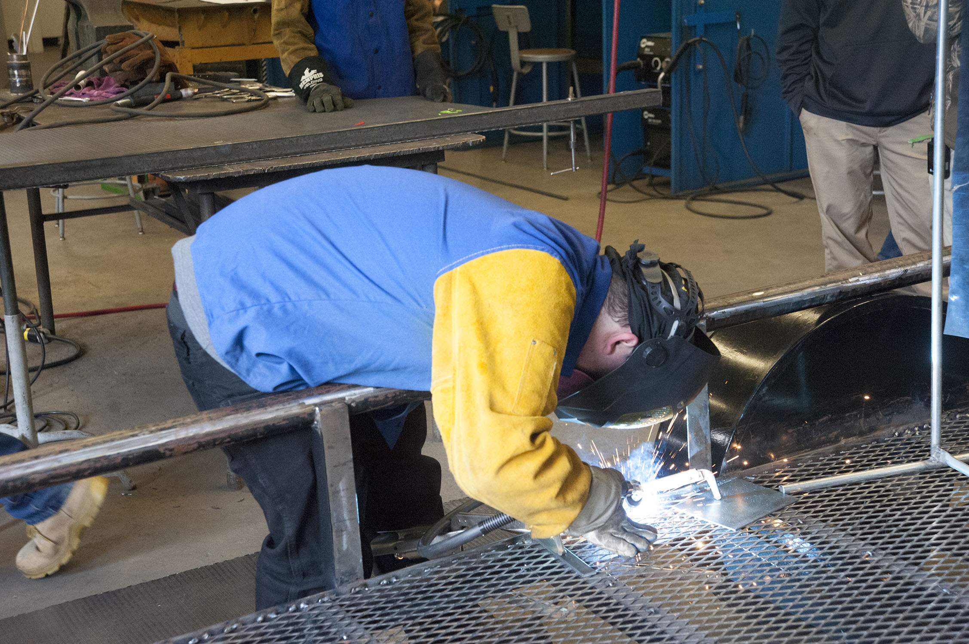

Slide 5
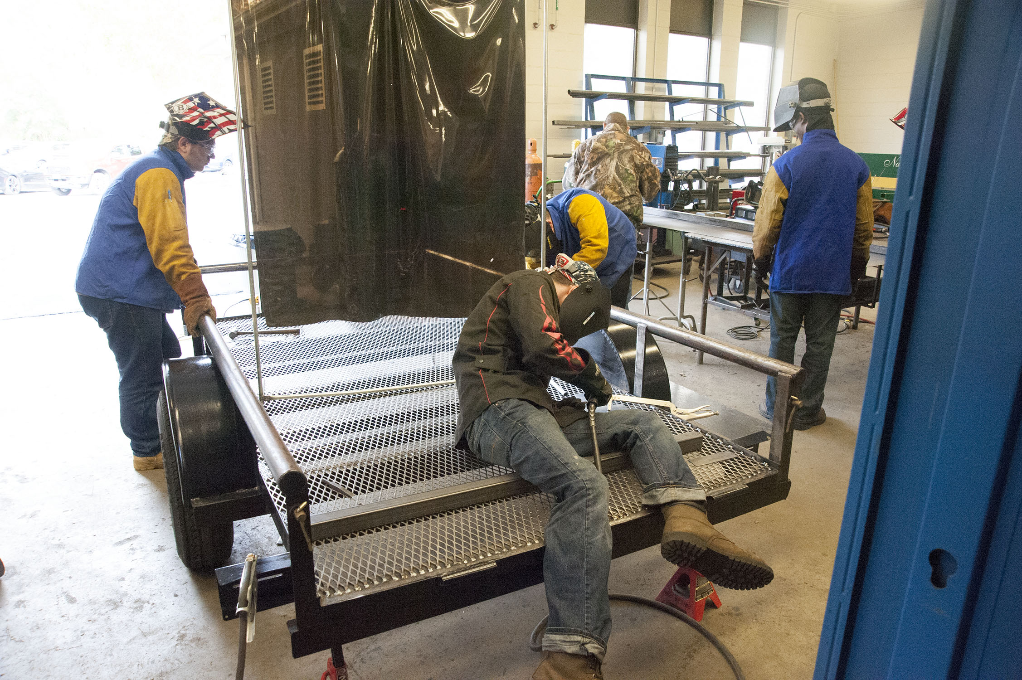

Slide 6
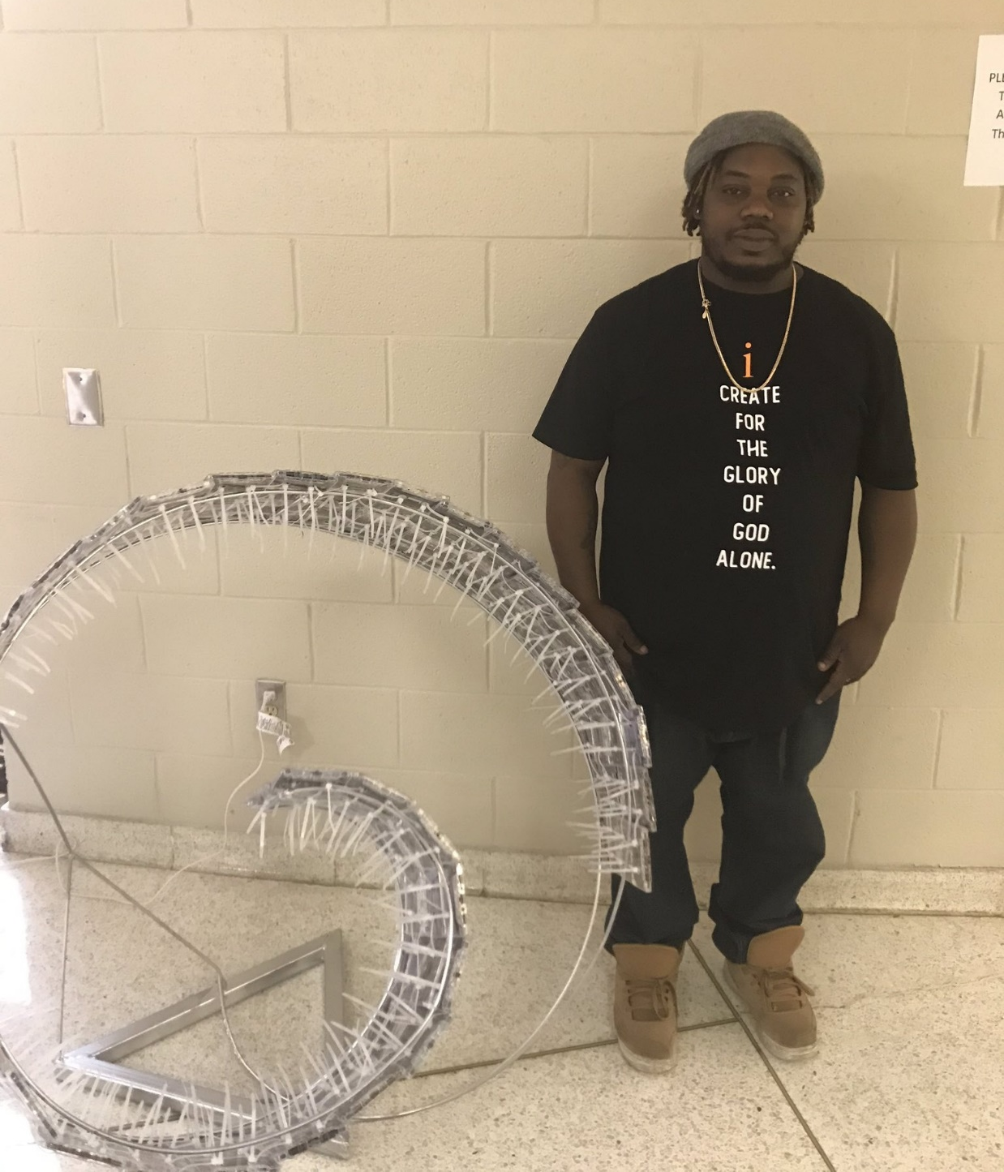

Slide 7
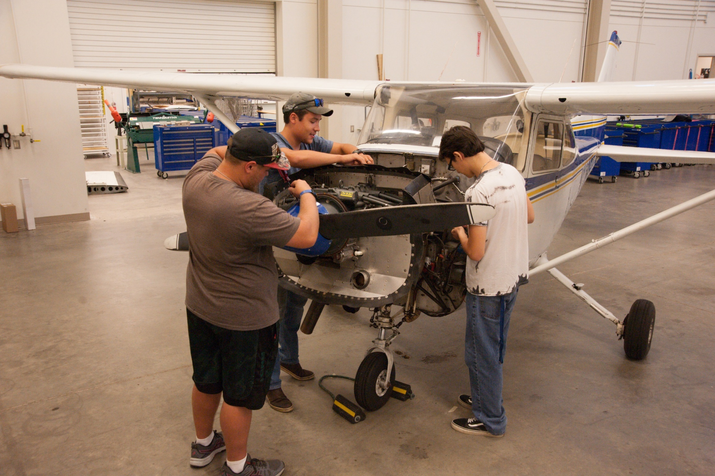

Slide 8
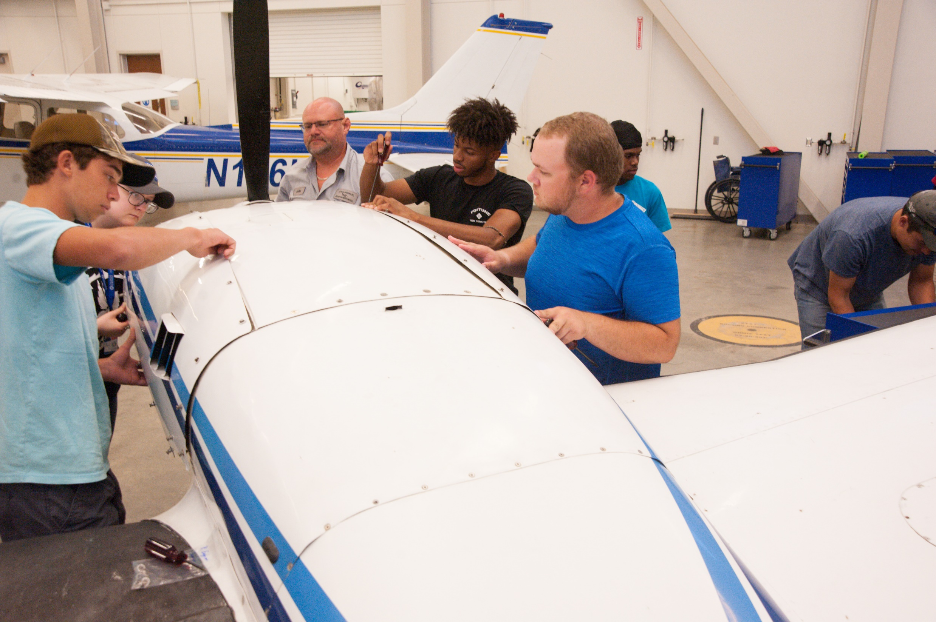

Slide 9
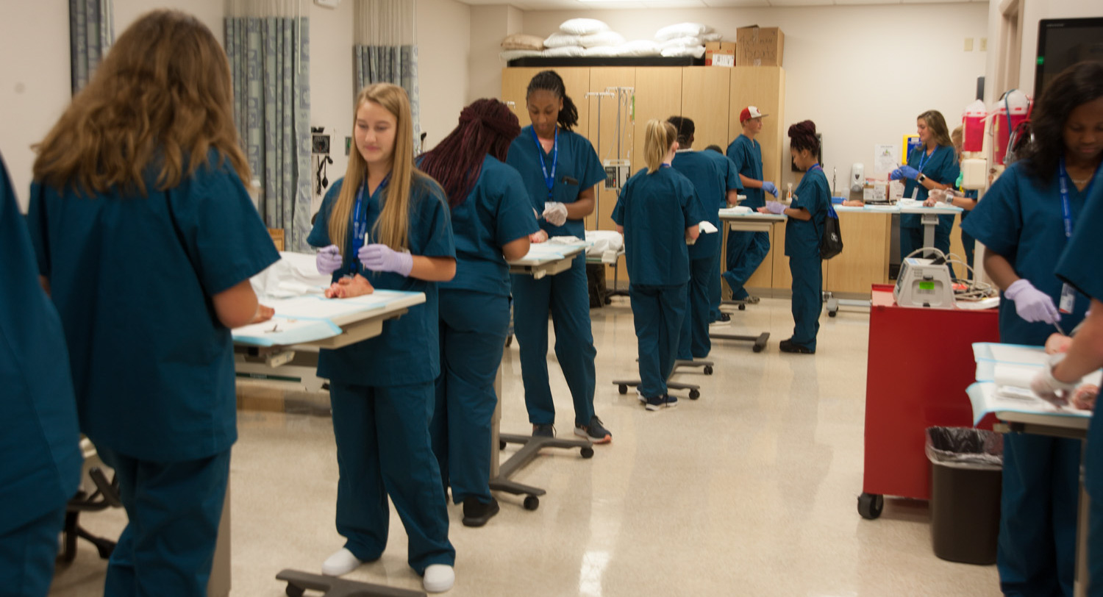

Slide 10
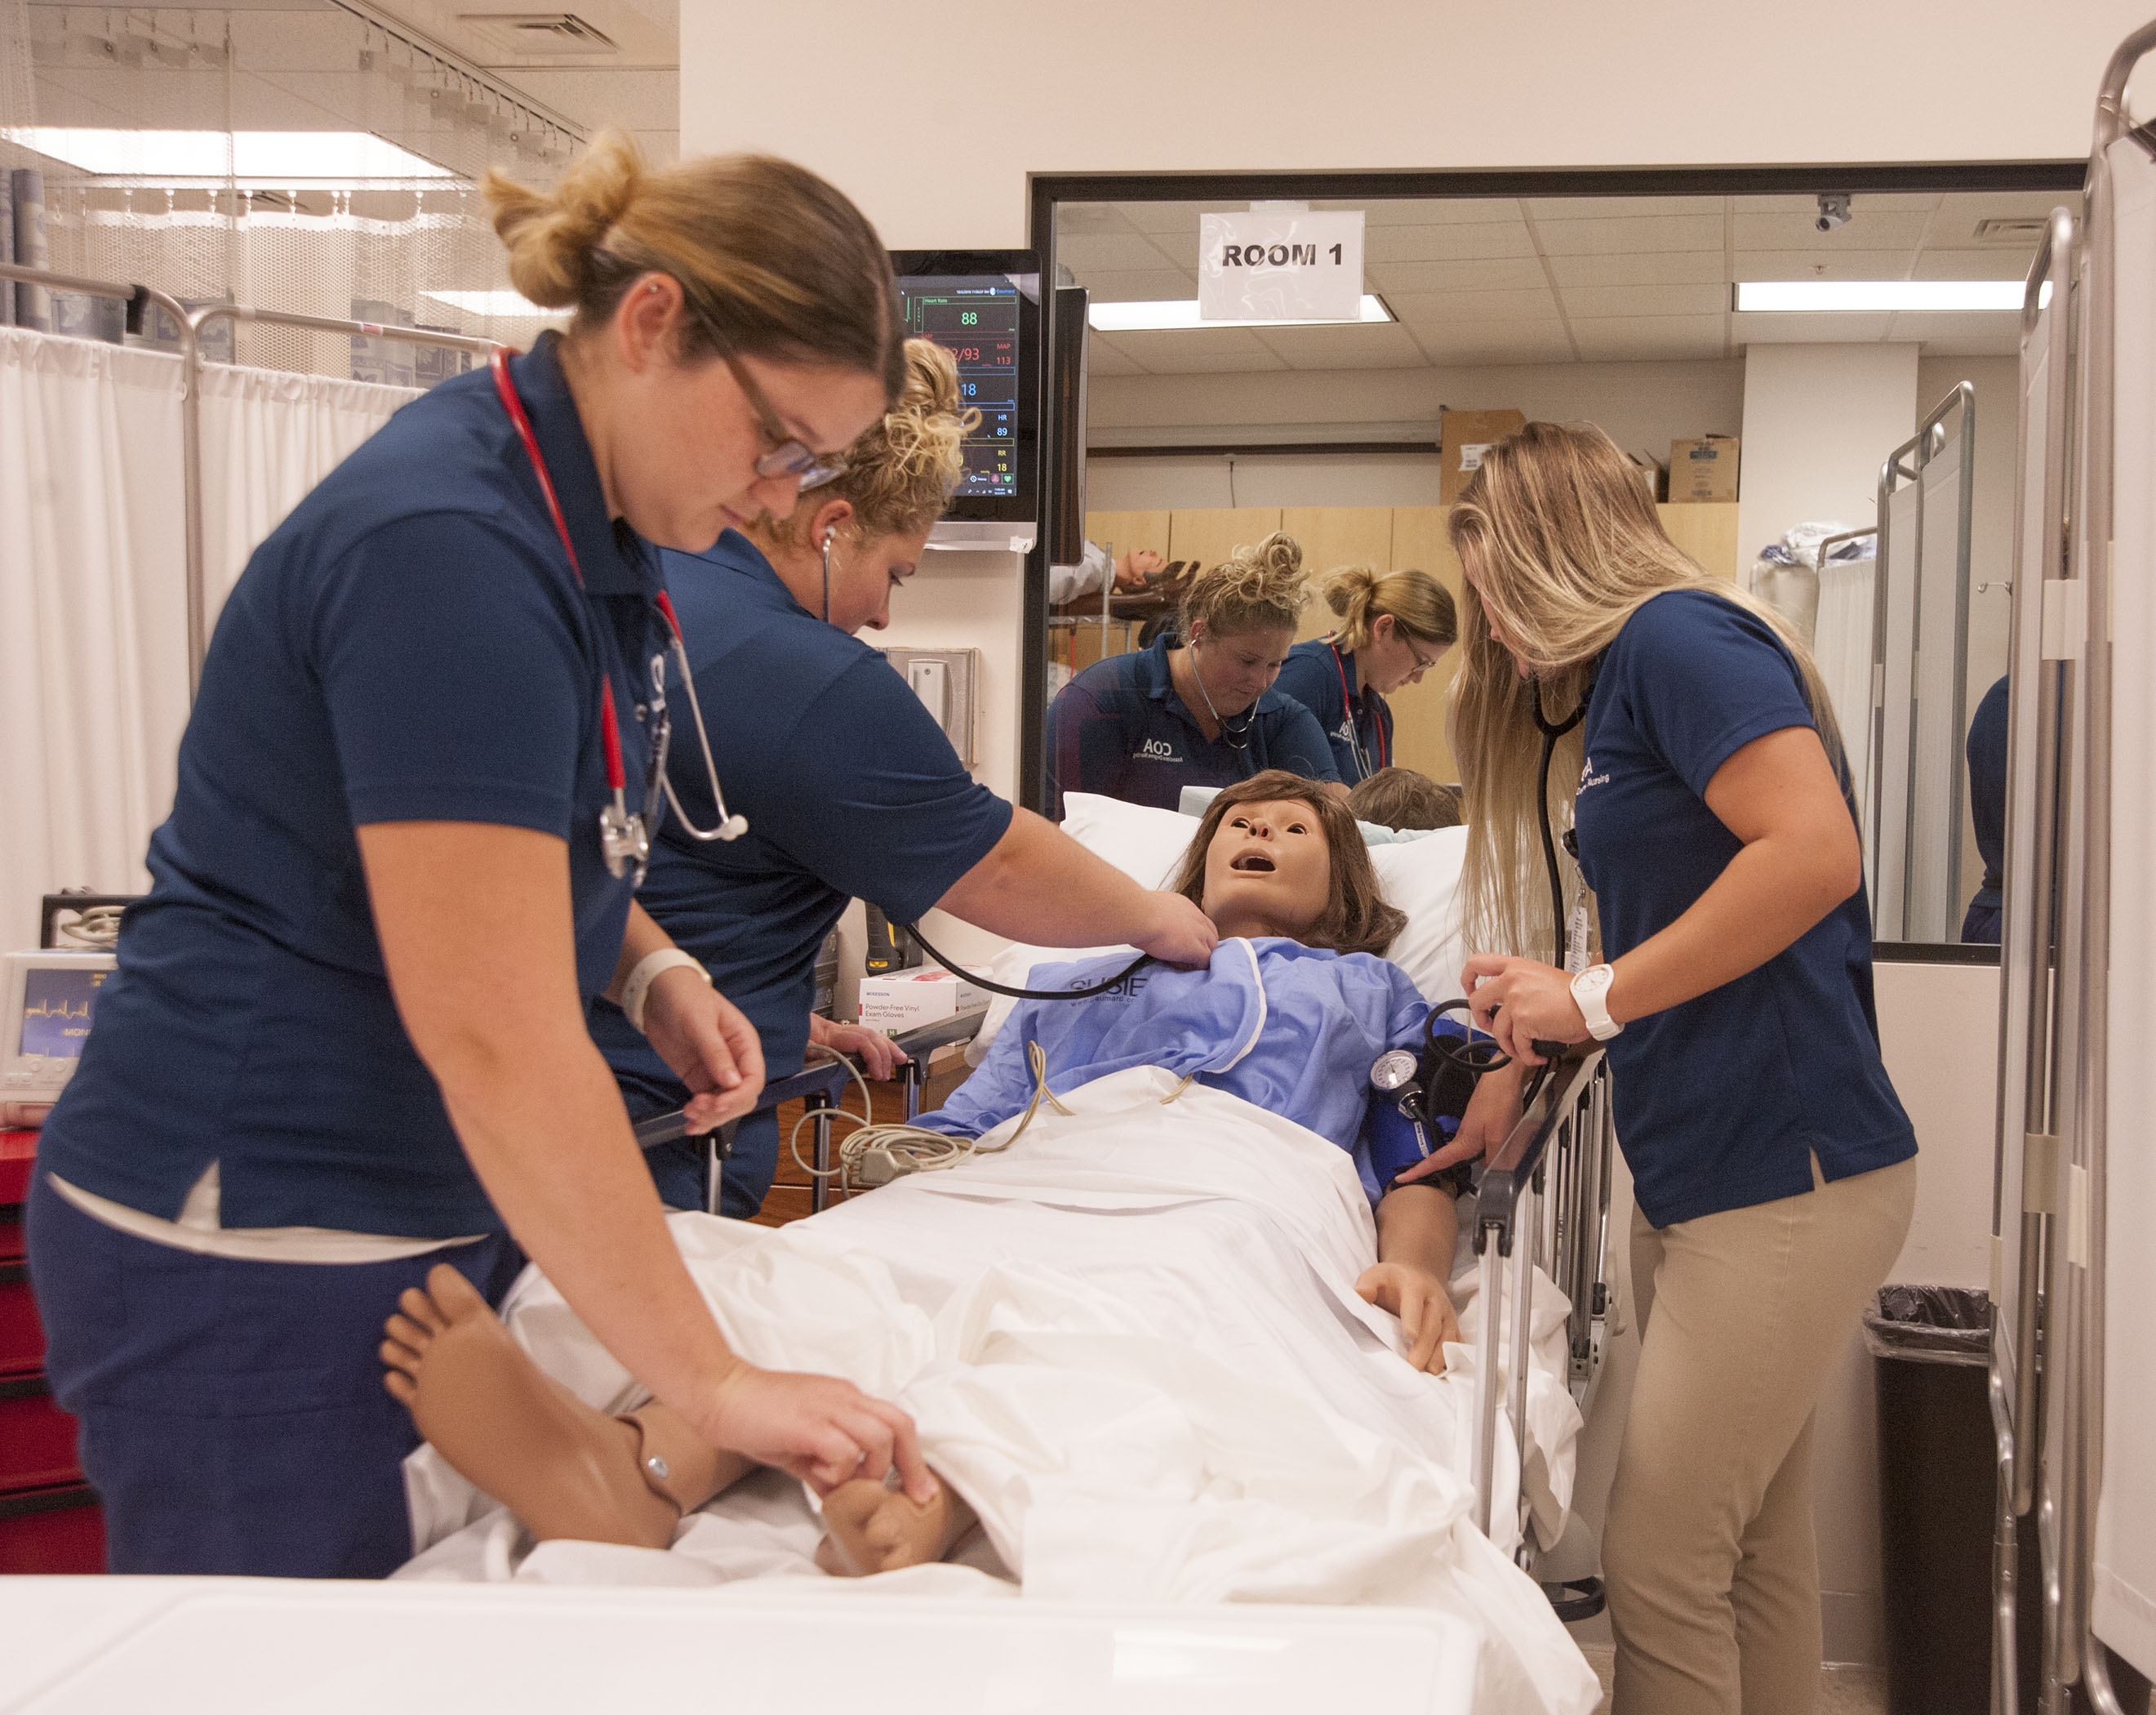

Slide 11
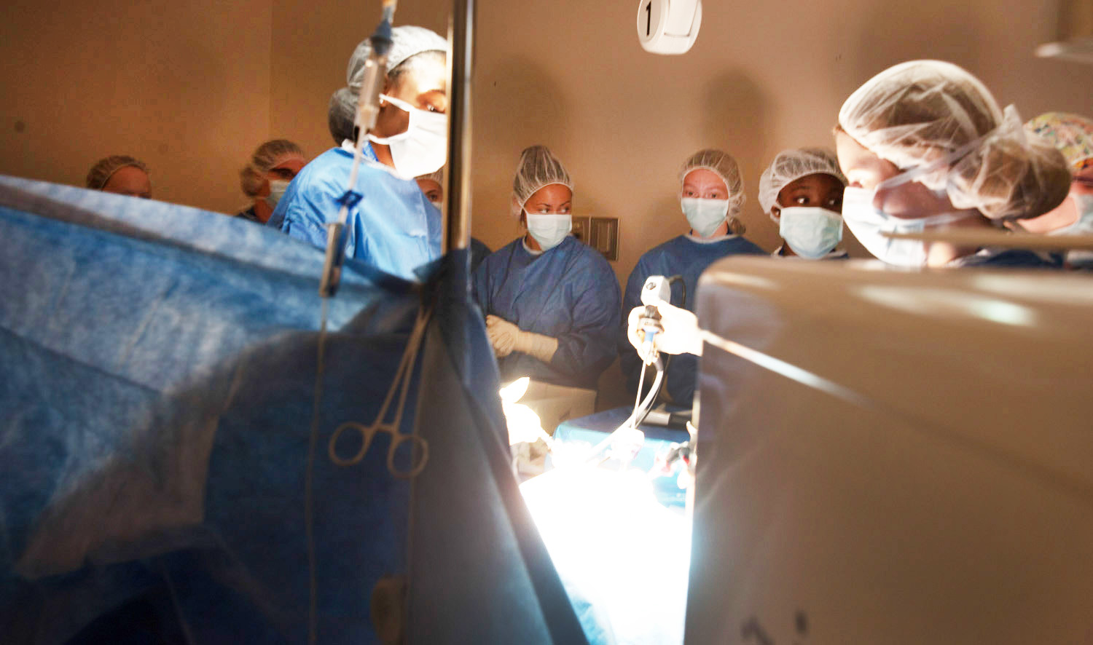

Slide 12
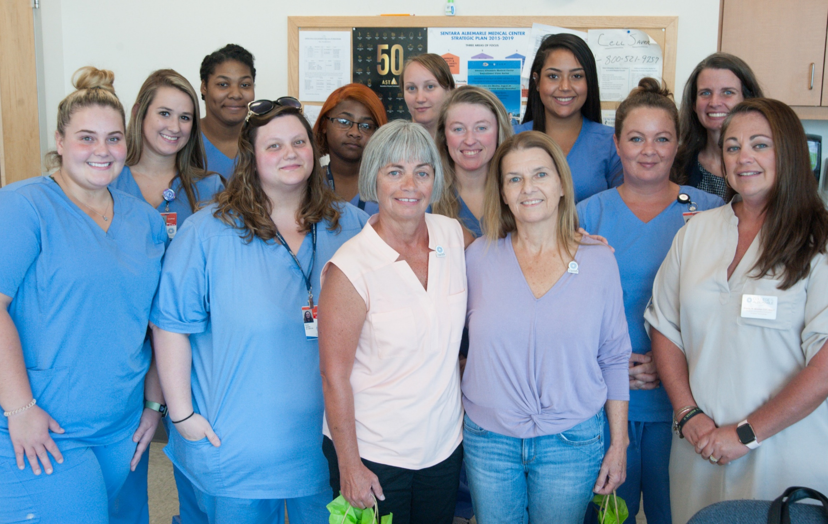

Slide 13
Informational and Marketing Meeting with Parents and Students

Slide 14
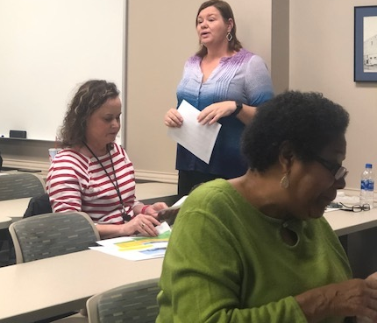
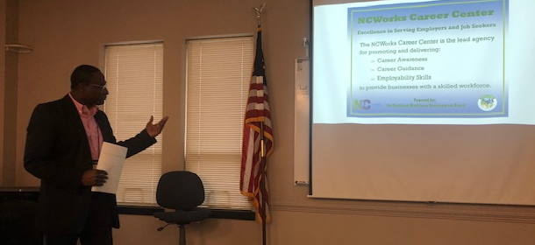
CLNA needs assessment
Pathways and Partners
Advanced Manufacturing
Healthcare
Business

Slide 15
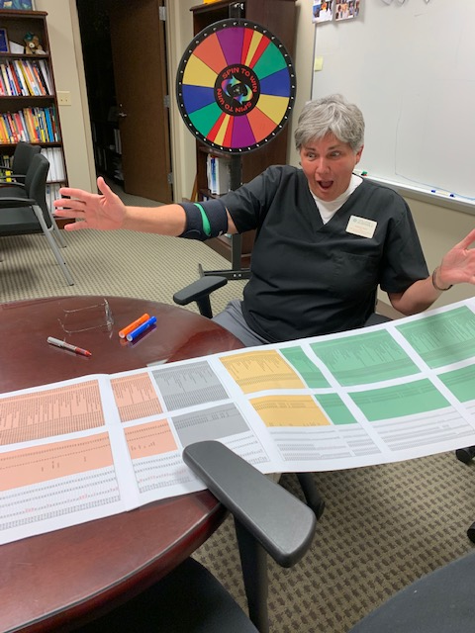
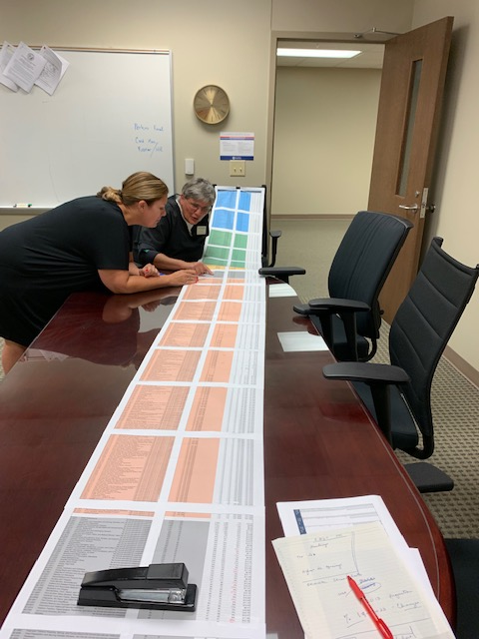
EMSI Data analysis

Slide 16
Promising Practice – College to Career Signing Day
Strategic Plan activity – College-wide support of CTE programs and students; seek more adult students
Showcase CTE Programs to students, parents and community
Support from College Foundation for Scholarships
Student Services provided enrollment information/ Student Life/Ambassadors
Employer and Industry Representatives

Slide 17
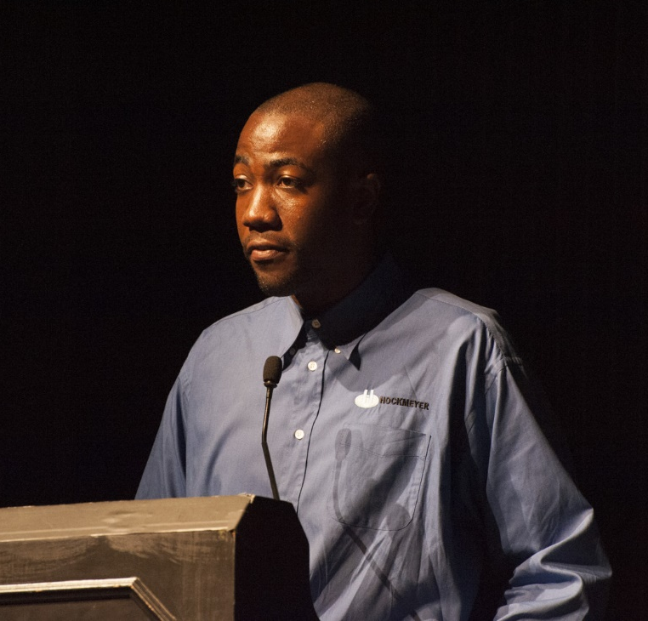
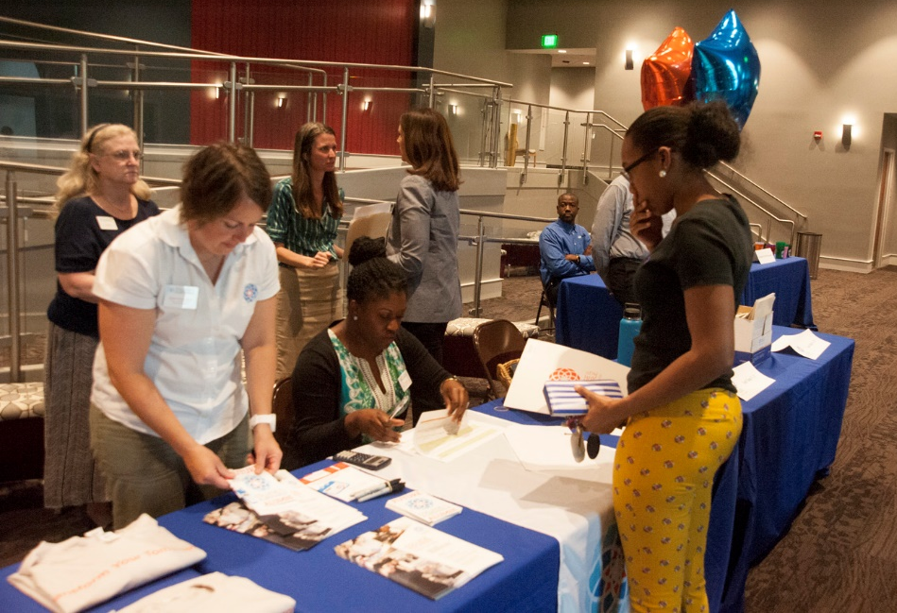
Staff and employers
Graduate/ Speaker
Student for Aviation Tech

Slide 18
Our New Welding Instructor - PT

Slide 19
Budget Update, COA
To date – Amount spent to date: 76% of budget
Professional Development/Certification of Faculty
Equipment
Recruitment/ Secondary Ed connections
Curriculum Development
Differences with CLNA –
Funding for Programs that have Jobs which are high wage/high need
Data focus will allow COA to better track improvements

