Slide 2
Perkins 19-20
Mid-Year Update
Meghan Reece Brown
Executive Director,
College Access and Strategic Initiatives

Slide 3
BIOPROCESS TECHNOLOGY

Slide 4
Bioprocess Technology
New Program Creation
Pfizer’s announcement in Fall 2019 to invest $500 million in its Sanford operations in Lee County, which will create over 300 jobs as the industry expands its gene therapy efforts.
Harnett County’s gain over more than 100 jobs via $7 million investment from KriGen Pharmaceuticals
Increased demand by local industry to offer customized training via BioWork, and requests for on-and-off ramp short-term trainings and associate degree educations.

Slide 5
Electrical Systems Technology

Slide 6
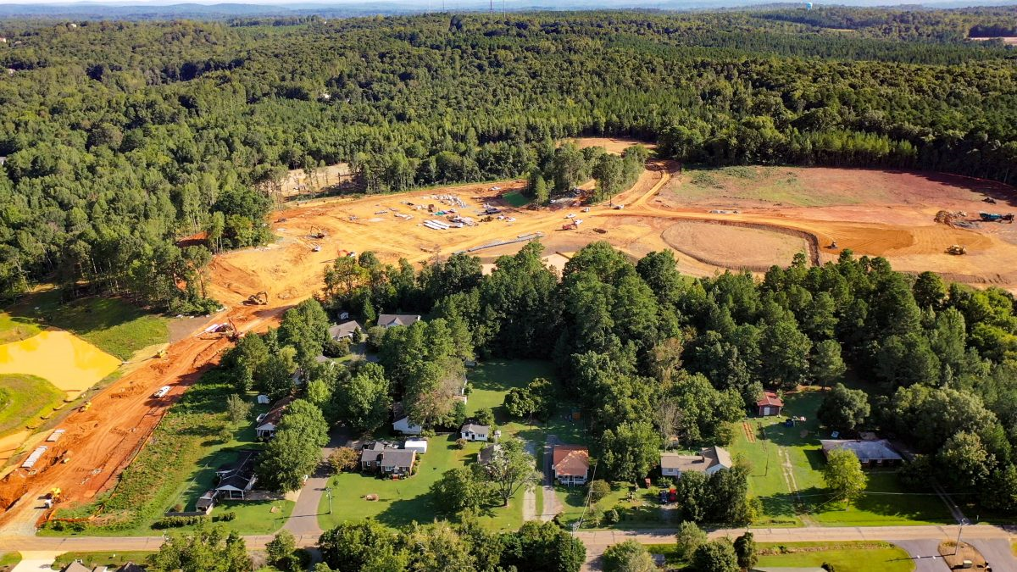
Electrical Systems Technology
New Program Creation
This area of study prepares students to install and maintain electrical systems found in residential, commercial, and industrial settings.
During Phase I of Chatham Park’s development, approximately 650 single-family detached homes and townhomes will be offered for sale. Among those first offerings will be 25 traditional single-family home sites with prices starting at the mid $300’s, along with 30 cottages (850– 1,250 square feet) starting from low $200’s.

Slide 7
Air Conditioning, Heating & Refrigeration Technology

Slide 8
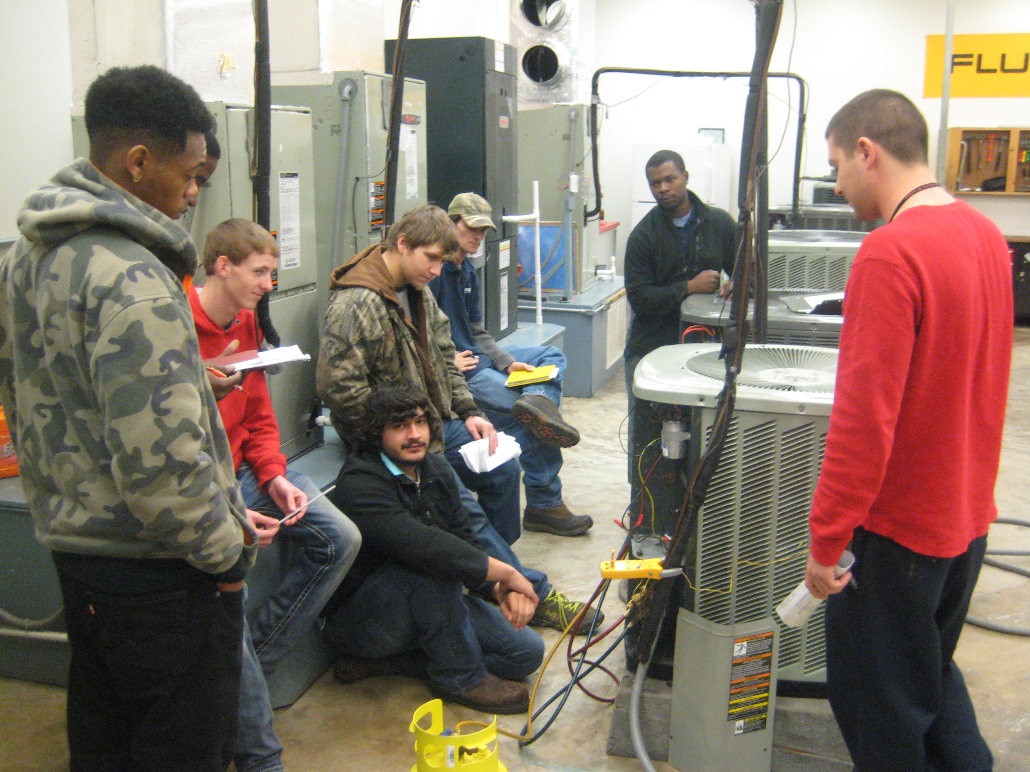
Air Conditioning, Heating & Refrigeration Technology
New Program Creation
Starting in Fall 2019, CCCC is excited to offer a new Associate in Applied Science Degree in Air Conditioning, Heating, and Refrigeration Technology (ACHR) in Lee County at the Howard James Center for Industry Training.
Came from direct requests from local businesses
Department of Labor Grant moving youth in service area to in-demand jobs

Slide 9
Skills USA

Slide 10
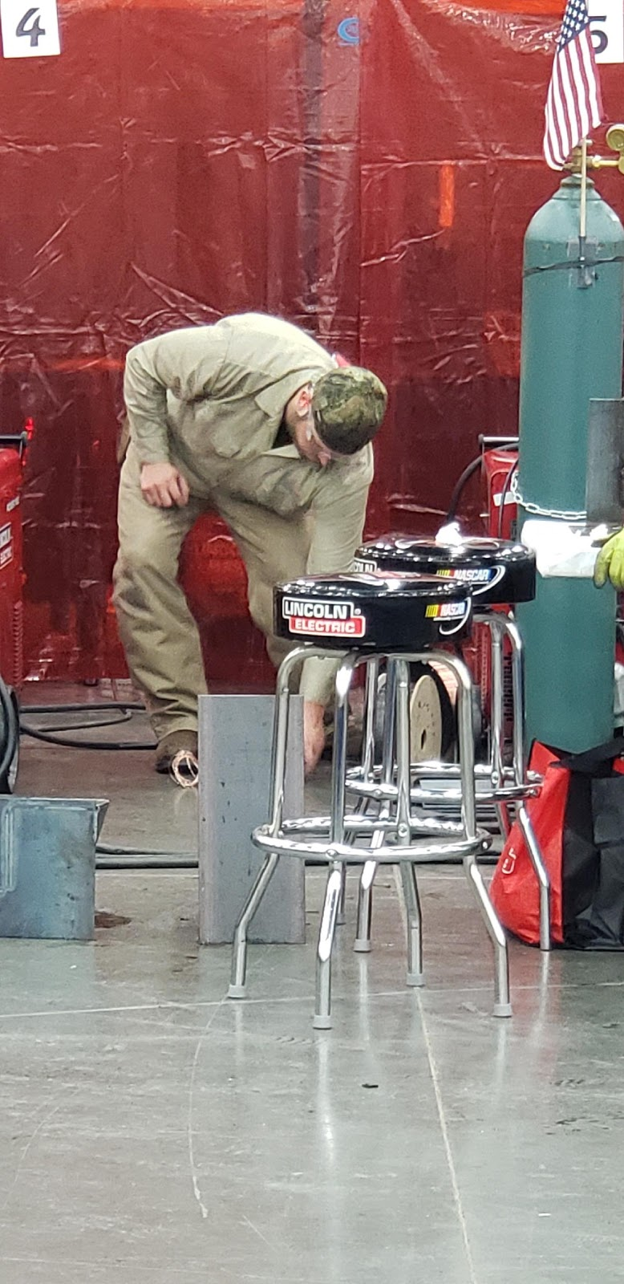
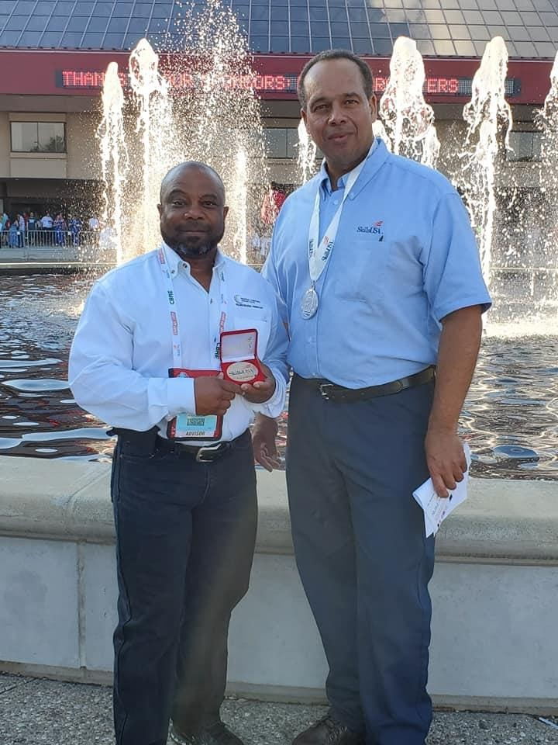
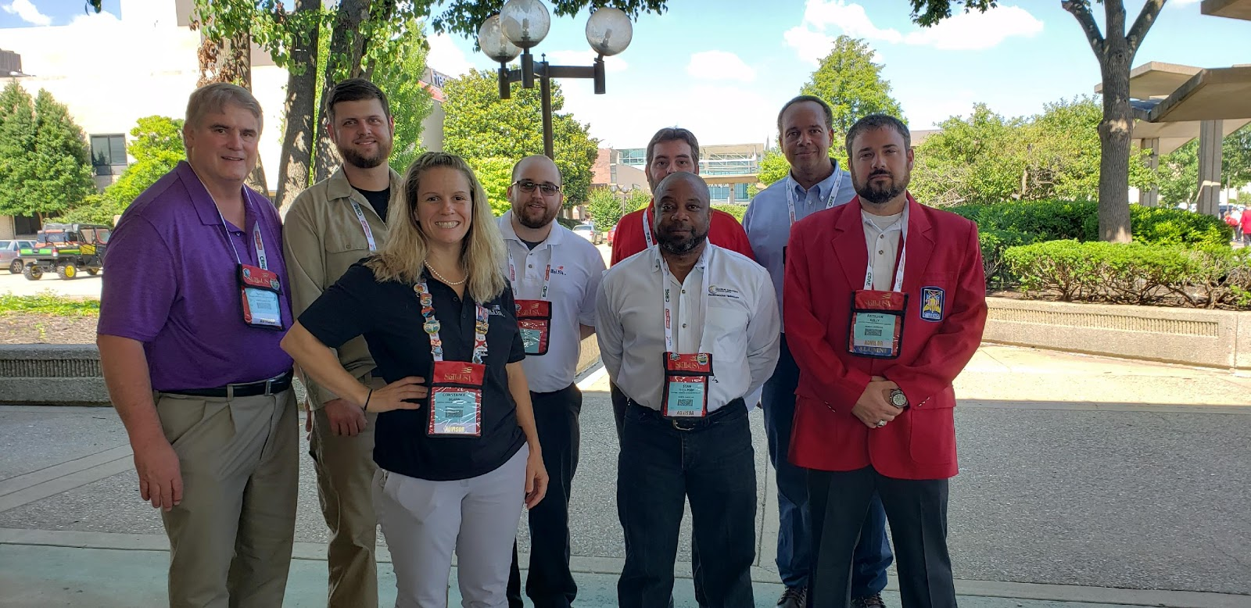
Skills USA
First year with dedicated chapter: three students to the National Conference and Competition; two students finished as Silver Champions
More than 15 CTE programs at CCCC are having local competitions to determine which students will represent at the state level

Slide 11
Mini-Grants, Professional Development, Special Populations Emergency Assistance

