Slide 1
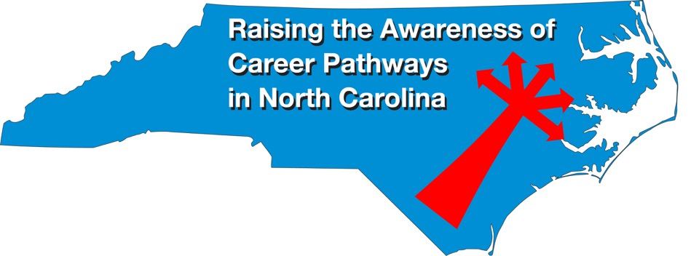
Careers in Diesel Mechanics December 14, 2022
Download the PowerPoint and access the recording: www.ncperkins.org/presentations
Notes:
Good morning. Welcome to our monthly career pathways webinar.
We are here to help promote the great jobs, often unknown, in the great state of North Carolina.
Through these meetings, we are going to let you know about some great career opportunities in North Carolina.
And bring in special guests talk about these opportunities.
Please download this PowerPoint file and use it anyway you can to help get folks on a career pathway.
In the notes section of the PowerPoint, you will find any reference from where the information was found, as well as the contact information for the speaker.
Get the PowerPoint on our NCPerkins.org website on our Presentations and Webinars page.
The direct address is on the screen, just scroll down to today’s date.
-----
Many of the videos shown during this webinar can be found here:
https://www.ncperkins.org/video/

Slide 2
Career & Technical Education Team
Bob Witchger
Tony Reggi
Patti Coultas
Mary Olvera
Anne Bacon
Darice McDougald
Lane Freeman
Aaron Mabe

Slide 3
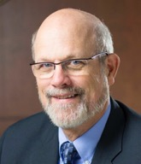
Dr. Bob Witchger
CTE Director, Team Perkins
Notes:
Dr. Robert (Bob) Witchger
NCCCS, CTE Director
919-807-7126
witchgerb@nccommunitycolleges.edu

Slide 4
Dr. Tony Reggi
CTE Associate Director,
Notes:
Tony Reggi
919-807-7131
reggia@nccommunitycolleges.edu

Slide 5
Aaron Mabe
Career & College Promise Coordinator
Notes:
Aaron Mabe
919-807-7098
mabea@nccommunitycolleges.edu

Slide 6
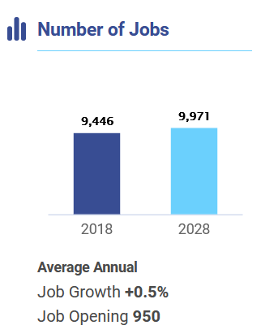
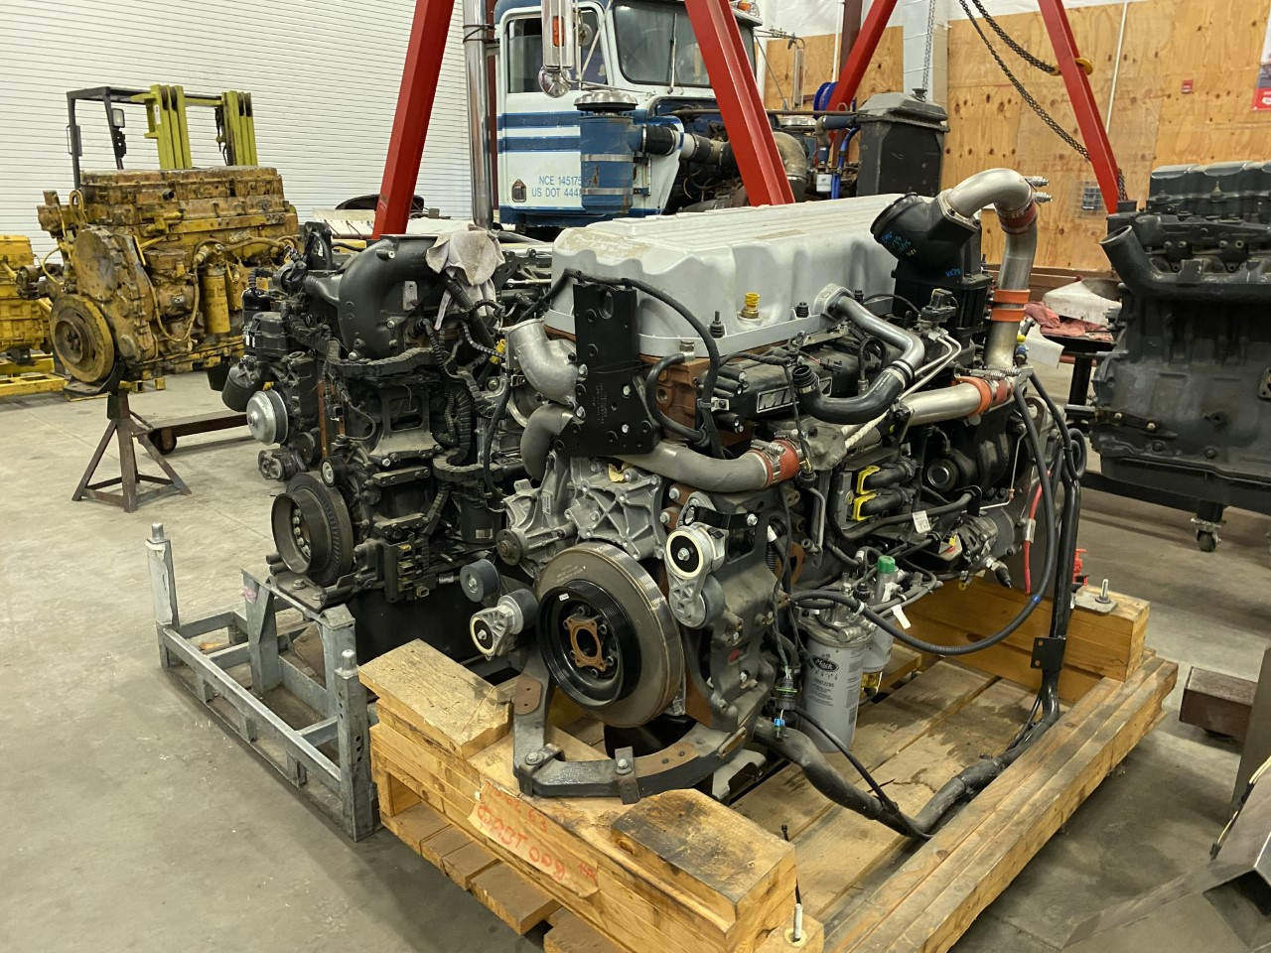
Truck Mechanics & Diesel Engine Specialists
Notes:
Source
https://nccareers.org/occupation-profile/493031/1284

Slide 7
Steven Cumming
Stanly Community College
Career and College Promise Liaison
Notes:
Steve Cumming
Career and College Promise Liaison
Stanly Community College
scumming0450@stanly.edu
704-991-0139

Slide 8
Joshua Aldridge
Stanly Community College
Dean, Adv. Manufacturing, Industry & Trades
Notes:
Joshua Aldrige
Stanly Community College
jaldridge065@stanly.edu

Slide 9
Allen Doub
Forsyth Technical Community College
Program Coordinator Diesel & Heavy Equipment
Notes:
Allen Doub Forsyth Technical Community College Program Coordinator Diesel and Heavy Equipment Technology
mdoub@forsythtech.edu 336-757-3362

Slide 10
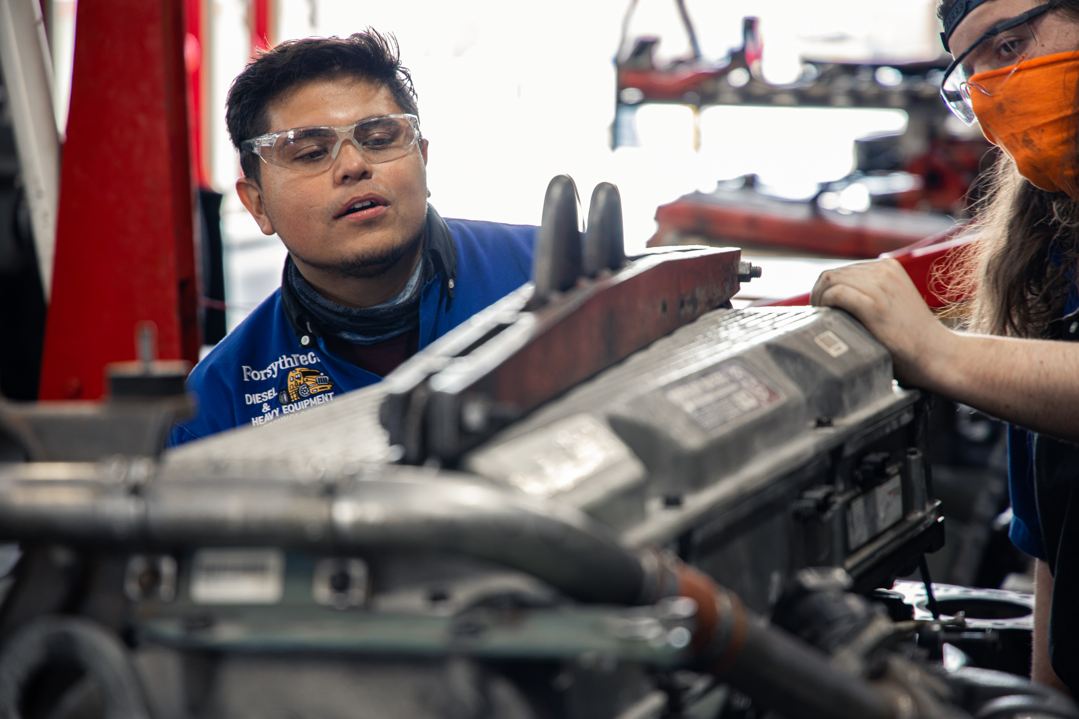
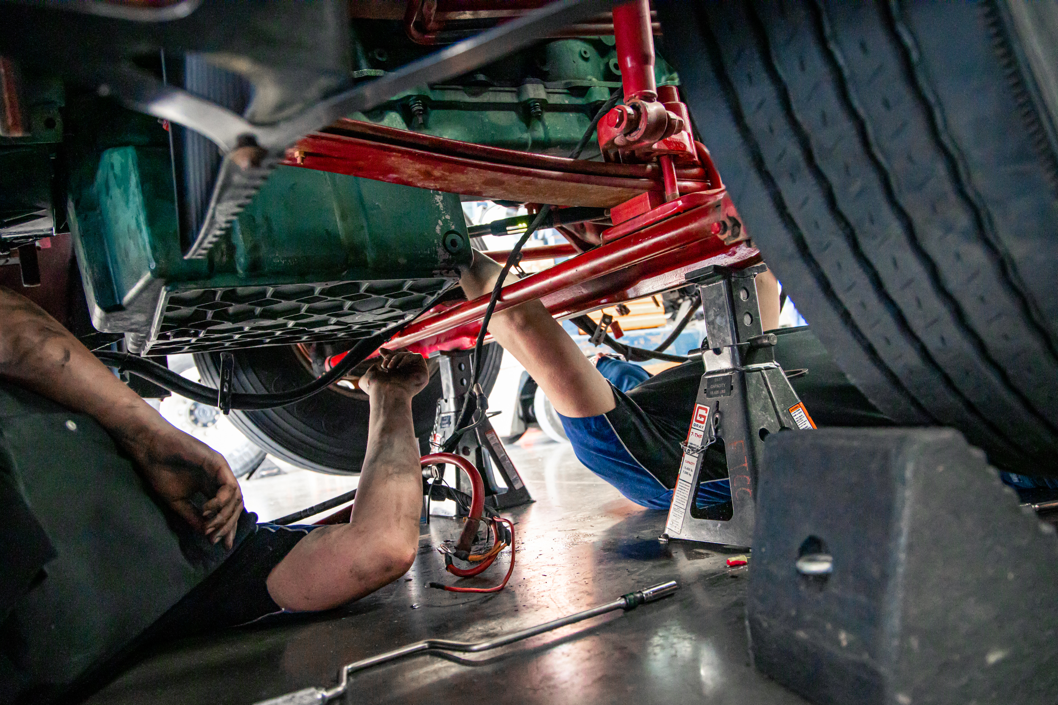
Forsyth Technical Community College

Slide 11
Forsyth Technical Community College

Slide 12
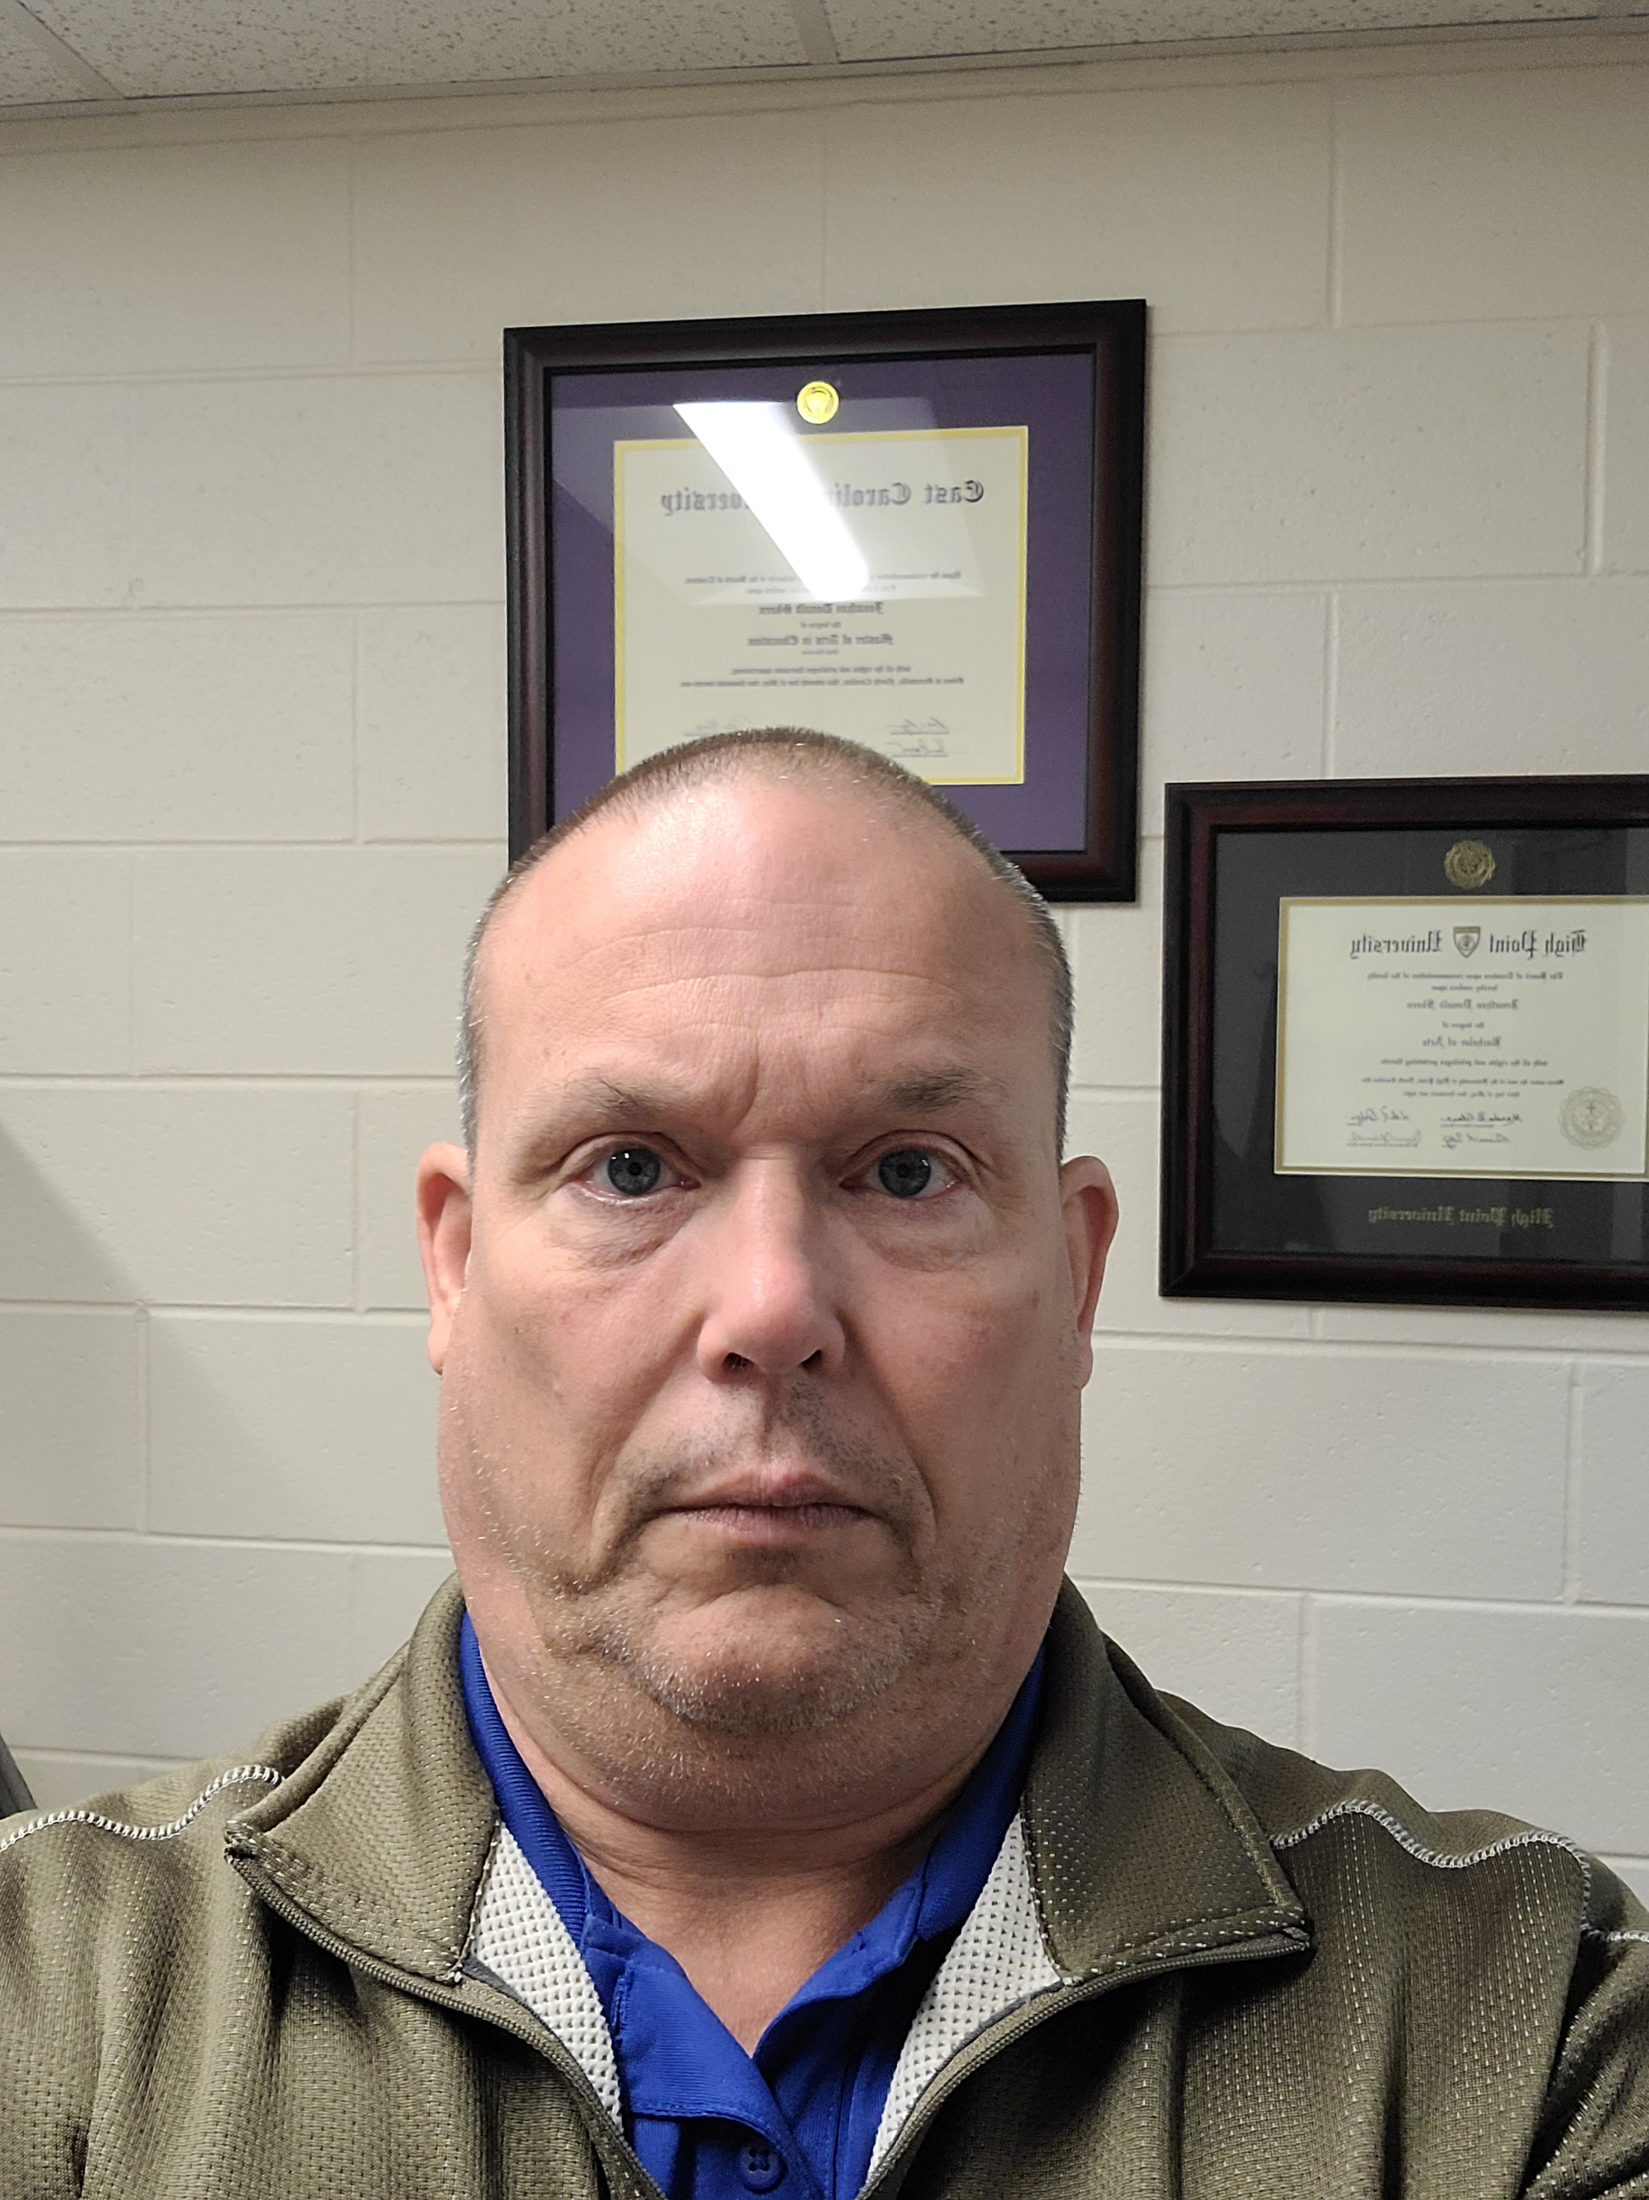
Jonathan Skeen
Guilford Technical Community College
Instructor
Diesel/Heavy Equipment Technology
Notes:
Email: jdskeen@gtcc.edu
Phone: 336-334-4822 Ext: 50687

Slide 13
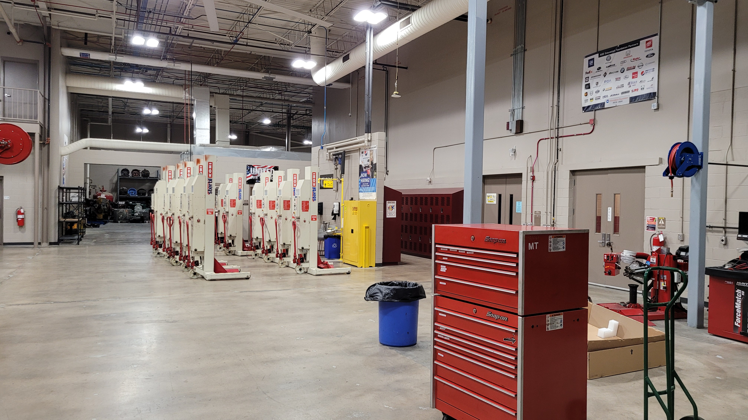
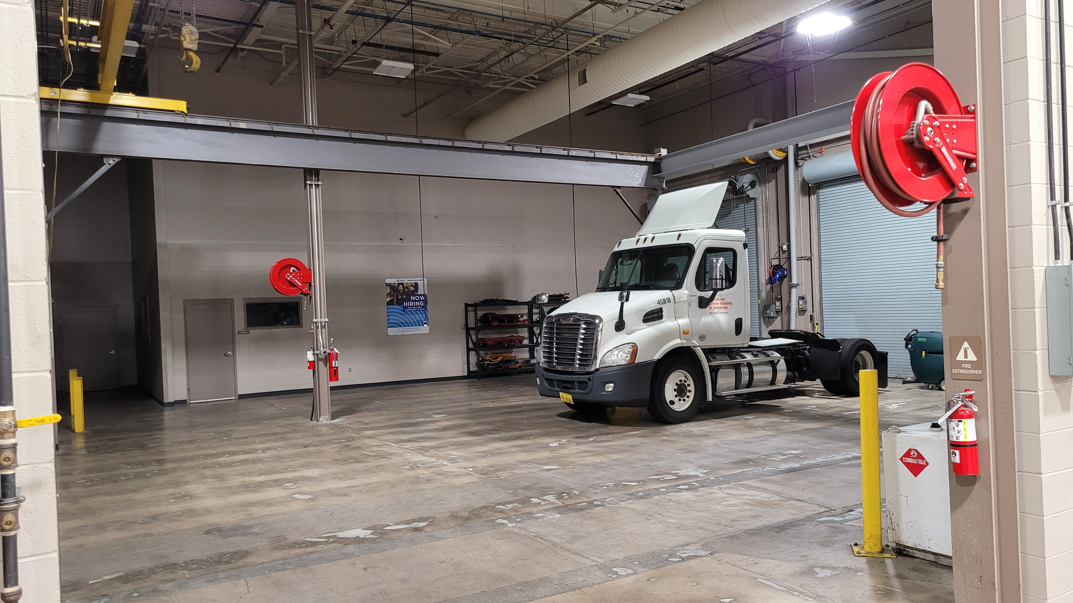
Guilford Technical Community College

Slide 14
Community College Programs in Diesel Mechanics
Agricultural Systems Technology (A60410)
Automotive Light-Duty Diesel Technology (D60430)
Diesel and Heavy Equipment Technology (A60460)
Notes:
https://www.nccommunitycolleges.edu/academic-programs/nc-community-college-system-catalog

Slide 15
Diesel & Heavy Equipment Technology (A60460)
Curriculums in the Mobile Equipment Maintenance and Repair pathway prepare individuals for employment as entry-level transportation service technicians. The program provides an introduction to transportation industry careers and increases student awareness of the diverse technologies associated with this dynamic and challenging field.
Course work may include transportation systems theory, braking systems, climate control, design parameters, drive trains, electrical/electronic systems, engine repair, engine performance, environmental regulations, materials, product finish, safety, steering/ suspension, transmission/transaxles, and sustainable transportation, depending on the program major area chosen.
Graduates of this pathway should be prepared to take professional licensure exams, which correspond to certain programs of study, and to enter careers as entry-level technicians in the transportation industry.
The Diesel and Heavy Equipment Technology program prepares individuals to apply technical knowledge and skills to repair, service, and maintain diesel engines in vehicles such as heavy-duty trucks over one ton classification, buses, ships, railroad locomotives, and equipment; as well as stationary diesel engines in electrical generators and related equipment.

Slide 16
NC Community Colleges offering Diesel Mechanics:
Asheville-Buncombe Technical Community College Caldwell Community College and Technical Institute Cape Fear Community College Carteret Community College Central Piedmont Community College Coastal Carolina Community College | Davidson-Davie Community College Forsyth Technical Community College Guilford Technical Community College James Sprunt Community College Johnston Community College Wake Technical Community College Wilkes Community College

Slide 17
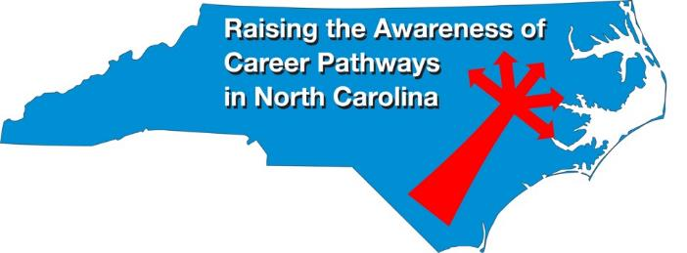
Raising the Awareness of Career Pathways Webinars
January 18 Teacher Preparation
February 15 Machine Programming (CNC)
March 15 Occupational Therapy Assistants
April 19 Food Industry
May 17 Entrepreneurship
June 21 Nonprofit Leadership and Management
Register for all webinars at www.ncperkins.org/presentations

