Slide 1
Perkins Update
January 14, 2025

Slide 2
Purpose of Perkins V
Develop more fully the academic knowledge and technical and employability skills of secondary education students and postsecondary education students who elect to enroll in CTE curriculum programs and programs of study
Notes:
The Strengthening Career and Technical Education for the 21st Century Act reauthorized and updated the Carl D. Perkins Career and Technical Education Act of 2006 to become the current Carl D. Perkins Career and Technical Education Act of 2006 as amended by the Strengthening Career and Technical Education for the 21st Century Act (Perkins V)
This updated act stresses:
- Academic, Technical, and Employability Skills
- Funding Secondary and Postsecondary CTE
- Focusing on Students who elect to enroll in CTE Programs of Study

Slide 3
Bob’s retiring!
February 1, 2025
March 1, 2025

Slide 4
Perkins Spending Guidance
June’s activities must be paid with 2024-25 funds. Funds may be obligated and disbursed in July.
July’s activities must be paid with 2025-26 funds. People may pay for P.D. earlier, and then get reimbursed after the activity is completed in July.

Slide 5
Updated Guidance on Perkins V Support for Special Populations
Key Provision: Perkins V, Section 135(b)(5)(s), allows colleges to utilize Perkins funding to reduce or eliminate out-of-pocket expenses for CTE students who are members of special populations.
Updated Approved Guidance:
Reviewed and approved by The Bruman Group, PLLC
Includes (for adaptation by colleges as needed):
1. *Sample Generic Policy and Procedure
2. *Student Attestation Form
Key Changes:
Ensures compliance with federal regulations, including supplement - not-supplant requirements.
Establishes a streamlined process for determining and documenting student eligibility for support.
*The generic forms can be found on NCPerkins.org
ThePhoto by PhotoAuthor is licensed under CCYYSA.

Slide 6
Career Advising Training
4-hour training
Partner with WFD Board or Career Center
Content:
Career Theory
Tools for career advising
Navigating difficult conversations
Conversation Prompts

Slide 7
Seth Kamen: State Director of Credit Mobility
Quick Intro of the Credit Mobility Position
Seth Kamen, Ed.D.
State Director of Credit Mobility
Division of Programs and Student Services
919-807-7115
kamens@nccommunitycolleges.edu
Research into Universal Articulation Agreements for Adult Students and AAS Programs

Slide 8
CPL Virtual Listening Tours
CPL Virtual Listening Tours to learn more about Credit for Prior Learning at the colleges. Faculty, staff, and administration are invited to share their thoughts, needs, and ideas. Topics may include community perceptions of CPL, challenges with implementing or expanding a CPL program, training needs for faculty and staff, how to engage students, or more. These will be held on the following:
Please RSVP here; registration will stay open until one hour before the scheduled time
If you would like to set up a call specifically for your institution, please let me know and I'll be happy to coordinate.
Thursday, 2/6/25 10 – 11am or 3 – 4pm | Wednesday, 2/12/25 9 – 10am
Monday, 2/10/25 4pm – 5pm | Friday, 2/14/25 12 – 1pm or 2 – 3pm
Tuesday, 2/11/25 11am – 12pm or 4pm – 5pm

Slide 9
Leveraging AI in Education Series Workshops and Presentations
Hands-on training for CTE faculty and staff
Focus on integrating AI into classroom environments
Practical AI applications: Personalized assessments, AI-assisted lesson planning
Ethical considerations in AI use
Upcoming Sessions: Available through Spring 2025
Contact: Reach out to Lane Freeman (freemanl@nccommunitycolleges.edu) to schedule an in-person or online session

Slide 10
Immersive Learning Conference (May 20-22, 2025)
https://www.youtube.com/watch?v=FywwfRxQTBc
Notes:
https://www.youtube.com/watch?v=FywwfRxQTBc

Slide 11
Immersive Learning Conference (May 20-22, 2025)
Immersive technologies in Career and Technical Education (CTE)
Focusing on BioTechnology
Revolutionizing student advising and workforce training using VR and other tools
Funding: Perkins Leadership Funds to cover room, board, and registration (no cost for colleges)
Submit a proposal or apply to attend: https://www.nccommunitycolleges.edu/2025-immersive-learning-conference-event-webpage/

Slide 12
AI Integration for CTE Faculty - Training Event (January 30-31, 2025)
Two-day (6 hour) training for CTE faculty at Caraway Conf. Center
AI applications relevant to CTE fields
Practical examples of AI in the classroom
Discussions on AI’s future role in workforce training
Registration is FULL. Keep an eye out for future AI in CTE Conferences
Notes:
https://sites.google.com/view/aiinthecteclassroom/home

Slide 13
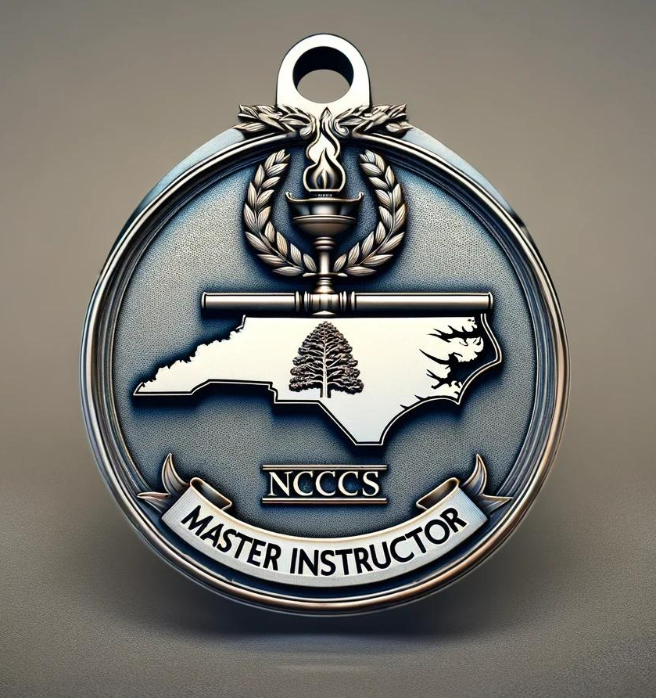
Congratulations to the following Master Instructor Certification Program Candidates from CTE fields (2025 Cohort)
Name | Discipline | College
Hope Carroll | Graphic Design | Catawba Valley CC
Ramie Robinson | Electrical Machining, HVAC, and Sustainable Tech | Catawba Valley CC
Terri Fesmire | Career and Technical Education | Pamlico CC
Samuel Grubbs | Business and Accounting | Gaston College
Brooke Elder | Business and Accounting | Caldwell CC and Technical
Susan Randall | Information Technology | Cleveland CC
Angie Rudd | Information Technology | Gaston College
Hollie Garrett | Information Technology | Vance Granville CC
Andrew Capps | Biotechnology | Caldwell CC and Technical
Martin Hubner | Business Administration | Caldwell CC and Technical
Elizabeth Dellinger | Business Administration | Mayland CC
Stephanie Slade | Allied Health & Public Services | South Piedmont CC
Nathan Godsey | Skilled Trades/Welding | Central Piedmont CC
Jennifer Osborn | Criminal Justice | Fayetteville Tech CC
Courtney Calhoun | Health Sciences | Wilson CC
Danielle Hensley | Health Sciences | Central Piedmont CC
Victoria Johnson | Health Sciences | Wilkes CC
This year's program includes 42 candidates representing 23 community colleges, with 17 CTE faculty spanning 12 of these colleges.
Notes:
https://www.nccommunitycolleges.edu/college-faculty-staff/nccc-master-instructor-certification-program/

Slide 14
January 29-30, 2025
Registration deadline is January 17
Fayetteville Technical College
Tony Rand Student Center
Multipurpose Room

Slide 15
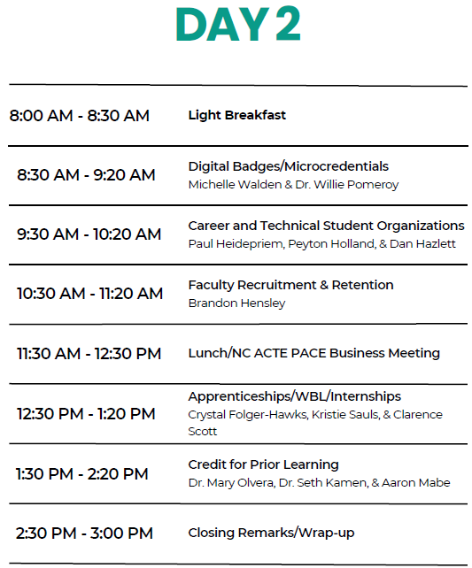
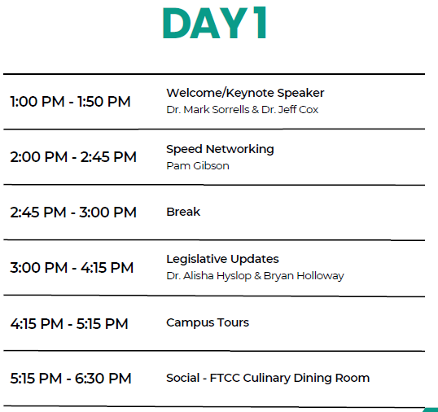

Slide 16
Perkins Mid-Year Meeting Agenda
Monday, February 3rd 3-5pm
Optional Perkins 101 (you must register separately for this workshop)
Tuesday, February 4th 8:30 – 5:00
Advance CTE Opportunity Gap Analysis for CLNA Section E: Progress toward improving access and equity for all students
Optional evening session for assistance reading your college’s data
Wednesday, February 5th 8:30 – 3:00
Connections between Propel NC and Perkins
Credit Mobility
Round Table discussions and sharing

Slide 17
Mid-Year Meeting Logistics
Caraway Conference Center, Sophia, NC
Deadline to register is January 17th https://forms.office.com/r/gE7xskuTTJ
If you have any questions about registration contact Darice McDougald at mcdougaldd@nccommunitycolleges.edu
Lodging Accommodations
Perkins will pay for 1 room per college (May accommodate 2 in 2 full size beds)
Additional people from your college may attend, but they are responsible for their own lodging.
Everyone must register so the meal count is correct (even day attendees).

Slide 18
Perkins Annual Meeting for 2025-2026
April 9th Koury Convention Center, Greensboro
Registration coming in March
9am – 12pm Education Department General Administrative Regulations (EDGAR) presented by Bruman Group, LLC
12-1pm – Lunch on your own
1-4pm – Preparing for Perkins 2025-2026 year facilitated by Team Perkins

Slide 19
SKILLSUSANC Leadership Conference
April 8-10 Greensboro Convention Center, Greensboro
Post Secondary Competitions April 10
Visit : State Conference | skillsusanc
For last years results go to:
https://www.skillsusanc.org/_files/ugd/6b19e9_df933ba0fd9243fdaf2dca329da879a3.pptx?dn=Awards%20PPT%20SLSC%202024%20PS.pptx

Slide 20
Perkins Monthly Updates 2024-25
2/11/2025
3/11/2025
4/8/2025 canceled
5/13/2025
6/10/2025
Attendance (or viewing the recording within 30 days) is recorded on the monitoring rubric. Recording may be accessed at the same link as the registration.
You can register for these now at
www.ncperkins.org/presentations
and put them on your calendar
Notes:
Register now and let the system remind you.

Slide 21
Virtual Office Hours for Technical Assistance
2nd Tuesday of the month 1-2pm
4th Wednesday of the month 9-10
** See the top of the NCPerkins.org/presentations page for TEAMS link
Need help?
Let's meet.
CTE Team Perkins
Virtual
Office Hours
Drop in to ask a CTE Coordinator your questions

