Slide 1
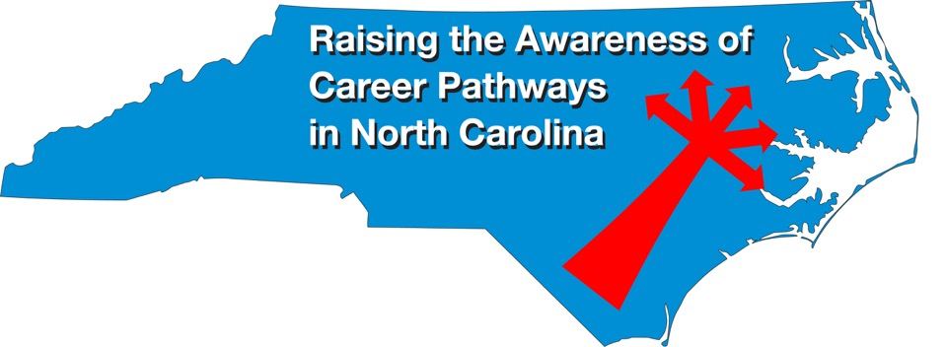
P-12 Teacher Pipeline at the NC Community Colleges January 18, 2023
Download the PowerPoint and access the recording: www.ncperkins.org/presentations

Slide 2
Career & Technical Education Team
Bob Witchger
Tony Reggi
Patti Coultas
Mary Olvera
Anne Bacon
Darice McDougald
Lane Freeman
Aaron Mabe

Slide 3
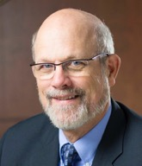
Dr. Bob Witchger
CTE Director, Team Perkins
Notes:
Dr. Robert (Bob) Witchger
NCCCS, CTE Director
919-807-7126
witchgerb@nccommunitycolleges.edu

Slide 4
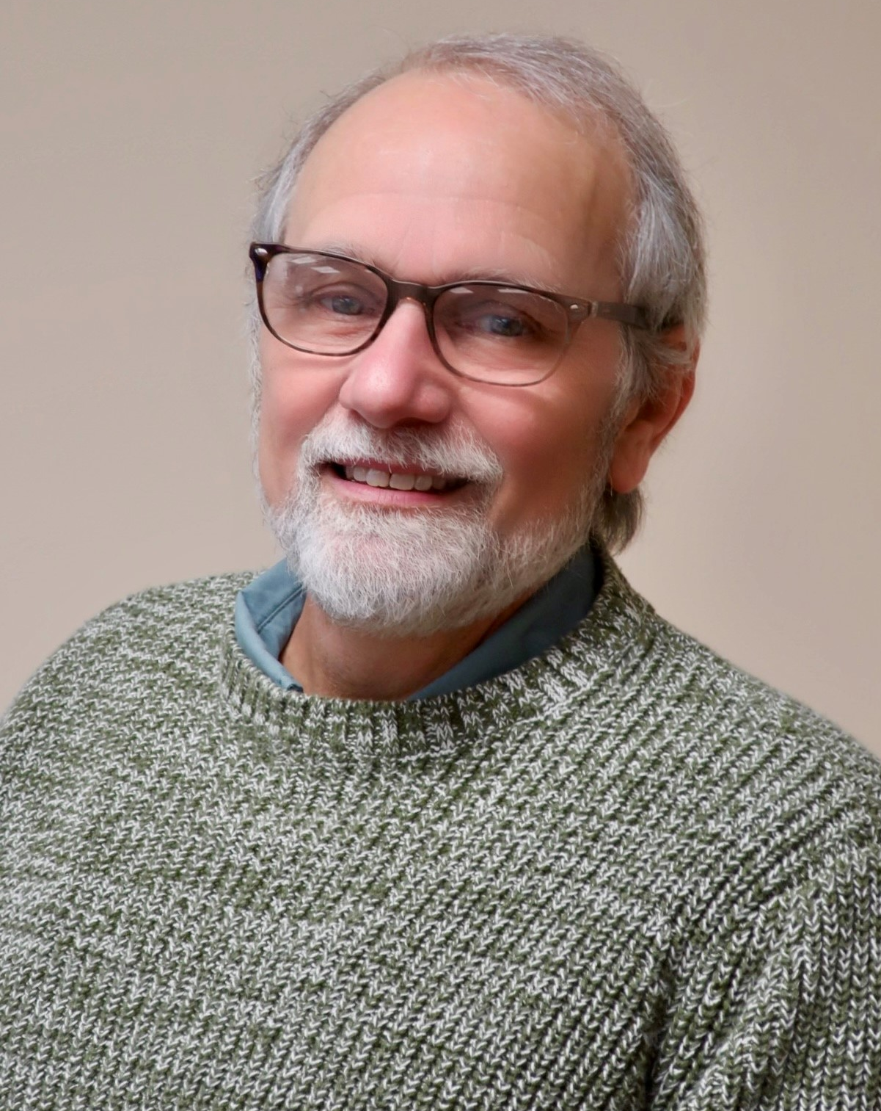
Dr. Tony Reggi
CTE Associate Director,
Notes:
Tony Reggi
919-807-7131
reggia@nccommunitycolleges.edu

Slide 5
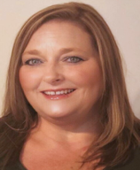
Dr. Mary Olvera
CTE Coordinator and Senior Program Administrator
Public Service Technologies, Agriculture and Natural Resources Technologies, and Commercial Artistic Productions
Notes:
Dr. Mary Olvera
Career and Technical Education Coordinator & Senior Program Administrator
Public Service Technologies, Agriculture and Natural Resources Technologies, and Commercial Artistic Productions
North Carolina Community College System Office
919-807-7120
olveram@nccommunitycolleges.edu

Slide 6
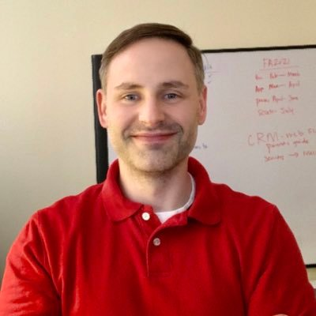
Aaron Mabe
Career & College Promise Coordinator
Notes:
Aaron Mabe
919-807-7098
mabea@nccommunitycolleges.edu

Slide 7
Teacher Vacancies by Grade Level 2021 & 2022
Source: NC School Superintendents Association
Retrieved from WUNC, see link in Notes
Notes:
WUNC Story: https://www.wunc.org/education/2022-08-22/nc-has-over-11-000-vacancies-in-public-schools-a-statewide-survey-finds

Slide 8
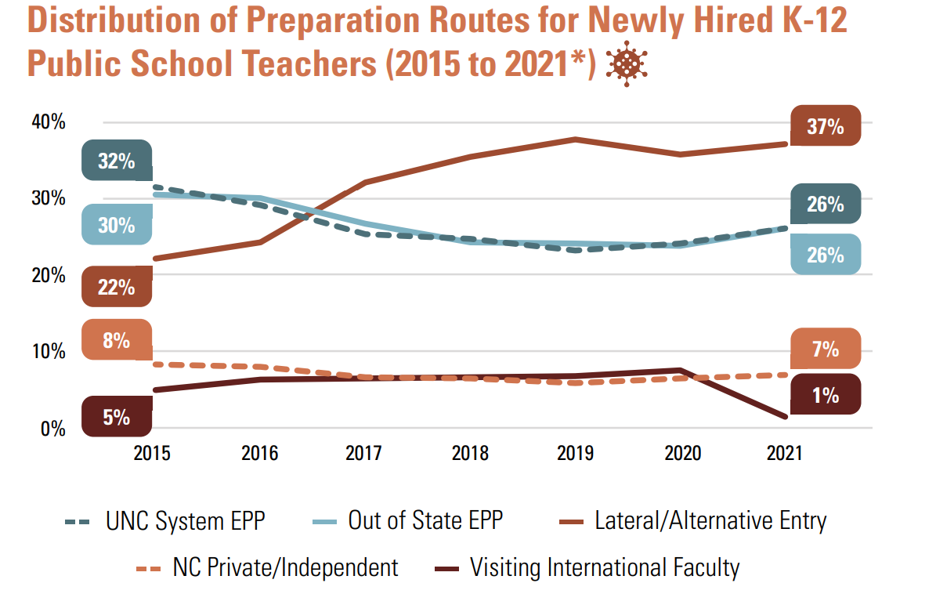
Residency/Alternative Licensure most popular pathway
Residency/Alternative Licensure

Slide 9
NC Community College Teacher Pipeline Opportunities: Birth – age 8
Birth – age 8
A55220 Early Childhood Education Degree (Associate in Applied Science)
Three-Pathways:
Career Ready
Birth-Kindergarten Licensure Transfer, or
Non-Licensure Transfer
Birth – age 3
C55290 Infant / Toddler Care (Certificate)*
Statewide certificate counts towards formal education for the CDA
* The NC Early Childhood Credential (NCECC) is included in this certificate

Slide 10
NC Community College Teacher Pipeline Opportunities: Grades PreK-K
Grades PreK-K
C55860 Early Childhood Preschool (Certificate)*
Statewide certificate counts towards formal education courses for the CDA
* The NC Early Childhood Credential (NCECC) is included in this certificate

Slide 11
NC Community College Teacher Pipeline Opportunities: Birth – age 12
Birth – age 12
C55820 Early Child Care Workforce (Certificate)*
Potential to earn 9 credit hours through Credit for Prior Learning
C55850 Early Childhood Administration (Certificate)*
The NC Early Childhood Administration Credential (NCECAC) is included in this certificate
* The NC Early Childhood Credential (NCECC) is included in this certificate

Slide 12
NC Community College Teacher Pipeline Opportunities: Grades K-12
Grades K-6
C55490 Elementary Education Residency Certificate (former lateral entry)
A55440 School-Age Education Degree
C55450 School-Age Care (Certificate)
Grades K-12
A1010T Associate in Arts in Teacher Preparation
A1040T Associate in Science in Teacher Preparation

Slide 13
NC Community College Offerings
57 community colleges offer Early Childhood Education degree
55 community colleges offer at least one CCP Pathway (Infant/Toddler or Preschool)
56 community colleges offer Associate in Arts Teacher Preparation/Associate in Science Teacher Preparation
All of these offer at least one CCP Pathway for Teacher Prep
Elementary Education Residency Licensure Certificate (coming Fall 2023)

Slide 14
Sample Pathway to K-12 teaching license
High School
Course: Teaching as a Profession, and/or
CCP Teacher Preparation Pathway
Community College
Associates Art Teacher Prep, or
University/ 4-year college
Bachelor’s Degree with teaching licensure
Associates Science Teacher Prep
With Associates, may work as a teaching assistant

Slide 15
Sample Pathway to B-K teaching license
High School
Course: Early Childhood, and/or
CCP Teacher Preparation Pathway
Community College
Associates in Applied Science Early Childhood Education
University/ 4-year college
Bachelor’s Degree with teaching licensure
Upon graduation, may work in childcare field
With Associates, may work as a teaching assistant or lead teacher depending on licensure requirements of workplace

Slide 16
Resources
NC Teaching License Area
https://www.dpi.nc.gov/educators/educators-licensure/areas-licensure#Tab-ElementaryK-6-388
Teacher Vacancies
https://northcarolina.teach.org/jobs?utm_source=partner-ncdpi&utm_medium=website
Alternative License (Residency)
https://northcarolina.teach.org/alternative-licensure

Slide 17
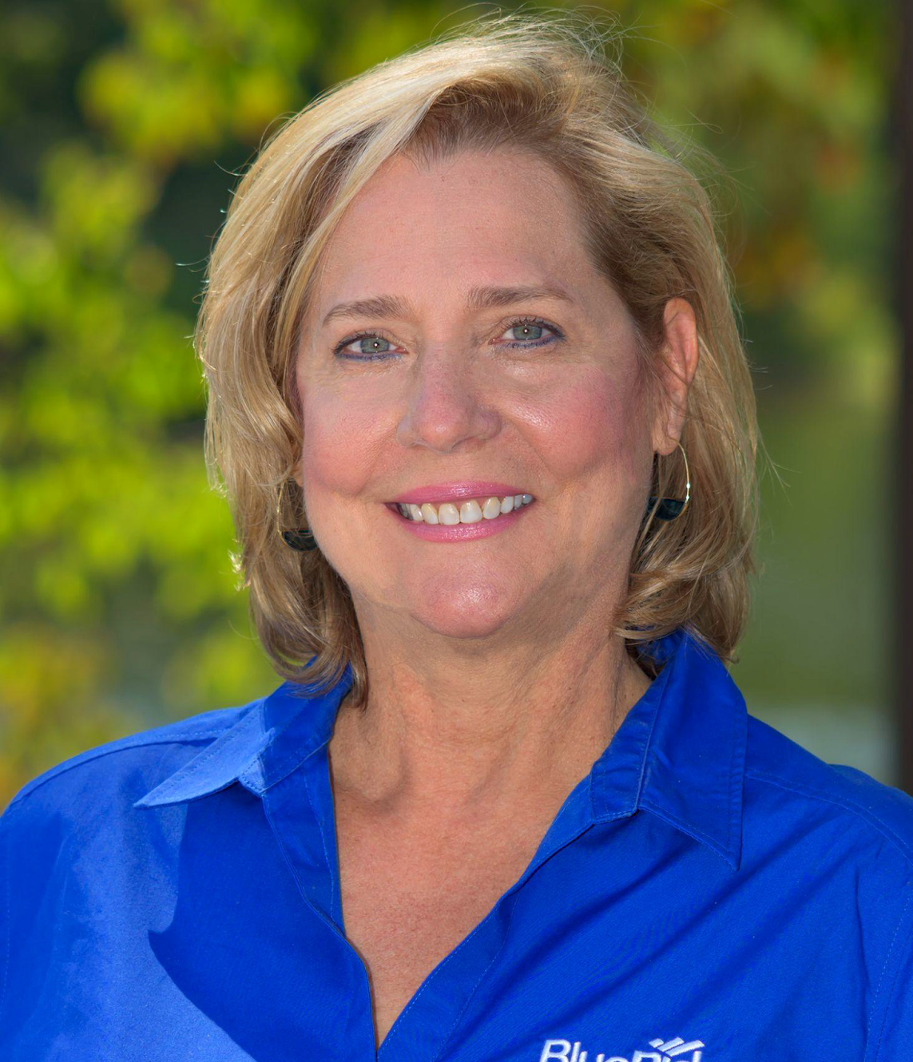
Shelah Combs, M.Ed.
Blue Ridge Community College
Teacher Preparation/ Early Childhood Education
Notes:
Shelah Combs, M.Ed
Blue Ridge Community College
Teacher Preparation/Early Childhood Education
(828) 694-1819
Email: sk_combs@blueridge.edu

Slide 18
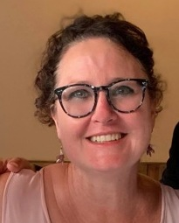
Melanie Wilkins
Blue Ridge Community College
Early Childhood/Teacher Education Faculty
Notes:
Melanie Wilkins, M.Ed. Blue Ridge Community College
Office: Patton 283, 828-694-1850 Early Childhood/Teacher Education Faculty mc_wilkins@blueridge.edu

Slide 19
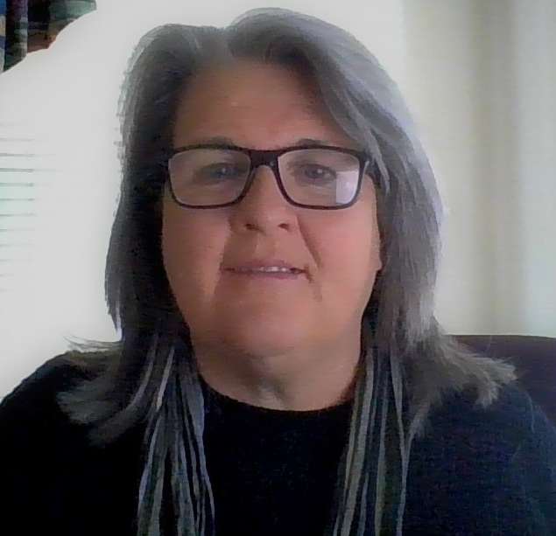
Kathleen Worsdale
Wake Technical Community
College
Assist. Professor Education Department
Notes:
Kathy Worsdale
Wake Tech
kworsdale@waketech.edu
919-866-5433

Slide 20
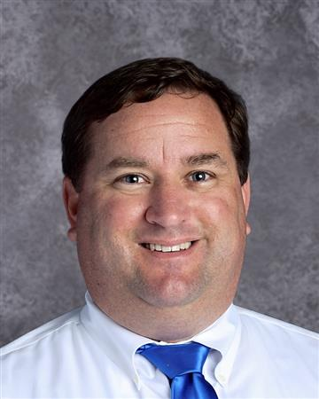
Bennett Jones, Ed.D.
UNC System Office
Director
NC Teaching Fellows Program
Notes:
Bennett Jones, Ed.D.
Director
North Carolina Teaching Fellows Program
UNC System Office
btjones@northcarolina.edu
Mobile: 919-333-3942
https://myapps.northcarolina.edu/ncteachingfellows/

Slide 21
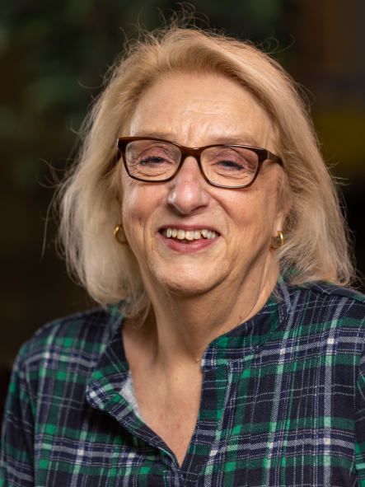
Sharon Carter
Davidson-Davie Community College
Professor,
Teacher Education
Notes:
Sharon Carter
Davidson-Davie Community College
scarter1289@davidsondavie.edu
336-249-8186 X6127

Slide 22
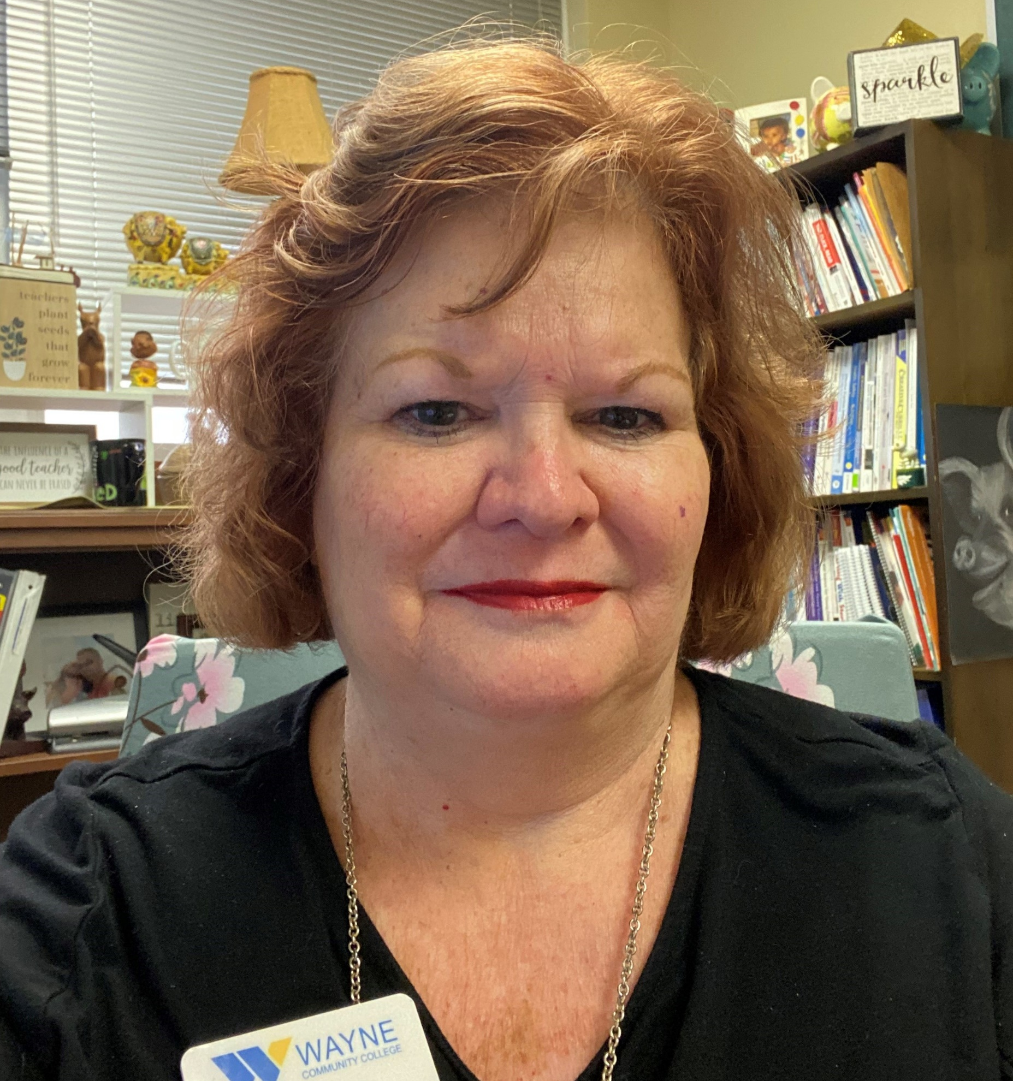
Jodi Baker
Wayne Community College
Public Services Department Chair
Notes:
Jodi Baker
Public Services Department Chair
Public Services
919-739-6794
jbbaker@waynecc.edu

Slide 23
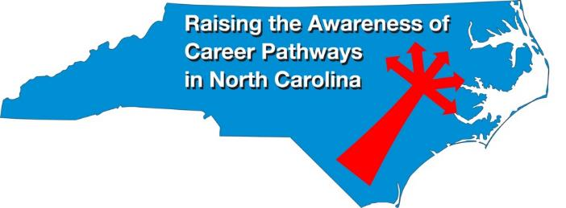
Raising the Awareness of Career Pathways Webinars
February 15 Machine Programming (CNC)
March 15 Occupational Therapy Assistants
April 19 Food Industry
May 17 Entrepreneurship
June 21 Nonprofit Leadership and Management
Register for all webinars at www.ncperkins.org/presentations

