Slide 1
Perkins Update
August 13, 2024

Slide 2
NCCCS Perkins/Programs Staff
Peyton Bell Director of Curriculum Management
Patti Coultas Assistant Director of Perkins CTE - East
Dr. Lisa Eads Associate Vice President of Programs
Dr. Lane Freeman Director of Online Learning Programs and Student Services
Dr. Trudie Hughes State Director of Disability Services and Title IX
Dr. Hilmi Lahoud Sr State Director of Business & IT and Academic Programs Operations
Aaron Mabe State Director of Dual Enrollment and Ag & Natural Resources Technology
Darice McDougald Perkins Program Specialist
Dr. Jennifer McLean State Director of Advising and Coaching
Dr. Mary Olvera State Director of Teacher Ed., Public Services, & Perkins Special Populations
Ashley Parrott State Director of College Ready Graduates and Developmental Education
Dr. Tony Reggi Associate Director of Perkins CTE
Reyna Rodriguez Director of Course Management and Credentialing
Todd Roth State Director of Skilled Trades and Work Based Learning
Stefanie Schroeder Assistant Director of Perkins CTE – West
Melissa Smith Senior State Director of Health Science Programs
Dr. Bob Witchger Executive Director of Perkins CTE

Slide 3
Purpose of Perkins V
Develop more fully the academic knowledge and technical and employability skills of secondary education students and postsecondary education students who elect to enroll in CTE curriculum programs and programs of study
Notes:
The Strengthening Career and Technical Education for the 21st Century Act reauthorized and updated the Carl D. Perkins Career and Technical Education Act of 2006 to become the current Carl D. Perkins Career and Technical Education Act of 2006 as amended by the Strengthening Career and Technical Education for the 21st Century Act (Perkins V)
This updated act stresses:
- Academic, Technical, and Employability Skills
- Funding Secondary and Postsecondary CTE
- Focusing on Students who elect to enroll in CTE Programs of Study

Slide 4
2P1: Using the Colleague FPAT Mnemonic
FPAT = Batch Fast Path Analysis
A Colleague report that identifies certificate and diploma completers
Beaufort County Community College
Joanna Rieg, Assistant Director of Admissions and Records Joanna.rieg@beaufortccc.edu 252-940-6221
NCCCS
Bryan McCullough, Business Systems Analyst II - Student Services,
Programs and Student Services mcculloughb@nccommunitycolleges.edu 919-807-6959

Slide 5
9-14 PATHWAYS CONSULTATION
This training offers a deep dive into all secondary engagement opportunities by reviewing best practices, local data, and inter-office collaborations, e.g. career advising, articulation, and CCP pathways. Sessions typically last about 2-3 hours at no cost to the college.
If interested, please email Aaron Mabe,
mabea@nccommunitycolleges.edu

Slide 6
May colleges spend Perkins on Teacher Education or Teacher Preparation Programs?
You MAY spend Perkins on:
Early Childhood Education A55220
Elementary Education Residency Licensure C55490
Courses with an EDU prefix
You MAY NOT spend Perkins on:
Assoc. in Arts in Teacher Prep. A1010T *Except EDU Courses
Assoc. Science in Teacher Prep. A1040T *Except EDU Courses
edTPA Success Coach (or other similar title)

Slide 7
Admin Voc Code 10 Guidance
As stipulated by Perkins V section 135(d), a college shall use not more than 5% of its allotment for administrative expenses. Admin. activities are those activities necessary for the effective and efficient performance of the eligible college’s duties under Perkins V, including the supervision of such activities. Any cost that supports the management of the Perkins V program is administrative.
The college’s 5% maximum admin. expenses are reduced by the Workforce Innovation and Opportunity Act (WIOA), which requires all required partner programs of the one-stop delivery system to contribute to the infrastructure costs (non-personnel) based on proportionate use and relative benefit received.
The total allotment approved by the State Board will be reduced by this amount, therefore the infrastructure contribution should not be in the local plan and budget. Colleges must pay attention to the total amount they can budget for administration as listed on the State Board item as “Admin Costs Available”.
It is important to note that administrative expenses may be used only in proportion to the grant expenditure. For example, if after the first quarter, 25 percent of the grant has been spent, then 25 percent of the administrative funds may be billed to the grant. (See EDGAR, CFR Part 76.707)

Slide 8
Promising Practice Video from 2023-2024
South Piedmont Community College
Surgical Technology Program
The link to all EOY videos is www.ncperkins.org/video

Slide 9
NCCCS System Conference
https://events.lifelonglearning.ncsu.edu/ncccs/
Registration:
Early Bird through September 24, 2024: $249
After September 24, 2024: $299
Notes:
https://events.lifelonglearning.ncsu.edu/ncccs/

Slide 10
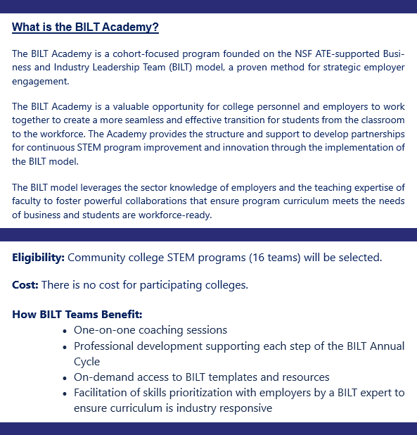
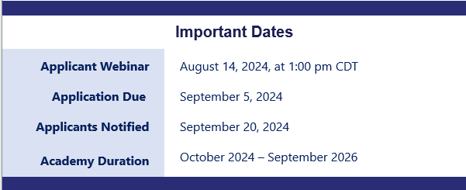
BILT Academy A Pathways to Innovation Project of CORD
Contact BILT@cord.org with any questions
Notes:
To Register for Webinar: https://us06web.zoom.us/meeting/register/tZAofuqsqTsjHdCDKkuKxy99ThiWEOyJ-l0_#/registration
More Information: https://www.pathwaystoinnovation.org/bilt-academy/
Questions: BILT@cord.org

Slide 11
Listservs you may wish to join
Perkins: ll-perkins
Advising: ll-advising
Career & College Promise: ll-ccp
Chief Academic Officer: ll-cao
Title IX & VII: ll-titleix-vii
** Ask your college’s IT Department to add you
To send to the entire listserve, change the ll to cc. For Perkins, email cc-perkins@nccommunitycolleges.edu

Slide 12
Perkins Monthly Updates 2024-25
9/10/2024
10/8/2024
11/12/2024
12/10/2024
1/14/2025
2/11/2025
3/11/2025
4/8/2025
5/13/2025
6/10/2025
Attendance (or viewing the recording within 30 days) is recorded on the monitoring rubric. Recording may be accessed at the same link as the registration.
You can register for these now at
www.ncperkins.org/presentations
and put them on your calendar
Notes:
Register now and let the system remind you.

Slide 13
Virtual Office Hours for Technical Assistance
2nd Tuesday of the month 1-2pm
4th Wednesday of the month 9-10
** See the top of the NCPerkins.org/presentations page for TEAMS link
Need help?
Let's meet.
CTE Team Perkins
Virtual
Office Hours
Drop in to ask a CTE Coordinator your questions

Slide 14
Technical Assistance is available
We are here to help!
Team Perkins is available by phone, email, virtually, or in-person

