Slide 1
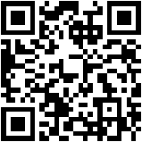
A Changing World: Helping youth prepare for life in a scary world that we know little about
Chris Droessler, CTE Coordinator,
NC Community Colleges
NCperkins.org/presentations
Notes:
The job market has changed considerably from when we graduated from high school.
Good afternoon. I am Chris Droessler, a CTE coordinator from the North Carolina Community College System.
If you have a smart phone, and you are smart enough to use it, you can capture that QR code, and your phone or tablet takes you to the webpage where you can download a copy of this PowerPoint file.
Or you can just go to NCperkins dot org and click on the “presentations” link.
How many of you have already downloaded my presentation??
Warning: I talk fast and have lots of information to cover. My goal is to get the information to you so that you can go back and digest it later.
I have documented my information sources in the notes section of the PowerPoint, to allow you to further research anything that you see here.
In fact, the notes from which I am reading are there as well.
(In some cases I am reading directly from an original source, because they said it so well.)
Download the PowerPoint and use it any way you wish -- if it will help people discover their perfect career. --
This presentation takes a hard look at where we are -- and where we should be -- in preparing the youth of North Carolina for the future job market.
=====
www.NCperkins.org/presentations
====
CDC/SPC Mini Conference
October 24, 2016
New Bern, NC

Slide 2
You can’t see the whole sky through a bamboo tube
Notes:
An Ancient Japanese proverb says “You can’t see the whole sky through a bamboo tube.”
We are trained from an early age to look at things through a tube.
Our education system is set up to train students to look at math, English, and other subjects in isolation from each other.
The focus is on doing just enough in those independent classes to make the grade you wish.
If you are caught looking at the world outside your bamboo tube, -- you might be accused of cheating.
Our current process of learning does not have to relate to the real world, you just have to memorize and apply your recent learnings to tests.
Then when you have enough credits, you are passed on to the next level of education, -- or just out the door.
Just as you can not see the whole sky by looking through a bamboo tube, you can’t learn everything from me.
So I’ll show you what I have been looking at through my own bamboo tube.
And I’ll show you some of the things that I get to see when I put the bamboo tube aside -- and just look at the whole sky.
====
Quote
http://www.rodneyohebsion.com/japan.htm
http://www.worldofproverbs.com/2012/04/you-cant-see-whole-sky-through-bamboo.html
Panda photo
https://www.flickr.com/photos/kjdrill/148617834/sizes/z/

Slide 3
Begin with the End in Mind
A Changing World: Helping youth prepare for life in a scary world that we know little about
Notes:
Stephen Covey’s second habit of highly effective people says “Begin with the end in mind.”
Too often that habit is summed up with the phrase “What do you want to be when you grow up?”
This habit relies on using your imagination, -- which is something that is not often valued in our society, especially in education and training. We have become accustomed to allowing others tell us how to act -- and where to go.
We need a clear vision of where we are headed before we can help others get a clear vision of where they are headed.
You should be in charge of your own life.
And we have to help others do the same, or we end up like riding in bumper cars without a steering wheel.
Always reacting to outside stimulations -- rather than creating our own path.
=====
Steven Covey
https://www.stephencovey.com/7habits/7habits-habit2.php
Tortoise race
https://theleadershipwiki.wikispaces.com/Begin+with+the+End+in+Mind

Slide 4
A Changing World: Helping youth prepare for life in a scary world that we know little about
Notes:
The end for this presentation is the future.
(About an hour into the future to be precise.)
What will the future look like?
(Not an hour from now, but like ten or twenty years in the future.)
The more important question is:
“What do we want our future to look like?”
=====
https://i.ytimg.com/vi/MFEw37uMQyM/maxresdefault.jpg

Slide 5
Notes:
We all got a glimpse of the future by watching the Jetsons.
But that was back in the early Nineteen Sixties.
That was over 50 years ago.
Several years before we actually stepped foot on the moon, the Jetsons were showing us life in the future.
Is this the world we are preparing our youth to take over and run?
Have we asked them what they want?
======
http://lovelace-media.imgix.net/uploads/315/297c6fd0-e98c-0131-6d32-0aa0f90d87b4.jpg?

Slide 6
NCCCS Mission
The mission of the North Carolina Community College System is to …
… develop a globally and multi-culturally competent workforce …
Notes:
6
For those of you who haven’t heard, I now work for the North Carolina Community College System.
I was at the state Department of Public Instruction for 6 years connecting high school technical programs with community college technical programs.
My work with the community college system still connects high school programs with community college programs.
It’s the same work I have been doing for many years,
but I can now tell folks that in my professional life, --
I have finally graduated to college.
=====
The mission of the North Carolina Community College System is to open the door to high-quality, accessible educational opportunities that minimize barriers to post-secondary education, maximize student success, develop a globally and multi-culturally competent workforce, and improve the lives and well-being of individuals by providing:
Education, training and retraining for the workforce including basic skills and literacy education, occupational and pre-baccalaureate programs.
Support for economic development through services to and in partnership with business and industry and in collaboration with the University of North Carolina System and private colleges and universities.
Services to communities and individuals which improve the quality of life.
=======
http://www.nccommunitycolleges.edu/mission-history

Slide 7
NC Education Plan
All students must graduate from high school and be career, college, and citizenship READY.
Notes:
7
Here is the simplified version of our state education plan. This is what everyone in education across the state should be striving to support.
It does not matter whether you are working with high school students or adults, Everyone must be career, college, and citizenship ready.
Notice the “and.”
That means we recognize that everyone needs to be ready for all three.
Career ready means they have the technical skills and soft skills for which the employer is looking, and they are ready to get and keep the job.
“College ready” does not mean that everyone needs a four-year college degree. It means life-long learning, -- and it could occur anywhere at any time.
Today I’m focusing on the Career-Ready part.
===
http://legislative.ncpublicschools.gov/resources-for-legislation/2012/20120608-sup-howmeasure.pdf

Slide 8
Surprises Future Demand Changing World New Ideas
www.ncPerkins.org/presentations
Notes:
Here is what we will be covering today.
Surprises in the job market,
Future Demand in occupations and the business world,
Our Changing World,
And some New Ideas about career preparation
→
We will start with a few facts that might surprise you.

Slide 9
Notes:
The current and future job market is full of surprises.
Let’s start off by talking about education attainment.
=======
Gomer photo:
http://www.nofrackingway.us/wp-content/uploads/2014/05/gomer.jpg

Slide 10
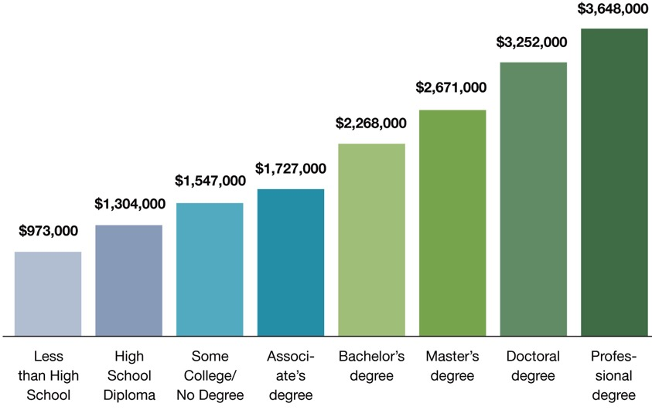
Degree Level Matters People with more education make more money than those with less education
Notes:
This chart shows that, on average, people earn more over their lifetime if they have a higher level of education.
There’s no surprise here.
But the reason I include this chart is to remind you that this chart shows people who are currently employed.
What does chart this say to our students who will be employed five to ten years from now?
Will the chart look different for them?
What if lifetime education costs and student loan interest is figured in? Does that narrow the gap?
What about the cost of business attire, business social expenses, club memberships, and other expenses that might be different at different levels of employment?
What if all of that is figured in?
What about a lifestyle choice?
What does this chart tell our kids about their future?
====
http://cew.georgetown.edu/collegepayoff/
http://www9.georgetown.edu/grad/gppi/hpi/cew/pdfs/collegepayoff-summary.pdf
Page 4, 5
10

Slide 11
Average Starting Salaries for 2009 College Graduates in FL
$47,708 Associate in Science (community college)
$44,558 Bachelor degree (private college)
$39,108 Certificate (community college)
$36,552 Bachelor degree (state college)
Miami Herald - Jan 1, 2011
Notes:
This study in Florida looked at the actual starting salaries of college graduates.
What they discovered was that the community college graduates earned more money than the folks who earned a Bachelor’s degree.
The stark reality is that there is a high demand for jobs - for which you prepare by attending community college.
And those jobs being in high demand, often command surprisingly high salaries.
Compare this slide with the previous slide, and you can see that the data can be very confusing.
The previous slide shows us were we were for past graduates,
this slide shows us were we are now for our current graduates.
I’m about to show you where we will be in the future, which is when our high school students will be employed.
But first, -- let’s look at a few more states.
====
http://www.miamiherald.com/2011/01/01/1996875/study-less-earn-more-at-least.html#ixzz1BP94m3Nj
http://www.miamiherald.com/2011/01/01/1996875/study-less-earn-more-at-least.html
11

Slide 12
Average Starting Salaries for 2005 College Graduates in OH
$35,648 Associate degree
$33,218 Bachelor degree
Notes:
Ohio found similar results when they polled their college graduates.
Associate degree pays more than bachelor degree.
====
http://www.ohiocommunitycolleges.org/public-page.php?s=community-college-facts
12

Slide 13
Average Salaries
TN CC earn $1,300 higher than 4-year grads.
VA CC - occupational and technical degree programs earn $2,500 more than bachelor's.
Notes:
Recent Tennessee Community College graduates earn more than the graduates of the state's four-year institutions.
Similar for Virginia.
I have seen data for several more states that all show that the folks earning a two-year technical degree on average start out making more money than the folks with a four-year degree.
I’m not down on Bachelor degrees,
it’s just that associate degrees have been the Rodney Dangerfield of the education world.
It’s time they get the respect they deserve.
============
http://money.cnn.com/2013/02/26/pf/college/community-college-earnings/index.html
13

Slide 14
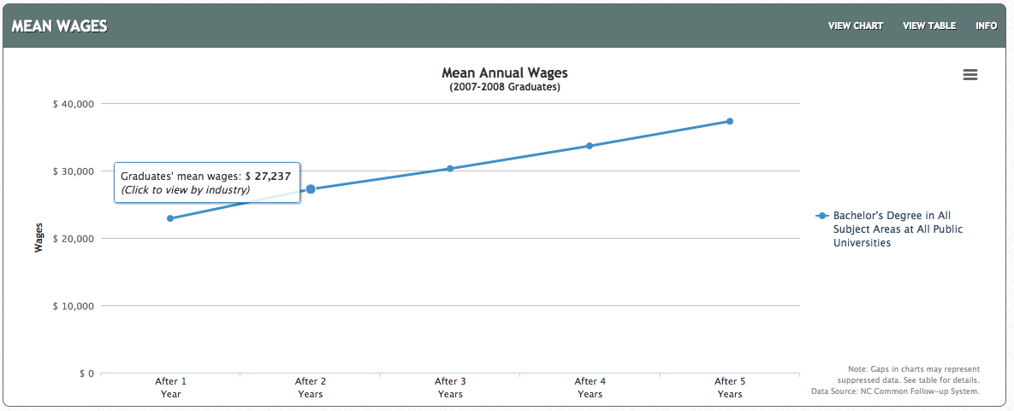
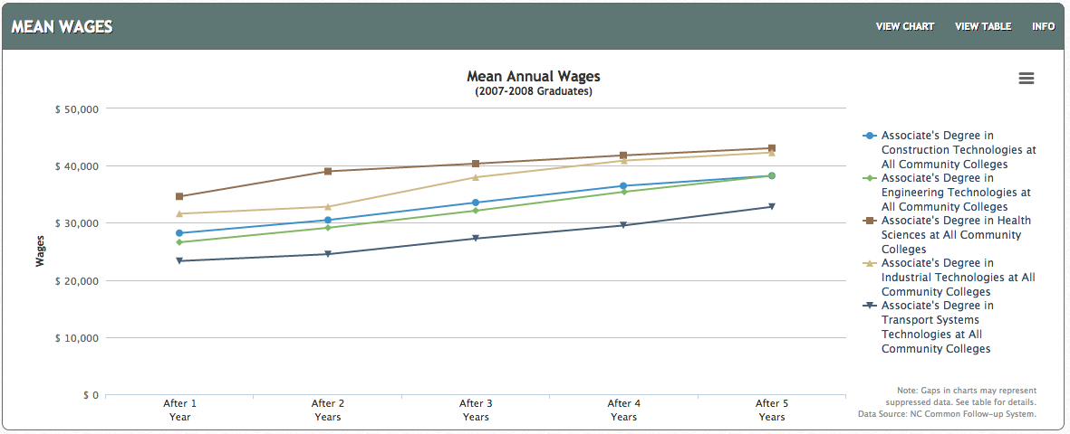
NC Bachelor Degree
NC Associate Degrees
Notes:
And here are the data for North Carolina
On the top you see the first five years of salaries for graduates of North Carolina Bachelor Degree programs.
On the bottom is graduates from Associate Degree programs from our North Carolina Community Colleges.
After five years of working, a bachelor degree graduate in North Carolina earned 37 thousand dollars in 2013.
Whereas an associate degree graduate earned between 32 and 42 thousand dollars depending on the program area.
Health Science and Industrial Technologies are the two programs with the highest wages. Higher than the 4-year degrees.
As I said earlier, the web addresses where you can find all of my data sources is in the Notes section under each slide.
At this website you can break it down by exact degree and college.
====
http://nctower.com/output/unc/7810/
2007-2008 Bachelor Degree graduates from All NC Universities
http://nctower.com/output/ncccs/4840-4946-4797-4887-5059/
2007-2008 graduates from selected Associate Degree programs in NC

Slide 15
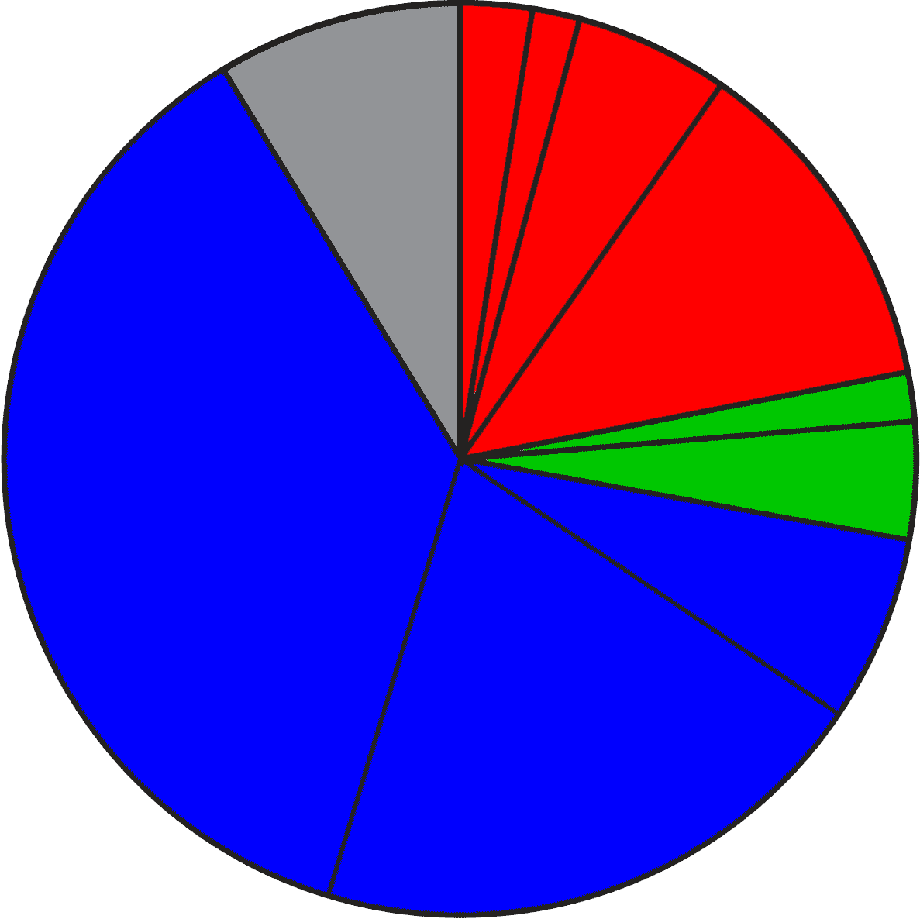
2020 Projected NC Employment: Education Required
Doctorate & Professional degree
work exp.
Master’s degree
8.7%
Bachelor + work exp.
5.5%
Bachelor’s degree
12.3%
1.7%
Associate degree
4.2%
36.6%
1,2 year college
short OJT
6.6%
long OJT
20.2%
moderate OJT
Notes:
Here is the breakdown of the minimum education required for all jobs projected in North Carolina in the year 2020.
The red jobs require four or more years of college.
Green jobs require one or two years of college.
You will notice that the largest portion, in blue, are the jobs that do not require any formal education past high school in order to get the job. They require various amounts of On-The-Job Training.
The 8.7 percent in the gray slice of the pie requires previous work experience.
Think of this as the worker who rises up to become the shop foreman or a manager.
====
NC Employment Security Commission data via www.CareerOutlook.US
http://careeroutlook.us/
These are for all jobs that get a paycheck, not for contracted positions, or small business owners who do not write themselves a paycheck.
NC Projections for 2020
2.54% Doctoral or professional degree
1.68% Master's Degree
5.47% Bachelor's Degree plus work experience
12.25% Bachelor's Degree
1.74% Associate Degree
4.17% One/two years of college
6.59% Long-term on-the-job (OJT) training
20.24% Moderate-term on-the-job (OJT) training
36.6% Short-term on-the-job (OJT) training
8.72% Work experience in a related occupation

Slide 16
2015 NC High School Graduate Intentions
Other
Employment
9.7%
Military
Trade and
Business
Schools
4.6%
Public Senior
Institutions
34.4%
Private
Junior
Colleges
37.2%
Community and
Technical Colleges
10.4%
Private Senior
Institutions
Notes:
And here you see the breakdown of the postsecondary intentions of our North Carolina high school graduates.
The red shows that almost half of our high school graduates say they are going to a four-year college program.
The green is one or two years at a community college, junior college, or trade school.
The blue is joining the military or going directly into employment.
The Other category is the one-and-a-half percent of our recent high school graduates who plan to sit on Mom’s couch the rest of their lives playing Nintendo.
=====
http://www.ncpublicschools.org/fbs/resources/data/
Pupil Information
Table 12.1 High School Graduates by Intentions
NC Public Schools Statistical Profile 2014-2015
Of the 96,846 graduates in the class of 2015, here is where they say they are going after high school.
34.4% Public Senior Institutions
10.4% Private Senior Institutions
37.2% Community/Technical College
0.5% Private Junior College
1.2% Trade/Business School
4.6% Military
9.7% Employment
1.9% Other

Slide 17
Postsecondary Intentions vs. Reality
Graduate Intentions
Education Required
8.7%
OJT
4 year
14.3%
21.9%
4 year
5.9%
44.8%
1-2 year
1-2 year
OJT
38.9%
63.4%
Notes:
Here we can compare these two charts.
On the left is where the students say they are going, and on the right is what kind of education the jobs require.
→almost 45 percent of our students say they are going to a four-year college program, which will prepare them for almost 22 percent of the job openings. Do you see that in the red part of the two charts?
If you do the math, it looks like half of them will be left holding a sheepskin with no job to show for it. We’ll discus that in a few minutes.
→Likewise, in green you see that 39 percent of our high school graduates say they are going to a one- or two-year program at a community college or private training facility.
This prepares them for almost 6 percent of the jobs.
Whether you use old math or new math, you still see that there is some disparity between the number of people going into a postsecondary education program and the number of jobs that will demand that kind of education.
→Though the blue on the right shows that 63 percent of the jobs do not require postsecondary education (that means that you can get any of those blue jobs right out of high school), there are community college and technical school programs for most of these jobs, which means that the education is not required, but in these days of high unemployment, the postsecondary education is preferred, and you will be more likely to get hired, and might start at a higher salary.
=============

Slide 18
Short OJT NC starting salaries - high-projected demand 2024
$26,070 Costume Attendants
$26,020 Loan Interviewers and Clerks
$23,430 Office and Administrative Support Workers, all other
$21,820 Interviewers, Except Eligibility and Loan
$20,550 Healthcare Support Workers, all other
$20,300 Helpers--Brickmasons, Blockmasons, Stonemasons, and Tile and Marble Setters
$20,200 Medical Equipment Preparers
$19,960 Occupational Therapist Aides
$19,450 Helpers--Carpenters
$19,380 Physical Therapist Aides
$18,400 Helpers--Painters, Paperhangers, Plasterers, and Stucco Masons
$18,310 Receptionists and Information Clerks
$17,650 Landscaping and Groundskeeping Workers
$17,290 Helpers--Installation, Maintenance, and Repair Workers
$17,180 Laborers and Freight, Stock, and Material Movers, Hand
$17,060 Helpers--Roofers
$17,020 Nursing Assistants
$16,800 Taxi Drivers and Chauffeurs
$16,750 Veterinary Assistants and Laboratory Animal Caretakers
$16,610 Stock Clerks and Order Fillers
$16,460 Retail Salespersons
$16,420 Cleaners of Vehicles and Equipment
$16,390 Janitors and Cleaners, Except Maids and Housekeeping Cleaners
$16,290 Personal Care Aides
$16,260 Childcare Workers
$16,200 Nonfarm Animal Caretakers
$16,180 Food Preparation Workers
$16,140 Home Health Aides
$16,130 Maids and Housekeeping Cleaners
$16,100 Bartenders
$16,010 Waiters and Waitresses
$15,980 Counter Attendants, Cafeteria, Food Concession, and Coffee Shop
$15,980 Hosts and Hostesses, Restaurant, Lounge, and Coffee Shop
$15,950 Lifeguards, Ski Patrol, and Other Recreational Protective Service Workers
$15,940 Combined Food Preparation and Serving Workers, Including Fast Food
$15,930 Amusement and Recreation Attendants
Notes:
Let’s look at some salaries.
Here you see the jobs that require short on-the-job training, That means you can get one of these jobs right out of high school, and within a month you know all you need to know to do the job.
And this is showing only the jobs projected to be in high demand over the next ten years.
And you see the starting salaries for North Carolina.
Most of these are helper positions. You are typically doing the grunt work for a higher-paid professional.
Many of these are considered starter jobs.
With a little experience and a little more education, you could move up to a higher paying job, and get yourself one of these helpers.
=====
CareerOutlook.us
These are all ”high demand” occupations, projected to have high growth over the 2014-2024 projection period.
Estimated average salary for all entry-level (first-year) workers in this occupation in North Carolina in 2016. Technically it is the annual 10th percentile wage.

Slide 19
Moderate OJT NC starting salaries - high-projected demand 2024
$42,960 Sales Representatives, Wholesale and Manufacturing, Technical and Scientific Products
$28,160 Dental Assistants
$28,000 Insurance Claims and Policy Processing Clerks
$27,000 Sales Representatives, Wholesale and Manufacturing, Except Technical and Scientific Products
$26,360 Computer-Controlled Machine Tool Operators, Metal and Plastic
$25,920 Operating Engineers and Other Construction Equipment Operators
$25,670 Sales Representatives, Services, all other
$25,660 Mechanical Door Repairers
$25,230 Heavy and Tractor-Trailer Truck Drivers
$24,540 Billing and Posting Clerks and Machine Operators
$24,070 Insulation Workers, Floor, Ceiling, and Wall
$23,540 Cement Masons and Concrete Finishers
$23,290 Ambulance Drivers and Attendants, Except Emergency Medical Technicians
$23,250 Painters, Construction and Maintenance
$22,580 Maintenance and Repair Workers, General
$22,490 Medical Assistants
$22,300 Roofers
$19,920 Social and Human Service Assistants
$19,640 Pharmacy Technicians
$18,870 Customer Service Representatives
$18,220 Floor Layers, Except Carpet, Wood, and Hard Tiles
$18,080 Construction Laborers
$17,660 Assemblers and Fabricators, all other
$16,860 Cooks, Institution and Cafeteria
Notes:
Moderate on-the-job training means you need more than a month training, but within a year, you are ready to work by yourself.
=====
CareerOutlook.us
These are all ”high demand” occupations, projected to have high growth over the 2014-2024 projection period.
Estimated average salary for all entry-level (first-year) workers in this occupation in North Carolina in 2016. Technically it is the annual 10th percentile wage.

Slide 20
Long OJT NC starting salaries - high-projected demand 2024
$36,570 Compliance Officers
$31,910 Electrical Power-Line Installers and Repairers
$30,470 Electricians
$29,900 Computer Numerically Controlled Machine Tool Programmers, Metal and Plastic
$28,560 Industrial Machinery Mechanics
$28,190 Plumbers, Pipefitters, and Steamfitters
$25,700 Heating, Air Conditioning, and Refrigeration Mechanics and Installers
$25,530 Opticians, Dispensing
$25,180 Brickmasons and Blockmasons
$24,040 Machinists
$22,880 Carpenters
$21,930 Medical Appliance Technicians
$20,360 Firefighters
$17,070 Coaches and Scouts
$16,460 Cooks, Restaurant
Notes:
Long on-the-job training means you can get these jobs right out of high school, but it will take on-the-job training for over a year to get you completely trained.
Most of these jobs have training programs at our community colleges. Which means you could get the training first, and then probably start at a higher salary.
=====
CareerOutlook.us
These are all ”high demand” occupations, projected to have high growth over the 2014-2024 projection period.
Estimated average salary for all entry-level (first-year) workers in this occupation in North Carolina in 2016. Technically it is the annual 10th percentile wage.

Slide 21
1-2 Year Diploma/Certificate NC starting salaries - high-projected demand 2024
$32,680 Licensed Practical and Licensed Vocational Nurses
$31,820 Surgical Technologists
$28,100 Bus and Truck Mechanics and Diesel Engine Specialists
$25,020 Real Estate Sales Agents
$24,840 Health Technologists and Technicians, all other
$22,930 Medical Secretaries
$22,200 Emergency Medical Technicians and Paramedics
$19,040 Massage Therapists
$18,110 Preschool Teachers, Except Special Education
$17,880 Fitness Trainers and Aerobics Instructors
$16,660 Hairdressers, Hairstylists, and Cosmetologists
Notes:
These jobs require one or two years at a community college or other training school.
You might end up with a diploma or a certificate, but not an Associate degree.
The starting salaries are not much better than the jobs that do not require any college work.
Some of these require a state license in order to work in these occupations.
=====
CareerOutlook.us
These are all ”high demand” occupations, projected to have high growth over the 2014-2024 projection period.
Estimated average salary for all entry-level (first-year) workers in this occupation in North Carolina in 2016. Technically it is the annual 10th percentile wage.

Slide 22
Associate Degree NC starting salaries - high-projected demand 2024
$55,360 Radiation Therapists
$51,330 Dental Hygienists
$51,000 Diagnostic Medical Sonographers
$45,110 Cardiovascular Technologists and Technicians
$43,280 Registered Nurses
$43,120 Physical Therapist Assistants
$41,720 Respiratory Therapists
$40,170 Radiologic Technologists
$39,560 Occupational Therapist Assistants
$29,260 Medical and Clinical Laboratory Technicians
$28,210 Computer User Support Specialists
$26,430 Paralegals and Legal Assistants
$23,180 Medical Records and Health Information Technicians
$21,430 Veterinary Technologists and Technicians
Notes:
Here is where you see the jump in salaries.
These are the jobs that are predicted to be in high-demand that require an Associate Degree, which is a two-year degree program at a community college or technical school.
(;-) Who is wishing they saw this chart before deciding to become a teacher????
Note that most of these occupations are the “helping” or “assisting”-type jobs in the Healthcare industry.
All of the “assisting”-type jobs in the Healthcare industry are in high demand, -- were in high demand throughout the recent recession, -- and should stay in high demand for many years to come -- to help support the aging baby boomers.
The starting salary for public school teachers in North Carolina is $35,000. Think about the difference in repaying student loans for these two. Four years at a state university costs ten times as much as a two-year degree.
=====
CareerOutlook.us
These are all ”high demand” occupations, projected to have high growth over the 2014-2024 projection period.
Estimated average salary for all entry-level (first-year) workers in this occupation in North Carolina in 2016. Technically it is the annual 10th percentile wage.

Slide 23
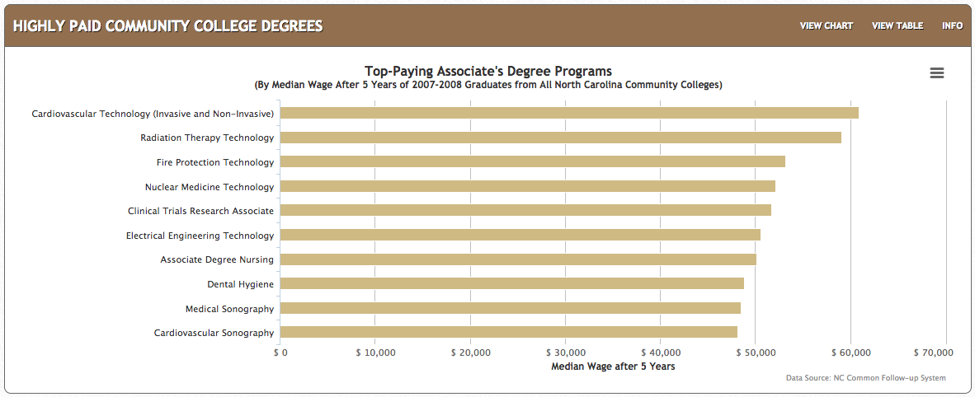
Top-Paying Associate Degrees – NC 2013
Notes:
Here are the actual salaries for Associate Degree graduates from our North Carolina Community Colleges.
These are the highest paying jobs, five years after graduation.
- Cardiovascular Technicians making almost 61 thousand dollars, and the
- Radiation Therapy Techs making 59 thousand dollars.
Keep an eye on the last two on this list. I predict an increasing demand for Sonographers -- as the industry is finding more uses for this technology, -- and it’s not just in health care.
====
http://nctower.com/
2007-2008 graduates from All NC Community Colleges

Slide 24
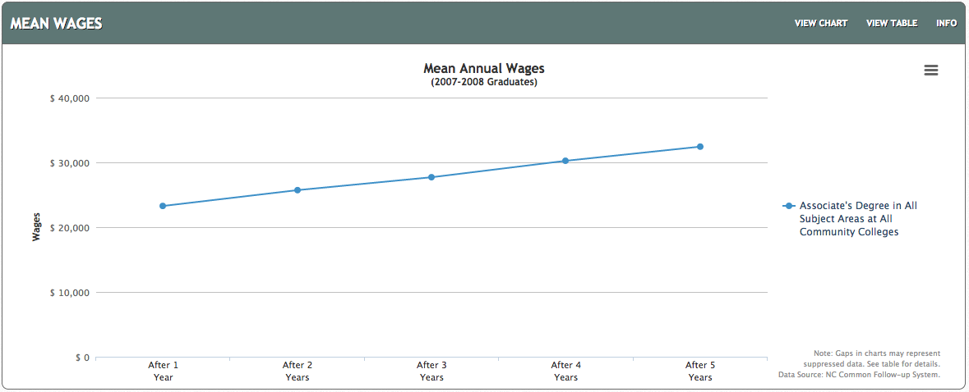
All NC Associate Degrees - 2007-2008 Graduates
Notes:
Average wage the first year out of college with a North Carolina Associate Degree is about 23 thousand dollars.
After 5 years, the average is about 32 thousand dollars.
That’s really good.
====
http://nctower.com/output/ncccs/4506/2008/
2007-2008 graduates from all Associate Degree programs in NC

Slide 25
Selected Associate Degrees – NC 2013
Notes:
And here are the salaries for some specific technical program areas.
Five years out of college, the average salary for all Associate Degree graduates in Health Sciences and Industrial Technologies is about 42 thousand dollars.
Transport Systems is the low line on this chart making almost 33 thousand dollars after five years of work.
====
http://nctower.com/output/ncccs/4840-4946-4797-4887-5059/
2007-2008 graduates from selected Associate Degree programs in NC
The five year mark is the year 2013.

Slide 26
Bachelor Degree NC starting salaries - high-projected demand 2024
$74,810 Physician Assistants
$69,540 Software Developers, Systems Software
$59,960 Electrical Engineers
$58,600 Software Developers, Applications
$54,450 Computer Systems Analysts
$53,130 Mechanical Engineers
$52,280 Civil Engineers
$52,060 Occupational Therapists
$49,600 Financial Analysts
$49,430 Biomedical Engineers
$49,140 Financial Examiners
$46,660 Network and Computer Systems Administrators
$45,660 Personal Financial Advisors
$45,650 Technical Writers
$43,720 Credit Analysts
$42,880 Accountants and Auditors
$42,260 Medical and Clinical Laboratory Technologists
$38,760 Business Operations Specialists, all other
$38,500 Cartographers and Photogrammetrists
$38,250 Property, Real Estate, and Community Association Managers
$34,980 Training and Development Specialists
$34,900 Healthcare Social Workers
$34,270 Human Resources Specialists
$33,780 Orthotists and Prosthetists
$33,120 Loan Officers
$32,150 Public Relations Specialists
$31,080 Securities, Commodities, and Financial Services Sales Agents
$30,960 Therapists, all other
$28,160 Athletic Trainers
$27,470 Credit Counselors
$24,690 Insurance Sales Agents
$17,790 Religious Workers, all other
$16,610 Recreation Workers
Notes:
And now the Bachelor's degree – a four-year degree program at a college or university is required to get these jobs.
And this is showing only the jobs projected to be in high demand
The starting salaries are a little higher than most Associate degrees, but not all.
=====
CareerOutlook.us
These are all ”high demand” occupations, projected to have high growth over the 2014-2024 projection period.
Estimated average salary for all entry-level (first-year) workers in this occupation in North Carolina in 2016. Technically it is the annual 10th percentile wage.

Slide 27
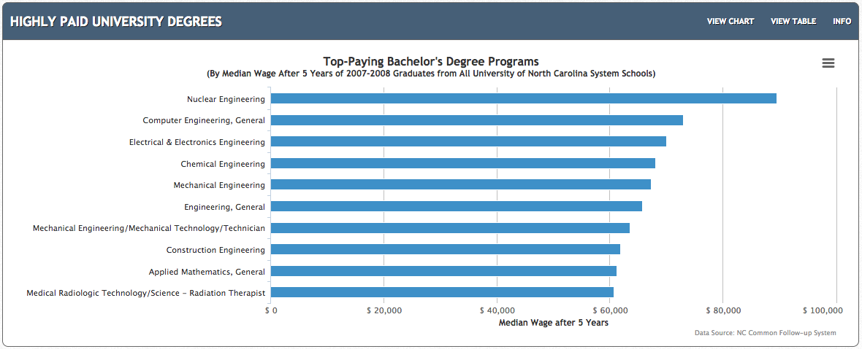
Top-Paying Bachelor Degrees – NC 2013
Notes:
Here are the actual salaries for Bachelor Degree graduates from our NC Public Universities.
These are the average salaries after working for five years. This is the actual salaries, not just a projection.
In 2013, Nuclear Engineering was the highest paying at 89 and a half thousand dollars.
You see lots of Engineers on this list because the pay is good, but how about the chances of getting a job?
We will look at that in a minute.
====
http://nctower.com/
2007-2008 graduates from All NC Universities

Slide 28
All NC Bachelor Degrees 2007-2008 graduates
Notes:
For the folks who graduated with a Bachelor’s Degree from a North Carolina Public University in 2007-2008,
the average salary after five years of work is just above 37 thousand dollars.
====
http://nctower.com/output/unc/7810/
2007-2008 Bachelor Degree graduates from All NC Universities

Slide 29
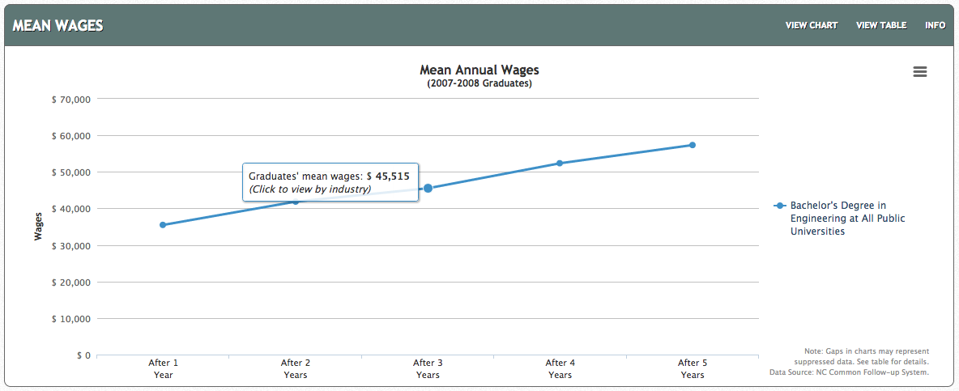
NC Engineering Bachelor Degree 2007-2008 Graduates
Notes:
And if you look at just the graduates with a Bachelor’s Degree in Engineering,
They started working at just 35 thousand dollars, and after five years jumped to 57 thousand dollars.
Later on we will see how only half of these graduates are getting a regular paycheck.
====
http://nctower.com/output/unc/7901/
2007-2008 Bachelor Degree, Engineering graduates from All NC Universities

Slide 30
Bachelor Degree + Work NC starting salaries - high-projected demand 2024
$81,360 Computer and Information Systems Managers
$74,030 Financial Managers
$73,370 Marketing Managers
$68,970 Human Resources Managers
$67,540 Medical and Health Services Managers
$59,900 Construction Managers
$59,090 Sales Managers
$59,000 Administrative Services Managers
$56,510 General and Operations Managers
$56,190 Actuaries
$43,420 Management Analysts
Notes:
These occupations require a Bachelor's degree plus previous work experience.
You don’t get these jobs right out of college, you have to work up to them.
=====
CareerOutlook.us
These are all ”high demand” occupations, projected to have high growth over the 2014-2024 projection period.
Estimated average salary for all entry-level (first-year) workers in this occupation in North Carolina in 2016. Technically it is the annual 10th percentile wage.

Slide 31
Masters Degree NC starting salaries - high-projected demand 2024
$58,530 Physical Therapists
$54,750 Statisticians
$53,150 Audiologists
$45,110 Speech-Language Pathologists
$42,150 Operations Research Analysts
$40,460 Environmental Scientists and Specialists, Including Health
$35,280 Market Research Analysts and Marketing Specialists
$35,260 Health Specialties Teachers, Postsecondary
$33,870 Educational, Guidance, School, and Vocational Counselors
$32,770 Mental Health and Substance Abuse Social Workers
$32,680 Mental Health Counselors
$31,660 Substance Abuse and Behavioral Disorder Counselors
$28,280 Survey Researchers
Notes:
These occupations require a Master’s Degree. That’s two more years beyond a Bachelor’s Degree,
But the salaries you see here are mostly lower than the occupations that require only a bachelor’s degree, and similar to the starting salaries for occupations that require only an Associate degree.
It does not always make sense.
Sometimes higher education does not mean higher salary. This is why your students need to explore these data to see what occupation meets all of their desires.
=====
CareerOutlook.us
These are all ”high demand” occupations, projected to have high growth over the 2014-2024 projection period.
Estimated average salary for all entry-level (first-year) workers in this occupation in North Carolina in 2016. Technically it is the annual 10th percentile wage.

Slide 32
Doctorate/Professional Degree NC starting salaries - high-projected demand 2024
>$187,200 Oral and Maxillofacial Surgeons
>$187,200 Surgeons
>$187,200 Anesthesiologists
$142,350 Orthodontists
$118,090 Psychiatrists
$100,460 Pharmacists
$90,210 Dentists, General
$66,280 Optometrists
$56,830 Physicians and Surgeons, all other
$52,660 Medical Scientists, Except Epidemiologists
$46,490 Law Teachers, Postsecondary
$45,520 Lawyers
$45,270 Nursing Instructors and Teachers, Postsecondary
$40,760 Clinical, Counseling, and School Psychologists
$40,660 Criminal Justice and Law Enforcement Teachers, Postsecondary
$26,850 Clergy
Notes:
These occupations require a Doctorate or Professional Degree. Similar coursework, but some industries call it Doctorate, and some industries call it Professional Degree.
The federal government does not report salaries above 187 thousand dollars, so that is why you see the greater-than symbol.
Some of these high-demand occupations pay less than the occupations requiring an Associate Degree,
but they have the potential to raise much higher over the course of a career.
=====
CareerOutlook.us
These are all ”high demand” occupations, projected to have high growth over the 2014-2024 projection period.
Estimated average salary for all entry-level (first-year) workers in this occupation in North Carolina in 2016. Technically it is the annual 10th percentile wage.

Slide 33
Postsecondary Enrollment
Fall 2014 – 20.7 million undergraduate and graduate students in USA.
65.3% enrolled in 4-year institutions
33.1% enrolled in 2-year institutions
1.6% enrolled in less-than-2-year institutions
US College Enrollment
43.3% Men
56.7% Women
US Census
49.2% Men
50.8% Women
Notes:
33
These data show that almost twice as many folks are going to a four-year college than a two-year college.
But what I have been showing you on the last few slides seems to indicate that many of the four-year graduates will be left holding a sheepskin, -- but have no job.
And as an aside –
Where are our men? Why are they not in college?
That’s almost a 15 percent difference between the college enrollment of men verses women.
Compare that to the census data
The difference between men and women enrollment in postsecondary education is 10 times the difference in the census data.
Are they staying at home raising families rather than going to college?
-- Just another thing to consider.
======
National Center for Education statistics, U.S. Department of Education (nces.ed.gov)
2014 data
“Enrollment and Employees in Postsecondary Institutions, Fall 2014; and Financial Statistics and Academic Libraries, Fiscal Year 2014”
http://nces.ed.gov/pubs2016/2016005.pdf
Table 1. Number and percentage of students enrolled at Title IV institutions, by control of institution, student level, and other selected characteristics: United States, fall 2014
Census data
http://www.census.gov/prod/cen2010/briefs/c2010br-03.pdf

Slide 34
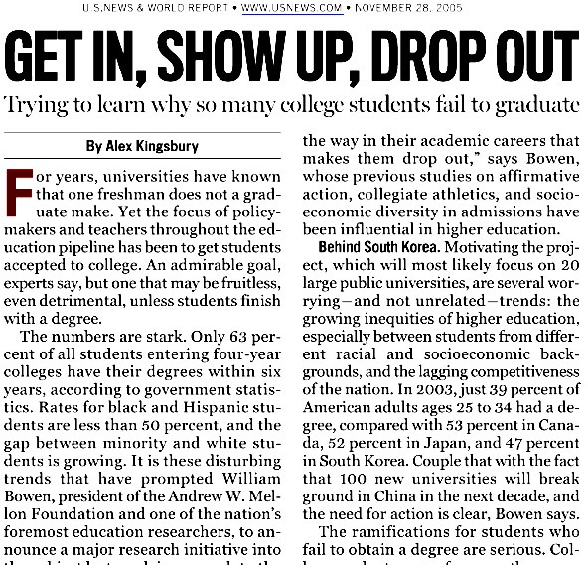
57.2% of bachelor’s-seeking students get degree in 6 years (36.4% in 4 years)
31.4% of degree or certificate-seeking students at 2-year institution get degree in 3 years (18.9% in 2 years)
Notes:
34
Too many folks go to college and never complete their degree.
→Almost half of the folks who start a four-year college program will drop out -- or take a lot longer than 4 years. (like me)
These are our national statistics.
→Similarly, less than a third of the folks who start a certificate or associate degree complete their certificate or degree in three years.
======
http://www.usnews.com/usnews/news/articles/051128/28bowen.htm
National Center for Education statistics, U.S. Department of Education (nces.ed.gov)
“Enrollment in Postsecondary Institutions, Fall 2008; Graduation Rates, 2002 & 2005 Cohorts; and Financial Statistics, Fiscal Year 2008”
http://nces.ed.gov/pubs2010/2010152rev.pdf
----
GRS=150 percent of normal completion time
GR200=200 percent of normal completion time
The 2009 Graduation Rates (GRS) component collected counts of full-time, first-time10 degree/certificate-seeking undergraduate students beginning college in the reference period, and their completion status as of August 31, 2008 (150 percent of normal program completion time) at the same institution where the students started. Four-year institutions use cohort year 2002 as the reference period, while less-than-4-year institutions use cohort year 2005 as the reference period. For 4-year institutions operating on standard academic terms (semester, trimester, quarter), students beginning in cohort year 2002 are those that first attended college in the fall of the 2002-03 academic year. For 4-year institutions operating on other than standard academic terms, students beginning in cohort year 2002 are those that first attended college between September 1, 2002 and August 31, 2003. Similarly, for less-than-4-year institutions operating on standard academic terms (semester, trimester, quarter), students beginning in cohort year 2005 are those that first attended college in the fall of the 2005-06 academic year. For less-than-4-year institutions operating on other than standard academic terms, students beginning in cohort year 2005 are those that first attended college between September 1, 2005 and August 31, 2006. The GRS component was required of all Title IV institutions that had full-time, first-time degree/certificate-seeking undergraduate students in the reference period. For this collection, 6,009 institutions in the United States and other jurisdictions were required to respond; of these, 5,989, or 99.7 percent, responded. Of the institutions in the United States (excluding any other jurisdictions), 5,865 were required to complete this component and 5,845, or 99.7 percent, responded.

Slide 35
North Carolina 6-year Graduation Rate – 2008
57.6% average
Notes:
35
Here’s a chart that shows the graduation rate for all of the four-year colleges in North Carolina
Almost half of the students that we send to a four-year college program in North Carolina will drop out or take longer than 6 years to complete. (repeat)
It took me 11 years to complete my four-year degree.
Duke’s graduation rate, on the far left, is very high, but they are also very picky about who they let in.
One drawback to this data is that it is showing how many start a four-year program and complete it within six years at the same institution.
Some of the smaller, private colleges have low graduation rates because students might start there, and then transfer to a larger state university.
This counts as a negative where the student started, and does not count at all where the student completed their degree.
Anytime you look at data, you have to take time to truly understand them, -- so you don’t jump to the wrong conclusion.
The main point I want to make here is that when we send someone to a four-year college, we need to make sure that they are truly ready for the work -- and are in the right education program for their chosen career pathway.
====
www.collegeresults.org
Average 57.6% for all NC undergraduates listed

Slide 36
It makes you think?
What happens to our 4-year program dropouts?
25% of all students in Community College have a 4-year degree.
Notes:
36
So, what happens to our college dropouts?
Remember that almost 50 percent do not complete their 4-year degree in 6 years.
Do they come back to high school – and say “That didn’t work out. What should I try next?”
How often has that happened to you?
Anybody ???
Probably not often, if at all.
→Many university graduates are going to community colleges to get the specific training they need for a job.
I’m not saying that four-year degrees are not important… But for career purposes, (especially entry-level) it may not always be the best choice.
Wake Tech, Our state’s largest Community College claims to be the largest graduate school in North Carolina based on the number of students they have who already have a four-year degree.

Slide 37
Surprises Future Demand Changing World New Ideas
www.ncPerkins.org/presentations
Notes:
Now --- let’s look towards the future.
Unfortunately I don’t have a budget code for a crystal ball, so I have to divine the future using Google.

Slide 38
Notes:
38
Last year was 2015, -- the year to which Marty McFly traveled in Back to the Future part 2.
How well did they predict the future?
For one thing -- The Hover Boards of today are nothing like the Hover Boards in the movie.
Today’s Hover Boards don’t really hover, they have wheels.
And Marty McFly never worried that his Hover Board would catch fire.
========
http://static6.businessinsider.com/image/54a8b647ecad040d3b68d5bc-1200/we-also-dont-have-automatic-dog-walkers-to-take-sparky-for-a-stroll-around-the-block.jpg
http://25.media.tumblr.com/tumblr_m13y12wUqk1qf7kwgo1_500.jpg
http://boxofficescoop.first.netdna-cdn.com/wp-content/uploads/2014/03/back-to-the-future-hoverboard.jpg
admintell.napco.com/ee/images/uploads/gadgetell/delorean-external-harddrive-02-640.jpg
https://sp.yimg.com/ib/th?id=HN.607990799156251306&pid=15.1&P=0
http://mentalfloss.com/sites/default/files/hill-valley.png
https://www.screenused.com/images/auction_nov13/13946_5.jpg

Slide 39
If we really want to prepare our students for successful careers, we need to know all we can about the rapidly changing job market.
Emil Barnabas
Notes:
39
The job market has changed considerably from when we graduated from high school.
People get most of their career guidance from their parents.
But, -- do our parents keep up with the rapidly changing job market?
What do the parents of our students know about bioinformatics and nanotechnology?
====
Emil Barnabas

Slide 40
Fastest Growing Occupations in NC Requiring Postsecondary Education (Total Change in Positions Projected from 2014 - 2024)
20,320 Registered Nurses
7,970 General and Operations Managers
5,550 Accountants and Auditors
4,990 Computer Systems Analysts
4,700 Software Developers, Applications
4,410 Carpenters
3,950 Business Operations Specialists, All Other
3,900 Market Research Analysts and Marketing Specialists
3,670 Management Analysts
3,320 Computer User Support Specialists
3,260 Elementary School Teachers, Except Special Education
3,150 Computer and Information Systems Managers
2,940 Financial Managers
2,800 Licensed Practical and Licensed Vocational Nurses
2,750 Personal Financial Advisors
2,530 Loan Officers
2,520 Automotive Service Technicians and Mechanics
2,510 Medical Secretaries
2,480 Electricians
2,290 Dental Assistants
2,270 Medical and Clinical Laboratory Technicians
2,260 Clergy
2,240 Physicians and Surgeons, All Other
2,130 Emergency Medical Technicians and Paramedics
2,040 Industrial Machinery Mechanics
Notes:
40
Not counting the occupations that require less than a year of on-the-job-training (OJT),
here are the high-demand occupations in North Carolina that require some kind of postsecondary education.
The number listed is the projected change in the number of positions in North Carolina over the ten-year projection period.
Does that top number stand out a little?
More about that on the next slide.
=========
These data are from www.CareerOutlook.US
http://www.bls.gov/emp/ep_table_112.htm
Education and training assignments
updated January 13, 2012

Slide 41
Fastest Growing Occupations in NC (Total Change in Positions Projected from 2014 - 2024)
29,310 Combined Food Preparation and Serving Workers, Including Fast Food
20,320 Registered Nurses
19,930 Retail Salespersons
16,840 Home Health Aides
15,190 Customer Service Representatives
13,510 Nursing Assistants
9,360 Waiters and Waitresses
9,080 Cooks, Restaurant
8,170 Laborers and Freight, Stock, and Material Movers, Hand
8,000 Cashiers
7,970 General and Operations Managers
6,560 Office Clerks, General
6,480 First-Line Supervisors of Office and Administrative Support Workers
6,430 First-Line Supervisors of Food Preparation and Serving Workers
6,080 Janitors and Cleaners, Except Maids and Housekeeping Cleaners
5,950 Stock Clerks and Order Fillers
5,820 Heavy and Tractor-Trailer Truck Drivers
5,550 Accountants and Auditors
5,520 First-Line Supervisors of Retail Sales Workers
5,230 Secretaries and Administrative Assistants, Except Legal, Medical, and Executive
4990 Computer Systems Analysts
4990 Construction Laborers
4850 Childcare Workers
4810 Landscaping and Groundskeeping Workers
4800 Maids and Housekeeping Cleaners
4780 Receptionists and Information Clerks
4700 Software Developers, Applications
4680 Sales Representatives, Wholesale and Manufacturing, Except Technical and Scientific Products
4540 Maintenance and Repair Workers, General
4470 First-Line Supervisors of Construction Trades and Extraction Workers
4410 Carpenters
3950 Business Operations Specialists, All Other
3950 Personal Care Aides
3900 Market Research Analysts and Marketing Specialists
3670 Management Analysts
3620 Medical Assistants
3400 Team Assemblers
3320 Computer User Support Specialists
3260 Elementary School Teachers, Except Special Education
3150 Computer and Information Systems Managers
3020 Managers, All Other
3020 Sales Representatives, Services, All Other
2940 Financial Managers
2900 Food Preparation Workers
2800 Licensed Practical and Licensed Vocational Nurses
2750 Personal Financial Advisors
2680 Teacher Assistants
2640 Packers and Packagers, Hand
2550 Billing and Posting Clerks
2540 Pharmacy Technicians
2530 Loan Officers
2520 Automotive Service Technicians and Mechanics
2510 Medical Secretaries
2480 Electricians
2290 Dental Assistants
2270 Counter Attendants, Cafeteria, Food Concession, and Coffee Shop
2270 Medical and Clinical Laboratory Technicians
2270 Security Guards
2260 Clergy
2240 Physicians and Surgeons, All Other
2140 Bartenders
2130 Emergency Medical Technicians and Paramedics
2040 Industrial Machinery Mechanics
2030 Amusement and Recreation Attendants
Notes:
41
Here I have added to the list the short and moderate on-the-job-training occupations in green so you can compare their demand with the others.
Thus the green jobs are the ones you can get right out of high school, whereas the blue ones require some college or postsecondary work.
This list shows all occupations in North Carolina that require the most new workers projected through 2020.
That’s the burger flippers at the top of the list. Lots of restaurants, lots of hungry customers, and lots of turnover.
Only one occupation on this list requires a 4-year degree! There are some more if you scroll past the bottom of the screen, which you can do when you download the PowerPoint file.
In 2024, North Carolina will need 20,320 more registered nurses than we had in 2014.
From Where will they all come?
Tell your students: “If you don’t know what you want to be when you grow up, -- consider nursing.”
--------
These data are from www.CareerOutlook.US

Slide 42
Fastest Growing Occupations in NC (Percent Change in Positions Projected from 2014 - 2024)
45.8 Statisticians
43.0 Credit Counselors
42.6 Cartographers and Photogrammetrists
39.7 Operations Research Analysts
39.4 Nurse Practitioners
39.1 Personal Financial Advisors
38.5 Orthotists and Prosthetists
38.2 Helpers--Brickmasons, Blockmasons, Stonemasons, and Tile and Marble Setters
37.9 Occupational Therapy Assistants
35.9 Hearing Aid Specialists
35.1 Physical Therapist Assistants
34.8 Physician Assistants
34.7 Home Health Aides
34.5 Biomedical Engineers
33.8 Diagnostic Medical Sonographers
33.4 Physical Therapist Aides
33.1 Phlebotomists
32.6 Veterinary Technologists and Technicians
32.2 Cardiovascular Technologists and Technicians
31.9 Occupational Therapy Aides
31.8 Web Developers
31 Brickmasons and Blockmasons
30.8 Electrical Power-Line Installers and Repairers
29.4 Taxi Drivers and Chauffeurs
29.1 Physical Therapists
29 Medical and Clinical Laboratory Technicians
28.9 Computer Systems Analysts
28.6 Market Research Analysts and Marketing Specialists
28.6 Mathematicians
28.1 Information Security Analysts
27.8 Health Technologists and Technicians, All Other
27.6 Therapists, All Other
27.4 Mental Health and Substance Abuse Social Workers
27.4 Helpers--Roofers
27.3 Costume Attendants
27.2 Audiologists
27.1 Mental Health Counselors
27.1 Actuaries
150 in 2014 :: 50 increase
48,520 in 2014 :: 16,840 increase
Notes:
42
Here you see the projected percentage change over the same ten-year period.
Sometimes you might have a small number of workers in a particular occupation, but the percentage change might be high, which means that the industry is expanding.
→ For example: There were only 150 Hearing Aid Specialists in North Carolina in 2014, so a 35.9 percent increase is an additional 50 positions.
But -- Compare that with the Home Health Aides with over 48 thousand positions in 2014, so a 34.7 percent increase is an additional 17 thousand positions.
When looking at the job projections, You need to look at both the numbers of positions and the percentage increase.
========
These data are from www.CareerOutlook.US

Slide 43
Fastest Declining Occupations in NC (Total Change in Positions Projected from 2014 - 2024)
-7,970 Farmers, Ranchers, and Other Agricultural Managers
-1,790 Farmworkers and Laborers, Crop, Nursery, and Greenhouse
-1,720 Bookkeeping, Accounting, and Auditing Clerks
-1,270 Postal Service Mail Carriers
-1,180 Farmworkers, Farm, Ranch, and Aquacultural Animals
-1,110 Switchboard Operators, Including Answering Service
-850 Molding, Coremaking, and Casting Machine Setters, Operators, and Tenders, Metal and Plastic
-780 Cutting, Punching, and Press Machine Setters, Operators, and Tenders, Metal and Plastic
-720 Postal Service Mail Sorters, Processors, and Processing Machine Operators
-580 Sewing Machine Operators
-530 Extruding and Drawing Machine Setters, Operators, and Tenders, Metal and Plastic
-520 Textile Knitting and Weaving Machine Setters, Operators, and Tenders
-500 Printing Press Operators
-480 Textile Winding, Twisting, and Drawing Out Machine Setters, Operators, and Tenders
-420 Cooks, Fast Food
-380 Executive Secretaries and Executive Administrative Assistants
-360 Mail Clerks and Mail Machine Operators, Except Postal Service
-350 Extruding, Forming, Pressing, and Compacting Machine Setters, Operators, and Tenders
-300 Grinding, Lapping, Polishing, and Buffing Machine Tool Setters, Operators, and Tenders, Metal and Plastic
-280 Extruding and Forming Machine Setters, Operators, and Tenders, Synthetic and Glass Fibers
-260 Paper Goods Machine Setters, Operators, and Tenders
-250 Lathe and Turning Machine Tool Setters, Operators, and Tenders, Metal and Plastic
-240 Postal Service Clerks
-230 Furnace, Kiln, Oven, Drier, and Kettle Operators and Tenders
-220 Welding, Soldering, and Brazing Machine Setters, Operators, and Tenders
-220 Prepress Technicians and Workers
-220 Photographic Process Workers and Processing Machine Operators
-210 Computer Operators
-200 Office Machine Operators, Except Computer
-180 Print Binding and Finishing Workers
-180 Reporters and Correspondents
-170 Tire Builders
-170 Food and Tobacco Roasting, Baking, and Drying Machine Operators and Tenders
-160 Textile Bleaching and Dyeing Machine Operators and Tenders
-160 Radio and Television Announcers
-140 Power Plant Operators
-140 Travel Agents
-140 Forging Machine Setters, Operators, and Tenders, Metal and Plastic
-140 Electronic Equipment Installers and Repairers, Motor Vehicles
-130 Insurance Underwriters
-130 Meter Readers, Utilities
-120 Graders and Sorters, Agricultural Products
-120 Milling and Planing Machine Setters, Operators, and Tenders, Metal and Plastic
-120 Plating and Coating Machine Setters, Operators, and Tenders, Metal and Plastic
-110 First-Line Supervisors of Farming, Fishing, and Forestry Workers
-110 Word Processors and Typists
-100 Probation Officers and Correctional Treatment Specialists
-100 Tool and Die Makers
-90 Data Entry Keyers
-90 Highway Maintenance Workers
-80 Order Clerks
-80 Surveying and Mapping Technicians
-80 Drilling and Boring Machine Tool Setters, Operators, and Tenders, Metal and Plastic
-70 Procurement Clerks
-70 Fallers
-70 Postmasters and Mail Superintendents
-60 Correctional Officers and Jailers
-60 Coin, Vending, and Amusement Machine Servicers and Repairers
-60 Cutters and Trimmers, Hand
-60 Tool Grinders, Filers, and Sharpeners
-60 Heat Treating Equipment Setters, Operators, and Tenders, Metal and Plastic
-60 Metal Workers and Plastic Workers, All Other
-50 Telecommunications Equipment Installers and Repairers, Except Line Installers
-50 Pressers, Textile, Garment, and Related Materials
-50 Floral Designers
-50 Broadcast Technicians
-50 Rolling Machine Setters, Operators, and Tenders, Metal and Plastic
-50 Locksmiths and Safe Repairers
-50 Desktop Publishers
-50 Manufactured Building and Mobile Home Installers
-40 Police, Fire, and Ambulance Dispatchers
-40 Textile, Apparel, and Furnishings Workers, All Other
-40 Jewelers and Precious Stone and Metal Workers
-30 Cutting and Slicing Machine Setters, Operators, and Tenders
-30 Separating, Filtering, Clarifying, Precipitating, and Still Machine Setters, Operators, and Tenders
-30 Chemical Equipment Operators and Tenders
-30 Editors
-30 Mechanical Drafters
-30 Agricultural Equipment Operators
-20 File Clerks
-20 Tax Examiners and Collectors, and Revenue Agents
-20 Conveyor Operators and Tenders
-20 Chemical Plant and System Operators
-20 Molders, Shapers, and Casters, Except Metal and Plastic
-20 Tailors, Dressmakers, and Custom Sewers
-20 Textile Cutting Machine Setters, Operators, and Tenders
-20 Forest and Conservation Technicians
-20 Nuclear Technicians
-20 Agricultural Inspectors
-20 Crushing, Grinding, and Polishing Machine Setters, Operators, and Tenders
-20 Administrative Law Judges, Adjudicators, and Hearing Officers
-20 Foundry Mold and Coremakers
-20 Pourers and Casters, Metal
-10 Woodworking Machine Setters, Operators, and Tenders, Except Sawing
-10 Electrical and Electronics Repairers, Powerhouse, Substation, and Relay
-10 Biological Scientists, All Other
-10 Labor Relations Specialists
-10 Credit Authorizers, Checkers, and Clerks
-10 Social Workers, All Other
-10 Air Traffic Controllers
-10 Fabric and Apparel Patternmakers
-10 Sewers, Hand
-10 Statistical Assistants
-10 Fish and Game Wardens
-10 Fabric Menders, Except Garment
-10 Log Graders and Scalers
-10 Correspondence Clerks
-10 Home Economics Teachers, Postsecondary
-10 Travel Guides
-10 Respiratory Therapy Technicians
-10 Motion Picture Projectionists
-10 Model Makers, Metal and Plastic
-10 Parking Enforcement Workers
0 Pile-Driver Operators
0 Explosives Workers, Ordnance Handling Experts, and Blasters
0 Mining and Geological Engineers, Including Mining Safety Engineers
0 Choreographers
0 Refractory Materials Repairers, Except Brickmasons
0 Agricultural Engineers
0 Rail-Track Laying and Maintenance Equipment Operators
0 Transit and Railroad Police
0 Musical Instrument Repairers and Tuners
0 Petroleum Pump System Operators, Refinery Operators, and Gaugers
0 Sociologists
0 Museum Technicians and Conservators
0 Dentists, All Other Specialists
0 Gas Plant Operators
0 Nuclear Power Reactor Operators
0 Atmospheric and Space Scientists
0 Legal Secretaries
0 Drafters, All Other
0 Aircraft Cargo Handling Supervisors
0 Historians
0 Pump Operators, Except Wellhead Pumpers
0 Agricultural and Food Science Technicians
0 Legal Support Workers, All Other
0 Embalmers
0 Patternmakers, Metal and Plastic
0 Layout Workers, Metal and Plastic
Notes:
43
And now we flip to the bottom of the list.
This is the bottom of the list of all jobs in North Carolina based on projected demand.
We need this many less of each of these jobs over this 10-year projection period.
For most of these positions, machines are replacing humans.
It used to be that these were the jobs you could get easily if you dropped out of high school.
But the jobs you used to get without a high school education are going away.
A high school education plus additional training is now the new minimum for employment.
Simply put - These are the jobs to stay away from.
=======
These data are from www.CareerOutlook.US
Textiles – socks in NC
http://www.nctextileconnect.com/connect_detail.cfm?valuechain_catid=38
Socks made in USA
http://www.americansworking.com/socks.html

Slide 44
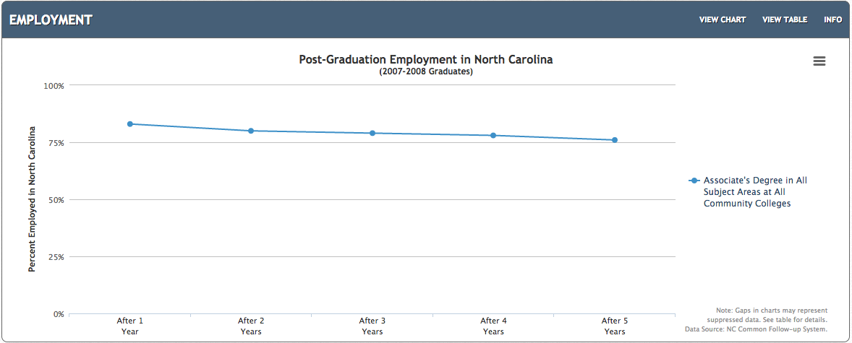
All NC Associate Degrees 2007-2008
Notes:
This shows employment for the first five years after graduation for folks who earned an Associate Degree in North Carolina.
This shows the graduates who are receiving a paycheck. It does not include independent contractors or self-employed.
Over 75 percent of the folks who earned an Associate Degree in North Carolina are receiving a paycheck 5 years after graduation. That’s really good.
====
http://nctower.com/output/ncccs/4506/2008/
2007-2008 graduates from all Associate Degree programs in NC

Slide 45
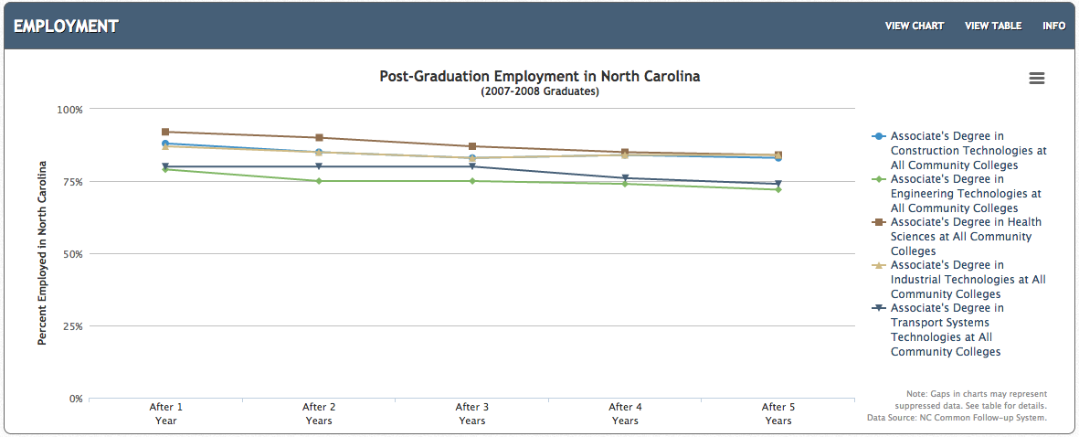
Selected NC Associate Degrees – 2007-2008
Notes:
And if we look at some selected Associate Degree programs.
For the most part they are all over 75 percent employed after five years.
Health Sciences, Construction, and Industrial Technologies are the three highest with 84 percent employment after 5 years.
Engineering Technologies is at 74 percent employment. Still not bad.
====
http://nctower.com/output/ncccs/4840-4946-4797-4887-5059/
2007-2008 graduates from selected Associate Degree programs in NC

Slide 46
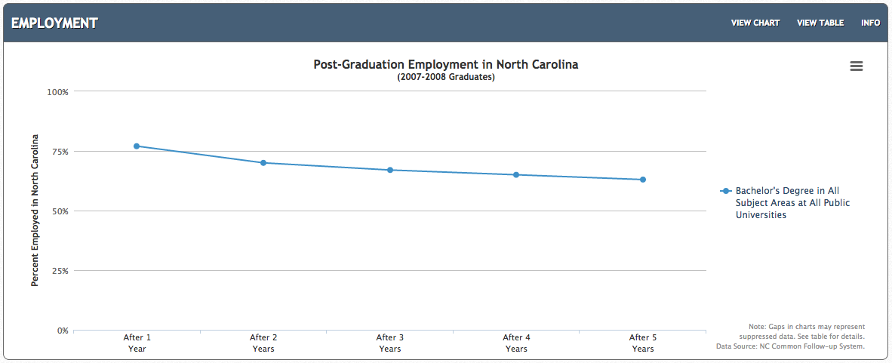
All NC Bachelor Degrees 2007-2008 graduates
Notes:
And here is the employment for the first five years out of college for Bachelor Degree graduates from our NC Public Universities.
After 5 years, 63 percent are receiving a paycheck.
====
http://nctower.com/output/unc/7810/
2007-2008 Bachelor Degree graduates from All NC Universities

Slide 47
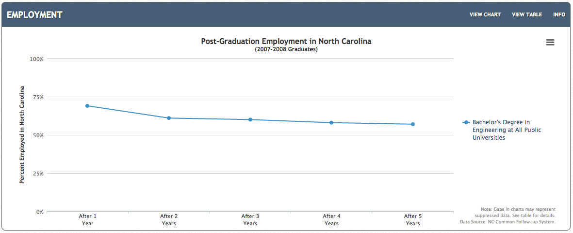
NC Engineering Bachelor Degree 2007-2008 Graduates
Notes:
If we focus just on Engineering. This is the data for all engineering graduates from all UNC campuses.
After five years of work, the employment is 57 percent. That means that almost half of the engineering graduates are not receiving a paycheck five years after graduation.
Does that mean we are graduating too many engineers, or are high schools funneling folks into engineering programs who probably should be doing something else?
Let’s compare this data to the folks earning the Associate Degrees.
====
http://nctower.com/output/unc/7901/
2007-2008 Bachelor Degree, Engineering graduates from All NC Universities

Slide 48
compare
NC Bachelor Degree – Engineering
1,297 graduates
NC Associate Degrees
5,310 graduates
Notes:
On top is the Bachelor of Engineering graduates
And on the bottom is the Associate Degree graduates in these five technical areas.
Notice the Bachelor of Engineering graduates start out at 69 percent employment, and after five years are at 57 percent employment.
But at the bottom of the slide -- you see that 80 to 92 percent of the graduates with an associate degree are employed right out of college.
And then after 5 years of employment, the rate is 74 to 84 percent.
This seems to indicate a high demand for folks with a technical associate degree. And less demand for graduates of a four-year engineering program.
====
http://nctower.com/output/unc/7901/
2007-2008 Bachelor Degree, Engineering graduates from All NC Universities
http://nctower.com/output/ncccs/4840-4946-4797-4887-5059/
2007-2008 graduates from selected Associate Degree programs in NC

Slide 49
NC Bachelor Degree
29,044 graduates
NC Associate Degrees
5,310 graduates
Notes:
Here at the top we see all Bachelor Degree graduates -- where the employment rate right out of college is 77 percent, and after five years, the employment rate is 63 percent.
That is much higher than the employment rate of our Engineering School graduates.
On the bottom you see the same graph of our associate degree graduates.
This seems to indicate a high demand for folks with a technical associate degree. And less demand for graduates of a four-year program.
====
http://nctower.com/output/unc/7810/
2007-2008 Bachelor Degree graduates from All NC Universities
http://nctower.com/output/ncccs/4840-4946-4797-4887-5059/
2007-2008 graduates from selected Associate Degree programs in NC

Slide 50
States with Most New Jobs (Total Change in Positions Projected from 2012 - 2022)
Numeric Change
% Change
15,627,900 United States
2,436,980 Texas
2,427,600 California
1,362,980 Florida
1,048,220 New York
679,110 Georgia
582,750 Arizona
578,220 Washington
548,650 North Carolina
534,210 Virginia
520,180 Colorado
512,330 Illinois
467,940 Pennsylvania
455,010 Ohio
388,450 Tennessee
385,570 Massachusetts
371,460 Michigan
333,660 Indiana
317,970 Utah
313,190 New Jersey
259,660 Louisiana
258,390 Oregon
244,610 Missouri
229,350 Kentucky
228,800 South Carolina
217,840 Wisconsin
213,220 Alabama
205,000 Minnesota
197,270 Iowa
179,310 Maryland
175,070 Oklahoma
166,470 Connecticut
164,150 Nevada
163,250 Kansas
135,950 Arkansas
109,380 Puerto Rico
109,000 Idaho
102,250 Nebraska
101,610 New Mexico
81,680 Mississippi
68,730 New Hampshire
64,700 Hawaii
61,950 Montana
61,390 North Dakota
57,930 District of Columbia
51,420 Rhode Island
40,900 Delaware
39,110 West Virginia
36,660 Wyoming
36,120 Alaska
33,260 South Dakota
30,900 Vermont
15,000 Maine
11,240 Guam
70 Virgin Islands
24.3 Utah
21.8 Arizona
21.3 Texas
21.0 Colorado
19.1 Guam
17.3 Washington
16.7 Florida
16.3 Georgia
16.2 Idaho
15.4 Oregon
14.9 California
13.8 Nevada
13.5 Virginia
13.2 Tennessee
13.0 Louisiana
12.9 North Carolina
12.8 Montana
12.8 North Dakota
12.2 Wyoming
12.0 New Mexico
11.9 Indiana
11.6 Kentucky
11.5 South Carolina
11.3 Massachusetts
11.3 Kansas
11.2 Iowa
11.1 New York
10.8 United States
10.8 Alaska
10.5 Arkansas
10.4 Alabama
10.4 Rhode Island
10.3 Puerto Rico
10.3 New Hampshire
10.0 Oklahoma
9.7 Hawaii
9.5 Nebraska
9.4 Connecticut
9.3 Delaware
8.7 Michigan
8.6 Missouri
8.5 Vermont
8.3 Illinois
8.3 Ohio
7.7 Pennsylvania
7.7 District of Columbia
7.5 New Jersey
7.1 Wisconsin
7 Minnesota
7 Mississippi
7 South Dakota
6.5 Maryland
5 West Virginia
2.3 Maine
0.2 Virgin Islands
Notes:
Here you can compare the states with the most projected job openings.
On the left you see the number of job openings projected over the ten years for each state or territory.
On the right you see the percentage change in jobs over the ten years for each state or territory.
Some states are predicting a large number of job openings, but for our highly populated states, it might not be a large percentage of jobs based on the size of the population.
You see states that I have highlighted in blue. They are near the top of both sides.
That means they are expecting a large number of job openings, which is also a large percentage of their current workforce. Those are the states that are growing the fastest.
You see North Carolina on the left. Projected to have the eighth most number of new jobs. On the right our state is not far down at 12.9 percent.
Maine is at the bottom of both lists.
============
“Total, All Occupations” for each state.
“Numeric Employment Change” is the number of new jobs projected over the ten year period.
www.projectionscentral.com/

Slide 51
Notes:
If you Google “Hot Jobs,” you will be overwhelmed with lots of lists of what someone considers to be jobs that are in high demand.
=====
http://hhstaffingservices.com/wp-content/uploads/2013/02/hot-jobs-icon.jpg
http://hhstaffingservices.com/job-seekers/hot-jobs-list-will-pay-cash-referral-bonus/

Slide 52
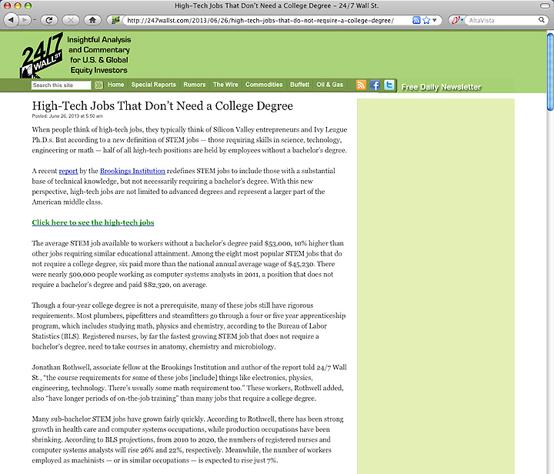
1. Registered Nurses
2. Automotive Service Technicians and Mechanics
3. Carpenters
4. Electricians
5. Computer Systems Analysts
6. Machinists
7. Plumbers, Pipefitters, Steamfitters
8. Welders, Cutters, Solderers and Brazers
Notes:
This list shows the top jobs that don’t require a four-year degree.
====
The average STEM job available to workers without a bachelor’s degree paid $53,000, 10% higher than other jobs requiring similar educational attainment.
1. Registered Nurses
2. Automotive Service Technicians and Mechanics
3. Carpenters
4. Electricians
5. Computer Systems Analysts
6. Machinists
7. Plumbers, Pipefitters, Steamfitters
8. Welders, Cutters, Solderers and Brazers
====
http://247wallst.com/2013/06/26/high-tech-jobs-that-do-not-require-a-college-degree/
High-Tech Jobs That Don’t Need a College Degree
Read more: High-Tech Jobs That Don’t Need a College Degree - 24/7 Wall St. http://247wallst.com/2013/06/26/high-tech-jobs-that-do-not-require-a-college-degree/#ixzz2XQ7hpswB
June 26, 2013
The average STEM job available to workers without a bachelor’s degree paid $53,000, 10% higher than other jobs requiring similar educational attainment. Among the eight most popular STEM jobs that do not require a college degree, six paid more than the national annual average wage of $45,230. There were nearly 500,000 people working as computer systems analysts in 2011, a position that does not require a bachelor’s degree and paid $82,320, on average.
Though a four-year college degree is not a prerequisite, many of these jobs still have rigorous requirements. Most plumbers, pipefitters and steamfitters go through a four or five year apprenticeship program, which includes studying math, physics and chemistry, according to the Bureau of Labor Statistics (BLS). Registered nurses, by far the fastest growing STEM job that does not require a bachelor’s degree, need to take courses in anatomy, chemistry and microbiology.
Read more: High-Tech Jobs That Don’t Need a College Degree - 24/7 Wall St. http://247wallst.com/2013/06/26/high-tech-jobs-that-do-not-require-a-college-degree/#ixzz2XQ7ptbo3

Slide 53
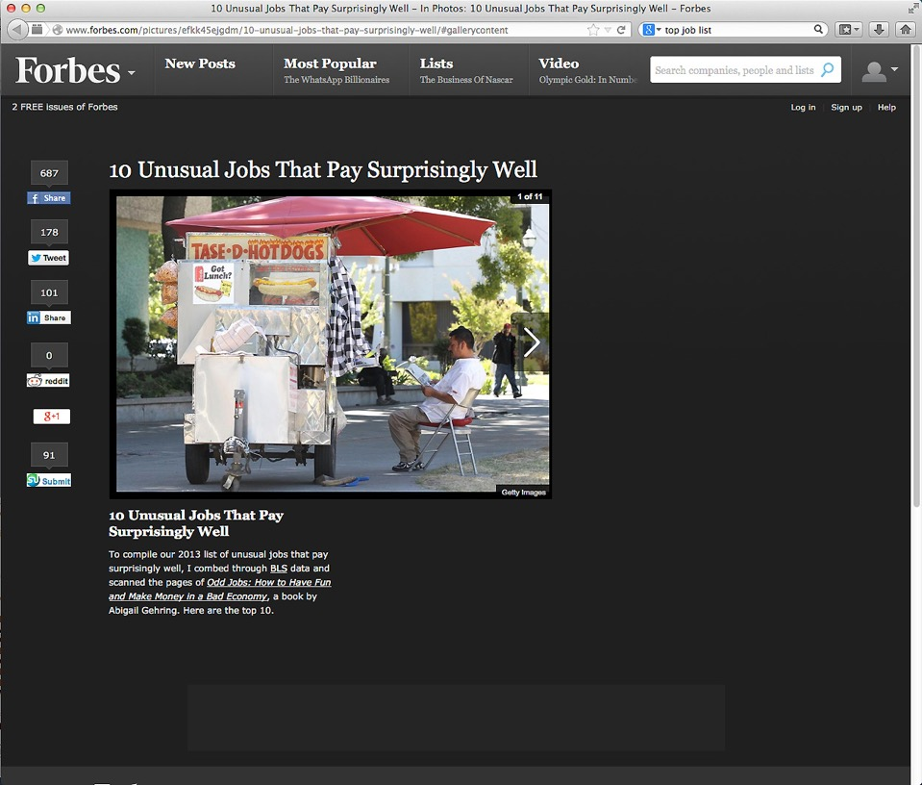
Notes:
This hot jobs list shows the top ten unusual jobs that pay surprisingly well.
-- like running a hot dog cart.
Who thinks that would be fun ??????
======
http://www.forbes.com/pictures/efkk45ejgdm/10-unusual-jobs-that-pay-surprisingly-well/#gallerycontent

Slide 54
10 Hardest to Fill Jobs in America
Notes:
Here is a list of the top ten hardest-to-fill jobs.
Teachers are on the list at number ten.
Teachers of all kinds are the occupation that requires a bachelor degree -- that is in the highest demand.
======
Forbes recently looked at the 10 Hardest to Fill Jobs in America
===
http://www.forbes.com/sites/jacquelynsmith/2013/05/28/the-10-hardest-jobs-to-fill-in-2013/

Slide 55
10 Hardest to Fill Jobs in America
Notes:
Mechanics are in high demand. We depend on our cars and want them fixed fast and correctly.
Top mechanics can make over $100,000 working at the large dealerships.
======
Forbes recently looked at the 10 Hardest to Fill Jobs in America
===
http://www.forbes.com/sites/jacquelynsmith/2013/05/28/the-10-hardest-jobs-to-fill-in-2013/

Slide 56
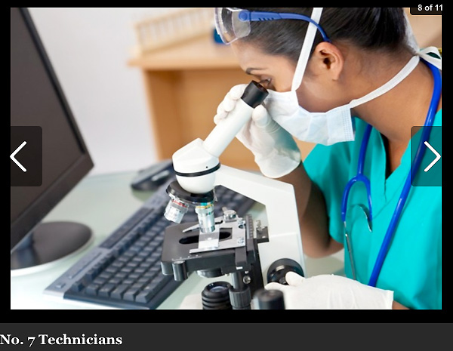
10 Hardest to Fill Jobs in America
Notes:
Technicians are in high demand.
This is the Science and Technology side of the STEM that we keep hearing about.
======
Forbes recently looked at the 10 Hardest to Fill Jobs in America
===
http://www.forbes.com/sites/jacquelynsmith/2013/05/28/the-10-hardest-jobs-to-fill-in-2013/

Slide 57
10 Hardest to Fill Jobs in America
Notes:
Engineers
Not just engineers who can design buildings that don’t fall down, but engineers who can think outside the box and create something exciting and new.
======
Forbes recently looked at the 10 Hardest to Fill Jobs in America
===
http://www.forbes.com/sites/jacquelynsmith/2013/05/28/the-10-hardest-jobs-to-fill-in-2013/

Slide 58
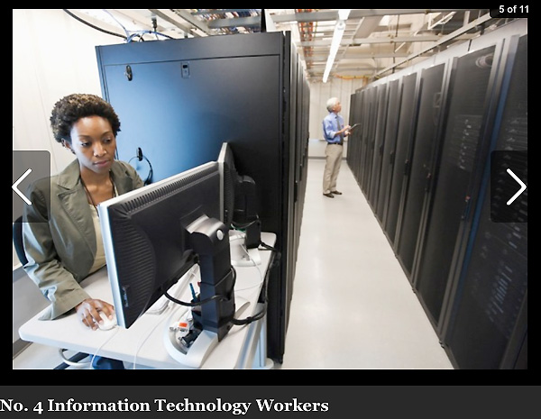
10 Hardest to Fill Jobs in America
Notes:
IT workers at all levels.
Notice that we are seeing a lot of the STEM jobs in these lists.
======
Forbes recently looked at the 10 Hardest to Fill Jobs in America
===
http://www.forbes.com/sites/jacquelynsmith/2013/05/28/the-10-hardest-jobs-to-fill-in-2013/

Slide 59
10 Hardest to Fill Jobs in America
Notes:
Sales Representatives are in high demand because businesses need to sell their products and services.
======
Forbes recently looked at the 10 Hardest to Fill Jobs in America
===
http://www.forbes.com/sites/jacquelynsmith/2013/05/28/the-10-hardest-jobs-to-fill-in-2013/

Slide 60
10 Hardest to Fill Jobs in America
Notes:
One reason that skilled trades are in high demand is because years ago we started discouraging kids from going into blue-collar jobs.
And now that we are coming out of the recession, -- the building boom is beginning with no one to do the work.
======
Forbes recently looked at the 10 Hardest to Fill Jobs in America
===
http://www.forbes.com/sites/jacquelynsmith/2013/05/28/the-10-hardest-jobs-to-fill-in-2013/

Slide 61
Top 10 Job Titles that Didn’t Exist Five Years Ago
Notes:
You’ve heard about the cloud … Now someone has to maintain it and keep it going.
I found this list of Top Ten Job Titles that Didn’t Exist Five Years Ago.
My dad spent his whole career working on clouds, but then he was a meteorologist. The clouds have changed.
=====
http://talent.linkedin.com/blog/index.php/2014/01/top-10-job-titles-that-didnt-exist-5-years-ago-infographic
Top 10 Job Titles That Didn’t Exist 5 Years Ago
Methodological details: We counted the frequencies of all English words and phrases used in job titles that were held in 2013 and compared the results to job titles that were held in 2008. We then took the top titles that saw the largest growth in frequency in that 5 year period and ranked them by their relative size in 2013. “Big data” and “cloud services” were the root phrases used to determine frequencies for “big data architect” and “cloud services manager” (which had many permutations, e.g. “big data architect/analyst/engineer” etc.). For simplicity’s sake, the titles you see above were used as examples. Data is current as of November 26, 2013.

Slide 62
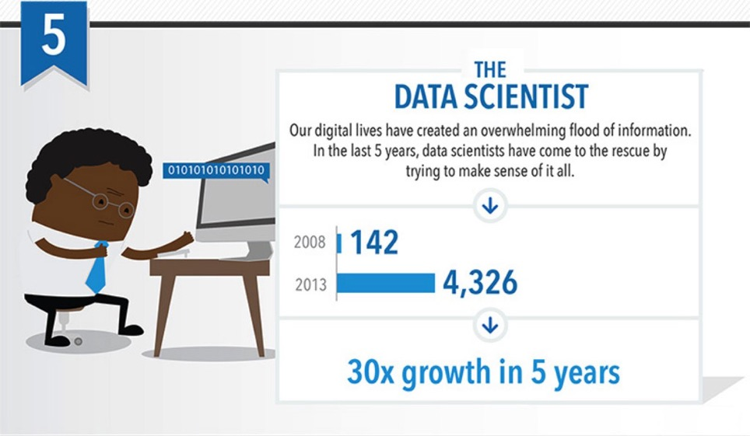
Top 10 Job Titles that Didn’t Exist Five Years Ago
Notes:
Someone needs to take all that data we’ve collected and turn it into information.
That’s the Data Scientist.
=====
http://talent.linkedin.com/blog/index.php/2014/01/top-10-job-titles-that-didnt-exist-5-years-ago-infographic
Top 10 Job Titles That Didn’t Exist 5 Years Ago
Methodological details: We counted the frequencies of all English words and phrases used in job titles that were held in 2013 and compared the results to job titles that were held in 2008. We then took the top titles that saw the largest growth in frequency in that 5 year period and ranked them by their relative size in 2013. “Big data” and “cloud services” were the root phrases used to determine frequencies for “big data architect” and “cloud services manager” (which had many permutations, e.g. “big data architect/analyst/engineer” etc.). For simplicity’s sake, the titles you see above were used as examples. Data is current as of November 26, 2013.

Slide 63
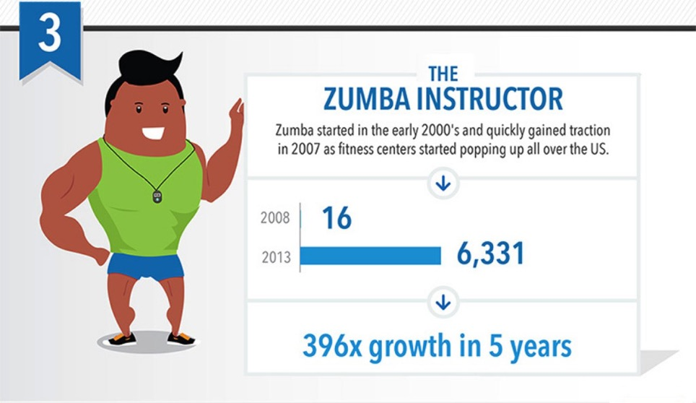
Top 10 Job Titles that Didn’t Exist Five Years Ago
Notes:
Look! It’s a high demand job that does not require a computer!
Raise your hand if you Zumba.
Sometimes we need to get away from our computers for a little while, and that’s why Zumba instructors are in high demand.
=====
http://talent.linkedin.com/blog/index.php/2014/01/top-10-job-titles-that-didnt-exist-5-years-ago-infographic
Top 10 Job Titles That Didn’t Exist 5 Years Ago
Methodological details: We counted the frequencies of all English words and phrases used in job titles that were held in 2013 and compared the results to job titles that were held in 2008. We then took the top titles that saw the largest growth in frequency in that 5 year period and ranked them by their relative size in 2013. “Big data” and “cloud services” were the root phrases used to determine frequencies for “big data architect” and “cloud services manager” (which had many permutations, e.g. “big data architect/analyst/engineer” etc.). For simplicity’s sake, the titles you see above were used as examples. Data is current as of November 26, 2013.

Slide 64
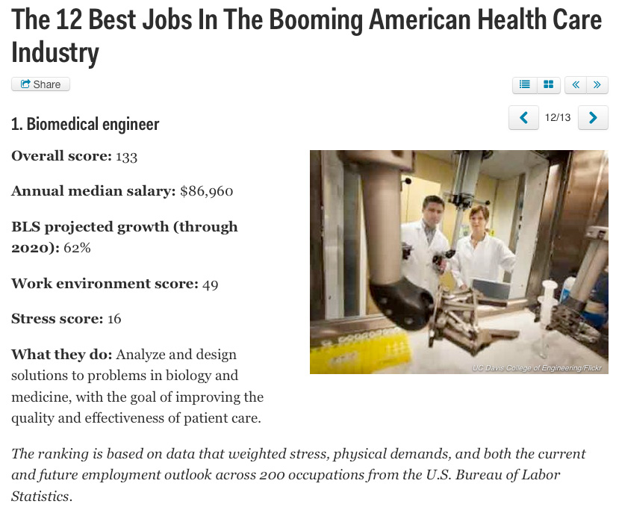
Notes:
New forms of engineering emerge every year.
The Biomedical Engineer combines engineering principals with medicine and biology to create better healthcare for all of us.
=====
http://www.businessinsider.com/best-health-care-jobs-2013-12
The 12 Best Jobs In The Booming American Health Care Industry
To find out which jobs offer the best opportunities in health care, job search site CareerCast analyzed survey data that weighed stress, physical demands, and both the current and future employment outlook of 200 occupations.
"What's similar for the jobs on this list, with the exception of biomedical engineer, is that they work individually one-on-one with another person," Tony Lee, publisher at CareerCast.com, tells Business Insider. "When you're working with someone else, the job satisfaction is pretty high because you see someone often and they're giving you feedback, as opposed to having very few people thanking you."
Lee predicts that the need for these professionals will last for years to come. "Baby boomers are entering retirement, and as our body ages, the type of medical professionals that are needed to help people deal with that are going to be in greater demand."
The overall score for each job takes into account the pay; hiring outlook; stress; emotional factors, including the level of competitiveness and degree of public contact; and physical demands, such as stamina required and work conditions, that normally come with a job. Once the categories are combined, a lower overall score signals that the job is more desirable to employees.
Definition: http://en.wikipedia.org/wiki/Biomedical_engineer

Slide 65
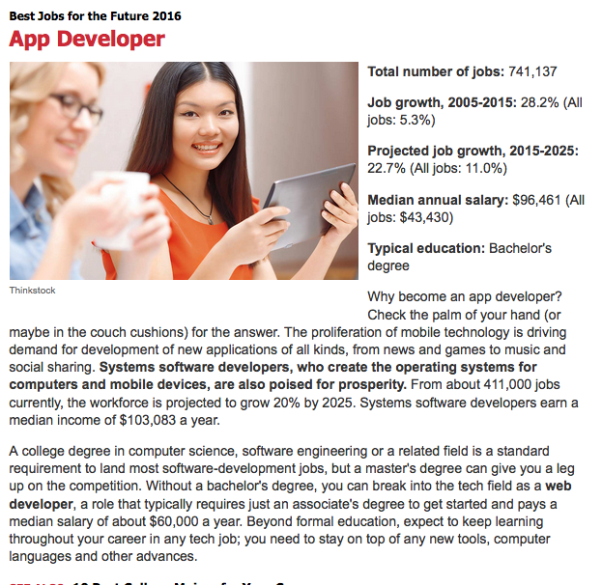
Notes:
We can’t get enough of those smart phone apps, and someone has to create them.
=======
http://www.kiplinger.com/slideshow/business/T012-S001-best-jobs-for-the-future-2016/index.html

Slide 66
Notes:
Nurse Practitioner is similar to the Physician’s Assistant, but can work independently from the doctor.
=======
http://www.kiplinger.com/slideshow/business/T012-S001-best-jobs-for-the-future-2016/index.html

Slide 67
Notes:
It seems that we hear about some kind of data breach every day.
Keeping up with the criminals is a job that is in high demand.
=======
http://www.kiplinger.com/slideshow/business/T012-S001-best-jobs-for-the-future-2016/index.html

Slide 68
Notes:
Keeping computer systems up to date and suitable for a particular company are duties for the Computer Systems Analyst.
=======
http://www.kiplinger.com/slideshow/business/T012-S001-best-jobs-for-the-future-2016/index.html

Slide 69
Notes:
As the population gets older and lives longer, there is more potential for personal breakage.
And someone has to help us get back on our feet.
=======
http://www.kiplinger.com/slideshow/business/T012-S001-best-jobs-for-the-future-2016/index.html

Slide 70
Notes:
How do stores decide what price to put on an item?
How do they decide which items to sell?
And how do they decide where to open a new store?
The Market Research Analyst does all this and much more.
=======
http://www.kiplinger.com/slideshow/business/T012-S001-best-jobs-for-the-future-2016/index.html

Slide 71
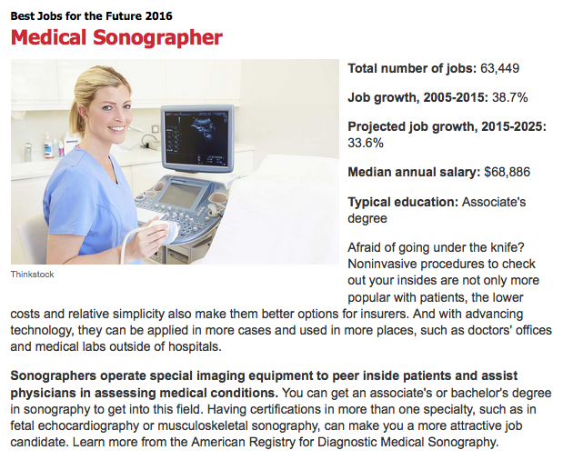
Notes:
The sonographer uses ultrasound, a process of sending sound waves through your body to allow the doctors to know what’s going on inside.
It’s not just for looking at unborn babies, there are many uses of sonography.
My doctor used it on me to look inside my head.
There were no babies in there!
=======
http://www.kiplinger.com/slideshow/business/T012-S001-best-jobs-for-the-future-2016/index.html

Slide 72
Notes:
For only two years of college, you can start at a very high salary.
That is, if you don’t mind putting your hands in other people’s mouths.
But you do have Fridays off.
And the dental hygienists will be in high demand for many years to come.
=======
http://www.kiplinger.com/slideshow/business/T012-S001-best-jobs-for-the-future-2016/index.html

Slide 73
Surprises Future Demand Changing World New Ideas
www.ncPerkins.org/presentations
Notes:
Next we will look at the rapidly changing world in which we are preparing folks to live and work.

Slide 74
Upsetting the Projection Data
Recession
Natural Disasters
Immigration
Automation / Technology
Job relocation
Elections
Notes:
All of that projection data I showed you earlier can be easily upset by a variety of conditions.
The current recession swooped in just after those data were published.
Natural disasters, such as hurricanes, can drastically change which jobs are in high demand and which ones are not.
The flooding in Louisiana is constantly changing which jobs are in high demand.
And we don’t have to talk about how elections and politics can change the job market.

Slide 75
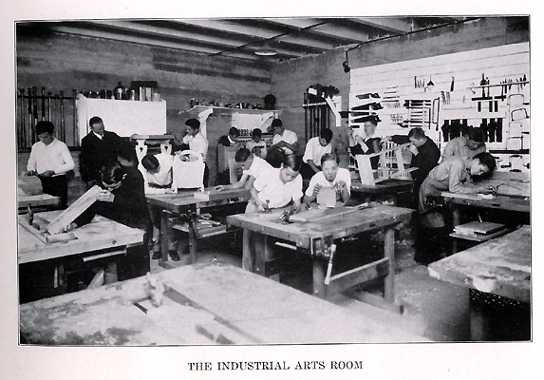
Notes:
I’m certified to teach Industrial Arts Education.
How many of you took Industrial Arts, or Shop class while in high school????
Unfortunately, some of our high schools are still teaching classes like this.
Some because of a lack of funds to modernize, and
Some because the same teacher is still there after 40 years.
=====
http://www.rootsweb.ancestry.com/~innwigs/ImageArchive/LibertyTownship/LibertyTwpPorterCoIndiana-LibertyCenterHighSchool-IndustrialArtsRoom-1931-SS.jpg

Slide 76
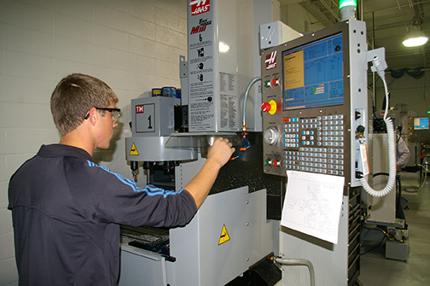
Notes:
But our modern shop classes should look like this. And many of them do.
We’ve had to modernize to keep up with business and industry.
Fortunately in North Carolina, we can send our high school students to a community college to learn in shops like this.
====
http://www.caboces.org/sites/default/files/images/John%20Gethicker/AMPBabb8744LR.jpg

Slide 77
Notes:
Why would a school counselor allow a young lady to take a manufacturing class knowing that she could end up with a job like this?
Compare the cleanliness of the work environment in this OLD picture with …
====
https://dwd.wisconsin.gov/dwd/dwdhistory/images/women_in_factory_big.jpg

Slide 78
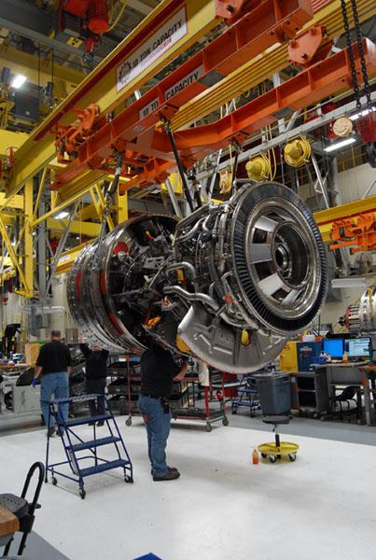
Notes:
…this one, where they are building jet engines in Durham, North Carolina.
You could eat off of that floor!
====
http://www.bizjournals.com/triangle/news/2012/08/03/slideshow-a-look-at-ge-aviations.html?ana=e_du_pap&s=article_du&ed=2012-08-03
Slideshow: A look at General Electric Aviation engine plant
The Durham plant, just off Miami Boulevard, is beginning to retool as the company triples its production of GEnx turbofan engines for Boeing Co.’s (NYSE: BA) new 787 Dreamliner. It has also recently expanded production of the giant GE90 engine and several lines of smaller engines, all of which are aimed at replacing older designs that are less fuel efficient.
photo shows:
A GE90 engine nears completion at the GE Aviation factory off South Miami Boulevard in Durham. The GE90 is used for large commercial aircraft such as the Boeing 777. More than 1,000 777s have been built over the years, incorporating a total of more than 2,000 engines from Boeing, Rolls-Royce and United Technologies' Pratt & Whitney division.

Slide 79
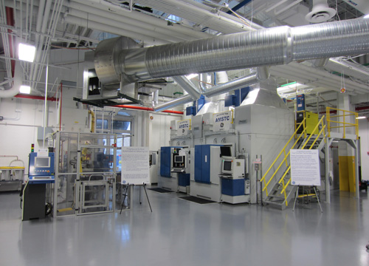
Notes:
The reality is that most educators, students, and their parents have no idea of what is happening in today’s factories.
Name one TV show that shows employees working in a modern factory.
How can students, teachers, and everyone else learn about modern industry?
Field trips, job shadowing, internships, open houses?
=====
http://files.gereports.com/wp-content/uploads/2012/04/AMSTC3.jpg

Slide 80
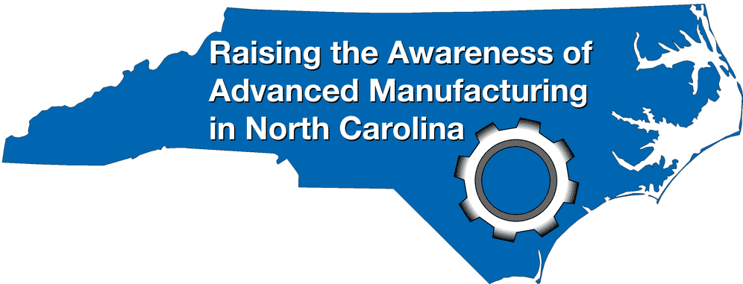
NC Advanced Manufacturing Careers Awareness Week
October 2-6, 2017
NCperkins.org/manufacturing
Notes:
This was our fifth year for Advanced Manufacturing Careers Awareness Week
We had 60 open houses all across the state, mostly at manufacturing companies and community colleges, helping people learn about the modern careers in Advanced Manufacturing.
Make sure your students, and their parents, know about these open houses next fall.
Details are on the nc perkins dot org website.
======
http://www.ncperkins.org/moodle/course/view.php?id=14

Slide 81
We are currently preparing people for jobs that don’t yet exist …
Notes:
You may have seen this quote that is spread across the next three slides.
It profoundly reminds us that we are preparing people for jobs that don’t yet exist…
=======
Shift Happens
Karl Fisch and Scott McLeod
http://shifthappens.wikispaces.com/

Slide 82
… using technologies that haven’t yet been invented …
Notes:
… Using technologies that have not yet been invented …
=======
Shift Happens
Karl Fisch and Scott McLeod
http://shifthappens.wikispaces.com/

Slide 83
… in order to solve problems we don’t even know are problems yet.
Notes:
… In order to solve the problems that we do not yet know are problems.
Have we enabled the next generation with the knowledge and tools they will need to do this?
=======
Shift Happens
Karl Fisch and Scott McLeod
http://shifthappens.wikispaces.com/

Slide 84
Who predicted these?
Cell phones for everyone
iPads, Kindles
Smart phones
iPod - portable music and videos
Hand-held GPS
Text messaging
Blogs, Twitter
MySpace, FaceBook
Wikipedia
YouTube
Pinterest
Google Plus
Tumblr
Instagram
SUVs
Self-driving cars
Electric cars
Wearable tech - Fitbits
Cloud computing
“Reality” TV
3D printing
Presentations like this one !!
Notes:
Think back 20 years ago.
Would you have predicted any of these?
What’s next?
How soon will these become obsolete?
Yes, these will all become obsolete someday soon!

Slide 85
Old technologies making a comeback
Vegetable powered-Diesel engines
Electric cars
Wind power
Rain barrels
Recycling building materials
Biofuel (Moonshine)
Notes:
Some of the latest trends are actually old technologies making a comeback.
Over 100 years ago. When Rudolph Diesel first demonstrated his diesel engine, he powered it with peanut oil.
Then along came this cheap stuff called petroleum that even Jed Clampett didn't want at first, and Rudolph Diesel quickly switched over to the newly created Diesel fuel, because it was so cheap to make.
Now people are paying McDonalds to let them take away their waste cooking oil, so they can use it to fuel their Diesel-powered vehicle.
And Electric cars? Invented almost 200 years ago. Electric cars were very popular until the early 1900s when gasoline-powered engines took over, because -- at the time -- gasoline was very cheap.
And the Biofuels Center of North Carolina is helping people build government-approved stills to create legal moonshine that we can burn in our cars.
Yes, some old technologies are coming back around again.

Slide 86
2016 NC Employer Needs Survey
Notes:
The North Carolina Department of Commerce surveyed businesses all across the state earlier this year.
For 2016, they collected 19 hundred surveys.
This included companies of all sizes from all 100 counties.
=====
2016 NC Employer Needs Survey
http://www.nccommerce.com/Portals/47/Publications/Industry%20Reports/2016-Employer-Needs-Survey.pdf
2016 NC Employer Needs Survey - PowerPoint
http://www.ncga.state.nc.us/documentsites/committees/BCCI-6578/2015-16%20Session/Meeting%20Documents/March%201,%202016/Employer%20Needs%20Survey%202016%20-%20Leg%20Workforce%20Development%20Committee.pdf

Slide 87
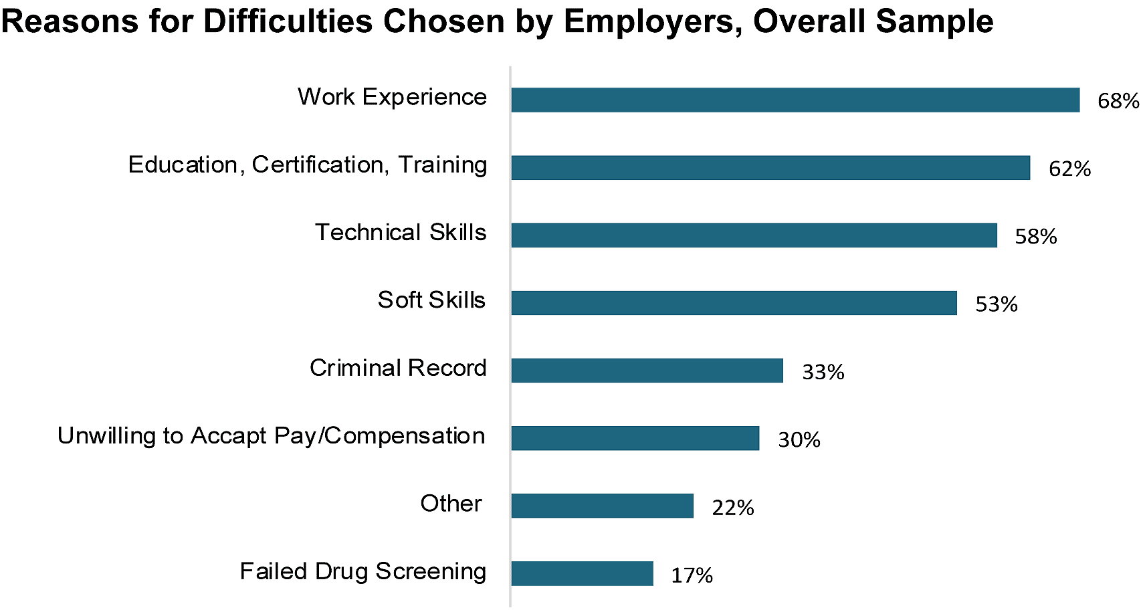
Hiring Difficulties
Notes:
This survey found that Four out of Ten employers who tried to hire in the past year had difficulty filling at least one position.
First on the list - The employers said their new recruits lacked work experience.
Well if that is true, you can show them how a good work-based learning program can help their future employees get the work experience they need.
And the second one is education and training. That’s why we are here to help educate their new recruits.
What else can we do to help prepare their new recruits?
Ask your local employers if this chart is true for their company.
Are there other items they think should be added to his list?
Ask them.
=====
2016 NC Employer Needs Survey
http://www.nccommerce.com/Portals/47/Publications/Industry%20Reports/2016-Employer-Needs-Survey.pdf
2016 NC Employer Needs Survey - PowerPoint
http://www.ncga.state.nc.us/documentsites/committees/BCCI-6578/2015-16%20Session/Meeting%20Documents/March%201,%202016/Employer%20Needs%20Survey%202016%20-%20Leg%20Workforce%20Development%20Committee.pdf

Slide 88
Notes:
We educators place a great emphasis on grades, class rank, and being valedictorian.
These create parental bragging rights for the parents, but what do they mean outside of high school and college?
Many colleges are saying that GPA and high school grades are not important when deciding to accept a student.
======
http://www.usatoday.com/story/news/nation/2013/02/27/college-grade-point-averages/1947415/

Slide 89
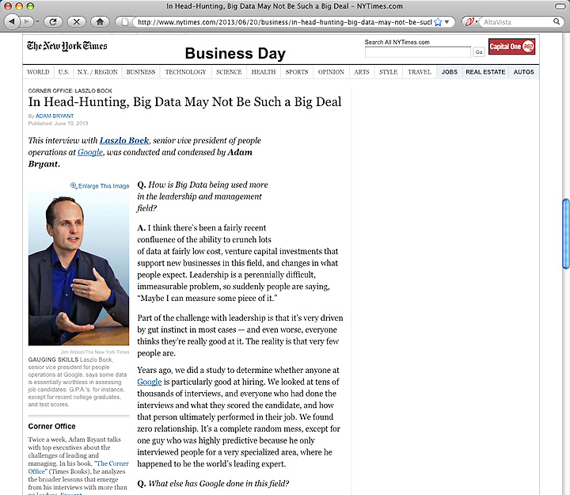
Notes:
Google has crunched the numbers and found that GPA is a worthless criteria for hiring.
They compared the GPA of their new recruits with how well they were performing years later -- and found no correlation.
You can imagine how well this news goes over in our high schools and colleges where grades appear to be everything.
=======
http://www.nytimes.com/2013/06/20/business/in-head-hunting-big-data-may-not-be-such-a-big-deal.html?pagewanted=all&_r=1&
In Head-Hunting, Big Data May Not Be Such a Big Deal
June 19, 2013
One of the things we’ve seen from all our data crunching is that G.P.A.’s are worthless as a criteria for hiring, and test scores are worthless — no correlation at all except for brand-new college grads, where there’s a slight correlation. Google famously used to ask everyone for a transcript and G.P.A.’s and test scores, but we don’t anymore, unless you’re just a few years out of school. We found that they don’t predict anything.
What’s interesting is the proportion of people without any college education at Google has increased over time as well. So we have teams where you have 14 percent of the team made up of people who’ve never gone to college.
After two or three years, your ability to perform at Google is completely unrelated to how you performed when you were in school, because the skills you required in college are very different. You’re also fundamentally a different person. You learn and grow, you think about things differently.
Another reason is that I think academic environments are artificial environments. People who succeed there are sort of finely trained, they’re conditioned to succeed in that environment. One of my own frustrations when I was in college and grad school is that you knew the professor was looking for a specific answer. You could figure that out, but it’s much more interesting to solve problems where there isn’t an obvious answer. You want people who like figuring out stuff where there is no obvious answer.
===
Google no longer hires based on GPA or test scores
"One of the things we’ve seen from all our data crunching is that G.P.A.’s are worthless as a criteria for hiring, and test scores are worthless"
Google also said that "academic environments are artificial environments." Students are "conditioned to succeed in that environment ... looking for a specific answer." Google wants "people who like figuring out stuff where there is no obvious answer."
These problem-solving skills that Google and others are looking for can be taught in our CTE classes, but the learning can be hard to measure, which makes it tough to convice the administration that these skills need to be taught.
http://www.nytimes.com/2013/06/20/business/in-head-hunting-big-data-may-not-be-such-a-big-deal.html?pagewanted=all&_r=1&

Slide 90
Notes:
Besides saying that GPAs are a worthless hiring criteria, Google says that test scores, and even college degree don’t matter much when hiring.
Google says the No. 1 thing they look for is general cognitive ability, and it’s not I.Q. It’s learning ability. It’s the ability to process on the fly.
Businesses want people who can grab a bunch of data, quickly turn it into useful information, and use that information to solve a problem.
Google says the second thing they are looking for is leadership. --in particular, emergent leadership as opposed to traditional leadership.
What they are looking for is: when faced with a problem, and you’re a member of a team, do you, at the appropriate time, step in and lead.
And just as critically, do you step back at the right time and stop leading, and let someone else lead?
How do people learn to take the leadership reigns when necessary and to relinquish when it’s time for someone else to lead?
Google said “It’s feeling the sense of responsibility, the sense of ownership, to step in,” to try to solve any problem – and the humility to step back and embrace the better ideas of others.
The end goal is group problem-solving. How do people learn that? Can we do more leadership training in our schools?
======
http://www.wnd.com/2014/02/google-calls-these-talents-worthless/

Slide 91
Vs
CompTIA
ServSafe
ProStart
CNA
ASE
NCCER
NIMS
PrintEd
AWS
HS Diploma
2-year Certificate
Associate Degree
Bachelor Degree
Master Degree
Doctoral Degree
Professional Degree
Notes:
We asked industry what they wanted, and they said they would like for us to teach our students to their standards.
Many of our Career and Technical Education courses now use industry-written curriculum that prepares kids to pass industry certification exams.
Who or what is driving education?
What are the important credentials?
Which is better, -- the education credentials that you see on the left, or industry credentials that you see on the right?
Better for whom? -- better for educators, business, parents, etc?
Do you think there will come a time when the education credentials on the left don’t mean anything and the businesses will look only for their credentials in their new recruits?
Many are doing that now.
Is that good or bad?

Slide 92
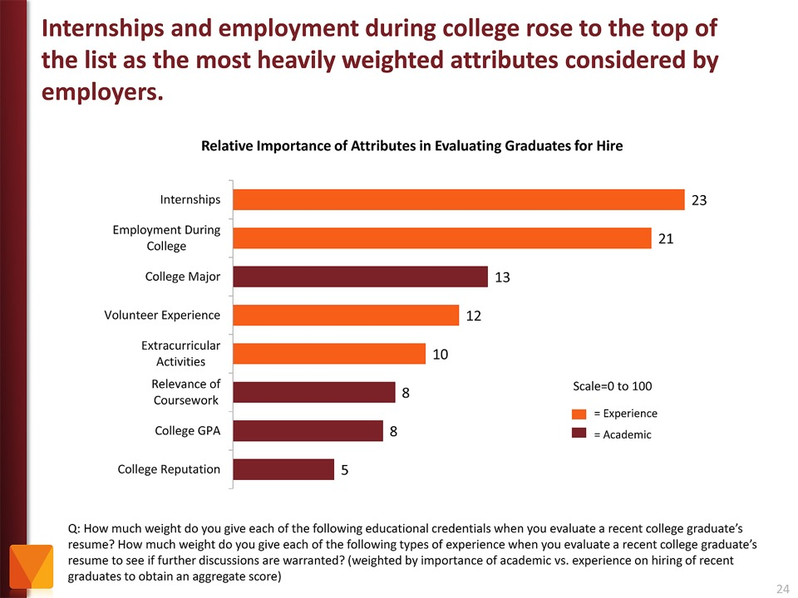
Notes:
Employers value Internships and other employment while in school as more important than college major and GPA.
Even volunteer work and extra-curricular activities are more important to the business community than grades.
Yet, -- most students are too focused on getting good grades -- and are missing out on the experiences that really matter.
If you “begin with the end in mind” like I said earlier, then high school students should ask the businesses what they will want in their new recruits, rather than focusing on something like grades that the business community could care less about.
======
http://chronicle.com/article/The-Employment-Mismatch/137625/#id=overview
The Employment Mismatch: A College Degree Sorts Job Applicants, but Employers Wish It Meant More
Employers value a four-year college degree, many of them more than ever.
Yet half of those surveyed recently by The Chronicle and American Public Media's Marketplace said they had trouble finding recent graduates qualified to fill positions at their company or organization. Nearly a third gave colleges just fair to poor marks for producing successful employees. And they dinged bachelor's-degree holders for lacking basic workplace proficiencies, like adaptability, communication skills, and the ability to solve complex problems.
The report
The Role of Higher Education in Career Development: Employer Perceptions
http://chronicle.com/items/biz/pdf/Employers%20Survey.pdf

Slide 93
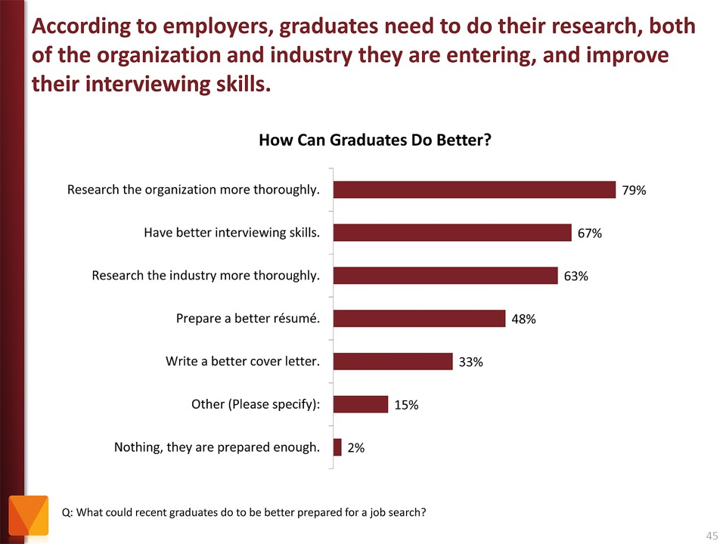
Notes:
Tell your students to research the companies where they are applying for work. And learn about the interview process.
It just amazes me that folks would try to get a job at a company they know nothing about.
The focus of the job interview should be on what you can do for the company.
======
http://chronicle.com/article/The-Employment-Mismatch/137625/#id=overview
The Employment Mismatch: A College Degree Sorts Job Applicants, but Employers Wish It Meant More
Employers value a four-year college degree, many of them more than ever.
Yet half of those surveyed recently by The Chronicle and American Public Media's Marketplace said they had trouble finding recent graduates qualified to fill positions at their company or organization. Nearly a third gave colleges just fair to poor marks for producing successful employees. And they dinged bachelor's-degree holders for lacking basic workplace proficiencies, like adaptability, communication skills, and the ability to solve complex problems.
The report
The Role of Higher Education in Career Development: Employer Perceptions
http://chronicle.com/items/biz/pdf/Employers%20Survey.pdf

Slide 94
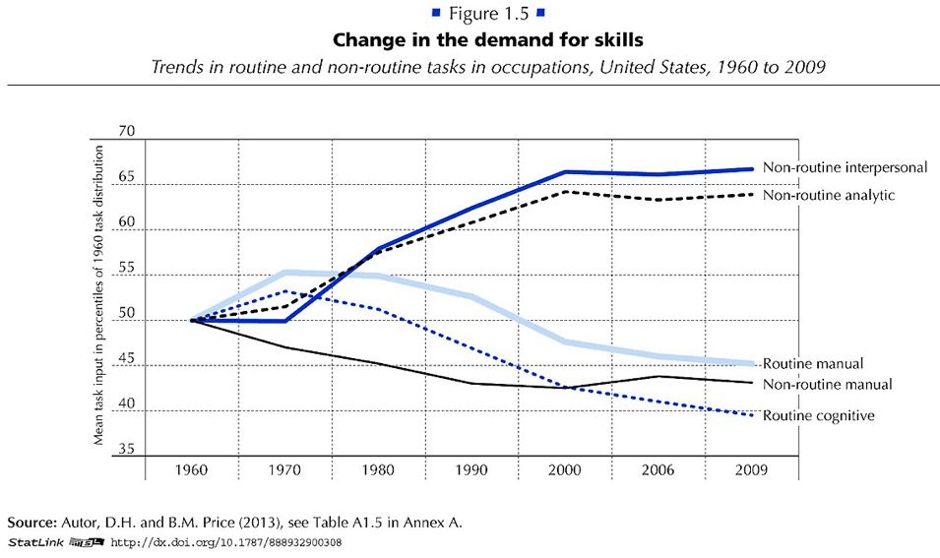
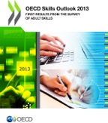
Notes:
Employers want employees that can do non-routine work.
They want folks that can identify and solve new problems.
Gone are the jobs that required routine manual labor.
The computers and robots can take care of that.
===
http://www.oecd.org/site/piaac/
https://www.oecd.org/site/piaac/
-----
OECD Skills Outlook 2013
http://skills.oecd.org/skillsoutlook.html
First Results from the Survey of Adult Skills
OECD_Skills_Outlook_2013.pdf
Key Findings
SkillsOutlook_2013_KeyFindings.pdf
Summary
9789264204256-sum-en.pdf
-----
PIAAC Results Released
On Oct. 8, 2013, the Organization for Economic Cooperation and Development (OECD) released the results of the Program for International Assessment of Adult Competencies, (PIAAC). This direct assessment was conducted with nationally representative samples from 23 countries from adults ages 16 through 65. It is an international household survey to assess the cognitive and workplace skills needed for success in the 21st-century global economy. The results are designed to help public, private, educational, and philanthropic sectors work with a shared language and set of benchmarks to enhance cooperation around the development and implementation of economic, education, and social policies that strengthen adult skills. The survey is intended to be administered every 10 years, making this a baseline report to set benchmarks against which countries and sectors can measure their improvement efforts. Multiple reports, datasets, and several data tools were released with the results, including:
The OECD Skills Outlook 2013: First Results from the Survey of Adult Skills, a freely available book in PDF form;
a summary, Skilled for Life? Key Findings;
a brief U.S. report, Survey of Adult Skills, First Results: United States; and
a report from the U.S. Department of Education’s National Center for Educational Statistics, Literacy, Numeracy, and Problem Solving in Technology-Rich Environments Among U.S. Adults: Results from the Program for the International Assessment of Adult Competencies 2012: First Look, was published on Oct. 18, once the U.S. federal government was re-opened. This report highlights the U.S. performance in the international data and unique U.S. demographic characteristics.
On Nov. 12, 2013, the OECD-authored report, Time for the United States to Reskill? What the Survey of Adult Skills Says, will be released. This report was funded by OVAE to offer a more detailed profile of low-skilled adults in the U.S. It will also identify policy implications and offer broad policy recommendations for the U.S.
Links to all of these resources, as well as events and press coverage, may be found at www.piaacgateway.com.
This article relies heavily on data included in the NCES “First Look” report. Further analysis of the PIAAC data will appear in future issues of OVAE Connection.
The Survey
The PIAAC assessment focuses on the working-age adult population, and measures cognitive and workplace skills necessary for successful participation in the 21st century society and global economy. In the U.S., as in all of the countries participating, 5,000 individuals were surveyed to create a nationally representative dataset. An additional 5,000 people will be surveyed for a supplement that will be added to the data set in 2015.
Drawing from a rich background questionnaire, the PIAAC measures relationships among respondents’ educational background, parental educational attainment, work history and skills, occupational attainment, use of information and communications technology, and cognitive skills in the domains of literacy, numeracy, and problem solving in technology-rich environments.
Findings are presented in the First Look report as country averages, and tables are used to place countries’ performances above, at, or below the international average. Within each domain, performance is also reported as a percentage of the population that performs in five levels of proficiency: Below Level 1, Level 1, Level 2, Level 3, and combined Levels 4/5, Level descriptors can be found in the First Look report in Exhibit B-1 for literacy, B-3 for numeracy, and B-5 for problem-solving in a technology-rich environment. Performance below Level 2 is considered “weak” or “low.”
The assessment is unique in that it is the first international literacy survey that is both adaptive and administered on a laptop computer. Given as a household survey, respondents were allowed to choose whether to take the assessment on a laptop or with pencil and paper. In the U.S., nearly 80 percent of respondents completed the survey on the computer, which means that they passed an initial screening test on basic computer use and navigation.
The direct measure of cognitive and workplace skills in this study creates a much more nuanced perspective on skills than the more commonly reported measure of educational attainment. For example, the attainment category of “some college,” which appears on many surveys of adult skills, says very little about the knowledge, skills, and abilities of an individual, and is rarely accompanied by information on the courses taken, training completed, and skills gained. Having more information about skills, including where they are learned and how they are used, as this survey provides, will inform educators, workforce development stakeholders, human resource personnel, employers, and policymakers about the mechanisms that are effective in increasing the skill and talent inventory in regions, sectors, and across the country.
Key Findings
On three domains (literacy, numeracy, and problem-solving in a technology-rich environment) the U.S. average performance is significantly lower than the international average. Within domains, the U.S. profile shows a large portion of adults with skills below Level 2, and small percentages of adults with strong skills in the upper level.
In the literacy domain, the U.S. average percentile performance is 270; the international average is 273. Within the domain, the U.S. profile shows 4 percent at Below Level 1, 14 percent at Level 1, 34 percent at Level 2, 36 percent at Level 3, and 12 percent at the combined Level 4/5. The U.S. has an equivalent percentage of adults in the highest level as the international average, 12 percent (see First Look, Figure 2A).
In the numeracy domain, the U.S. average performance is 253; the international average is 269. Within the domain, the U.S. profile shows 10 percent at Below Level 1, 20 percent at Level 1, 34 percent at Level 2, 27 percent at Level 3, and 9 percent at the combined Level 4/5. The U.S. has a lower percentage of adults in the highest level than the international average, which is 12 percent (see First Look, Figure 2B).
In problem-solving in a technology-rich environment, the U.S. average performance is 277; the international average is 283. Within the domain, which reports only four levels, the U.S. profile shows 20 percent at Below Level 1, 41 percent at Level 1, 33 percent at Level 2, and 6 percent at Level 3. The U.S. has a lower percentage of adults in the highest level than the international average, which is 8 percent (see First Look, Figure 2C).
The PIAAC item framework is aligned to previous international literacy assessments, allowing trend analysis for the past 20 years. The First Look report shows that the average U.S. literacy score for adults on the PIAAC is not significantly lower than it was in 2003-08 as reported on the International Adult Literacy Survey (IALS), but is lower than the average score was in 1994-98 as reported on the Adult Literacy and Lifeskills Survey (ALL) (Tables 1-A and 1-B). The average U.S. numeracy score on the PIAAC is lower than it was in 2003-08 as reported in the IALS.
Implications
These survey findings show that the U.S. has significant basic skill weaknesses within the adult working-age population in comparison to other industrialized countries. This skill profile has negative implications for the growth and strength of the U.S. economy and middle class. Although two-thirds of the low-skilled respondents in the U.S. sample are employed, they are not employed in jobs with high wages.
The findings show that work tasks influence skills. Adults who report frequently using literacy, numeracy, and problem-solving skills in their daily work routines have greater proficiencies in those skills. The reverse is also shown in the data: Workers in low-skilled jobs may have fewer opportunities to use and enhance their skills (see First Look, Figures 8 A, B, and C).
Weak skills have implications for civic life as well, as has been demonstrated in previous surveys of adult literacy. Adults with weak skills are less likely to vote or volunteer in their communities, and more likely to suffer poor health. In fact, adults with low skills are four times more likely to report “fair” or “poor” health than those with strong skills (see First Look, Figures 10 A, B, and C). This relationship is twice as strong as the international average.
Moreover, a concerning trend emerges in this data set. Unlike most other countries surveyed, in the U.S., younger cohorts’ skills are not surpassing the older cohorts’ skills. This has serious implications for the future of our workforce and underscores the need for continuing education and training.

Slide 95
Myth # 1
All of the manufacturing is moving to China.
Notes:
95
If you read the front page of the newspaper (or listen to the politicians), you might still believe this.
But if you read the Business section like I do …
=====
http://www.honestfilms.net/wp-content/uploads/burtynsky_manufacturing.jpg

Slide 96
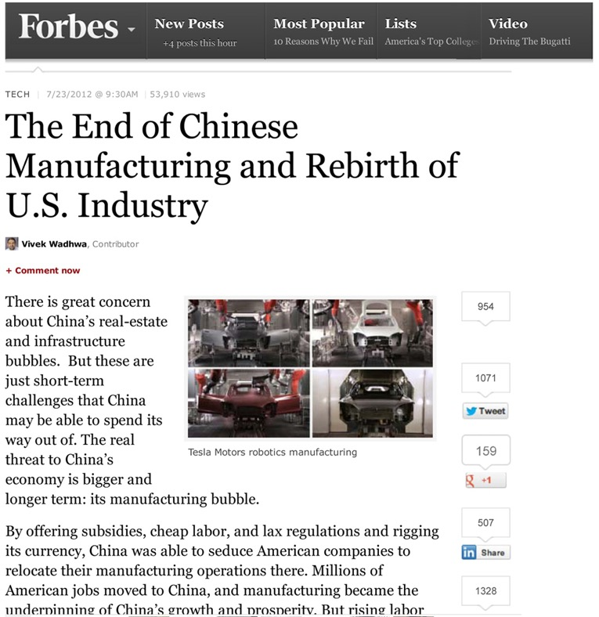
Notes:
… you will find that times have changed -- and the manufacturing is coming back home.
=====
http://www.forbes.com/sites/singularity/2012/07/23/the-end-of-chinese-manufacturing-and-rebirth-of-u-s-industry/
The End of Chinese Manufacturing and Rebirth of U.S. Industry

Slide 97
Notes:
People don’t believe me when I tell them that Chinese companies have moved some of their manufacturing to North Carolina.
=====
http://money.cnn.com/2012/04/24/smallbusiness/china-us-manufacturing/index.htm
China offshores manufacturing to the U.S.

Slide 98
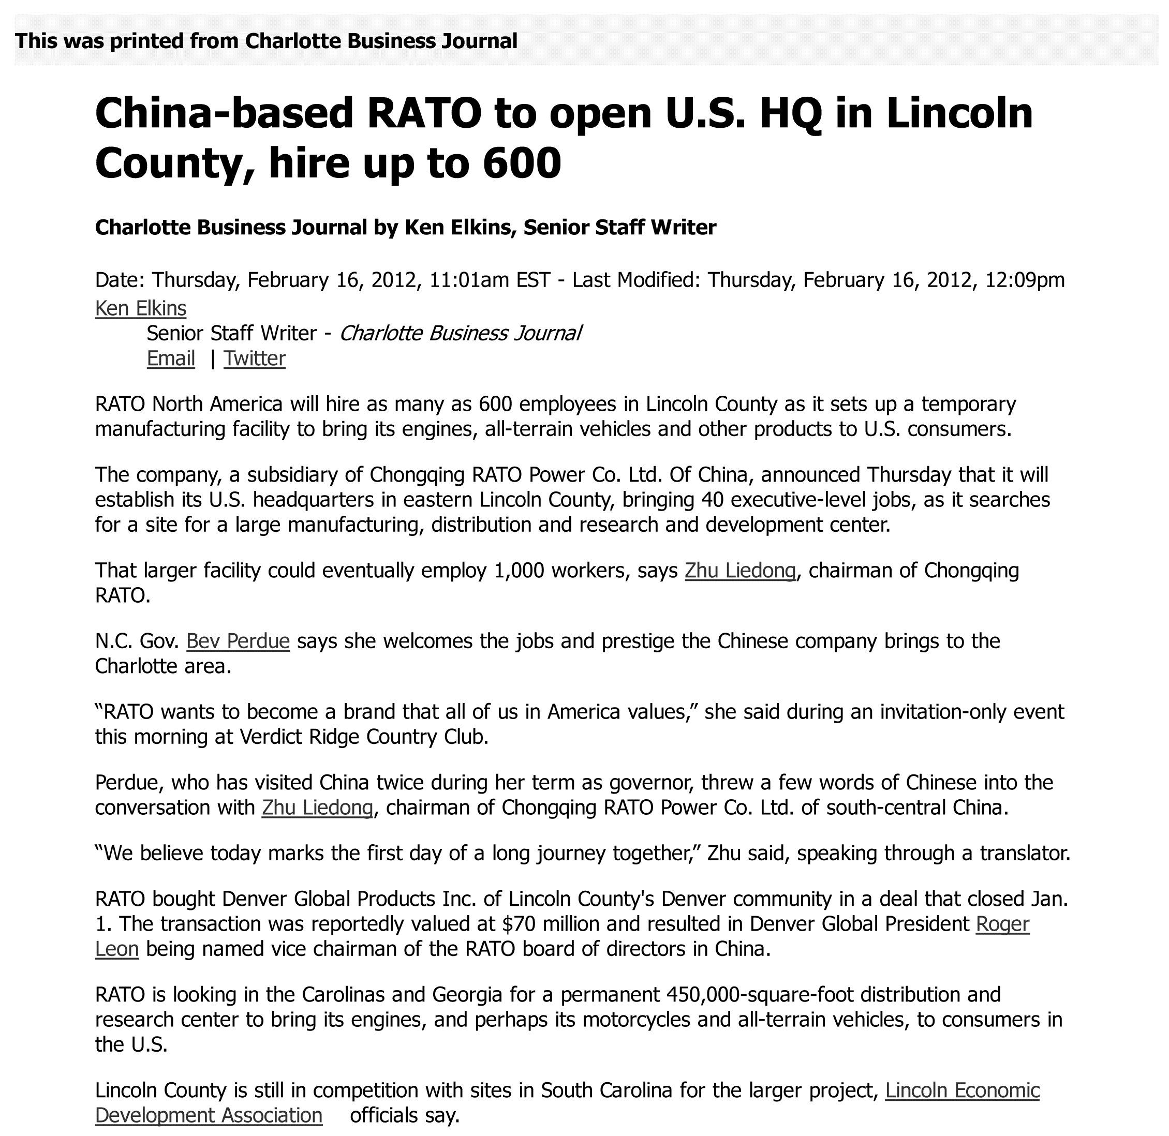
Notes:
98
Here we have a Chinese all-terrain vehicle company that is building a manufacturing plant in North Carolina that will hire 600, and maybe 1,000 workers by the time they complete the facility.
====
China-based RATO to open U.S. HQ in Lincoln County, hire up to 600 (maybe 1000 jobs)
Feb 16, 2012
http://www.bizjournals.com/charlotte/blog/outside_the_loop/2012/02/chinese-company-to-open-in-lincoln.html

Slide 99
Notes:
Another Chinese company is bringing their solar panel factory to Charlotte, North Carolina.
====
International company will bring up to 36 jobs; site will serve as main manufacturing
plant.
http://www.charlotteobserver.com/2011/06/24/2402136/solar-panel-jobs-coming-to-charlotte.html#storylink=misearch
99

Slide 100
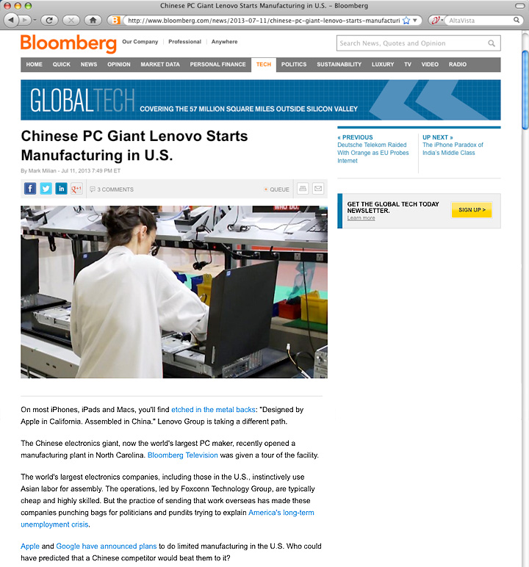
Notes:
And Lenovo, who makes the IBM ThinkPads, is setting up manufacturing in the United States.
=====
http://www.bloomberg.com/news/2013-07-11/chinese-pc-giant-lenovo-starts-manufacturing-in-u-s-.html
Chinese PC Giant Lenovo Starts Manufacturing in U.S.
The Chinese electronics giant, now the world's largest PC maker, recently opened a manufacturing plant in North Carolina. Bloomberg Television was given a tour of the facility.
The world's largest electronics companies, including those in the U.S., instinctively use Asian labor for assembly. The operations, led by Foxconn Technology Group, are typically cheap and highly skilled. But the practice of sending that work overseas has made these companies punching bags for politicians and pundits trying to explain America's long-term unemployment crisis.

Slide 101
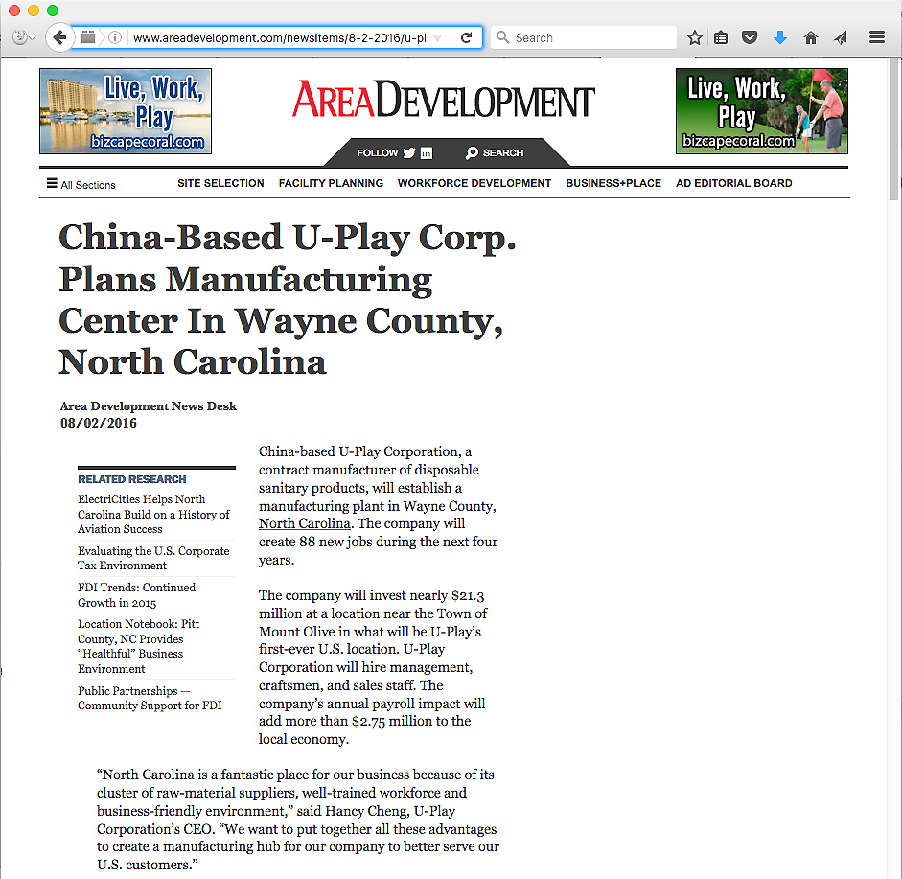
Notes:
Here is a Chinese manufacturer who recently picked North Carolina over South Carolina for a new manufacturing facility, and 88 jobs.
====
http://www.areadevelopment.com/newsItems/8-2-2016/u-play-corporation-wayne-county-north-carolina.shtml
http://www.bizjournals.com/triangle/blog/techflash/2016/08/chinese-firm-picks-north-carolina-over-south.html

Slide 102
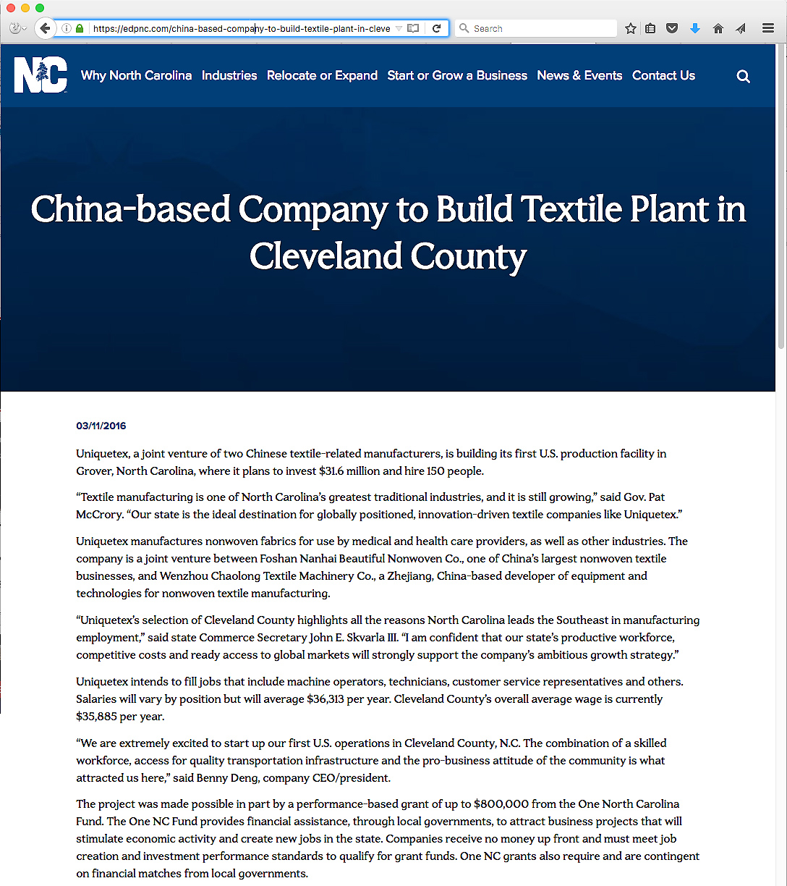
Notes:
Chinese textile company setting up shop in North Carolina.
Plans to hire 150 people
====
https://edpnc.com/china-based-company-to-build-textile-plant-in-cleveland-county/

Slide 103
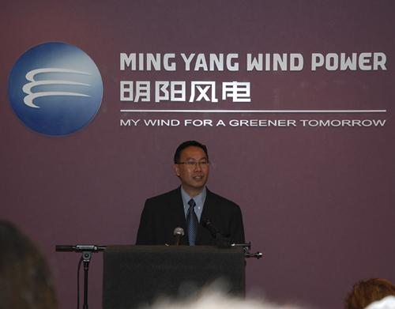
Notes:
103
And Chinese Wind Power Technologies is coming to Raleigh.
What should we be doing to prepare our current students for these jobs, and the jobs that will follow?
How are we preparing our youth to work for a company with cultural norms that our different from ours?
===
China Ming Yang Wind Power Group Limited, a wind turbine manufacturer in China, opened a North American research and development center on N.C. State’s Centennial Campus on Tuesday.
The center will focus on offshore wind turbine research and development. Shu Ching Quek, president of Ming Yang Wind Power USA Inc. (NYSE: MY), will lead the center.
Initially, the company will employ about five people at Centennial Campus, according to Gene Pinder, the campus’ marketing director. It has leased space formerly occupied by WebAssign in the Venture Center IV building at Centennial Campus.
http://www.bizjournals.com/triangle/news/2012/03/13/ncsus-centennial-campus-lands-new.html

Slide 104
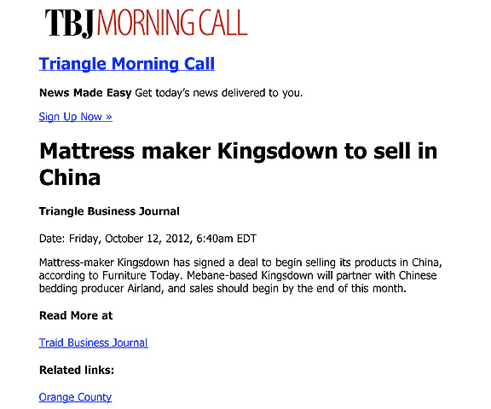
Notes:
And here it works the other way around.
Here is an American manufacturing company in North Carolina that is shipping it’s high-quality mattresses to China.
Yes, products made in America being sold in China.
===
http://www.bizjournals.com/triangle/morning_call/2012/10/mattress-maker-kingsdown-to-sell-in.html?ana=e_trig_rdup&s=newsletter&ed=2012-10-12
104

Slide 105
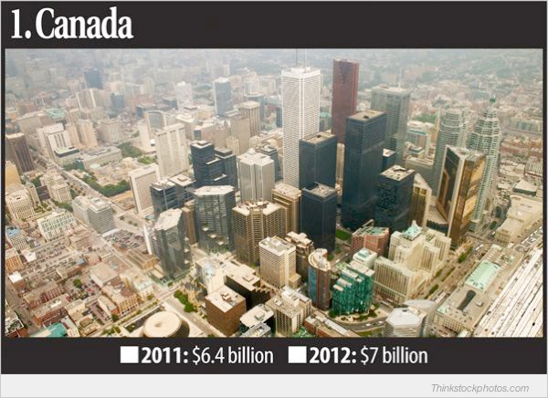
Who’s Buying North Carolina’s Goods
Notes:
The country that buys the most goods made in North Carolina is Canada.
They buy Seven billion dollars of stuff from us each year.
=====
Who’s Buying North Carolina’s Goods
Feb 26, 2013
Triangle Business Journal
http://www.bizjournals.com/triangle/news/2013/02/26/slideshow-whos-buying-north.html

Slide 106
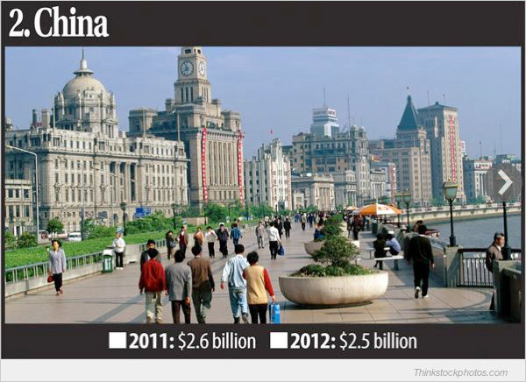
Who’s Buying North Carolina’s Goods
Notes:
And number two is China, buying two and a half billion dollars worth of stuff from North Carolina each year.
Who knew that?
And we need skilled workers to keep making this stuff that the Chinese, and others are buying from us.
=====
Who’s Buying North Carolina’s Goods
Feb 26, 2013
Triangle Business Journal
http://www.bizjournals.com/triangle/news/2013/02/26/slideshow-whos-buying-north.html

Slide 107
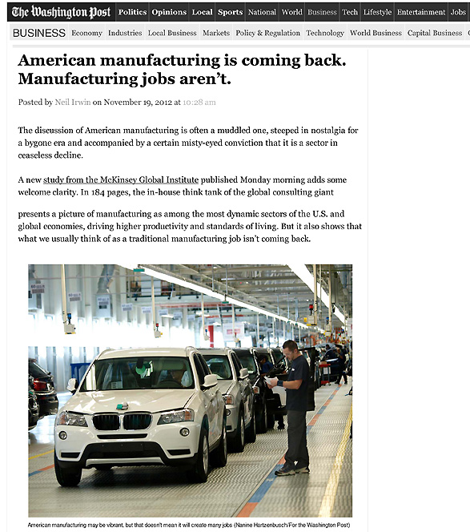
Notes:
As American manufacturing is making its comeback, we find that the old Manufacturing jobs that required a strong back and no education are not coming back.
=====
http://www.washingtonpost.com/blogs/wonkblog/wp/2012/11/19/american-manufacturing-is-coming-back-manufacturing-jobs-arent/
107

Slide 108
NC Advanced Manufacturing Careers Awareness Week
October 2-6, 2017
ncperkins.org/manufacturing
Notes:
I mentioned this earlier.
Here is the date for next year.
We expect over 60 open houses all across the state helping people learn about the modern careers in Advanced Manufacturing.
Spread the word.
======
http://www.ncperkins.org/moodle/course/view.php?id=14

Slide 109
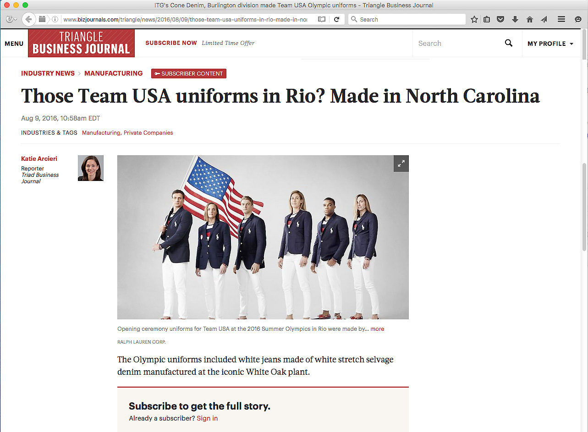
Notes:
The textile industry is alive and well in North Carolina. And folks around the world recently got a chance to see our textiles in action at the Olympics.
The white thread in the pants you see here was made in North Carolina and shipped to South Carolina where the white fabric was made.
Then the white fabric came back to North Carolina where the pants were assembled in Rutherfordton and Greensboro, North Carolina.
The blazers were assembled in Burlington, Raeford, and Cordova, North Carolina
There are no longer sweat shops in North Carolina with young ladies hunched over a manual sewing machine.
No -- these textile operations are high tech and require smart folks to operate the equipment.
Advance Manufacturing, including textile production, is big in North Carolina.
====
Opening Ceremony
http://www.bizjournals.com/triangle/news/2016/08/09/those-team-usa-uniforms-in-rio-made-in-north.html?ana=e_du_prem&s=article_du&ed=2016-08-09&u=DFsejj4U8KnV9lBFgI8D1Q03b85e1a&t=1470853007&j=75380092
Rowing Team
http://www.wcnc.com/sports/olympics/local-business-made-olympic-uniforms/280016944
White fabric
http://www.wyff4.com/sports/2016-olympics/upstate-company-helps-make-uniforms-for-us-olympians/41032828
Pants
http://www.twcnews.com/nc/triangle-sandhills/news/2016/08/6/usa-olympic-opening-ceremony-uniforms-made-in-nc.html
Blazers
http://www.twcnews.com/nc/triangle-sandhills/news/2016/08/6/usa-olympic-opening-ceremony-uniforms-made-in-nc.html

Slide 110
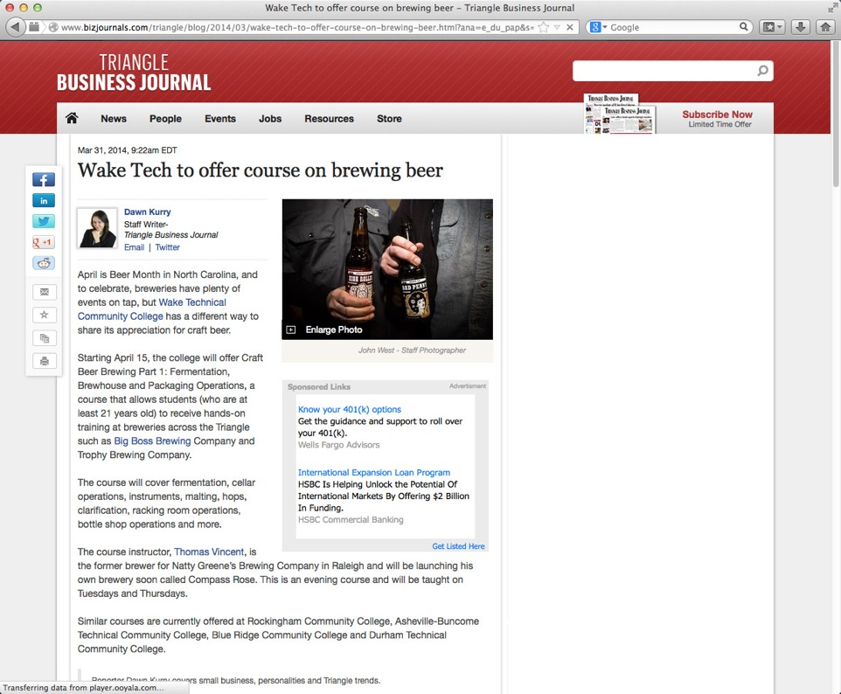
Notes:
We giggle when we think that college students are taking classes to learn how to make beer.
What’s next, classes on how to drink beer?
======
http://www.bizjournals.com/triangle/blog/2014/03/wake-tech-to-offer-course-on-brewing-beer.html?ana=e_du_pap&s=article_du&ed=2014-03-31
Mar 31, 2014, 9:22am EDT
Wake Tech to offer course on brewing beer
Starting April 15, the college will offer Craft Beer Brewing Part 1: Fermentation, Brewhouse and Packaging Operations, a course that allows students (who are at least 21 years old) to receive hands-on training at breweries across the Triangle such as Big Boss Brewing Company and Trophy Brewing Company.

Slide 111
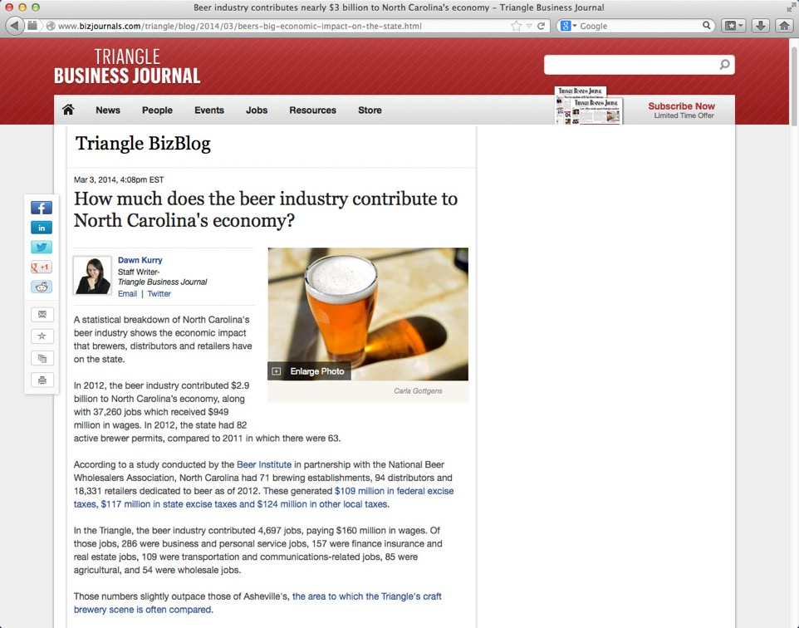
$2.9 billion contribution to NC economy in 2012
37,000 jobs in 2012
$350 million in taxes
Notes:
Seriously though, beer making is becoming big business in North Carolina, especially in the Triangle region and in Asheville.
In 2012 the beer industry contributed 2.9 billion dollars to North Carolina’s economy, which included over 37 thousand jobs.
In federal, state and local taxes, North Carolina beer contributed 350 million dollars.
This is manufacturing, and it is not like the beer making factories of old.
=============
http://www.bizjournals.com/triangle/blog/2014/03/beers-big-economic-impact-on-the-state.html
Mar 3, 2014, 4:08pm EST
How much does the beer industry contribute to North Carolina's economy?
In 2012, the beer industry contributed $2.9 billion to North Carolina’s economy, along with 37,260 jobs which received $949 million in wages. In 2012, the state had 82 active brewer permits, compared to 2011 in which there were 63.
According to a study conducted by the Beer Institute in partnership with the National Beer Wholesalers Association, North Carolina had 71 brewing establishments, 94 distributors and 18,331 retailers dedicated to beer as of 2012. These generated $109 million in federal excise taxes, $117 million in state excise taxes and $124 million in other local taxes.

Slide 112
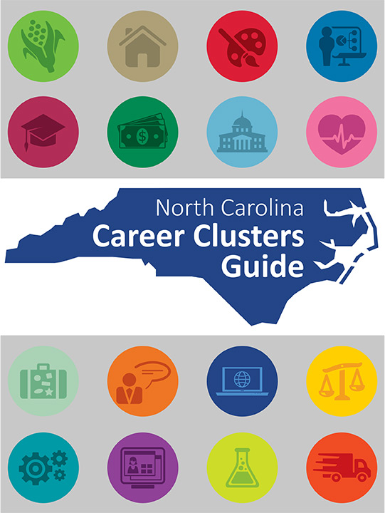
Notes:
Working together with the Department of Public Instruction, we published a new Career Clusters Guide last year in 2015.
Copies have been distributed to the community colleges, high schools, and other locations across the state.
We want to ensure that everyone has both timely and accurate career information, thus promoting informed decisions about choosing a career path.
This guide will assist anyone in identifying the available career options by using individual interests, clearly defined career pathways, and timely employment projections.
=====
http://ncperkins.org/careers/

Slide 113
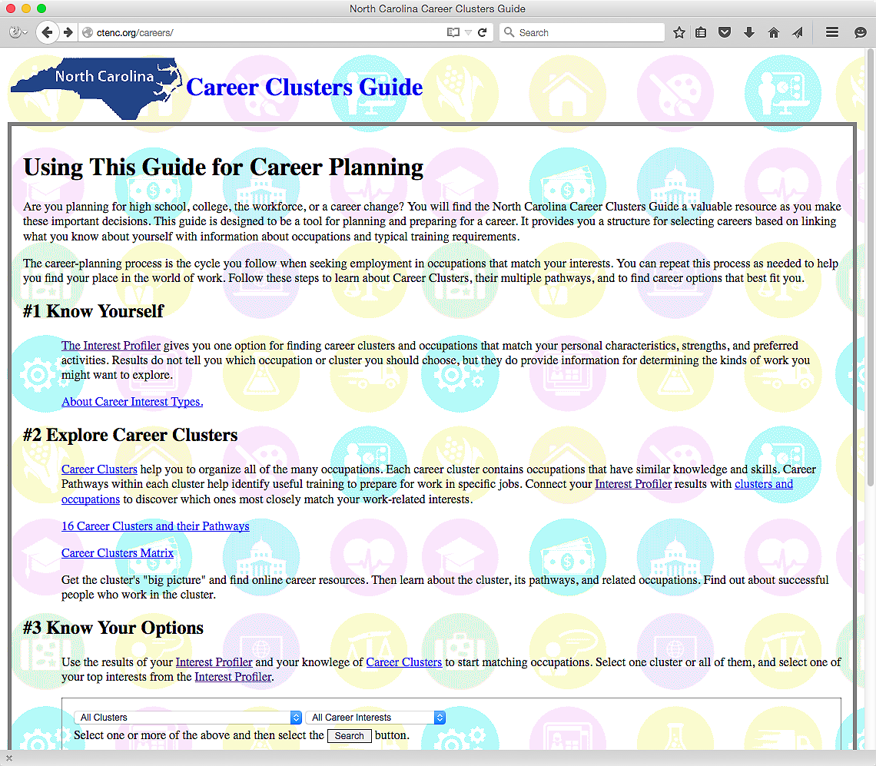
NCperkins.org/careers
Notes:
And now look. We took the book and made it into an interactive website. How cool is that?
Here is the web address. NC Perkins dot org is the same website where you can find this PowerPoint.
You can see the job projections and salaries for each occupation for each of the eight North Carolina Prosperity Zones as well as the composite for the state.
There is also a career interest assessment to help the kids get started.
We have to help our students discover who they are first -- before we can help them find the career that is best suited for them.
Besides the interactive web pages, a PDF of the printed book is available at the bottom of the main page.
And also at the bottom of the main page is a link to a 17-minute tutorial video on the book and the website.
Check it out.
=====
http://ncperkins.org/careers/

Slide 114
Notes:
The FDIC protects all bank deposits in the United States.
But - Who is protecting the bitcoin, or PayPal, or your frequent flyer miles?
It used to be that all currency was create and managed by governments who stood behind the value of their currency.
But now even governments are failing
The great city of Detroit, Michigan, filed for bankruptcy in 2013. Who’s next?
Businesses used to be faithful to their country. In World War I and II, companies stopped production to do what they could for the war effort.
Would they do that today?
The Internet and the flattening of the world has made some great changes. What’s next?
======
http://www.bizjournals.com/newyork/news/2016/08/03/72m-worth-of-bitcoin-was-stolen-in-hong-kong.html?ana=e_sjo_tf&s=newsletter&ed=2016-08-04&u=DFsejj4U8KnV9lBFgI8D1Q03b85e1a&t=1470656855&j=75325132

Slide 115
Surprises Future Demand Changing World New Ideas
www.ncPerkins.org/presentations
Notes:
Let’s look at some new ideas.

Slide 116
Notes:
There is a lot of high-tech going on in modern kitchens. The appliances are all talking to each other.
And when you are running low on milk, the refrigerator orders another gallon that could be delivered directly to your house.
When the milk arrives, your refrigerator could even unlock and open the front door of the house -- and let the drone in -- and have the drone put the milk in the refrigerator. It’s all possible now through current technology.
-- We still have to drink the milk ourselves. There’s no app for that!
=====
http://siliconangle.com/blog/2015/01/08/best-new-apps-for-apple-homekit-at-ces2015/

Slide 117
Notes:
Your home automation system could anticipate your needs and even make you a sandwich.
We need workers who will dream up these ideas, do the engineering, build them, install them, program them, fix them when they don’t work, and keep the hackers at bay.
And then we need some special workers - to convince us all - that this new technology is actually a good thing.
=====
http://www.cnn.com/2012/06/18/tech/predictive-technology-future/

Slide 118
Notes:
Sometimes we have to think outside the box.
This is not just for our us, but for our students as well.
====
http://cdn.elev8.com/files/2010/07/think-outside-the-box.jpg

Slide 119
Notes:
Soul Stix Surfboards had a problem like many other companies about what to do with it’s waste material when they cut a new surfboard from a block of polyurethane foam.
It creates plastic flakes like snowflakes that are hard enough just to capture out of the air, much less dispose of.
What they found is that this special plastic “saw dust” is very good at sopping up chemicals, like spilled oil in the ocean.
Yes -- what was once a waste product is now helping to clean up oil spills.
You know the saying – “One man’s trash is another man’s treasure.”
Are we teaching our youth to recycle? and then to go one step further to look for new things to recycle?
In my house, the recycle bin always has more in it than the garbage bin.
Can we ever get to the point where everything is recyclable and nothing goes to the landfill?
We have to get people to get outside of the box and look for new ways to make money. One way is by selling trash.
=====
http://www.forbes.com/forbes/2011/1024/entrepreneurs-green-technology-surfboards-monarch-todd-woody.html
Photo
http://www.degree33surfboards.com/blog/surf-education/sell-surfboard-craigslist/

Slide 120
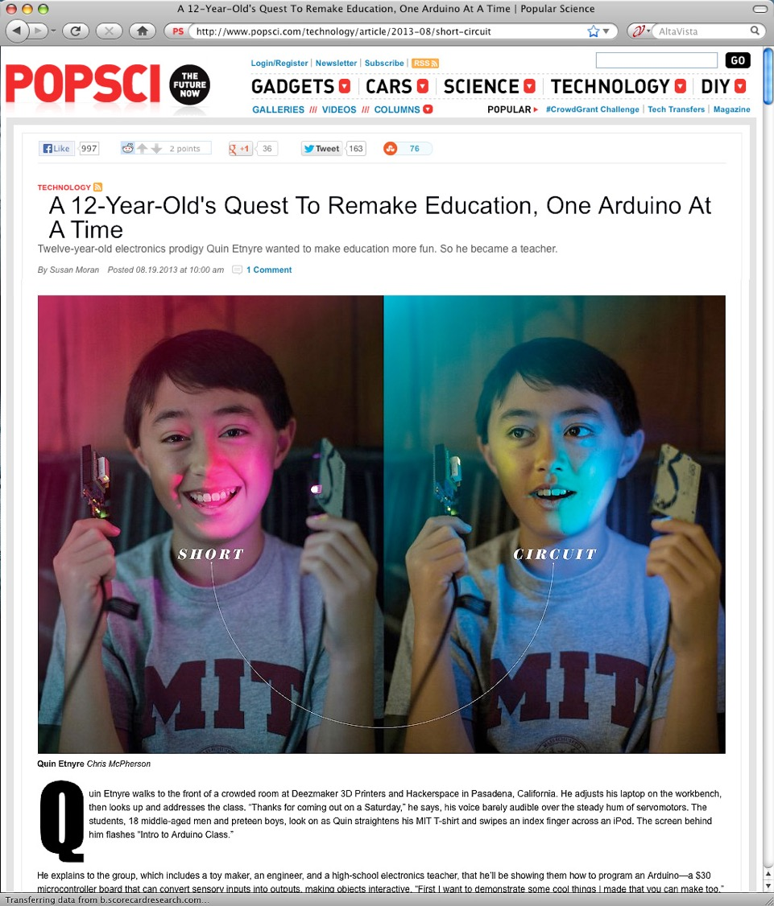
Notes:
An Arduino is a small circuit board with a microprocessor that can be used to build almost anything.
Here is a 12-year old who has unleashed the potential of the Arduino and is building useful products.
======
http://www.popsci.com/technology/article/2013-08/short-circuit
A 12-Year-Old's Quest To Remake Education, One Arduino At A Time

Slide 121
Notes:
Here is a close up of this circuit board that costs about $30.
Think of this as an electronic version of the tinker toys or erector sets that we grew up with.
======
http://www.popsci.com/technology/article/2013-08/short-circuit
A 12-Year-Old's Quest To Remake Education, One Arduino At A Time

Slide 122
Notes:
What does a typical 12 year old build with all this technology? . . .
Here is a small robot that is built around one of these Arduino circuits that has a built-in methane detector.
In plain language--- this 12-year old boy has built a remote-controlled fart detector.
But seriously, -- a simple robot like this could be programmed to patrol a sealed landfill looking for methane leaks.
======
http://www.popsci.com/technology/article/2013-08/short-circuit
A 12-Year-Old's Quest To Remake Education, One Arduino At A Time

Slide 123
Notes:
Here is the same 12-year old teaching a class on a Saturday morning to people that want to learn how to make and program things with the Arduino microprocessor.
This kid might just end up at MIT.
======
http://www.popsci.com/technology/article/2013-08/short-circuit
A 12-Year-Old's Quest To Remake Education, One Arduino At A Time

Slide 124
Notes:
Pizza Hut has developed this new computer-topped table that allows you to see what your food will look like before you order.
You just decide how big you want your pizza, drag over the ingredients, pay with your smart phone, and hit send.
No need for a person to take your order.
After you order, you can use the table top to play games or read the newspaper while you wait.
Technology like this could eliminate many waiter and order-taker positions.
But it creates high-tech positions to design, build, install, and maintain these technologies.
And best of all for the guys --- this eliminates all reasons to have to talk on a date. Just point and click! ;-)
====
http://www.adweek.com/adfreak/pizza-huts-swipe-order-table-cool-and-useful-or-gross-and-inefficient-156080
Pizza Hut's Swipe-to-Order Table: Cool and Useful, or Gross and Inefficient? When talking to a human just won't cut it
Video: http://www.youtube.com/watch?v=xvT0MCugb58#t=13

Slide 125
The way of doing business is changing
Competitiveness is not working and is going away.
Collaboration is the way of the future. Businesses creating a niche market and working with other businesses to help each other.
We need to change the focus from self-centered learning to group-centered learning.
Notes:
We need more diversity of thought. With more women entering the higher levels of business, we are seeing a shift in the way of doing business. And I like it.
The traditional male version of running a business, built upon a platform of competitiveness, is now evolving.
Collaboration is the new way of life in the business world.
Small businesses supporting each other -- rather than trying to buy out the competition or acquire the supply line.
So how does this affect what we are doing in the classroom?
Our education system is set up to encourage students to compete with each other for the best grades, class rank, and the honor of being the valedictorian. Is this preparing them for the future workplace?
In schools, we have traditionally called collaboration -- “cheating.”
Kids are collaborating with each other on their smart phones, but rather than trying to stop it, we should be encouraging it.
And we should be teaching them the proper way of using technology and the proper way of collaborating that brings about synergistic results.
We need to change the focus from self-centered learning to group-centered learning.
From individuals doing great on individualized assessments to students working together to solve a relevant problem.
We need to change our schools to reflect this change in the work environment.
This assumes that one of the purposes of education is to prepare kids for the workplace.
125

Slide 126
Notes:
North Carolina ranks number three for growth in women entrepreneurship
The number of women-owned businesses has increased 68 percent since 1997.
Entrepreneurship, or starting your own business, is what is building the economy.
The only way to get a kid to think about being an entrepreneur is to empower them to take charge of their own education first, - and then see if they like being in charge.
=====
http://www.bizjournals.com/triangle/blog/2014/03/north-carolina-ranks-no-3-for-growth-in-women.html?ana=e_du_pap&s=article_du&ed=2014-03-31
Mar 28, 2014, 4:45pm EDT Updated: Mar 28, 2014, 4:57pm EDT
North Carolina ranks No. 3 for growth in women entrepreneurship
In North Carolina, women own 267,800 firms and employ 268,300 people, according to a new report from American Express OPEN, which ranks the state third in the growth of women-owned firms over the last 17 years.
The number of women-owned businesses has increased 68 percent since 1997, the report says, while women-owned businesses in 2007 generated $32 million in sales, a figure that grew to $35.9 million in 2014.
The report shows an estimated 1,288 women start new businesses every day, which is double the rate from three years ago. There are more than 9.1 million women-owned businesses in the United States, compared to 8.6 million in 2013. These businesses generate more than $1.4 trillion in revenues, employ 7.9 million people and account for 30 percent of all enterprises.
"The report clearly shows that women are choosing the path of entrepreneurship at record rates," said Randi Schochet, vice president of brand strategy and activation, American Express OPEN. "Imagine the economic impact if more of these new ventures were transformed into thriving businesses. This is why American Express OPEN remains so passionately dedicated to helping women entrepreneurs become successful business owners."

Slide 127
Notes:
Here is a middle school engineering class that is designing a prosthetic hand for a classmate -- who wants to be a cheerleader, -- but couldn’t hold the pompoms.
So far they have built a working prototype of a finger.
This class is not about kids individually learning engineering principles and then releasing them on a summative assessment.
It’s about kids working together as a team to solve a real, and personal problem that does not have a textbook answer.
This is what the business community is looking for. They want new recruits that can work in teams to solve new problems.
====
http://www.sj-r.com/article/20131230/ENTERTAINMENTLIFE/131239999/10298/LIFESTYLE
Students build prosthetic hand for classmate
By Amy Scalf
The Kentucky Enquirer
Posted Dec. 30, 2013 @ 9:50 pm
Dec 30, 2013 at 11:27 PM
EDGEWOOD, Ky. (AP) — A Turkey Foot Middle School engineering class is working on a unique hands-on project.
Teacher Dwayne Humphrey teaches sixth- and seventh-graders how to use engineering design and modeling software, starting with toys and video games, then moving into biomedical design in the eighth grade.
This year, his older students are using those skills and a 3-D printer to build a prosthetic hand for a fellow student who was born without the lower part of her left arm.
“Each year, the students make some kind of prosthetic, a leg or a hand, and someone has to walk on the leg or use the hand to do specific tasks. My students have the skills and ability to do this, but they’re not medical professionals. We’re not licensed to create prosthetics for students,” said Humphrey. “Instead of making something that would just be discarded, I thought, ‘Why can’t we find someone who could really use this?’”
Then, a new seventh-grade student enrolled at the school.
When Makayla Murphy entered Humphrey’s engineering class, the teacher noticed she has only one hand.
Makayla was born without the lower part of her left arm, and she quickly agreed to be the model for the eighth-grade class project.
“I have difficulties getting dressed and carrying books and stuff,” she said.
She wanted to be a cheerleader, but said she couldn’t hold the pompoms.
“I’m really excited about it because having an arm that can actually move is going to be really cool,” Makayla said.
“We’re on a journey here. We don’t know how it’s going to end. We do know we’re going to give it our best effort and it’s coming together pretty nicely,” said Humphrey. “It’s incredible how quickly things are changing. As we look into the future, we realize we haven’t seen anything yet.”
He also said the project has sparked a special interest among the students.
“Middle-schoolers want to influence the world and they get frustrated over lack of control in their lives. With this project, they get to change someone’s real life. There’s a real opportunity in class to design lessons that have real-world connections,” Humphrey said. “Around the world, kids between the ages of 11-14 are adding to the well of human knowledge and invention. We’re trying to engage students in work that is meaningful.”
Josh Suedkamp and Malachi Pike said that’s exactly why they like this project.
“It’s better because you’re actually affecting someone’s life,” said Malachi. “It’s cool because it helps a real person and it’s not just a school project.”
“I think we’re setting the right kind of tone to really get kids to consider their future careers and giving opportunities to research many of them,” Humphrey said. “Hopefully, we’ll spark something great.”
Read more: http://www.sj-r.com/article/20131230/ENTERTAINMENTLIFE/131239999/10298/LIFESTYLE#ixzz2pGvV3D3y

Slide 128
Notes:
This leads us to what this author has proposed as the number one job skill that employers are looking for in 2020.
It’s getting past the computer screen and really getting to know your customer as a person, not just a number.
It’s getting to know them so well that you truly feel their pain.
This crucial career skill is called -- Empathy.
Not to just feel sorry for someone, like Sympathy, but to truly feel their pain is Empathy.
When do we get to know our students (or clients) so well we feel their pain?
How can we teach this highly prized skill to get folks ready for a career?
=====
http://www.linkedin.com/today/post/article/20130611180041-59549-the-no-1-job-skill-in-2020
The Number One Job Skill in 2020
June 11, 2013
Empathy
Dictionary: the intellectual identification with or vicarious experiencing of the feelings, thoughts, or attitudes of another.
Cultural Dictionary: Identifying oneself completely with an object or person, sometimes even to the point of responding physically, as when, watching a baseball player swing at a pitch, one feels one's own muscles flex.

Slide 129
The 10 Key Skills for the Future of Work
Sense-making
Social intelligence
Novel and adaptive thinking
Cross-cultural competency
Computational thinking
New-media literacy
Transdisciplinarity
Design mind-set
Cognitive load management
Virtual collaboration
Notes:
Here are some broad skills that will help workers adapt to the changing career landscape:
Sense-making is the ability to determine the deeper meaning or significance of what is being expressed
Social intelligence is the ability to connect to others in a deep and direct way, to sense and stimulate reactions and desired interactions
Novel and adaptive thinking is proficiency at thinking and coming up with solutions and responses beyond that which is rote or rule-based
Cross-cultural competency is the ability to operate in different cultural settings
Download my PowerPoint and read the descriptions for the rest of these.
Where are we teaching these skills that the workforce needs?
==========
Computational thinking is the ability to translate vast amounts of data into abstract concepts and to understand data-based reasoning
New-media literacy is the ability to critically assess and develop content that uses new media forms and to leverage these media for persuasive communication
Transdisciplinarity is literacy in, and ability to understand concepts across multiple disciplines
Design mind-set is the ability to represent and develop tasks and work processes for desired outcomes
Cognitive load management is the ability to discriminate and filter information for importance and to understand how to maximize cognitive functioning using a variety of tools and techniques, and
Virtual collaboration is the ability to work productively, drive engagement, and demonstrate presence as a member of a virtual team
Are we teaching these skills to our students? If not, then who will?
========
GigaOM
Dec. 16, 2011,
http://gigaom.com/collaboration/the-10-key-skills-for-the-future-of-work/?utm_source=General%20Users&utm_campaign=9bd9bdcde9-c%3Atec%20d%3A12-17&utm_medium=email
What are the jobs of the future? The demographics of an aging population suggests health care will be big, say some.
Broad skills that will help workers adapt to the changing career landscape:
Sense-making. The ability to determine the deeper meaning or significance of what is being expressed
Social intelligence. The ability to connect to others in a deep and direct way, to sense and stimulate reactions and desired interactions
Novel and adaptive thinking. Proficiency at thinking and coming up with solutions and responses beyond that which is rote or rule-based
Cross-cultural competency. The ability to operate in different cultural settings
Computational thinking. The ability to translate vast amounts of data into abstract concepts and to understand data-based reasoning
New-media literacy. The ability to critically assess and develop content that uses new media forms and to leverage these media for persuasive communication
Transdisciplinarity. Literacy in and ability to understand concepts across multiple disciplines
Design mind-set. Ability to represent and develop tasks and work processes for desired outcomes
Cognitive load management. The ability to discriminate and filter information for importance and to understand how to maximize cognitive functioning using a variety of tools and techniques
Virtual collaboration. The ability to work productively, drive engagement and demonstrate presence as a member of a virtual team

Slide 130
Preparing for Future Employment
Notes:
What are the employers really looking for in an entry-level employee?
What sets one applicant apart from all of the other job applicants?
Will all that change three to five years from now when our students are looking for their first job?
=====
http://theimpactnews.com/news/2014/03/20/ways-future-graduates-should-begin-to-prepare-before-graduation/
http://www.huffingtonpost.com/jennifer-kushell/how-to-prepare-young-peop_b_4593076.html

Slide 131
Ambition
Notes:
Employers are willing to train their employees to learn new technical skills, but they do not have time to make their employees ambitious.
Cultivating ambition and an eagerness to learn and do well -- are really important.
Young people who show ambition are more employable,
And when they have a passion for achievement, there are no limits to what they can do.
Ambition is a good thing, -- however, -- too much ambition can be bad.
Remember that as a new employee you are ambitious to learn, not ambitious to take over.
Being overly ambitious could indicate an unwillingness to learn.
======
http://www.huffingtonpost.com/jennifer-kushell/how-to-prepare-young-peop_b_4593076.html
http://www.therecruitmentdesk.com/?tag=ronald-mcdonald
With the world changing as fast as it is - industries rising, evolving and crashing; technology leading to more efficient, effective ways of doing everything; globalization interconnecting us all; and a whole new generation emerging and entering the workforce - how do we best ensure young people are prepared for the world of work from here forward? Keep in mind that along with the jobs being phased out, countless more jobs don’t even exist yet.
In order to create employment for those who are graduating, it’s important for us to review a system that has become antiquated. Even more critical, however, is to note that our current models of education, career planning and job searching are not just in need of a facelift - we need a major paradigm shift in how we think about training our emerging workforce and the skills they need to have to be relevant, let alone have a chance at being wildly successful.
But we do not need to wait for this shift in order to start teaching the new rules of success every day, in every forum, and every possible platform and channel available to us. It can be done in simple conversations or formalized programs - everyone can play a role in training our young people; they are, after all, our kids, cousins, neighbors, friends, colleagues and employees. The bottom line is that we can all ensure this emerging generation is primed for success, and it’s in our best interest to do so. Our future depends on it.
The following 10 skills are most vital to young people entering the workforce:
Ambition Ambition changes the opportunity outlooks for a young person dramatically. Employers are increasingly looking to hire for attitude and train for skill, so cultivating ambition and an eagerness to learn and do well are really Step 1 toward a solid future. Young people who are hungry, interested and engaged are infinitely more employable, and when they have a passion for achievement, there are no limits to what they can do. Rather than just hire warm bodies, companies would much rather choose people who show promise and a solid foundation.
Value Understanding what it means to add value to a company or organization is a fundamental question that should be answered by anyone looking for work, along with appreciating why that’s an important question in the first place. Employment is an earned privilege, not a right - even with a fancy diploma in hand, there are no promises or guarantees. People are typically the biggest expense in any organization, and those who add most value have the best job security. Those who don’t usually don’t stay employed for very long. In a corporate world that is looking more than ever before at operating lean, it’s no longer possible to hide and not contribute to a company’s financial well-being.
Articulation The vast majority of young people struggle with explaining what they want to do, what work-related activities interest them, what transferable skills they have, and which industries or positions might best suit them. As a result, when they set out to market themselves, or interview with potential employers, they offer little useful information, and instead rely on those doing the hiring to find the right fit and figure it out. Recruiters are not career counselors - selling oneself in the job market is the responsibility of the seeker! Relying on our institutions or parents to “place” young people in jobs is a practice fraught with problems, and enabling entitlement or minimizing the importance of self-sufficiency - or the fortitude to secure meaningful work - are only a few of the drawbacks. Teaching people to pitch themselves effectively early in their working lives enables them to find employment on their own over a lifetime.
Skills The basis of any solid employment marketing campaign (job search) is the actual skill base a worker presents to potential employers. At the most fundamental level, soft skills like interpersonal communication, the ability to speak and write correctly and present ideas clearly, are the areas most often cited when employers discuss the downside of hiring young people. Dressing appropriately (highly subjective these days) is also considered a critical part of communication. So despite the constant “communication” through technology that has dominated young lives, they are at a massive disadvantage because in person those soft skills are not present.
Expertise Besides being a good person to work with and around, bringing some substantive expertise to the table cannot be urged enough. It doesn’t matter what the topic, as long as it’s valuable in the marketplace (remember the “Adding Value” piece above?). Ideally, expertise is transferable to other applications and industries too - and it’s important to note that attending specialty schools and formal training programs are not the only ways to acquire expertise. It can and should be cultivated constantly, with young people maximizing every opportunity to read, learn, volunteer, train, practice or work.
Terminology Every industry relies on its own lexicon of terminology to operate and communicate. Often these are technical concepts, processes or acronyms that sound foreign to people new to a field. Teaching young people to learn the language of a given workplace, industry or role is directly related to how smart they will sound and how well they will function in an environment, and dramatically improve their chance of securing jobs because companies will first choose someone who needs less time to be brought up to speed.
Curiosity When young people are supported in pursuing fields that are of true interest, they are more likely to want to learn more and become well-versed in those areas. Intellectual curiosity leads to better educated and more informed workers, who can quickly cultivate themselves into real talent with a little help. The more inspired and motivated they are, and the more space they are given to explore, create and innovate, the more their potential becomes unlimited. This is an important consideration given that school curriculum often focus on a core set of skills, and other programs such as art, music or other non-academics are eliminated.
Context The concept of context is a vital one to address with young people, from 4 key perspectives:
1) The working world operates by a different set of rules than most homes and schools. Training young people to acclimate to the adult world of work requires a dramatic shift in routines and expectations from a lifetime of studying and attending classes.
2) Different workplaces have different expectations about dress, attendance, communication, metrics for success and even use of personal technologies. Expectations that aren’t clearly understood are difficult to meet and that sets everyone up for failure. 3) It is a big problem that most young graduates don’t understand how business fundamentally works and is organized. For example, what is the difference between marketing and sales, or operations? What signs would signal that a company or industry is hiring, or worth studying or pursuing jobs in? How does one company fare in a market of other competitors (who happen to be other potential employers too)? What do industries look like? 4) How do we all fit into the bigger context of the world economy as global citizens? With a billion young people entering the workforce, there’s a lot of competition, but also plenty of untapped opportunity.
All of these conversations, if nothing else, break young people from the idea that they’re the center of the universe. Or, conversely, that their world is small, restricted and their options are limited.
Experience Students, unemployed people and those in jobs they hate are all missing opportunities to improve their circumstances and marketability by building experience, which can be acquired in countless ways. In many cases, they can do so simply by volunteering time to local organizations, businesses, campaigns and community events. The more relevant to the skills or the industries someone wants to use at work, the better. With countless organizations struggling to survive and grow, but desperate for help they cannot afford, volunteering or interning can be the perfect opportunity for people to gain practical experience and connections, and to seed future opportunities. Even if the opportunities are unpaid, by staying active and engaged makes the unemployed infinitely more marketable.
Resourcefulness Teaching young people to be solution-driven (rather than easily deterred by failure) makes them more valuable, competitive and self-sufficient. When people are resourceful, they will always entertain new ideas, approaches and possibilities. Entrepreneurship education and experience is an excellent way to drive this home and make young people more resourceful, as are hackathons, leadership activities and organizations. Cultivating resourcefulness as a skill prepares young people for jobs that may not yet exist; in fact, the more resourceful they are, the more likely the next generation will be to create their own jobs - and companies that will create jobs for others.

Slide 132
Value
Notes:
Understanding what it means to add value to a company or organization is a fundamental question that should be answered by anyone looking for work, along with appreciating why that’s an important question in the first place.
Employment is an earned privilege, not a right - even with a fancy diploma in hand, there are no promises or guarantees.
People are typically the biggest expense in any organization, and those who add the most value have the best job security.
Those who don’t add value usually don’t stay employed for very long.
What makes you a valuable person?
How can you convey that image to a potential employer?
======
http://www.huffingtonpost.com/jennifer-kushell/how-to-prepare-young-peop_b_4593076.html
http://www.therecruitmentdesk.com/?tag=ronald-mcdonald
http://worldofdtcmarketing.com/ensure-pharma-websites-add-value/health-information-online/
With the world changing as fast as it is - industries rising, evolving and crashing; technology leading to more efficient, effective ways of doing everything; globalization interconnecting us all; and a whole new generation emerging and entering the workforce - how do we best ensure young people are prepared for the world of work from here forward? Keep in mind that along with the jobs being phased out, countless more jobs don’t even exist yet.
In order to create employment for those who are graduating, it’s important for us to review a system that has become antiquated. Even more critical, however, is to note that our current models of education, career planning and job searching are not just in need of a facelift - we need a major paradigm shift in how we think about training our emerging workforce and the skills they need to have to be relevant, let alone have a chance at being wildly successful.
But we do not need to wait for this shift in order to start teaching the new rules of success every day, in every forum, and every possible platform and channel available to us. It can be done in simple conversations or formalized programs - everyone can play a role in training our young people; they are, after all, our kids, cousins, neighbors, friends, colleagues and employees. The bottom line is that we can all ensure this emerging generation is primed for success, and it’s in our best interest to do so. Our future depends on it.
The following 10 skills are most vital to young people entering the workforce:
Ambition Ambition changes the opportunity outlooks for a young person dramatically. Employers are increasingly looking to hire for attitude and train for skill, so cultivating ambition and an eagerness to learn and do well are really Step 1 toward a solid future. Young people who are hungry, interested and engaged are infinitely more employable, and when they have a passion for achievement, there are no limits to what they can do. Rather than just hire warm bodies, companies would much rather choose people who show promise and a solid foundation.
Value Understanding what it means to add value to a company or organization is a fundamental question that should be answered by anyone looking for work, along with appreciating why that’s an important question in the first place. Employment is an earned privilege, not a right - even with a fancy diploma in hand, there are no promises or guarantees. People are typically the biggest expense in any organization, and those who add most value have the best job security. Those who don’t usually don’t stay employed for very long. In a corporate world that is looking more than ever before at operating lean, it’s no longer possible to hide and not contribute to a company’s financial well-being.
Articulation The vast majority of young people struggle with explaining what they want to do, what work-related activities interest them, what transferable skills they have, and which industries or positions might best suit them. As a result, when they set out to market themselves, or interview with potential employers, they offer little useful information, and instead rely on those doing the hiring to find the right fit and figure it out. Recruiters are not career counselors - selling oneself in the job market is the responsibility of the seeker! Relying on our institutions or parents to “place” young people in jobs is a practice fraught with problems, and enabling entitlement or minimizing the importance of self-sufficiency - or the fortitude to secure meaningful work - are only a few of the drawbacks. Teaching people to pitch themselves effectively early in their working lives enables them to find employment on their own over a lifetime.
Skills The basis of any solid employment marketing campaign (job search) is the actual skill base a worker presents to potential employers. At the most fundamental level, soft skills like interpersonal communication, the ability to speak and write correctly and present ideas clearly, are the areas most often cited when employers discuss the downside of hiring young people. Dressing appropriately (highly subjective these days) is also considered a critical part of communication. So despite the constant “communication” through technology that has dominated young lives, they are at a massive disadvantage because in person those soft skills are not present.
Expertise Besides being a good person to work with and around, bringing some substantive expertise to the table cannot be urged enough. It doesn’t matter what the topic, as long as it’s valuable in the marketplace (remember the “Adding Value” piece above?). Ideally, expertise is transferable to other applications and industries too - and it’s important to note that attending specialty schools and formal training programs are not the only ways to acquire expertise. It can and should be cultivated constantly, with young people maximizing every opportunity to read, learn, volunteer, train, practice or work.
Terminology Every industry relies on its own lexicon of terminology to operate and communicate. Often these are technical concepts, processes or acronyms that sound foreign to people new to a field. Teaching young people to learn the language of a given workplace, industry or role is directly related to how smart they will sound and how well they will function in an environment, and dramatically improve their chance of securing jobs because companies will first choose someone who needs less time to be brought up to speed.
Curiosity When young people are supported in pursuing fields that are of true interest, they are more likely to want to learn more and become well-versed in those areas. Intellectual curiosity leads to better educated and more informed workers, who can quickly cultivate themselves into real talent with a little help. The more inspired and motivated they are, and the more space they are given to explore, create and innovate, the more their potential becomes unlimited. This is an important consideration given that school curriculum often focus on a core set of skills, and other programs such as art, music or other non-academics are eliminated.
Context The concept of context is a vital one to address with young people, from 4 key perspectives:
1) The working world operates by a different set of rules than most homes and schools. Training young people to acclimate to the adult world of work requires a dramatic shift in routines and expectations from a lifetime of studying and attending classes.
2) Different workplaces have different expectations about dress, attendance, communication, metrics for success and even use of personal technologies. Expectations that aren’t clearly understood are difficult to meet and that sets everyone up for failure. 3) It is a big problem that most young graduates don’t understand how business fundamentally works and is organized. For example, what is the difference between marketing and sales, or operations? What signs would signal that a company or industry is hiring, or worth studying or pursuing jobs in? How does one company fare in a market of other competitors (who happen to be other potential employers too)? What do industries look like? 4) How do we all fit into the bigger context of the world economy as global citizens? With a billion young people entering the workforce, there’s a lot of competition, but also plenty of untapped opportunity.
All of these conversations, if nothing else, break young people from the idea that they’re the center of the universe. Or, conversely, that their world is small, restricted and their options are limited.
Experience Students, unemployed people and those in jobs they hate are all missing opportunities to improve their circumstances and marketability by building experience, which can be acquired in countless ways. In many cases, they can do so simply by volunteering time to local organizations, businesses, campaigns and community events. The more relevant to the skills or the industries someone wants to use at work, the better. With countless organizations struggling to survive and grow, but desperate for help they cannot afford, volunteering or interning can be the perfect opportunity for people to gain practical experience and connections, and to seed future opportunities. Even if the opportunities are unpaid, by staying active and engaged makes the unemployed infinitely more marketable.
Resourcefulness Teaching young people to be solution-driven (rather than easily deterred by failure) makes them more valuable, competitive and self-sufficient. When people are resourceful, they will always entertain new ideas, approaches and possibilities. Entrepreneurship education and experience is an excellent way to drive this home and make young people more resourceful, as are hackathons, leadership activities and organizations. Cultivating resourcefulness as a skill prepares young people for jobs that may not yet exist; in fact, the more resourceful they are, the more likely the next generation will be to create their own jobs - and companies that will create jobs for others.

Slide 133
Articulation
Notes:
The vast majority of young people struggle with explaining what they want to do, what work-related activities interest them, what transferable skills they have, and which industries or positions might best suit them.
As a result, when they set out to market themselves, or interview with potential employers, they offer little useful information, and instead rely on those doing the hiring to help them find the right fit and figure it out.
But - Job Recruiters are not career counselors
Teaching people to pitch themselves effectively early in their working lives enables them to find employment on their own over a lifetime.
It takes practice to become an articulate speaker.
The thing that helped me the most was working retail sales where I was constantly communicating with the customers.
Letting down your guard and not worrying about how people will perceive you helps.
Be yourself. People want to hear what you have to offer.
Practice, practice, practice.
Getting Constructive criticism from folks you can trust is important.
======
http://www.huffingtonpost.com/jennifer-kushell/how-to-prepare-young-peop_b_4593076.html
http://www.therecruitmentdesk.com/?tag=ronald-mcdonald
http://prakovic.edublogs.org/2015/11/09/writing-about-articulation-in-a-progress-report/
With the world changing as fast as it is - industries rising, evolving and crashing; technology leading to more efficient, effective ways of doing everything; globalization interconnecting us all; and a whole new generation emerging and entering the workforce - how do we best ensure young people are prepared for the world of work from here forward? Keep in mind that along with the jobs being phased out, countless more jobs don’t even exist yet.
In order to create employment for those who are graduating, it’s important for us to review a system that has become antiquated. Even more critical, however, is to note that our current models of education, career planning and job searching are not just in need of a facelift - we need a major paradigm shift in how we think about training our emerging workforce and the skills they need to have to be relevant, let alone have a chance at being wildly successful.
But we do not need to wait for this shift in order to start teaching the new rules of success every day, in every forum, and every possible platform and channel available to us. It can be done in simple conversations or formalized programs - everyone can play a role in training our young people; they are, after all, our kids, cousins, neighbors, friends, colleagues and employees. The bottom line is that we can all ensure this emerging generation is primed for success, and it’s in our best interest to do so. Our future depends on it.
The following 10 skills are most vital to young people entering the workforce:
Ambition Ambition changes the opportunity outlooks for a young person dramatically. Employers are increasingly looking to hire for attitude and train for skill, so cultivating ambition and an eagerness to learn and do well are really Step 1 toward a solid future. Young people who are hungry, interested and engaged are infinitely more employable, and when they have a passion for achievement, there are no limits to what they can do. Rather than just hire warm bodies, companies would much rather choose people who show promise and a solid foundation.
Value Understanding what it means to add value to a company or organization is a fundamental question that should be answered by anyone looking for work, along with appreciating why that’s an important question in the first place. Employment is an earned privilege, not a right - even with a fancy diploma in hand, there are no promises or guarantees. People are typically the biggest expense in any organization, and those who add most value have the best job security. Those who don’t usually don’t stay employed for very long. In a corporate world that is looking more than ever before at operating lean, it’s no longer possible to hide and not contribute to a company’s financial well-being.
Articulation The vast majority of young people struggle with explaining what they want to do, what work-related activities interest them, what transferable skills they have, and which industries or positions might best suit them. As a result, when they set out to market themselves, or interview with potential employers, they offer little useful information, and instead rely on those doing the hiring to find the right fit and figure it out. Recruiters are not career counselors - selling oneself in the job market is the responsibility of the seeker! Relying on our institutions or parents to “place” young people in jobs is a practice fraught with problems, and enabling entitlement or minimizing the importance of self-sufficiency - or the fortitude to secure meaningful work - are only a few of the drawbacks. Teaching people to pitch themselves effectively early in their working lives enables them to find employment on their own over a lifetime.
Skills The basis of any solid employment marketing campaign (job search) is the actual skill base a worker presents to potential employers. At the most fundamental level, soft skills like interpersonal communication, the ability to speak and write correctly and present ideas clearly, are the areas most often cited when employers discuss the downside of hiring young people. Dressing appropriately (highly subjective these days) is also considered a critical part of communication. So despite the constant “communication” through technology that has dominated young lives, they are at a massive disadvantage because in person those soft skills are not present.
Expertise Besides being a good person to work with and around, bringing some substantive expertise to the table cannot be urged enough. It doesn’t matter what the topic, as long as it’s valuable in the marketplace (remember the “Adding Value” piece above?). Ideally, expertise is transferable to other applications and industries too - and it’s important to note that attending specialty schools and formal training programs are not the only ways to acquire expertise. It can and should be cultivated constantly, with young people maximizing every opportunity to read, learn, volunteer, train, practice or work.
Terminology Every industry relies on its own lexicon of terminology to operate and communicate. Often these are technical concepts, processes or acronyms that sound foreign to people new to a field. Teaching young people to learn the language of a given workplace, industry or role is directly related to how smart they will sound and how well they will function in an environment, and dramatically improve their chance of securing jobs because companies will first choose someone who needs less time to be brought up to speed.
Curiosity When young people are supported in pursuing fields that are of true interest, they are more likely to want to learn more and become well-versed in those areas. Intellectual curiosity leads to better educated and more informed workers, who can quickly cultivate themselves into real talent with a little help. The more inspired and motivated they are, and the more space they are given to explore, create and innovate, the more their potential becomes unlimited. This is an important consideration given that school curriculum often focus on a core set of skills, and other programs such as art, music or other non-academics are eliminated.
Context The concept of context is a vital one to address with young people, from 4 key perspectives:
1) The working world operates by a different set of rules than most homes and schools. Training young people to acclimate to the adult world of work requires a dramatic shift in routines and expectations from a lifetime of studying and attending classes.
2) Different workplaces have different expectations about dress, attendance, communication, metrics for success and even use of personal technologies. Expectations that aren’t clearly understood are difficult to meet and that sets everyone up for failure. 3) It is a big problem that most young graduates don’t understand how business fundamentally works and is organized. For example, what is the difference between marketing and sales, or operations? What signs would signal that a company or industry is hiring, or worth studying or pursuing jobs in? How does one company fare in a market of other competitors (who happen to be other potential employers too)? What do industries look like? 4) How do we all fit into the bigger context of the world economy as global citizens? With a billion young people entering the workforce, there’s a lot of competition, but also plenty of untapped opportunity.
All of these conversations, if nothing else, break young people from the idea that they’re the center of the universe. Or, conversely, that their world is small, restricted and their options are limited.
Experience Students, unemployed people and those in jobs they hate are all missing opportunities to improve their circumstances and marketability by building experience, which can be acquired in countless ways. In many cases, they can do so simply by volunteering time to local organizations, businesses, campaigns and community events. The more relevant to the skills or the industries someone wants to use at work, the better. With countless organizations struggling to survive and grow, but desperate for help they cannot afford, volunteering or interning can be the perfect opportunity for people to gain practical experience and connections, and to seed future opportunities. Even if the opportunities are unpaid, by staying active and engaged makes the unemployed infinitely more marketable.
Resourcefulness Teaching young people to be solution-driven (rather than easily deterred by failure) makes them more valuable, competitive and self-sufficient. When people are resourceful, they will always entertain new ideas, approaches and possibilities. Entrepreneurship education and experience is an excellent way to drive this home and make young people more resourceful, as are hackathons, leadership activities and organizations. Cultivating resourcefulness as a skill prepares young people for jobs that may not yet exist; in fact, the more resourceful they are, the more likely the next generation will be to create their own jobs - and companies that will create jobs for others.

Slide 134
Communication
Notes:
Families don’t sit around the dinner table and talk like they used to.
If they get together at all it is often at a fast-food restaurant on the way to soccer practice or dance lessons.
Often these days most of the folks around the table are busy texting or otherwise engaged in an off-table conversation.
Old-fashioned dinner-time conversations are an important part of family life that helps to build relationships.
These dinner-time conversations are an important way to learn how to communicate better with family, friends, in the classroom, and later on the job.
Simply reciting what you learned that day and what you are planning to do the following day is great practice for when your future boss wants to know why he should keep you around.
But it takes practice speaking in front of your supportive family --- that will give you the confidence to speak in front of others.
Do what you can to encourage dinner-time conversations. Both at home and in the classroom.
======
Photo:
http://fatherhood.about.com/od/challenges/a/dinner_talk.htm

Slide 135
Skills
Notes:
Employers would like to see evidence that you possess a skill before they hire you.
Industry certifications are a good way of quickly showing that you have mastered certain skills.
Employers are willing to teach high-level technical skills that you do not have in order to do your job.
But -- You have to be teachable -- and willing to learn.
Businesses do not want to teach you soft skills like communication, teamwork, collaboration, commitment, adaptability, and conflict resolution. They assume that you already have those skills.
Learning how to text message and update your FaceBook page are important ways of communicating, but talking face-to-face is the skill that will get you hired.
Technical skills may get you hired, but it is the soft skills that will keep you hired.
It is crucial that we teach in such a way as to perfect the soft skills in our youth. Some kids learn these skills at home, some don’t.
Many learn these skills taking part in a team-based extracurricular activity like athletics, band, chorus, or theater.
Team-based activities in our classrooms will help prepare the youth for a career, but unfortunately, those kinds of activities may not count towards evaluating the school’s performance.
======
http://www.huffingtonpost.com/jennifer-kushell/how-to-prepare-young-peop_b_4593076.html
http://www.therecruitmentdesk.com/?tag=ronald-mcdonald
http://lifehacker.com/diversify-your-skills-to-find-your-value-and-build-a-be-1708814777
With the world changing as fast as it is - industries rising, evolving and crashing; technology leading to more efficient, effective ways of doing everything; globalization interconnecting us all; and a whole new generation emerging and entering the workforce - how do we best ensure young people are prepared for the world of work from here forward? Keep in mind that along with the jobs being phased out, countless more jobs don’t even exist yet.
In order to create employment for those who are graduating, it’s important for us to review a system that has become antiquated. Even more critical, however, is to note that our current models of education, career planning and job searching are not just in need of a facelift - we need a major paradigm shift in how we think about training our emerging workforce and the skills they need to have to be relevant, let alone have a chance at being wildly successful.
But we do not need to wait for this shift in order to start teaching the new rules of success every day, in every forum, and every possible platform and channel available to us. It can be done in simple conversations or formalized programs - everyone can play a role in training our young people; they are, after all, our kids, cousins, neighbors, friends, colleagues and employees. The bottom line is that we can all ensure this emerging generation is primed for success, and it’s in our best interest to do so. Our future depends on it.
The following 10 skills are most vital to young people entering the workforce:
Ambition Ambition changes the opportunity outlooks for a young person dramatically. Employers are increasingly looking to hire for attitude and train for skill, so cultivating ambition and an eagerness to learn and do well are really Step 1 toward a solid future. Young people who are hungry, interested and engaged are infinitely more employable, and when they have a passion for achievement, there are no limits to what they can do. Rather than just hire warm bodies, companies would much rather choose people who show promise and a solid foundation.
Value Understanding what it means to add value to a company or organization is a fundamental question that should be answered by anyone looking for work, along with appreciating why that’s an important question in the first place. Employment is an earned privilege, not a right - even with a fancy diploma in hand, there are no promises or guarantees. People are typically the biggest expense in any organization, and those who add most value have the best job security. Those who don’t usually don’t stay employed for very long. In a corporate world that is looking more than ever before at operating lean, it’s no longer possible to hide and not contribute to a company’s financial well-being.
Articulation The vast majority of young people struggle with explaining what they want to do, what work-related activities interest them, what transferable skills they have, and which industries or positions might best suit them. As a result, when they set out to market themselves, or interview with potential employers, they offer little useful information, and instead rely on those doing the hiring to find the right fit and figure it out. Recruiters are not career counselors - selling oneself in the job market is the responsibility of the seeker! Relying on our institutions or parents to “place” young people in jobs is a practice fraught with problems, and enabling entitlement or minimizing the importance of self-sufficiency - or the fortitude to secure meaningful work - are only a few of the drawbacks. Teaching people to pitch themselves effectively early in their working lives enables them to find employment on their own over a lifetime.
Skills The basis of any solid employment marketing campaign (job search) is the actual skill base a worker presents to potential employers. At the most fundamental level, soft skills like interpersonal communication, the ability to speak and write correctly and present ideas clearly, are the areas most often cited when employers discuss the downside of hiring young people. Dressing appropriately (highly subjective these days) is also considered a critical part of communication. So despite the constant “communication” through technology that has dominated young lives, they are at a massive disadvantage because in person those soft skills are not present.
Expertise Besides being a good person to work with and around, bringing some substantive expertise to the table cannot be urged enough. It doesn’t matter what the topic, as long as it’s valuable in the marketplace (remember the “Adding Value” piece above?). Ideally, expertise is transferable to other applications and industries too - and it’s important to note that attending specialty schools and formal training programs are not the only ways to acquire expertise. It can and should be cultivated constantly, with young people maximizing every opportunity to read, learn, volunteer, train, practice or work.
Terminology Every industry relies on its own lexicon of terminology to operate and communicate. Often these are technical concepts, processes or acronyms that sound foreign to people new to a field. Teaching young people to learn the language of a given workplace, industry or role is directly related to how smart they will sound and how well they will function in an environment, and dramatically improve their chance of securing jobs because companies will first choose someone who needs less time to be brought up to speed.
Curiosity When young people are supported in pursuing fields that are of true interest, they are more likely to want to learn more and become well-versed in those areas. Intellectual curiosity leads to better educated and more informed workers, who can quickly cultivate themselves into real talent with a little help. The more inspired and motivated they are, and the more space they are given to explore, create and innovate, the more their potential becomes unlimited. This is an important consideration given that school curriculum often focus on a core set of skills, and other programs such as art, music or other non-academics are eliminated.
Context The concept of context is a vital one to address with young people, from 4 key perspectives:
1) The working world operates by a different set of rules than most homes and schools. Training young people to acclimate to the adult world of work requires a dramatic shift in routines and expectations from a lifetime of studying and attending classes.
2) Different workplaces have different expectations about dress, attendance, communication, metrics for success and even use of personal technologies. Expectations that aren’t clearly understood are difficult to meet and that sets everyone up for failure. 3) It is a big problem that most young graduates don’t understand how business fundamentally works and is organized. For example, what is the difference between marketing and sales, or operations? What signs would signal that a company or industry is hiring, or worth studying or pursuing jobs in? How does one company fare in a market of other competitors (who happen to be other potential employers too)? What do industries look like? 4) How do we all fit into the bigger context of the world economy as global citizens? With a billion young people entering the workforce, there’s a lot of competition, but also plenty of untapped opportunity.
All of these conversations, if nothing else, break young people from the idea that they’re the center of the universe. Or, conversely, that their world is small, restricted and their options are limited.
Experience Students, unemployed people and those in jobs they hate are all missing opportunities to improve their circumstances and marketability by building experience, which can be acquired in countless ways. In many cases, they can do so simply by volunteering time to local organizations, businesses, campaigns and community events. The more relevant to the skills or the industries someone wants to use at work, the better. With countless organizations struggling to survive and grow, but desperate for help they cannot afford, volunteering or interning can be the perfect opportunity for people to gain practical experience and connections, and to seed future opportunities. Even if the opportunities are unpaid, by staying active and engaged makes the unemployed infinitely more marketable.
Resourcefulness Teaching young people to be solution-driven (rather than easily deterred by failure) makes them more valuable, competitive and self-sufficient. When people are resourceful, they will always entertain new ideas, approaches and possibilities. Entrepreneurship education and experience is an excellent way to drive this home and make young people more resourceful, as are hackathons, leadership activities and organizations. Cultivating resourcefulness as a skill prepares young people for jobs that may not yet exist; in fact, the more resourceful they are, the more likely the next generation will be to create their own jobs - and companies that will create jobs for others.

Slide 136
Skills – Value Line
Notes:
What is your value line?
There is a level of skill for which people will pay you. Below that, there’s a level of skill where you pay others to do these things. The line that divides the two is the “value line.”
Some people have a skill for changing the oil in their own car. Would others pay you to change the oil in their car? Would it be worth your time to do it for them?
If it is below your value line, you just take your car to Jiffy Lube. Even if you have the skill, it might not be worth the time to do it yourself. That’s your value line.
What skill do you have that people would rather pay you to do it rather than do it themselves?
Once you gain a skill, you have to hone that skill through repetition and evaluation. Apply your skills everyday to the real world. Critique your application of skills and see where you can improve.
Diversity of skills is important.
Having a lot of different skills widens your horizons in terms of things you can do to earn a living.
You don’t know you have a skill until you give it a try.
======
http://www.huffingtonpost.com/jennifer-kushell/how-to-prepare-young-peop_b_4593076.html
http://www.therecruitmentdesk.com/?tag=ronald-mcdonald
http://lifehacker.com/diversify-your-skills-to-find-your-value-and-build-a-be-1708814777
http://static1.squarespace.com/static/52177782e4b04422e040157b/t/562b9ccde4b02f107e14571a/1445698768564/
With the world changing as fast as it is - industries rising, evolving and crashing; technology leading to more efficient, effective ways of doing everything; globalization interconnecting us all; and a whole new generation emerging and entering the workforce - how do we best ensure young people are prepared for the world of work from here forward? Keep in mind that along with the jobs being phased out, countless more jobs don’t even exist yet.
In order to create employment for those who are graduating, it’s important for us to review a system that has become antiquated. Even more critical, however, is to note that our current models of education, career planning and job searching are not just in need of a facelift - we need a major paradigm shift in how we think about training our emerging workforce and the skills they need to have to be relevant, let alone have a chance at being wildly successful.
But we do not need to wait for this shift in order to start teaching the new rules of success every day, in every forum, and every possible platform and channel available to us. It can be done in simple conversations or formalized programs - everyone can play a role in training our young people; they are, after all, our kids, cousins, neighbors, friends, colleagues and employees. The bottom line is that we can all ensure this emerging generation is primed for success, and it’s in our best interest to do so. Our future depends on it.
The following 10 skills are most vital to young people entering the workforce:
Ambition Ambition changes the opportunity outlooks for a young person dramatically. Employers are increasingly looking to hire for attitude and train for skill, so cultivating ambition and an eagerness to learn and do well are really Step 1 toward a solid future. Young people who are hungry, interested and engaged are infinitely more employable, and when they have a passion for achievement, there are no limits to what they can do. Rather than just hire warm bodies, companies would much rather choose people who show promise and a solid foundation.
Value Understanding what it means to add value to a company or organization is a fundamental question that should be answered by anyone looking for work, along with appreciating why that’s an important question in the first place. Employment is an earned privilege, not a right - even with a fancy diploma in hand, there are no promises or guarantees. People are typically the biggest expense in any organization, and those who add most value have the best job security. Those who don’t usually don’t stay employed for very long. In a corporate world that is looking more than ever before at operating lean, it’s no longer possible to hide and not contribute to a company’s financial well-being.
Articulation The vast majority of young people struggle with explaining what they want to do, what work-related activities interest them, what transferable skills they have, and which industries or positions might best suit them. As a result, when they set out to market themselves, or interview with potential employers, they offer little useful information, and instead rely on those doing the hiring to find the right fit and figure it out. Recruiters are not career counselors - selling oneself in the job market is the responsibility of the seeker! Relying on our institutions or parents to “place” young people in jobs is a practice fraught with problems, and enabling entitlement or minimizing the importance of self-sufficiency - or the fortitude to secure meaningful work - are only a few of the drawbacks. Teaching people to pitch themselves effectively early in their working lives enables them to find employment on their own over a lifetime.
Skills The basis of any solid employment marketing campaign (job search) is the actual skill base a worker presents to potential employers. At the most fundamental level, soft skills like interpersonal communication, the ability to speak and write correctly and present ideas clearly, are the areas most often cited when employers discuss the downside of hiring young people. Dressing appropriately (highly subjective these days) is also considered a critical part of communication. So despite the constant “communication” through technology that has dominated young lives, they are at a massive disadvantage because in person those soft skills are not present.
Expertise Besides being a good person to work with and around, bringing some substantive expertise to the table cannot be urged enough. It doesn’t matter what the topic, as long as it’s valuable in the marketplace (remember the “Adding Value” piece above?). Ideally, expertise is transferable to other applications and industries too - and it’s important to note that attending specialty schools and formal training programs are not the only ways to acquire expertise. It can and should be cultivated constantly, with young people maximizing every opportunity to read, learn, volunteer, train, practice or work.
Terminology Every industry relies on its own lexicon of terminology to operate and communicate. Often these are technical concepts, processes or acronyms that sound foreign to people new to a field. Teaching young people to learn the language of a given workplace, industry or role is directly related to how smart they will sound and how well they will function in an environment, and dramatically improve their chance of securing jobs because companies will first choose someone who needs less time to be brought up to speed.
Curiosity When young people are supported in pursuing fields that are of true interest, they are more likely to want to learn more and become well-versed in those areas. Intellectual curiosity leads to better educated and more informed workers, who can quickly cultivate themselves into real talent with a little help. The more inspired and motivated they are, and the more space they are given to explore, create and innovate, the more their potential becomes unlimited. This is an important consideration given that school curriculum often focus on a core set of skills, and other programs such as art, music or other non-academics are eliminated.
Context The concept of context is a vital one to address with young people, from 4 key perspectives:
1) The working world operates by a different set of rules than most homes and schools. Training young people to acclimate to the adult world of work requires a dramatic shift in routines and expectations from a lifetime of studying and attending classes.
2) Different workplaces have different expectations about dress, attendance, communication, metrics for success and even use of personal technologies. Expectations that aren’t clearly understood are difficult to meet and that sets everyone up for failure. 3) It is a big problem that most young graduates don’t understand how business fundamentally works and is organized. For example, what is the difference between marketing and sales, or operations? What signs would signal that a company or industry is hiring, or worth studying or pursuing jobs in? How does one company fare in a market of other competitors (who happen to be other potential employers too)? What do industries look like? 4) How do we all fit into the bigger context of the world economy as global citizens? With a billion young people entering the workforce, there’s a lot of competition, but also plenty of untapped opportunity.
All of these conversations, if nothing else, break young people from the idea that they’re the center of the universe. Or, conversely, that their world is small, restricted and their options are limited.
Experience Students, unemployed people and those in jobs they hate are all missing opportunities to improve their circumstances and marketability by building experience, which can be acquired in countless ways. In many cases, they can do so simply by volunteering time to local organizations, businesses, campaigns and community events. The more relevant to the skills or the industries someone wants to use at work, the better. With countless organizations struggling to survive and grow, but desperate for help they cannot afford, volunteering or interning can be the perfect opportunity for people to gain practical experience and connections, and to seed future opportunities. Even if the opportunities are unpaid, by staying active and engaged makes the unemployed infinitely more marketable.
Resourcefulness Teaching young people to be solution-driven (rather than easily deterred by failure) makes them more valuable, competitive and self-sufficient. When people are resourceful, they will always entertain new ideas, approaches and possibilities. Entrepreneurship education and experience is an excellent way to drive this home and make young people more resourceful, as are hackathons, leadership activities and organizations. Cultivating resourcefulness as a skill prepares young people for jobs that may not yet exist; in fact, the more resourceful they are, the more likely the next generation will be to create their own jobs - and companies that will create jobs for others.

Slide 137
Expertise
Notes:
You might have a skill that you can use to add value to the company, but are you an expert?
Expertise is having great skill or extensive knowledge in a particular area.
With a skill, you are following rote directions or pattern to complete a task within certain tolerances.
The Expert can not only demonstrate skill by performing a certain operation, but also knows why the work is done in a certain way.
It’s not just changing the oil, but knowing all about the lubrication properties of oil and how they protect various metal and plastic surfaces, and how heat, dust, and other environmental conditions can affect both the oil and the materials they are protecting. That’s the extra knowledge that turns a skilled person into an expert.
An expert could write reference book on changing oil, whereas a non-expert could change the oil correctly every time, but still have no idea how his actions truly affect the life of the engine.
Companies will pay more for expertise that they do not already have. Expertise adds value to you as an employee and adds value to the company for which you work.
Expertise should be cultivated constantly with young people by maximizing every opportunity to read, learn, volunteer, train, practice, or work.
======
http://www.huffingtonpost.com/jennifer-kushell/how-to-prepare-young-peop_b_4593076.html
http://www.therecruitmentdesk.com/?tag=ronald-mcdonald
http://chucksblog.typepad.com/.a/6a00d83451be8f69e201b8d0997c11970c-popup
With the world changing as fast as it is - industries rising, evolving and crashing; technology leading to more efficient, effective ways of doing everything; globalization interconnecting us all; and a whole new generation emerging and entering the workforce - how do we best ensure young people are prepared for the world of work from here forward? Keep in mind that along with the jobs being phased out, countless more jobs don’t even exist yet.
In order to create employment for those who are graduating, it’s important for us to review a system that has become antiquated. Even more critical, however, is to note that our current models of education, career planning and job searching are not just in need of a facelift - we need a major paradigm shift in how we think about training our emerging workforce and the skills they need to have to be relevant, let alone have a chance at being wildly successful.
But we do not need to wait for this shift in order to start teaching the new rules of success every day, in every forum, and every possible platform and channel available to us. It can be done in simple conversations or formalized programs - everyone can play a role in training our young people; they are, after all, our kids, cousins, neighbors, friends, colleagues and employees. The bottom line is that we can all ensure this emerging generation is primed for success, and it’s in our best interest to do so. Our future depends on it.
The following 10 skills are most vital to young people entering the workforce:
Ambition Ambition changes the opportunity outlooks for a young person dramatically. Employers are increasingly looking to hire for attitude and train for skill, so cultivating ambition and an eagerness to learn and do well are really Step 1 toward a solid future. Young people who are hungry, interested and engaged are infinitely more employable, and when they have a passion for achievement, there are no limits to what they can do. Rather than just hire warm bodies, companies would much rather choose people who show promise and a solid foundation.
Value Understanding what it means to add value to a company or organization is a fundamental question that should be answered by anyone looking for work, along with appreciating why that’s an important question in the first place. Employment is an earned privilege, not a right - even with a fancy diploma in hand, there are no promises or guarantees. People are typically the biggest expense in any organization, and those who add most value have the best job security. Those who don’t usually don’t stay employed for very long. In a corporate world that is looking more than ever before at operating lean, it’s no longer possible to hide and not contribute to a company’s financial well-being.
Articulation The vast majority of young people struggle with explaining what they want to do, what work-related activities interest them, what transferable skills they have, and which industries or positions might best suit them. As a result, when they set out to market themselves, or interview with potential employers, they offer little useful information, and instead rely on those doing the hiring to find the right fit and figure it out. Recruiters are not career counselors - selling oneself in the job market is the responsibility of the seeker! Relying on our institutions or parents to “place” young people in jobs is a practice fraught with problems, and enabling entitlement or minimizing the importance of self-sufficiency - or the fortitude to secure meaningful work - are only a few of the drawbacks. Teaching people to pitch themselves effectively early in their working lives enables them to find employment on their own over a lifetime.
Skills The basis of any solid employment marketing campaign (job search) is the actual skill base a worker presents to potential employers. At the most fundamental level, soft skills like interpersonal communication, the ability to speak and write correctly and present ideas clearly, are the areas most often cited when employers discuss the downside of hiring young people. Dressing appropriately (highly subjective these days) is also considered a critical part of communication. So despite the constant “communication” through technology that has dominated young lives, they are at a massive disadvantage because in person those soft skills are not present.
Expertise Besides being a good person to work with and around, bringing some substantive expertise to the table cannot be urged enough. It doesn’t matter what the topic, as long as it’s valuable in the marketplace (remember the “Adding Value” piece above?). Ideally, expertise is transferable to other applications and industries too - and it’s important to note that attending specialty schools and formal training programs are not the only ways to acquire expertise. It can and should be cultivated constantly, with young people maximizing every opportunity to read, learn, volunteer, train, practice or work.
Terminology Every industry relies on its own lexicon of terminology to operate and communicate. Often these are technical concepts, processes or acronyms that sound foreign to people new to a field. Teaching young people to learn the language of a given workplace, industry or role is directly related to how smart they will sound and how well they will function in an environment, and dramatically improve their chance of securing jobs because companies will first choose someone who needs less time to be brought up to speed.
Curiosity When young people are supported in pursuing fields that are of true interest, they are more likely to want to learn more and become well-versed in those areas. Intellectual curiosity leads to better educated and more informed workers, who can quickly cultivate themselves into real talent with a little help. The more inspired and motivated they are, and the more space they are given to explore, create and innovate, the more their potential becomes unlimited. This is an important consideration given that school curriculum often focus on a core set of skills, and other programs such as art, music or other non-academics are eliminated.
Context The concept of context is a vital one to address with young people, from 4 key perspectives:
1) The working world operates by a different set of rules than most homes and schools. Training young people to acclimate to the adult world of work requires a dramatic shift in routines and expectations from a lifetime of studying and attending classes.
2) Different workplaces have different expectations about dress, attendance, communication, metrics for success and even use of personal technologies. Expectations that aren’t clearly understood are difficult to meet and that sets everyone up for failure. 3) It is a big problem that most young graduates don’t understand how business fundamentally works and is organized. For example, what is the difference between marketing and sales, or operations? What signs would signal that a company or industry is hiring, or worth studying or pursuing jobs in? How does one company fare in a market of other competitors (who happen to be other potential employers too)? What do industries look like? 4) How do we all fit into the bigger context of the world economy as global citizens? With a billion young people entering the workforce, there’s a lot of competition, but also plenty of untapped opportunity.
All of these conversations, if nothing else, break young people from the idea that they’re the center of the universe. Or, conversely, that their world is small, restricted and their options are limited.
Experience Students, unemployed people and those in jobs they hate are all missing opportunities to improve their circumstances and marketability by building experience, which can be acquired in countless ways. In many cases, they can do so simply by volunteering time to local organizations, businesses, campaigns and community events. The more relevant to the skills or the industries someone wants to use at work, the better. With countless organizations struggling to survive and grow, but desperate for help they cannot afford, volunteering or interning can be the perfect opportunity for people to gain practical experience and connections, and to seed future opportunities. Even if the opportunities are unpaid, by staying active and engaged makes the unemployed infinitely more marketable.
Resourcefulness Teaching young people to be solution-driven (rather than easily deterred by failure) makes them more valuable, competitive and self-sufficient. When people are resourceful, they will always entertain new ideas, approaches and possibilities. Entrepreneurship education and experience is an excellent way to drive this home and make young people more resourceful, as are hackathons, leadership activities and organizations. Cultivating resourcefulness as a skill prepares young people for jobs that may not yet exist; in fact, the more resourceful they are, the more likely the next generation will be to create their own jobs - and companies that will create jobs for others.

Slide 138
Terminology
Notes:
Every industry relies on its own lexicon of terminology to operate and communicate.
Often these are technical concepts, processes or acronyms that sound foreign to people new to a field.
In education we use a whole lot of acronyms that are gibberish to those outside our field.
Because I often work with folks from across many industries, I try to avoid acronyms and jargon and use simple words that everyone should be able to understand.
But you won’t know how to do this if you stay in one industry your whole life.
Teaching young people to learn the language of a given workplace, industry or role is directly related to how smart they will sound and how well they will function in the work environment.
It will dramatically improve their chance of securing jobs, because companies would rather choose someone who needs less time to be brought up to speed.
It is often tedious in CTE classes to teach vocabulary, like the parts of a table saw, but knowing the industry terminology might just impress a potential employer.
======
http://www.huffingtonpost.com/jennifer-kushell/how-to-prepare-young-peop_b_4593076.html
http://www.therecruitmentdesk.com/?tag=ronald-mcdonald
https://shearsdirect.com/terminology
With the world changing as fast as it is - industries rising, evolving and crashing; technology leading to more efficient, effective ways of doing everything; globalization interconnecting us all; and a whole new generation emerging and entering the workforce - how do we best ensure young people are prepared for the world of work from here forward? Keep in mind that along with the jobs being phased out, countless more jobs don’t even exist yet.
In order to create employment for those who are graduating, it’s important for us to review a system that has become antiquated. Even more critical, however, is to note that our current models of education, career planning and job searching are not just in need of a facelift - we need a major paradigm shift in how we think about training our emerging workforce and the skills they need to have to be relevant, let alone have a chance at being wildly successful.
But we do not need to wait for this shift in order to start teaching the new rules of success every day, in every forum, and every possible platform and channel available to us. It can be done in simple conversations or formalized programs - everyone can play a role in training our young people; they are, after all, our kids, cousins, neighbors, friends, colleagues and employees. The bottom line is that we can all ensure this emerging generation is primed for success, and it’s in our best interest to do so. Our future depends on it.
The following 10 skills are most vital to young people entering the workforce:
Ambition Ambition changes the opportunity outlooks for a young person dramatically. Employers are increasingly looking to hire for attitude and train for skill, so cultivating ambition and an eagerness to learn and do well are really Step 1 toward a solid future. Young people who are hungry, interested and engaged are infinitely more employable, and when they have a passion for achievement, there are no limits to what they can do. Rather than just hire warm bodies, companies would much rather choose people who show promise and a solid foundation.
Value Understanding what it means to add value to a company or organization is a fundamental question that should be answered by anyone looking for work, along with appreciating why that’s an important question in the first place. Employment is an earned privilege, not a right - even with a fancy diploma in hand, there are no promises or guarantees. People are typically the biggest expense in any organization, and those who add most value have the best job security. Those who don’t usually don’t stay employed for very long. In a corporate world that is looking more than ever before at operating lean, it’s no longer possible to hide and not contribute to a company’s financial well-being.
Articulation The vast majority of young people struggle with explaining what they want to do, what work-related activities interest them, what transferable skills they have, and which industries or positions might best suit them. As a result, when they set out to market themselves, or interview with potential employers, they offer little useful information, and instead rely on those doing the hiring to find the right fit and figure it out. Recruiters are not career counselors - selling oneself in the job market is the responsibility of the seeker! Relying on our institutions or parents to “place” young people in jobs is a practice fraught with problems, and enabling entitlement or minimizing the importance of self-sufficiency - or the fortitude to secure meaningful work - are only a few of the drawbacks. Teaching people to pitch themselves effectively early in their working lives enables them to find employment on their own over a lifetime.
Skills The basis of any solid employment marketing campaign (job search) is the actual skill base a worker presents to potential employers. At the most fundamental level, soft skills like interpersonal communication, the ability to speak and write correctly and present ideas clearly, are the areas most often cited when employers discuss the downside of hiring young people. Dressing appropriately (highly subjective these days) is also considered a critical part of communication. So despite the constant “communication” through technology that has dominated young lives, they are at a massive disadvantage because in person those soft skills are not present.
Expertise Besides being a good person to work with and around, bringing some substantive expertise to the table cannot be urged enough. It doesn’t matter what the topic, as long as it’s valuable in the marketplace (remember the “Adding Value” piece above?). Ideally, expertise is transferable to other applications and industries too - and it’s important to note that attending specialty schools and formal training programs are not the only ways to acquire expertise. It can and should be cultivated constantly, with young people maximizing every opportunity to read, learn, volunteer, train, practice or work.
Terminology Every industry relies on its own lexicon of terminology to operate and communicate. Often these are technical concepts, processes or acronyms that sound foreign to people new to a field. Teaching young people to learn the language of a given workplace, industry or role is directly related to how smart they will sound and how well they will function in an environment, and dramatically improve their chance of securing jobs because companies will first choose someone who needs less time to be brought up to speed.
Curiosity When young people are supported in pursuing fields that are of true interest, they are more likely to want to learn more and become well-versed in those areas. Intellectual curiosity leads to better educated and more informed workers, who can quickly cultivate themselves into real talent with a little help. The more inspired and motivated they are, and the more space they are given to explore, create and innovate, the more their potential becomes unlimited. This is an important consideration given that school curriculum often focus on a core set of skills, and other programs such as art, music or other non-academics are eliminated.
Context The concept of context is a vital one to address with young people, from 4 key perspectives:
1) The working world operates by a different set of rules than most homes and schools. Training young people to acclimate to the adult world of work requires a dramatic shift in routines and expectations from a lifetime of studying and attending classes.
2) Different workplaces have different expectations about dress, attendance, communication, metrics for success and even use of personal technologies. Expectations that aren’t clearly understood are difficult to meet and that sets everyone up for failure. 3) It is a big problem that most young graduates don’t understand how business fundamentally works and is organized. For example, what is the difference between marketing and sales, or operations? What signs would signal that a company or industry is hiring, or worth studying or pursuing jobs in? How does one company fare in a market of other competitors (who happen to be other potential employers too)? What do industries look like? 4) How do we all fit into the bigger context of the world economy as global citizens? With a billion young people entering the workforce, there’s a lot of competition, but also plenty of untapped opportunity.
All of these conversations, if nothing else, break young people from the idea that they’re the center of the universe. Or, conversely, that their world is small, restricted and their options are limited.
Experience Students, unemployed people and those in jobs they hate are all missing opportunities to improve their circumstances and marketability by building experience, which can be acquired in countless ways. In many cases, they can do so simply by volunteering time to local organizations, businesses, campaigns and community events. The more relevant to the skills or the industries someone wants to use at work, the better. With countless organizations struggling to survive and grow, but desperate for help they cannot afford, volunteering or interning can be the perfect opportunity for people to gain practical experience and connections, and to seed future opportunities. Even if the opportunities are unpaid, by staying active and engaged makes the unemployed infinitely more marketable.
Resourcefulness Teaching young people to be solution-driven (rather than easily deterred by failure) makes them more valuable, competitive and self-sufficient. When people are resourceful, they will always entertain new ideas, approaches and possibilities. Entrepreneurship education and experience is an excellent way to drive this home and make young people more resourceful, as are hackathons, leadership activities and organizations. Cultivating resourcefulness as a skill prepares young people for jobs that may not yet exist; in fact, the more resourceful they are, the more likely the next generation will be to create their own jobs - and companies that will create jobs for others.

Slide 139
Curiosity
Notes:
When young people are supported in pursuing fields that are of true interest, they are more likely to want to learn more and become well-versed in those areas.
Intellectual curiosity leads to better educated and more informed workers who can quickly cultivate themselves into real talent with a little help.
The more inspired and motivated they are, and the more space they are given to explore, create and innovate, -- the more their potential becomes unlimited.
This is an important consideration given that school curriculum often focuses on a core set of skills, -- and other programs such as art, music or other non-academics where curiosity is actually encouraged and nourished -- are often eliminated.
======
http://www.huffingtonpost.com/jennifer-kushell/how-to-prepare-young-peop_b_4593076.html
http://www.therecruitmentdesk.com/?tag=ronald-mcdonald
http://thecontextofthings.com/2014/08/29/curiosity-quotient-is-the-next-big-thing/
With the world changing as fast as it is - industries rising, evolving and crashing; technology leading to more efficient, effective ways of doing everything; globalization interconnecting us all; and a whole new generation emerging and entering the workforce - how do we best ensure young people are prepared for the world of work from here forward? Keep in mind that along with the jobs being phased out, countless more jobs don’t even exist yet.
In order to create employment for those who are graduating, it’s important for us to review a system that has become antiquated. Even more critical, however, is to note that our current models of education, career planning and job searching are not just in need of a facelift - we need a major paradigm shift in how we think about training our emerging workforce and the skills they need to have to be relevant, let alone have a chance at being wildly successful.
But we do not need to wait for this shift in order to start teaching the new rules of success every day, in every forum, and every possible platform and channel available to us. It can be done in simple conversations or formalized programs - everyone can play a role in training our young people; they are, after all, our kids, cousins, neighbors, friends, colleagues and employees. The bottom line is that we can all ensure this emerging generation is primed for success, and it’s in our best interest to do so. Our future depends on it.
The following 10 skills are most vital to young people entering the workforce:
Ambition Ambition changes the opportunity outlooks for a young person dramatically. Employers are increasingly looking to hire for attitude and train for skill, so cultivating ambition and an eagerness to learn and do well are really Step 1 toward a solid future. Young people who are hungry, interested and engaged are infinitely more employable, and when they have a passion for achievement, there are no limits to what they can do. Rather than just hire warm bodies, companies would much rather choose people who show promise and a solid foundation.
Value Understanding what it means to add value to a company or organization is a fundamental question that should be answered by anyone looking for work, along with appreciating why that’s an important question in the first place. Employment is an earned privilege, not a right - even with a fancy diploma in hand, there are no promises or guarantees. People are typically the biggest expense in any organization, and those who add most value have the best job security. Those who don’t usually don’t stay employed for very long. In a corporate world that is looking more than ever before at operating lean, it’s no longer possible to hide and not contribute to a company’s financial well-being.
Articulation The vast majority of young people struggle with explaining what they want to do, what work-related activities interest them, what transferable skills they have, and which industries or positions might best suit them. As a result, when they set out to market themselves, or interview with potential employers, they offer little useful information, and instead rely on those doing the hiring to find the right fit and figure it out. Recruiters are not career counselors - selling oneself in the job market is the responsibility of the seeker! Relying on our institutions or parents to “place” young people in jobs is a practice fraught with problems, and enabling entitlement or minimizing the importance of self-sufficiency - or the fortitude to secure meaningful work - are only a few of the drawbacks. Teaching people to pitch themselves effectively early in their working lives enables them to find employment on their own over a lifetime.
Skills The basis of any solid employment marketing campaign (job search) is the actual skill base a worker presents to potential employers. At the most fundamental level, soft skills like interpersonal communication, the ability to speak and write correctly and present ideas clearly, are the areas most often cited when employers discuss the downside of hiring young people. Dressing appropriately (highly subjective these days) is also considered a critical part of communication. So despite the constant “communication” through technology that has dominated young lives, they are at a massive disadvantage because in person those soft skills are not present.
Expertise Besides being a good person to work with and around, bringing some substantive expertise to the table cannot be urged enough. It doesn’t matter what the topic, as long as it’s valuable in the marketplace (remember the “Adding Value” piece above?). Ideally, expertise is transferable to other applications and industries too - and it’s important to note that attending specialty schools and formal training programs are not the only ways to acquire expertise. It can and should be cultivated constantly, with young people maximizing every opportunity to read, learn, volunteer, train, practice or work.
Terminology Every industry relies on its own lexicon of terminology to operate and communicate. Often these are technical concepts, processes or acronyms that sound foreign to people new to a field. Teaching young people to learn the language of a given workplace, industry or role is directly related to how smart they will sound and how well they will function in an environment, and dramatically improve their chance of securing jobs because companies will first choose someone who needs less time to be brought up to speed.
Curiosity When young people are supported in pursuing fields that are of true interest, they are more likely to want to learn more and become well-versed in those areas. Intellectual curiosity leads to better educated and more informed workers, who can quickly cultivate themselves into real talent with a little help. The more inspired and motivated they are, and the more space they are given to explore, create and innovate, the more their potential becomes unlimited. This is an important consideration given that school curriculum often focus on a core set of skills, and other programs such as art, music or other non-academics are eliminated.
Context The concept of context is a vital one to address with young people, from 4 key perspectives:
1) The working world operates by a different set of rules than most homes and schools. Training young people to acclimate to the adult world of work requires a dramatic shift in routines and expectations from a lifetime of studying and attending classes.
2) Different workplaces have different expectations about dress, attendance, communication, metrics for success and even use of personal technologies. Expectations that aren’t clearly understood are difficult to meet and that sets everyone up for failure. 3) It is a big problem that most young graduates don’t understand how business fundamentally works and is organized. For example, what is the difference between marketing and sales, or operations? What signs would signal that a company or industry is hiring, or worth studying or pursuing jobs in? How does one company fare in a market of other competitors (who happen to be other potential employers too)? What do industries look like? 4) How do we all fit into the bigger context of the world economy as global citizens? With a billion young people entering the workforce, there’s a lot of competition, but also plenty of untapped opportunity.
All of these conversations, if nothing else, break young people from the idea that they’re the center of the universe. Or, conversely, that their world is small, restricted and their options are limited.
Experience Students, unemployed people and those in jobs they hate are all missing opportunities to improve their circumstances and marketability by building experience, which can be acquired in countless ways. In many cases, they can do so simply by volunteering time to local organizations, businesses, campaigns and community events. The more relevant to the skills or the industries someone wants to use at work, the better. With countless organizations struggling to survive and grow, but desperate for help they cannot afford, volunteering or interning can be the perfect opportunity for people to gain practical experience and connections, and to seed future opportunities. Even if the opportunities are unpaid, by staying active and engaged makes the unemployed infinitely more marketable.
Resourcefulness Teaching young people to be solution-driven (rather than easily deterred by failure) makes them more valuable, competitive and self-sufficient. When people are resourceful, they will always entertain new ideas, approaches and possibilities. Entrepreneurship education and experience is an excellent way to drive this home and make young people more resourceful, as are hackathons, leadership activities and organizations. Cultivating resourcefulness as a skill prepares young people for jobs that may not yet exist; in fact, the more resourceful they are, the more likely the next generation will be to create their own jobs - and companies that will create jobs for others.

Slide 140
Context
Notes:
The concept of context is a vital one to address with young people
- The working world operates by a different set of rules than most homes and schools. Training young people to acclimate to the adult world of work requires a dramatic shift in routines and expectations from a lifetime of studying and attending classes.
- Different workplaces have different expectations about dress, attendance, communication, metrics for success, and even use of personal technologies. Expectations that aren’t clearly understood are difficult to meet, -- and that sets everyone up for failure. - How do we all fit into the bigger context of the world economy as global citizens? With a billion young people entering the workforce, there’s a lot of competition, but also plenty of untapped opportunity.
All of these conversations, if nothing else, break young people from the idea that they are the center of the universe. Or, conversely, that their world is small, restricted, and their options are limited.
This is why work-based learning is so important.
Getting youth out of the classroom into the workplace to learn the difference between school and work, and how one is preparing for the other. The contexts are very different, and the youth need to be able to understand how to operate in both contexts.
======
http://www.huffingtonpost.com/jennifer-kushell/how-to-prepare-young-peop_b_4593076.html
http://www.therecruitmentdesk.com/?tag=ronald-mcdonald
http://www.learntotradethemarket.com/forex-trading-strategies/context-is-king-in-price-action-trading
With the world changing as fast as it is - industries rising, evolving and crashing; technology leading to more efficient, effective ways of doing everything; globalization interconnecting us all; and a whole new generation emerging and entering the workforce - how do we best ensure young people are prepared for the world of work from here forward? Keep in mind that along with the jobs being phased out, countless more jobs don’t even exist yet.
In order to create employment for those who are graduating, it’s important for us to review a system that has become antiquated. Even more critical, however, is to note that our current models of education, career planning and job searching are not just in need of a facelift - we need a major paradigm shift in how we think about training our emerging workforce and the skills they need to have to be relevant, let alone have a chance at being wildly successful.
But we do not need to wait for this shift in order to start teaching the new rules of success every day, in every forum, and every possible platform and channel available to us. It can be done in simple conversations or formalized programs - everyone can play a role in training our young people; they are, after all, our kids, cousins, neighbors, friends, colleagues and employees. The bottom line is that we can all ensure this emerging generation is primed for success, and it’s in our best interest to do so. Our future depends on it.
The following 10 skills are most vital to young people entering the workforce:
Ambition Ambition changes the opportunity outlooks for a young person dramatically. Employers are increasingly looking to hire for attitude and train for skill, so cultivating ambition and an eagerness to learn and do well are really Step 1 toward a solid future. Young people who are hungry, interested and engaged are infinitely more employable, and when they have a passion for achievement, there are no limits to what they can do. Rather than just hire warm bodies, companies would much rather choose people who show promise and a solid foundation.
Value Understanding what it means to add value to a company or organization is a fundamental question that should be answered by anyone looking for work, along with appreciating why that’s an important question in the first place. Employment is an earned privilege, not a right - even with a fancy diploma in hand, there are no promises or guarantees. People are typically the biggest expense in any organization, and those who add most value have the best job security. Those who don’t usually don’t stay employed for very long. In a corporate world that is looking more than ever before at operating lean, it’s no longer possible to hide and not contribute to a company’s financial well-being.
Articulation The vast majority of young people struggle with explaining what they want to do, what work-related activities interest them, what transferable skills they have, and which industries or positions might best suit them. As a result, when they set out to market themselves, or interview with potential employers, they offer little useful information, and instead rely on those doing the hiring to find the right fit and figure it out. Recruiters are not career counselors - selling oneself in the job market is the responsibility of the seeker! Relying on our institutions or parents to “place” young people in jobs is a practice fraught with problems, and enabling entitlement or minimizing the importance of self-sufficiency - or the fortitude to secure meaningful work - are only a few of the drawbacks. Teaching people to pitch themselves effectively early in their working lives enables them to find employment on their own over a lifetime.
Skills The basis of any solid employment marketing campaign (job search) is the actual skill base a worker presents to potential employers. At the most fundamental level, soft skills like interpersonal communication, the ability to speak and write correctly and present ideas clearly, are the areas most often cited when employers discuss the downside of hiring young people. Dressing appropriately (highly subjective these days) is also considered a critical part of communication. So despite the constant “communication” through technology that has dominated young lives, they are at a massive disadvantage because in person those soft skills are not present.
Expertise Besides being a good person to work with and around, bringing some substantive expertise to the table cannot be urged enough. It doesn’t matter what the topic, as long as it’s valuable in the marketplace (remember the “Adding Value” piece above?). Ideally, expertise is transferable to other applications and industries too - and it’s important to note that attending specialty schools and formal training programs are not the only ways to acquire expertise. It can and should be cultivated constantly, with young people maximizing every opportunity to read, learn, volunteer, train, practice or work.
Terminology Every industry relies on its own lexicon of terminology to operate and communicate. Often these are technical concepts, processes or acronyms that sound foreign to people new to a field. Teaching young people to learn the language of a given workplace, industry or role is directly related to how smart they will sound and how well they will function in an environment, and dramatically improve their chance of securing jobs because companies will first choose someone who needs less time to be brought up to speed.
Curiosity When young people are supported in pursuing fields that are of true interest, they are more likely to want to learn more and become well-versed in those areas. Intellectual curiosity leads to better educated and more informed workers, who can quickly cultivate themselves into real talent with a little help. The more inspired and motivated they are, and the more space they are given to explore, create and innovate, the more their potential becomes unlimited. This is an important consideration given that school curriculum often focus on a core set of skills, and other programs such as art, music or other non-academics are eliminated.
Context The concept of context is a vital one to address with young people, from 4 key perspectives:
1) The working world operates by a different set of rules than most homes and schools. Training young people to acclimate to the adult world of work requires a dramatic shift in routines and expectations from a lifetime of studying and attending classes.
2) Different workplaces have different expectations about dress, attendance, communication, metrics for success and even use of personal technologies. Expectations that aren’t clearly understood are difficult to meet and that sets everyone up for failure. 3) It is a big problem that most young graduates don’t understand how business fundamentally works and is organized. For example, what is the difference between marketing and sales, or operations? What signs would signal that a company or industry is hiring, or worth studying or pursuing jobs in? How does one company fare in a market of other competitors (who happen to be other potential employers too)? What do industries look like? 4) How do we all fit into the bigger context of the world economy as global citizens? With a billion young people entering the workforce, there’s a lot of competition, but also plenty of untapped opportunity.
All of these conversations, if nothing else, break young people from the idea that they’re the center of the universe. Or, conversely, that their world is small, restricted and their options are limited.
Experience Students, unemployed people and those in jobs they hate are all missing opportunities to improve their circumstances and marketability by building experience, which can be acquired in countless ways. In many cases, they can do so simply by volunteering time to local organizations, businesses, campaigns and community events. The more relevant to the skills or the industries someone wants to use at work, the better. With countless organizations struggling to survive and grow, but desperate for help they cannot afford, volunteering or interning can be the perfect opportunity for people to gain practical experience and connections, and to seed future opportunities. Even if the opportunities are unpaid, by staying active and engaged makes the unemployed infinitely more marketable.
Resourcefulness Teaching young people to be solution-driven (rather than easily deterred by failure) makes them more valuable, competitive and self-sufficient. When people are resourceful, they will always entertain new ideas, approaches and possibilities. Entrepreneurship education and experience is an excellent way to drive this home and make young people more resourceful, as are hackathons, leadership activities and organizations. Cultivating resourcefulness as a skill prepares young people for jobs that may not yet exist; in fact, the more resourceful they are, the more likely the next generation will be to create their own jobs - and companies that will create jobs for others.

Slide 141
Experience
Notes:
You can’t get a job without experience, -- and you can’t get experience without a job. It’s a paradox, conundrum, or catch-22.
Sometimes you have to get creative.
Sometimes you can gain skills and experiences by volunteering.
Helping to build a Habitat for Humanity house is not just about training carpenters and plumbers, it’s learning about safety on the job, working as a team, communication skills, and sometimes just discovering which skills you do not have.
If you want to become an event planner, start by volunteering your services at a church or a community event. Same goes for running sound systems, stage lights, video systems, food service, greeters, photography, and even financial management. Churches and other non-profits would love the volunteer time, -- and you end up with resume items and skills.
Even if the opportunities are unpaid, by staying active and engaged makes the unemployed infinitely more marketable.
Another way to show experience is to earn industry credentials.
Some can be earned by taking courses at a community college and then sitting for an exam.
Experiences in a classroom setting is not usually as good as experiences at the worksite, but the industry credential tells the potential employer that you have a certain level of experience.
And most importantly, -- be willing to start at the bottom.
It takes time to prove you have the skills.
======
http://www.huffingtonpost.com/jennifer-kushell/how-to-prepare-young-peop_b_4593076.html
http://www.therecruitmentdesk.com/?tag=ronald-mcdonald
http://www.eastsidelumberaustin.com/2013-nari-housebuild-for-habitat-for-humanity/
With the world changing as fast as it is - industries rising, evolving and crashing; technology leading to more efficient, effective ways of doing everything; globalization interconnecting us all; and a whole new generation emerging and entering the workforce - how do we best ensure young people are prepared for the world of work from here forward? Keep in mind that along with the jobs being phased out, countless more jobs don’t even exist yet.
In order to create employment for those who are graduating, it’s important for us to review a system that has become antiquated. Even more critical, however, is to note that our current models of education, career planning and job searching are not just in need of a facelift - we need a major paradigm shift in how we think about training our emerging workforce and the skills they need to have to be relevant, let alone have a chance at being wildly successful.
But we do not need to wait for this shift in order to start teaching the new rules of success every day, in every forum, and every possible platform and channel available to us. It can be done in simple conversations or formalized programs - everyone can play a role in training our young people; they are, after all, our kids, cousins, neighbors, friends, colleagues and employees. The bottom line is that we can all ensure this emerging generation is primed for success, and it’s in our best interest to do so. Our future depends on it.
The following 10 skills are most vital to young people entering the workforce:
Ambition Ambition changes the opportunity outlooks for a young person dramatically. Employers are increasingly looking to hire for attitude and train for skill, so cultivating ambition and an eagerness to learn and do well are really Step 1 toward a solid future. Young people who are hungry, interested and engaged are infinitely more employable, and when they have a passion for achievement, there are no limits to what they can do. Rather than just hire warm bodies, companies would much rather choose people who show promise and a solid foundation.
Value Understanding what it means to add value to a company or organization is a fundamental question that should be answered by anyone looking for work, along with appreciating why that’s an important question in the first place. Employment is an earned privilege, not a right - even with a fancy diploma in hand, there are no promises or guarantees. People are typically the biggest expense in any organization, and those who add most value have the best job security. Those who don’t usually don’t stay employed for very long. In a corporate world that is looking more than ever before at operating lean, it’s no longer possible to hide and not contribute to a company’s financial well-being.
Articulation The vast majority of young people struggle with explaining what they want to do, what work-related activities interest them, what transferable skills they have, and which industries or positions might best suit them. As a result, when they set out to market themselves, or interview with potential employers, they offer little useful information, and instead rely on those doing the hiring to find the right fit and figure it out. Recruiters are not career counselors - selling oneself in the job market is the responsibility of the seeker! Relying on our institutions or parents to “place” young people in jobs is a practice fraught with problems, and enabling entitlement or minimizing the importance of self-sufficiency - or the fortitude to secure meaningful work - are only a few of the drawbacks. Teaching people to pitch themselves effectively early in their working lives enables them to find employment on their own over a lifetime.
Skills The basis of any solid employment marketing campaign (job search) is the actual skill base a worker presents to potential employers. At the most fundamental level, soft skills like interpersonal communication, the ability to speak and write correctly and present ideas clearly, are the areas most often cited when employers discuss the downside of hiring young people. Dressing appropriately (highly subjective these days) is also considered a critical part of communication. So despite the constant “communication” through technology that has dominated young lives, they are at a massive disadvantage because in person those soft skills are not present.
Expertise Besides being a good person to work with and around, bringing some substantive expertise to the table cannot be urged enough. It doesn’t matter what the topic, as long as it’s valuable in the marketplace (remember the “Adding Value” piece above?). Ideally, expertise is transferable to other applications and industries too - and it’s important to note that attending specialty schools and formal training programs are not the only ways to acquire expertise. It can and should be cultivated constantly, with young people maximizing every opportunity to read, learn, volunteer, train, practice or work.
Terminology Every industry relies on its own lexicon of terminology to operate and communicate. Often these are technical concepts, processes or acronyms that sound foreign to people new to a field. Teaching young people to learn the language of a given workplace, industry or role is directly related to how smart they will sound and how well they will function in an environment, and dramatically improve their chance of securing jobs because companies will first choose someone who needs less time to be brought up to speed.
Curiosity When young people are supported in pursuing fields that are of true interest, they are more likely to want to learn more and become well-versed in those areas. Intellectual curiosity leads to better educated and more informed workers, who can quickly cultivate themselves into real talent with a little help. The more inspired and motivated they are, and the more space they are given to explore, create and innovate, the more their potential becomes unlimited. This is an important consideration given that school curriculum often focus on a core set of skills, and other programs such as art, music or other non-academics are eliminated.
Context The concept of context is a vital one to address with young people, from 4 key perspectives:
1) The working world operates by a different set of rules than most homes and schools. Training young people to acclimate to the adult world of work requires a dramatic shift in routines and expectations from a lifetime of studying and attending classes.
2) Different workplaces have different expectations about dress, attendance, communication, metrics for success and even use of personal technologies. Expectations that aren’t clearly understood are difficult to meet and that sets everyone up for failure. 3) It is a big problem that most young graduates don’t understand how business fundamentally works and is organized. For example, what is the difference between marketing and sales, or operations? What signs would signal that a company or industry is hiring, or worth studying or pursuing jobs in? How does one company fare in a market of other competitors (who happen to be other potential employers too)? What do industries look like? 4) How do we all fit into the bigger context of the world economy as global citizens? With a billion young people entering the workforce, there’s a lot of competition, but also plenty of untapped opportunity.
All of these conversations, if nothing else, break young people from the idea that they’re the center of the universe. Or, conversely, that their world is small, restricted and their options are limited.
Experience Students, unemployed people and those in jobs they hate are all missing opportunities to improve their circumstances and marketability by building experience, which can be acquired in countless ways. In many cases, they can do so simply by volunteering time to local organizations, businesses, campaigns and community events. The more relevant to the skills or the industries someone wants to use at work, the better. With countless organizations struggling to survive and grow, but desperate for help they cannot afford, volunteering or interning can be the perfect opportunity for people to gain practical experience and connections, and to seed future opportunities. Even if the opportunities are unpaid, by staying active and engaged makes the unemployed infinitely more marketable.
Resourcefulness Teaching young people to be solution-driven (rather than easily deterred by failure) makes them more valuable, competitive and self-sufficient. When people are resourceful, they will always entertain new ideas, approaches and possibilities. Entrepreneurship education and experience is an excellent way to drive this home and make young people more resourceful, as are hackathons, leadership activities and organizations. Cultivating resourcefulness as a skill prepares young people for jobs that may not yet exist; in fact, the more resourceful they are, the more likely the next generation will be to create their own jobs - and companies that will create jobs for others.

Slide 142
Resourcefulness
Notes:
Young people are used to adults telling them how to do something. And they are expected to do it a certain way in a certain amount of time using certain materials.
Teaching young people to be solution-driven (rather than easily deterred by failure) makes them more valuable, competitive and self-sufficient.
When people are resourceful, they will always entertain new ideas, approaches and possibilities.
Entrepreneurship education and experience is an excellent way to drive this home and make young people more resourceful.
Cultivating “resourcefulness as a skill” prepares young people for jobs that may not yet exist; in fact, the more resourceful they are, the more likely the next generation will be to create their own jobs - and companies that will create jobs for others.
What else can you do with those 2-liter bottles -- other than making shoes.
I keep thinking - What would MacGyver do?
======
http://www.huffingtonpost.com/jennifer-kushell/how-to-prepare-young-peop_b_4593076.html
http://www.therecruitmentdesk.com/?tag=ronald-mcdonald
2-liter shoes
http://www1.ibys.org/index.php/category/resourcefulness/
MacGyver
http://www.boxtheorygold.com/blog/bid/102427/Systems-Thinking-What-We-Can-Learn-From-the-Legendary-MacGyver
With the world changing as fast as it is - industries rising, evolving and crashing; technology leading to more efficient, effective ways of doing everything; globalization interconnecting us all; and a whole new generation emerging and entering the workforce - how do we best ensure young people are prepared for the world of work from here forward? Keep in mind that along with the jobs being phased out, countless more jobs don’t even exist yet.
In order to create employment for those who are graduating, it’s important for us to review a system that has become antiquated. Even more critical, however, is to note that our current models of education, career planning and job searching are not just in need of a facelift - we need a major paradigm shift in how we think about training our emerging workforce and the skills they need to have to be relevant, let alone have a chance at being wildly successful.
But we do not need to wait for this shift in order to start teaching the new rules of success every day, in every forum, and every possible platform and channel available to us. It can be done in simple conversations or formalized programs - everyone can play a role in training our young people; they are, after all, our kids, cousins, neighbors, friends, colleagues and employees. The bottom line is that we can all ensure this emerging generation is primed for success, and it’s in our best interest to do so. Our future depends on it.
The following 10 skills are most vital to young people entering the workforce:
Ambition Ambition changes the opportunity outlooks for a young person dramatically. Employers are increasingly looking to hire for attitude and train for skill, so cultivating ambition and an eagerness to learn and do well are really Step 1 toward a solid future. Young people who are hungry, interested and engaged are infinitely more employable, and when they have a passion for achievement, there are no limits to what they can do. Rather than just hire warm bodies, companies would much rather choose people who show promise and a solid foundation.
Value Understanding what it means to add value to a company or organization is a fundamental question that should be answered by anyone looking for work, along with appreciating why that’s an important question in the first place. Employment is an earned privilege, not a right - even with a fancy diploma in hand, there are no promises or guarantees. People are typically the biggest expense in any organization, and those who add most value have the best job security. Those who don’t usually don’t stay employed for very long. In a corporate world that is looking more than ever before at operating lean, it’s no longer possible to hide and not contribute to a company’s financial well-being.
Articulation The vast majority of young people struggle with explaining what they want to do, what work-related activities interest them, what transferable skills they have, and which industries or positions might best suit them. As a result, when they set out to market themselves, or interview with potential employers, they offer little useful information, and instead rely on those doing the hiring to find the right fit and figure it out. Recruiters are not career counselors - selling oneself in the job market is the responsibility of the seeker! Relying on our institutions or parents to “place” young people in jobs is a practice fraught with problems, and enabling entitlement or minimizing the importance of self-sufficiency - or the fortitude to secure meaningful work - are only a few of the drawbacks. Teaching people to pitch themselves effectively early in their working lives enables them to find employment on their own over a lifetime.
Skills The basis of any solid employment marketing campaign (job search) is the actual skill base a worker presents to potential employers. At the most fundamental level, soft skills like interpersonal communication, the ability to speak and write correctly and present ideas clearly, are the areas most often cited when employers discuss the downside of hiring young people. Dressing appropriately (highly subjective these days) is also considered a critical part of communication. So despite the constant “communication” through technology that has dominated young lives, they are at a massive disadvantage because in person those soft skills are not present.
Expertise Besides being a good person to work with and around, bringing some substantive expertise to the table cannot be urged enough. It doesn’t matter what the topic, as long as it’s valuable in the marketplace (remember the “Adding Value” piece above?). Ideally, expertise is transferable to other applications and industries too - and it’s important to note that attending specialty schools and formal training programs are not the only ways to acquire expertise. It can and should be cultivated constantly, with young people maximizing every opportunity to read, learn, volunteer, train, practice or work.
Terminology Every industry relies on its own lexicon of terminology to operate and communicate. Often these are technical concepts, processes or acronyms that sound foreign to people new to a field. Teaching young people to learn the language of a given workplace, industry or role is directly related to how smart they will sound and how well they will function in an environment, and dramatically improve their chance of securing jobs because companies will first choose someone who needs less time to be brought up to speed.
Curiosity When young people are supported in pursuing fields that are of true interest, they are more likely to want to learn more and become well-versed in those areas. Intellectual curiosity leads to better educated and more informed workers, who can quickly cultivate themselves into real talent with a little help. The more inspired and motivated they are, and the more space they are given to explore, create and innovate, the more their potential becomes unlimited. This is an important consideration given that school curriculum often focus on a core set of skills, and other programs such as art, music or other non-academics are eliminated.
Context The concept of context is a vital one to address with young people, from 4 key perspectives:
1) The working world operates by a different set of rules than most homes and schools. Training young people to acclimate to the adult world of work requires a dramatic shift in routines and expectations from a lifetime of studying and attending classes.
2) Different workplaces have different expectations about dress, attendance, communication, metrics for success and even use of personal technologies. Expectations that aren’t clearly understood are difficult to meet and that sets everyone up for failure. 3) It is a big problem that most young graduates don’t understand how business fundamentally works and is organized. For example, what is the difference between marketing and sales, or operations? What signs would signal that a company or industry is hiring, or worth studying or pursuing jobs in? How does one company fare in a market of other competitors (who happen to be other potential employers too)? What do industries look like? 4) How do we all fit into the bigger context of the world economy as global citizens? With a billion young people entering the workforce, there’s a lot of competition, but also plenty of untapped opportunity.
All of these conversations, if nothing else, break young people from the idea that they’re the center of the universe. Or, conversely, that their world is small, restricted and their options are limited.
Experience Students, unemployed people and those in jobs they hate are all missing opportunities to improve their circumstances and marketability by building experience, which can be acquired in countless ways. In many cases, they can do so simply by volunteering time to local organizations, businesses, campaigns and community events. The more relevant to the skills or the industries someone wants to use at work, the better. With countless organizations struggling to survive and grow, but desperate for help they cannot afford, volunteering or interning can be the perfect opportunity for people to gain practical experience and connections, and to seed future opportunities. Even if the opportunities are unpaid, by staying active and engaged makes the unemployed infinitely more marketable.
Resourcefulness Teaching young people to be solution-driven (rather than easily deterred by failure) makes them more valuable, competitive and self-sufficient. When people are resourceful, they will always entertain new ideas, approaches and possibilities. Entrepreneurship education and experience is an excellent way to drive this home and make young people more resourceful, as are hackathons, leadership activities and organizations. Cultivating resourcefulness as a skill prepares young people for jobs that may not yet exist; in fact, the more resourceful they are, the more likely the next generation will be to create their own jobs - and companies that will create jobs for others.

Slide 143
How to Prepare Young People for Jobs of the Future
Ambition
Value
Articulation
Skills
Expertise
Terminology
Curiosity
Context
Experience
Resourcefulness
Notes:
We just covered many ways ways to differentiate yourself from the other job candidates.
What sets one person apart from the sea of other applicants?
How can our youth learn these valuable skills?
With the world changing as fast as it is - industries rising, evolving and crashing; technology leading to more efficient, effective ways of doing everything; globalization interconnecting us all; and a whole new generation emerging and entering the workforce - how do we best ensure young people are prepared for the world of work from here forward?
In order to create employment for those who are graduating, it’s important for us to note that our current models of education, career planning and job searching are not just in need of a facelift - we need a major paradigm shift in how we think about training our emerging workforce and the skills they need to have -- to be relevant, -- let alone have a chance at being wildly successful.
The bottom line is that we can all ensure this emerging generation is primed for success, and it’s in our best interest to do so.
-- Our future depends on it.
======
http://www.huffingtonpost.com/jennifer-kushell/how-to-prepare-young-peop_b_4593076.html
http://www.therecruitmentdesk.com/?tag=ronald-mcdonald
With the world changing as fast as it is - industries rising, evolving and crashing; technology leading to more efficient, effective ways of doing everything; globalization interconnecting us all; and a whole new generation emerging and entering the workforce - how do we best ensure young people are prepared for the world of work from here forward? Keep in mind that along with the jobs being phased out, countless more jobs don’t even exist yet.
In order to create employment for those who are graduating, it’s important for us to review a system that has become antiquated. Even more critical, however, is to note that our current models of education, career planning and job searching are not just in need of a facelift - we need a major paradigm shift in how we think about training our emerging workforce and the skills they need to have to be relevant, let alone have a chance at being wildly successful.
But we do not need to wait for this shift in order to start teaching the new rules of success every day, in every forum, and every possible platform and channel available to us. It can be done in simple conversations or formalized programs - everyone can play a role in training our young people; they are, after all, our kids, cousins, neighbors, friends, colleagues and employees. The bottom line is that we can all ensure this emerging generation is primed for success, and it’s in our best interest to do so. Our future depends on it.
The following 10 skills are most vital to young people entering the workforce:
Ambition Ambition changes the opportunity outlooks for a young person dramatically. Employers are increasingly looking to hire for attitude and train for skill, so cultivating ambition and an eagerness to learn and do well are really Step 1 toward a solid future. Young people who are hungry, interested and engaged are infinitely more employable, and when they have a passion for achievement, there are no limits to what they can do. Rather than just hire warm bodies, companies would much rather choose people who show promise and a solid foundation.
Value Understanding what it means to add value to a company or organization is a fundamental question that should be answered by anyone looking for work, along with appreciating why that’s an important question in the first place. Employment is an earned privilege, not a right - even with a fancy diploma in hand, there are no promises or guarantees. People are typically the biggest expense in any organization, and those who add most value have the best job security. Those who don’t usually don’t stay employed for very long. In a corporate world that is looking more than ever before at operating lean, it’s no longer possible to hide and not contribute to a company’s financial well-being.
Articulation The vast majority of young people struggle with explaining what they want to do, what work-related activities interest them, what transferable skills they have, and which industries or positions might best suit them. As a result, when they set out to market themselves, or interview with potential employers, they offer little useful information, and instead rely on those doing the hiring to find the right fit and figure it out. Recruiters are not career counselors - selling oneself in the job market is the responsibility of the seeker! Relying on our institutions or parents to “place” young people in jobs is a practice fraught with problems, and enabling entitlement or minimizing the importance of self-sufficiency - or the fortitude to secure meaningful work - are only a few of the drawbacks. Teaching people to pitch themselves effectively early in their working lives enables them to find employment on their own over a lifetime.
Skills The basis of any solid employment marketing campaign (job search) is the actual skill base a worker presents to potential employers. At the most fundamental level, soft skills like interpersonal communication, the ability to speak and write correctly and present ideas clearly, are the areas most often cited when employers discuss the downside of hiring young people. Dressing appropriately (highly subjective these days) is also considered a critical part of communication. So despite the constant “communication” through technology that has dominated young lives, they are at a massive disadvantage because in person those soft skills are not present.
Expertise Besides being a good person to work with and around, bringing some substantive expertise to the table cannot be urged enough. It doesn’t matter what the topic, as long as it’s valuable in the marketplace (remember the “Adding Value” piece above?). Ideally, expertise is transferable to other applications and industries too - and it’s important to note that attending specialty schools and formal training programs are not the only ways to acquire expertise. It can and should be cultivated constantly, with young people maximizing every opportunity to read, learn, volunteer, train, practice or work.
Terminology Every industry relies on its own lexicon of terminology to operate and communicate. Often these are technical concepts, processes or acronyms that sound foreign to people new to a field. Teaching young people to learn the language of a given workplace, industry or role is directly related to how smart they will sound and how well they will function in an environment, and dramatically improve their chance of securing jobs because companies will first choose someone who needs less time to be brought up to speed.
Curiosity When young people are supported in pursuing fields that are of true interest, they are more likely to want to learn more and become well-versed in those areas. Intellectual curiosity leads to better educated and more informed workers, who can quickly cultivate themselves into real talent with a little help. The more inspired and motivated they are, and the more space they are given to explore, create and innovate, the more their potential becomes unlimited. This is an important consideration given that school curriculum often focus on a core set of skills, and other programs such as art, music or other non-academics are eliminated.
Context The concept of context is a vital one to address with young people, from 4 key perspectives:
1) The working world operates by a different set of rules than most homes and schools. Training young people to acclimate to the adult world of work requires a dramatic shift in routines and expectations from a lifetime of studying and attending classes.
2) Different workplaces have different expectations about dress, attendance, communication, metrics for success and even use of personal technologies. Expectations that aren’t clearly understood are difficult to meet and that sets everyone up for failure. 3) It is a big problem that most young graduates don’t understand how business fundamentally works and is organized. For example, what is the difference between marketing and sales, or operations? What signs would signal that a company or industry is hiring, or worth studying or pursuing jobs in? How does one company fare in a market of other competitors (who happen to be other potential employers too)? What do industries look like? 4) How do we all fit into the bigger context of the world economy as global citizens? With a billion young people entering the workforce, there’s a lot of competition, but also plenty of untapped opportunity.
All of these conversations, if nothing else, break young people from the idea that they’re the center of the universe. Or, conversely, that their world is small, restricted and their options are limited.
Experience Students, unemployed people and those in jobs they hate are all missing opportunities to improve their circumstances and marketability by building experience, which can be acquired in countless ways. In many cases, they can do so simply by volunteering time to local organizations, businesses, campaigns and community events. The more relevant to the skills or the industries someone wants to use at work, the better. With countless organizations struggling to survive and grow, but desperate for help they cannot afford, volunteering or interning can be the perfect opportunity for people to gain practical experience and connections, and to seed future opportunities. Even if the opportunities are unpaid, by staying active and engaged makes the unemployed infinitely more marketable.
Resourcefulness Teaching young people to be solution-driven (rather than easily deterred by failure) makes them more valuable, competitive and self-sufficient. When people are resourceful, they will always entertain new ideas, approaches and possibilities. Entrepreneurship education and experience is an excellent way to drive this home and make young people more resourceful, as are hackathons, leadership activities and organizations. Cultivating resourcefulness as a skill prepares young people for jobs that may not yet exist; in fact, the more resourceful they are, the more likely the next generation will be to create their own jobs - and companies that will create jobs for others.

Slide 144
Questions before I conclude?
Chris Droessler
CTE Coordinator
NC Community Colleges
DroesslerC@NCcommunitycolleges.edu
Get the PowerPoint
www.NCperkins.org/presentations
Notes:
Before I conclude my presentation, I will pause here to see if anyone has any questions.
I have a few more slides to share.
But first I want to know if you have any questions.
Usually by this time most of the audience is overwhelmed and just need a break to digest what I’ve said.
Remember that you can download the PowerPoint and use it however you can.
Do we have any questions?

Slide 145
Helping Youth Discover their Passion and Turn it into a Career
October 26, 2016 @ 10 am
NCperkins.org/presentations
Notes:
All year long, I have been doing a series of free webinars for the Youth Service Providers who work out of the NCWorks Career Centers.
For those of you who do not know, these Youth Service Providers work with the local kids who have dropped out of high school or are in danger of dropping out. And all youth from age 14 to 24 who need a little help getting on a career pathway
They have a strong emphasis on getting these youth work-ready and gainfully employed, and self-supporting.
----
I did webinar last month on Keeping our Youth Out of Trouble with the Law.
The next webinar will be this Wednesday, October 26. “Helping Youth Discover their Passion and Turn it into a Career”
Go to the ncperkins dot org Presentation web page for the link to the free webinar registration.
You can watch videos of the previous webinars by going to our ncperkins dot org website. It’s the same page where you can download this powerpoint.
=====
ncPerkins.org/presentations

Slide 146
Notes:
---
Too many people go through life not knowing who they are -- and why they are here on planet Earth.
For some -- the revelation comes late in life.
Somewhere along the way -- all of us found out that we cared about helping others–
and we were supposed to be right here – this very morning –
listening to an old high-school shop teacher talk about the future.
========
http://www.goodreads.com/quotes/505050-the-two-most-important-days-in-your-life-are-the
“The two most important days in your life are the day you are born and the day you find out why.”
― Mark Twain
http://www.huffingtonpost.com/karen-ann-kennedy/the-two-most-important-days-of-your-life_b_5229311.html
Photo
http://myincrediblewebsite.com/mark-twain-on-the-days-of-your-life/

Slide 147
Passion and Purpose
Thriving in your work, not just surviving.
Leaving the world a little better off because you cared to make a difference in your work.
Helping people discover their passion and then helping them turn that passion into an educational pathway that will lead to a rewarding career.
Notes:
Though the term “vocational” has earned a bad reputation in the last few decades, the original meaning of the term is clear that your “vocation” is your life’s calling.
Our vocation as educators (and workforce professionals) is preparing youth for careers.
What is your student’s (or client’s) vocation?
What is life calling them to do?
What is their purpose in life?
We need to help people discover their passion.
What makes them get up in the morning and want to learn something new?
It’s more than just working for a paycheck.
It’s doing satisfying work, making a difference in the world, feeling needed.
And we need to help them to turn that passion into a rewarding career.
--
In the future -- when the students with whom we work are employed, -- and someone asks them what they do for a living, --
wouldn’t it be great if they could say –
“I get to make a difference in the world.”
“I get to make a difference”
===
Chris Droessler

Slide 148
Thanks for listening!
Chris Droessler, CTE Coordinator, NCCCS
NCperkins.org/presentations
Notes:
Thanks for inviting me to come speak today.
=====
Chris Droessler, Consultant, NCDPI
www.ncPerkins.org/presentations

Slide 150
Prosperity Zones
Notes:
We assume that many of our high school graduates will venture out beyond the borders of Wake County looking for work, so we will look at the data form the North Central prosperity zone, which includes Wake and 14 other counties.
====
http://nccareers.org/employmentprojections/images/Prosperity-Zones-Map.png

Slide 151
School administrators have identified six broad career themes that they may want to offer more in high schools:
design, education, engineering, food industry, senior-citizen care and public safety
Notes:
=====
http://www.newsobserver.com/news/local/education/article89098527.html

Slide 152
Selected Associate Degrees
Notes:
We are going to look at a selection of Associate Degree Graduates.
This is showing Construction Technologies in Blue
Engineering Technologies in Green
Health Sciences in Brown – That is by far the largest number of graduates in this comparison.
Industrial Technologies in tan
And Transport Systems Technologies in dark blue.
====
http://nctower.com/output/ncccs/4840-4946-4797-4887-5059/
2007-2008 graduates from selected Associate Degree programs in NC

