Slide 1
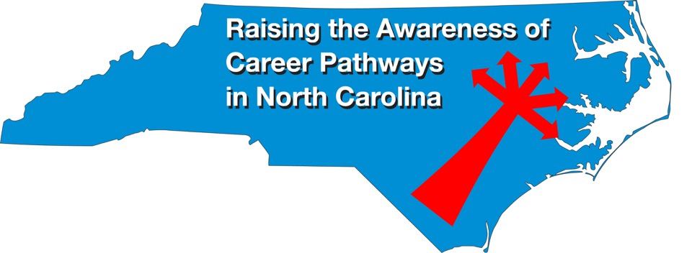
Computer-Integrated Machining February 15, 2023
Download the PowerPoint and access the recording: www.ncperkins.org/presentations

Slide 2
Career & Technical Education Team
Bob Witchger
Tony Reggi
Patti Coultas
Mary Olvera
Anne Bacon
Darice McDougald
Lane Freeman
Aaron Mabe

Slide 3
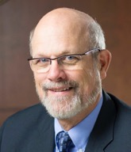
Dr. Bob Witchger
CTE Director, Team Perkins
Notes:
Dr. Robert (Bob) Witchger
NCCCS, CTE Director
919-807-7126
witchgerb@nccommunitycolleges.edu

Slide 4
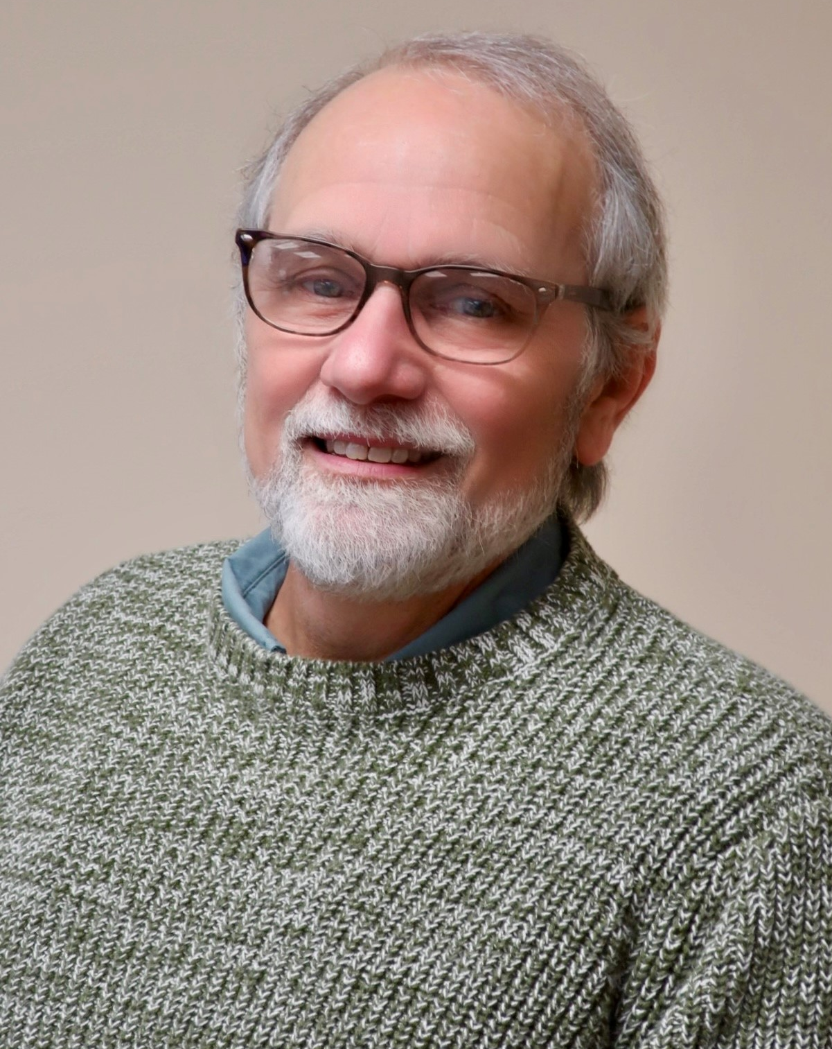
Dr. Tony Reggi
CTE Associate Director,
Notes:
Tony Reggi
919-807-7131
reggia@nccommunitycolleges.edu

Slide 5
Aaron Mabe
Coordinator for Career and College Promise
Notes:
Aaron Mabe
919-807-7098
mabea@nccommunitycolleges.edu

Slide 6
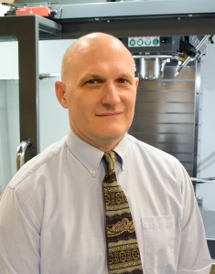
Alex Barnhill
Nash Community College
Dean, Curriculum CTE and
Dept Chair, Applied Engineering Technologies
Notes:
Alex Barnhill Dean, Curriculum Career and Technical Education and
Department Chair, Applied Engineering Technologies
252-451-8382 ­
labarnhill337@nashcc.edu ­

Slide 7
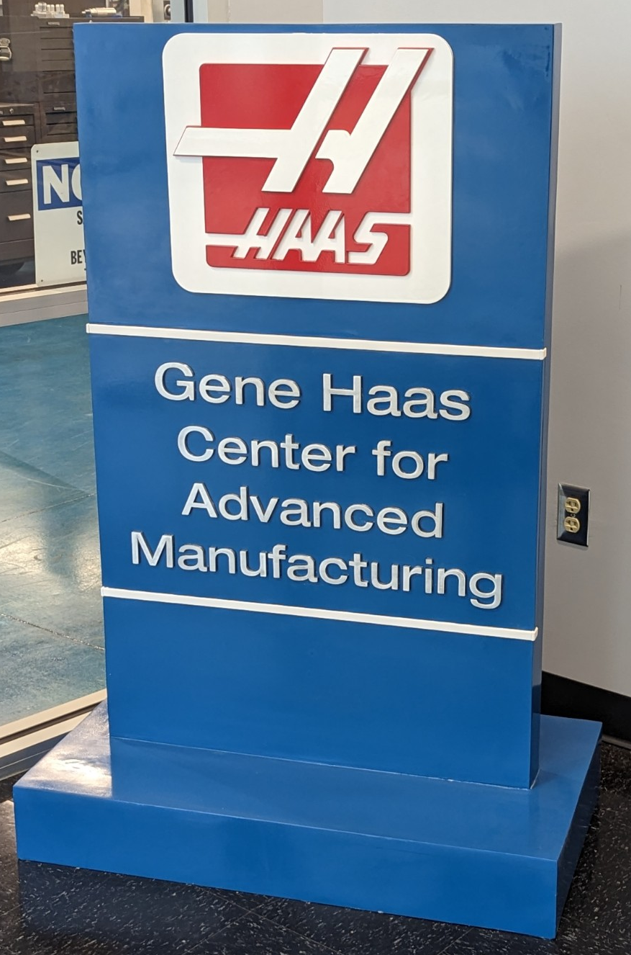
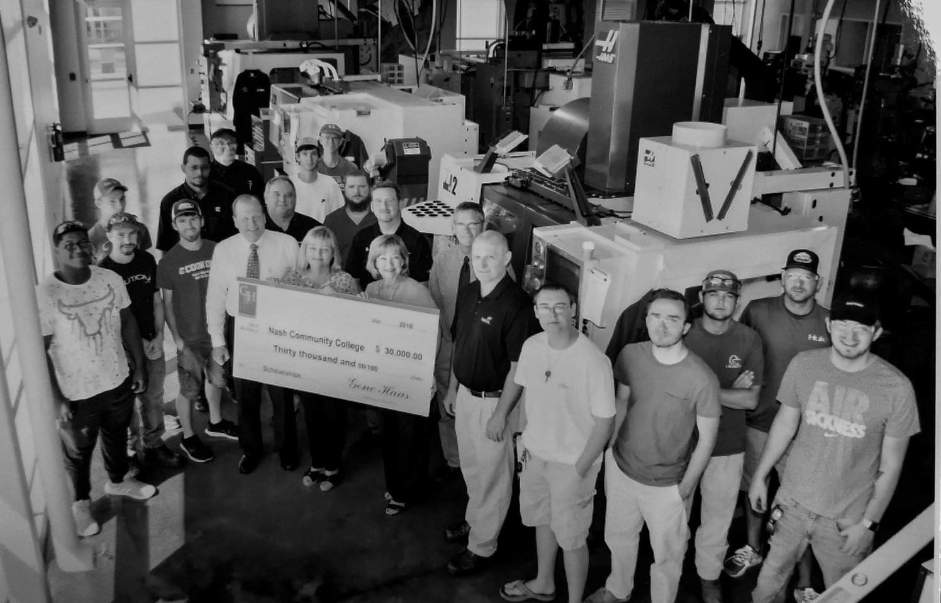
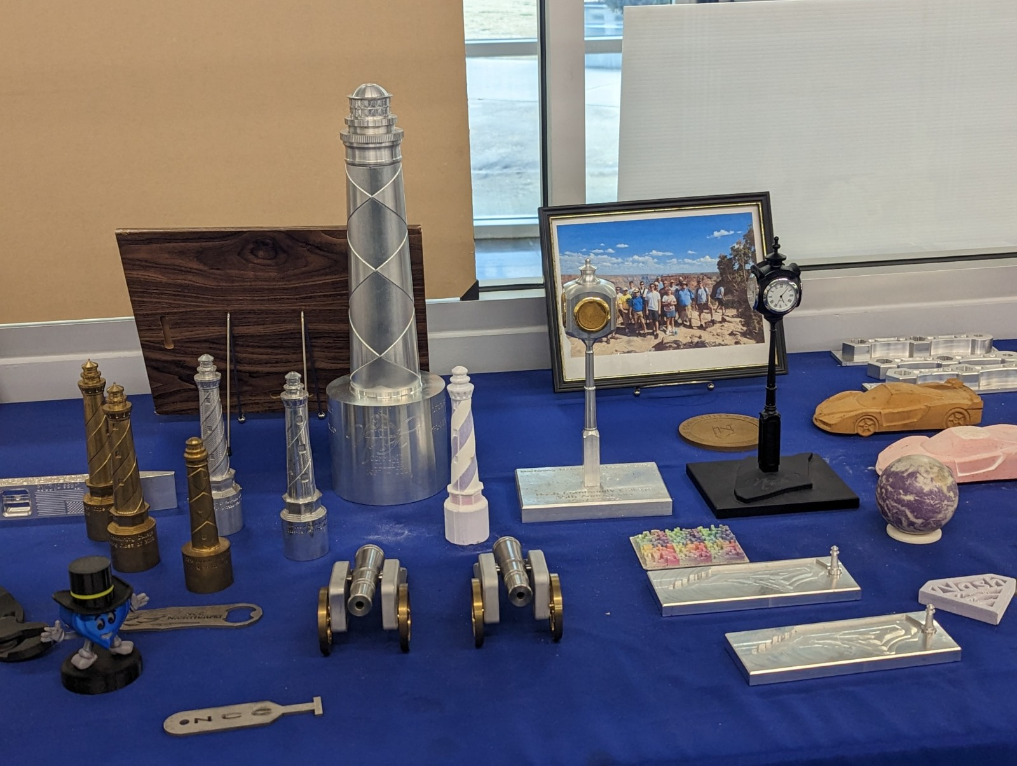
Nash Community College’s
Computer Integrating Machining Program
Notes:
Alex Barnhill Dean, Curriculum Career and Technical Education and
Department Chair, Applied Engineering Technologies
252-451-8382 ­
labarnhill337@nashcc.edu ­

Slide 8
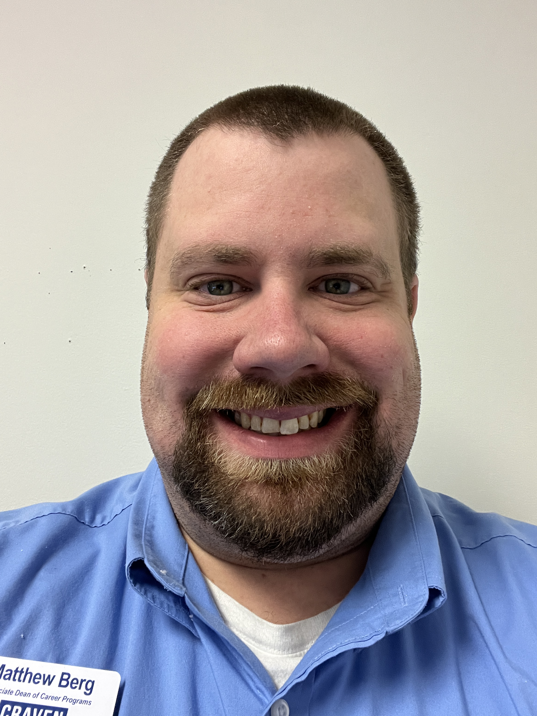
Matthew Berg
Craven Community College
Associate Dean of Career Programs
Notes:
Matthew Berg
252-638-7372
bergm@cravencc.edu

Slide 9
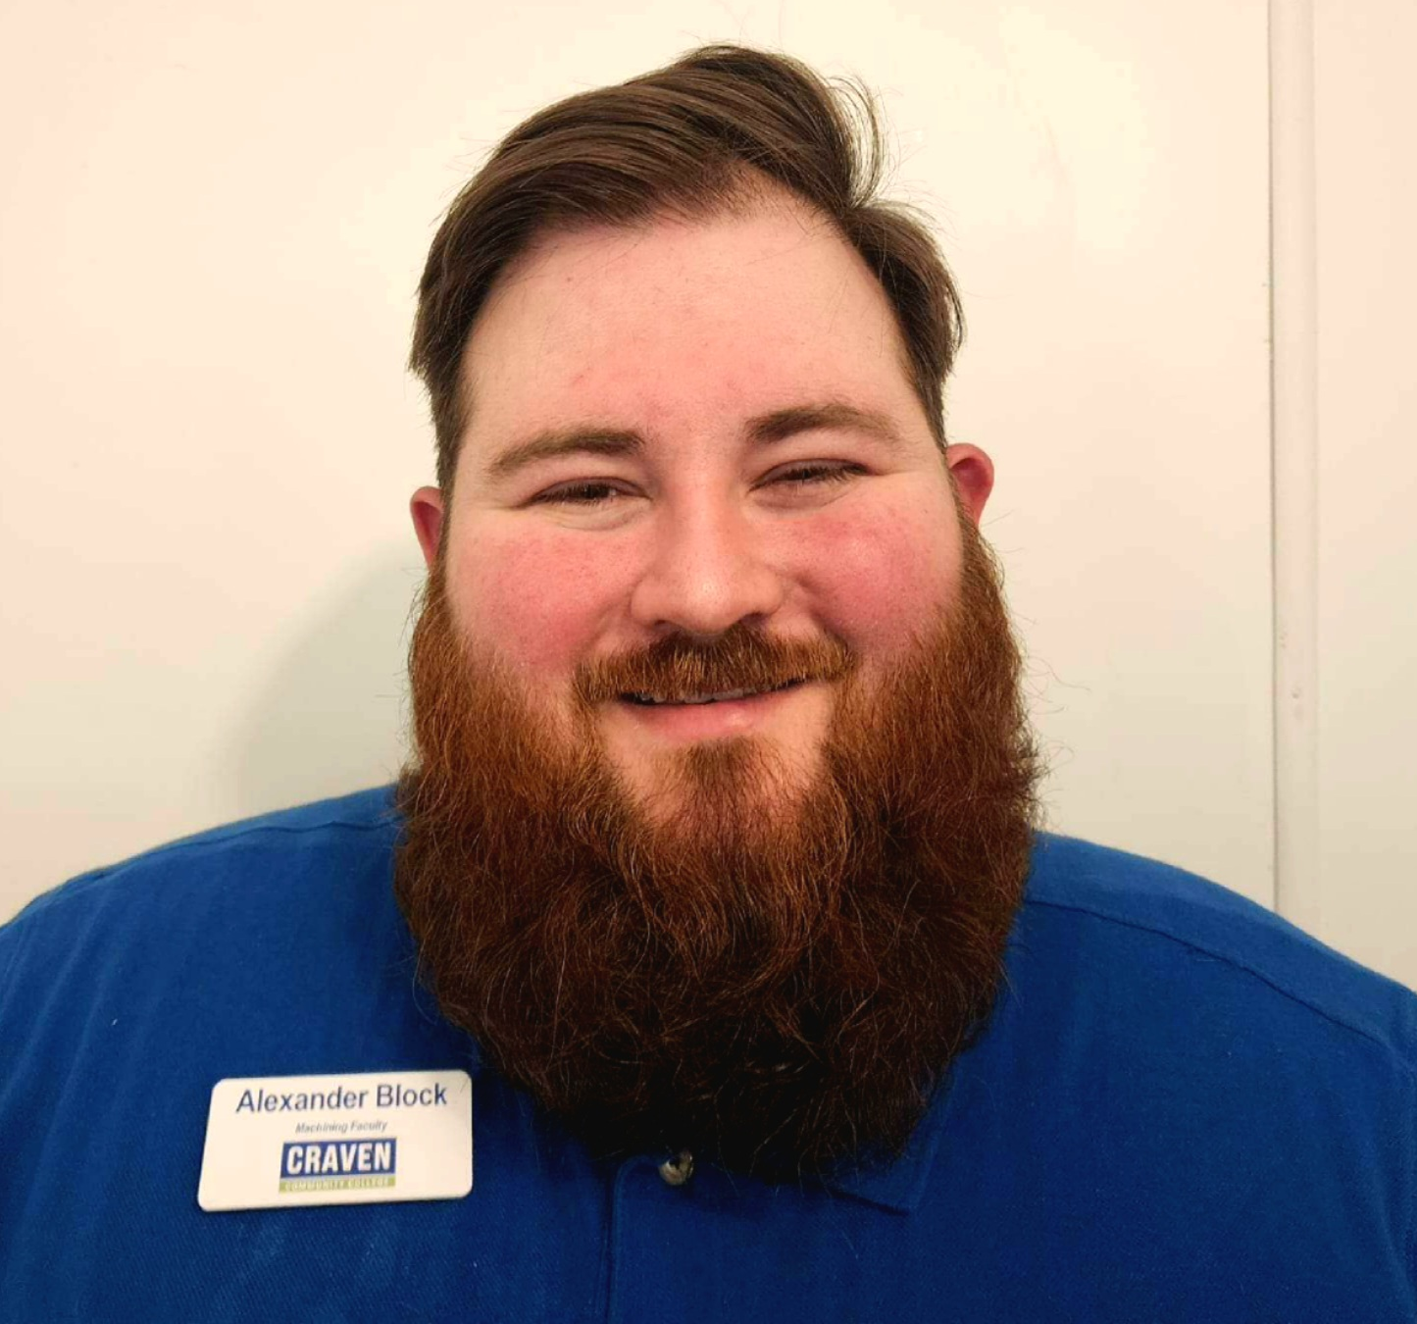
Alex Block
Craven Community College
Computer-Integrated Machining Instructor
Notes:
Alex Block
252-638-7237
blocka@cravencc.edu

Slide 10
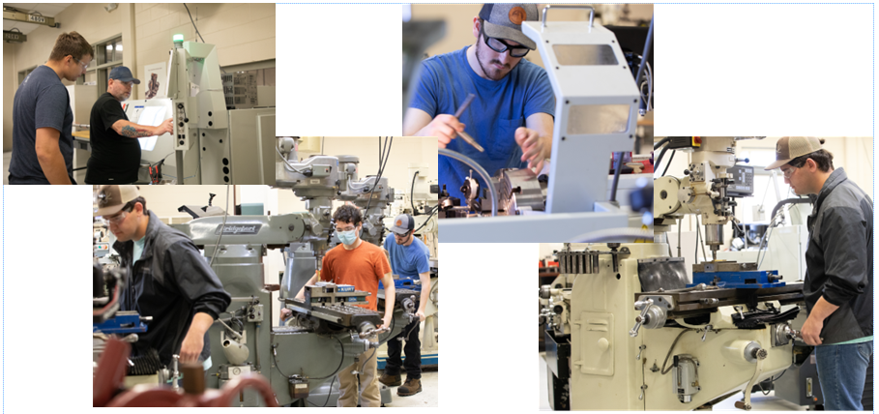
Craven Community College
Notes:
Alex Block
252-638-7237
blocka@cravencc.edu

Slide 11
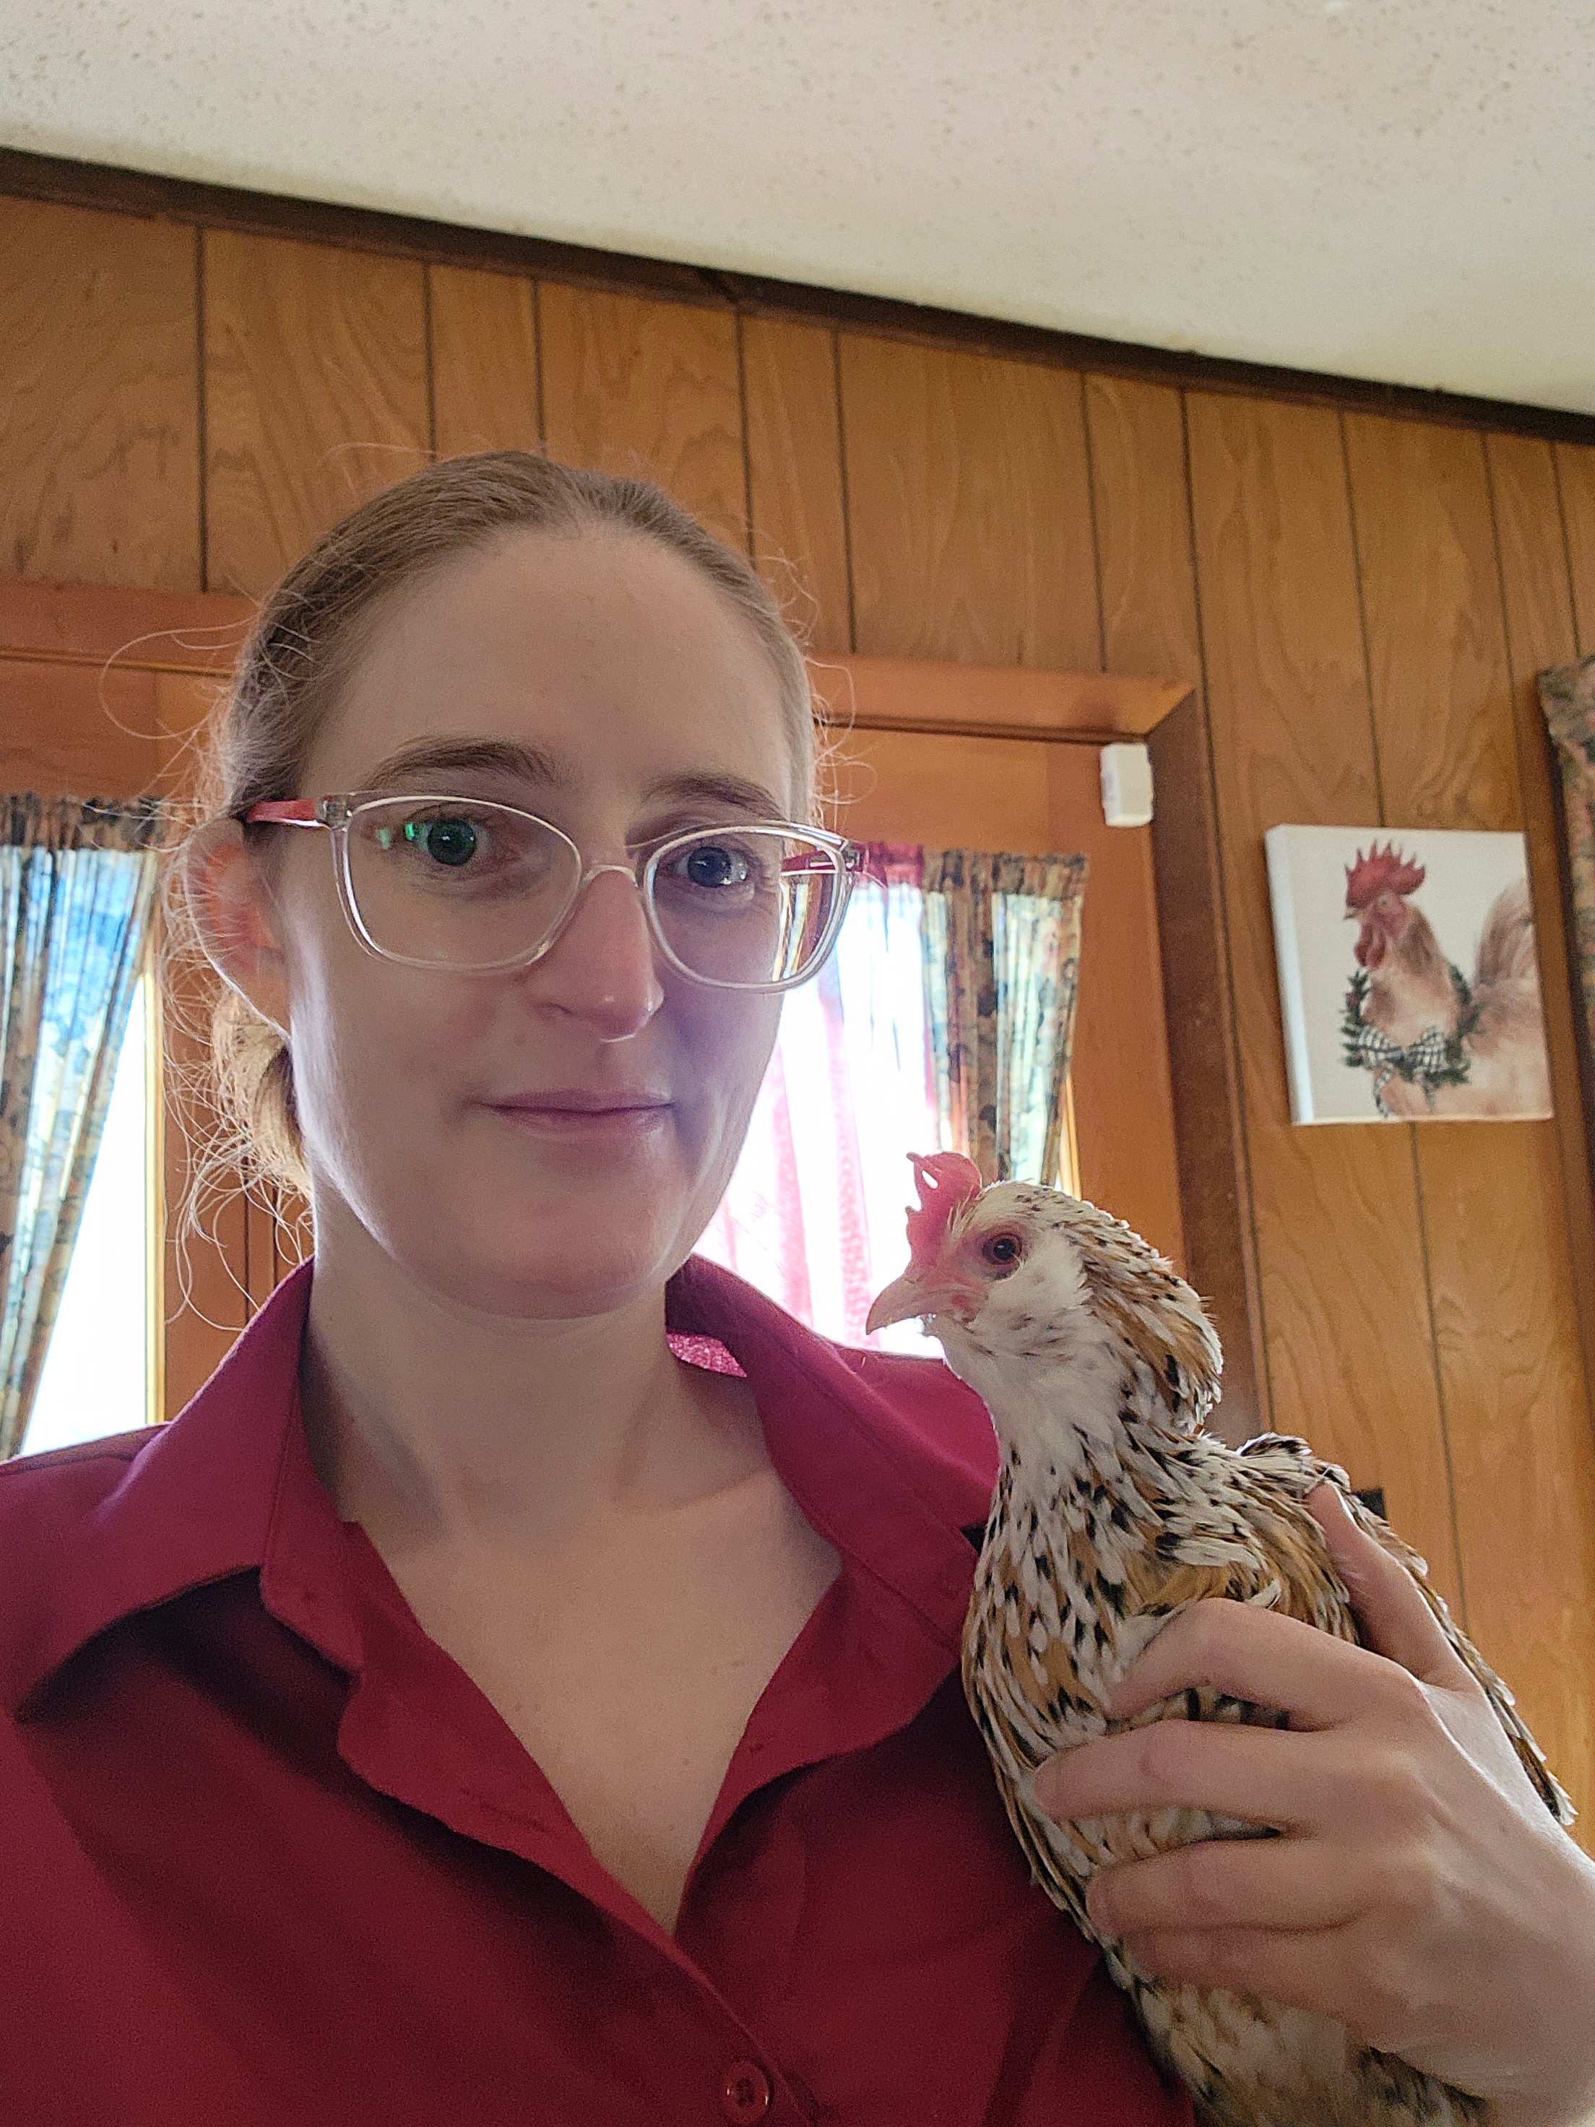
Rachael Ann Tipton
Asheville-Buncombe Technical Community College
Computer Integrated Machining and Mechanical Engineering Technology Faculty
Notes:
Rachael Ann Tipton
rachaelatipton@abtech.edu
828-398-8211

Slide 12
Bryan Hartzog
Wilkes Community College
Lead Instructor – Industrial Engineering/Robotics, Automation and Mechatronics Technology
Notes:
Bryan Hartzog Lead Instructor - Industrial Engineering/Robotics, Automation and Mechatronics Technology 336-838-6228 jbhartzog762@wilkescc.edu

Slide 13
Career Pathways
Notes:
From nccareers.org

Slide 14
Computer-Integrated Machining Associates in Applied Science Degree
The Computer-Integrated Machining curriculum prepares students with the analytical, creative and innovative skills necessary to take a production idea from an initial concept through design, development and production, resulting in a finished product.
Coursework may include manual machining, computer applications, engineering design, computer-aided drafting (CAD), computer-aided machining (CAM), blueprint interpretation, advanced computerized numeric control (CNC) equipment, basic and advanced machining operations, precision measurement and high-speed multi-axis machining.
Graduates should qualify for employment as machining technicians in high-tech manufacturing, rapid-prototyping and rapid-manufacturing industries, specialty machine shops, fabrication industries, and high-tech or emerging industries such as aerospace, aviation, medical, and renewable energy, and to sit for machining certification examinations.

Slide 15
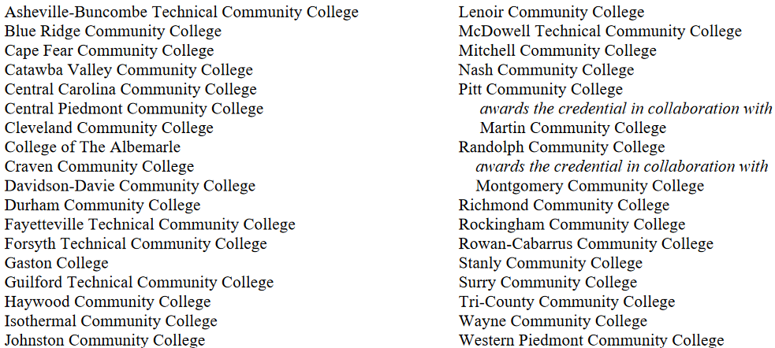
Offered at many of North Carolina’s Community Colleges
Notes:
Total 32 colleges

Slide 16
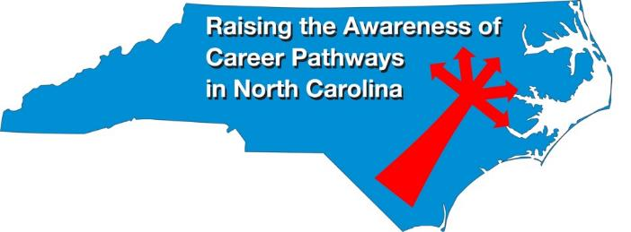
Raising the Awareness of Career Pathways Webinars
March 15 Occupational Therapy Assistants
April 19 Food Industry Attend SkillsUSA Competition
May 17 Entrepreneurship
June 21 Nonprofit Leadership and Management
Register for all webinars at www.ncperkins.org/presentations

