Slide 1
Updating the Articulation Agreement
Bob Witchger
Director, Career and Technical Education - NC Community College System
WitchgerB@ncCommunityColleges.edu
Jo Anne Honeycutt
Director, Career and Technical Education - NC Department of Public Instruction
Joanne.Honeycutt@dpi.nc.gov
Chris Droessler
Career and Technical Education Coordinator - NC Community College System
DroesslerC@ncCommunityColleges.edu
Notes:
Good afternoon and welcome to Articulation 101.
Thanks for coming out on this wintery day.
I have posted this PowerPoint file for you to use.
Find the PowerPoint at CTPNC dot org. Then select the Presentation link.
How many of you have already downloaded the PowerPoint file. I see a few hands raised. Those are my A students.
You will find that much of this presentation is a good primer on the Articulation Agreement. Feel free to use any part of this PowerPoint presentation to spread the word about articulation.

Slide 2
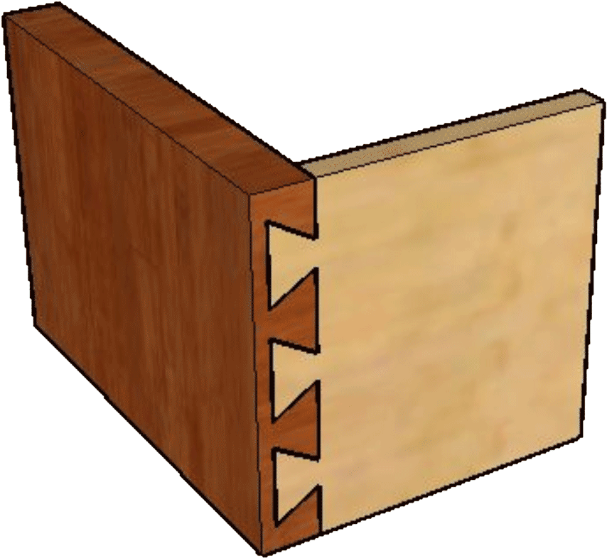
Articulation = Joining Parts Together
Articulation is a seamless process that joins secondary and postsecondary education and minimizes duplication of effort
Articulation connects high school coursework with community college coursework.
Notes:
Our vocabulary word for today is Articulation.
Articulation is parts that are joined together with a joint, like the way our bones are held together.
In this case we are joining high school and community college programs, -- and one joint that holds them together is the Articulation Agreement.
An articulate speaker is one who expertly joins syllables and words together to create effective expressions. It’s all about joining things.

Slide 3
Which Agreement?
North Carolina Comprehensive Articulation Agreement (CAA)
NC High School to Community College Articulation Agreement
Notes:
There are two different articulation agreements.
The North Carolina Comprehensive Articulation Agreement, also known as the CAA, is a statewide agreement governing the transfer of credits between North Carolina community colleges and North Carolina public universities.
That is not what we are discussing today.
→
Today we are discussing the North Carolina High School to Community College Articulation Agreement. An agreement that identifies certain high school courses that match the learning objectives of certain college courses and awards college credit to students who show proficiency in the course.
This eliminates the need for a student to retake a course at college that he or she has already passed in high school.

Slide 4
Articulation (Perkins Act of 2006)
Each program shall --
Be carried out under an articulation agreement between participants in the consortium
Consist of a program of study
Minimum 2-years secondary
Minimum 2-years postsecondary
Include professional development
Provide equal access to special populations
Provide preparatory services
Notes:
Articulation is part of Perkins legislation, which means we have to do it to keep the funds flowing.
The Articulation Agreement is between the high schools and the local community college.
The Articulation Agreement is a commitment to create a seamless program of study that combines two years of technical study in high school with two more years of technical instruction at the community college.
What we are discussing today, -- course matches that award college credit for high school courses, -- is really just a small part of an articulation agreement.

Slide 5
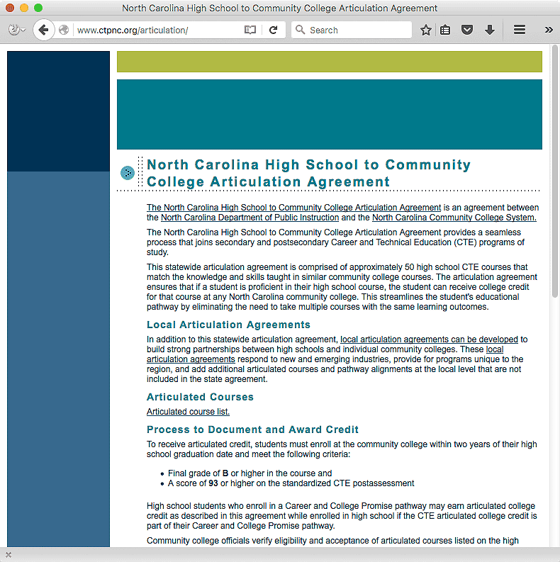
Notes:
Here is the Articulation Agreement webpage.
You can access it from ctpnc.org.
There is a link to it on the DPI website.
→
To get to the list of course matches on the current agreement, select this link.

Slide 6
Criteria to Award Articulation Credit
To receive articulated credit, students must enroll at the community college within two years of their high school graduation date and meet the following criteria:
Final grade of B or higher in the course and
A score of 93 or higher on the standardized CTE postassessment
High school students who enroll in a Career and College Promise pathway may earn articulated college credit as described in this agreement while enrolled in high school if the CTE articulated college credit is part of their Career and College Promise pathway.
Notes:
The criteria to award articulated credit changed in 2011 when the high schools changed from reporting Raw scores to Scale scores on the CTE course postassessment tests.

Slide 7
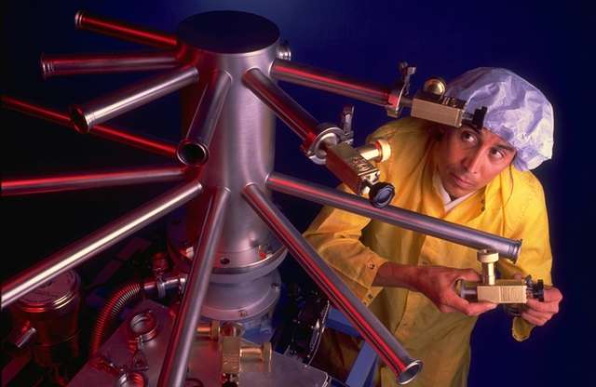
Programs of Study
Work
High School
Notes:
Programs of Study take the student from high school,
--through community college,
-- and on to the workplace.

Slide 8
Program of Study Mechanical Engineering
Articulation
Minimize duplication of coursework
Seamless education in program of study
Advance postsecondary skills
Reduce cost of education
Promote local partnerships
Notes:
A Program of Study is a prescribed sequence of courses that is taken in high school and in community college.
This Program of Study chart also shows the college credits that may be earned while the student is still in high school through the Articulation Agreement or Career and College Promise.
Indicated in Red are three drafting courses that could be taken while in high school through the Articulation Agreement.

Slide 9
Articulation Agreement History
First Articulation Agreement in 1999
Updated Agreement in 2005
Updated criteria to award credit in 2011
Updated Agreement in 2011
Attempted update in 2013
Notes:
One problem we face with our High School to Community College Articulation Agreement is that our high school courses change over time, as do the courses at the community college.
Adding or deleting courses from the official list requires much deliberation, and thus cannot happen as soon as changes occur.
It has been five years since the current articulation agreement was updated, and we are just now starting to look at the process.

Slide 10
Articulation Update Process
State staff review & recommend courses
Webinar for Chief Academic Officers and CTE Directors
Teams of Teachers/Instructors review proposed matches
Chief Instructional Officers input data online
Data is reviewed, final list created
Chief Academic Officers have final approval
Updated list sent to College Presidents, State Boards
Notes:
Here is the update process.
Step 1 is where we are now -- with the DPI curriculum consultants getting together with their counterparts at the community college system to identify courses that appear to teach the same or similar competencies.
In Step 2 we convene the Chief Academic Officers and CTE Directors in a webinar to discuss the process of coordinating teams of teachers and instructors to evaluate the proposed course matches.
In Step 3. CTE teachers from our high schools, and instructors from the community colleges, will compare the course blueprints and college course outlines to determine if there is enough similarity between the two courses to justify adding the course match to the articulation agreement.
After that -- it’s just data gathering and final approvals.

Slide 11
Articulation Update Process
Today we are looking at course matches for the list of articulated courses.
We can also look at
Text of the agreement
Criteria for awarding credit
The agreement update process
Local Articulation Agreements
Notes:
Today -- we are primarily looking at adding course matches to the list of articulated courses.
We can also discuss these other items.
If there is anything about the Articulation Agreement that needs to be updated, please let me know.

Slide 12
Articulation Review
Course for Course
80% match of competencies
Understanding of teaching methods
Understanding of anticipated student outcomes
Secondary blueprint
Postsecondary course description
Understanding of competency measure
Credential vs postassessment
Notes:
Here is what we are doing today.
Basically we are looking for course matches that might need to be removed from the articulation agreement -- and for course matches that might need to be included in the articulation agreement.
You are not making final decisions today, only recommendations.
The final decision will come from the collaboration among the teachers and instructors from across the state.

Slide 13
Notes:
Here is the form you will be working with today. You will complete one of these forms for each proposed course match.
Complete this paper form, or feel free to complete the form electronically and submit it that way.
-- And if we zoom in on it …

Slide 14
Notes:
At the top of the page is a box to list the high school course or courses -- and a second box to list the community college course or courses.

Slide 15
Example
7722 Carpentry II
=
CST-111 Construction I
Notes:
Many times there is a one-to-one match between a high school course and a community college course.
In that case, you list the high school course in the high school course box -- and list the community college course in the college course box.

Slide 16
Example
6417 Microsoft Word, Power Point, and Publisher
=
CIS-111 Basic PC Literacy OR
CIS-124 DTP Graphics Software OR
OST-136 Word Processing
Notes:
An example from the current agreement shows that sometimes there are options.
In this case, the one high school course can articulate to one of three college courses.
The actual course used would be determined by the student’s actual course of study.
Be sure to clearly enter the OR conjunction.

Slide 17
Example
7741 Electrical Trades I AND
7742 Electrical Trades II
=
ELC-113 Basic Wiring I
Notes:
In this example, the student has to show proficiency in two high school courses to articulate to a single college course.
Sometimes you will use the AND conjunction.

Slide 18
Example
7631 Electronics I AND
7632 Electronics II
=
ELC-112 DC/AC Electricity AND
(ELC-126 Electrical Computations OR
EGR-131 Intro to Electronics Tech)
Notes:
And sometimes the matches become so complicated that you have to use parenthesis. See them?
In this case, showing proficiency in the two high school courses articulates to ELC-112 and one of the other two courses.
Be careful to get your parentheses and conjunctions in the right places. A misplaced conjunction can radically change the agreement.

Slide 19
Notes:
All together now – “Conjunction Junction, what’s your function?” “Hooking up words and phrases and clauses.”
As I said - Be sure to clearly insert the conjunctions AND and OR.

Slide 20
X
X
X
X
Notes:
Next is where you do your real thinking.
We are considering four areas of possible course alignment.
First - Compare the course description for the high school course and the course description for the college course. Do you see an alignment? If you think there is a significant match, more then 80% of the description is essentially the same, → then check the box under the column marked Significant Match.
If you feel there is not quite an 80 percent match, but better than a 60 percent match, → put your check in the next column entitled Close Match.
→Negligible Match is less than 60 percent, --and if you see no match at all , put your check → in the No Match column.
→- The second item is to compare the course blueprint with a course syllabus. This is here so you can see what the teachers and instructors will be comparing.
The third item is the alignment between the high school course essential standards and the college course student learning outcomes.
The fourth item is the number of hours for hands-on learning in the classroom or lab. This would include any required work-based learning, such as the clinical hours required in nursing.
In a few weeks, the high school teachers and college instructors across the state will be comparing these.
So for now, you don’t have much to put here.

Slide 21
Notes:
→Next we look at credentials.
If there are any industry certifications and/or licenses that are aligned with the high school course, enter them here.
- What we are looking for are the certifications or licenses for which the course specifically prepares the student.
- Usually this means the course uses industry-developed curriculum designed specifically for a particular certification.
The last revision of the articulation agreement was made before the practice of allowing an industry certification to serve in place of the high school course postassessment.
- The next question on the form addresses this by asking if earning an industry certification or license instead of taking the high school postsecondary exam gives the same evidence of knowledge. Select the best answer based on your discussions today.

Slide 22
Notes:
Based on your discussions today -- and what you have entered on this worksheet, -- do you think this potential course match should be sent to the consortia across the state for the high school teachers and college instructors to review?
Make your selection.

Slide 23
Notes:
Next is a box to include your comments about this potential course match.
If you feel there is a course match on the current articulation list that needs to be removed, please complete one of these sheets for that, and indicate here that the course match needs to be removed from our current list.
→
Then at the bottom of the page, please enter the names and titles of the review team.
You may have already consulted with teachers or instructors, but we need only the DPI staff and the community college system office staff listed here.
Include state staff who helped with the process but are not here today.

Slide 24
Articulation Update Process
State staff review & recommend courses
Webinar for Chief Academic Officers and CTE Directors
Teams of Teachers/Instructors review proposed matches
Chief Instructional Officers input data online
Data is reviewed, final list created
Chief Academic Officers have final approval
Updated list sent to College Presidents, State Boards
Notes:
After you complete a form for each of your potential matches, -- you are done.
I am giving you two weeks to complete these forms. email them to me by February 25.
We will compile all of your data and then contact the college Chief Academic Officers and the CTE Directors for the next step.

Slide 25
Updating the Articulation Agreement
Questions?
Notes:
Are there any Questions??

Slide 26
Updating the Articulation Agreement
Bob Witchger
Director, Career and Technical Education - NC Community College System
WitchgerB@ncCommunityColleges.edu
Jo Anne Honeycutt
Director, Career and Technical Education - NC Department of Public Instruction
Joanne.Honeycutt@dpi.nc.gov
Chris Droessler
Career and Technical Education Coordinator - NC Community College System
DroesslerC@ncCommunityColleges.edu
Notes:
Thanks

